Slide 2
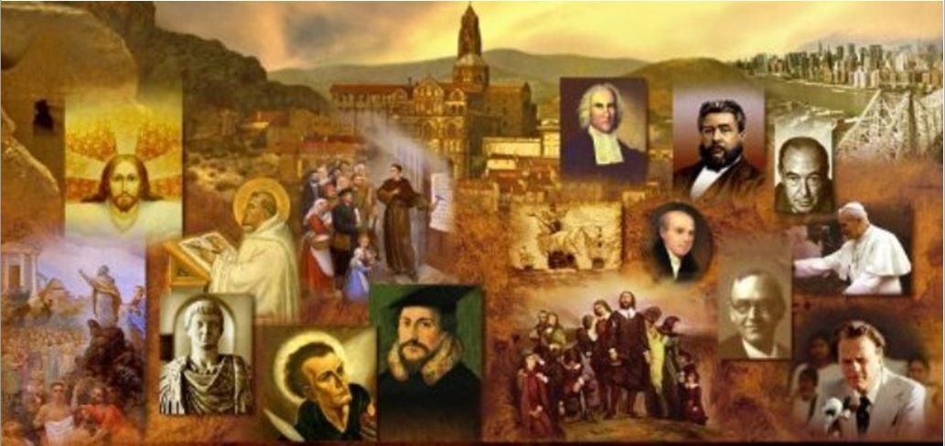
Review
Who was Ignatius and when did he live?
He was the bishop of the church in Antioch.
He lived from AD 35 – 107
How many of Ignatius’ letters do we have, to whom were they written?
Ignatius wrote seven letters –
Five to churches in Asia Minor:
Ephesus
Magnesia
Tralles
Philadelphia
Smyrna
One to the church of Rome
One a personal letter to Polycarp, bishop of the church in Smyrna.

Slide 3
Review
What were Ignatius’ circumstances as he wrote these letters?
He had been arrested for being a Christian, he was taken to Rome by a military escort, where he was to be executed under the emperor Trajan.
If someone (like the Jehovah Witnesses) gives a citation from a letter they claim was written by Ignatius, what do you need to watch out for?
Make sure it’s not one of the pseudo-Ignatian Epistles which modern historians agree were not actually written by Ignatius.

Slide 4
Review
Ignatius had a strong orthodoxy concerning the deity and humanity of Christ, but unfortunately his ecclesiology was not as encouraging.
In Ignatius’ letters we see the beginnings of what theologians call a “monarchical episcopate” – explain what that is and tell what is wrong with it.
The “monarchical episcopate” – is the form of church government where there is a single bishop within each church who presides over a board of elders.
Such a form of church government is not taught in the NT:
In the NT the norm is a plurality of elders/bishops/pastors in each church (Acts 14:23; Acts 20:17; Philippians 1:1; James 5:14)
While the NT recognizes that elders/bishops/pastors may differ in their abilities and some may work harder than others (1Tim. 5:17), they must all meet the same set of qualifications in order to serve (1Tim. 3; Titus 1) and the three terms used to describe these men (elders/bishops/pastors ) are used interchangeably for all who serve in this capacity within a local church (Acts 20).

Slide 5
Review
How did Ignatius view his pending, painful death by execution?
He viewed it as a privilege and hoped that nothing would keep him from it.
If you were in Ignatius’ shoes, how do you think you would feel?
Do you think there is anything wrong with a Christian wanting to be martyred and not willing that any efforts be made to rescue him from it?
Do you think there is anything wrong with a Christian wanting to avoid martyrdom, if they can do so without compromising their faith?

Slide 6
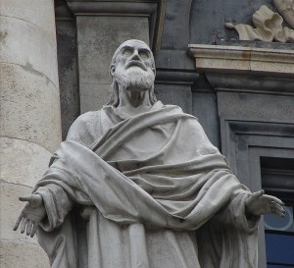
Polycarp
http://www.returntoorder.org/2016/01/courage-play-the-man/

Slide 7
*Polycarp
Polycarp (AD 69-156) was bishop of the church of Smyrna in Asia Minor and one of the most famous martyrs of the 2nd century.
We know very little about him. We have one letter written by him to the Philippians and it’s fairly short.
Polycarp’s letter was mostly made up of quotations from the New Testament. He warned the Philippians against departing from apostolic doctrine, and especially against the heresy of Gnosticism.
He also exhorted them to live upright Christian lives, admonishing them against the sin of greed, and urged on them the duty of submitting to their elders.
* Needham, Nick. 2,000 Years of Christ's Power Vol. 1: The Age of the Early Church Fathers

Slide 8
*Polycarp
According to Irenaeus, Polycarp was a disciple of John, though in his letter to the Philippians, there is no reference to John or any of John’s writings.
The martyrdom of Polycarp is better known than the life of Polycarp.
The fame of Polycarp in history is primarily due to a letter from the church of Smyrna (where he was bishop) to the church in Philomelium narrating the events of Polycarp’s death.
We will be looking at excepts from this letter for the remainder of our class.
*Based on notes taken from James White’s 2016 Church History Series; Lesson 12 – Ignatius and Polycarp

Slide 9
*The Martyrdom of Polycarp
Introduction
The church of God at Smyrna to the church of God at Philomelium and to all gatherings of the holy catholic church everywhere. Mercy, peace, and love from God the Father of our Lord Jesus Christ be yours in large measure.
Chapter 1
We are writing to you, brethren, to tell about the martyrs and the blessed Polycarp, whose martyrdom put an end to the persecution.
Chapter 2
…those who were condemned to the wild beasts endured dreadful tortures, being stretched out upon beds full of spikes, and subjected to various other kinds of torments, in order that, if it were possible, the tyrant might, by their lingering tortures, lead them to a denial [of Christ].
* As cited and summarized by Eusebius in The Church History; Translation by Paul Maier; pp. 130-134

Slide 10
The Martyrdom of Polycarp
Chapter 3
The noble Germanicus overcame the natural fear of death by the grace of God. Even when the proconsul tried to dissuade him, pleading that he spare himself as still in the very flower of his youth, [Germanicus] did not hesitate to drag the beast to himself, nearly forcing and goading it, the sooner to be free of their unjust, wicked life. At his glorious death, the whole crowd was so amazed at the bravery of the God-loving martyr and at the courage of Christians in general that they began to shout together, “Kill the atheists! Get Polycarp!"
* As cited and summarized by Eusebius in The Church History; Translation by Paul Maier; pp. 130-134

Slide 11
The Martyrdom of Polycarp
Chapter 4
Now one named Quintus, newly arrived from Phrygia, when he saw the wild beasts, became afraid. This was the man who forced himself and some others to come forward voluntarily [for trial]. After many entreaties, the proconsul persuaded him to swear and to offer sacrifice [to the emperor]. Wherefore, brethren, we do not commend those who give themselves up [to suffering], seeing the Gospel does not teach so to do.
Here we see the example of a Christian who, upon threat of torture and death, was willing to offer incense to the emperor.
So even though Polycarp was martyred voluntarily, they say here that they don’t praise those who volunteer to die, since this man shows what can happen.
* As cited and summarized by Eusebius in The Church History; Translation by Paul Maier; pp. 130-134

Slide 12
The Martyrdom of Polycarp
Chapter 5
The wonderful Polycarp, however, was undisturbed at the news and had a fixed determination to stay in the city [Smyrna]. But when his friends pleaded with him to escape, we was persuaded to go to a farm not far from the city, where he stayed with a few others and prayed to the Lord night and day that peace be granted the churches throughout the world, as was his custom. Three nights before his capture, while at prayer he saw in a vision the pillow under his head suddenly burst into flame and burn up, which he interpreted to his friends as foretelling that for Christ's sake he would give up his life by fire.
* As cited and summarized by Eusebius in The Church History; Translation by Paul Maier; pp. 130-134

Slide 13
The Martyrdom of Polycarp
Chapter 6
Since those hunting him were relentless, the love of the brethren obliged him to move on to another farm. Soon the pursuers arrived and arrested two of the servants there, one of whom, under torture, showed them to Polycarp’s quarters.
* As cited and summarized by Eusebius in The Church History; Translation by Paul Maier; pp. 130-134

Slide 14
The Martyrdom of Polycarp
Chapter 7
It was night, and they found him lying in an upper bedroom. He could have moved to another house, but he had refused, saying, “God's will be done.” When he heard that they had come, he went down and talked with them in such a cheerful, serene manner that they were astounded in view of his old age and confident air and wondered why there was such anxiety to arrest an old man of such character. He ordered that a table be set for them and invited them to dine with gusto, asking only for a single hour to pray undisturbed. This granted, he stood up and prayed, filled with the grace of the Lord, to the astonishment of those present, many of whom grew distressed that so dignified and godlike a man was going to his death.
* As cited and summarized by Eusebius in The Church History; Translation by Paul Maier; pp. 130-134

Slide 15
The Martyrdom of Polycarp
Chapter 8
Finally he finished his prayer, after remembering all with whom he had ever come into contact – small or great, famous or obscure – and the whole Catholic Church throughout the world. When the hour for departure had come, they set him on a donkey and led him into the city on a great Sabbath. Herod, the chief of police, and his father Nicetes met him and transferred him to their carriage. Sitting beside him, they tried to persuade him: “What harm is there in saying ‘Lord Caesar' and sacrificing – and so be saved?’” At first he did not answer them, but when they persisted, he said, “I will not do what you advise.” Threats now replaced persuasion, and they ejected him so quickly that he scraped his shin in getting down from the carriage. But he walked on briskly to the stadium, as if nothing had happened. There the noise was so great that no one could be heard.
* As cited and summarized by Eusebius in The Church History; Translation by Paul Maier; pp. 130-134

Slide 16
The Martyrdom of Polycarp
Chapter 9
When Polycarp entered the stadium, a voice from heaven said, “Be strong and play the man, Polycarp!” No one saw the speaker, but many of our people who were there heard the voice. As word spread that Polycarp had been arrested, there was a tremendous roar. When he approached, the proconsul asked him if he were Polycarp and after he admitted it he tried to dissuade him, saying, “Respect your years! Swear by Caesar's fortune! Recant and say, ‘Away with the atheists!’” So Polycarp swept his hand across the crowd, sighed, looked up to heaven, and cried, “Yes, away with the atheists!” But the governor pressed him, “Take the oath and I will set you free. Curse Christ!” But Polycarp replied, “For eighty six years I have been his servant, and he has never done me wrong. How can I blaspheme my King who saved me?”
* As cited and summarized by Eusebius in The Church History; Translation by Paul Maier; pp. 130-134

Slide 17
The Martyrdom of Polycarp
Chapter 10
But when the proconsul persisted, “Swear by Caesar's fortune,” Polycarp replied, “lf you suppose that I could do this, pretending not to know who I am, listen carefully: I am a Christian. And if you wish to learn the teachings of Christianity, choose a day and you will hear them.” The proconsul replied, “Persuade the people!” Polycarp responded, “You would be worthy of such a discussion, for we have been taught to render appropriate honor to rulers and authorities ordained by God if it does not compromise us. As for the people, I do not feel a defense is appropriate.”
* As cited and summarized by Eusebius in The Church History; Translation by Paul Maier; pp. 130-134

Slide 18
The Martyrdom of Polycarp
Chapter 11
Said the proconsul, “I have wild beasts. I'll throw you to them if you don't change your mind!” “Call them,” he replied, “for we cannot change our mind from better to worse. But to change from cruelty to justice is excellent.” Again he countered “If you disregard the beasts, I'll have you consumed by fire unless you repent!” But Polycarp declared, “You threaten a fire that burns for a time and is quickly extinguished. Yet a fire that you know nothing about awaits the wicked in the judgement to come and in eternal punishment. But what are you waiting for? Do what you will."
* As cited and summarized by Eusebius in The Church History; Translation by Paul Maier; pp. 130-134

Slide 19
The Martyrdom of Polycarp
Chapter 12
As he said these and many other things, he was filled with courage and joy, and his features with such grace that they did not pale with alarm at what was said to him. The proconsul was astounded and sent his herald into the center of the stadium to announce three times: “Polycarp has confessed that he is a Christian!” At this, the whole multitude of Gentiles and Jews living in Smyrna boiled with anger and shouted at the tops of their lungs, “This is the teacher of Asia, the father of the Christians, the destroyer of our gods, who teaches many not to offer sacrifice or worship!” They then demanded that Philip the Asiarch let a lion loose on Polycarp. But he said that this would be illegal, since he had closed the sports. Then a general shout arose that Polycarp should be burned alive. Indeed, the vision of the burning pillow had to be fulfilled, and, [Polycarp] turning to the faithful with him, he said, prophetically, “l must be burned alive.”
* As cited and summarized by Eusebius in The Church History; Translation by Paul Maier; pp. 130-134

Slide 20
The Martyrdom of Polycarp
Chapter 13
In less time than it takes to tell, the crowd gathered logs and faggots from the workshops and baths – as usual, the Jews in particular. When the pyre was ready, he took off all his clothes, loosened his belt, and tried to take off his shoes though he was unused to doing this because the faithful had vied with each other for this privilege. As they were going to nail him to the grid for the fire, he said, “Let me be, for he who enables me to endure the flames will also enable me to remain in them unmoved, even without nails.”
* As cited and summarized by Eusebius in The Church History; Translation by Paul Maier; pp. 130-134

Slide 21
The Martyrdom of Polycarp
Chapter 14
So they bound him without nailing, hands behind his back, like a noble ram from a great flock, as a whole burnt offering acceptable to almighty God, He prayed: “O Father of your beloved Son, Jesus Christ, through whom we know you, I bless you for this day and hour, that I may, with the martyrs, share in the cup of Christ for the resurrection to eternal life of both soul and body in the immortality of the Holy Spirit. May I be received among them today as a rich and acceptable sacrifice, according to your divine fulfillment. For this reason I praise you for everything, I bless and glorify you through the eternal high priest, Jesus Christ, your beloved Son, through whom be glory to you and the Holy Spirit, both now and in the ages to come. Amen”
* As cited and summarized by Eusebius in The Church History; Translation by Paul Maier; pp. 130-134

Slide 22
The Martyrdom of Polycarp
Chapter 15
When he had finished, the fire was lit and a great flame blazed up, and we who were privileged to witness it saw something marvelous. The fire assumed the shape of a room, like a billowing ship's sail that surrounded the martyr's body inside it, not like burning flesh but like gold and silver being refined in a furnace. We also smelled a pleasant fragrance like the scent of incense or other costly spices.
* As cited and summarized by Eusebius in The Church History; Translation by Paul Maier; pp. 130-134

Slide 23
The Martyrdom of Polycarp
Chapter 16
Finally the lawless mob, seeing that his body could not be consumed by fire, ordered an executioner to slash him with a sword. When he did so, blood gushed out and quenched the fire, and the entire crowd was amazed at the difference between unbelievers and the elect. Indeed he was one of the elect, the most wonderful apostolic and prophetic teacher of our time, bishop of the Catholic Church in Smyrna. For every word that he uttered was and will be fulfilled.
* As cited and summarized by Eusebius in The Church History; Translation by Paul Maier; pp. 130-134

Slide 24
The Martyrdom of Polycarp
Chapter 17
But when the Evil One saw the greatness of his martyrdom and his blameless life, he saw to it that we could not even take away his poor body, as many desired to do. He prompted Nicetes, the father of Herod and brother of Alce, to ask the governor not to give us his body “lest they abandon the one crucified and start worshiping this man.” This idea came from pressure by the Jews, who watched when we were going to take him from the fire, not realizing that we can never abandon Christ to worship anyone else. Him we worship as the Son of God, but the martyrs we love as disciples and imitators of the Lord.
* As cited and summarized by Eusebius in The Church History; Translation by Paul Maier; pp. 130-134

Slide 25
The Martyrdom of Polycarp
Chapter 18
When, then, the centurion saw that the Jews were making trouble, he put [the body] into their midst and burned it, as was their custom. Later we gathered up his bones, more precious than jewels and finer than gold, and laid them where appropriate. There, if possible, we will assemble in gladness and joy to celebrate the anniversary of his martyrdom, both in memory of those who have already contended and for the training of those who will do so. Such is the account of the blessed Polycarp. Including those from Philadelphia, he was the twelfth martyr in Smyrna, but he alone is particularly remembered and spoken of by all, even by the heathen.
Precious in the sight of the LORD is the death of his saints. (Psalm 116:15)
* As cited and summarized by Eusebius in The Church History; Translation by Paul Maier; pp. 130-134

Slide 26
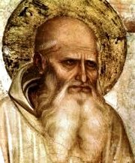
Papias
https://thebodythebride.wordpress.com/2016/01/18/what-did-papias-of-hierapolis-teach/

