Slide 2
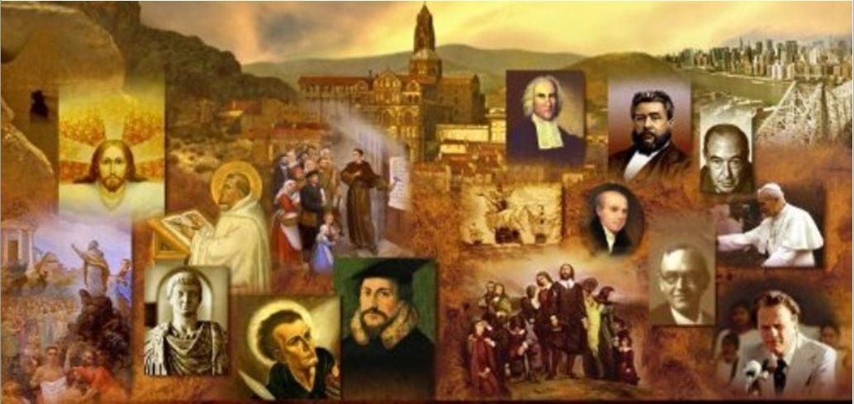
Review
A typical second century (AD 101-200) church service took place every Sunday. There was no seating, as the people stood throughout the service.
How long did the church service typically last?
Three hours
Their Service was divided into two parts.
What took place during the first part of the service?
Opening greeting
Scripture reading
Singing (usually from the Psalms or the NT poetic literature)
Sermon delivered by the Bishop while seated
What happened at the end of this part of the service?
All but the baptized believers were dismissed

Slide 3
Review
What took place during the second part of the service?
Congregational Prayer
The Lord’s Supper
Benediction at the close of the service
What was the pattern followed for congregational prayer?
The prayer leader would announce the first topic.
The congregation prayed silently for a while.
Then the leader summed up the petitions with his own spoken prayer.
Then he would repeat the pattern with a new topic. This was a lengthy part of the service.

Slide 4
Review
Where did the elements used for the Lord’s Supper come from?
Church members brought their own small loaf of bread and flask of wine from home; the deacons took these and spread them out on the Lord’s table, emptying the flasks of wine into one large silver cup.
What things about the second century church worship did you find most surprising?
Besides the weekly schedule of meeting on Sundays, the early church followed an annual schedule that centered around what day?
Easter

Slide 5
Review
A “serious” controversy arose in the second century over the celebration of Easter. Describe the controversy and tell how and when it was resolved.
The churches of Asia Minor observed Easter on the precise day of Passover, the fourteenth of Nisan (in the Hebrew calendar), which was not necessarily a Sunday.
But the churches of Palestine, Alexandria and Rome always observed Easter on a Sunday, the one that fell just after the fourteenth of Nisan.
It was resolved in AD 325 at the Council of Nicaea where all the churches agreed to the custom of observing Easter on the Sunday following the fourteenth of Nisan.

Slide 6
Review
Another worship custom which was a part of church life in these early centuries was the “agape (love) feast”.
What kinds of things do writers of the early church tell us happened at this feast?
Tertullian (AD 160-220), a communal meal, which begins with prayer, followed by people eating and drinking, the singing of hymns, and a closing prayer. (Apology 39)
Hippolytus (AD 170-235) a meal that was taken by believers at someone's house or in the church and was presided over by a church officer – normally the bishop. (Apostolic Tradition 26.5)
Do we know for sure that the Lord’s supper was normally celebrated as a part of the early church “agape feast?
While it is possible that some, perhaps many, of the early churches celebrated the Lord’s Supper during their agape feast, given the scriptural and historical information that we have, we can’t be sure that was the case.

Slide 7
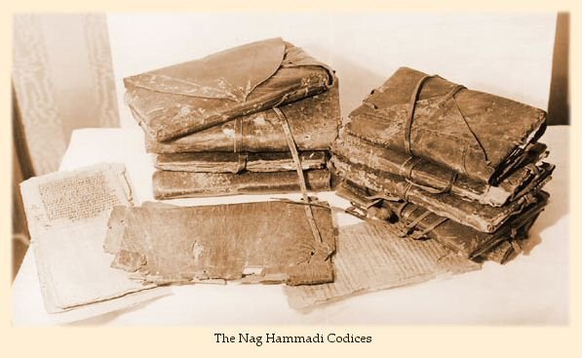
Gnosticism
http://jewishchristianlit.com/Texts/nagHam.html

Slide 8
*Gnosticism
One of the most serious spiritual threats the Christian Church has ever faced was the Gnostic movement.
This movement arose in the middle of the 2nd century – around AD 130-160.
The dangerous and divisive thing about the Gnostics was their claim that they, not the Church, were the true Christians.
This created a crisis of identity for the Christian faith, and great confusion among Pagans about who the real Christians actually were.
* Needham, Nick. 2,000 Years of Christ's Power Vol. 1: The Age of the Early Church Fathers

Slide 9
*Gnosticism
For centuries, practically the only sources that historians had for the study of Christian Gnosticism were the descriptions of early Christian writers arguing against Gnosticism and its tenets.
Then, in 1945, a large collection of Gnostic writings was discovered in Nag Hammadi, in Egypt. This included, among other things, the Gospel of Thomas.
For a number of reasons, it was not until the 1970s that these writings became generally known and available to scholars as well as to the public at large.
These and other discoveries—including the Gospel of Judas, published in 2006—have both corrected and reinforced much of what the early Christian writers told us about these Gnostic writings.
* Gonzalez, Justo L.. The Story of Christianity: Volume 1: The Early Church to the Dawn of the Reformation (p. 70)

Slide 10
*Gnosticism
The roots of Gnosticism predate Christianity, but it was not until the 2nd century that the movement became widespread and a serious menace to the life of the Church.
When we speak of “Gnosticism” or a “Gnostic movement”, we must not think of one single united organization or philosophy. There was a wide variety of different Gnostic groups.
However, these groups all shared a number of basic beliefs in common.
* Needham, Nick. 2,000 Years of Christ's Power Vol. 1: The Age of the Early Church Fathers

Slide 11
*Gnosticism
Gnostics embraced an idea from Greek philosophy that the physical, material world of space, time and matter was, by nature, evil and the unseen spiritual world was good.
According to Gnosticism, the material world had not been created by the supreme God, but by an inferior and foolish being called the Demiurge (Greek for “architect”).
The Gnostics identified the Demiurge with the God of the Old Testament, and therefore regarded the Old Testament as an evil and unspiritual book.
In the mind of the Gnostic, the supreme God and the physical universe were completely alien to each other.
The human body was part of this evil material world. Therefore, to Gnostics, salvation meant escaping from the physical body, and from the world of space and time in which the body holds us prisoner.
In Gnostic thinking, there was no place for a physical resurrection.
* Needham, Nick. 2,000 Years of Christ's Power Vol. 1: The Age of the Early Church Fathers

Slide 12
*Gnosticism
In light of the Gnostic belief that our soul was trapped in an evil physical body, how was this life to be lived?
At this point, the early Christian writers say that the Gnostics gave two divergent answers:
Most declared that, since the body is the prison of the spirit, one must control the body and its passions and thus weaken its power over the spirit.
But, there were also some who held that, since the spirit is by nature good and cannot be destroyed, what we are to do is to leave the body to its own devices and let it follow the guidance of its own passions.
Thus, while some Gnostics were extreme ascetics, others may have been libertines.
* Gonzalez, Justo L.. The Story of Christianity: Volume 1: The Early Church to the Dawn of the Reformation (p. 72)

Slide 13
*Gnosticism
The Gnostics further claimed that our spirit has been imprisoned our human bodies and must be liberated through a special, mystical knowledge or gnosis.
In order to achieve that liberation, a spiritual messenger must come to this world, to waken us from our dream or spiritual confusion.
Our spirits are asleep within our bodies, being driven by the impulses and passions of the body, and someone must come from beyond to remind us who we really are and to call us to struggle against our incarceration.
* Gonzalez, Justo L.. The Story of Christianity: Volume 1: The Early Church to the Dawn of the Reformation (p. 72)

Slide 14
*Gnosticism
In Christian Gnosticism—one should always remember that there were also non-Christian Gnostics—that messenger is Christ.
What Christ has done then is to come to earth in order to remind us of our heavenly origin, and to give us the secret knowledge without which we cannot return to the spiritual mansions.
Since Christ is a heavenly messenger, and since body and matter are evil, most Christian Gnostics rejected the notion that Christ had a body like ours.
Some said that his body was an appearance, a sort of ghost that miraculously seemed to be a real body.
* Gonzalez, Justo L.. The Story of Christianity: Volume 1: The Early Church to the Dawn of the Reformation (p. 72)

Slide 15
*Gnosticism
Many distinguished between the heavenly “Christ” and the earthly “Jesus,” apparently believing that the earthly Jesus was merely the shell in which Christ appeared.
In some cases, this was coupled with the notion that Jesus did have a body, but that his body was made of a “spiritual matter,” different from ours.
Most Gnostics denied the birth of Jesus, since this would have put him under the power of the material world.
All these notions are various degrees of what the church at large called Docetism—a name derived from a Greek word meaning “to seem”— for all of them implied, in one way or another, that the body of Jesus appeared to be fully human, but was not.
* Gonzalez, Justo L.. The Story of Christianity: Volume 1: The Early Church to the Dawn of the Reformation (p. 72)

Slide 16
*Gnosticism
Ignatius of Antioch condemned Docetism with special vigor, seeing it as a betrayal of apostolic teaching and a threat to the unity of the Church.
We can see the beginnings of Docetism recorded in the New Testament itself.
Writing near the end of the first century, the apostle John attacks what appears to be an early form of Docetic Gnosticism in 1 John 4:1-3:
Beloved, do not believe every spirit, but test the spirits to see whether they are from God, for many false prophets have gone out into the world. By this you know the Spirit of God: every spirit that confesses that Jesus Christ has come in the flesh is from God, and every spirit that does not confess Jesus is not from God. This is the spirit of the antichrist, which you heard was coming and now is in the world already. Little children, you are from God and have overcome them, for he who is in you is greater than he who is in the world.
* Needham, Nick. 2,000 Years of Christ's Power Vol. 1: The Age of the Early Church Fathers

Slide 17
*Gnosticism
According to Polycarp, a student of the Apostle John, on one occasion the apostle was entering the baths at Ephesus. Inside he saw Cerinthus, a well-known Docetic Gnostic, preparing to bathe. John, presumably garbed in a towel and a sour expression, rushed outside without taking a bath. “Let’s flee,” he said, “before the baths fall in. Cerinthus the enemy of the truth is inside.”
Thus we see what a modern Christian might find rather surprising: The first major attack on the faith in the early church was not a denial of Jesus Christ’s deity, but a rejection of his humanity!
* Shelley, Dr. Bruce L.. Church History in Plain Language: Fourth Edition (p. 54-57)

Slide 18
*Gnosticism
There were a number of Gnostic leaders, each teaching different types of Gnosticism.
Two of the most important were:
Basilides, who taught in Alexandria during the reign of the emperor Hadrian (AD 117-138),
Valentinus who taught in Rome from about AD 137 to 154.
However, the most outstanding Gnostic leader was Marcion.
* Needham, Nick. 2,000 Years of Christ's Power Vol. 1: The Age of the Early Church Fathers

Slide 19
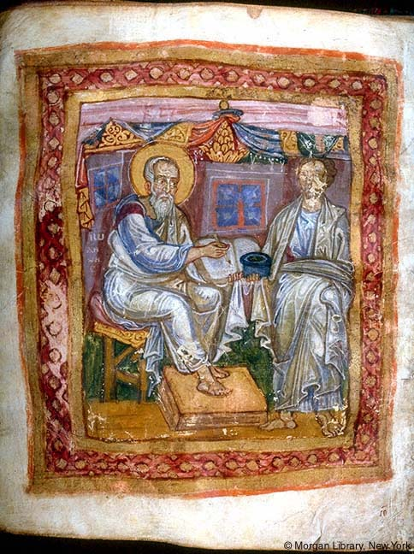
Marcion
https://en.wikipedia.org/wiki/Marcion_of_Sinope

