Slide 2
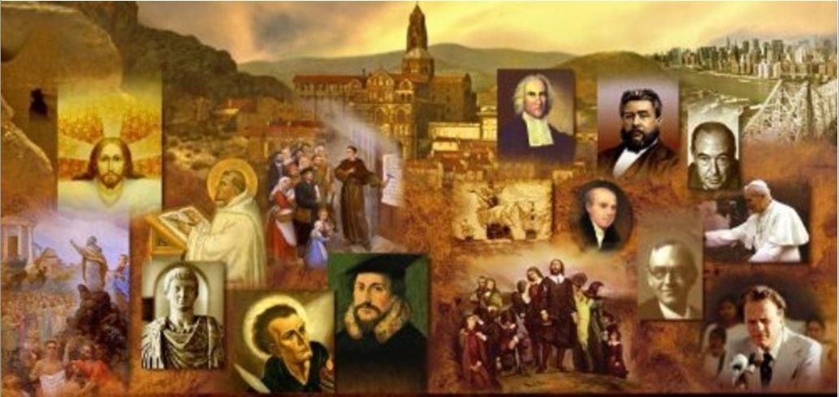
Review
When did Gnosticism arise and what made it such a threat to the early Christian church?
Gnosticism arose in the middle of the 2nd century – around AD 130-160
The dangerous and divisive thing about the Gnostics was their claim that they, not the Church, were the true Christians. This created confusion among pagans about who the real Christians were.
For centuries, practically the only sources that historians had for the study of Christian Gnosticism were the descriptions of early Christian writers arguing against Gnosticism and its tenets.
When and how did that change?
In 1945, with the discovery of a large collection of Gnostic writings in Nag Hammadi, Egypt – although, it was not until the 1970s that these writings became generally known and available to scholars as well as to the public at large.

Slide 3
Review
Gnostics embraced an idea from Greek philosophy that the physical world was, by nature, evil and the unseen spiritual world was good.
Since, in the mind of the Gnostic, the supreme God and the physical universe were completely alien to each other – who did they say created the physical universe?
An inferior and foolish being called the Demiurge (Greek for “architect”).
How did the Gnostics view the Old Testament?
The Gnostics identified the Demiurge with the God of the Old Testament, and therefore regarded the Old Testament as an evil and unspiritual book.

Slide 4
Review
How did Gnostics view the relationship between the human body and soul?
They claimed that our spirit is imprisoned in our human bodies and must be liberated through a special, mystical knowledge or gnosis.
Within Christian Gnosticism, what was Christ’s role?
Christ came to earth in order to remind us of our heavenly origin, and to give us the secret knowledge without which we cannot return to the spiritual mansions.
How did the Gnostics view Jesus’ physical body and what is the theological term for this view?
They did not believe that Christ, our heavenly messenger, could have had an evil physical body like ours, therefore he must have only seemed to have a real body, but actually had a ghostlike, spiritual body.
This belief is known as Docetism—a name derived from a Greek word meaning “to seem”.

Slide 5
Review
Where do we see evidence of an early form of Docetic Gnosticism strongly condemned in the New Testament?
1 John 4:1-3: Beloved, do not believe every spirit, but test the spirits to see whether they are from God, for many false prophets have gone out into the world. By this you know the Spirit of God: every spirit that confesses that Jesus Christ has come in the flesh is from God, and every spirit that does not confess Jesus is not from God. This is the spirit of the antichrist, which you heard was coming and now is in the world already.
There were a number of Gnostic leaders, each teaching different types of Gnosticism.
But who was one of the most outstanding Gnostic Leaders that almost every early church father wrote against?
Marcion

Slide 6
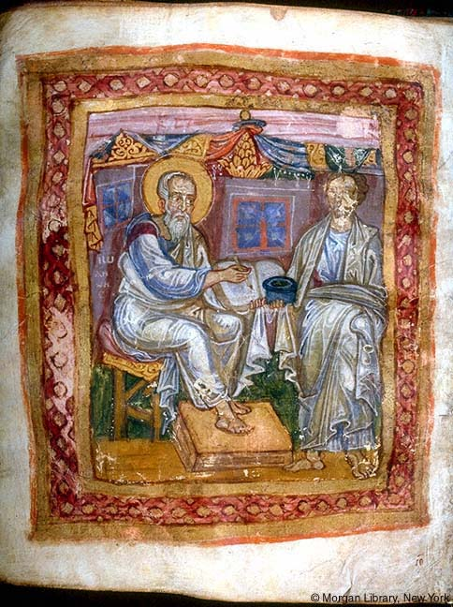
Marcion
https://en.wikipedia.org/wiki/Marcion_of_Sinope

Slide 7
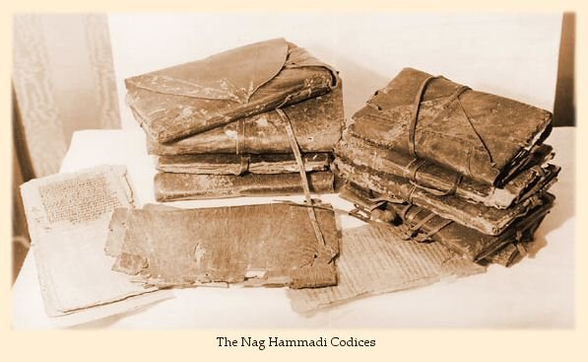
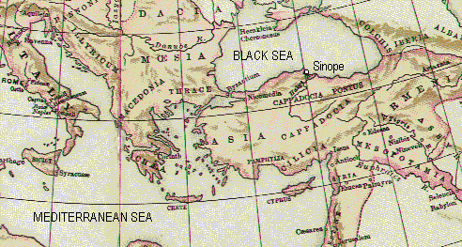
Marcion
About AD 140 a wealthy and much-traveled ship owner named Marcion came to Rome from Sinope, a town on the southern coast of the Black Sea.¹
http://www.marcionite-scripture.info/Sinope.html
¹ Shelley, Dr. Bruce L.. Church History in Plain Language: Fourth Edition (p. 69)

Slide 8
Marcion
Marcion, whose father was bishop of Sinope, knew Christianity from an early age.¹
But, despite his being the son of a bishop, Marcion came under the influence of a gnostic teacher named Cerdo, who believed that the God of the Old Testament was different from the God and Father of the Lord Jesus Christ.²
Cerdo, who is said to have started out as a follower of Simon Magus (cf. Acts 8:5-24), had been expelled from the church at Rome as a heretic in around AD 138.³
Cerdo held that the Old Testament God was full of wrath and the author of evil. This God, he said, was only concerned for the Jewish people. He was prepared to destroy all other people.²
In contrast, the Christian’s God was a God of grace and love for all, who disclosed himself in Jesus Christ, his Son.²
¹ Gonzalez, Justo L.. The Story of Christianity: Volume 1: The Early Church to the Dawn of the Reformation (p. 74)
² Shelley, Dr. Bruce L.. Church History in Plain Language: Fourth Edition (p. 69)
³ https://en.wikipedia.org/wiki/Cerdo_(gnostic)

Slide 9
*Marcion
Thus Marcion (following Cerdo) developed an understanding of Christianity that was both anti-Jewish and anti-material.
And (like Cerdo) Marcion taught that the God and Father of Jesus is not the same as Yahweh, the God of the Old Testament.
Marcion also believed that it was Yahweh who made this physical world, while the Father’s purpose was to have only a spiritual world.
But Yahweh, either through ignorance or out of evil intent, made this world and placed humankind in it—a theme that one finds in many other Gnostic writings as well.
* Gonzalez, Justo L.. The Story of Christianity: Volume 1: The Early Church to the Dawn of the Reformation (p. 74)

Slide 10
*Marcion
And (like Cerdo) Marcion taught that the Hebrew scriptures were inspired by Yahweh, and not the Supreme Father.
Yahweh is an arbitrary god, who chooses a particular people above all the rest. And he is also vindictive, constantly keeping an account on those who disobey him, and punishing them.
In short, Yahweh is a god of justice—and of an arbitrary justice at that. Over against Yahweh, and far above him, is the Father of Christians.
This God is not vindictive, but loving. This God requires nothing of us, but rather gives everything freely, including salvation.
* Gonzalez, Justo L.. The Story of Christianity: Volume 1: The Early Church to the Dawn of the Reformation (p. 74)

Slide 11
*Marcion
According to Marcion, in contrast to Yahweh, the god of the Old Testament, the God of the New Testament does not seek to be obeyed, but to be loved. It is out of compassion for us—Yahweh’s creatures—that the Supreme God has sent his Son to save us.
But Jesus was not really born of Mary, since such a thing would have made him subject to Yahweh.
Rather, he simply appeared as a grown man during the reign of Tiberius, and his body was not made of material flesh.
Naturally, at the end of time there will be no judgment, since the Supreme God is absolutely loving, and will simply forgive us.
* Gonzalez, Justo L.. The Story of Christianity: Volume 1: The Early Church to the Dawn of the Reformation (p. 74)

Slide 12
Modern Day Marcion?
In Love Wins, bestselling author, international teacher, and speaker Rob Bell (Velvet Elvis, Drops Like Stars) addresses one of the most controversial issues of faith—hell and the afterlife—arguing, would a loving God send people to eternal torment forever?
Rob Bell is an electrifying, unconventional pastor whom Time magazine calls “a singular rock star in the church world,” with millions viewing his NOOMA videos.
With searing insight, Bell puts hell on trial with a hopeful message—eternal life doesn’t start when we die; it starts right now. And ultimately, Love Wins.
https://www.amazon.com/Love-Wins-About-Heaven-Person-ebook/dp/B004IWR3CE

Slide 13
*Marcion
All of this led Marcion to set the Hebrew scriptures aside.
Marcion reasoned that if the Old Testament was the Word of an inferior god, it should not be read in the churches, nor used as the basis of Christian instruction.
In order to fill this gap, Marcion compiled a list of books that he considered true Christian scriptures. These were the Epistles of Paul — according to Marcion, one of the few who had really understood Jesus’ message — and the Gospel of Luke, who had been Paul’s companion.
Marcion believed that all other ancient Christian books were plagued by Jewish views.
As to the many quotations from the Old Testament in Luke and Paul, Marcion explained them away as interpolations — the handiwork of Judaizers seeking to subvert the original message.
* Gonzalez, Justo L.. The Story of Christianity: Volume 1: The Early Church to the Dawn of the Reformation (p. 74)

Slide 14
*Marcion
Marcion’s garbled Christian views were firmly repudiated by the church in Rome, and Marcion was excommunicated from the church in AD 144.
Before long, however, Marcionite churches appeared, modeled on orthodox congregations.
They had their own ministers and rituals. For example, they did not use wine at communion, as a result of the ascetic emphasis of their teaching.
Some of the Marcionite beliefs spilled over into the other gnostic sects, and Marcionites were themselves affected by other gnostic views.
Their ideas spread, however, throughout Italy and as far afield as Arabia, Armenia, and Egypt.
In the East they exercised a considerable influence for many decades. A number of Marcionite villages existed near Damascus as late as the fourth century.
* Shelley, Dr. Bruce L.. Church History in Plain Language: Fourth Edition (p. 70). Thomas Nelson.

Slide 15
The Gnostic Gospels
http://jewishchristianlit.com/Texts/nagHam.html

Slide 16
The Gnostic Gospels
There are those today who try to argue that these gnostic gospels which have come to light in recent years are “lost books of the Bible” that should have been included in the New Testament.
But in reality, the early church fathers rightly rejected these books on the basis of at least one of three criteria:
They were not produced in association with an apostle
They explicitly contradict the scriptures
Include absurd teachings that clearly make them unworthy to be included in the NT.

Slide 17
The Gnostic Gospels
The “Gospel of Thomas” (AD 140-200), for example contains the following absurd statement: Simon Peter said to them: “Let Mary go away from us, for women are not worthy of life.” Jesus said: “Lo, I shall lead her, so that I may make her a male, that she too may become a living spirit, resembling you males. For every woman who makes herself a male will enter the kingdom of heaven” (par.114)
This flies in the face of clear scriptures which teach that man and woman are both made in the image of God (Gen 1:27) and while the scriptures teach that men and women have differing roles in certain areas (e.g. women are not allowed to teach or have spiritual authority over men 1 Tim 2:12) in terms of their standing before God: There is neither Jew nor Greek, there is neither slave nor free, there is no male and female, for you are all one in Christ Jesus. (Gal. 3:28)

Slide 18
The Gnostic Gospels
The Gospel of Phillip (AD 180-350) contains numerous absurd statements that either contradict the scriptures, are nonsensical, or both:
Adam came into being from two virgins, from the Spirit and from the virgin earth. (verse 90) – which directly contradicts Gen. 2:7 – the LORD God formed the man of dust from the ground and breathed into his nostrils the breath of life, and the man became a living creature.
The soul of Adam came into being by means of a breath. The partner of his soul is the spirit. His mother is the thing that was given to him. His soul was taken from him and replaced by a spirit. When he was united (to the spirit), he spoke words incomprehensible to the powers. (verse 87) - ???
Some said, “Mary conceived by the Holy Spirit.” They are in error. They do not know what they are saying. When did a woman ever conceive by a woman? Mary is the virgin whom no power defiled. (verse 18) – which directly contradicts Mat 1:20 –an angel of the Lord appeared to [Joseph] in a dream, saying, “Joseph, son of David, do not fear to take Mary as your wife, for that which is conceived in her is from the Holy Spirit”.

Slide 19
The Gnostic Gospels
The Gospel of Phillip (180-350) contains numerous absurd statements that either contradict the scriptures, are nonsensical, or both:
Those who say that the Lord died first and (then) rose up are in error, for he rose up first and (then) died. (verse 22) – which directly contradicts 1 Cor. 15:3-4 – For I delivered to you as of first importance what I also received: that Christ died for our sins in accordance with the Scriptures, that he was buried, that He was raised on the third day in accordance with the Scriptures.
By perfecting the water of baptism, Jesus emptied it of death. Thus we do go down into the water, but we do not go down into death, in order that we may not be poured out into the spirit of the world. When that spirit blows, it brings the winter. When the Holy Spirit breathes, the summer comes. (verse 115) - ???

Slide 20
The Gnostic Gospels
The Infancy Gospel of Thomas (AD 140-170) – not to be confused with the so-called Gospel of Thomas – claims to contain stories about Jesus in his youth. But one well known story from this so-called gospel depicts the young Jesus as a hot-tempered murderer:
The son of Annas the scribe was standing there with Jesus. Taking a branch from a willow tree, he dispersed the waters which Jesus had gathered. When Jesus saw what had happened, he became angry and said to him, “You godless, brainless moron, what did the ponds and waters do to you? Watch this now: you are going to dry up like a tree and you will never produce leaves or roots or fruit.” And immediately, this child withered up completely. Then, Jesus departed and returned to Joseph's house. The parents of the one who had been withered up, however, wailed for their young child as they took his remains away. Then, they went to Joseph and accused him, “You are responsible for the child who did this.” (Chapter 3)
This contradicts Heb. 4:15 which teaches that Jesus: in every respect has been tempted as we are, yet without sin.

Slide 21
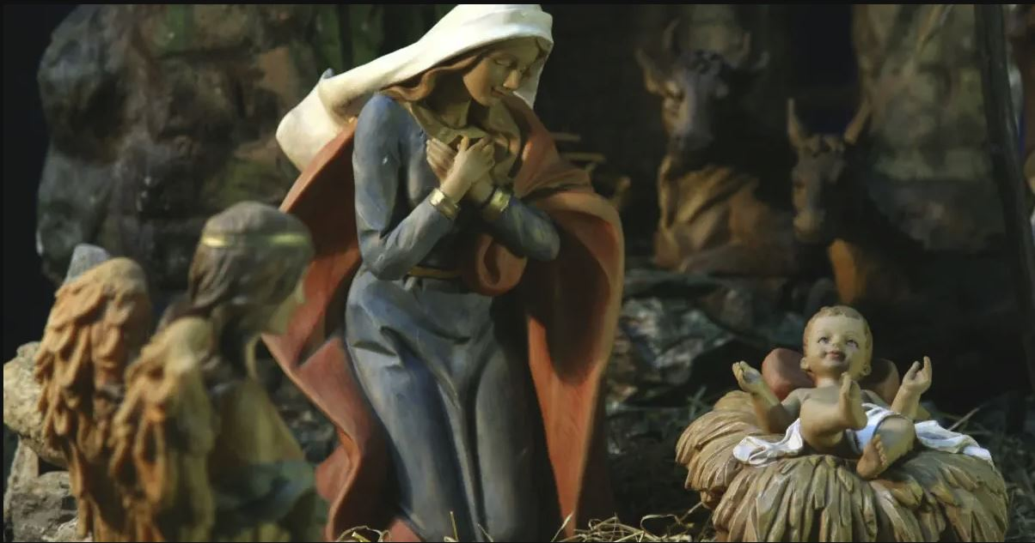
The Origins of Christmas
https://www.crosswalk.com/special-coverage/christmas-and-advent/was-jesus-really-born-on-dec-25.html

