Slide 1


Slide 2

Review
Marcion was born in Sinope, a town on the southern coast of the Black Sea. What prominent position in that town did Marcion’s father hold?
  Bishop of Sinope
Marcion first came to Rome in AD 140. What was his occupation?
  He was a wealthy and much-traveled ship owner.
Despite his being the son of a bishop, another influence came into the life of Marcion that pulled him away from his father’s Christian beliefs. What was that influence?
  Marcion came under the influence of a gnostic teacher named Cerdo

Slide 3
Review
What are some of the standard gnostic beliefs that Marcion picked up, initially under the influence of Cerdo, and later, perhaps, on his own?
  That the God and Father of Jesus is not the same as Yahweh, the God of the Old Testament
  It was Yahweh who made this physical world, while the Father’s purpose was to have only a spiritual world
  Yahweh, the OT God, was full of wrath and the author of evil. In contrast, the Christian’s God was a God of grace and love for all, who disclosed himself in Jesus Christ, his Son.
  Marcion taught that the Hebrew scriptures were inspired by Yahweh, and not the Supreme Father.
  He taught that Jesus was not really born of Mary, since that would have made him subject to Yahweh.
  Jesus simply appeared as a grown man during the reign of Tiberius, and his body was not made of material flesh.
  At the end of time there will be no judgment, since the Supreme God is absolutely loving, and will simply forgive us.

Slide 4
Review
What books did Marcion include/exclude from his Bible?
  Marcion included:
    The Epistles of Paul — according to Marcion, one of the few who had really understood Jesus’ message
    The Gospel of Luke, who had been Paul’s companion.
  Marcion excluded:
    The entire Old Testament and all the other books of the New Testament.
    He even excluded OT citations in Paul and Luke, claiming that they had been added by the Judaizers.
Why did he exclude the books that he did?
  He believed that the Old Testament was the Word of an inferior god (Yahweh)
  He believed that all other ancient Christian books (except the ones he accepted) were plagued by Jewish views.

Slide 5
Review
How did the church at Rome respond to the teachings of Marcion?
  Marcion was excommunicated from the church in AD 144.
Before long, however, Marcionite churches began to appear – modeled on orthodox congregations. How far did the teachings of Marcion spread?
  His ideas spread throughout Italy and as far afield as Arabia, Armenia, and Egypt.
  In the East they exercised a considerable influence for many decades. A number of Marcionite villages existed near Damascus as late as the fourth century.

Slide 6
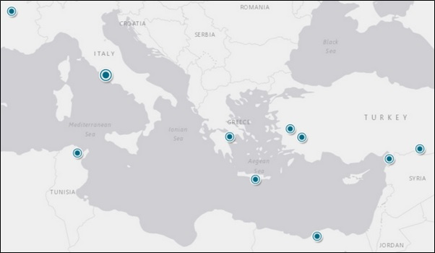
Review
Origin of Authors on Marcionism in the Second and Early Third Century
http://mediterraneannetworks.weebly.com/the-rise-and-fall-of-marcionism.html

Slide 7
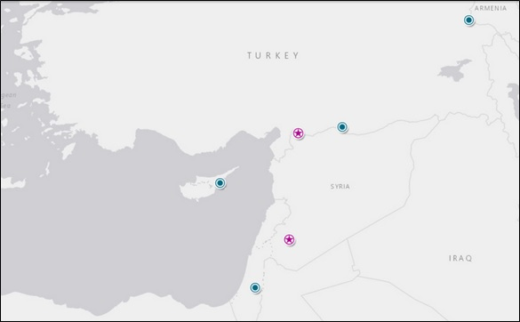
Review
Origin of Authors on Marcionism in the Fourth and Fifth Century AD
Stars indicate the certain existence of a Marcionite church.
http://mediterraneannetworks.weebly.com/the-rise-and-fall-of-marcionism.html

Slide 8
Review
The early church fathers rightly rejected the Gnostic writings on the basis of three criteria. What were they?
  They were not produced in association with an apostle
  They explicitly contradict the scriptures
  Include absurd teachings that clearly make them unworthy to be included in the NT.
The well known Gnostic work, the Gospel of Thomas, contains an absurd, unbiblical statement concerning Mary Magdalene. Give a rough paraphrase of what it says.
  Simon Peter said to them: “Let Mary go away from us, for women are not worthy of life.” Jesus said: “Lo, I shall lead her, so that I may make her a male, that she too may become a living spirit, resembling you males. For every woman who makes herself a male will enter the kingdom of heaven” (par.114)

Slide 9
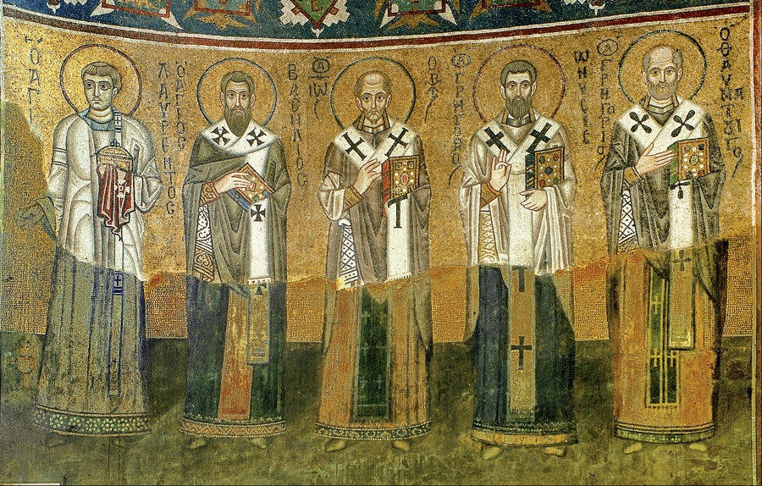
The Second Century Apologists
https://start2finish.org/why-christians-shouldnt-neglect-early-christian-literature/

Slide 10
*The Second Century Apologists
With followers in the billions, Christianity today is the world’s largest religion.
According to a Pew Research Poll taken in 2010, the Worldwide percentage of Adherents by Religion are:
  Christianity (31.5%)
  Islam (23.2%)
  Irreligion (16.3%)
  Hinduism (15.0%)
  Buddhism (7.1%)
  Folk religions (5.9%)
  Other religions (1%)
* https://en.wikipedia.org/wiki/Major_religious_groups#cite_note-Pew2012-28

Slide 11
*The Second Century Apologists
Spires of churches dominate the skylines of most major cities. Christians are represented in all levels of society, from the richest to the poorest.
As an institution, the Christian Church wields substantial influence over major aspects of our modern culture.
But this has not always been the case. There was a time, nearly two thousand years ago, when Christianity was in its infancy. It possessed very little cultural influence, was weak and frail, and found itself fighting for its life.
* Kruger, Michael J.. Christianity at the Crossroads: How the Second Century Shaped the Future of the Church (p. 1).

Slide 12
*The Second Century Apologists
Theological formulations were imprecise and undeveloped, factions and “heresies” were dominant, attacks from pagan philosophers were rampant, and the future was altogether uncertain.
On top of all of this, Christianity was, for the first time, moving forward without the direct guidance of living apostles and still did not yet have a fully formed New Testament canon.
When was this time? It was the second century.
This particular block of time is one of the most critical in the life of the Church – perhaps the moment when it was most vulnerable.
It is what we might call the transitional century for the early Christian faith.
* Kruger, Michael J.. Christianity at the Crossroads: How the Second Century Shaped the Future of the Church (p. 1).

Slide 13
*The Second Century Apologists
The Church was out of the apostolic womb and now trying to take its first breath.
Christians found themselves in a dangerous world. The second century was a time of sharp disappointments, gradual adjustments, bitter controversies, and grave hazards for Christian communities.
Christians during this period stood at a crossroads: the changes and challenges they faced, and how they would respond to them, would (re)shape the Christian movement for years to come.
* Kruger, Michael J.. Christianity at the Crossroads: How the Second Century Shaped the Future of the Church (p. 1-5).

Slide 14
*The Second Century Apologists
The second-century Church had a large population of Gentiles that brought with it a number of intellectual and cultural challenges.
This demographic shift (away from the predominantly Jewish composition of Christianity in the early first century) allowed Christianity to reshape the standard definition of ‘religion’ in the Greco-Roman world.
Whereas most religions were seen as tightly bound to a particular ethnic or national identity, Christianity was adopted by a variety of people groups, crossing the standard boundaries.
In a rather unprecedented fashion, Christianity now allowed religion to be conceived as an entity independent of the ethnic-cultural components that were normally (and inevitably) attached to it.
* Kruger, Michael J.. Christianity at the Crossroads: How the Second Century Shaped the Future of the Church (p. 5).

Slide 15
*The Second Century Apologists
The second century proved to be a time when Christianity found itself immersed deeply in a “pluralistic” world – very different from both the Jewish world into which it was born and the later Christian Empire it would become under Constantine.
Due to the fact that Christianity was now more visible as its own “religion”, it garnered additional attention from the governing authorities and intellectual leaders in the Greco-Roman world.
Although Christians had already begun to suffer persecution from the Roman government in the first century (e.g., under Nero), the barrage of attacks in the second century would prove to be substantial.
* Kruger, Michael J.. Christianity at the Crossroads: How the Second Century Shaped the Future of the Church (p. 6).

Slide 16
*The Second Century Apologists
Christianity’s commitment to exclusive, monotheistic worship of Jesus was viewed as not only culturally peculiar and intellectually wanting, but also as politically subversive and a threat to the stability of the Roman state.
Consequently, governing authorities began to arrest and (at times) even execute Christians – often at the behest of the Roman mob – and the intellectual elites began to attack Christianity’s philosophical credibility.
This situation gave rise to the second-century apologists who pushed back on a number of fronts, defending and explaining the infant Christian faith to all who would listen.
As a result, the second century would prove to be the “golden age” of apologetics. Or, as Professor of Early Church History, Eric Osborn put it, “Christian philosophy begins here in the second century.”
* Kruger, Michael J.. Christianity at the Crossroads: How the Second Century Shaped the Future of the Church (p. 6).

Slide 17
*The Second Century Apologists
It is worth noting that this particular feature of second-century Christianity makes it especially relevant us today.
Given that we, too, live in a pluralistic society, we are asking questions that sound more like the questions asked by second-century Christians than by fourth- or fifth-century Christians.
Such questions include ‘Is there a god?’, ‘How many gods are there?’, ‘How can we know this God?’, and ‘Are all religions the same?’
The second century was the time when Christians began to develop more well-rounded answers to these questions.
* Kruger, Michael J.. Christianity at the Crossroads: How the Second Century Shaped the Future of the Church (p. 6).

Slide 18
*The Second Century Apologists
Perhaps the most dominant feature of second-century Christianity, is its profound doctrinal and theological diversity.
This century witnessed an explosion of what might be called ‘heresies’ (e.g., Gnosticism, Montanism, the Ebionites) and ‘heretics’ (e.g., Marcion, Basilides, Valentinus, Ptolemy, Heracleon, Theodotus).
During this century, God raised up a number of “orthodox” writers to do battle with these heretical groups – men like Polycarp, Ignatius, Justin Martyr, Irenaeus and Clement of Alexandria.
And these writers appealed to what is known as the “rule of faith” – a widespread and well-established summary of the apostolic teaching that had been passed down to the churches.
Thus, the second century was a battleground where different versions of Christianity were competing for the right to be regarded as the authentic (or original) version of the faith.
* Kruger, Michael J.. Christianity at the Crossroads: How the Second Century Shaped the Future of the Church (p. 6).

Slide 19
*The Second Century Apologists
The second century stands as a crossroads in the development of the early Christian movement.
Gerd Lüdemann, Chair of History and Literature of Early Christianity at the University of Göttingen, Germany, said this about the overall importance of this century:
  To put it pointedly, in the period from the first Christian generations to the end of the second century, more important decisions were made for the whole of Christianity than were made from the end of the second century to the present day.
* Kruger, Michael J.. Christianity at the Crossroads: How the Second Century Shaped the Future of the Church (p. 8).

Slide 20
*The Second Century Apologists
Both the political and intellectual persecution of Christianity in the second century gave rise to a distinctive type of Christian literature.
Most Christian literature was written for the believing community – theological treatises, exhortational letters, and even apocryphal writings.
In these writings, they would speak about the world outside the Church rather than to it.
But apologetic writings were different. They were unique because they were written primarily to engage non-Christian thinking (regardless of who actually read the work).
* Kruger, Michael J.. Christianity at the Crossroads: How the Second Century Shaped the Future of the Church (p. 62).

Slide 21
*The Second Century Apologists
Apologetic writings were designed to accomplish many tasks:
  To overturn caricatures and misrepresentations,
  To defend against false accusations,
  To explain controversial beliefs and doctrines,
  To plead for tolerance and fair treatment from governing officials.
But such works were not only defensive. Apologists would also go on the offensive, demonstrating that pagan philosophies and religions were problematic, irrational, and the foundation for immoral behavior.
* Kruger, Michael J.. Christianity at the Crossroads: How the Second Century Shaped the Future of the Church (p. 62).

Slide 22
Quadratus and Aristides
The early fourth century church historian, Eusebius (AD 260-340) informs us of the apologies of Quadratus and Aristides, which are probably two of Christianity’s earliest apologetic works (both wrote in the early second century).
Both presented their works to Emperor Hadrian round AD 125 – the first of many appeals to Roman emperors by Christian apologists.
Of course, most apologetic treatises had very little chance of actually being read by the emperor; and even less of a chance of receiving an answer.
Regardless, addressing an apologetic work to the emperor was an effective rhetorical device designed to call attention to political and civil issues that were affecting Christian communities.
* Kruger, Michael J.. Christianity at the Crossroads: How the Second Century Shaped the Future of the Church (p. 62-63).

Slide 23
*Quadratus
We know very little about Quadratus, but his apology was popular enough that Eusebius informs us that by his day “It is still extant among many of the brethren and we have a copy ourselves.”
The rationale for his apology is what we would expect: Quadratus composed “a defense for our religion because some wicked men were trying to trouble the Christians”.
Eusebius then records the only known excerpt from Quadratus:
  Our Savior’s deeds were always present, for they were true. Those healed or risen from the dead did not just appear as healed or risen but were always present, not just while the Savior visited us but even when he went away; they remained for a long time so that some of them even reached our own time.
* Kruger, Michael J.. Christianity at the Crossroads: How the Second Century Shaped the Future of the Church (p. 63).

Slide 24
*Quadratus
Quadratus appears to be defending the validity of Christ’s miracles by pointing out that they weren’t done in such a fashion that people only appeared healed or risen, but the miracles were real enough that healed/risen people survived even till “our own time”.
It is difficult to know exactly what claims Quadratus is responding to, but it is possible that he is contrasting the quality of Jesus’ miracles with that of other (perhaps gnostic) miracle workers.
* Kruger, Michael J.. Christianity at the Crossroads: How the Second Century Shaped the Future of the Church (p. 63).

Slide 25
*Aristides
Aristides was an Athenian philosopher who was converted to Christ and yet continued to wear “his philosopher’s garb”.
His full Apology survives only in Syriac (although there is an abbreviated Greek version embedded within an eighth-century Greek novel, Barlaam and Josaphat).
Aristides begins his treatise by offering a thorough explanation of the Christian doctrine of God, laying out the divine characteristics and attributes.
Then he proceeds to contrast the Christian God with the gods of the Barbarians, Greeks and Egyptians.
* Kruger, Michael J.. Christianity at the Crossroads: How the Second Century Shaped the Future of the Church (p. 63-64).

Slide 26
*Aristides
His analysis is impressive in its scope and depth – perhaps not surprising given his philosophical learning – and one of the very first critical comparisons between Christianity and other religions.
The Barbarians effectively are pantheists, argues Aristides, and thus foolishly worship the earth.
The Greek gods, Aristides demonstrates, have attributes that are all too human and fallible, even engaging in adultery and murder themselves.
And the Egyptians just worship animals, not realizing that “they daily witness their gods being eaten and consumed by men”.
* Kruger, Michael J.. Christianity at the Crossroads: How the Second Century Shaped the Future of the Church (p. 63-64).

Slide 27
*Aristides
Towards the end of his treatise, Aristides links the Christian God to the God of Judaism, acknowledging that “as we learned from their writings, they [the Jews] have come nearer to truth and genuine knowledge than the rest of the nations”.
However, Aristides faults the Jews for denying Christ and, in turn, offers one of the most succinct descriptions of early Christian beliefs about Jesus.
* Kruger, Michael J.. Christianity at the Crossroads: How the Second Century Shaped the Future of the Church (p. 64).

Slide 28
*Aristides
Aristides writes:
The Christians, then, trace the beginning of their religion from Jesus the Messiah; and he is named the Son of God Most High. And it is said that God came down from heaven, and from a Hebrew virgin assumed and clothed himself with flesh; and the Son of God lived in a daughter of man. This is taught in the gospel, as it is called, which a short time was preached among them; and you also if you will read therein, may perceive the power which belongs to it. This Jesus, then, was born of the race of the Hebrews; and he had twelve disciples in order that the purpose of his incarnation might in time be accomplished. But he himself was pierced by the Jews, and he died and was buried; and they say that after three days he rose and ascended to heaven.
* Kruger, Michael J.. Christianity at the Crossroads: How the Second Century Shaped the Future of the Church (p. 64).

Slide 29
*Aristides
As you can see, this statement reflects a number of core Christian beliefs, such as:
  The deity of Jesus (“God came down from heaven”)
  The Incarnation (“clothed himself with flesh”)
  The virgin birth (“from a Hebrew virgin”)
  Christ’s death, resurrection and Ascension.
* Kruger, Michael J.. Christianity at the Crossroads: How the Second Century Shaped the Future of the Church (p. 64).

Slide 30
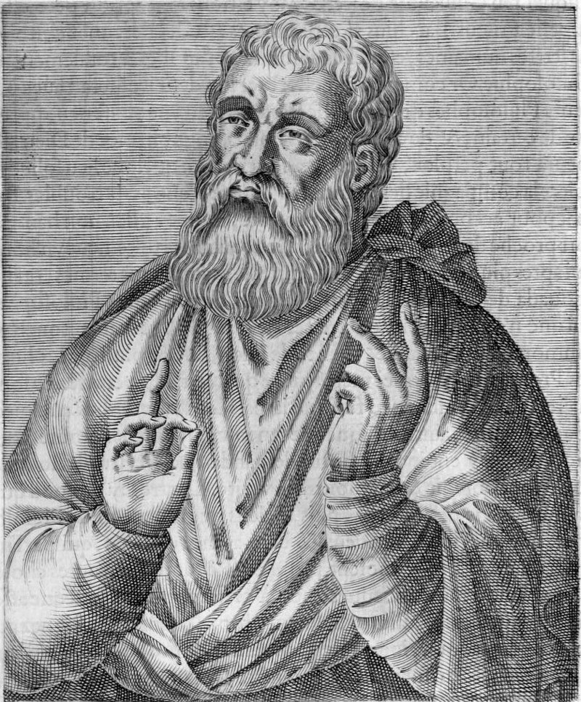
Justin Martyr
https://en.wikipedia.org/wiki/Justin_Martyr#/media/File:Justin_Martyr.jpg

