Slide 2
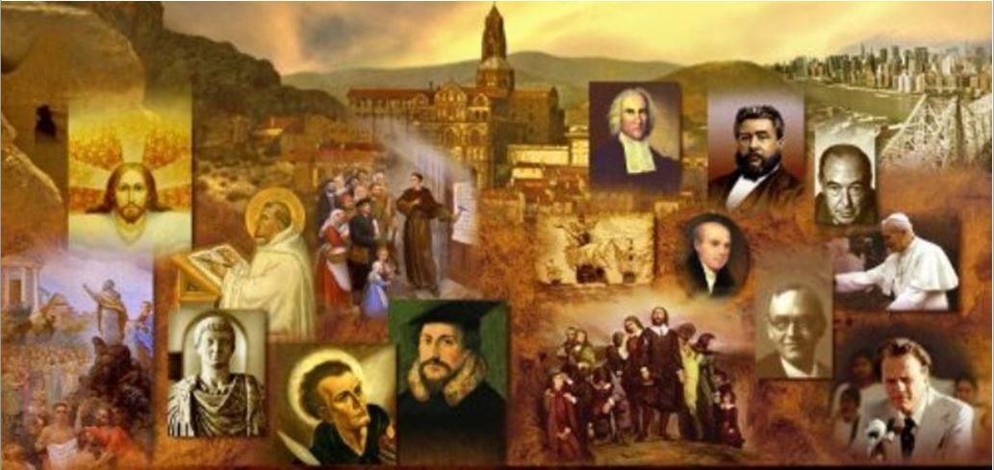
Review
The Christian Church today wields substantial influence over major aspects of our modern culture.
How does this compare with how Christianity looked in the second century?
In the second century, Christianity was in its infancy, It possessed very little cultural influence, was weak and frail, and found itself fighting for its life.
Most religions in the second century were seen as tightly bound to a particular ethnic or national identity. How did second century Christianity look in this regard?
Christianity was adopted by a variety of people groups, crossing the standard boundaries.

Slide 3
Review
How is the world that Christians face today is more similar to the world the second century Christians faced than the world that fourth or fifth century Christians faced?
The second century Christians lived in a pluralistic society and were are being asked questions that sound more like the questions being asked today than those asked in the Christianized fourth and fifth century Roman world.
Both the political and intellectual persecution of Christianity in the second century gave rise to a what type of Christian literature?
Apologetic literature

Slide 4
Review
What is the difference between standard Christian literature written for Christians versus apologetic literature?
Most Christian literature was written for Christians about the world outside the Church rather than to it; whereas apologetic writings were written primarily to engage non-Christian thinking.
List some of the purposes that apologetic writings sought to accomplish:
To overturn caricatures and misrepresentations,
To defend against false accusations,
To explain controversial beliefs and doctrines,
To plead for tolerance and fair treatment from governing officials.

Slide 5
Review
The early fourth century church historian, Eusebius (AD 260-340) tells us about the apologies of Quadratus and Aristides, which are probably two of Christianity’s earliest apologetic works (both wrote in the early second century).
To whom did these two men present their apologetic works in AD 125 and what was the significance of their doing so?
Both presented their works to Emperor Hadrian – the first of many appeals to Roman emperors by Christian apologists.
Though he was unlikely to read, much less answer their appeals, addressing an apologetic work to the emperor was an effective rhetorical device designed to call attention to political and civil issues that were affecting Christian communities.

Slide 6
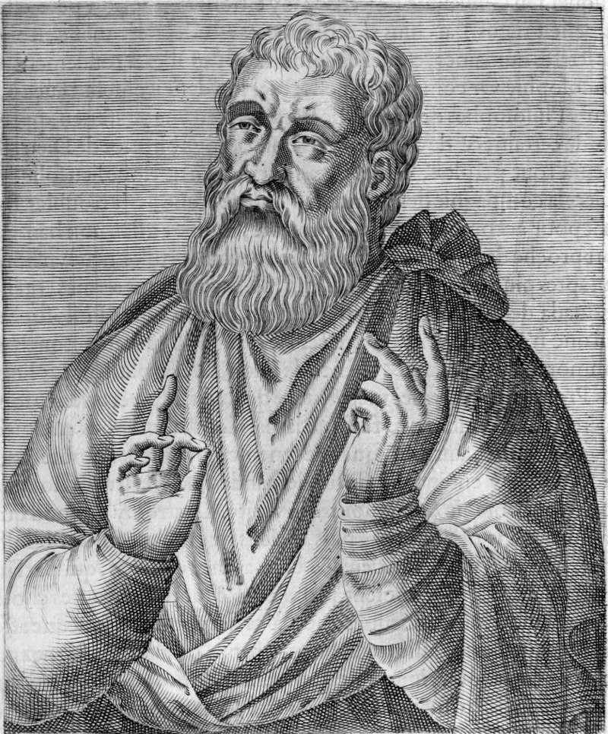
Justin Martyr
https://en.wikipedia.org/wiki/Justin_Martyr#/media/File:Justin_Martyr.jpg

Slide 7
Justin Martyr
Justin Martyr (c.103–165) was one of the most well-known Christian philosophers and apologists in the second century.¹
When Justin was arrested for his faith in Rome, the prefect asked him to denounce his faith by making a sacrifice to the gods. Justin replied, “No one who is right-minded turns from true belief to false.” ²
It was in one sense, an easy answer for Justin to give because he had spent most of his adult life discerning the true from the false. ²
¹ Kruger, Michael J.. Christianity at the Crossroads: How the Second Century Shaped the Future of the Church (p. 49).
² Galli, Mark. 131 Christians Everyone Should Know (p. 49). B&H Publishing Group

Slide 8
*Justin Martyr
Justin was born in Samaria, but was raised by pagan parents.
He was educated in the Greek philosophical systems having studied Stoicism, then having studied with a peripatetic philosopher (someone who would walk from place to place and collect disciples), then with a Pythagorean, and then with a Platonist.
In Platonism Justin believed that he had finally found what he was looking for and was content with that until one day he was walking along the seashore and he encountered an elderly Christian man and in the ensuing conversation, Justin’s faith in the wisdom of man was shaken.
*Based on notes taken from James White’s 2016 Church History Series; Lessons 16 and 17

Slide 9
*Justin Martyr
Justin later wrote of his conversation with the elderly Christian man:
“A fire was suddenly kindled in my soul. I fell in love with the prophets and these men who had loved Christ; I reflected on all their words and found that this philosophy alone was true and profitable. That is how and why I became a philosopher. And I wish that everyone felt the same way that I do.”
Justin continued to wear his philosopher's cloak after becoming a Christian, believing that the Christian faith was compatible with sound philosophy and reason.
*Galli, Mark. 131 Christians Everyone Should Know (p. 49-50). B&H Publishing Group

Slide 10
*Justin Martyr
Justin’s primary area of training was philosophy, and he does not seem to have had a complete NT canon. He doesn’t ever quote from Paul, for example.
There are imbalances in Justin’s theology, but given what few books of scripture he had, it’s understandable.
Justin devoted himself to the defense of the Christian faith.
He held no church office, which is interesting because most of the early Christian writers were bishops.
He didn’t stay in one place, so there is not a place associated with his name.
*Based on notes taken from James White’s 2016 Church History Series; Lessons 16 and 17

Slide 11
*Justin Martyr
Justin is not deeply influenced by NT writings, especially those of the Apostle Paul, and as a result his theology very legal and very works-oriented when it comes to soteriology (theology dealing with salvation).
Soteriology is not a big area of his discussion because that is not what he was being challenged on.
He was being challenged on things like monotheism, one truth, the incarnation, Jesus as the Son of God, etc., and so these are the things he focused on.
Besides, if you weren’t familiar with Galatians and Romans, how well-informed would you be on soteriology?
*Based on notes taken from James White’s 2016 Church History Series; Lessons 16 and 17

Slide 12
*Justin Martyr
Justin’s most important writings are:
His Dialogue with Trypho the Jew
His First and Second Apology
He is also said to have written against Marcion, but those works have been lost.
Through Justin’s writings, we not only learn a great deal about the intellectual attacks on Christians, but we also gain critical insights into the political persecutions that were occurring during his day.
* Kruger, Michael J.. Christianity at the Crossroads: How the Second Century Shaped the Future of the Church (p. 49).

Slide 13
Justin Martyr
Justin’s teaching ministry took him first to Ephesus (c. 132), where he held a disputation with Trypho, a Jew, about the true interpretation of Scripture.¹
His Dialogue with Trypho presents a back-and-forth conversation with Trypho where Justin offers a defense of Christianity against the claims of Judaism.²
The Dialogue teaches three main points:¹
The Old Covenant was passing away to make place for the New.
The Logos (translated “Word” in John 1:1) is the God of the Old Testament.
The Gentiles are the new Israel.
¹ Galli, Mark. 131 Christians Everyone Should Know (p. 49-50). B&H Publishing Group
² Kruger, Michael J.. Christianity at the Crossroads: How the Second Century Shaped the Future of the Church (p. 49).

Slide 14
*Justin Martyr
Justin argues that the major Old Testament stories – Noah’s flood, the exodus from Egypt, Joshua’s conquest of the land – all foreshadowed how God would deliver his people from judgement through Christ.
Thus, the Old Testament Scriptures, according to Justin, are effectively “Christian” documents.
This sort of argument provided yet another rebuttal to the oft-repeated accusation that Christianity is a new religion without the tradition or history of established faiths like Judaism.
* Kruger, Michael J.. Christianity at the Crossroads: How the Second Century Shaped the Future of the Church (p. 67-68).

Slide 15
Justin Martyr
Later Justin moved to Rome, founded a Christian school, and wrote his two bold apologies (i.e., defenses—from the Greek apologia).¹
Justin's First Apology, addressed to Emperor Antoninus Pius, was published in AD 155 and attempted to explain the Christian faith.¹
Christianity was not a threat to the state, he asserted, and should be treated as a legal religion.¹
Justin denies that Christians are guilty of the typical charges levelled against them – atheism, immorality and disloyalty – and makes an extended case for the morality and virtue of the Christian faith. ²
Justin argued that Christians are, in fact, the emperor's “best helpers and allies in securing good order, convinced as we are that no wicked man…can be hidden from God, and that everyone goes to eternal punishment or salvation in accordance with the character of his actions.” ¹
¹ Galli, Mark. 131 Christians Everyone Should Know (p. 49-50). B&H Publishing Group
² Kruger, Michael J.. Christianity at the Crossroads: How the Second Century Shaped the Future of the Church (p. 49).

Slide 16
*Justin Martyr
Justin further argued that Christians ought not to be prosecuted just because they bear the “name” of Christ – nor should they be forced by governing officials to deny Christ, but they should be prosecuted solely on the basis of whether or not they have committed an actual crime.¹
Then Justin embarked on an extended defense of monotheism by exposing the futility of the pagan gods.¹
He further showed that Christianity is superior to paganism, that the coming of Christ was the fulfillment of numerous OT prophesies, and that paganism is actually a poor imitation of the true religion.²
¹ Kruger, Michael J.. Christianity at the Crossroads: How the Second Century Shaped the Future of the Church (p. 49).
² Galli, Mark. 131 Christians Everyone Should Know (p. 49-50). B&H Publishing Group

Slide 17
*Justin Martyr
You may recall that Justin’s First Apology is also where we get one of the clearest and lengthiest detailed descriptions of the kind of things that took place in a Christian worship service in the second century.
He gave this detailed description of the Christian worship service in order dispel misconceptions that unbelievers had about what went on in a Christian worship service and to show that Christianity was not subversive.
* Kruger, Michael J.. Christianity at the Crossroads: How the Second Century Shaped the Future of the Church (p. 49).

Slide 18
Justin Martyr
In his Second Apology, written soon after Marcus Aurelius became emperor in AD 161,¹ Justin gives specific examples of Christian persecution in order to show the absurd and unjust nature of this persecution.
He tells the story of a Christian woman who was married to a wicked, unbelieving husband and eventually sought a divorce due to his repeated infidelity. In revenge, her husband accused her “saying that she was a Christian” – a charge that was sufficient to have her arrested.²
Justin recounts similar stories of Ptolemaeus and Lucius who were both arrested merely because they were “called by the name of Christian” and others who were “dragged to the torture” until they confessed crimes.²
¹ Galli, Mark. 131 Christians Everyone Should Know (p. 51-52). B&H Publishing Group
² Kruger, Michael J.. Christianity at the Crossroads: How the Second Century Shaped the Future of the Church (p. 49).

Slide 19
*Justin Martyr
But Justin is not content to address only political issues in these two apologies. He is also intent on making the intellectual case for the truth of Christianity.
If the emperor is to be persuaded, Justin will need more than a legal case; he will need to show that Christians are not really irrational atheists but the only ones who are worshipping the true God with reason.
* Kruger, Michael J.. Christianity at the Crossroads: How the Second Century Shaped the Future of the Church (p. 66-67).

Slide 20
*Justin Martyr
To accomplish this task, Justin turns to a well-established line of argumentation, namely that Jesus has successfully fulfilled Old Testament prophecies – an approach that would be repeated by other Christian apologists in generations to come.
Justin offers a lengthy and detailed discussion of a wide variety of texts such as Exodus, Isaiah, Micah, Psalms, Zechariah and more, all designed to show that Christ fulfills the Old Testament promises.
Not only does this argument serve to bolster the truth of Christianity, but it also serves to show, again, that Christianity is not new but has an ancient and established pedigree.
* Kruger, Michael J.. Christianity at the Crossroads: How the Second Century Shaped the Future of the Church (p. 66-67).

Slide 21
*Justin Martyr
But Justin does not make his argument for Christianity only on a biblical basis; he also makes it on a philosophical one.
The emperor was more likely to be persuaded by the latter, as opposed to the former.
Although Justin is quite willing to critique pagan philosophies, he is quick to point out that the great thinkers of the past, like Socrates and Plato, really did think according to Christian principles.
They were able to do so, argues Justin, because the logos – the true knowledge and wisdom of God – has always been made manifest throughout the world. “Whatever either lawgivers or philosophers uttered well, they elaborated according to their share of the logos.”
* Kruger, Michael J.. Christianity at the Crossroads: How the Second Century Shaped the Future of the Church (p. 67).

Slide 22
*Justin Martyr
Thus, even pagan thinkers before Christ were able to apprehend aspects of the true God because this logos principle was accessible to them.
And, argues Justin, this logos was ultimately incarnate in the person of Jesus Christ.
* Kruger, Michael J.. Christianity at the Crossroads: How the Second Century Shaped the Future of the Church (p. 67).

Slide 23
*Justin Martyr
This comparison between Christians and Socrates is particularly poignant when Justin points out that Socrates was also martyred for his willingness to reject the state-sponsored gods, just like the Christians.
In essence, Justin is arguing that Christians are like Socrates as they stand up for reason and oppose the false gods of Rome, and Roman officials are actually like the enemies of Socrates when they persecute Christians.
This would have been a powerful argument because it presents Christians as the only true, rational philosophers.
* Kruger, Michael J.. Christianity at the Crossroads: How the Second Century Shaped the Future of the Church (p. 67).

Slide 24
*Justin Martyr
Justin returned for the last time to Rome around AD 166 when through the machinations of Crescens, a cynic philosopher, he and six other Christians were scourged and beheaded.
Justin bore testimony to the grace of God before the tribunal of Junius Rusticus and his final words were:
“We desire nothing more than to suffer for our Lord Jesus Christ who gives us salvation and joyfulness before this dreadful judgement seat at which all the world must appear.”
That’s where he earned his last name.
*Based on notes taken from James White’s 2016 Church History Series; Lessons 16 and 17

Slide 25
*Tratian: Justin Martyr’s Student
Tatian, one of Justin Martyr’s most famous students, was born in Syria in around AD 130.
He was converted to Christianity in Rome after being dissatisfied with the various philosophical and religious systems that he had studied during his pilgrimage throughout the empire.
The Christian faith was the only one that proved to be intellectually compelling to him.
Although he is most known for publishing a wildly popular harmony of the four Gospels known as the Diatessaron, he also composed the influential apologetic work, Oration to the Greeks (c.165).
In this work, Tatian engaged in a lengthy polemic against the Greek gods and also offered a defense of monotheism and other key Christian doctrines.
*Kruger, Michael J.. Christianity at the Crossroads: How the Second Century Shaped the Future of the Church (p. 68)

Slide 26
*Tratian: Justin Martyr’s Student
In the account of his own conversion, Tatian explains that it was the reading of the Scriptures that convinced him of the truth of Christianity.
After carefully examining the pagan religious writings and finding them incoherent and problematic, Tatian happened to come across the Scriptures and began to read them. He later tells us:
I was led to put my faith in these [Scriptures] by the unpretending cast of the language, the inartificial character of the writers, the foreknowledge displayed of future events, the excellent quality of the precepts, and the declaration of the government of the universe as centered on one Being. And my soul being taught of God, I discern that the former class of [pagan] writings lead to condemnation, but that these [Scriptures] put an end to the slavery that is in the world.
*Kruger, Michael J.. Christianity at the Crossroads: How the Second Century Shaped the Future of the Church (p. 68-69)

Slide 27
*Tratian: Justin Martyr’s Student
Tatian’s treatise, while much more polemical and aggressive than his predecessors, also reaffirms a number of key points raised by prior apologists.
He complains about the persecution of Christians, observing that even a robber is not punished only for the “name” they bear but “only when the truth about him has been clearly ascertained”.
Thus, Tatian asks, “Yet we [Christians] are to be assailed with abuse on a judgment formed without examination?”
*Kruger, Michael J.. Christianity at the Crossroads: How the Second Century Shaped the Future of the Church (p. 69)

Slide 28
*Tratian: Justin Martyr’s Student
Tatian also continues to make the case that Christianity is not new, arguing that “our philosophy is older than the system of the Greeks” and that the Greeks even “drew” upon the teachings of Moses.
And Tatian pushes the origins of Christianity back even further by reaffirming the logos doctrine of his teacher Justin.
He affirms that the logos was there in the beginning, shared the essential essence of the Father, and was the creator of the world.
*Kruger, Michael J.. Christianity at the Crossroads: How the Second Century Shaped the Future of the Church (p. 69)

Slide 29
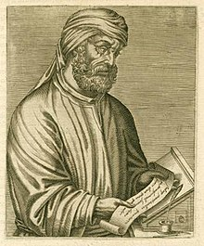
Tertullian
https://en.wikipedia.org/wiki/Tertullian

