Slide 2
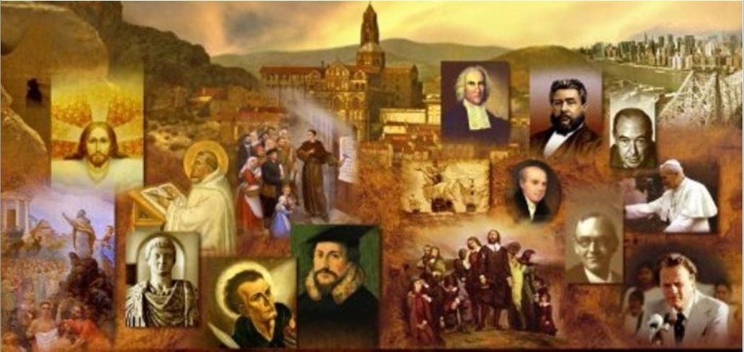
Review
What was Justin Martyr’s educational background before becoming a Christian?
He was educated in the Greek philosophical systems having studied Stoicism, then having studied with a peripatetic philosopher (someone who would walk from place to place and collect disciples), then with a Pythagorean, and then with a Platonist.
What led to Justin’s conversion?
One day he was walking along the seashore and he encountered an elderly Christian man and in the ensuing conversation, Justin’s faith in the wisdom of man was shaken.
Justin is not deeply influenced by NT writings, especially those of the Apostle Paul. What negative effect did this have on his theology?
His theology very works-oriented when it comes to soteriology (theology dealing with salvation).

Slide 3
Review
What were Justin Martyr’s most important writings?
His Dialogue with Trypho the Jew
His First and Second Apology
He is also said to have written against Marcion, but those works have been lost.
Justin’s Dialogue with Trypho the Jew presents a back-and-forth conversation where Justin offers a defense of Christianity against the claims of Judaism.
What did we say were the three main points Justin makes in the Dialogue?
The Old Covenant was passing away to make place for the New.
The Logos (translated “Word” in John 1:1) is the God of the Old Testament.
The Gentiles are the new Israel.

Slide 4
Review
To whom was Justin's First Apology addressed?
To the Emperor Antoninus Pius
What are some legal arguments that Justin made in defense of Christians and Christianity his First Apology?
Christianity was not a threat to the state, he asserted, and should be treated as a legal religion.
Christians are not guilty of the typical charges levelled against them, e.g., atheism, immorality and disloyalty.
Christians are, in fact, the emperor's “best helpers and allies in securing good order”.
Christians ought not to be prosecuted just because they bear the “name” of Christ, but they should be prosecuted solely on the basis of whether or not they have committed an actual crime.

Slide 5
Review
We cited a large portion of Justin’s First Apology earlier in our study of church history. What was Justin describing in the portion that we quoted, and what was his purpose in giving that description?
He gave a detailed description of the Christian worship service in his day in order dispel misconceptions that unbelievers had about what went on there.
Justin realized that if the emperor was to be persuaded, he would need to address more than just political injustices; he also needed to make an intellectual case for the truth of Christianity.
What Biblical argument did Justin use to make this case?
That Jesus has successfully fulfilled a number of Old Testament prophecies in Exodus, Isaiah, Micah, Psalms, Zechariah and more.

Slide 6
Review
What poignant comparison did Justin make between Christians and Socrates?
That Socrates was also martyred for his willingness to reject the state-sponsored gods, just like the Christians.
That Christians are like Socrates as they stand up for reason and oppose the false gods of Rome, and Roman officials are actually like the enemies of Socrates when they persecute Christians.
How did Justin Martyr die?
He was scourged and beheaded for his Christian faith, refusing to offer incense to the Roman emperor.
Who was one of Justin Martyr’s most famous students that we talked about last week, and what was he most known for?
Tatian, who is most known for publishing a wildly popular harmony of the four Gospels known as the Diatessaron

Slide 7
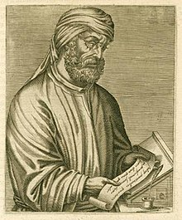
Tertullian
https://en.wikipedia.org/wiki/Tertullian

Slide 8
*Tertullian
Tertullian was born in Carthage, North Africa around AD 155, the son of a Roman centurion.¹
¹ https://www.churchhistory101.com/century2-p6.php
² Based on notes taken from James White’s 2016 Church History Series; Lesson 17

Slide 9
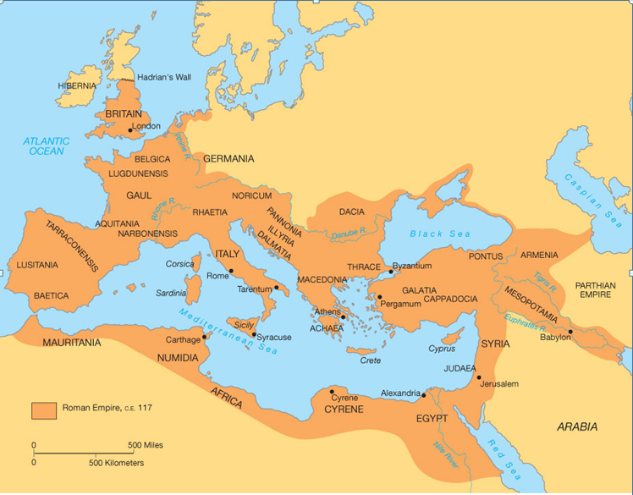
*Tertullian
https://sljglobal.wikispaces.com/Roman+Geography

Slide 10
*Tertullian
Tertullian was born in Carthage, North Africa around AD 155, the son of a Roman centurion.¹
The church historian Eusebius refers to him as “a famed, distinguished expert on Roman law”, suggesting that Tertullian may have been a lawyer. ²
Tertullian was converted to Christianity at the age of 40 and died when he was about 70 years old (around AD 225 ). ³
He was a prolific writer and is the first Christian writer to write in Latin. His biblical quotations come from a Latin bible as well. ¹
His writings are terse, direct, and always attacking – as he probably argued in courtrooms, his aim is always to win the battle of the argument. ¹
¹ https://www.churchhistory101.com/century2-p6.php
² Eusebius in The Church History; Translation by Paul Maier; p. 55
³ Based on notes taken from James White’s 2016 Church History Series; Lesson 17

Slide 11
*Tertullian
Tertullian’s hawkish, fire-breathing personality perfectly expressed the uncompromising hostility of the North-West African Church towards the Pagan society of the Roman Empire.
He was also a talented, many-sided theologian, with a gift for expressing his piercing thoughts with bold, colorful and dazzling words.
In the period between AD 196-212, he produced a series of extremely important Christian writings, which fall into three main groups, according to their theme:
The Relationship Between Christianity and the Roman Empire
The Defense of Orthodoxy Against Heresy
The Moral Behavior of Christians
* Needham, Nick. 2,000 Years of Christ's Power Vol. 1: The Age of the Early Church Fathers

Slide 12
*Tertullian on the Relationship Between Christianity and the Roman Empire
Tertullian’s first Christian book, which appeared in AD 196, is called Apologeticus (Latin for Apology).
He argued that the Roman government should stop persecuting the Church, because Christians paid their taxes and prayed for the emperor and the welfare of the Empire.
However, he was equally insistent that no Christian could actually take part in any of the affairs of Pagan society. Tertullian insisted that:
No Christian could work for the government, the army, any educational institution, or any business which supported Pagan religion, e.g. painting and sculpting, which often involved making idols.
No Christian could ever go to any kind of public entertainment.
Indeed, Tertullian called the whole Roman world “the camp of darkness”, as against the Church which was “the camp of light”.
* Needham, Nick. 2,000 Years of Christ's Power Vol. 1: The Age of the Early Church Fathers

Slide 13
*Tertullian on the Relationship Between Christianity and the Roman Empire
So Tertullian advocated an almost totally negative attitude towards the Empire. He said: “Nothing could be more alien to us than the state. We Christians know of only one ‘state’, of which we are all citizens: the universe.”
Tertullian’s hostility to Pagan culture meant that he took a different approach to Greek philosophy from that of Justin Martyr, Clement of Alexandria and Origen.
Justin and Clement saw Christianity as the fulfilment of Greek philosophy; Platonism pervaded Origen’s theology.
By contrast, Tertullian called Christians to be on their strictest guard against Pagan philosophy; it was spiritually dangerous, always threatening to poison and corrupt the purity of Christian truth.
* Needham, Nick. 2,000 Years of Christ's Power Vol. 1: The Age of the Early Church Fathers

Slide 14
Tertullian on the Relationship Between Christianity and the Roman Empire
In a famous saying, Tertullian asked: “What has Athens to do with Jerusalem?” That is, What has Greek philosophy to do with the Bible? ¹
As far as Tertullian was concerned, all the truth that a Christian needs to know has been revealed in the Word of God. ¹
However, despite Tertullian’s thunderous warnings, Stoicism deeply influenced his own religious beliefs (e.g. about the nature of God and the soul). ¹
Another famous idea that Tertullian put forth in Apologeticus is the idea that religious liberty is an inalienable right given to man by God! ²
¹ Needham, Nick. 2,000 Years of Christ's Power Vol. 1: The Age of the Early Church Fathers
² Based on notes taken from James White’s 2016 Church History Series; Lesson 17

Slide 15
*Tertullian on the Relationship Between Christianity and the Roman Empire
Tertullian ends his Apologeticus by returning again to the theme of persecution.
He points out that regardless of the blameless character of the Christians, and despite the fact that they are a blessing to society, they are still blamed for virtually every bad thing that happens in Rome.
Or, to quote another of Tertullian’s well-known statements:
If the Tiber rises as high as the city walls, if the Nile does not send its waters up over the fields, if the heavens give no rain, if there is an earthquake, if there is famine or pestilence, straightaway the cry is, “Away with the Christians to the lions!”
*Kruger, Michael J.. Christianity at the Crossroads: How the Second Century Shaped the Future of the Church (p. 73)

Slide 16
*Tertullian on the Relationship Between Christianity and the Roman Empire
But nevertheless, even in the midst of these sufferings, Tertullian says that God will grow his Church.
Or, as he says in another one of his famous quotes: “The oftener we [Christians] are mowed down by you [pagans], the more in numbers we grow; the blood of the martyrs is the seed of the Church.”
*Kruger, Michael J.. Christianity at the Crossroads: How the Second Century Shaped the Future of the Church (p. 73)

Slide 17
*Tertullian on the Defense of Orthodoxy Against Heresy
Tertullian made his most positive and lasting impact in the area of doctrinal theology.
Tertullian’s most significant theological writing was his work: Against Praxeas.
Praxeas was a Roman Christian who taught a Sabellian view of the Trinity.
Sabellianism, a heresy that still taught by some in our day, denies that there is any real personal distinction between Father, Son and Holy Spirit – that they are all the same person Who simply acted out three different roles.
* Needham, Nick. 2,000 Years of Christ's Power Vol. 1: The Age of the Early Church Fathers

Slide 18
*Tertullian on the Defense of Orthodoxy Against Heresy
In his teaching against Sabellianism, Tertullian developed many of the ideas and language which the Church soon accepted as essential to the orthodox doctrine of the Trinity.
He was the first Christian writer to use the word “Trinity” (in Latin, Trinitas) as a description of God’s one-in-threeness.
He also employed the Latin words substantia (“substance”) and persona (“person”) to distinguish between God’s oneness and threeness.
Tertullian said that God is one substance who exists in three persons – which to this day is considered the orthodox definition of the Trinity.
* Needham, Nick. 2,000 Years of Christ's Power Vol. 1: The Age of the Early Church Fathers

Slide 19
*Tertullian on the Defense of Orthodoxy Against Heresy
Tertullian applied the same thinking about substance and person to the relationship between the divine and human natures of Christ.
Jesus Christ, he said, was one person who united in Himself two distinct substances, a divine and human substance.
The two substances were joined together but not mixed up; each retained its own distinctive properties.
Christ was therefore fully and truly God, fully and truly man, at one and the same time, in one single person.
* Needham, Nick. 2,000 Years of Christ's Power Vol. 1: The Age of the Early Church Fathers

Slide 20
*Tertullian on the Defense of Orthodoxy Against Heresy
With some modifications, the whole Western Latin-speaking Church accepted Tertullian’s theology of the Trinity and the incarnation.
As a result, the West was prepared to deal with the Arian heresy that arose in the 4th century.
Tertullian also produced another important book, Against Marcion, in which he viciously attacked the infamous Gnostic leader.¹
Philip Schaff, the well known church historian, tells us:²
In this book [Tertullian] displays all his power of solid argument, subtle sophistry, ridicule and sarcasm, and exhausts his vocabulary of vituperation. He is more severe upon heretics than Jews or Gentiles.
* Needham, Nick. 2,000 Years of Christ's Power Vol. 1: The Age of the Early Church Fathers

Slide 21
*Tertullian on the Defense of Orthodoxy Against Heresy
Tertullian begins with a graphic description of all the physical abnormities of Pontus, the native province of Marcion, and the gloomy temper, wild passions, and ferocious habits of its people, and then goes on to say:
Nothing in Pontus is so barbarous and sad as the fact that Marcion was born there, fouler than any Scythian, more roving than the Sarmatian, more inhuman than the Massagete, more audacious than an Amazon, darker than the cloud of the Euxine, colder than its winter, more brittle than its ice, more deceitful than the Ister, more craggy than Caucasus. Nay, more, the true Prometheus, Almighty God, is mangled by Marcion’s blasphemies.
* Schaff, Philip. History Of The Christian Church

Slide 22
*Tertullian on the Defense of Orthodoxy Against Heresy
Tertullian begins with a graphic description of all the physical abnormities of Pontus, the native province of Marcion, and the gloomy temper, wild passions, and ferocious habits of its people, and then goes on to say:
Marcion is more savage than even the beasts of that barbarous region. For what beaver was ever a greater emasculator than he who has abolished the nuptial bond? What Pontic mouse ever had such gnawing powers as he who has gnawed the Gospel to pieces? Verily, O Euxine, thou hast produced a monster more credible to philosophers than to Christians. For the cynic Diogenes used to go about, lantern in hand, at mid-day, to find [an honest] man; whereas Marcion has quenched the light of his faith, and so lost the God whom he had found.
* Schaff, Philip. History Of The Christian Church

Slide 23
*Tertullian on the Moral Behavior of Christians
Tertullian had very high and strict ideals of the true Christian life.
He recommended frequent fasts.
He taught that a Christian could get married only once – even if one partner died, the other could not remarry.
A Christian who committed a serious sin after baptism could be forgiven only once (later Tertullian said he could not be forgiven at all).
Above all, Tertullian glorified martyrdom, teaching that if a Christian ran away, or bribed a magistrate to save his life, he had betrayed Christ. “He who fears to suffer,” he said, “cannot belong to Him who suffered.”
* Needham, Nick. 2,000 Years of Christ's Power Vol. 1: The Age of the Early Church Fathers

Slide 24
*Tertullian on the Moral Behavior of Christians
Tertullian’s fierce moral zeal made his soul burn with sympathy for the Montanists, a group that arose in the second century that believed in ongoing revelation from God and were very strict moralists.
Tertullian wrote in defense of the Montanists, scornfully condemning the church of his day for their opposition to the “New Prophecy”, and leaving behind him at his death a North-West African Montanist sect called the “Tertullianists” who survived until the 5th century.
For Tertullian, the focus of unity in the Church was not the local bishop, but the sanctifying presence of the Holy Spirit, revealed through holiness, prophecies and miracles.
* Needham, Nick. 2,000 Years of Christ's Power Vol. 1: The Age of the Early Church Fathers

Slide 25
*Tertullian on the Moral Behavior of Christians
Tertullian died peacefully in about AD 225; the crown of martyrdom which he had so praised was not to be his.
Nor did he receive the recognition he deserved as a theologian; Tertullian’s Montanism made him highly suspect in the eyes of the early Church fathers who came after him – they increasingly regarded Tertullian as a heretic.
* Needham, Nick. 2,000 Years of Christ's Power Vol. 1: The Age of the Early Church Fathers

Slide 26
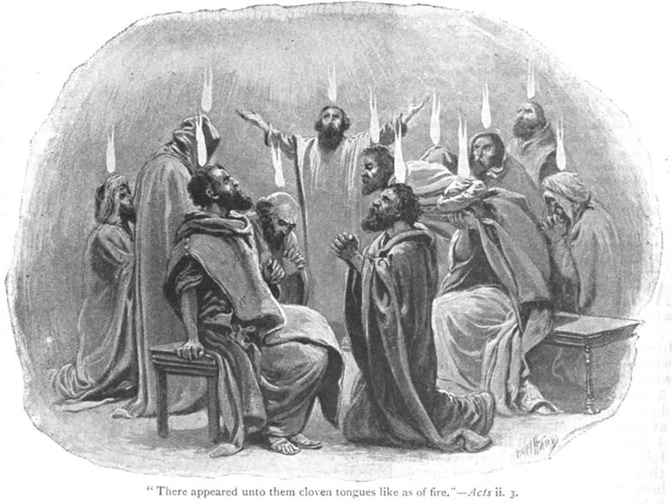
Montanism
http://www.newworldencyclopedia.org/entry/File:Acts-2.jpg

