Slide 2
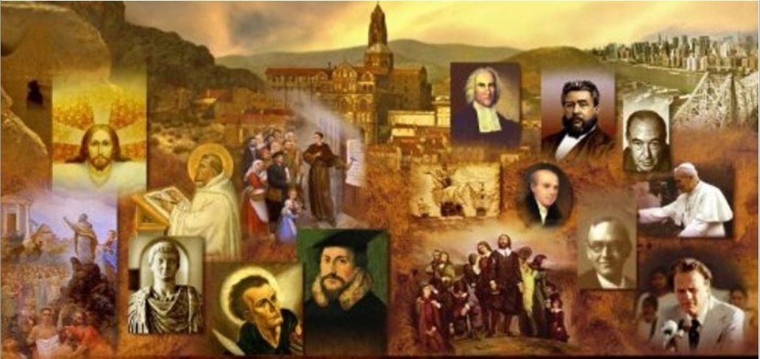
Review
According to the church historian Eusebius, what was Tertullian’s occupational area of expertise?
Eusebius refers to Tertullian as “a famed, distinguished expert on Roman law”, suggesting that Tertullian may have been a lawyer.
How would you describe Tertullian’s style of writing?
His writings are terse, direct, and always attacking – as he probably argued in courtrooms, his aim is always to win the battle of the argument.
He was also a talented, many-sided theologian, with a gift for expressing his piercing thoughts with bold, colorful and dazzling words.

Slide 3
Review
In the period between AD 196-212, Tertullian produced a series of extremely important Christian writings, which fall into three main groups, or areas for which Tertullian evidently had great passion.
What were those three areas?
The Relationship Between Christianity and the Roman Empire
The Defense of Orthodoxy Against Heresy
The Moral Behavior of Christians

Slide 4
Review
Tertullian’s first Christian book, Apologeticus he argued that the Roman government should stop persecuting the Church, because Christians paid their taxes and prayed for the emperor and the welfare of the Empire.
However, he was equally insistent that no Christian could actually take part in any of the affairs of Pagan society. What are some of the specific areas that Tertullian believed that Christians should not participate in?
No Christian could work for the government, the army, any educational institution, or any business which supported Pagan religion, e.g. painting and sculpting, which often involved making idols.
No Christian could ever go to any kind of public entertainment.

Slide 5
Review
What is Tertullian’s famous question that implies that there is nothing very biblical to be found in Greek philosophy?
“What has Athens to do with Jerusalem?”
What famous principle did Tertullian put forth in his Apologeticus that ended up in both the American Declaration of Independence and the Constitution?
Religious liberty is an inalienable right given to man by God.
Give a paraphrase of Tertullian’s famous statement that indicates his confidence that the Christian Church would survive and even flourish in the face of martyrdom and persecution.
“The oftener we [Christians] are mowed down by you [pagans], the more in numbers we grow; the blood of the martyrs is the seed of the Church.”

Slide 6
Review
Tertullian’s most significant theological writing was his work: Against Praxeas - a Roman who taught a Sabellian view of the Trinity.
What is the Sabellian view of the Trinity?
Sabellianism, a heresy that still taught by some in our day, denies that there is any real personal distinction between Father, Son and Holy Spirit – that they are all the same person Who simply acted out three different roles.
In his teaching against Sabellianism, Tertullian developed many of the ideas and language which the Church soon accepted as essential to the orthodox doctrine of the Trinity. What were some of these key terms that Tertullian used that prepared the Church to deal with the Arian heresy that arose in the 4th century?
He was the first Christian writer to use the word “Trinity” (in Latin, Trinitas) as a description of God’s one-in-threeness.
He also employed the Latin words substantia (“substance”) and persona (“person”) to distinguish between God’s oneness and threeness.

Slide 7
Review
Give the name of the of second century group for whom Tertullian had great sympathy because they believed in ongoing revelation from God and were very strict moralists.
Montanists
How did Tertullian’s alignment with the Montanist movement affect his standing in the eyes of the Church fathers who came after him
Tertullian’s Montanism made him highly suspect in the eyes of the Church fathers who came after him – they increasingly regarded Tertullian as a heretic.

Slide 8
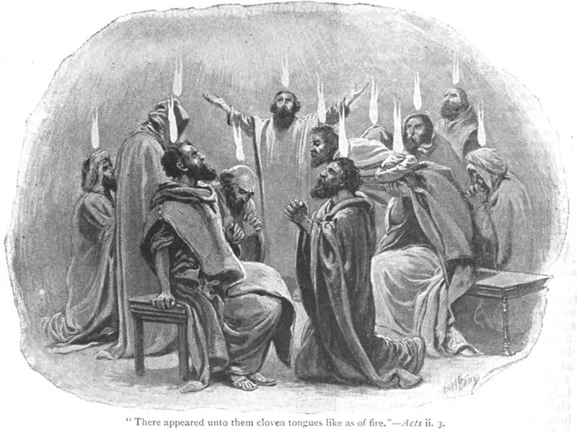
Montanism
http://www.newworldencyclopedia.org/entry/File:Acts-2.jpg

Slide 9
*Montanism
From the New Testament writings themselves – particularly the book of Acts – it is clear that the first-century Christians experienced a variety of what one might call charismatic activity, including experiences with the Spirit and prophetic utterances.
However, at the turn of the century, after the apostles had died, it appears that this sort of prophetic activity had begun to quieten down considerably.
Although there is patristic evidence that some level of prophetic activity continued in certain quarters, the Church, for the most part, looked to the scriptures as its source of divine revelation.
* Kruger, Michael J.. Christianity at the Crossroads: How the Second Century Shaped the Future of the Church (pp. 129-130)

Slide 10
*Montanism
But in the latter half of the second century (c.165–170), a new group emerged that rekindled interest in prophetic and charismatic gifts.
While the origins of this movement are unclear, it seems to have emerged from the region of Phrygia in Asia Minor with an enigmatic individual named Montanus.
* Kruger, Michael J.. Christianity at the Crossroads: How the Second Century Shaped the Future of the Church (pp. 129-130)

Slide 11
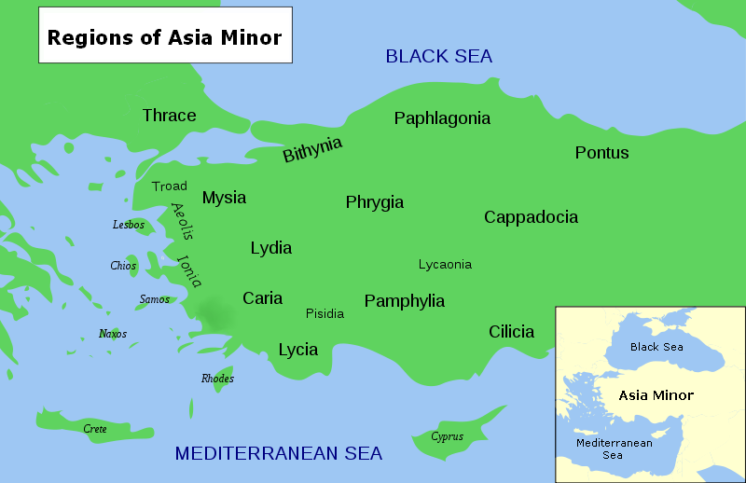
https://asiaminorcoins.com/mysia.html

Slide 12
*Montanism
Consequently, in some circles it was known as the “Phrygian” or “Cataphrygian” heresy, but later was dubbed Montanism after its supposed founder.
While later writers make a number of extravagant claims about Montanus’ life – for instance, Jerome claimed he was castrated(!) – most of them have dubious historical value.
The truth is that we have very few reliable details about his background. Nevertheless, he emerged out of Asia Minor as the leading spokesman for what was dubbed by its followers as the “New Prophecy” and was joined by two female “prophetesses”, Priscilla and Maximilla.
* Kruger, Michael J.. Christianity at the Crossroads: How the Second Century Shaped the Future of the Church (pp. 129-130)

Slide 13
*Montanism
It was not long before Montanism had expanded beyond Asia Minor and into other regions of the second-century Church.
There is evidence that places such as Gaul, Rome, Antioch, Carthage and Alexandria were all affected by the rapidly spreading movement.
* Kruger, Michael J.. Christianity at the Crossroads: How the Second Century Shaped the Future of the Church (pp. 129-130)

Slide 14
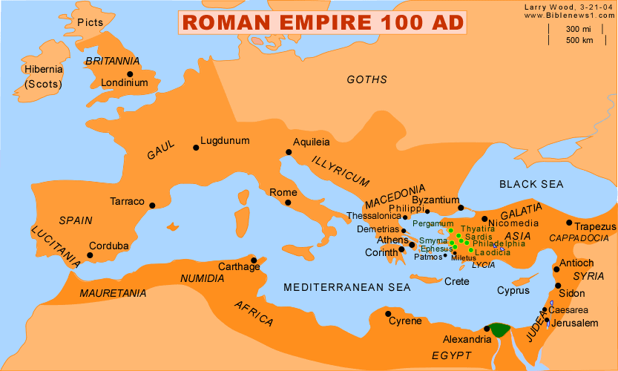
http://www.freedomfrommedom.com/wp3/believe/sympathetic-savior-relationships-of-jesus

Slide 15
*Montanism
It was not long before Montanism had expanded beyond Asia Minor and into other regions of the second-century Church.
There is evidence that places such as Gaul, Rome, Antioch, Carthage and Alexandria were all affected by the rapidly spreading movement.
Additional Montanist leaders, beyond Montanus himself, are mentioned in the historical records, such as Theodotus, Proculus and Aeschinus.
In fact, as we have already seen, even the famed Tertullian adopted some of the Montanist beliefs.
* Kruger, Michael J.. Christianity at the Crossroads: How the Second Century Shaped the Future of the Church (pp. 129-130)

Slide 16
*Montanism
Although the Montanists in each of these locales had their own distinctives, and although the movement changed and developed over time, it was, generally speaking, characterized by the following features:
Prophetic utterances.
Ecstatic experiences.
Apocalyptic fervor.
* Kruger, Michael J.. Christianity at the Crossroads: How the Second Century Shaped the Future of the Church (pp. 129-130)

Slide 17
*Montanism - Prophetic Utterances
At its core, the Montanists were a prophetic movement, claiming to receive direct revelation from God.
Indeed, Montanus himself claimed that he was the mouthpiece of God himself, and that he was the Paraclete (Greek word for “Helper”) or Holy Spirit promised in John 14:16 and 16:12-13.
His prophetesses, Priscilla and Maximilla, also claimed to receive direct revelation from God.
Evidently, the Montanists produced a great number of texts containing the oracles they claimed to have received by the Holy Spirit, even penning letters similar to that of the apostle Paul.
Not surprisingly, orthodox leaders of the Church became concerned that such writings might be considered Scripture by the followers of Montanus.
* Kruger, Michael J.. Christianity at the Crossroads: How the Second Century Shaped the Future of the Church (pp. 129-130)

Slide 18
*Montanism - Prophetic Utterances
Indeed, we are told that Gaius, in his dialogue with the Montanist Proclus, rebuked “the recklessness and audacity of his opponents in composing new Scriptures”.
Others objected on the grounds that Montanist prophets were putting their “empty sounding words” on the same level as Christ and the apostles.
And Hippolytus complained that the Montanists “allege that they have learned something more through these [Montanist writings], than from law, and prophets, and the Gospels”.
Even the Muratorian Fragment, which contains our earliest canonical list, condemned the writings of “the Asian founder of the Cataphrygians”, a likely reference to the writings of Montanus.
* Kruger, Michael J.. Christianity at the Crossroads: How the Second Century Shaped the Future of the Church (pp. 129-130)

Slide 19
*Montanism - Ecstatic Experiences
Although the Montanist claim to receive direct revelation caused considerable concern among the orthodox, it was really the manner in which they prophesied that proved most problematic.
Montanists were known for their ecstatic experiences and trance-like states.
Eusebius records a description of Montanus’ own prophetic activity: “[He] became obsessed, and suddenly fell into frenzy and convulsions. He began to be ecstatic and to speak and to talk strangely.”
The two prophetesses are described as speaking in a similar fashion: “they spoke madly and improperly and strangely, like Montanus”.
* Kruger, Michael J.. Christianity at the Crossroads: How the Second Century Shaped the Future of the Church (pp. 131-132))

Slide 20
*Montanism - Ecstatic Experiences
The orthodox writers condemned this behavior on the grounds that it was “contrary to the custom which belongs to the tradition and succession of the church from the beginning”.
In other words, in prior experiences of true prophecy among God’s people, especially those instances described in Scripture, this is not how prophets behaved.
On the contrary, the orthodox writers insisted that prophets maintained their own state of mind and their own sensibilities even in the midst of a revelation from God.
* Kruger, Michael J.. Christianity at the Crossroads: How the Second Century Shaped the Future of the Church (pp. 131-132))

Slide 21
Montanism - Apocalyptic Fervor
Closely connected to the revelatory activity of the Montanists was their bold prediction of Jesus’ imminent return.¹
Epiphanius records Montanist prophecies claiming the end of all things was near and that the New Jerusalem would descend to earth at the popular Montanist site of Pepuza.¹
Although the Montanists referred to their movement as “the New Prophecy”, the Montanist prophets did not offer any new doctrinal revelations. ²
Their main “prophetic” message was the nearness of the second coming of Christ; as Maximilla prophesied, “After me, there will be no more prophecy, but the End.” ²
¹Kruger, Michael J.. Christianity at the Crossroads: How the Second Century Shaped the Future of the Church (pp. 132-133)
²Needham, Nick. 2,000 Years of Christ's Power Vol. 1: The Age of the Early Church Fathers

Slide 22
*Montanism - Apocalyptic Fervor
In the light of this imminent return of the Lord, Montanists taught a severe moral code.
Among the distinctive teachings of the “New Prophecy” were:
An absolute ban on second marriages in all circumstances
An obligation to frequent fasting and “xerophagies” (eating only dried food)
The veiling of virgins
The belief that “serious” sins committed after one’s baptism cannot be forgiven.
Commands from the Paraclete that Christians must never seek to escape persecution and martyrdom but embrace them eagerly.
* Needham, Nick. 2,000 Years of Christ's Power Vol. 1: The Age of the Early Church Fathers

Slide 23
*Montanism - Apocalyptic Fervor
Although Montanism caused great concern among many orthodox Christians, the movement was not condemned with the same degree of swiftness and clarity as other divergent groups.
Montanism was a distinctive sort of heresy because it did not, generally speaking, reject the more fundamental doctrines held by the Church, particularly those related to Christology.
And the fact that an orthodox leader like Tertullian could embrace Montanism bolstered its credibility in the eyes of many.
Even Hippolytus admitted that Montanism had an orthodox view of creation, of the Church, and of Christ.
Although, he did express concern that some of the Montanists had a modalistic (Sabellian) view of the Trinity and thereby “affirm that the Father himself is the Son”.
* Kruger, Michael J.. Christianity at the Crossroads: How the Second Century Shaped the Future of the Church (p. 133)

Slide 24
*Montanism - Apocalyptic Fervor
Even so, the Montanist movement eventually did receive widespread condemnation.
According to Eusebius, the churches in Asia assembled together to discuss the New Prophecy and “tested the recent utterances, pronounced them profane, and rejected the heresy – then at last the Montanists were driven out of the church and excommunicated”.
Consequently, the Montanist movement began to fade in the third century and was reduced substantially by the fourth and fifth centuries, after which it is barely visible.
* Kruger, Michael J.. Christianity at the Crossroads: How the Second Century Shaped the Future of the Church (p. 133)

Slide 25
*Montanism
Montanism was the first manifestation of a particular form of Christianity which has appeared several times in the course of Church history.
Today it would be called “Pentecostal” or “charismatic”. Many modern Pentecostals and charismatics look back to the Montanists as their spiritual ancestors. However, there are differences.
Not many of today’s Pentecostals and charismatics would share the Montanists’ enthusiasm for fasting, celibacy and martyrdom; yet these were essential to Montanism, part of the New Prophecy’s revelation of how true Christians were to live in the light of Christ’s imminent return.
And despite the Montanist emphasis on prophecy and vision, there is no evidence that Montanism taught a special “baptism in the Spirit” as a distinct second experience for all believers – as do modern Pentecostals.
* Needham, Nick. 2,000 Years of Christ's Power Vol. 1: The Age of the Early Church Fathers

Slide 26
*Montanism
The rise of Montanism forces us to ask important historical questions about the supernatural gifts of the Holy Spirit in the age of the apostles (prophecy, tongues, miraculous healing) and whether they continued in the Church after the 1st century AD.
But the claim of Montanus, Priscilla and Maximilla to be indwelt by the Paraclete in fulfilment of John 14:16 and 16:12-13 raised serious problems.
Should the early church fathers accept the exalted status which this claim bestowed on Montanus?
Here was a simple question of truth and falsehood: Montanus was either the special organ of the Paraclete, as he asserted, or he was not.
The early church fathers decided he was not, and that his interpretation of Christ’s teaching on the Paraclete in John’s Gospel was both false and self-serving. (The early church view was that these verses had been fulfilled on the day of Pentecost.)
* Needham, Nick. 2,000 Years of Christ's Power Vol. 1: The Age of the Early Church Fathers

Slide 27
*Montanism
Furthermore, the various Montanist prophecies, and the authority claimed for them, seemed to conflict with the authority of the apostolic Scriptures which the Church was then collecting into the New Testament.
How could the apostolic writings be the final rule for Christian beliefs and practices, if the Montanist prophecies with their new revelations about how Christians were to live, were genuine?
And why should bishops devoted to maintaining the apostolic tradition taught in scripture be so important in Church life, if the Holy Spirit Himself was present to lead and to guide us through His Montanist prophets?
* Needham, Nick. 2,000 Years of Christ's Power Vol. 1: The Age of the Early Church Fathers

Slide 28
Montanism
In addition to the aforementioned concerns, is the fact that the Montanists claimed to be speaking for God and yet many of the Montanist prophecies did not come true!
For example, Maximilla prophesied, “After me, there will be no more prophecy, but the End.” Maximilla died in about AD 179 and the End did not come.
In light of such problems, I believe the early church fathers were justified in their rejection of the Montanist claims.

Slide 29
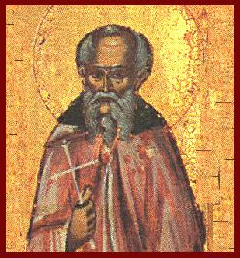
Melito of Sardis
https://alchetron.com/Melito-of-Sardis#-

