Slide 1


Slide 2

Review
The response of Irenaeus and the early Church to Gnosticism had a great effect on the way the Christian faith developed in the patristic age in that it prompted the Church to place a strong emphasis on apostolic tradition.
We can see this emphasis on apostolic tradition in three areas. What were they?
  The Basic Teachings of the Apostles (aka the Rule of Faith)
  The Churches Founded by the Apostles
  The Inspired Writings of the Apostles (i.e. the New Testament)
In order to refute the false doctrines of the Gnostics, the early Church pointed to what is known as the “rule of faith”.
Give the Latin term for rule of faith, and describe what it is.
  The rule of faith (Latin: regula fidei) was basically a summary of what the early church fathers believed to be the essential, orthodox apostolic teachings.

Slide 3
Review
What did the rule of faith used in the Roman church come to be called?
  The Apostles’ Creed
Explain how the early church emphasis on apostolic churches in response to Gnostic teachings became one of the reasons why the Roman church and its bishop later became so important in the Western half of the Empire.
  While there were a good number of apostolic churches in the East, the church in Rome, where Paul (and possibly Peter) had taught was the only church in the West that could claim to have any direct connection with the apostles.
What were the two extremes that the early church had to deal with that threatened the preservation and/or proper recognition of the true canon of the NT?
  On one hand, the early Church had to guard against Marcion throwing out authentic Scriptures, and on the other hand the Gnostics adding their own false teachings to Scriptures.

Slide 4
Review
What was the key criterion by which the Church judged and accepted a writing to be authoritative NT scripture?
  It had been written or dictated by an apostle (e.g. Paul, John, Peter, Matthew), or by someone under apostolic direction.
What is the earliest extant historical document that contains a complete authoritative list of New Testament books that we have in our New Testaments today and (approximately) when was it written?
  The 39th Festal Letter of Athanasius, bishop of Alexandria, written in AD 367.
Why did the early orthodox churches refer to themselves as “Catholic”?
  The word comes from the Greek katholikos, which means “universal” or “throughout the world”.
  By calling itself “Catholic”, the early Church was setting itself apart from Gnosticism.

Slide 5
Review
Explain the difference between “Catholic” as the early church used the term and “Roman Catholic” – a term that we use today.
  The early church used the term “Catholic” to refer to the Orthodox churches of that day in their unified stance against Gnosticism.
  We give the title “Roman Catholic” to that branch of the Western Church which, in the 16th century, rejected the Protestant Reformation.
Name the two important things that I said last week that we could learn from the strong disagreement that occurred over the Quartodeciman controversy that occurred in the late second century between Victor, the bishop of Rome and the bishops of the Asian churches.
  The problem of breaking fellowship with other believers over issues which are not definitional to the faith.
  By their response to Victor, bishop of Rome, it is clear that the bishops in the late third century did not regard the bishop of Rome as an infallible pope.

Slide 6
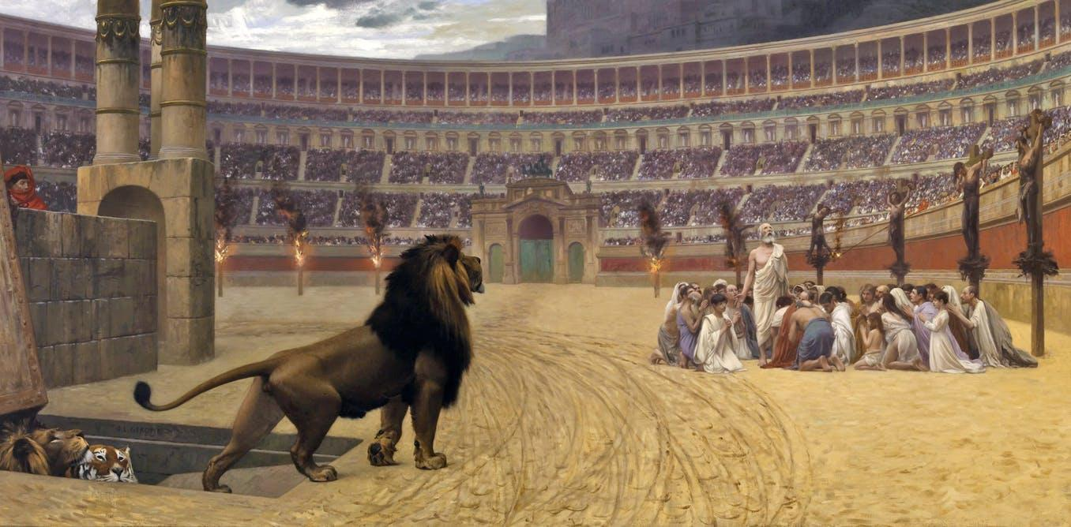
A Further Look at Christian Persecution
https://www.sutori.com/story/world-religions-christianity-7ba5

Slide 7
*A Further Look at Christian Persecution
Persecution is a relevant topic even in the world today.
  We see new kinds of persecution today in the West – legal persecution, criminalization of thought that does not match the worldview of secular society.
  We see very intense persecution in many other parts of the world today, much like what took place in the early church: attempts to severely restrict Christian activities, strong financial penalties, imprisonment, and even torture and death.
None of this should come as a surprise to us, as Jesus warned us that we would be persecuted (John 15:20).
As we look at the church from AD 30 – AD 313, we see that persecution is not constant everywhere throughout the empire – rather it comes and goes in spurts and tends to occur in particular local areas, for the most part.
*Based on notes taken from James White’s 2016 Church History Series; Lesson 14 – Persecution

Slide 8
*A Summary of Christian Persecution AD 30 – 313
Initially Christians were persecuted by the Jews:
  Saul of Tarsus
  Stoning of Stephen
The Romans began to persecute Christians, once they began to recognize the difference between Judaism and Christianity.
From AD 50 onward, the Romans considered Christianity to be a religio illicita.
Christians were tortured, fed to the lions, or burned.
But there were other times and places when things were quite peaceful for Christians in that day.
Nevertheless, Christian persecution was always like the “sword of Damocles” hanging over their heads.
*Based on notes taken from James White’s 2016 Church History Series; Lesson 19 – Irenaeus (Part 2)

Slide 9
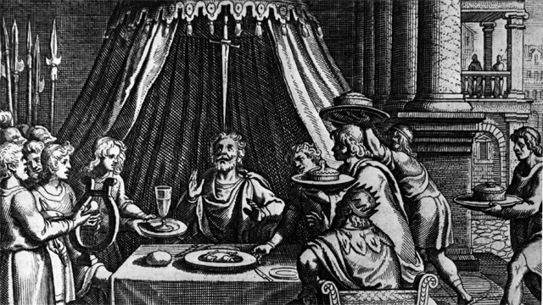
The Sword of Damocles
https://diannesbucketlist.wordpress.com/2014/03/04/still-absorbing-the-news/

Slide 10
*A Summary of Christian Persecution AD 30 – 313
The First major Roman persecutor was Nero who reigned from AD 54-68.
  You’ve heard “Nero fiddled while Rome burned”.
  Ten of Rome’s fourteen sections were gutted by a fire.
  Everybody knew that Nero wanted to do some major remodeling in the city and the sections that burned were the sections that Nero wanted to remodel.
  But Nero blamed the burning of Rome on the Christians, and he got away with it because the Christians were so hated.
  Nero himself was insane. He killed the Stoic philosopher, Seneca; He killed his mother, brother, and two wives.
  He used to wrap Christians in animal skins, tied them to posts and lit them on fire to light his parties.
  He probably killed Paul and Peter.
  At age 32 he killed himself.
*Based on notes taken from James White’s 2016 Church History Series; Lesson 19 – Irenaeus (Part 2)

Slide 11
*A Summary of Christian Persecution AD 30 – 313
The next emperor to persecute Christians was Domitian who reigned from AD 81-96.
  He demanded that he be confessed as Lord and God of all who were under the control of the Roman Empire.
  All were made to swear an oath by the “genius of the emperor”.
  According to Irenaeus, the NT book of Revelation was written by the Apostle John near the end of Domitian’s reign .
  Next was Trajan who reigned from AD 98-117. He was less fanatical than Domitian. But still, during his reign, a profession of Christianity was a capital offense.
  After Trajan things were pretty peaceful for about 50 years.
*Based on notes taken from James White’s 2016 Church History Series; Lesson 19 – Irenaeus (Part 2)

Slide 12
*A Summary of Christian Persecution AD 30 – 313
The next persecution occurred under Marcus Aurelius who reigned from AD 161-180 and was played so brilliantly in the movie Gladiator (though the film contains numerous historical inaccuracies).
  It was during this time that Celsus, a 2nd-century Greek philosopher and opponent of early Christianity, wrote a book entitled The True Doctrine, in which he argued, among other things, that Christians were a danger to the Empire and therefore must be kept from spreading their teaching.
  It was during his reign (AD 166) that Justin Martyr earned his name.
  In AD 177 a great persecution broke out in Lyons, Gaul (modern day France).
  It was during the reign of Marcus Aurelius that Tertullian remarked that if the Tiber is too high or the Nile too low, everyone blames the Christians.
*Based on notes taken from James White’s 2016 Church History Series; Lesson 19 – Irenaeus (Part 2)

Slide 13
*A Summary of Christian Persecution AD 30 – 313
Septimius Severus reigned from AD 193-211. He forbade all new conversions to Christianity in 202.
  It was during his reign that Tertullian said that the blood of the martyrs was the seed of the church.
  Origin’s father Leonidas died a martyr in AD 202, Origin wanted to be martyred along with his father, but his mother prevented him from leaving the house by hiding his clothes!
When Severus died persecutions ceased with one exception, from AD 235-238 under Maximin.
*Based on notes taken from James White’s 2016 Church History Series; Lesson 19 – Irenaeus (Part 2)

Slide 14
*A Summary of Christian Persecution AD 30 – 313
Persecutions began again under Decius, AD 249-251.
  He began empire-wide persecution.
  He believed that that Christians were the reason for the decline of the empire.
  He issued an edict requiring everyone in the Empire (except Jews, who were exempted) to perform a sacrifice to the gods in the presence of a Roman magistrate and obtain a signed and witnessed certificate, called a libellus.
Valerian, AD 253-260 continued Decius’ policy of empire-wide persecution.
  Clergy were order ordered killed if they did not sacrifice.
  All right of Christian assembly was taken away under Valerian.
*Based on notes taken from James White’s 2016 Church History Series; Lesson 19 – Irenaeus (Part 2)

Slide 15
*A Summary of Christian Persecution AD 30 – 313
Diocletian AD 284-305 was the final persecuting emperor and the most fierce.
  He established a co-regency with Maximian in the east, Galerius in the central regions, and Constantius in the west.
  Galerius was rabidly anti-Christian.
  In AD 303 Diocletian, with encouragement from Galerius, undertook to extinguish Christianity, he forbad all Christian worship, all Christian churches and books had to be destroyed, all clergy were arrested unless they sacrificed to the emperor and this was eventually extended to all Christians.
  This lasted until 311 when Galerius, having fallen ill, rescinded the persecution and asked Christians to pray for his health!
*Based on notes taken from James White’s 2016 Church History Series; Lesson 19 – Irenaeus (Part 2)

Slide 16
*A Summary of Christian Persecution AD 30 – 313
The Emperor Constantine came to power in AD 306.
In AD 313 Constantine issued the Edit of Toleration (sometimes referred to as the “Peace of the Church”) which brought an end to all formal persecution of Christians by the government of Rome.
*Based on notes taken from James White’s 2016 Church History Series; Lesson 19 – Irenaeus (Part 2)

Slide 17
*Martyrdom at Lyons in AD 177
So far today, we have taken a broad, academic view of the persecution suffered by Christians in the first three centuries.
As helpful as that is, I think it’s important that we also get an occasional up close view of what Christian persecution actaully looked like.
With that in mind, I would like for us look at an eyewitness account of some heavy persecution that took place in Lyons and Vienne, Gaul (modern day France) near the end of the second century.
This account will give us a vivid picture of the sort of treatment Christians could expect from the Roman authorities.
* Needham, Nick. 2,000 Years of Christ's Power Vol. 1: The Age of the Early Church Fathers

Slide 18
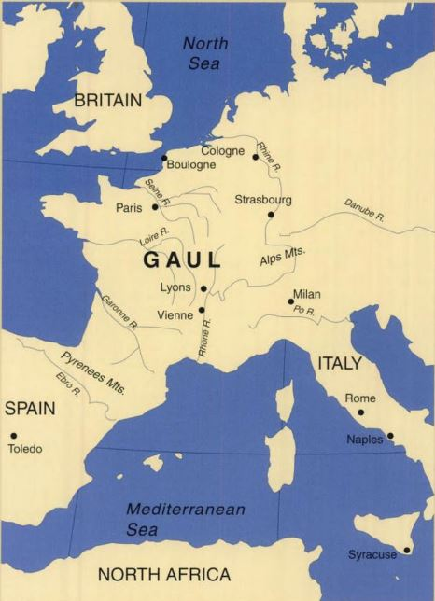
The Region of Gaul
* Eusebius in The Church History; Translation by Paul Maier; p. 154

Slide 19
*Martyrdom at Lyons in AD 177
It was the year 177 in Lyons, Gaul (modern day France). Christianity had first come to Lyons over 25 years earlier when Polycarp of Smyrna (in modern day Turkey) had sent Pothinus as a missionary to Gaul. Pothinus had diligently established the church of Christ in Lyons and nearby Viennes. As the church grew, spiritual resistance began to mount, and persecution against the Christians began. Christians were shut out of businesses and houses. They endured all kinds of shame and personal injuries. Mobs formed to beat, stone and rob the Christians. When believers were arrested and examined by the city authorities, they boldly confessed their allegiance to Christ. They were imprisoned to await the arrival of the governor to the region.
* https://www.christianity.com/church/church-history/timeline/1-300/blandina-a-faithful-witness-11629606.html

Slide 20
*Martyrdom at Lyons in AD 177
Holiday Entertainment
August 1st was a holiday to celebrate the greatness of Rome and the emperor; the governor was expected to show his patriotism by sponsoring entertainment for the whole city. It was expensive to hire gladiators, boxers and wrestlers. It would be a lot cheaper to torture these Christians as part of the holiday entertainment!
* https://www.christianity.com/church/church-history/timeline/1-300/blandina-a-faithful-witness-11629606.html

Slide 21
*Martyrdom at Lyons in AD 177
The full fury of the mob, the governor, and the soldiers fell on Sanctus, the deacon from Vienne… on Attalus, who had always been a pillar among the Christians in Pergamum; and on Blandina, through whom Christ proved that what men think lowly God deems worthy of great glory…
* Eusebius in The Church History; Translation by Paul Maier; p. 154

Slide 22
*Martyrdom at Lyons in AD 177
Blandina was filled with such power that those who tortured her from morning to night grew exhausted and admitted that they were defeated, for they had nothing left to do to her. They were astounded that she was still alive, since her whole body was smashed and lacerated, and they claimed that any one of the tortures was enough to end her life... But the blessed woman, like a noble athlete, gained in strength while confessing the faith and found comfort for her sufferings by saying, “I am a Christian, and nothing wicked happens among us.”
* Eusebius in The Church History; Translation by Paul Maier; p. 154

Slide 23
*Martyrdom at Lyons in AD 177
The bloodthirsty mob in the amphitheater had never seen such courage. People were astonished at the slave girl's victorious cry even in the midst of her pain and suffering… Even though the crowd detested these Christians, they had to admit that never had a woman endured so many and so terrible tortures.
* https://www.christianity.com/church/church-history/timeline/1-300/blandina-a-faithful-witness-11629606.html

Slide 24
*Martyrdom at Lyons in AD 177
Human Barbecue
The Christians were confined in the darkest and most awful part of the prison; many of them suffocated there. Some were placed in stocks; others were placed in a hot-iron seat where their flesh was burned. This was literally a human barbecue where the victim was chained onto a grate over burning coals. An example of this barbaric torture instrument can still be seen today at the archeological museum at Lyons.
* https://www.christianity.com/church/church-history/timeline/1-300/blandina-a-faithful-witness-11629606.html

Slide 25
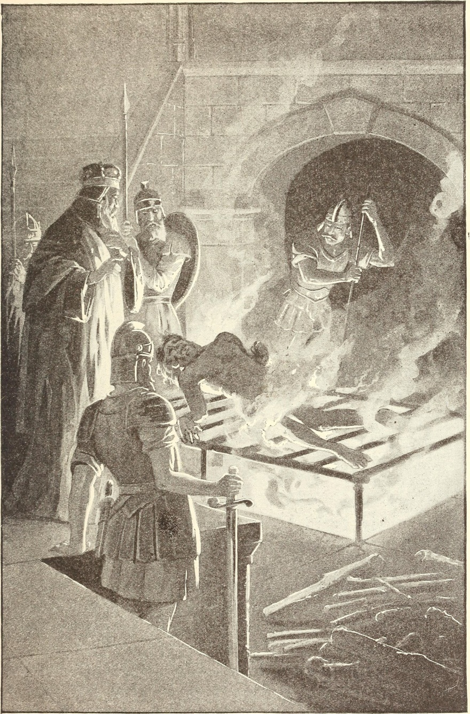
Human Barbecue
https://commons.wikimedia.org/wiki/File:Christian_heroes_and_martyrs_(1895)_(14778548661).jpg

Slide 26
*Martyrdom at Lyons in AD 177
Sanctus, a deacon from Vienne stood firm in his faith, even after red hot plates were fastened to the most tender parts of his body and he was one complete wound and bruise. He was “an example for the others, showing that nothing is fearful where the love of the Father is, and nothing is painful where there is the glory of Christ.”
* https://www.christianity.com/church/church-history/timeline/1-300/blandina-a-faithful-witness-11629606.html

Slide 27
*Martyrdom at Lyons in AD 177
Even a 92-Year-Old Bishop Tortured
The blessed Pothinus, Bishop of Lyons, was more than ninety years old and physically weak. He could scarcely breathe but was fortified by his fervor for martyrdom. He was dragged before the tribunal by soldiers, accompanied by local authorities, and with the populace howling at him as if he were Christ himself.
But he gave a noble witness, When the governor asked him, “Who is the god of the Christians?” he replied, “If you are worthy, you will know.” Then he was dragged about mercilessly, pummeled by hands and feet that showed no respect for his age, while those at a distance hurled whatever was at hand at him, all imagining that they were avenging their gods. He was thrown into prison, barely breathing, and died two days later.
* https://www.christianity.com/church/church-history/timeline/1-300/blandina-a-faithful-witness-11629606.html

Slide 28
*Martyrdom at Lyons in AD 177
What an Amazing Young Woman!
In addition to all this, on the last day of the games Blandina was again brought in, with Ponticus, a lad of about fifteen. Each day they had been led in to watch the torturing and were urged to swear by the idols. Furious at their steadfast refusal, they showed no sympathy for the boy's youth or respect for the woman but subjected them to every torture. Ponticus was heartened by his sister in Christ and bravely endured each horror until he gave up his spirit. Last of all, the blessed Blandina like a noble mother who had comforted her children and sent them on triumphantly to the king, rejoiced at her own departure as if invited to a wedding feast.
* https://www.christianity.com/church/church-history/timeline/1-300/blandina-a-faithful-witness-11629606.html

Slide 29
*Martyrdom at Lyons in AD 177
After the whips, the beasts, and the roasting seat, she was finally put into a net and thrown to a bull. Indifferent to her circumstances through faith in Christ, she was tossed by the animal for some time before being sacrificed. The heathen admitted that never before had a woman suffered so much so long.
* Eusebius in The Church History; Translation by Paul Maier; p. 158

Slide 30
*Martyrdom at Lyons in AD 177
After they were exposed and insulted for six days, the martyrs' bodies were burned to ash and swept by the wicked into the Rhone, which flows nearby, so that not even a trace of them would still appear on earth. They did this as if to conquer God and defeat their rebirth so that, as they said, “they might not have any hope of resurrection, because they have introduced a strange new cult, ignored torture, and gone joyfully to death. Now let's see if they will rise again and if their god will save them.”
* Eusebius in The Church History; Translation by Paul Maier; p. 158-9

Slide 31
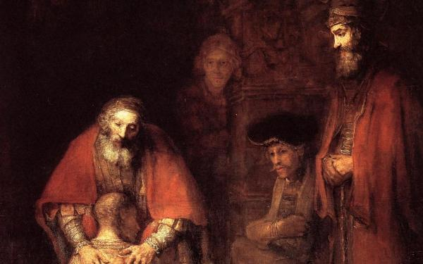
Response to Persecution
https://en.wikipedia.org/wiki/The_Return_of_the_Prodigal_Son_(Rembrandt)

