Slide 1


Slide 2

Review
Hippolytus (c. 170–235 AD) served as presbyter in the Church of Rome and was probably one of the most important Christian theologians in the third century.
Hippolytus came into conflict the Bishop of Rome over what issue?
  Over his “modalistic” views of the Father and the Son
What is Modalism (also known as “Sabellianism”)?
  A heresy that is still taught by some in our day, which denies that there is any real personal distinction between Father, Son and Holy Spirit – that they are all the same person who simply acted out three different roles or “manifestations”.
What Hippolytus eventually do as a result of his conflict with the Roman church?
  Hippolytus left the communion of the Roman Church and had himself elected bishop by those who followed him.

Slide 3
Review
Cyprian was Bishop of Carthage from 249-258.
He had a strong view of the local bishop – that each bishop was supreme in his own church.
He believed that membership in a Catholic Church was essential. Finish this statement by Cyprian: “You cannot have God as your Father unless…
  you have the Church as your Mother.
Cyprian came into conflict with Stephen, the Bishop of Rome over what issue?
  Whether someone who had been baptized in a schismatic church had to be rebaptised if they later joined a Catholic church. Cyprian said yes; Stephen said no.
When Stephen threatened to excommunicate Cyprian and the other bishops who disagreed with him, Cyprian and his fellow bishops pushed back, insisting: None of us must set himself up as… (finish the statement)
  a bishop of bishops.

Slide 4
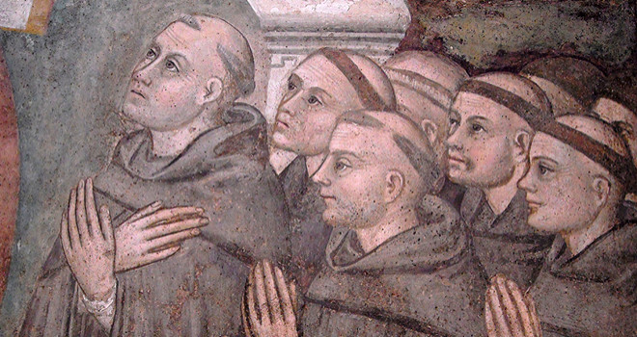
The Development of Monasticism
https://www.crisismagazine.com/2017/monasticism-testifies-gods-reality

Slide 5
*The Development of Monasticism
One of the most significant developments in the spiritual life of the early church was monasticism.
Starting in the late third century, many ordinary Christians became so disgusted with the sinful state of the Empire that they decided to “drop out” of society completely.
They would go off into remote unpopulated regions, such as deserts, and live simple ascetic lives there, away from the corrupting influences of the world.
Men who did this were called monks (from the Greek monachos, a person who lives alone).
Monasticism originally began in the less civilized areas of Syria and Egypt, where Hellenistic culture had not made much impact.
* Needham, Nick. 2,000 Years of Christ's Power Vol. 1: The Age of the Early Church Fathers . Kindle Edition.

Slide 6
*The Development of Monasticism
The early monks of Egypt had a great influence on later generations of monks, ascetics and theologians, and are often referred to as the “desert fathers”.
Their understanding and practice of the Christian life, were based on the teachings of Origen, who was himself an ascetic.
As their name suggests, the early monks lived solitary lives, but soon two different types of monks came into existence. Those who lived:
  Alone as Hermits
  In a Community of Monks
* Needham, Nick. 2,000 Years of Christ's Power Vol. 1: The Age of the Early Church Fathers . Kindle Edition.

Slide 7
*Monks Who Lived Alone as Hermits
The supreme example of the hermit was an Egyptian desert monk named Antony (251- 356), a close friend of Athanasius, the great bishop of Alexandria.
Athanasius wrote a popular biography of Antony which helped to spread monastic ideals in both East and West.
Born into a rich Christian family, Antony withdrew from society as a young man, giving away all his money and property to the poor.
He then spent some twenty years alone in the Egyptian desert, in a ruined fort near the Red Sea, where he fasted, prayed, studied the Scriptures, and claimed to have engaged in dramatic struggles with demons.
Emerging from his solitude in the early 4th century, he gathered a group of disciples and taught them the spiritual wisdom he had learned in his lonely years.
People looked on Antony as an exemplary figure, someone who seemed on a higher spiritual plane than ordinary Christians.
Probably no-one had a greater effect than Antony in attracting others to live the monastic life.
* Needham, Nick. 2,000 Years of Christ's Power Vol. 1: The Age of the Early Church Fathers . Kindle Edition.

Slide 8
*Monks Who Lived in a Community of Monks
The place where the monks lived as a community was called a monastery – the word originally meant a hermit’s cave.
Early on, the person most known for giving instructions on how monks should go about living in a community of monks was Pachomius (AD 290-346), an ex-soldier from southern Egypt.
Pachomius at first practiced the solitary life of a hermit, but in about AD 320 he founded a community of monks in a village in Egypt.
His monks lived a common life, working and praying and eating together, and sharing all property in common.
They were economically self-sufficient through their manual work – e.g. weaving and farming.
Pachomius wrote a list of rules to govern the community life of his monks, and other monastic communities adopted these rules.
These rules laid down a sort of schedule or timetable for the daily activities of the community – when the monks were to work, pray, study, etc.
* Needham, Nick. 2,000 Years of Christ's Power Vol. 1: The Age of the Early Church Fathers . Kindle Edition.

Slide 9
*Monks Who Lived in a Community of Monks
Another important aspect of the monastic community was its practice of strict obedience to its leader.
Monks normally called the head of a monastery an abbot (from the Aramaic abba, father).
From “abbot” came the word abbey as a description for a monastery.
The monastic movement was not restricted to men.
Christian women also established communities devoted to cultivating the spiritual life; these women were called nuns and their communities nunneries.
This comes from the Latin word nonna, which is the feminine form of the Latin word for a monk, nonnus.
The head of a nunnery was known as an abbess (the feminine form of abbot)
* Needham, Nick. 2,000 Years of Christ's Power Vol. 1: The Age of the Early Church Fathers . Kindle Edition.

Slide 10
*Asceticism and Celibacy
All monks, whether they lived in a community or alone as hermits, would renounce all worldly property and pleasures, be celibate, and consecrate themselves to prayer, fasting and Bible study.
This simple, disciplined style of life practiced by monks and nuns was part of the general spirit of asceticism, which had become increasingly popular even in non-Christian Roman society from the 3rd century on, partly through the impact of Stoicism and Neoplatonism.
Even Christians who did not become monks often practiced an ascetic lifestyle and by the fifth century, almost all the leading Churchmen were ascetics.
* Needham, Nick. 2,000 Years of Christ's Power Vol. 1: The Age of the Early Church Fathers . Kindle Edition.

Slide 11
*Asceticism and Celibacy
An popular aspect of Christian asceticism in that day was a belief in the high spiritual worth of celibacy – i.e. leading a single (unmarried) life.
By the end of the 4th century, most Christians had come to believe that celibacy was better than marriage!
Congregations began to insist that their bishops must be celibate men.
And as Christians more and more saw the monasteries as the best training-grounds for spiritual life, churches increasingly drew their bishops from among monks who were already committed to celibacy.
* Needham, Nick. 2,000 Years of Christ's Power Vol. 1: The Age of the Early Church Fathers . Kindle Edition.

Slide 12
*The Influence of Monasticism
From the outset, Western monasticism enjoyed the enthusiastic support of leading Churchmen – Ambrose of Milan, Jerome, Augustine of Hippo.
This gave it respectability and authority.
In Western monasticism, the ideal of withdrawing from the world to cultivate the ascetic life came to include cultivating the mind through the study of literature.
This was an old Roman aristocratic ideal, and was one of the reasons why Western monasticism tended to attract converts from the ranks of the Roman aristocracy.
* Needham, Nick. 2,000 Years of Christ's Power Vol. 1: The Age of the Early Church Fathers . Kindle Edition.

Slide 13
*The Influence of Monasticism
After the collapse of the Roman Empire in the West, the Western monasteries acted as the guardians of Western European culture and civilization, and became the vital centers of education in the Western Catholic world.
The monks were also the great missionary force of the later patristic age and Middle Ages: free from all ties of marriage and family, disciplined to live in poverty, they carried the faith into Pagan lands, planting and watering it there.
England and Germany, to give two outstanding examples, were Christianized by missionary monks.
* Needham, Nick. 2,000 Years of Christ's Power Vol. 1: The Age of the Early Church Fathers . Kindle Edition.

Slide 14
*Later Thoughts About Monasticism
Modern men are not sure what to make of the of the whole idea of monasticism.
Most feel about like the well known eighteenth century British historian, Edward Gibbon, who scoffed those who, in earlier times, had lived in monasteries as “unhappy exiles from social life, impelled by the dark and implacable genius of superstition.”
Why would anyone want to renounce sex?
And if there is any axiom of modern times it is this: the good life is found in a spacious home, well stocked with all the latest labor-saving conveniences.
* Shelley, Dr. Bruce L.. Church History in Plain Language: Fourth Edition (pp. 125-126).

Slide 15
*Later Thoughts About Monasticism
The Reformation of the sixteenth century struck a heavy blow against monasticism.
Martin Luther, who had been a monk himself, declared war on the monasticism.
Monasticism, said Luther and the other Reformers, encourages the idea of two roads to God, a higher road and a lower road.
But the gospel knows only one way to salvation. It is by faith alone in the Lord Jesus Christ. This faith is no dead faith, however; it is active in love for God and one’s neighbor.
* Shelley, Dr. Bruce L.. Church History in Plain Language: Fourth Edition (pp. 125-126).

Slide 16
*Later Thoughts About Monasticism
There is a fundamentally unbiblical impulse in separating oneself from the world and living in a tree somewhere, or in a monastery.
It’s true that many of those involved in monasticism were very dedicated individuals: they got up at 2 and 4am to pray and fasted on a regular basis, etc. But it is not a balanced biblical impulse to see the church as separated from the world.
Where did this idea come from? Certainly not the apostles or Jesus.
* Based on notes taken from James White’s 2016 Church History Series; Lesson 24 – Monasticism

Slide 17
*Later Thoughts About Monasticism
A lot of later monasticism came in response to the effect of the union of Church and State on the Church:
  Once Constantine established Christianity as the state church, Rome became a “Christian” empire until the time of the Reformation and beyond!
  For over a thousand years a member of the state was a member of the church and vice versa.
  Once the entire Roman Empire became “Christian”, there was a massive influx of non-believers into the church.
  This lead to massive nominalism.
  Which, in turn, lead to a major deadness within the church.
  Because of this, people wanted to break away from their dead churches, join a monastery and become fervent in prayer, live holy lives, etc.
* Based on notes taken from James White’s 2016 Church History Series; Lesson 24 – Monasticism

Slide 18
*Later Thoughts About Monasticism
We should also note that historically, the practice of celibacy, often lead to sexual immorality: those who claimed to be celibate, but were not. It was not at all uncommon for priests to have a concubine and kids on the side.
Desiderius Erasmus (1469 – 1536), for example, was the illegitimate son of a priest and had to receive a special dispensation from the church to become a priest himself.
During a period in the tenth century that came to be known as the “Pornocracy” – everybody knew that the pope had multiple women and that the Vatican was a debauched place.
* Based on notes taken from James White’s 2016 Church History Series; Lesson 24 – Monasticism

Slide 19
*Later Thoughts About Monasticism
Part of the push for celibacy had to do with the declining view of women, due to a departure from biblical standards.
In the NT women are highly valued and played a prominent role in the church.
We also find a high view of marriage in the NT – even to the point of likening it to Christ’s relationship to the church (Eph. 5:22-33).
These views were eventually allegorized away. And what allowed them to do that? Origen and the allegorical method of interpretation.
  This shows what can happen when you move away from looking to the Bible alone as your standard of faith and practice, and philosophy ends up determining how you read the scriptures.
* Based on notes taken from James White’s 2016 Church History Series; Lesson 24 – Monasticism

Slide 20
*Later Thoughts About Monasticism
We talk a lot about the “women’s movement” today.
We should keep in mind that he beginning of the positive aspects of the woman’s movement took place during the Reformation:
  The Reformers recovered a biblical view of marriage as a picture of the relationship between Christ and the church.
  Luther married Catherine, a former nun who had escaped from the monastery in a pickle barrel. Very early on, Luther began preaching against these unbiblical “vows”.
* Based on notes taken from James White’s 2016 Church History Series; Lesson 24 – Monasticism

Slide 21
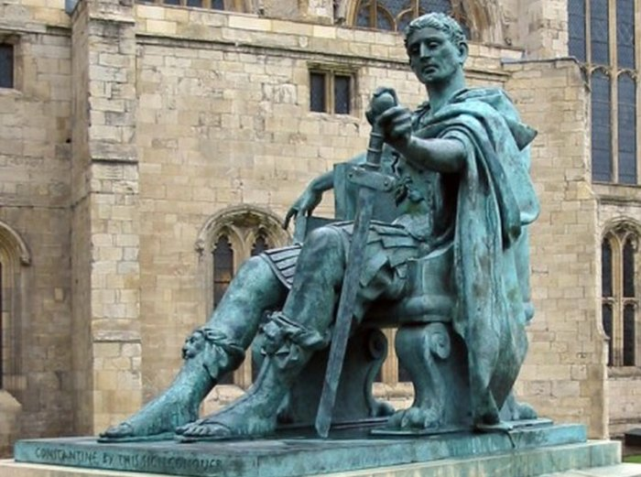
The Emperor
Constantine
http://www.ancientpages.com/2017/07/12/triumphal-arch-of-roman-emperor-constantine-and-its-great-vision/

Slide 22

https://www.hopehelps.org/volunteer-appreciation-week-2018/

Slide 23

Class Discussion Time
https://www.weareteachers.com/moving-beyond-classroom-discussions/

Slide 24
*Class Discussion Time
Some have tried to make a NT case for monastic living by pointing out that:
  John the Baptist (Mark 1:4-6) lived an ascetic life off by himself in the desert.
  Monks who lived a monastic life were imitating a pattern set for us in Acts 2:44-45 where they “had all things in common”
What do you think about the idea of monasticism?
Are there aspects of monasticism that appeal to you?
What do you think about the idea of celibacy?
Some have argued that Paul seems to be advocate celibacy in 1 Cor. 7:25-38. Do you agree?
Do you have a topic or question that you would like to see us to discuss?

