Slide 2
Review
One of the most significant developments in the spiritual life of the early church was monasticism.
Starting in the late third century, many ordinary Christians (and non-Christians!) became so disgusted with the sinful state of the Empire that they decided to go off into remote unpopulated regions, and live simple ascetic lives there, away from the corrupting influences of the world as monks.
What were the two major types of living arrangements practiced by monks? Those who lived:
Alone as Hermits
In a Community of Monks
The monastic movement was not restricted to men.
What were the women called who withdrew into isolated communities?
Nuns

Slide 3
Review
What were some of the ascetic practices of those who withdrew from society?
Renouncing all worldly property and pleasures
Consecrating themselves to prayer, fasting and Bible study
Abstaining from marriage
By the end of the 4th century, most Christians had come to believe that celibacy was better than marriage!
Who were some of the leading church leaders in the early centuries who advocated monastic living – thus lending respectability and authority to the movement?
Athanasius
Ambrose of Milan
Jerome
Augustine of Hippo
During what major period of church history did major church leaders begin to criticize and discourage monasticism?
The Reformation

Slide 4
The Emperor Constantine
http://www.ancientpages.com/2017/07/12/triumphal-arch-of-roman-emperor-constantine-and-its-great-vision/

Slide 5
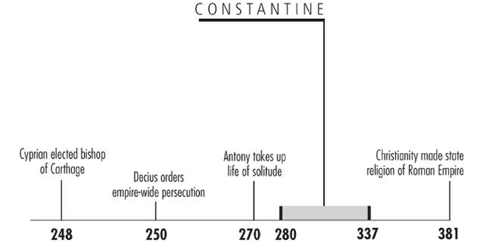
*The Emperor Constantine
* Galli, Mark. 131 Christians Everyone Should Know (p. 307). B&H Publishing Group. Kindle Edition.

Slide 6
*The Emperor Constantine
Constantine was born in AD 280; at which time his father, Constantius, was a Roman official on the rise.
By the time Constantine was 31, he himself had become emperor of the western portion of the empire.
* Galli, Mark. 131 Christians Everyone Should Know (p. 307). B&H Publishing Group. Kindle Edition.

Slide 7
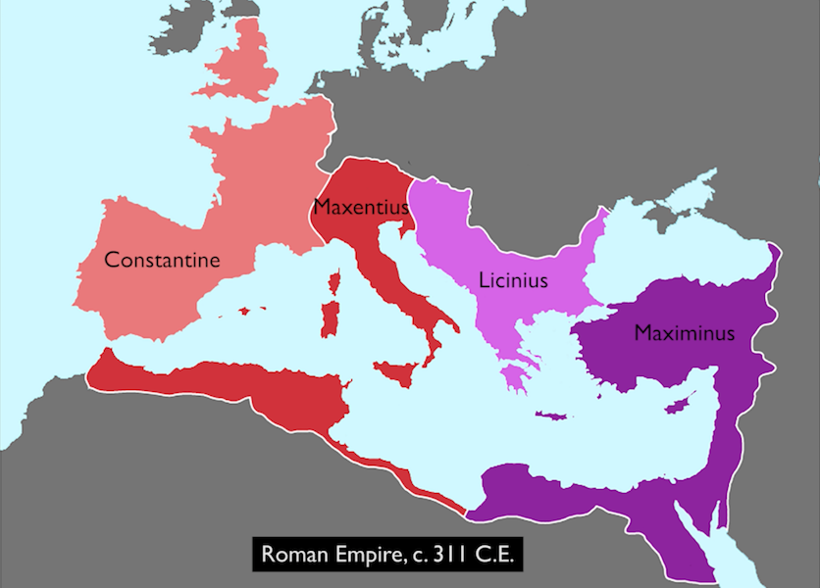
*The Emperor Constantine
https://www.khanacademy.org/humanities/ancient-art-civilizations/roman/late-empire/a/arch-of-constantine

Slide 8
*The Emperor Constantine
In the spring of 311, with 40,000 soldiers behind him, Constantine rode toward Rome to confront Maxentius, a rival emperor whose numbers were four times his own.
Maxentius, waited in Rome with his Italian troops and the elite Praetorian Guard, confident no one could successfully invade the city.
But Constantine's army was already overwhelming his foes in Italy as he marched towards the capital.
Maxentius turned to pagan oracles, and was given a prophecy that the “enemy of the Romans” would perish.
So, bolstered by the prophecy, Maxentius left the city to meet his foe, who was still miles away.
* Galli, Mark. 131 Christians Everyone Should Know (p. 307). B&H Publishing Group. Kindle Edition.

Slide 9
*The Emperor Constantine
Constantine, up to this point, had been a sun-worshipper.
As the story goes, on the night before his battle with Maxentius, Constantine had a dream in which chi and rho, the first two letters in the Greek word for Christ (Χριστοs), appeared one on top of the other in the shape of a cross:
Constantine is said to have seen or heard the words, “By this sign you will conquer.”
* Needham, Nick. 2,000 Years of Christ's Power Vol. 1: The Age of the Early Church Fathers

Slide 10
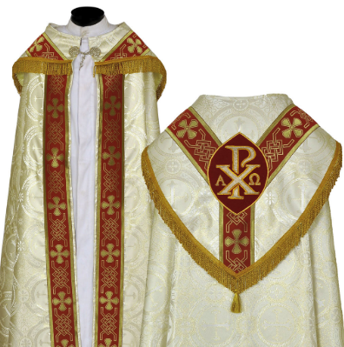
*The Emperor Constantine
The following day Constantine had the Chi-Rho sign painted on the shields of his troops.
Interesting side note: to this day, the Roman Catholic Church often uses the Chi-Rho sign as a Christian symbol.
http://www.catholicliturgicals.com/index.php?URL=product.htm&pro_id=555
* Needham, Nick. 2,000 Years of Christ's Power Vol. 1: The Age of the Early Church Fathers

Slide 11
*The Emperor Constantine
Constantine is then said to have prayed to the God of the Christians for victory, and won an amazing and crushing triumph over Maxentius who was killed in battle at the Milvian Bridge.
So, at the age of thirty-two, Constantine was now emperor of the West.
He believed that the Christian God had granted him victory, and from then on Constantine acted as the great champion and protector of Christians.
Constantine was a tall, strong, handsome man, whose physical presence always had a very positive and imposing impact on others.
He had a sharp insight into people’s characters and motives, an ability to strike swiftly and precisely in war and politics, and an overflowing energy which he devoted unselfishly to the affairs of the Empire.
* Needham, Nick. 2,000 Years of Christ's Power Vol. 1: The Age of the Early Church Fathers

Slide 12
*The Emperor Constantine
The brightest features of Constantine’s moral character were his:
Generosity with money
Sense of justice as a ruler
Purity in matters of sex – a virtue that all his Christian biographers gloried in, given how rare this was in politicians at that time.
However, Constantine was also:
Vain and flashy about his personal appearance
An easy prey to flattery, and increasingly tyrannical as his power increased.
He could be extremely suspicious about the loyalty of relatives, friends and servants, often with tragic results, as in the case of his son Crispus.
* Needham, Nick. 2,000 Years of Christ's Power Vol. 1: The Age of the Early Church Fathers

Slide 13
*Was Constantine a Genuine Christian?
Christians and historians have often debated this question.
Some have argued that Constantine did not sincerely embrace Christianity at all; they point to some distinctly unchristian acts in Constantine’s later life, e.g. he ordered the killing of a number of people for purely political reasons, or in a fit of rage.
The darkest of these episodes was when Constantine had his own son Crispus put to death in AD 326:
Constantine’s wife Fausta falsely accused Crispus (her step-son) of trying to rape her.
Constantine, seething with fury, ordered Crispus’s execution without giving him a chance to answer the charge.
Does this prove that Constantine was not a Christian?
Unless we want to argue that Christian rulers are sinlessly perfect (like King David?), or that Constantine never repented (some historians from the early Church period say he did repent of Crispus’s judicial murder), we simply cannot know for sure.
* Needham, Nick. 2,000 Years of Christ's Power Vol. 1: The Age of the Early Church Fathers

Slide 14
*Was Constantine a Genuine Christian?
As Christians, we can’t help but be disturbed by the way that in his last years, Constantine began favoring the Arian heresy which denied that Christ was God in the flesh.
It certainly calls into question his theological judgment, but to be fair, this happened at a confusing time when many “orthodox” bishops opposed those who upheld the deity of Christ.
There does seem to be evidence of a Christian conscience at work in many of Constantine’s laws and policies.
We must also recognize that Constantine had nothing to gain, either in the political or military sphere, by professing the Christian faith; the Roman ruling classes were almost entirely Pagan in their religious loyalties, and by far the most popular religion in the army was the Eastern mystery cult of Mithraism.
* Needham, Nick. 2,000 Years of Christ's Power Vol. 1: The Age of the Early Church Fathers

Slide 15
*Was Constantine a Genuine Christian?
So whatever Constantine’s motives were, his conversion is not likely to have been the product of a desire to win political or military favor.
After his victory over Maxentius, he certainly conformed outwardly to Christianity. Constantine:
Regularly attended Christian worship
Listened to the longest sermons without murmuring
Observed Easter with great solemnity
Indeed, Constantine often made speeches to his court in which he condemned Pagan idolatry and sang the praises of Christianity as the one true faith; and when his courtiers clapped and cheered him, he would always redirect their applause by pointing upwards to heaven.
* Needham, Nick. 2,000 Years of Christ's Power Vol. 1: The Age of the Early Church Fathers

Slide 16
*Was Constantine a Genuine Christian?
No doubt the arguments over Constantine’s conversion will continue to rumble on.
But the simple fact is that at a distance of 1,700 years, it is impossible for us to be sure what was really going on in Constantine’s heart and mind when he professed the Christian faith.
All we can do is look at the effects which this crucial event had on the history of the Church.
* Needham, Nick. 2,000 Years of Christ's Power Vol. 1: The Age of the Early Church Fathers

Slide 17
*Constantine Conquers the East
While Constantine was triumphing over Maxentius in the West, war broke out in the East between Licinius and Maximinus.
Licinius won.
As a result, Licinius now controlled the entire Eastern half of the Empire.
* Needham, Nick. 2,000 Years of Christ's Power Vol. 1: The Age of the Early Church Fathers

Slide 18
*The Emperor Constantine
https://www.khanacademy.org/humanities/ancient-art-civilizations/roman/late-empire/a/arch-of-constantine

Slide 19
*Constantine Conquers the East
In AD 313, Constantine and Licinius met in Milan, northern Italy, and agreed on a policy of freedom for all religions, Pagan and Christian.
For the first time, the Empire gave Christianity full legal status as an officially tolerated faith.
However, Licinius was still a Pagan, and grew increasingly anti-Christian over the next decade.
He dismissed all Christians from the army and prohibited all meetings of bishops.
In AD 320 Licinius started persecuting Christians violently: his soldiers destroyed church buildings and put bishops and presbyters to death.
* Needham, Nick. 2,000 Years of Christ's Power Vol. 1: The Age of the Early Church Fathers

Slide 20
*Constantine Conquers the East
Licinius’s motive was probably suspicion; he had become convinced that his Christian subjects were secretly loyal to Constantine, their fellow believer.
The tensions between Licinius and Constantine finally broke out into open war in AD 324.
Constantine invaded the East; he regarded himself as fighting a holy war against Licinius, to rescue the Eastern Church from persecution by an anti-Christian tyrant.
Constantine defeated Licinius at the battle of Chrysopolis (in Bithynia, Asia Minor), took him prisoner and executed him.
At that point, Constantine became the single undisputed emperor of the entire Roman Empire.
* Needham, Nick. 2,000 Years of Christ's Power Vol. 1: The Age of the Early Church Fathers

Slide 21
*Constantine Conquers the East
One of Constantine’s most historic decisions was to build a new capital city for the Eastern Empire at Byzantium in Thrace, just across the sea from Asia Minor. It was finished in AD 330.
Constantine called it “New Rome”, but it became known as “Constantinople” (Greek for “city of Constantine” ) – modern Istanbul in Turkey.
* Needham, Nick. 2,000 Years of Christ's Power Vol. 1: The Age of the Early Church Fathers

Slide 22
*Constantine Conquers the East
http://www.drshirley.org/geog/geog23.html

Slide 23
*Constantine and Sacralism
It’s common for people to think that Rome converted to Christianity in AD 313 or 325 under Constantine. But that’s simply not true.
In AD 380, Theodosius is the first emperor to decree Christianity as the official religion of the Roman Empire.
However, once Constantine became a Christian, Christian persecution ended.
After that we start seeing people become “Christians” in order to curry favor with the emperor.
Christians at first were very excited about the emperor’s conversion.
But pretty soon Christians began to realize that this is actually a problem.
This becomes the beginning of Sacralism – the union of church and state.
* Based on notes taken from James White’s 2016 Church History Series; Lesson 29 – Constantine

Slide 24
*Constantine and Sacralism
No one at that time could foresee that 700-800 years later the Holy Roman Emperor would be left outside shoveling the snow at the gates of the papal palace, seeking the pope’s approval and forgiveness!
In hindsight we can see how important this was.
All the Reformers were Sacralists. They couldn’t imagine what it would be to have a free church separate from the government.
Many people would say that the Reformers “laid the egg” that turned into secularism that has now turned to eat Christianity up!
* Needham, Nick. 2,000 Years of Christ's Power Vol. 1: The Age of the Early Church Fathers

Slide 25
The Council of Nicaea
https://en.wikipedia.org/wiki/First_Council_of_Nicaea#/media/File:Nicea.jpg

Slide 26
https://www.hopehelps.org/volunteer-appreciation-week-2018/

Slide 27
Class Discussion Time
https://www.weareteachers.com/moving-beyond-classroom-discussions/

Slide 28
*Class Discussion Time
The story of Constantine raises many questions about the relationship between church and state.
In our day, there is a great difference of opinion over what role, if any, that Christians should play in the affairs of politics and government:
How much influence should Christians try to exert over the making of laws?
Should Christians actively support or oppose political candidates who run for office?
Are there political issues that pastors should address from the pulpit?
What are your thoughts on these questions?
Do you have a topic or question that you would like to see us to discuss?

