Slide 1


Slide 2

Review
When was the Council of Nicaea?
  AD 325
What was the primary topic discussed at the Council of Nicaea?
  The nature and deity of Christ
Who called for the Council of Nicaea and why did he call it?
  Constantine – the church was becoming divided over Christ’s nature and deity and Constantine recognized that a schism in the Christian church would be a destabilizing factor in his empire, and so he moved to solve the problem.
Describe the three principle parties at the Council of Nicaea and their respective views.
  The Arian Group – Christ was of a different substance than the Father (heteroousios)
  The Orthodox Group – Christ was of the same substance as the Father (homoousios)
  The Middle Group – Christ was of a similar substance to the Father (homoiousios)

Slide 3
Review
Athanasius notes that the gathered bishops started off wanting to define their positions in scriptural language alone –
What obstacle did they run into using this approach and what did they have to do instead?
  Every time they came up with a statement that was limited solely to biblical terms, the Arians would find a way of “reading” the statement so as to allow for agreement.
  Eventually the members of the council were forced to realize that they needed to use an extra-biblical term that would clearly differentiate between a belief in the full deity of Christ and all those positions that would compromise that belief.
Belief in the Deity of Christ did not originate at Nicaea. Name two early church fathers who clearly believed in the Deity of Christ prior to AD 325.
  Ignatius (died c. 108)
  Melito of Sardis (c. 170-180)

Slide 4
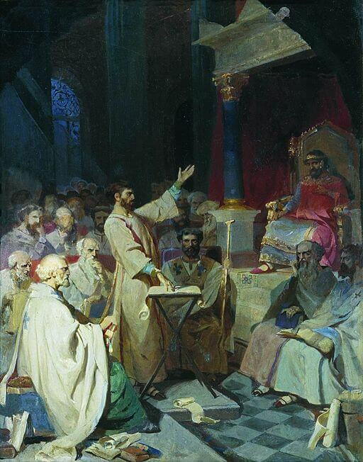
The Rise of Arianism After Nicaea
https://sgwmscog.com/wp-content/uploads/Council-of-Nicea-2-1.jpg

Slide 5
*The Rise of Arianism After Nicaea
The Council of Nicaea seemed to have settled the Arian controversy and restored unity and peace to the Eastern Church. The appearance, however, was deceptive.
While the eastern bishops had signed off on the full deity of Christ at Nicaea (and the use of homoousios rather than homoiousios), many still had reservations.
The Arians were able to take advantage of this reticence on the part of the eastern bishops to build sympathy and political support.
* Needham, Nick. 2,000 Years of Christ's Power Vol. 1: The Age of the Early Church Fathers

Slide 6
*The Rise of Arianism After Nicaea
The Arian leader was the bishop Eusebius of Nicomedia, a clever politician who had spun a vast web of influence in Constantine’s court, and became bishop of Constantinople in AD 339. (He must not be confused with Eusebius of Caesarea, the father of Church history)
In AD 328 Eusebius managed to get Arius recalled from exile.
Then Eusebius started a campaign to have supporters of the Creed of Nicaea deposed and exiled.
* Needham, Nick. 2,000 Years of Christ's Power Vol. 1: The Age of the Early Church Fathers

Slide 7
*The Rise of Arianism After Nicaea
During the six decades between the Council of Nicaea and the Council of Constantinople in 381, Arianism experienced many victories.
In fact, there were times during those six decades when the majority of bishops were Arian!
Eusebius of Nicomedia and others sought to completely overturn Nicaea, and for a number of decades it looked as if they might succeed!
* https://www.equip.org/articles/what-really-happened-at-nicea-/

Slide 8
*The Rise of Arianism After Nicaea
Constantine eventually began to compromise under the influence of the Arians and semi-Arians.
Constantine put little stock in the definition of Nicaea itself: he was a politician to the last.
Upon his death, his second son Constantius ruled in the East, and he gave great aid and comfort to Arianism.
United by their rejection of the term homoousion, semi-Arians and Arians worked to unseat a common enemy, almost always proceeding with political power on their side.
* https://www.equip.org/articles/what-really-happened-at-nicea-/

Slide 9
*The Rise of Arianism After Nicaea
Under Constantius, council after council met in this location or that.
So furious was the activity that one commentator wrote of the time, “The highways were covered with galloping bishops.”
Most importantly, regional councils meeting at Ariminum, Seleucia, and Sirmium presented Arian and Semi-Arian creeds, and many leaders were coerced into subscribing to them.
Even Liberius, bishop of Rome, having been banished from his position as bishop and longing to return, was persuaded to give in and compromise on the matter.
* https://www.equip.org/articles/what-really-happened-at-nicea-/

Slide 10
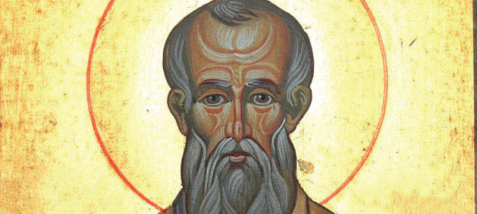
Athanasius Against the World
https://www.wordonfire.org/resources/blog/st-athanasius-against-the-world/

Slide 11
*Athanasius Against the World
In 328 Alexandria acquired a new bishop, Athanasius (296-373).
Athanasius became the outstanding champion of Nicene theology in the East, and was one of the greatest and most influential thinkers in the history of the Christian Church.
He had taken part in the Council of Nicaea, where he had distinguished himself by his eloquent arguments for Christ’s deity, and it was on the recommendation of the dying Alexander that the Alexandrian church elected Athanasius as his successor.
* Needham, Nick. 2,000 Years of Christ's Power Vol. 1: The Age of the Early Church Fathers

Slide 12
*Athanasius Against the World
The time and place of Athanasius’s birth are not known, although it is likely that he had rather obscure origins in a small town or village on the shore of the Nile River.
His complexion was dark, like that of the Copts, it is very likely that he belonged to that group, and that therefore he was a member of the lower classes in Egypt.
Throughout his life Athanasius kept in close contact with the monks of the desert, who repeatedly gave him support and asylum.
From the monks, Athanasius learned a rigid discipline that he applied to himself, and an austerity that earned him the admiration of his friends and even the respect of many of his enemies.
* Gonzalez, Justo L.. The Story of Christianity: Volume 1: The Early Church to the Dawn of the Reformation; p. 199-200

Slide 13
*Athanasius Against the World
Eusebius of Nicomedia and the other Arian leaders knew that Athanasius was one of their most formidable enemies.
They soon began to take steps to assure his downfall, circulating rumors that he dabbled in magic, and that he was a tyrant over the Christian flock in Egypt.
As a result, Constantine ordered Athanasius to appear before a synod gathered at Tyre, where he was to answer to grave charges brought against him.
* Gonzalez, Justo L.. The Story of Christianity: Volume 1: The Early Church to the Dawn of the Reformation; p. 201-202

Slide 14
*Athanasius Against the World
In particular, Athanasius was accused of having killed a certain Arsenius, a bishop of a rival group, and having cut off his hand in order to use it in rites of magic.
Athanasius went to Tyre as ordered, and after hearing the charges brought against him he brought into the room a man covered in a cloak.
After making sure that several of those present knew Arsenius, he uncovered the face of the hooded man, and his accusers were confounded when they realized that it was Athanasius’s supposed victim.
* Gonzalez, Justo L.. The Story of Christianity: Volume 1: The Early Church to the Dawn of the Reformation; p. 201-202

Slide 15
*Athanasius Against the World
Then someone who had been convinced by the rumors circulating against the bishop of Alexandria suggested that perhaps Athanasius had not killed Arsenius, but had cut off his hand.
Athanasius waited until the assembly insisted on proof that the man’s hand had not been cut.
He then uncovered one of Arsenius’s hands.
“It was the other hand!” shouted some of those who had been convinced by the rumors.
Then Athanasius uncovered the man’s other hand and demanded: “What kind of a monster did you think Arsenius was? One with three hands?”
Laughter broke out through the assembly, and many were enraged that the Arians had misled them.
* Gonzalez, Justo L.. The Story of Christianity: Volume 1: The Early Church to the Dawn of the Reformation; p. 201-202

Slide 16
*Athanasius Against the World
During the course of the decades following Nicaea, Athanasius was removed from his position as bishop five times, once by a force of 5,000 soldiers coming in the front door while he escaped out the back!
By the end of the sixth decade of the century, it looked as if Nicaea would be defeated.
Jerome would later describe this moment in history as the time when “the whole world groaned and was astonished to find itself Arian.”
* https://www.equip.org/articles/what-really-happened-at-nicea-/

Slide 17
*Athanasius Against the World
Yet, in the midst of this darkness, a lone voice remained strong.
Arguing from Scripture, fearlessly reproaching error, writing from refuge in the desert, along the Nile, or in the crowded suburbs around Alexandria, Athanasius continued the fight.
His unwillingness to give up — even when banished by the Emperor, disfellowshipped by the established church, and condemned by local councils and bishops alike — gave rise to the phrase, Athanasius contra mundum: “Athanasius against the world.”
Convinced that Scripture is “sufficient above all things,” Athanasius acted as a true “Protestant” in his day.
* https://www.equip.org/articles/what-really-happened-at-nicea-/

Slide 18
*Athanasius Against the World
Athanasius protested against the consensus opinion of the established church, and did so because he was compelled by scriptural authority.
Athanasius would have understood, on some of those long, lonely days of exile, what Wycliffe meant a thousand years later: “If we had a hundred popes, and if all the friars were cardinals, to the law of the gospel we should bow, more than all this multitude.”
Movements that depend on political favor (rather than God’s truth) eventually die, and this was true of Arianism.
As soon as it looked as if the Arians had consolidated their hold on the Empire, they turned to internal fighting and quite literally destroyed each other.
They had no one like a faithful Athanasius, and it was not long before the tide turned against them.
* https://www.equip.org/articles/what-really-happened-at-nicea-/

Slide 19
*Athanasius Against the World
As it turned out, then, Athanasius was not all alone against the world.
He lived to see the triumph of the cause he championed.
He died a peaceful death at the age of seventy-five and could rest assured that the creed he had fought for at Nicaea and afterward was the creed of the church: “God in three persons, blessed Trinity.”
* Shelley, Dr. Bruce L.. Church History in Plain Language: Fourth Edition (p. 114)

Slide 20
*Athanasius Against the World
By A.D. 381, the Council of Constantinople could meet and reaffirm, without hesitancy, the Nicene faith, complete with the homoousious clause.
The full deity of Christ was affirmed, not because Nicaea had said so, but because God had revealed it to be so.
Nicaea’s authority rested upon the solid foundation of Scripture.
A century after Nicaea, we find the great bishop of Hippo, Augustine, writing to Maximin, an Arian, and saying: “I must not press the authority of Nicaea against you, nor you that of Ariminum against me; I do not acknowledge the one, as you do not the other; but let us come to ground that is common to both — the testimony of the Holy Scriptures.”
* https://www.equip.org/articles/what-really-happened-at-nicea-/

Slide 21
*Athanasius Against the World
Why do Christians believe in the deity of Christ today?
Is it because they have been forced to do so by legislated theology from councils and popes?
No, it’s because the Scriptures teach this truth.
When orthodox believers affirm the validity of the creed hammered out at Nicaea, they are simply affirming a concise, clear presentation of scriptural truth.
The authority of the Nicene creed, including its assertion of the homoousion, is not to be found in some concept of an infallible church, but in the fidelity of the creed to scriptural revelation.
It speaks with the voice of the apostles because it speaks the truth as they proclaimed it.
* https://www.equip.org/articles/what-really-happened-at-nicea-/

Slide 22
*Athanasius Against the World
Modern Christians can be thankful for the testimony of an Athanasius who stood for these truths even when the vast majority stood against him. We should remember his example in our day.
* https://www.equip.org/articles/what-really-happened-at-nicea-/

Slide 23
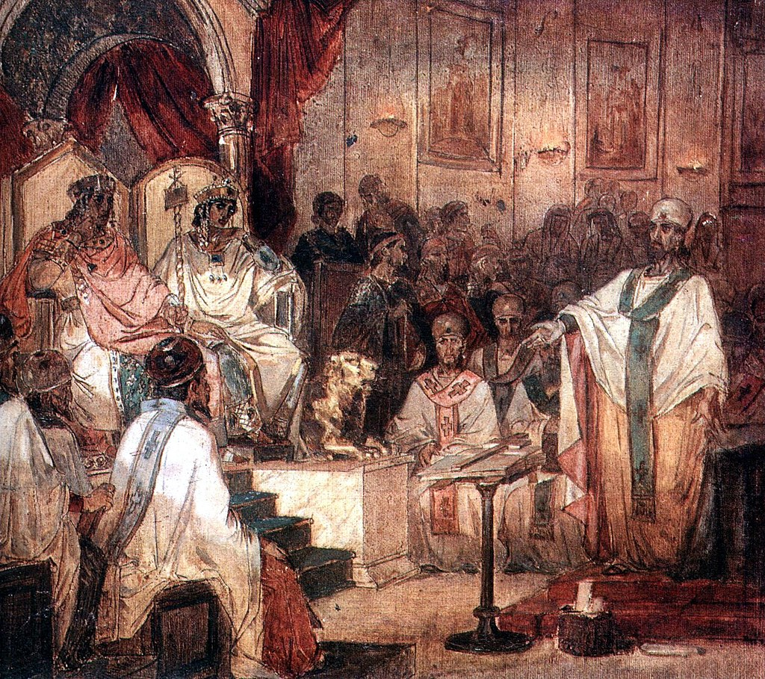
The Council of Chalcedon
https://sgwmscog.com/wp-content/uploads/Council-of-Nicea-2-1.jpg

Slide 24

https://www.hopehelps.org/volunteer-appreciation-week-2018/

Slide 25

Class Discussion Time
https://www.weareteachers.com/moving-beyond-classroom-discussions/

Slide 26
*Class Discussion Time
Paul, in his letter to the Corinthians states: “There must be factions among you in order that those who are genuine among you may be recognized”. (1 Cor. 11:19)
How does the conflict between Athanasius and the “world” illustrate this principle?
As you survey the issues being debated in the church today, do you see any issues that have the potential to become the “Arianism” of our day – i.e. an issue that could so divide the church that, for a time, perhaps, the majority of pastors throughout the world come down on the wrong side of the issue and attempt, through political force, to coerce the rest of us into agreeing with them?
Do you have a topic or question that you would like to see us to discuss?

