Slide 1


Slide 2

Review
How did Ambrose end up becoming bishop of Milan?
  In AD 374, the death of Auxentius, the bishop of Milan and the West’s leading Arian, threw the Milanese church into a fierce power-struggle between Arians and Trinitarians over who should succeed him as bishop.
  Ambrose was provincial governor of Milan at that time, and it was his duty to make sure that the election did not erupt into public disorder and violence.
  As he addressed the excited church members, a child’s voice suddenly shouted out, “Ambrose for bishop!” Soon, the whole crowd took up the cry.
  Ambrose was horrified, but he interpreted the event as God’s will and reluctantly submitted.
What was Ambrose’s view on the relationship between the emperor and the church?
  The Church belongs to God, not Caesar. The emperor is within the Church, not above it.
Describe how Ambrose’s view played out in the famous confrontation between him and the emperor Theodosius.
  The emperor ordered his troops to slaughter thousands of Thessalonians
  Ambrose excommunicated the emperor for giving such an order and exhorted him to deep, meaningful repentance.
  The emperor turned up at the church in Milan on Sunday, as if nothing had happened, only to find Ambrose barring his way, refusing to let him enter!
  Ambrose banned the emperor from attending worship for eight months

Slide 3
Review
How did John get the name Chrysostom?
  Because of his eloquent preaching – Chrysostom means “golden mouth” in Greek.
What were some of the things Chrysostom preached against in his day and what did he say about them?
  He denounced abortion, prostitution, gluttony, the theater, horse racing and swearing. He also railed against abuses of wealth and power.
What vivid analogy did Chrysostom give to describe the frustration that he sometimes experienced in preaching?
  “My work is like that of a man who is trying to clean a piece of ground into which a muddy stream is constantly flowing.”
Describe the contrast between the relationship of bishops and emperors in the West (as illustrated by Ambrose) and those in the East (as illustrated by Chrysostom).
  Ambrose faced the most powerful emperor of his time, and won.
  Chrysostom, on the other hand, was deposed and banished by the weak Arcadius.
  Theodosius was not the last Western emperor to be humbled by a Latin-speaking bishop. And John Chrysostom was not the last Greek-speaking bishop banished by an Eastern emperor.

Slide 4
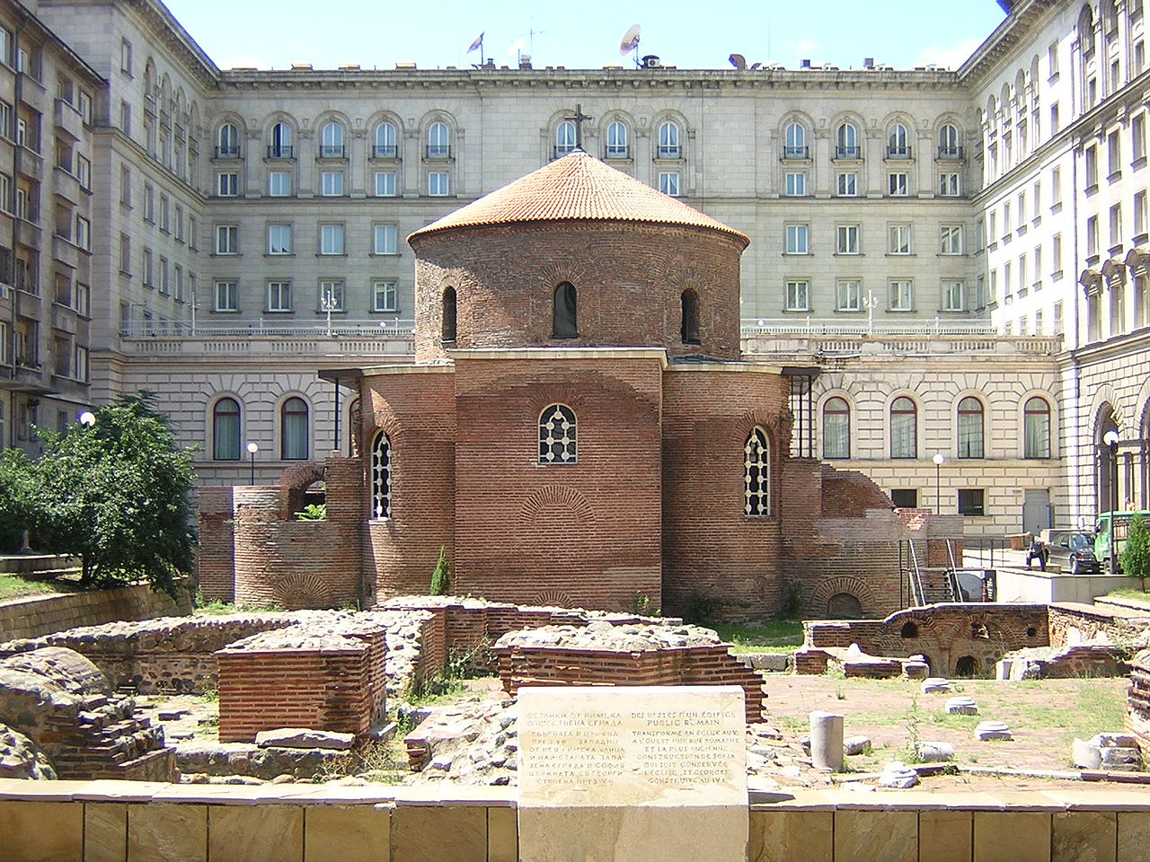
Church Teaching, Organization and Worship in the Fourth Century
https://en.wikipedia.org/wiki/History_of_Sofia#/media/File:StGeorgeRotundaSofia.JPG

Slide 5
*Church Teaching, Organization and Worship in the Fourth Century
Perhaps at no time before the Protestant Reformation of the 16th century did the theology, organization, worship and life of the Church undergo such important developments as they did in the 4th century.
In this section we want to take a look at what Christianity came to “look like” in the complex and colorful century of Constantine and Theodosius.
* Needham, Nick. 2,000 Years of Christ's Power Vol. 1: The Age of the Early Church Fathers

Slide 6
*Scripture and Tradition
The earliest known list that identifies all 27 books in our NT as canonical is found in the 39th Festal Letter of Athanasius written in AD 367.
Prior to the publication of that list, we have a number of references to and partial lists of the NT books as canonical.
We conclude from this that, prior to AD 367, the church was still in the process of compiling and coming to agreement on which books were a part of the NT canon.
After the fourth century there seems to have been little question over which books were to be included in the NT canon.
The Fourth Century Church recognized that the New Testament scriptures carried the divine authority given to the apostles.
They believed Old and New Testaments together were the divinely inspired and infallible Word of God, and they contained everything the believer needed to know for his salvation.
* Needham, Nick. 2,000 Years of Christ's Power Vol. 1: The Age of the Early Church Fathers

Slide 7
*Scripture and Tradition
Cyril of Jerusalem, a distinguished theologian of the early Church (AD 313 – 386) taught his students that:
  No doctrine concerning the divine and holy mysteries of the faith, however casual, may be taught without the backing of the holy Scriptures. We must not let ourselves be drawn aside by mere plausibility and cleverness of speech. Do not even give absolute belief to me, the one who tells you these things, unless you receive proof from the divine Scriptures of what I teach. For the salvation that flows from faith derives its power, not from clever human reasoning's, but rather from the demonstration of the holy Scriptures.
* Needham, Nick. 2,000 Years of Christ's Power Vol. 1: The Age of the Early Church Fathers

Slide 8
*Scripture and Tradition
Gregory of Nazianzus (one of the Cappadocian Fathers) saw the inspiration of the Holy Spirit behind the tiniest details of the Bible:
  The Spirit’s precise action we follow even in the details of Scripture, and we will never admit the godless idea that even the most trivial of Scripture’s statements about history were not set down accurately in writing by their authors with a serious purpose.
This doctrine of the Bible’s “inspiration and infallibility,” as we call it today, was held throughout the history of the Church in both the East and West – it was not until the Enlightenment of the 18th century, that some within the church began to question it.
* Needham, Nick. 2,000 Years of Christ's Power Vol. 1: The Age of the Early Church Fathers

Slide 9
*Scripture and Tradition
Unfortunately, in addition to recognizing the divine authority of the scriptures, many early church fathers also gave an alarmingly significant amount of weight to what they claimed to be “unwritten traditions” that had been “handed down” by the apostles.
As a rule, the church fathers of the fourth century did not (yet) see these unwritten traditions as speaking to the doctrinal content of the Christian faith, but they did believe that apostolic “tradition” contained other things the Church needed to know for its organization and worship.
* Needham, Nick. 2,000 Years of Christ's Power Vol. 1: The Age of the Early Church Fathers

Slide 10
*Scripture and Tradition
For example, Basil of Caesarea wrote:
  Some of the beliefs and practices which have been preserved in the Church we have received from written teaching [i.e. the scriptures]; others have been delivered to us … from the tradition of the apostles. Both have the same authority for true godliness. No-one will disagree with these things, if he has the smallest experience of the Church’s ordinances. If we tried to play down the value of the customs that lack written authority, claiming that they have little validity, we would unwittingly inflict serious damage on the gospel. For example, to mention the most common custom, who gave us a written command to make the sign of the cross over those who have set their hope on the name of the Lord Jesus? What written command do we have for turning to the east in prayer? … We do not simply limit ourselves to the written record found in the apostle Paul and the Gospels, but we add on … other things received from the unwritten tradition, and we regard these things as very important … We do these things on the basis of the unspoken secret tradition … Where does the custom of immersing people three times in baptism come from? … Does this not come from the unwritten secret teaching?
* Needham, Nick. 2,000 Years of Christ's Power Vol. 1: The Age of the Early Church Fathers

Slide 11
*Scripture and Tradition
It could be argued that many of the practices of the fourth century that they claimed were based on “unwritten tradition” were relatively harmless.
But as time went on, the practice of following “unwritten traditions” soon begin to corrupt their doctrinal beliefs and lead the church into serious error.
Thus we see the importance of looking to scripture alone (sola scriptura) as our authoritative voice.
* Needham, Nick. 2,000 Years of Christ's Power Vol. 1: The Age of the Early Church Fathers

Slide 12
*Church Organization
As we have already seen, Church organization in the first one and a half centuries had been very biblical: you had a plurality of equal bishops/elders and you had deacons.
By the middle of the 2nd century they began to deviate from the biblical teaching in this area and soon each individual church had only one bishop with a plurality of presbyters serving under that bishop – though at that point, when the leaders of multiple churches met to discuss and come to agreement over important doctrinal issues, all bishops continued to have an equal voice.
In the 4th century, a complex multiple church government began to form.
No longer were all bishops viewed as equals: Instead, the bishops of major cities came to be viewed as having more authority than bishops of smaller cities.
* Needham, Nick. 2,000 Years of Christ's Power Vol. 1: The Age of the Early Church Fathers

Slide 13
*Church Organization
The bishop of a provincial capital (like Rome or Constantinople) was called an archbishop (Greek for “chief bishop”).
In some cities when the congregation became too big to meet in one place, smaller congregations were set up, which were still under the authority of the bishop of the city, but cared for spiritually by a presbyter who in turn answered to the city bishop.
It soon became common for the normal pastor of a congregation to be a presbyter (whom they sometimes called a “priest”), and for the bishop to be pastor only of the central church of a city.
* Needham, Nick. 2,000 Years of Christ's Power Vol. 1: The Age of the Early Church Fathers

Slide 14
*Church Organization
Eventually, a few bishops became even more powerful than the archbishops, due to the outstanding spiritual or political importance of their cities and churches.
These supreme bishops came to be called patriarchs (Greek for “fatherly rulers”).
The Church eventually recognized the bishops of Rome, Constantinople, Alexandria, Antioch and Jerusalem as having this highest patriarchal rank; this recognition became official at the Council of Chalcedon in 451.
By the 5th century, the territories of the different patriarchs had become fairly well defined, and all other bishops and archbishops in each territory (called a “province”) were under their patriarch’s authority.
The patriarch of Constantinople became supremely important in the East, simply because his city was the capital of the Eastern or Byzantine Empire.
* Needham, Nick. 2,000 Years of Christ's Power Vol. 1: The Age of the Early Church Fathers

Slide 15
*Church Organization
In the West, the bishop of Rome was the only patriarch.
The Church might have recognized the bishop of the West’s second greatest city, Carthage, as a patriarch too, but Vandal and Arab invasions in the 5th and 7th centuries left Carthage in ruins.
Christians tended to give their patriarchs the affectionate title of “papa” or pope, which means “father”, however, the normal custom of many modern writers is to give the title “pope” specifically to the bishop of Rome, and the title “patriarch” to the bishops of Constantinople, Alexandria, Antioch and Jerusalem.
Until the great East– West schism of 1054, the Eastern Church held to the theory that the five patriarchs of Constantinople, Rome, Alexandria, Antioch and Jerusalem should act together as the leaders of the universal Church.
* Needham, Nick. 2,000 Years of Christ's Power Vol. 1: The Age of the Early Church Fathers

Slide 16
*Church Organization
The other important structure that developed in the 4th century was the Ecumenical Council.
This was an assembly of bishops from throughout the Empire. (“Ecumenical” comes from the Greek word meaning “the inhabited earth”).
From the 5th century on, the Church began to regard the decisions of an Ecumenical Council about doctrine and discipline as inspired by the Holy Spirit and therefore authoritative – thus creating another avenue through which error could creep into the church while being regarded as “authoritative”.
* Needham, Nick. 2,000 Years of Christ's Power Vol. 1: The Age of the Early Church Fathers

Slide 17
*Church Worship
The worship of the Church underwent important developments in the 4th century.
Up until now, virtually all churches throughout the Empire had conducted their worship in the same language: Greek. However, in the 4th century, the West increasingly began using Latin, until by about AD 350 it had replaced Greek as the preferred language of Western worship.
This reflected the fact that the Eastern and Western halves of the Empire were drifting apart culturally, and it contributed powerfully to the process by which Eastern and Western Christianity went different ways theologically and spiritually.
Also, within the East, many Syrian churches began to use Syriac in worship, and many Egyptian churches began to use Coptic.
This paved the way for Syrian and Egyptian Christians to form their own independent national Churches in the 5th and 6th centuries, separate from the mainstream of Eastern Byzantine Christianity.
* Needham, Nick. 2,000 Years of Christ's Power Vol. 1: The Age of the Early Church Fathers

Slide 18
*Church Worship
There was also an increasing emphasis in 4th century worship on liturgy – a fixed, written form of worship.
As we have seen, liturgies had been in use in Christian worship from the earliest times, but there was now less and less room for the bishop, who led the worship, to vary from the set pattern.
4th century worship also witnessed a powerful trend towards a greater use of ritual and ceremony.
We find the clearest example of this in the church of Jerusalem during the leadership of Cyril, who became bishop in AD 350.
It is in Cyril’s Jerusalem church that we first hear of clergy wearing special vestments, the use of incense, the carrying of lights (lamps, candles, tapers), and other ceremonies.
* Needham, Nick. 2,000 Years of Christ's Power Vol. 1: The Age of the Early Church Fathers

Slide 19
*Church Worship
In 4th century worship we begin to see the unfortunate growth of many idolatrous practices beginning to creep into the church.
Christians began to attach great importance to the dead bodies of those who had been considered outstandingly holy in their lifetimes, especially martyrs.
Chapels and shrines, and sometimes churches, were built over the tombs of revered “saints”.
Believers increasingly prized “relics” of saints – things that had belonged to the saint when he was alive, e.g. a piece of his clothing, or even one of his bones.
The idea developed that the dead saint, now in heaven, could help struggling believers on earth by his prayers.
So Christians practiced – not praying to the saints – but asking the saints in heaven to pray for them.
* Needham, Nick. 2,000 Years of Christ's Power Vol. 1: The Age of the Early Church Fathers

Slide 20
*Church Worship
In popular piety, it often drifted into a custom of actually praying to the saints which was little different from the way that Pagans had prayed to their various gods.
People considered particular saints to be especially good at meeting particular needs: one could bring about a cure for childlessness, another could protect travelers, another could reveal the future, etc.
* Needham, Nick. 2,000 Years of Christ's Power Vol. 1: The Age of the Early Church Fathers

Slide 21
*Church Worship
It was also during the 4th century that believers began to adorn churches with pictures of Christ and the saints (this would include holy men and women from the Bible itself and from the history of the Christian Church).
Christians in the East called these pictures “icons” – icon is the Greek word for “image”.
Prior to the 4th century, Christian icons had hardly ever been used to decorate churches, although Christians had certainly used them in other contexts.
For example, Tertullian spoke (disapprovingly) of cups which depicted Christ as a good shepherd carrying a sheep.
* Needham, Nick. 2,000 Years of Christ's Power Vol. 1: The Age of the Early Church Fathers

Slide 22
*Church Worship
Clement of Alexandria mentioned signet rings with which Christians attached their personal seal to a letter; these rings impressed a Christian symbol into the sealing wax:
  a fish (Christ)
  a dove (the Holy Spirit)
  an anchor (faith – see Heb. 6: 19)
  a loaf of bread (holy communion).
The fish was a favorite icon, symbolizing Christ. The Greek word for fish was ΙΧΘUΣ (in English, “ichthus”); each letter in the word stood for ΥΙησοῦς Χριστός Θεοῦ Uἱος Σωτηρ – “Jesus Christ, Son of God, Savior”.
The great Church historian of the 4th century, Eusebius of Caesarea, although himself personally opposed to icons, mentioned their widespread existence: “The features of the apostles Paul and Peter, and indeed of Christ Himself, have been preserved in colored pictures which I have seen.”
* Needham, Nick. 2,000 Years of Christ's Power Vol. 1: The Age of the Early Church Fathers

Slide 23
*Church Worship
Christian icons were particularly used in Rome on and around the tombs of believers.
These tombs were located in secret underground passages known as “catacombs”, and date back to the 1st century AD.
Early Christian art in the Roman catacombs often depicted Biblical scenes from the Old and New Testament.
The first church we know about which had pictures like these painted on its walls was a 3rd century church in Dura (in present-day Iraq).
* Needham, Nick. 2,000 Years of Christ's Power Vol. 1: The Age of the Early Church Fathers

Slide 24
*Church Worship
However, it was only in the 4th century that the adorning of churches with icons became a common practice.
In part, this was because it was only in the 4th century that church buildings themselves became the universal norm; before the conversion of Constantine, when the threat of persecution continually hung over Christians, many assemblies of believers still met in private houses.
But when the fear of government persecution vanished in Constantine’s reign, Christians could afford to be much more open and public in expressing their faith; and so the construction of special buildings for worship, and the adorning of these buildings with Christian art, went hand-in-hand.
* Needham, Nick. 2,000 Years of Christ's Power Vol. 1: The Age of the Early Church Fathers

Slide 25
*Church Worship
Even so, some of the 4th century fathers, notably Epiphanius of Salamis (315-403), were violently opposed to this use of icons in churches.
Epiphanius, bishop of the capital city of Cyprus, was a zealous foe of Arianism and all other deviations from orthodoxy; his book, Medicine Chest for the Cure of All Heresies, is our greatest single source of information about non-Catholic religious groups in the patristic period.
As far as Epiphanius was concerned, icons in churches were another deviation. He once saw a picture of Christ woven into a curtain in a church in Palestine, and was so angry that he tore it down and complained to the bishop of Jerusalem.
* Needham, Nick. 2,000 Years of Christ's Power Vol. 1: The Age of the Early Church Fathers

Slide 26
*Church Worship
But Epiphanius was fighting a losing battle.
Other great fathers of the 4th century, like Ambrose of Milan and Augustine of Hippo, defended the adorning of church buildings with religious icons.
They became extremely popular; most churches soon displayed images of Christ and the saints, in the form of paintings, tapestries, mosaics and sculptures.
Bibles, too, increasingly contained religious illustrations, which were often very beautiful.
However, Epiphanius’s hostility to icons never entirely died out in the Church, and it blazed up again in the Eastern Church with devastating ferocity in the great “iconoclastic controversy” of the 8th and 9th centuries.
* Needham, Nick. 2,000 Years of Christ's Power Vol. 1: The Age of the Early Church Fathers

Slide 27
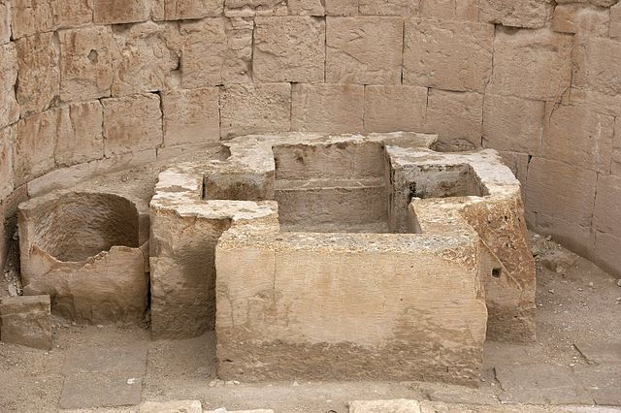
Baptism in the Early Church
https://commons.wikimedia.org/wiki/File:Shivta_Baptismal_font.jpg

Slide 28

https://www.hopehelps.org/volunteer-appreciation-week-2018/

Slide 29

Class Discussion Time
https://www.weareteachers.com/moving-beyond-classroom-discussions/

Slide 30
*Class Discussion Time
Were you surprised at how long it took the early church to come to a unanimous consensus on which NT books were to be considered canonical?
In today’s lesson we saw how the early church father’s deviation from have scripture as the sole infallible rule of faith and practice (sola scriptura) eventually allowed serious error to creep into the church.
They did it by insisting that “unwritten traditions” supposedly handed down from the apostles be practiced. Is there a parallel to this fatal error to be found in modern “protestant” churches in the form of man-made legalisms or denominational “traditions”?
During the Reformation, the Reformers rejected the practice of having images (and statues) in churches as a violation of the biblical commands against idolatry – “You shall not make for yourself a carved image, or any likeness of anything that is in heaven above, or that is in the earth beneath, or that is in the water under the earth.” (Exodus 20:4). Do you agree with them?
Do you have a topic or question that you would like to see us to discuss?

