Slide 1


Slide 2

Review
What is the earliest known list that identifies all 27 books in our NT as canonical and when was it written?
  The 39th Festal Letter of Athanasius written in AD 367
The Fourth Century Church recognized the inspiration and infallibility of both the Old and New Testament scriptures.
Unfortunately, in addition to recognizing the divine authority of the scriptures, many early church fathers also gave an alarmingly significant amount of weight to what other source of teaching?
  “unwritten traditions” that they claimed had been “handed down” by the apostles
Give some of the supposed “unwritten traditions” that we saw last week in the citation that I gave from Basil of Caesarea.
  to make the sign of the cross
  turning to the east in prayer
  immersing people three times in baptism

Slide 3
Review
In the 4th century, an complex multiple church government began to form. No longer were all bishops viewed as equals. Those of greater importance came to be called archbishops.
What was one of the major factors that from the 4th century on served to determine the importance of a bishop?
  The size and importance of the city that he was bishop over.
By the 5th century, a few bishops were viewed as being even more powerful than the archbishops, due to the outstanding spiritual or political importance of their cities and/or churches. What were these bishops called?
  “Patriarchs” or, in the case of Rome “papa” or “pope”
Give some examples of changes that took place in church worship in the 4th century.
  emphasis on liturgy – a fixed, written form of worship
  wearing special vestments
  use of incense
  the carrying of lights (lamps, candles, tapers)
Name some practices that crept into the church in the 4th century that, either were idolatrous or, over time, led to idolatry.
  Revering the “relics” of saints
  praying to saints (who had died)
  adorning of churches with icons

Slide 4
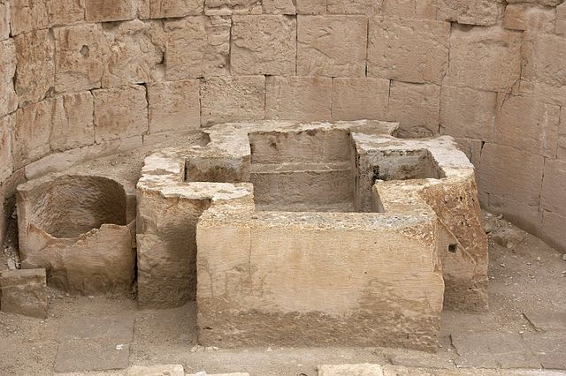
Baptism in the Early Church
https://commons.wikimedia.org/wiki/File:Shivta_Baptismal_font.jpg

Slide 5
*Description of a 4th Century
Baptismal Ceremony
Cyril of Jerusalem (AD 313 – 386) tells us that the catechumens (candidates for baptism) gathered in the vestibule (waiting area) of the baptistery, were to turn the west, and publicly renounced “Satan, his works, his pomp and his service”.
Then, turning to the east, they professed their faith in the Trinity.
After this the catechumens were led into the baptistery, where they took off their clothes and were anointed with oil which had first been exorcised.
Then, one by one, they were immersed three times in the baptismal pool; this threefold or triple immersion signified their faith in each of the three persons of the Trinity, and Christ’s three-day slumber in the tomb.
* Needham, Nick. 2,000 Years of Christ's Power Vol. 1: The Age of the Early Church Fathers

Slide 6
*Description of a 4th Century
Baptismal Ceremony
They were then anointed with oil again, on the forehead, ears, nostrils and breast, in a ceremony called chrismation (from chrisma, the Greek word for “anointing”).
Chrismation symbolized the gift of the Holy Spirit.
Finally, the newly baptized people were clothed in white garments, given lighted tapers, and led into the main part of the church where they took part in holy communion for the first time.
In the Western churches, they were also given milk and honey just before communion, to symbolize their entrance into the heavenly promised land.
Catechumens throughout the Empire were all baptized at the same time of year: Easter and Pentecost.
* Needham, Nick. 2,000 Years of Christ's Power Vol. 1: The Age of the Early Church Fathers

Slide 7
*4th Century Teaching on Baptism
Cyril’s Lectures give us a full account of how the Catholic Church had, by the 4th century, come to understand the meaning of baptism.
Cyril called baptism “the bath of regeneration” and taught his catechumens that it had three main effects.
  First, it washed away the guilt of all sins committed prior to baptism.
  Second, it sanctified the baptized person, by conferring on him spiritual union with Christ in His death and resurrection, the gift of the Spirit, and adoption as God’s child.
  Third, it impressed a “seal” or permanent mark on the soul, by virtue of which the baptized person was set apart as the Holy Spirit’s temple.
Cyril’s doctrine of baptism was the view held by all Christians in the 4th century, and indeed from the 150s onward.
* Needham, Nick. 2,000 Years of Christ's Power Vol. 1: The Age of the Early Church Fathers

Slide 8
*4th Century Teaching on Baptism
In assessing this patristic doctrine of “baptismal regeneration”, modern readers should keep in mind:
  Cyril and other fathers insisted that it was not the water of baptism that bestowed these spiritual benefits, but the Holy Spirit, who worked inwardly in the soul at the same time that the water outwardly washed the body.
* Needham, Nick. 2,000 Years of Christ's Power Vol. 1: The Age of the Early Church Fathers

Slide 9
*4th Century Teaching on Baptism
In assessing this patristic doctrine of “baptismal regeneration”, modern readers should keep in mind:
  Believers’ baptism was the norm of baptismal practice in the 4th century. Even though there is clear evidence that infant baptism was practiced (and probably had been since the 2nd century), most Christian parents would still not baptize their children, precisely because they linked baptism with the washing away of sin. For example, Monica, the mother of the great theologian Augustine of Hippo (354-430), did not have Augustine baptized in infancy, because she did not want him to lose the grace of baptism by all the sins she felt sure he would commit as a child and teenager.
* Needham, Nick. 2,000 Years of Christ's Power Vol. 1: The Age of the Early Church Fathers

Slide 10
*4th Century Teaching on Baptism
In assessing this patristic doctrine of “baptismal regeneration”, modern readers should keep in mind:
  Owing to this widespread belief that baptism could deal only with sins committed before a person was baptized, even adult converts often delayed their baptism till the last possible moment, when they were ill and dying. The classic example of this was the emperor Constantine the Great, who was baptized only in his last moments of life.
* Needham, Nick. 2,000 Years of Christ's Power Vol. 1: The Age of the Early Church Fathers

Slide 11
*4th Century Teaching on Baptism
In assessing this patristic doctrine of “baptismal regeneration”, modern readers should keep in mind:
  If a catechumen died before being baptized, some of the greatest of the early Church fathers taught that he or she was saved without baptism.
    When the godly young Western emperor Valentinian II (383-92) was murdered in AD 392 before his baptism, Ambrose of Milan comforted Valentinan’s two sisters with the assurance that their brother’s soul had gone to be with Christ. “It was enough that he desired baptism,” Ambrose said. “His sincere desire for baptism was just as effective as baptism itself.”
    Augustine taught the same: “A person is baptized invisibly, when his failure to be baptized in water was owing to an unavoidable death rather than contempt for Christianity.”
* Needham, Nick. 2,000 Years of Christ's Power Vol. 1: The Age of the Early Church Fathers

Slide 12
*4th Century Teaching on Baptism
In assessing this patristic doctrine of “baptismal regeneration”, modern readers should keep in mind:
  The fathers saw acceptance of the true faith as necessary if baptism was to be effective. The mere physical act of baptism, without true faith, was empty of value. Baptism given by heretics, e.g. Manichees and Arians, was therefore regarded by the early Church fathers as spiritually worthless; heretics performed the outward act of baptism, but their faith was not in the true gospel, and so their baptism conferred no spiritual benefit.
* Needham, Nick. 2,000 Years of Christ's Power Vol. 1: The Age of the Early Church Fathers

Slide 13

Early Church Teaching on the Atonement
https://www.michaeljkruger.com/did-the-earliest-christians-really-believe-in-substitutionary-atonement-and-even-imputation-one-important-example/

Slide 14
*Early Church Teaching on the Atonement
Critical scholars, led by the classic work of the neo-orthodox, Lutheran theologian Gustaf Aulén (1879-1977), have long argued that the earliest Christians did not believe that Christ died as a substitute for sinners.
If Aulén is correct, then when did the substitutionary view of the atonement arise? The typical critical approach says that it was not until the Middle Ages, when Anselm wrote Cur Deus Homo (Why the God-Man?), that Christians began to believe Christ died in place of sinners.
No doubt these sorts of scholarly arguments can explain why alternative theories of the atonement have gained popularity in recent years, while the substitutionary view continues to be vilified as un-Christian.
Rob Bell does precisely this in his book Love Wins, where he roundly rejects the substitutionary view in favor of other options.
* https://www.thegospelcoalition.org/article/did-early-christians-believe-in-substitutionary-atonement/

Slide 15
*Early Church Teaching on the Atonement
But is it really true that the substitutionary view of the atonement was not found before the Middle Ages?
Not at all. Such a claim can be readily refuted merely by examining the writings of the New Testament itself—particularly the letters of Paul.
Furthermore, we have already seen that key elements of the substitutionary view of atonement were held by some of the earliest Christian writers.
One example is the author of the Epistle to Diognetus, written by an one of the Apostolic Fathers in the early second century.
* https://www.thegospelcoalition.org/article/did-early-christians-believe-in-substitutionary-atonement/

Slide 16
*Early Church Teaching on the Atonement
Below are some excerpts from the Epistle to Diognetus that affirm key aspects of substitutionary atonement:
  Seriousness of Sin – And when we had demonstrated that we were powerless to enter the kingdom of God on our own, we were enabled to do so by the power of God. For our unrighteous way of life came to fruition and it became perfectly clear that we could expect only punishment and death as our ultimate reward. (9.1-2)
  Grace and Love of God – But then, when the time arrived that God planned to reveal at last his goodness and power (Oh the supreme beneficence and love of God!), he did not hate us, destroy us, or hold a grudge against us. (9.2)
  Christ Bore Our Sins on Himself – But [God] was patient, he bore with us, and out of pity for us took our sins upon himself. He gave up his own Son as a ransom for us, the holy one for the lawless, the innocent one for the wicked, the righteous one for the unrighteous, the imperishable one for the perishable, the immortal one for the mortal. (9.2)
* https://www.thegospelcoalition.org/article/did-early-christians-believe-in-substitutionary-atonement/

Slide 17
*Early Church Teaching on the Atonement
Subsequent to the Apostolic Fathers, early church teaching on the atonement becomes less prominent and, at times, intermixed or replaced by other ideas.
The Second Century Apologists contain very little on the subject that is of importance. In so far as Christ is represented as a Redeemer, it is usually as a Redeemer from the power of the devil.
Irenaeus (AD 130-202) agrees with the Second Century Apologists in seeing man as enslaved by the powers of darkness, and looks upon redemption partly as deliverance from the power of Satan, though he does not look upon it as a satisfaction due to Satan. His idea is rather that the death of Christ satisfied the justice of God and thus liberates man.
* Berkhof, Louis. The History of Christian Doctrines (p. 167)

Slide 18
*Early Church Teaching on the Atonement
In the Alexandrian School we find a number of ideas about the atonement:
  Clement of Alexandria in one of his minor works represents the death of Christ as a payment of man’s debt and as a ransom; but in his main works he gives more prominence to the thought that Christ as Teacher saves men by endowing them with true knowledge and inspiring them to a life of love and true righteousness!
  Origen presents several different views without really explaining how they all fit together:
    Christ saves by deifying human nature through the incarnation;
    By giving the supreme example of self-sacrifice, thus inspiring others to a similar sacrifice;
    By laying down his life as a sacrifice that takes away guilt by the payment of a penalty or the offering of an atonement;
    By redeeming men from the power of Satan.
* Berkhof, Louis. The History of Christian Doctrines (p. 168)

Slide 19
*Early Church Teaching on the Atonement
Origen in his teaching that Christ redeemed men from the power of Satan, introduces a new idea, namely that Satan was deceived in the transaction:
  Christ offered Himself as a ransom to Satan
  Satan accepted the ransom without realizing that he would not be able to retain his hold on Christ because of the latter’s divine power and holiness.
  Satan swallowed the bait of Christ’s humanity, and was caught on the hook of His divinity.
  Thus the souls of all men - even of those in hades - were set free from the power of Satan.
The Bible does speak of Christ’s death as a “ransom” (Mat. 20:28; 1Tim. 2:6; 1Pet. 1:18; Rev. 5:9) but not as a ransom to Satan.
* Berkhof, Louis. The History of Christian Doctrines (p. 168)

Slide 20
*Early Church Teaching on the Atonement
Athanasius wrote the first systematic treatise on the work of the atonement in De Incamatione. This work also contains several different ideas:
  The Logos became incarnate to restore to man the true knowledge of God, which had been lost by sin.
  The incarnate Logos is also represented as man’s substitute, who pays his debt for him by enduring the penalty of sin.
  The Logos assumed flesh in order to deify and immortalize it.
* Berkhof, Louis. The History of Christian Doctrines (p. 168-170)

Slide 21
*Early Church Teaching on the Atonement
The Cappadocian fathers are the true successors of Athanasius:
  Basil contributed little to the doctrine of the atonement.
  Gregory of Nyssa, is the author of the second important systematic treatment on the work of Christ, the Great Catechism, in which the underlying thought is the idea that in the incarnation God joined himself to our nature, in order to free it from sin and death.
  Gregory of Nazianzus repudiates with scorn and indignation the idea of a ransom paid to Satan. But he also rejects the idea that God the Father required a ransom. For the rest he virtually repeats the teachings of Athanasius.
* Berkhof, Louis. The History of Christian Doctrines (p. 168-170)

Slide 22
*Early Church Teaching on the Atonement
Augustine comes along at the end of the fourth century and beginning of the fifth.
  He provides us with an orthodox summary, de-emphasizing those elements in earlier writings that are the most unbiblical, and emphasizing the Pauline concepts of justification, substitution, and forgiveness.
  But Augustine does not have an in-depth handle on the Greek language (he is reading in the Latin) and so his analysis is not always as accurate or in-depth as we might wish.
There were further developments in this area in the medieval period with Anselm and Abelard.
But there is no question that the most biblically based discussion on the subject of the atonement comes post-Reformation.
* James White – 2016 Church History Series # 34 – Theories of the Atonement

Slide 23
*Early Church Teaching on the Atonement
You might ask why. If the atonement is such a central doctrine, why was so little said about it in those early periods of Christian history?
Primarily because the biblical categories relating to the atonement are most clearly expressed in the Old Covenant and in the book of Hebrews. It wasn’t until a Christian risked his life to have a Jew teach him the OT that these things really began to come to light.
The other reason it became so important to second and third generation reformers is that once the initial battle on justification has been put out there, then they began to dig more deeply into questions about the foundations of justification, which then takes you to the atonement of Christ.
* James White – 2016 Church History Series # 34 – Theories of the Atonement

Slide 24
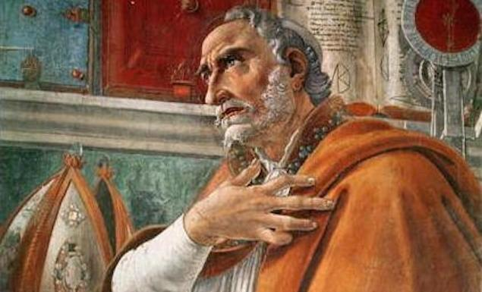
Augustine of Hippo
https://www.theschooloflife.com/thebookoflife/the-great-philosophers-augustine/

Slide 25

https://www.hopehelps.org/volunteer-appreciation-week-2018/

Slide 26

Class Discussion Time
https://www.weareteachers.com/moving-beyond-classroom-discussions/

Slide 27
*Class Discussion Time
By the fourth century, the early church had clearly added a number of elements to the baptismal ceremony that are not commanded in scripture. Do you see that as a problem?
Is it a problem to view baptism as necessary to salvation? Why or why not?
In the early church, there seems to be a very strong emphasis on the role of Satan in hindering our access to and/or our faithfulness to God. Do the scriptures support such an idea? Do you think the modern church gives adequate attention to this topic? Why or why not?
Do you have a topic or question that you would like to see us to discuss?

