Slide 1


Slide 2

Review
Describe the dream that Jerome had at one point that made him especially nervous about his love of Pagan classical literature.
  He dreamed that he was at the final judgment and was asked: “Who are you?” “I am a Christian,” Jerome answered. But the judge retorted: “You lie. You are a Ciceronian.”
What are some of the things Jerome did to overcome his lustful thoughts and memories of Roman banquets and dancing girls?
  He punished his body, and lived an austere life
  He ceased bathing
  Finally, he decided to study Hebrew
What monumental task did Damasus, the Bishop of Rome, suggest that Jerome take on – an accomplishment which, once Jerome did it, became his life’s legacy?
  Create a Latin translation of the Bible from the original languages.

Slide 3
Review
What kind of reception did Jerome’s Latin translation, known as the “Vulgate”, receive from the churches who first heard it?
  They accused him of tampering with the Word of God because, in places, his translation differed from the Septuagint, the popular Greek translation of that day.
Despite the initial negative reaction, what ended up happening with Jerome’s Vulgate translation?
  It became the standard Bible of the entire Latin-speaking church for more than a millennium.
What was Jerome’s view of the apocryphal books and their relationship to the OT scriptures?
  He believed they were not a part of scripture, because the Jews, who God had placed as custodians of the OT scriptures (Rom 3:2), did not view them as part of the OT canon.

Slide 4
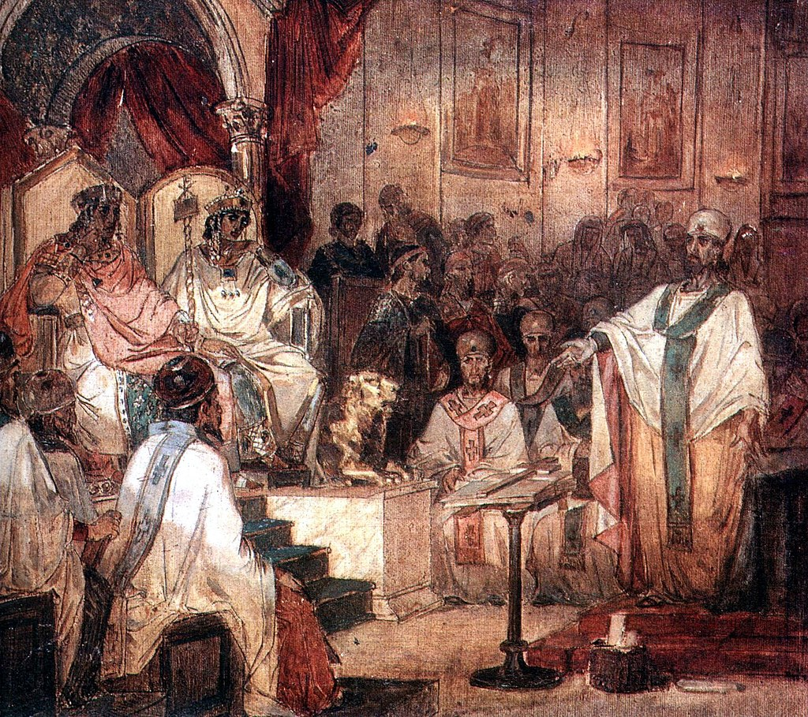
The Council of Chalcedon
https://sgwmscog.com/wp-content/uploads/Council-of-Nicea-2-1.jpg

Slide 5
*Lead up to the Council of Chalcedon
The question of the full deity of Christ (and of the Holy Spirit) had been settled by the Councils of Nicaea (AD 325) and Constantinople (AD 381).
Although the conversion to Arianism of some of the Germanic people beyond the borders of the empire, and their subsequent invasion of Western Europe, brought about a brief resurgence of Arianism, this eventually disappeared, and Christians everywhere were in basic agreement on Trinitarian doctrine.
But there were still other issues that would cause sharp theological disagreement.
Foremost among these was the question of how deity and humanity are joined in Jesus Christ.
* Gonzalez, Justo L.. The Story of Christianity: Volume 1: The Early Church to the Dawn of the Reformation (p. 296)

Slide 6
*Lead up to the Council of Chalcedon
There were two main ways of looking at this question:
  The theologians of Antioch , the “Antiochenes”, favored one way
  The theologians of Alexandria, the “Alexandrians”, preferred the other.
Both sides agreed that Jesus was both divine and human. The question was how to understand that union.
The Antiochenes emphasized the distinction between Christ’s human and divine natures.
They feared that if they did not keep the two natures apart, all the limitations and weaknesses of the human Jesus which the Gospels record (His frustration, His ignorance, His growth in wisdom and grace) would be applied to His divine nature.
They feared that if Jesus’s human limitations were applied to His divine nature, they would destroy His divinity. And then the Arians would have been right after all: Jesus Christ was not truly divine!
* Needham, Nick. 2,000 Years of Christ's Power Vol. 1: The Age of the Early Church Fathers

Slide 7
*Lead up to the Council of Chalcedon
The Antiochenes also feared that, unless they made a sharp separation between Christ’s two natures, His divine qualities (almighty power, perfect knowledge, etc.) might be ascribed to His humanity, making Him super-human and thus not genuinely human like us.
To avoid these disastrous conclusions, the Antiochenes kept the human and divine natures of Christ as far apart as possible.
They sometimes spoke as if the humanity of Jesus had a separate personality from the deity of Jesus, thus splitting Him apart into two persons.
In the extreme, this sort of thinking could lead to the belief that there were two Sons in Christ: a divine Son of God (the eternal Logos) and a human Son of Man (Jesus of Nazareth).
* Needham, Nick. 2,000 Years of Christ's Power Vol. 1: The Age of the Early Church Fathers

Slide 8
*Lead up to the Council of Chalcedon
The theologians of Alexandria favored the other way of approaching the question.
In contrast to the Antiochenes, the Alexandrians emphasized the divine nature in Christ.
Therefore all the words, actions and experiences of Christ recorded in the Gospels, were the words, actions and experiences, not of a human person, but of God Himself.
So instead of separating Christ’s human and divine natures, as the Antiochenes tended to do, the Alexandrians united them into as close a oneness as possible – but always at the expense of the human nature.
They often made Christ’s humanity into just a tool or instrument which the divine Son took up and used.
* Needham, Nick. 2,000 Years of Christ's Power Vol. 1: The Age of the Early Church Fathers

Slide 9
*Lead up to the Council of Chalcedon
The first stages of this controversy began even before the Trinitarian issue was settled.
One of the defenders of the Nicene position regarding the Trinity, Apollinaris of Laodicea, thought that he could help that cause by explaining how the eternal Word of God could be incarnate in Jesus.
This he attempted to do by claiming that in Jesus the Word of God, the second person of the Trinity, took the place of his human soul.
He taught that like all human beings, Jesus had a physical body, but that Jesus did not have a human soul – instead, the God the Son acted upon and controlled the body of Jesus in the same way that our soul does within the rest of us.
* Gonzalez, Justo L.. The Story of Christianity: Volume 1: The Early Church to the Dawn of the Reformation (p. 297)

Slide 10
*Lead up to the Council of Chalcedon
Although this explanation seemed satisfactory to Apollinaris, soon many began to see flaws in it.
A human body with a purely divine mind is not really a human being.
From the Alexandrine point of view, this was quite acceptable, for all that was needed was that Jesus really speak as God, and that he have the body necessary to communicate with us.
But the Antiochenes insisted that this was not enough. Jesus must be truly human. This was of paramount importance, because Jesus took up humanity so that humankind could be saved.
* Gonzalez, Justo L.. The Story of Christianity: Volume 1: The Early Church to the Dawn of the Reformation (p. 297)

Slide 11
*Lead up to the Council of Chalcedon
Gregory of Nazianzus (one of the Cappadocian Fathers) put it this way:
  If any believe in Jesus Christ as a human being without human reason, they are the ones devoid of all reason, and unworthy of salvation. For that which he has not taken up he has not saved. He saved that which he joined to his divinity. If only half of Adam had fallen, then it would be possible for Christ to take up and save only half. But if the entire human nature fell, all of it must be united to the Word in order to be saved as a whole.
After some debate, the theories of Apollinaris were rejected, first by a number of leading bishops and local synods called by them, and eventually by the Council of Constantinople in AD 381— the same council that reaffirmed the decisions of Nicaea against Arianism.
* Gonzalez, Justo L.. The Story of Christianity: Volume 1: The Early Church to the Dawn of the Reformation (p. 297-298)

Slide 12
*Lead up to the Council of Chalcedon
The next episode of the Christological controversies was precipitated by Nestorius, a representative of the Antiochene school who became patriarch of Constantinople in AD 428.
Nestorius declared that Mary should not be called Theotokos— that is, bearer of God— and suggested that she be called Christotokos— bearer of Christ.
It is difficult for Protestants to understand what was at stake here, for we have been taught to reject the notion that Mary is the “Mother of God,” and at first glance this seems to be what was at issue here.
But in truth, the debate was not so much about Mary as about Jesus.
The question was not what honors were due to Mary, but how one was to speak of the birth of Jesus.
* Gonzalez, Justo L.. The Story of Christianity: Volume 1: The Early Church to the Dawn of the Reformation (p. 298-299)

Slide 13
*Lead up to the Council of Chalcedon
When Nestorius declared that Mary was the bearer of Christ, but not of God, he was affirming that in speaking of the incarnate Lord one may and must distinguish between his humanity and his divinity, and that some of the things said of him are to be applied to the humanity, and others to the divinity.
This was a typically Antiochene position, which sought to preserve the full humanity of Jesus by making a very clear distinction between it and his divinity.
Nestorius and the rest of the Antiochenes feared that if the two were too closely joined together, the divinity would overwhelm the humanity, and one would no longer be able to speak of a true man Jesus.
* Gonzalez, Justo L.. The Story of Christianity: Volume 1: The Early Church to the Dawn of the Reformation (p. 298-299)

Slide 14
*Lead up to the Council of Chalcedon
As was to be expected, the center of opposition to Nestorius was Alexandria, whose leader, Bishop Cyril, was a much more able politician and theologian than Nestorius.
Cyril made certain that he had the support of the emperors Valentinian III and Theodosius II, who then called an ecumenical council to be gathered at Ephesus in AD 431.
Nestorius’s main supporters, John of Antioch and his party, were delayed in getting to the council.
After waiting for them for two weeks, the council convened, in spite of the protests of the Roman legate and several dozen bishops.
They then dealt with the case of Nestorius and, without allowing him to defend himself, declared him a heretic and deposed him from his position as patriarch of Constantinople.
* Gonzalez, Justo L.. The Story of Christianity: Volume 1: The Early Church to the Dawn of the Reformation (p. 299-300)

Slide 15
*Lead up to the Council of Chalcedon
John of Antioch and his party arrived a few days later, and they then convened a rival council, which was much smaller than Cyril’s, and which declared that Cyril was a heretic and reinstated Nestorius.
In retaliation, Cyril’s council reaffirmed its condemnation of Nestorius and added to it the names of John of Antioch and all who had taken part in his council.
Finally, Theodosius II intervened, arrested both Cyril and John, and declared that the actions of both councils were void.
Then followed a series of negotiations that led to a “formula of union” to which both Cyril and John agreed in AD 433.
But it was also decided that the actions of Cyril’s council against Nestorius would stand.
As to Nestorius, he spent the rest of his life in exile, first in a monastery in Antioch, and then eventually in the remote city of Petra.
* Gonzalez, Justo L.. The Story of Christianity: Volume 1: The Early Church to the Dawn of the Reformation (p. 300)

Slide 16
*Lead up to the Council of Chalcedon
Thus, the second episode in the Christological controversies ended with a victory for Alexandria, and with a truce that would not hold for long.
In AD 444, when Dioscorus succeeded Cyril as patriarch of Alexandria, the stage was set for a third and even more acrimonious confrontation, for Dioscorus was a convinced defender of the most extreme Alexandrian positions, and a rather unscrupulous maneuverer.
The storm centered on the teachings of Eutyches, a monk in Constantinople who lacked theological subtlety, and who held that, while the Savior was “of one substance with the Father,” he was not “of one substance with us.”
* Gonzalez, Justo L.. The Story of Christianity: Volume 1: The Early Church to the Dawn of the Reformation (p. 300)

Slide 17
*Lead up to the Council of Chalcedon
Eutyches also seems to have been willing to say that Christ was “from two natures before the union, but in one nature after the union.”
Exactly what this meant is not altogether clear. In any case, Patriarch Flavian of Constantinople, whose theology was of the Antiochene tradition, felt that Eutyches’s teachings were close to Docetism and condemned him.
Through a series of maneuvers, Dioscorus had the affair grow into a conflict that involved the entire church, so that a council was called by Emperor Theodosius II, to meet at Ephesus in AD 449.
* Gonzalez, Justo L.. The Story of Christianity: Volume 1: The Early Church to the Dawn of the Reformation (p. 300)

Slide 18
*Lead up to the Council of Chalcedon
When this council gathered, it was clear that Dioscorus and his supporters had taken all the necessary steps to predetermine the outcome.
Dioscorus himself had been appointed president of the assembly by the emperor, and given the authority to determine who would be allowed to speak.
This council took an extreme Alexandrian stand. When the legates of Leo, Bishop of Rome tried to present before the assembly a letter that Leo had written on the subject at hand— commonly known as Leo’s Tome— they were not allowed to do so.
* Gonzalez, Justo L.. The Story of Christianity: Volume 1: The Early Church to the Dawn of the Reformation (p. 300-301)

Slide 19
*Lead up to the Council of Chalcedon
Flavian was manhandled so violently that he died in a few days.
The doctrine that there are in Christ “two natures” was declared heretical, as were also all who defended the Antiochene position, even in moderate form.
Furthermore, it was decreed that any who disagreed with these decisions could not be ordained.
In Rome, Leo fumed, and called the council a “Robber Synod.”
But his protests were to no avail. Theodosius II and his court, who apparently had received large amounts of gold from Alexandria, considered the matter ended.
* Gonzalez, Justo L.. The Story of Christianity: Volume 1: The Early Church to the Dawn of the Reformation (p. 300-301)

Slide 20
*Lead up to the Council of Chalcedon
But then the unexpected happened. Theodosius’s horse stumbled, and the emperor fell and broke his neck.
He was succeeded by his sister Pulcheria and her husband Marcian.
Pulcheria had agreed earlier with the Western position, that Nestorius should be condemned, for it imperiled the union of the divine with the human.
But she was not an extreme Alexandrian, and felt that the proceedings at Ephesus in AD 449 had left much to be desired.
For this reason, at the behest of Leo, Bishop of Rome, she called a new council, which met at Chalcedon in AD 451 and which eventually became known as the Fourth Ecumenical Council.
* Gonzalez, Justo L.. The Story of Christianity: Volume 1: The Early Church to the Dawn of the Reformation (p. 301)

Slide 21
*The Council of Chalcedon
The Council of Chalcedon condemned Dioscorus and Eutyches, but forgave all others who had participated in the Robber Synod of Ephesus two years earlier.
Leo’s letter was finally read, and many declared that this expressed their own faith. It was a restatement of what Tertullian had declared centuries earlier, that in Christ there are “two natures in one person.”
Finally, the council produced a statement that was not a creed, but rather a Definition of Faith, or a clarification of what the church held to be true.
A careful reading of that “Definition” will show that, while rejecting the extremes of both Alexandrians and Antiochenes, it reaffirmed what had been done in the three previous great councils (Nicaea in 325, Constantinople in 381, and Ephesus in 431).
* Gonzalez, Justo L.. The Story of Christianity: Volume 1: The Early Church to the Dawn of the Reformation (p. 301)

Slide 22
Council of Chalcedon Definition of Faith
We all, with one voice, confess our Lord Jesus Christ, one and the same son, at once complete in deity and complete in humanity, truly God and truly man, consisting of a rational soul and body; of the same essence as the Father in His deity, of the same essence as us in His humanity, like us in all things apart from sin; begotten of the Father before all ages as regards His deity, the same born of the virgin Mary, the birth-giver of God, as regards His humanity, in the last days, for us and our salvation;
One and the same Christ, Son, Lord, Only-Begotten, to be acknowledged in two natures, without confusion, without change, without division, without separation; the distinction of the natures being in no way abolished because of the union, but rather the characteristic property of each nature being preserved, and coming together to form one person and one hypostasis. He is not split or divided into two persons, but he is one and the same Son and Only-Begotten, God the Logos, the Lord Jesus Christ, as formerly the prophets and later Jesus Christ Himself have taught us about Him, and as it has been handed down to us by the Creed of the Fathers.
Red = Alexandrian Theology Blue = Antiochene Theology

Slide 23
*The Council of Chalcedon
As you can see, this Definition does not seek to “define” the union in the sense of explaining how it took place, but rather in the sense of setting the limits beyond which error lies.
Thus, it rejected the notion that the union destroyed “the difference of the two natures” and also the view that the Savior is “divided into two persons”— thus rejecting the most extreme Alexandrine and Antiochene positions.
This Definition of Faith soon became the standard of Christological orthodoxy in the entire Western church, and in most of the East— although there were some in the East who rejected it, and thus gave rise to the first long-lasting schisms in the history of Christianity.
Some, mostly in Syria and Persia, insisted on a clear distinction between the divine and the human in Christ, and were eventually called “Nestorians.”
* Gonzalez, Justo L.. The Story of Christianity: Volume 1: The Early Church to the Dawn of the Reformation (p. 302)

Slide 24
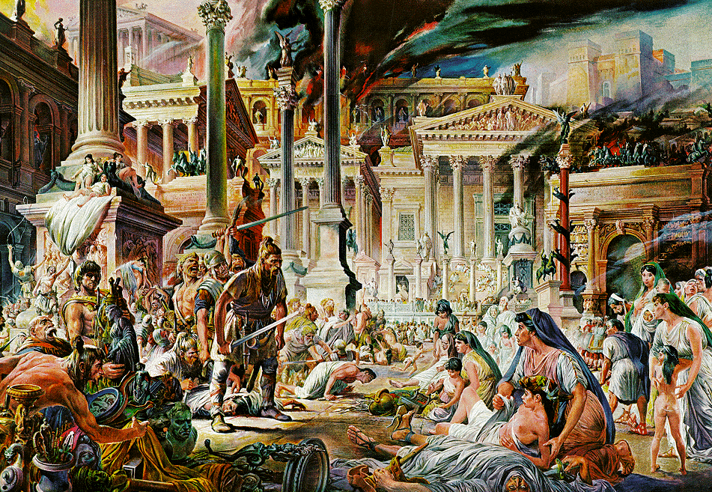
The Fall of Rome
https://www.historyonthenet.com/when-did-the-roman-empire-really-end

Slide 25

https://www.hopehelps.org/volunteer-appreciation-week-2018/

Slide 26

Class Discussion Time
https://www.weareteachers.com/moving-beyond-classroom-discussions/

Slide 27
*Class Discussion Time
Some scriptures to keep in mind:
  And Jesus increased in wisdom and in stature and in favor with God and man. (Luke 2:52)
  For we do not have a high priest who is unable to sympathize with our weaknesses, but one who in every respect has been tempted as we are, yet without sin (Hebrews 4:15)
  Although he was a son, he learned obedience through what he suffered. (Hebrews 5:8)
  …the rulers of this age … crucified the Lord of glory. (1 Cor. 2:8)
Do you think Nestorius was a heretic for not being willing to call Mary the “Mother of God”?
Do you believe the Chalcedonian Definition of Faith can be fully defended from scripture? Or do you think they were trying to “slice the bread too thin”, so to speak?
Do you have a topic or question that you would like to see us to discuss?

