Slide 2
Review
The question of the full deity of Christ (and of the Holy Spirit) had been settled by the Councils of Nicaea (AD 325) and Constantinople (AD 381).
What was the primary theological issue addressed in the Council of Chalcedon?
The question of how deity and humanity are joined in Jesus Christ
What were the two main ways of looking at this issue as represented by theologians of Antioch and Alexandria?
The Antiochenes emphasized the distinction between Christ’s human and divine natures.
The Alexandrians tended to unite Christ’s human and divine natures into as close a oneness as possible – but always at the expense of the human nature.
Apollinaris of Laodicea claimed that Jesus did not have a human soul – instead, God the Son acted upon and controlled the body of Jesus. What was the Antiochene objection to this idea?
Jesus became man so that mankind could be saved. Therefore Jesus must be fully human in order to redeem every aspect of those whom he saved.

Slide 3
Review
For what teaching (concerning Mary) was Nestorius condemned as a “heretic”?
Nestorius declared that Mary should not be called Theotokos— that is, mother of God— and suggested that she be called Christotokos— mother of Christ.
What did Bishop Cyril of Alexandria do that kept Nestorius’ representatives from ever getting a chance to defend their ideas before Nestorius was condemned as a heretic?
Cyril made certain that he had the support of the emperors Valentinian III and Theodosius II, then called an ecumenical council to condemn Nestorius before his representatives had even arrived.
Eutyches, a monk in Constantinople taught that Jesus was “of one substance with the Father,” he was not “of one substance with us”.
What unscrupulous tactics were employed to defend Eutyches, in a council that was called to discuss and debate his ideas?
Dioscorus, whom the Emperor Theodosius II appointed as president of the council, prevented those who disagreed with Eutyches’ view from speaking.
One of Eutyches’ opponents, Patriarch Flavian of Constantinople, was manhandled to the point that he died a few days later.
The Emperor Theodosius II and his court, who apparently had received large amounts of gold from Alexandria, turned a deaf ear to those who protested what had taken place in the council.

Slide 4
Beyond the Borders of the Empire
https://www.flickr.com/photos/eriagn/35994592396

Slide 5
*Beyond the Borders of the Empire
Up until this point our attention has centered on the history of Christianity within the borders of the Roman Empire.
There is a good reason for this, for Christianity was born within that empire, and most of today’s Christians— Catholic, Protestant, and Eastern Orthodox— trace their heritage to the early development of the church within those borders.
However, it is important to remember that this is not the whole story, for while Christianity was developing within the Roman Empire it was also taking root in lands beyond the reach of Roman rule.
* Gonzalez, Justo L.. The Story of Christianity: Volume 1: The Early Church to the Dawn of the Reformation (p. 253)

Slide 6
*Beyond the Borders of the Empire
For example, Christianity gained a foothold among the Germanic “barbarians” of the north, long before the barbarians themselves broke into the Roman Empire.
But the most impressive expansion of Christianity outside the empire was toward the east.
There are, in fact, a number of Christians in the world today who trace their origins to those early churches beyond the Eastern borders of the empire.
* Gonzalez, Justo L.. The Story of Christianity: Volume 1: The Early Church to the Dawn of the Reformation (p. 253)

Slide 7
*The Early History of Christianity in the East
History indicates that Christianity reached the lands east of the Arabian Peninsula very early on.
There are three early accounts that suggest an early movement of the gospel to peoples in the east, two of which are found in scripture.
The first account relates to the birth of Jesus where it mentions that Magi came from the East to honor him (Matthew 2:1-12), a group which is most commonly thought to be Zoroastrian astronomers from Persia.
The scriptures tell us that these men returned back to their homeland afterward.
* The Nestorian Impact on the Islamic World through the Turkic and Mongol Peoples – Jason Connolly

Slide 8
*The Early History of Christianity in the East
The second account is takes place at the beginning of the Christian church.
Men are said in Acts 2:9 to have come to Jerusalem from Mesopotamia, Media, Persia, Elam, and even Arabia (all to the east of Jerusalem) to celebrate one of the great annual Jewish feasts.
While they were in Jerusalem, they heard the Gospel message (from Peter) and many were converted and afterward returned to their homelands (Acts 2:5-11).
We find the third account in an early church tradition which says that the first century apostles Andrew and Thomas went east spreading the Christian message as far as India.
The Nestorian Impact on the Islamic World through the Turkic and Mongol Peoples – Jason Connolly

Slide 9
*The Early History of Christianity in the East
In addition to these first three events, there is another set of historical records which tell of a much more widespread movement of Christianity to the East.
You may recall that earlier in our series we discussed the fact that one of the first major cities that the Christian Church spread to outside of Jerusalem, was Antioch – a major metropolitan center in a Syriac-speaking area.
It was from this metropolitan center that the Apostle Paul launched his missionary journeys to the lands west of Antioch (which were a part of the Roman Empire at the time).
The Nestorian Impact on the Islamic World through the Turkic and Mongol Peoples – Jason Connolly

Slide 10
*The Early History of Christianity in the East
But Christianity also spread eastward at this point, from Antioch to the cities of:
Edessa (modern-day Urfa, Turkey)
Arbela (modern-day Erbil, Iraq)
From there Christianity began to spread throughout the Persian Empire (a.k.a the Sassanid Empire) as early as AD 120-140.
A Syriac Christian writing near the end of the second century mentioned Christians from a number of eastern people groups, including: Medes, Persians, Parthians and Bactrians.
He describes them as being unified “by the one name of the Messiah” and mentions several specific ways that these people lived differently after becoming Christians.
The Nestorian Impact on the Islamic World through the Turkic and Mongol Peoples – Jason Connolly

Slide 11
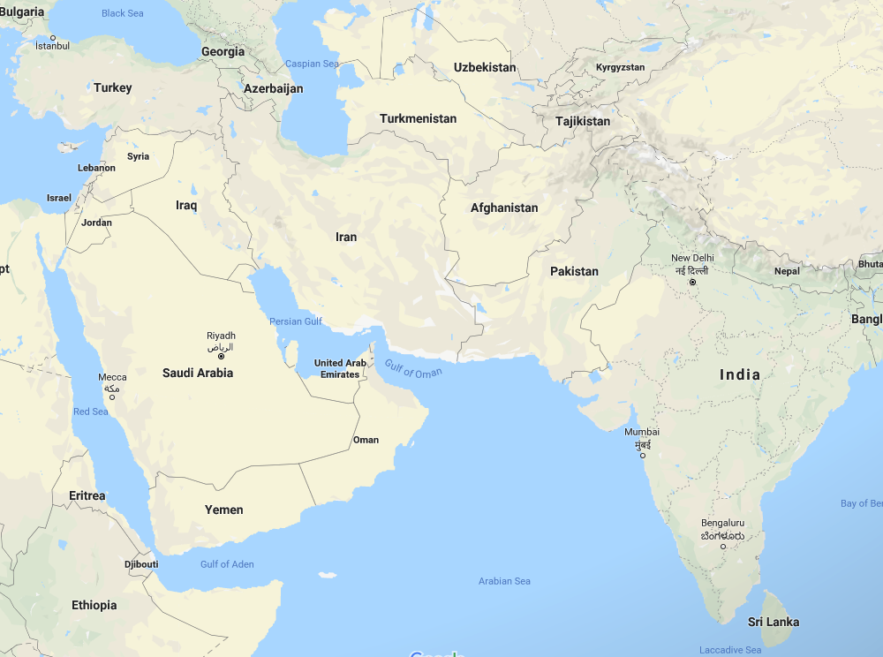
*The Early History of Christianity in the East
Edessa
Arbela
https://en.wikipedia.org/wiki/Sasanian_Empire#/media/File:Indo-Sassanid.jpg

Slide 12
*The Early History of Christianity in the East
By the 4th century Christianity had become well established throughout the Persian Empire.
However, when the conversion of Constantine made Christianity into the favored religion in the Roman Empire, the Persian emperors became suspicious of the political loyalties of their Persian Christian subjects and started to persecute them.
The official religion of Persia was Zoroastrianism, which viewed life as a conflict between two equal and opposite powers of good and evil:
Ormuzd, the Wise Lord
Ahriman, the Persian equivalent of the devil.
Needham, Nick. 2,000 Years of Christ's Power Vol. 1: The Age of the Early Church Fathers

Slide 13
*The Early History of Christianity in the East
Many of these Persian Christians were strongly influenced by an Antiochene theology and had strong leanings towards Nestorianism, in particular.
Which is one reason why in AD 486 a Persian Church council officially adopted a Nestorian statement of faith as the expression of the Persian Church’s Christology.
But perhaps the Persian church’s preference for a Christology viewed as heretical by the Christians in the West was in part motivated by a desire to have a theology of its own, distinct from the Western theology of the Roman empire.
And so the doctrinal rivalry between the Chalcedonian Christology of the Roman Empire and the Nestorian Christology of Persia now mirrored the national rivalry between the two great Empires.
Needham, Nick. 2,000 Years of Christ's Power Vol. 1: The Age of the Early Church Fathers

Slide 14
*The Early History of Christianity in the East
According to a leading scholar on Christianity in the Far East (Dr. Samuel Hugh Moffett), prior to the Arab Islamic invasion in the early seventh century, “Christianity had become, next to Zoroastrianism, the second most powerful religious force in the [Persian] empire.”
The rise of Islam in the early seventh century brought about an interesting mix of circumstances for Nestorians, now living under Islamic rule.
They had worked their way up from a persecuted minority in the Persian Empire to a place of trust and status where many Nestorians held influential positions.
In fact, these Nestorian believers had come to be known for their “learning and skill, especially as: accountants, architects, astronomers, bankers, doctors, merchants, philosophers, scientists, scribes, and teachers.”
The Nestorian Impact on the Islamic World through the Turkic and Mongol Peoples – Jason Connolly

Slide 15
*The Early History of Christianity in the East
When the Arabs came, the Nestorians didn’t immediately lose their status or have to start over again from the bottom. In fact, many Nestorians held positions of power while under Islamic rule.
However, Christians did have a number of restrictions under the Islamic Rule:
They had to pay a special religious tax for not being Muslim
They were restricted from building new churches, displaying the cross in public, and spreading their religion.
But the restriction on spreading Christianity under Islamic rule encouraged many Nestorians to migrate further east.
Even in the midst of these huge changes, the Nestorians seem only to increase their activities to spread Christianity to farther and farther lands and peoples.
The Nestorian Impact on the Islamic World through the Turkic and Mongol Peoples – Jason Connolly

Slide 16
*The Early History of Christianity in the East
And by the late eighth century, a Nestorian patriarch known as Timothy I (AD 779-820), oversaw a greater geographic area than any pope before the discovery of the New World!
At this time, 19 archbishops and 85 bishops represented the church in most of Asia.
Timothy I in writing about the provinces under [his] jurisdiction…spoke of: “the Indians, the Chinese, the Tibetans, [and] the Turks.”
In the early 11th century, one of the largest and most sudden mass movements into the church (reportedly 200,000 at one time) occurred among the Keraits, a Mongol-Turkic nomadic group living on the shores of Lake Baikal in western Mongolia.
The Nestorian Impact on the Islamic World through the Turkic and Mongol Peoples – Jason Connolly

Slide 17
Lake Baikal
https://www.beautifulworld.com/asia/russia/lake-baikal/

Slide 18
*The Early History of Christianity in the East
Some people have speculated that the Turkic conversions to the Church of the East were nominal, at best, but a letter written by a thirteenth century Christian writer who described the Christianity practiced by these Turks would seem to suggest otherwise:
These Christian Turks’…beliefs are orthodox and true like our own.... They believe in one glorious nature in the Holy Trinity... and profess that the Divine Word, one of the three Persons of the Holy Trinity, suffered, died, and was crucified, and by His death and His resurrection He saved us.... In their gatherings they translate the [the Old and New Testaments] into their Turkish language.... They are true believers and God-fearing folk, and they dwell under tents, and have no towns, no villages, and no houses.... These Christian Turks … have from themselves priests, deacons, and monks. They have many places of worship with them in their pavilions, and they ring the bells and read the Books in our Syriac tongue.
The Nestorian Impact on the Islamic World through the Turkic and Mongol Peoples – Jason Connolly

Slide 19
*The Early History of Christianity in the East
There is not enough time to tell about all the Turkic kings who were Nestorians or of all the Turkic cities that had so many Christians they were given bishops or of all the places in Turkic lands where significant Nestorian archeological artifacts have been found (not to mention all the groups whose conversions did not make it into recorded history).
According to a specialist in the history of Iranian civilization (Dr. Richard Foltz), “by the [thirteenth century] Christianity was certainly the most visible of the major religions amongst the [people of central Asia].”
The Nestorian Impact on the Islamic World through the Turkic and Mongol Peoples – Jason Connolly

Slide 20
*The Early History of Christianity in the East
https://www.reddit.com/r/MapPorn/comments/49gk0y/aramaic_language_and_syriac_christianity_in_the/

Slide 21
*The Early History of Christianity in the East
Sadly, after many centuries of remarkable expansion, things took a rather sudden turn for the worst for the Nestorian Christians spread across the vast lands of the East.
According to History and Religious studies professor Mark Dickens:
[Near the end of the thirteen century], the Nestorian Church still looked strong, with 25 [archbishops] and between 200 and 250 bishops in far-flung locations around Asia, including India, Central Asia and China. The patriarch in Baghdad still governed an area that was much larger than that overseen by the Pope. However, the end was near and it was to come swiftly and ultimately with great violence.
The Nestorian Impact on the Islamic World through the Turkic and Mongol Peoples – Jason Connolly

Slide 22
*The Early History of Christianity in the East
With the rise of the Timurid Empire (1370-1405), founded by Timur, a cruel conqueror and ruler who wiped out many entire cities, large numbers of Nestorians in Central Asia and Persia were killed.
Although many Christians died during his reign, it appears that it was under the persecution of his grandson Ulugh Beg (1409-1449) that the largest portion of the remaining Christians in the region were wiped out.
Unfortunately with all of the turmoil and violence of the time, most of the Christian documents were destroyed, and no texts documenting the sequence of events that ultimately stamped out the vast majority of the Church of the East survive today.
The Nestorian Impact on the Islamic World through the Turkic and Mongol Peoples – Jason Connolly

Slide 23
The Fall of Rome
https://www.historyonthenet.com/when-did-the-roman-empire-really-end

Slide 24
https://www.hopehelps.org/volunteer-appreciation-week-2018/

Slide 25
Class Discussion Time
https://www.weareteachers.com/moving-beyond-classroom-discussions/

Slide 26
*Class Discussion Time
Today, the areas of the world where the Gospel spread through the efforts of the early Nestorian Christians in the East are the areas where the fewest Christians live and where the least number of people are showing interest in converting to Christianity, including many of the core areas home to Islam, Buddhism, and Hinduism.
What does this say about the urgency to pass the gospel on to the next generation – even, or perhaps especially, in cultures where the gospel currently has a strong influence?
Historically, political circumstances have often lead to large swaths of society embracing Christianity at a nominal level.
While in one sense we would like for everyone who claims to be a Christian to actually be one, given that there will always be a sizable portion of any society that does not have a genuine Christian faith, which situation do you think best serves the advance of the gospel in a society:
Most unbelieving members of that society are nominal Christians who are familiar with and friendly towards Christianity?
Most unbelieving members of society are openly non-Christian or perhaps even anti-Christian?

