Slide 2
Review
How did Gregory feel about his role as pope as compared to his role as the abbot of a monastery?
Gregory often longed for the days when he had lived in a monastery. He felt his mind was “defiled with the mud of daily affairs” and that he was often wasting his time in “attending to the worldly business of countless people”.
What unique role did Pope Gregory play when the Lombards invaded Italy and surrounded Rome, threatening to invade it?
Gregory made treaties of his own with the Lombard invaders, and was thus instrumental in bringing peace to Italy.
Give a paraphrase of Gregory’s response to the Byzantine emperor Maurice officially bestowing on John Faster of Constantinople the title “universal” patriarch – the spiritual leader of all Christians.
“Whoever calls himself universal priest, or desires that title, is by his pride the forerunner of Antichrist.”

Slide 3
Review
Gregory taught that all human beings are born sinful, and that Christ alone by His sovereign grace can rescue sinners from their bondage to sin.
And yet he also taught some other things concerning baptism and “holy communion” that would seem to conflict with salvation by Christ alone. What role did Gregory teach that baptism and communion played in our salvation?
That salvation comes through baptism, in which the Holy Spirit causes the sinner (including the new-born baby) to be spiritually reborn.
For believers, “holy communion” had the power to wash away postbaptismal sin.
What did Gregory teach would happen to Christians who died with sins that had not been “dealt with”?
They must pay for those sins by suffering in purgatory, a place of purifying fire midway between heaven and hell
What statement is Gregory known to have made that contradicts the modern Roman Catholic belief that the apocryphal books are part of the canon of scripture?
That the Apocryphal Book of First Maccabees was not canonical.

Slide 4
The Celtic Church and the Conversion of the English
https://www.ricksteves.com/europe/scotland/oban-mull-iona

Slide 5
The Conversion of the English
Gregory the Great was deeply committed to evangelizing the Germanic tribes who were still Pagan.
His greatest concern was for the tribes that had conquered southern Britain – the Angles, Saxons and Jutes.
Tradition says that while Gregory was still a monk, he saw some boys being sold in the slave market in Rome.
He asked who they were, and was told that they were Pagan Angles.
Struck by the boys’ great physical loveliness, Gregory replied, “They are not Angles but angels!”
*Needham, Nick. 2,000 Years of Christ's Power Vol. 1: The Age of the Early Church Fathers

Slide 6
The Conversion of the English
When he became pope, Gregory prepared a great mission to England (“England” comes from “Angle-land” – the part of Britain conquered by the Angles, Saxons and Jutes).
He gathered religious and political information, and decided that the kingdom of the Jutes in Kent (south-eastern England) was the best place to begin.
The Pagan king of Kent, Ethelbert (589-616), had extended his power over the whole of eastern England.
Moreover, he had married a Frankish Catholic princess, Bertha, who had brought a Frankish bishop with her to England.
*Needham, Nick. 2,000 Years of Christ's Power Vol. 1: The Age of the Early Church Fathers

Slide 7
The Conversion of the English
So in AD 596 Gregory sent a team of Benedictine monks, led by an Italian abbot named Augustine, to king Ethelbert and the Jutes in Kent.
We must not confuse this Augustine with Augustine of Hippo, who died in AD 430. The Augustine who went to England lived 100 years later, and later came to be known as Augustine of Canterbury
Augustine humbly and faithfully served pope Gregory, but was tactless and high-handed towards everyone else.
*Needham, Nick. 2,000 Years of Christ's Power Vol. 1: The Age of the Early Church Fathers

Slide 8
The Conversion of the English
Augustine and his monks did not exactly relish their mission; in fact, they were so afraid of what the Jutes might do to them, that their spirits failed and they turned back at one point on their journey – pope Gregory had to use all his powers of persuasion to inspire them to continue.
They finally arrived in Kent just after Easter in AD 597. Their fears proved groundless; king Ethelbert welcomed them, giving them liberty to preach throughout his kingdom.
The Pagan monarch was impressed by the beauty and majesty of their worship, and their simple ascetic lives.
*Needham, Nick. 2,000 Years of Christ's Power Vol. 1: The Age of the Early Church Fathers

Slide 9
The Celtic Church
At the time pope Gregory sent Augustine and his Roman missionaries to Kent in southern England, a strong and vibrant Celtic Church already existed in Ireland, Scotland, Wales and the north of England.
Many Celtic Christians, however, did not look with favor on pope Gregory’s mission to the Angles, Saxons and Jutes.
There had been 150 years of warfare in Britain between the native Christian Celts and the invading Pagan Angles, Saxons and Jutes.
These wars had forced the British Celts out of most of their homeland.
Most of the British Celts now found it very difficult to look upon their traditional enemies, the Angles, Saxons and Jutes, as brothers in Christ.
*Needham, Nick. 2,000 Years of Christ's Power Vol. 1: The Age of the Early Church Fathers

Slide 10
The Celtic Church
Furthermore, the Celtic Christians did not like some of the religious beliefs and customs of Augustine and the Roman missionaries.
They did not share Augustine’s views of the papacy’s authority, as patriarch of the West, to determine Western forms of worship and Church organization.
And they certainly did not see why they should accept Augustine as their archbishop when they already had their own bishops.
They were deeply offended by Augustine’s rather clumsy attempt to force them to celebrate Easter according to the date used by the rest of the Church in both East and West (the Celts calculated the date differently).
*Needham, Nick. 2,000 Years of Christ's Power Vol. 1: The Age of the Early Church Fathers

Slide 11
The Celtic Church
Another problem arose from the fact that, in the Celtic Church, the abbot was a more powerful figure than the bishop, and bishops had no fixed dioceses but travelled about as the Spirit or their own inclinations led them.
This conflicted with the normal Catholic tradition, where the bishop was superior to the abbot and (usually) confined his ministry to his own diocese.
Finally, when a Christian became a monk, it was the custom to give him a “tonsure”, a special way of shaving hair from the top of the head; the Celts gave their monks a semi-circular tonsure, while the Roman tonsure was fully circular – and this became another cause of contention.
*Needham, Nick. 2,000 Years of Christ's Power Vol. 1: The Age of the Early Church Fathers

Slide 12
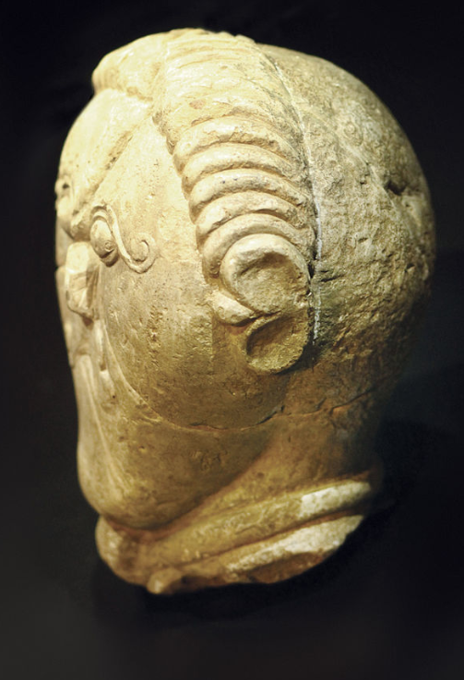
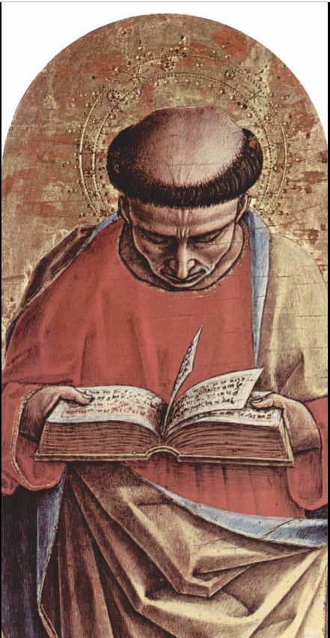
The Celtic Church
Celtic Tonsure
Roman Catholic
Tonsure
https://en.wikipedia.org/wiki/Tonsure

Slide 13
The Celtic Church
Modern Protestants sometimes think that this conflict between Celtic and Roman practice was a battle between “Protestant-minded” Celts and Roman Catholicism, but this was not really the case.
In the main point of the dispute – the date of Easter – Rome was simply championing the custom observed by the whole of the Church throughout East and West, with the Celts alone being out of step.
Furthermore, “Roman Catholicism”, as the Protestant Reformers knew it, did not begin to take solid shape until the great reform movement of Hildebrand (pope Gregory VII) in the 11th century.
*Needham, Nick. 2,000 Years of Christ's Power Vol. 1: The Age of the Early Church Fathers

Slide 14
The Celtic Church
It is historically inaccurate to speak of Roman Catholicism until the great East–West schism of 1054; prior to this, all Christians in East and West were one united Church, and did not collectively acknowledge the supremacy of the pope (as the Eastern Orthodox still do not).
The theology and spirituality of Western Catholicism in the 6th century were certainly not Protestant, but neither were they “Roman Catholic”.
Gregory the Great’s Church had no indulgences, no doctrine of icon-veneration or transubstantiation, no “vicar of Christ” claims for the popes, and no “immaculate conception” claims for Mary – these and other novelties emerged long after the 6th century
*Needham, Nick. 2,000 Years of Christ's Power Vol. 1: The Age of the Early Church Fathers

Slide 15
The Celtic Church
We must also realize that the authority claimed by Gregory the Great over the Celts was not papal authority as Protestants would understand the term. It was patriarchal authority.
Gregory claimed to be the patriarch of the Western Church.
There were four other patriarchs in the East, in Constantinople, Alexandria, Antioch and Jerusalem, each with their own territories.
The whole Church was supposed to be governed jointly by the five patriarchs.
If anyone in any of the other patriarchal jurisdictions had tried to celebrate Easter on a different date, they would have been dealt with by their patriarchs as Gregory dealt with the Celts.
*Needham, Nick. 2,000 Years of Christ's Power Vol. 1: The Age of the Early Church Fathers

Slide 16
The Celtic Church
Finally, it is difficult to think of the Celts as “Protestant-minded” when the argument they employed to oppose the authority-claims of Rome was not the sufficiency of Scripture. It was the authority of a different tradition.
For the date of Easter, the Celts took their stand on the authority of the holy Columba, and ultimately on an unwritten tradition which they claimed had been handed down from the apostle John.
It is also worth bearing in mind that the very unProtestant practice of monasticism dominated the entire Celtic form of Christianity, more than any other branch of the Church in history.
*Needham, Nick. 2,000 Years of Christ's Power Vol. 1: The Age of the Early Church Fathers

Slide 17
The Merging of Celts and Catholics
Both Celtic and Roman missionaries continued converting the other Anglo- Saxon kingdoms throughout England one by one, until by AD 681 Christianity had replaced Paganism as the national faith of the English people.
The first archbishop of Canterbury whose position both Roman and Celtic Christians in England recognized was Theodore (AD 668-90), a Greek monk from Tarsus.
*Needham, Nick. 2,000 Years of Christ's Power Vol. 1: The Age of the Early Church Fathers

Slide 18
The Merging of Celts and Catholics
Theodore did much to unite the Celtic and Anglo-Saxon forms of Christianity.
He did this in two ways:
By taking parts of each and blending them in the English Church – e.g. in the monasteries, combining Rome’s Benedictine rule with the Celtic monastic practice of private confession of sins to a presbyter;
By putting Celtic as well as Anglo-Saxon churchmen in leading positions.
Christian art, literature, biblical studies and missionary work flourished with amazing vigor in the monasteries of the new united English Church.
*Needham, Nick. 2,000 Years of Christ's Power Vol. 1: The Age of the Early Church Fathers

Slide 19
The Venerable Bede
https://en.wikipedia.org/wiki/Bede

Slide 20
The Venerable Bede
The most famous monastic center of learning in the English Church was the Benedictine monastery at Jarrow where a presbyter/monk called Bede (AD 673-735) earned the title “the father of English history”.
Bede wrote a complete history of the Church in England up to his own time, Church History of the English People, which is our main source of information about the Christian faith in England from its origins until the 8th century.
*Needham, Nick. 2,000 Years of Christ's Power Vol. 1: The Age of the Early Church Fathers

Slide 21
The Venerable Bede
Bede was one of the most highly educated Western Europeans of his day.
He knew all three of the Church’s great languages, Latin, Greek and Hebrew (a rare achievement for any Westerner at that time).
A dedicated follower of Augustine of Hippo, Bede was also well-versed in the writings of other early Church fathers, especially Ambrose, Jerome, and Gregory the Great, and in the ancient Pagan literature of Greece and Rome.
*Needham, Nick. 2,000 Years of Christ's Power Vol. 1: The Age of the Early Church Fathers

Slide 22
The Venerable Bede
In addition to his English Church history, Bede wrote many sermons, biographies, letters, poems, and commentaries on books of the Bible, and translated John’s Gospel into English.
Bede’s humble and holy character have made him one of the best-loved of English saints, among Roman Catholics, Protestants and Eastern Orthodox alike.
*Needham, Nick. 2,000 Years of Christ's Power Vol. 1: The Age of the Early Church Fathers

Slide 23
The Venerable Bede
The account of his death was a favorite story among English Christians, and his dying words were written down and treasured:
“The time of my release is near, and my soul longs to see Christ my King in all His beauty; I am not afraid to die, for we have a God who is good beyond comparison.”
From the 10th century onwards, people referred to him as the Venerable Bede (“venerable” means “worthy of veneration”).
*Needham, Nick. 2,000 Years of Christ's Power Vol. 1: The Age of the Early Church Fathers

Slide 24
The Rise of Islam
https://www.freepik.com/free-vector/mosque-silhouette-night-sky-with-crescent-moon-stars_870865.htm

Slide 25
https://www.hopehelps.org/volunteer-appreciation-week-2018/

Slide 26
Class Discussion Time
https://www.weareteachers.com/moving-beyond-classroom-discussions/

Slide 27
*Class Discussion Time
Before Gregory sent missionaries into England he did research to determine what would be the best way to strategically approach sending missions into the area. Do you think this is a good idea? Do you see this kind of research as incompatible with allowing the Spirit to direct our missions efforts?
Augustine feared the worst in leading an effort to evangelize the English, perhaps because they were known to be fierce and brutal warriors. His fears proved to be without merit. Can you think of a time in your Christian life when you did something that you thought you should do, but were afraid to do it? How did it turn out?
We looked at two groups today (the Celts and the English) who were hostile to each other to a point that, even after both groups had been converted, they had difficulty accepting each other and working together as brothers in Christ. Do we see conflicts like this occurring in our day?
Do you have a topic or question that you would like to see us to discuss?

