Slide 2
Review
Muslim rulers did not attempt to force Jews or Christians to convert to Islam. They were allowed to continue worshipping God in their own way.
BUT, what restrictions did Muslims place on Christians living under their “protection”?
Christians in the Islamic Empire became segregated communities of second-class citizens.
Christians had to pay a heavy poll tax.
Christians had to wear distinctive clothing.
They were forbidden to own or use swords or horses.
No public processions carrying crosses or icons were allowed.
Christians were not permitted to ring bells or beat drums to announce services of worship.
Islamic law prohibited Christians from evangelizing Muslims; conversion from Islam to Christianity was punished by death.

Slide 3
The Frankish Monarchs
https://dailygeekshow.com/rois-reines-france-anecdotes/

Slide 4
The Frankish Monarchs
Clovis
Invaded Gaul in the late 400s. He founded the Merovingian dynasty or the kingdom of the Franks.
Clovis’ wife Clotilda converted to Christianity and Clovis followed her in AD 496.
He divided his kingdom among his three inept sons.
Pepin of Herstal
He was the mayor of the palace and took advantage of the fact that Clovis’ sons were incompetent.
He became the founder of the Carolingian dynasty.
* James White – 2016 Church History Series #42 – Expansion of the Western Church

Slide 5
The Frankish Monarchs
Pepin and his Carolingian successors launched a campaign to restore the prestige and authority of the Merovingian monarchy, but only because it increased their own power as mayors of the palace.
Part of their strategy for expanding royal authority was the Christianizing of the still Pagan tribes in the Netherlands and Germany.
The Carolingians reasoned that Christian tribes would be less troublesome and rebellious than Pagan ones.
If they embraced the Catholic faith, the Germans would come under the authority of a great spiritual organization which had no local or tribal loyalties; and the Carolingians could then control the Germans through the Church – by putting the right men in positions of power as bishops.
* Needham, Nick. 2,000 Years of Christ's Power Vol. 2: The Middle Ages

Slide 6
The Frankish Monarchs
In pursuit of this policy, the Carolingian mayors, gave strong support to a new wave of English missionaries to Germany.
This was particularly true of Pepin’s illegitimate son, Charles Martel (AD 690-741).
This is the same Charles Martel who defeated the Muslims at the battle of Tours.
* Needham, Nick. 2,000 Years of Christ's Power Vol. 2: The Middle Ages

Slide 7
The English Missionaries
https://www.hinduhumanrights.info/the-saint-who-chopped-down-thors-sacred-tree/#!prettyPhoto/0/

Slide 8
The Eighth Century English Missionaries
Willibrord (AD 658-740)
Was from the northern Angle kingdom of Northumbria.
Brought up from childhood in the monastery at Ripon, Willibrord then spent 12 years as a student in Ireland.
* Needham, Nick. 2,000 Years of Christ's Power Vol. 2: The Middle Ages

Slide 9
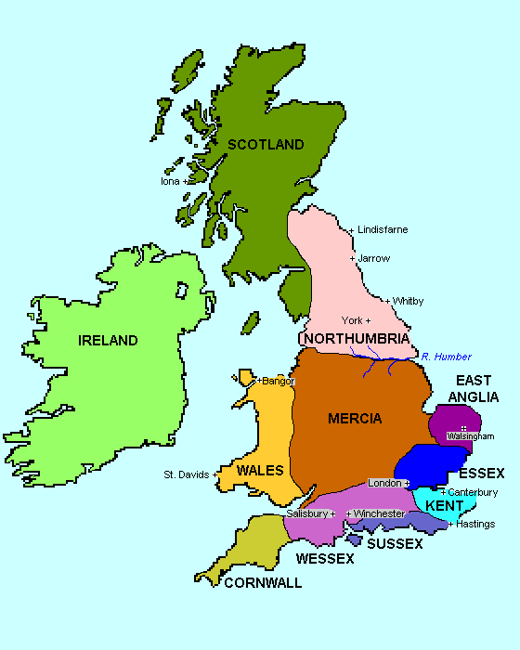
Britain AD 500-700
Ripon
Monastery
http://www.drshirley.org/geog/geog25.html

Slide 10
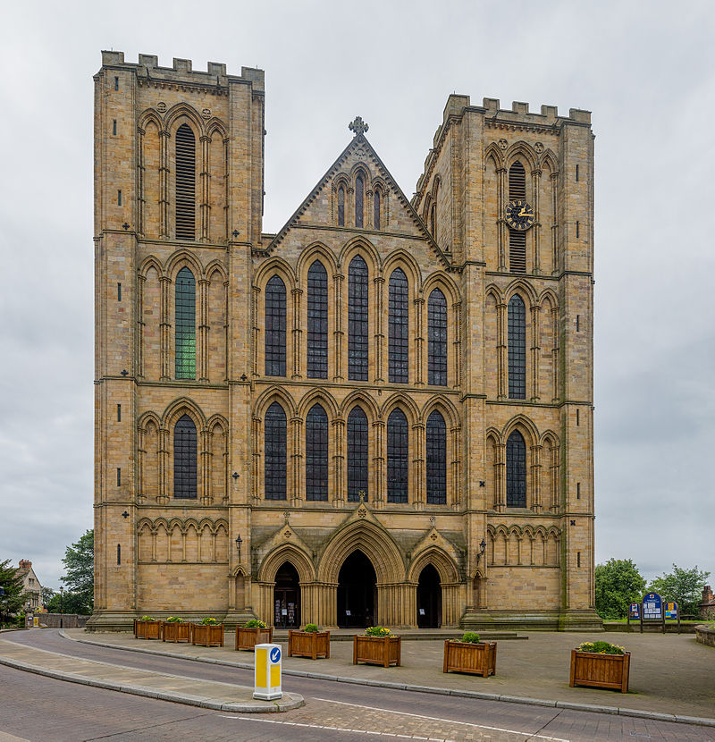
Ripon Cathedral (Today)
https://en.wikipedia.org/wiki/Ripon_Cathedral#/media/File:Ripon_Cathedral_Exterior,_Nth_Yorkshire,_UK_-_Diliff.jpg

Slide 11
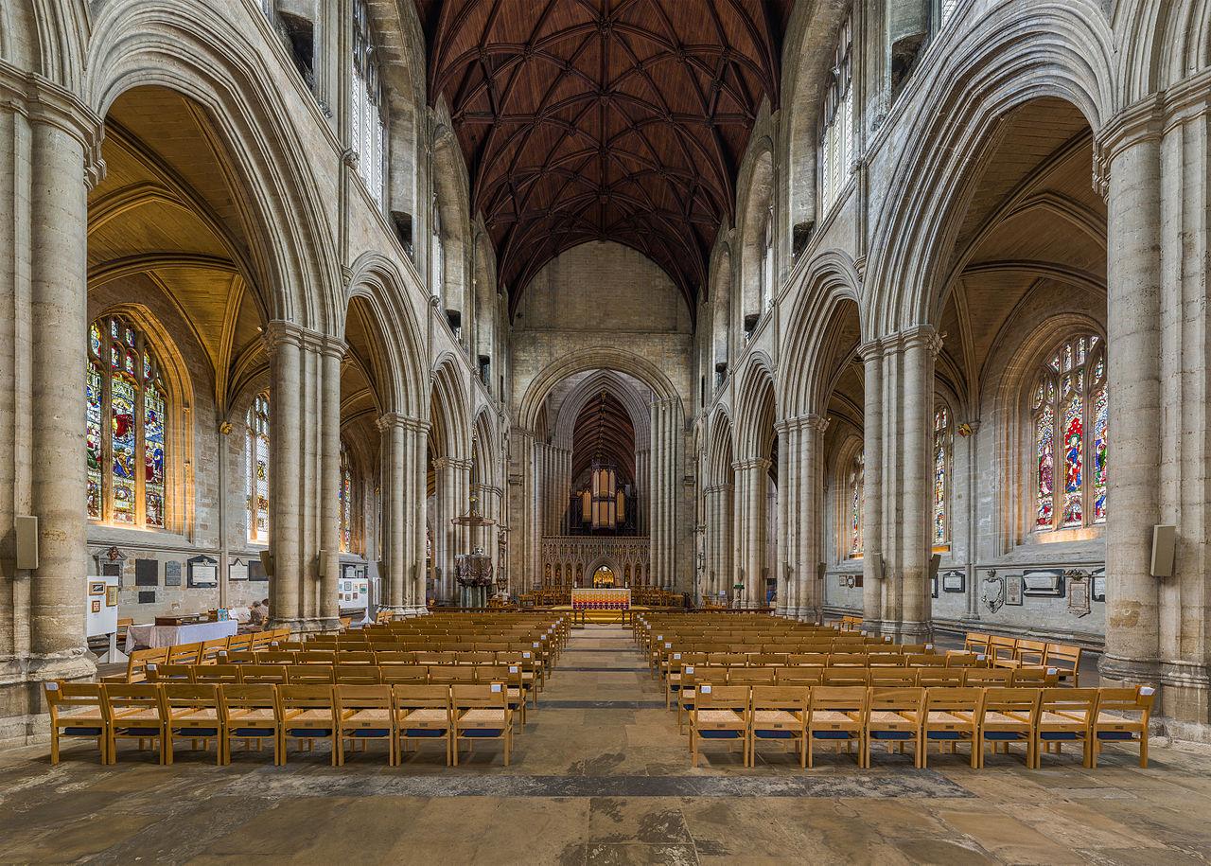
Ripon Cathedral (Today)
https://en.wikipedia.org/wiki/Ripon_Cathedral#/media/File:Ripon_Cathedral_Nave_1,_Nth_Yorkshire,_UK_-_Diliff.jpg

Slide 12
The Eighth Century English Missionaries
Willibrord (AD 658-740)
Was from the northern Angle kingdom of Northumbria.
Brought up from childhood in the monastery at Ripon, Willibrord then spent 12 years as a student in Ireland.
In AD 690, Willibrord journeyed to the Netherlands as the leader of 12 Irish missionaries, according to the traditional Irish practice of sending out mission teams in groups of 13.
Willibrord and his companions worked for 50 years in the Netherlands among the southern Frisian tribes; their preaching largely brought about the conversion of the Frisians to Christianity.
* Needham, Nick. 2,000 Years of Christ's Power Vol. 2: The Middle Ages

Slide 13
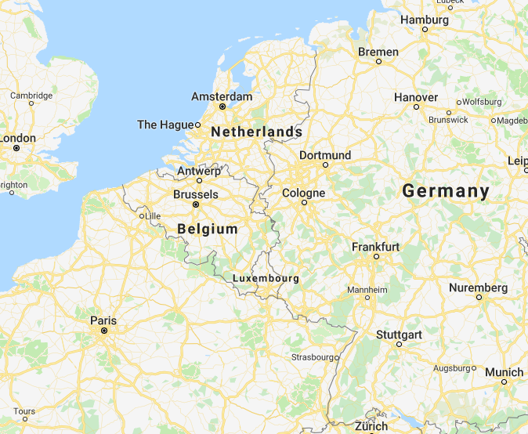
Modern Germany
Google Maps

Slide 14
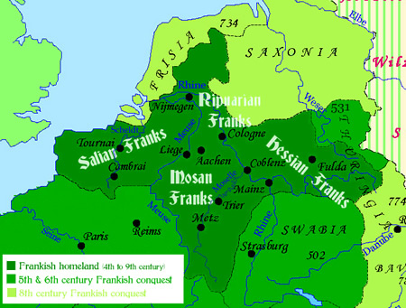
Frankish Empire Fourth to the Ninth Century
Ripon
Monastery
http://epicworldhistory.blogspot.com/2013/10/frankish-tribe.html

Slide 15
The Eighth Century English Missionaries
Boniface (658-754)
The most famous British missionary of the Middle Ages was Winfrid, better known as Boniface (“doer of good”).
Born in the Anglo Saxon kingdom of Wessex, Boniface was commissioned by Pope Gregory II in AD 729 to evangelize Germany.
Shelley, Dr. Bruce L.. Church History in Plain Language: Fourth Edition (p. 162-169)

Slide 16
Britain AD 500-700
Ripon
Monastery
http://www.drshirley.org/geog/geog25.html

Slide 17
The Eighth Century English Missionaries
Boniface (658-754)
The most famous British missionary of the Middle Ages was Winfrid, better known as Boniface (“doer of good”).
Born in the Anglo Saxon kingdom of Wessex, Boniface was commissioned by Pope Gregory II in AD 729 to evangelize Germany.
His primary task was to convert the pagan population, and in this he had great success.
The most famous incident was when Boniface marched into a shrine in Germany, the sacred forest of Thor, the god of thunder. The cult object was a massive oak.
Boniface, so the story goes, took an axe to it. Just as he leveled the first stroke, a mighty breath of wind from God toppled the tree. The pagans marveled and were converted.
Boniface then used the wood to build a chapel to St. Peter.
Shelley, Dr. Bruce L.. Church History in Plain Language: Fourth Edition (p. 162-169)

Slide 18
The Eighth Century English Missionaries
Boniface was deeply devoted to the cause.
He could not only chop down a sacred tree while the shuddering multitude watched, expecting to see him struck dead by fire from heaven; he could also win the masses to the faith and leave behind him a church that was firmly bound to the central authority at Rome.
Boniface became archbishop of Mainz and would have ended his splendid career there in peace if final qualms about the failure of his early efforts in Frisia (the Netherlands) had not drawn him back to that still pagan field.
There he sealed his faith with martyrdom.
Shelley, Dr. Bruce L.. Church History in Plain Language: Fourth Edition (p. 169-170)

Slide 19
The Eighth Century English Missionaries
Boniface at first worked (AD 715 onwards) alongside Willibrord among the Frisians, and then in AD 718 began a new work among the Hessians and Thuringians of central Germany.
Needham, Nick. 2,000 Years of Christ's Power Vol. 2: The Middle Ages

Slide 20
Frankish Empire Fourth to the Ninth Century
Ripon
Monastery
http://epicworldhistory.blogspot.com/2013/10/frankish-tribe.html

Slide 21
The Eighth Century English Missionaries
Boniface at first worked (AD 715 onwards) alongside Willibrord among the Frisians, and then in AD 718 began a new work among the Hessians and Thuringians of central Germany.
He established many monastic communities, including the famous abbey of Fulda in the central German state of Franconia; for 300 years after his death, Boniface’s monasteries (especially Fulda) were the life-giving centers of religion and culture in Germany.
Needham, Nick. 2,000 Years of Christ's Power Vol. 2: The Middle Ages

Slide 22
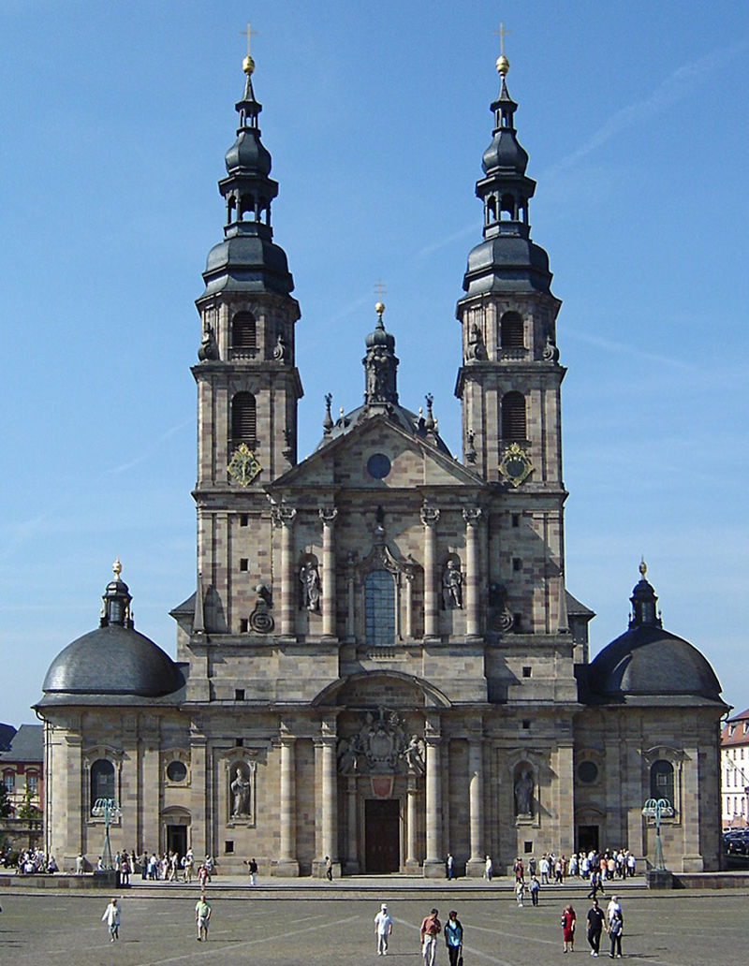
Fulda Cathedral (Today)
https://en.wikipedia.org/wiki/Fulda_Cathedral#/media/File:Fuldaer_Dom_028a.jpg

Slide 23
The Eighth Century English Missionaries
Boniface at first worked (AD 715 onwards) alongside Willibrord among the Frisians, and then in AD 718 began a new work among the Hessians and Thuringians of central Germany.
He established many monastic communities, including the famous abbey of Fulda in the central German state of Franconia; for 300 years after his death, Boniface’s monasteries (especially Fulda) were the life-giving centers of religion and culture in Germany.
In all his missionary labors, Boniface received strong support from the papacy, and he in turn upheld papal authority wherever he preached.
Pope Zacharias (AD 741-52) eventually appointed Boniface Archbishop of Mainz (western-central Germany) in AD 743, with a huge diocese stretching from Cologne in the north to Strasbourg in the south.
Needham, Nick. 2,000 Years of Christ's Power Vol. 2: The Middle Ages

Slide 24
Frankish Empire Fourth to the Ninth Century
Ripon
Monastery
http://epicworldhistory.blogspot.com/2013/10/frankish-tribe.html

Slide 25
The Eighth Century English Missionaries
The Church awarded Boniface the honorary title of “apostle of the Germans”; his decades of missionary enterprise brought large parts of Germany out of Paganism into the brighter world of Christendom.
As we have seen, both the papacy and Charles Martel in France gave powerful backing to the missionary work of Willibrord and Boniface.
This religious alliance between the Carolingians and the papacy grew stronger after Charles Martel’s death in AD 741 and the accession of his sons Carloman and Pepin the Short to power.
Carloman and Pepin the Short also invited Boniface to help them reform the Frankish Church.
Since Boniface acted as the pope’s representative, these reforms strengthened the bond between France and the papacy – a bond which was soon to have serious and lasting consequences.
Needham, Nick. 2,000 Years of Christ's Power Vol. 2: The Middle Ages

Slide 26
The Eighth Century English Missionaries
Carloman became a monk after Boniface’s reforms were completed, leaving his brother Pepin as sole ruler of the Franks.
But in theory, Pepin was still only the mayor of the palace, the chief servant of Childeric III, last of the feeble Merovingian kings.
The fires of ambition danced in Pepin’s heart; he felt that he, the real ruler of France, should wear its royal crown.
So Pepin obtained the support of Pope Zacharias, and in AD 751 deposed Childeric, who retired into a monastery.
Needham, Nick. 2,000 Years of Christ's Power Vol. 2: The Middle Ages

Slide 27
The Eighth Century English Missionaries
Then Boniface, again acting in the pope’s name, crowned Pepin king of the Franks – the first of the great Carolingian royal dynasty.
This was the first time a pope had claimed that his apostolic authority involved the right to sanction the dethroning of one king and his replacement by another.
This meant that the new royal family in France owed its legal authority to the papacy.
Political motives inspired the action of Pope Zacharias in crowning Pepin: Zacharias wanted military allies against the Lombards in Italy.
Needham, Nick. 2,000 Years of Christ's Power Vol. 2: The Middle Ages

Slide 28
Charlemagne
https://en.wikipedia.org/wiki/Charlemagne#/media/File:Charlemagne_Agostino_Cornacchini_Vatican_2.jpg

Slide 29
https://www.hopehelps.org/volunteer-appreciation-week-2018/

Slide 30
Class Discussion Time
https://www.weareteachers.com/moving-beyond-classroom-discussions/

Slide 31
*Class Discussion Time
We have seen where the Carolingians were motivated to encourage the evangelization of pagan Germany because they thought it would make it easier to control the people living there.
We could wish that their motive would have been their love and concern for the German people. But that aside, is there any sense in which, in the providence of God this is a good thing?
As you ponder the above question, consider this verse of scripture:
It is true that some preach Christ out of envy and rivalry, but others out of goodwill. The latter do so in love, knowing that I am put here for the defense of the gospel. The former preach Christ out of selfish ambition, not sincerely, supposing that they can stir up trouble for me while I am in chains. But what does it matter? The important thing is that in every way, whether from false motives or true, Christ is preached. And because of this I rejoice. Yes, and I will continue to rejoice. (Philippians 1:15-18 NIV)
Boniface has sometimes been criticized by later historians for the “insensitivity” that he showed the German pagans when he chopped down a tree that they considered sacred. What do you think of Boniface’s methods?
Do you have a topic or question that you would like to see us to discuss?

