Slide 2
Review
What motivated Pepin and his Carolingian successors to evangelize the still Pagan tribes in the Netherlands and Germany?
The Carolingians reasoned that Christian tribes would be less troublesome and rebellious than Pagan ones.
Where did the missionaries that the Carolingians called upon to evangelize Pagan tribes in the Netherlands and Germany come from?
England
Who was the Carolingian monarch from whom the Carolingians derived their name and for what other great act was he famous?
Charles Martel (“The Hammer”) who defeated the Muslims at the battle of Tours.

Slide 3
Review
The most famous British missionary of the Middle Ages was Winfrid, but he was better known for his Latin name – what was that name and what does it literally mean in Latin?
Boniface – Doer of Good
Describe the most famous incident that Boniface is known for?
Boniface took an axe to a tree in the sacred German forest of Thor. Just as he leveled the first stroke, a mighty breath of wind from God toppled the tree. The pagans marveled and were converted.
Who was it that acted on the pope’s behalf the first time a pope had claimed that his apostolic authority involved the right to sanction the dethroning of one king and his replacement by another?
Boniface
Whom did he crown and what did declare him to be as he crowned him?
Pepin the Short, King of the Franks

Slide 4
Charlemagne
https://en.wikipedia.org/wiki/Charlemagne#/media/File:Charlemagne_Agostino_Cornacchini_Vatican_2.jpg

Slide 5
Charlemagne – AD 742-814
Had long white hair from his youth (like one of the elves in Lord of the Rings) and was seven feet tall, a tremendous athlete, very pious, quite a scholar, loved literature.
His capital city was Aachen. He doubled the size of his kingdom during his reign.
He helped the pope by driving the Lombards out of Italy in AD 800. As a result, the pope crowned Charlemagne, “Emperor of the Romans”.
He was so popular; they thought no one could replace him. When he died they left his body on the throne for 100 years.
He introduced the Carolingian Renaissance, a period of energetic cultural and intellectual activity within the Western Church.
* James White – 2016 Church History Series #42 – Expansion of the Western Church

Slide 6
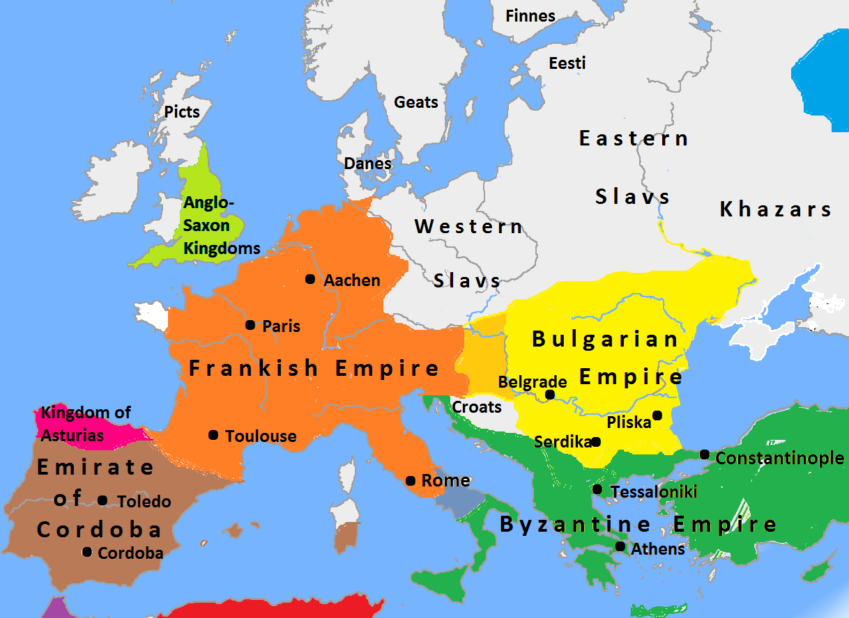
Europe in AD 814
Ripon
Monastery
https://en.wikipedia.org/wiki/Charlemagne#/media/File:Europe_in_814,_Charlemagne,_Krum,_Nicephorus_I.png

Slide 7
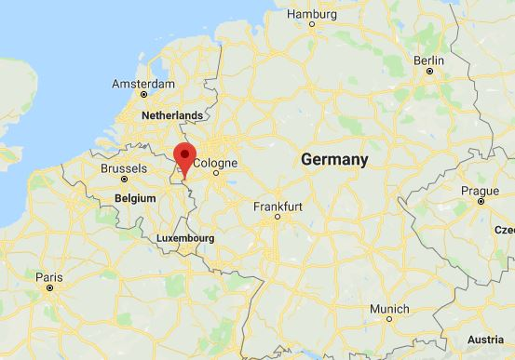
Modern Map - Aachen
Aachen
Google Maps

Slide 8
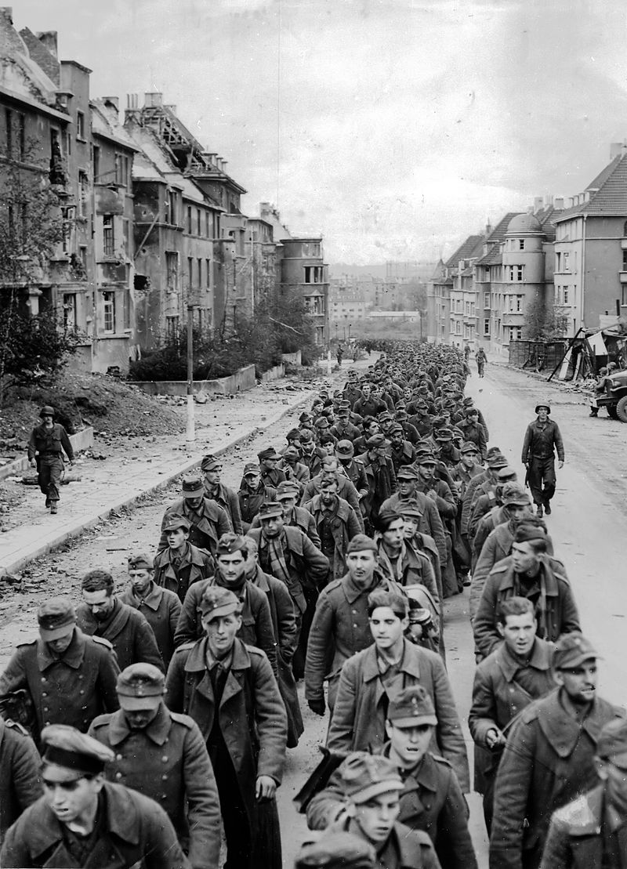
German Prisoners in Aachen - 1944
https://en.wikipedia.org/wiki/Aachen#/media/File:Kriegsgefangene_in_Aachen_(1944).jpg

Slide 9
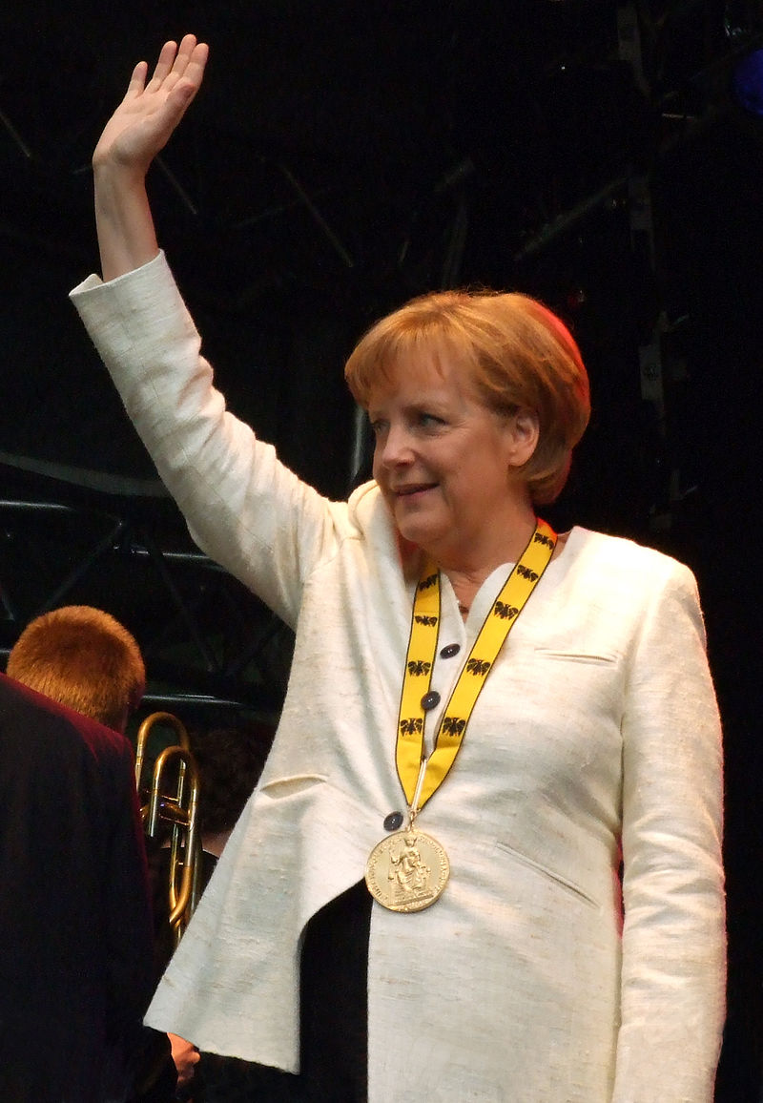
Chancellor of Germany Angela Merkel, wearing the Charlemagne Prize awarded to her in Aachen in 2008
https://en.wikipedia.org/wiki/Aachen#/media/File:Angela_Merkel,_Karlspreisverleihung_2008_-_1.jpg

Slide 10
Charlemagne
When Pepin the Short died in AD 768, his two sons Charles and Carloman succeeded him as joint rulers of France.
Carloman died in AD 771, leaving Charles as sole ruler. He reigned for the next 43 years (AD 771-814) and created the first great Western empire since the fall of Rome in AD 410.
He is called “Charles the Great” or Charlemagne (from the Latin magnus, “great”).
Charlemagne is one of the truly colossal figures of European history.
He has been called the “Moses of the Middle Ages”, because he led the Germanic peoples out of the wilderness of barbarism and gave them a new code of civil and ecclesiastical laws.
Needham, Nick. 2,000 Years of Christ's Power Vol. 2: The Middle Ages

Slide 11
Charlemagne
Medieval Churchmen often compared Charlemagne with Constantine the Great, because the illustrious Frankish king recreated the Western Roman Empire on a Christian basis.
His biographer tells us that Charlemagne was a physical giant of a man, with enough strength and energy for a dozen ordinary mortals; sober and simple in his private life, he was a just and generous ruler, an affectionate father, unswervingly loyal to his friends, and highly popular with his subjects.
He had a keen probing mind, a sincere devotion to the Christian faith and the Catholic Church, and a burning sense of personal mission from God to unite the Western nations under a Christian empire.
The only real fault in Charlemagne’s character was his imperfect standard of sexual conduct: he married and divorced several wives at will, and after the death of his fifth wife he took a number of concubines.
Needham, Nick. 2,000 Years of Christ's Power Vol. 2: The Middle Ages

Slide 12
Charlemagne’s Military Campaigns
https://en.wikipedia.org/wiki/Charlemagne#/media/File:Charlemagne_Notre_Dame_02.jpg

Slide 13
Charlemagne’s Military Campaigns
Charlemagne spent most of his long reign fighting wars. A brave warrior and an outstanding general, his armies only ever suffered defeat in battle one time.
His first great campaign was against the Lombards in Italy. Pope Adrian I (AD 772-95) appealed to Charlemagne to rescue him from the Lombards who were again threatening papal territory.
Charlemagne invaded Italy, conquered the Lombard kingdom and made himself king of Lombardy, thus adding northern Italy to his empire.
He fought the Muslims in Spain and brought the Spanish borderlands as far as Barcelona under his control.
He also carried out many campaigns on the German frontier, annexing Bavaria, and breaking the power of the Pagan Avars in the Danube valley (modern Hungary).
Needham, Nick. 2,000 Years of Christ's Power Vol. 2: The Middle Ages

Slide 14
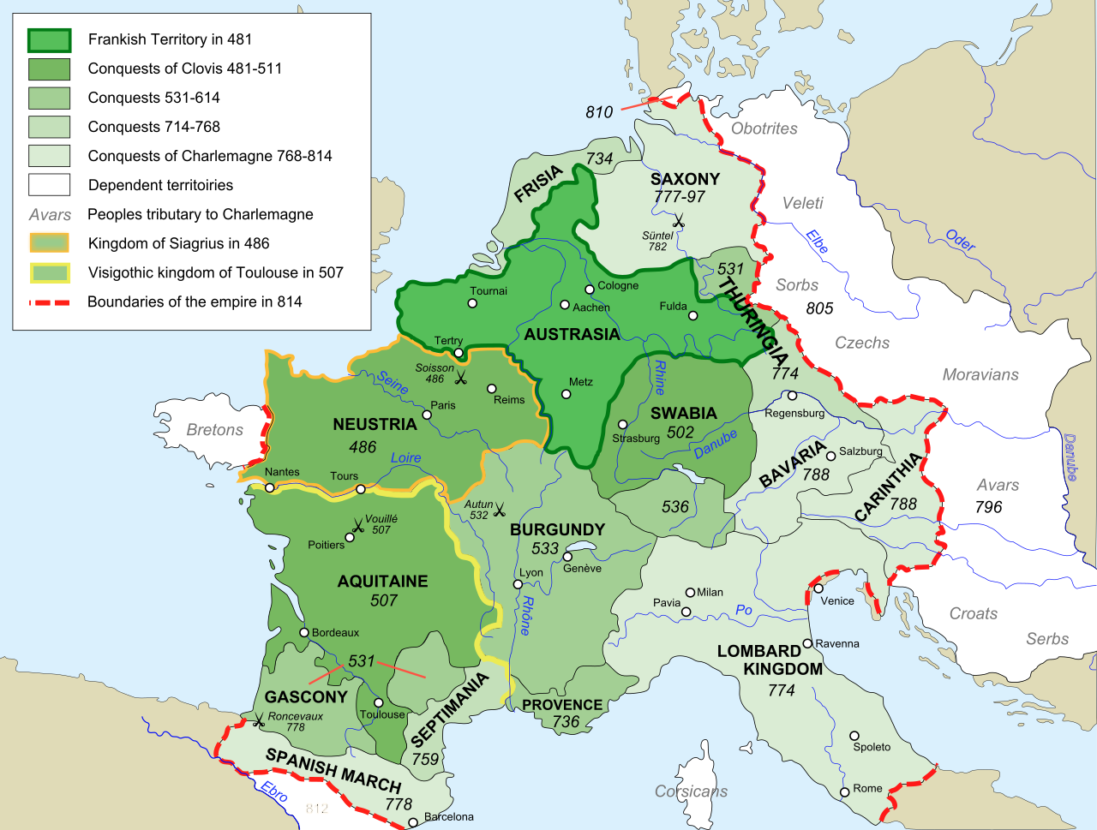
Frankish Empire AD 481-814
Ripon
Monastery
https://en.wikipedia.org/wiki/Charlemagne#/media/File:Frankish_Empire_481_to_814-en.svg

Slide 15
Charlemagne’s Military Campaigns
Charlemagne’s longest war was against the Pagan Saxons, which required 18 savage campaigns and occupied over 30 years of his reign.
He eventually crushed Saxon resistance through a policy of forcibly resettling large groups of Saxons in other parts of the Carolingian kingdom, and compelling them to choose between accepting Christian baptism and being put to death.
This forced conversion of the Saxons aroused protests from some leading Christians, e.g. Charlemagne’s chief religious advisor, Alcuin of York (AD 730-804).
Alcuin said: “Faith is a free act of the will, not a forced act. We must appeal to the conscience, not compel it by violence. You can force people to be baptized, but you cannot force them to believe.”
These protests finally succeeded; Charlemagne abolished the death penalty for Paganism in AD 797.
Needham, Nick. 2,000 Years of Christ's Power Vol. 2: The Middle Ages

Slide 16
Charlemagne Emperor of the Romans
https://en.wikipedia.org/wiki/Charlemagne#/media/File:Friedrich_Kaulbach_-_Kr%C3%B6nung_Karls_des_Gro%C3%9Fen.jpg

Slide 17
Charlemagne Emperor of the Romans
Many of Charlemagne’s Church advisors saw the wide extent of his kingdom as a re-creation of the Roman Empire in the West.
This led to Charlemagne being recognized as “Emperor of the Romans” in the year AD 800.
According to tradition, the man behind this move was Pope Leo III (AD 795-816).
On Christmas day, while Charlemagne was kneeling at the altar in Saint Peter’s Church, in Rome, receiving communion, surrounded by the Frankish nobility and Roman clergy, Pope Leo suddenly produced a crown and placed it on Charlemagne’s head.
Leo’s men then shouted out, “To Charles Augustus, crowned by God, great and peace-making Emperor of the Romans, long life and victory!”
So was born the Holy Roman Empire.
Needham, Nick. 2,000 Years of Christ's Power Vol. 2: The Middle Ages

Slide 18
Charlemagne Emperor of the Romans
Leo’s crowning of Charlemagne signified that he was not simply king of the Franks; he was the heir of the old Roman Emperors, the one in whom the Roman Empire had been reborn, the supreme ruler of the Western world.
The Byzantine Emperors, of course, bitterly resented this unilateral claim, since they saw themselves as the true heirs of Rome.
The coronation of Charlemagne thus caused East and West to drift apart still further.
Needham, Nick. 2,000 Years of Christ's Power Vol. 2: The Middle Ages

Slide 19
Charlemagne Emperor of the Romans
At the same time, Leo’s act announced that the new Roman Emperor owed his position to the papacy: Leo was determined to make the Emperor dependent for his imperial crown on God’s agent, the pope.
Charlemagne was pleased with his new status, but unhappy at the way Leo had given it to him.
He tried to kill the idea that he owed his authority to the pope by having his son Louis crown himself in Aachen, Charlemagne’s capital city.
But it was in vain. Leo’s act had convinced the people of the Middle Ages that the crown of the Holy Roman Emperor was the gift of the pope.
Needham, Nick. 2,000 Years of Christ's Power Vol. 2: The Middle Ages

Slide 20
Charlemagne and Christian Culture
https://en.wikipedia.org/wiki/Charlemagne#/media/File:Gare_de_Metz_-_portail_de_Charlemagne.JPG

Slide 21
Charlemagne and Christian Culture
Charlemagne’s empire saw a mighty flourishing of Christian culture.
This is called the Carolingian Renaissance.
Charlemagne gathered together in his court the most distinguished scholars of Western Europe. Most of these were monks – monasteries had become the focal points of knowledge and culture in the West.
However, the greatest of Charlemagne’s scholars was the English monk, Alcuin of York.
Alcuin was the most influential intellect behind the Carolingian Renaissance.
Needham, Nick. 2,000 Years of Christ's Power Vol. 2: The Middle Ages

Slide 22
Charlemagne and Christian Culture
Alcuin’s main contributions to the Carolingian Renaissance were as follows:
Language. Alcuin reformed spelling and developed a new style of handwriting called “Carolingian miniscule”, on which our modern printed letters are based. Carolingian scholars revived the Latin language, refined it, and taught it to all educated people.
Needham, Nick. 2,000 Years of Christ's Power Vol. 2: The Middle Ages

Slide 23
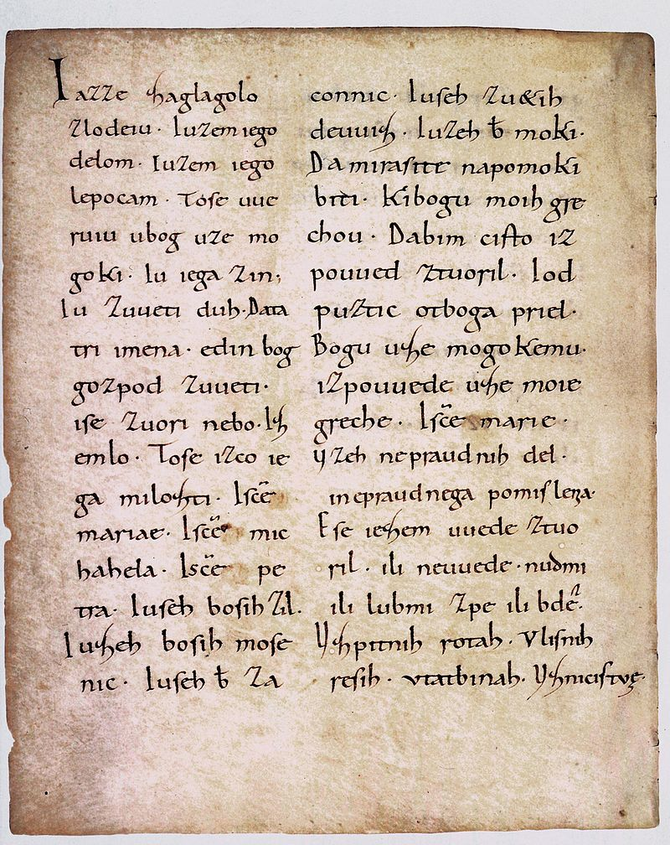
Text written in Carolingian minuscule
https://en.wikipedia.org/wiki/Carolingian_minuscule#/media/File:Freising_manuscript.jpg

Slide 24
Charlemagne and Christian Culture
Alcuin’s main contributions to the Carolingian Renaissance were as follows:
Language. Alcuin reformed spelling and developed a new style of handwriting called “Carolingian miniscule”, on which our modern printed letters are based. Carolingian scholars revived the Latin language, refined it, and taught it to all educated people.
Literature. In the days before printing was invented, monks had to copy books by hand. Charlemagne’s army of monk-scholars made numerous copies of ancient writings; most of our surviving texts from ancient Greece and Rome have come down to us from Carolingian copies. Alcuin oversaw the establishment of monastic libraries throughout Charlemagne’s empire where these books were copied and stored. In this way the Carolingian Renaissance helped to preserve and transmit to the present the knowledge and culture of the past.
Needham, Nick. 2,000 Years of Christ's Power Vol. 2: The Middle Ages

Slide 25
Charlemagne and Christian Culture
Alcuin’s main contributions to the Carolingian Renaissance were as follows:
The Bible. Alcuin revised the text of the Latin Bible and established a standard edition of Jerome’s Vulgate.
Education. Charlemagne took a strong personal interest in the spreading of education, advised chiefly by Alcuin. He ordered bishops and abbots to set up schools for training priests and monks. He decreed that every parish should have a school to educate all the male children of the neighborhood. He founded his own royal academy in Aachen, presided over by Alcuin, which encouraged the study of logic, philosophy, and literature.
Needham, Nick. 2,000 Years of Christ's Power Vol. 2: The Middle Ages

Slide 26
https://www.hopehelps.org/volunteer-appreciation-week-2018/

Slide 27
Class Discussion Time
https://www.weareteachers.com/moving-beyond-classroom-discussions/

Slide 28
*Class Discussion Time
The down side of a great leader like Charlemagne is that, when it comes time to replace him, it seems that no one can be found to “fill his shoes”. Can you think of any examples of this phenomenon in recent history?
We saw where Charlemagne’s chief religious advisor, Alcuin of York argued that “Faith is a free act of the will, not a forced act. We must appeal to the conscience, not compel it by violence. You can force people to be baptized, but you cannot force them to believe”.
We will see later in history, during the Spanish inquisition for example, the Roman Catholic Church (and even the Reformers!) will abandon this principle as they pressure heretics to recant through the use of physical torture or the threat of death.
Can you see where the idea expressed here by Alcuin is reflected in the founding documents of our nation? Does this give you a greater appreciation for the wisdom of our founding fathers?
Do you have a topic or question that you would like to see us to discuss?

