Slide 2
Review
What were some of Charlemagne’s positive characteristics that made him so well-liked and successful?
seven feet tall,
a tremendous athlete,
very pious,
quite a scholar,
loved literature
a just and generous ruler
an affectionate father
unswervingly loyal to his friends
Charlemagne doubled the size of his kingdom during his reign. His longest war was against the Pagan Saxons, which occupied over 30 years of his reign.
What policy did he use to overcome their resistance?
He forcibly resettled large groups of Saxons in other parts of the Carolingian kingdom, and compelled them to choose between accepting Christian baptism and being put to death.

Slide 3
Review
Charlemagne’s chief religious advisor, Alcuin of York voiced an objection to this policy. What was his objection and how did Charlemagne ultimately respond?
Alcuin said: “Faith is a free act of the will, not a forced act. We must appeal to the conscience, not compel it by violence. You can force people to be baptized, but you cannot force them to believe.”
His protest eventually succeeded; Charlemagne abolished the death penalty for Paganism in AD 797.
Pope Leo III surprised Charlemagne by crowning him as “Emperor of the Romans” in the year AD 800. How did Charlemagne feel about the pope doing this?
Charlemagne was pleased with his new status, but unhappy at the way Leo had given it to him.

Slide 4
Charlemagne’s Religious Policy
https://en.wikipedia.org/wiki/Charlemagne#/media/File:Gare_de_Metz_-_portail_de_Charlemagne.JPG

Slide 5
Charlemagne’s Religious Policy
Charlemagne saw himself as the spiritual as well as political leader of the Holy Roman Empire, modelling himself on the good Biblical kings of Judah, such as David and Josiah.
He interpreted all public disasters as judgments of God on his empire for its sins, and ordered public fasts.
For all victories in battle, he ordered public thanksgiving to God.
His imperial decrees were more often concerned with religion than with politics.
They dealt with the recruitment and education of priests, Church discipline, the religious instruction of the laity, and even theological issues.
Needham, Nick. 2,000 Years of Christ's Power Vol. 2: The Middle Ages

Slide 6
Charlemagne’s Religious Policy
Charlemagne presided over Church councils and actively participated in them.
He assumed authority over the bishops within his empire, nominating men of his choice to vacant bishoprics.
He tended to treat the bishops as a department of the Carolingian civil service; many bishops were appointed to secular government positions.
He took a strong interest in the monasteries, personally appointing many abbots.
He tried to reform the moral lives of the clergy.
Needham, Nick. 2,000 Years of Christ's Power Vol. 2: The Middle Ages

Slide 7
Charlemagne’s Religious Policy
Priests were also now set apart from the rest of Western society in their ordinary everyday dress, the “cassock” (a long black gown worn at all times).
It was also at this time that the “alb” (a white linen vestment worn at holy communion) became common.
Needham, Nick. 2,000 Years of Christ's Power Vol. 2: The Middle Ages

Slide 8
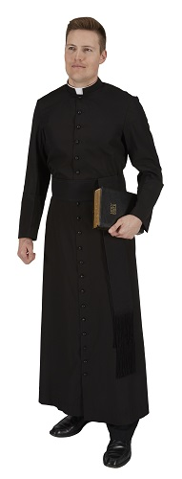
Medieval Priestly Attire
Cassock
Alb
https://www.autom.com/product/Summertime-Roman-Cleric-Cassock-305
https://www.autom.com/product/Hooded-Monastic-Alb-F2650

Slide 9
Charlemagne’s Religious Policy
Priests were also now set apart from the rest of Western society in their ordinary everyday dress, the “cassock” (a long black gown worn at all times).
It was also at this time that the “alb” (a white linen vestment worn at holy communion) became common.
Charlemagne’s religious legislation also affected society at large.
For example, he passed strong new laws on the observance of Sunday.
Lay people were forbidden to do any work on Sunday, except for burying the dead, and transporting food and necessary military supplies.
Needham, Nick. 2,000 Years of Christ's Power Vol. 2: The Middle Ages

Slide 10
Charlemagne’s Religious Policy
Furthermore, Charlemagne made the payment of tithes universal and compulsory.
Ever since the reign of King Pepin, people had paid tithes to their parish church in many places on a voluntary basis.
Charlemagne extended the practice throughout his empire and gave it the force of law.
Tithes were levied on land, not on persons, and were not paid in cash but in “kind” – corn, wine, hay, livestock.
The penalty for refusing to pay tithes to one’s parish church was excommunication.
Needham, Nick. 2,000 Years of Christ's Power Vol. 2: The Middle Ages

Slide 11
Charlemagne’s Religious Policy
Charlemagne’s exalted view of kingship brought him into serious conflict with the papacy. He looked upon himself as “both king and priest”.
This did not mean that Charlemagne thought he was a priest in the sense of a clergyman, with the right to celebrate the sacraments; but it did mean that he considered himself invested with power directly from Christ to regulate Church affairs within his empire.
This view of kingship was not Charlemagne’s invention; the Council of Chalcedon in 451 had referred to the Byzantine Emperor Marcian as “priest and king”, and Byzantium’s rulers saw themselves in these lofty terms.
Needham, Nick. 2,000 Years of Christ's Power Vol. 2: The Middle Ages

Slide 12
The Collapse of the Empire
Frederick II's gold and silver casket for Charlemagne at the Shrine of Charlemagne in Aachen Cathedral
https://en.wikipedia.org/wiki/Charlemagne#/media/File:Karlsschrein_front_side_left.jpg

Slide 13
The Collapse of the Empire
Charlemagne’s son, Louis the Pious (AD 814-40), continued to govern the Holy Roman Empire according to his father’s ideals, but without his father’s abilities.
At the end of his reign, Louis disastrously divided the Empire up between his three sons. This eventually lead to the disintegration of the empire.
The popes used the disintegration of the Holy Roman Empire to reassert their own supreme authority over Church affairs: papalism striking back against imperialism.
Yet they found that the disappearance of their greatest rival, a powerful Holy Roman Emperor, also meant the loss of their greatest ally.
Needham, Nick. 2,000 Years of Christ's Power Vol. 2: The Middle Ages

Slide 14
The Collapse of the Empire
Without an effective Emperor to protect them, the popes fell increasingly under the control of the Roman nobility, and simply became political pawns in the conflicts of different aristocratic factions.
By the time of Pope Sergius III (AD 904-11), the papacy had become hopelessly corrupt, incapable of offering any independent moral, spiritual or theological leadership to the Western Church.
Needham, Nick. 2,000 Years of Christ's Power Vol. 2: The Middle Ages

Slide 15
The Norsemen are Coming!
https://worldhistory.us/european-history/the-beginning-of-the-dane-norse-invasions.php

Slide 16
The Norsemen are Coming!
For a time, Charlemagne and his successors seemed to have brought Western Europe out of the confusion created by the Germanic invasions of the fourth and fifth centuries.
But in truth those invasions, which had subsided for a while, had not ended, and would start afresh at a time that coincided with the decline of the Carolingian empire.
For centuries, extreme northern Europe had been inhabited by Scandinavians.
During the eighth century, these heretofore sedentary people developed the art of shipbuilding to such a point that they mastered the neighboring seas.
Their ships, sixty or seventy feet in length and propelled by sail and oars, could carry up to eighty men.
In them, the Scandinavians began their expeditions to the rest of Europe, where they were called Norsemen.
Gonzalez, Justo L.. The Story of Christianity: Volume 1: The Early Church to the Dawn of the Reformation (pp. 321-322)

Slide 17
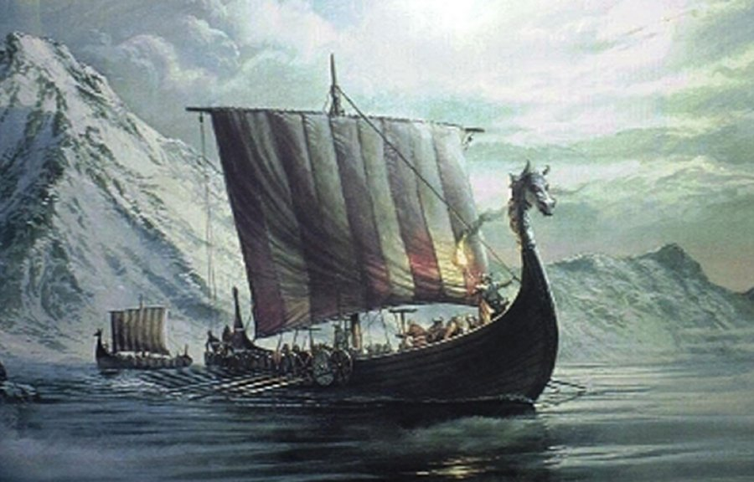
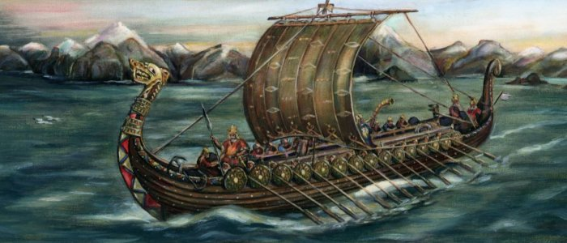
Viking Longships
http://www.ancientpages.com/2016/04/16/viking-longships-fearless-dragonships-daring-the-oceans-and-seas/

Slide 18
The Norsemen are Coming!
As the Carolingian empire began to disintegrate, the northern coasts of France became vulnerable to attack, and the Norsemen soon discovered that they could land on them, sack churches, monasteries, and palaces, and return to their lands with booty and slaves.
Since they often attacked churches and monasteries in pursuit of the treasures they held, they were taken to be enemies of God.
At first, the Norsemen limited their attacks to the nearby coasts of the British Isles and northern France.
But they soon grew more daring, both in reaching farther afield and in settling down as conquerors in new lands.
Gonzalez, Justo L.. The Story of Christianity: Volume 1: The Early Church to the Dawn of the Reformation (pp. 321-323)

Slide 19
The Norsemen are Coming!
In England, the only one who offered significant resistance was King Alfred the Great of Wessex, but by the eleventh century King Canute of the Danes was master of all of England— as well as of Denmark, Sweden, and Norway.
In France, they took and sacked such cities as Bordeaux, Nantes, and even Paris, which they reached in AD 845.
In Spain, they looted the Christian shrine of Santiago de Compostela, as well as the Muslim city of Seville, far south.
They crossed the Straits of Gibraltar, and made their presence felt in the Mediterranean.
Eventually they settled in Sicily, which they took from the Muslims, and in southern Italy, and founded a kingdom in those lands.
Others settled in northern France, in the region that came to be Normandy. From there, they would later cross to England, and conquer that land.
Gonzalez, Justo L.. The Story of Christianity: Volume 1: The Early Church to the Dawn of the Reformation (pp. 321-323)

Slide 20
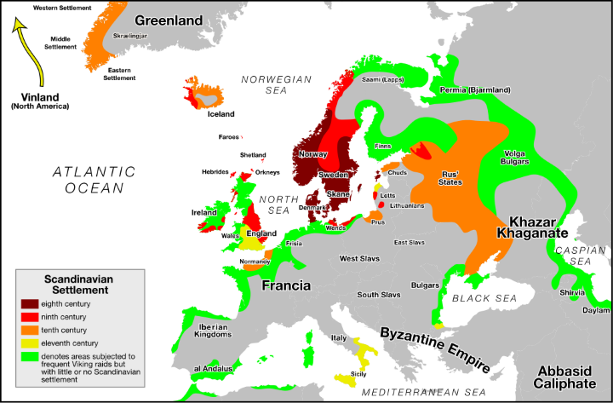
Viking Expansion 8th-11th Centuries
https://brilliantmaps.com/viking-world/

Slide 21
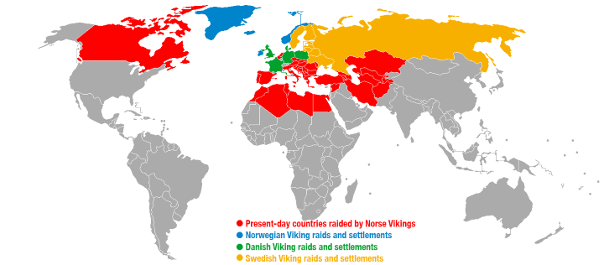
Countries That Were Raided Or Settled By The Vikings Based On Modern Borders
https://brilliantmaps.com/viking-world/

Slide 22
The Norsemen are Coming!
Eventually, the Norsemen became Christians. Many simply took over the faith of those whom they had conquered and among whom they settled.
Others, mostly in Scandinavia itself and in distant Iceland, were led to baptism by the example— and sometimes the coercion— of their leaders.
By Canute’s time, in the first half of the eleventh century, almost all Scandinavians had been baptized.
Gonzalez, Justo L.. The Story of Christianity: Volume 1: The Early Church to the Dawn of the Reformation (pp. 321-323)

Slide 23
The Hungarian Invasion
https://en.wikipedia.org/wiki/History_of_Hungary#/media/File:Arpadfeszty.jpg

Slide 24
The Hungarian Invasion
At about the same time as the Scandinavians invaded from the north, others were coming from the east.
These were the Magyars, whom the Latin West called “Hungarians” because they brought memories of the ancient Huns.
After settling in what is now Hungary, they repeatedly invaded Germany, and crossed the Rhine more than once.
Even distant Burgundy trembled under the hooves of their horses, and into southern Italy they marched, victorious and destructive.
Finally, in AD 933 and 955, Henry the Fowler and his son Otto I of Germany dealt them crushing defeats, and most of their attacks ceased.
The Hungarians assimilated much of the culture of their German neighbors, as well as of the Slavs they had conquered.
Gonzalez, Justo L.. The Story of Christianity: Volume 1: The Early Church to the Dawn of the Reformation (pp. 323)

Slide 25
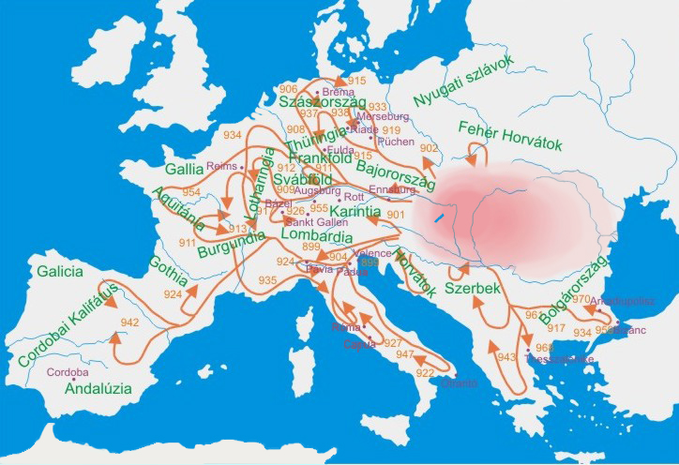
Hungarian Raids Across Europe in the 10th Century
https://en.wikipedia.org/wiki/History_of_Hungary#/media/File:Kalandozasok.jpg

Slide 26
The Hungarian Invasion
Missionaries went to Hungary both from Germany and from the Byzantine Empire, and late in the tenth century their king was baptized.
The next king, who took the name of Stephen and is generally known as Saint Stephen of Hungary, forced the conversion of all his subjects.
The incursions of Scandinavians and Hungarians made of the tenth century what an historian has called “a dark century of lead and iron.”
Although toward the end of the century the empire enjoyed a certain revival under Otto the Great and his immediate successors, it too was an empire of lead and iron.
And the papacy, reflecting the times, fell to the lowest depths of its entire history.
Gonzalez, Justo L.. The Story of Christianity: Volume 1: The Early Church to the Dawn of the Reformation (pp. 323)

Slide 27
Gottschalk of Orbais
https://deovivendiperchristum.wordpress.com/2013/09/26/gottschalk-of-orbais-c-804-869-an-important-link-between-augustine-and-calvin/

Slide 28
https://www.hopehelps.org/volunteer-appreciation-week-2018/

Slide 29
Class Discussion Time
https://www.weareteachers.com/moving-beyond-classroom-discussions/

Slide 30
*Class Discussion Time
Over and over in history, we see that pagans who conquered Christian lands end up converting to Christianity. At one level, we can say that this was the work of God’s sovereignty bringing about the spread of the gospel. But on a human level how do you think the gospel was spread from conquered Christians to conquering pagans? What do you think that might have looked like? Does this say something about their concern to spread the gospel? Do we have that kind of concern to spread the gospel in our day?
We have seen a number of cases historically, where kingdoms were lost when they passed from a great king to his sons? Does this say anything about the failure of those kings as parents to teach their children how to carry on their legacy? Is this a concern that we should have in raising our kids?
Do you have a topic or question that you would like to see us to discuss?

