Slide 1


Slide 2

Review
One of the most influential figures in Western monasticism was Benedict of Nursia.
What was the name of the document that he wrote that determined the shape of monasticism for centuries?
  The Rule
The government of the monastery was vested in an abbot.
What two terms describe the kind of obedience monks had to render to the abbot?
  Instant obedience
  Willing obedience
What was the ultimate penalty for an erring monk?
  Permanently expelled from the monastery

Slide 3
Review
How many chapel prayer services were monks required to attend?
  There the monks were to gather eight times a day: seven during the daytime, and once in the middle of the night.
There were two kinds of work required in the monastery: work of the ____ and work of the ____.
  Work of the mind and work of the hands.
What surprising category of woman served as the principal source of recruits for the nunneries?
  Aristocratic women
Over what issue did nuns have a running battle with bishops?
  Whether you could have pets in your room.

Slide 4
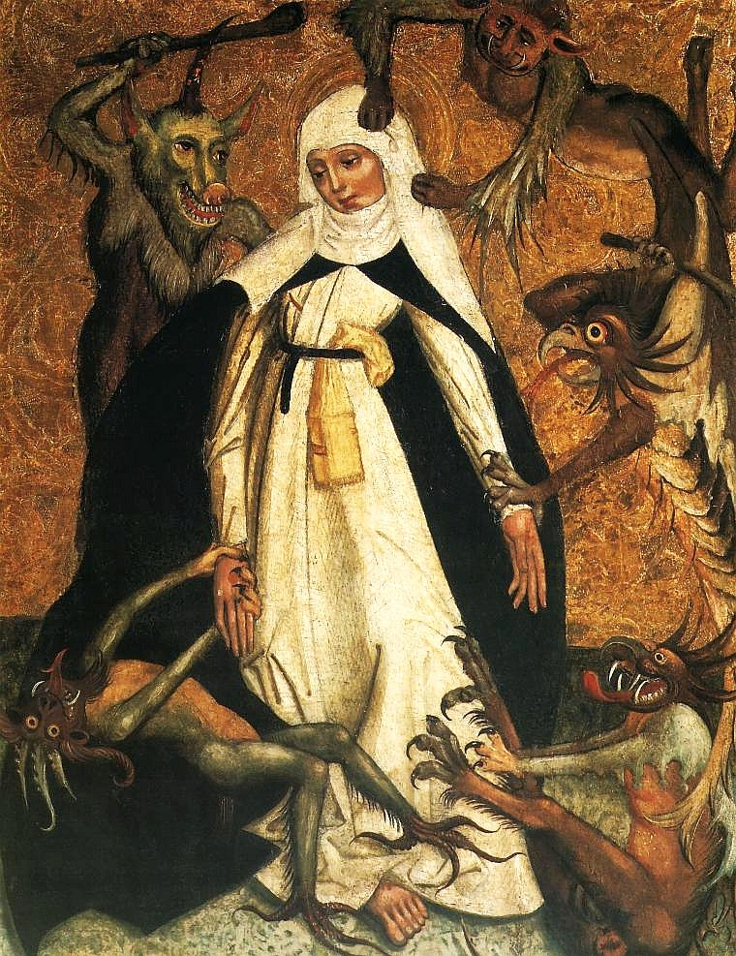
Corruption in the
Medieval Church
St Catherine and the Demons by an unknown artist, c. 1500, National Museum, Warsaw.
https://en.wikipedia.org/wiki/Catherine_of_Siena#/media/File:Lesser_Poland_St._Catherine_of_Siena.jpg

Slide 5
Corruption in the Medieval Church
By the 10th century, most Western monasteries had become very ill-disciplined, ignoring the Benedictine rule in practice ¹ and were in great need of reformation.²
Many monasteries had been sacked and destroyed by Norsemen and Hungarians. ²
Those in more sheltered areas became toys for the ambitions of corrupt abbots and church leaders. ²
The nobles and bishops who were supposed to be their guardians instead began using them for their own personal aggrandizement.²
¹Needham, Nick. 2,000 Years of Christ's Power Vol. 2: The Middle Ages
²Gonzalez, Justo L.. The Story of Christianity: Volume 1: The Early Church to the Dawn of the Reformation (p. 327).

Slide 6
Corruption in the Medieval Church
With the disappearance of a strong central government, people would look to a powerful local lord for protection against violence and injustice.
The local lord would build the local church buildings on his own land at his own expense; so while the clergy and the congregation could make use of the church’s property, they were ever mindful of the fact that it was the local lord who had provided it.
Consequently, the lord would often see it as his right to choose who would serve the local church as a priest or bishop.
This attitude swept away the ancient tradition of the clergy being elected by the votes of church members, and bishops being elected by clergy and church members together.
Needham, Nick. 2,000 Years of Christ's Power Vol. 2: The Middle Ages

Slide 7
Corruption in the Medieval Church
When a king or lord appointed (“invested”) a man of his choosing as a bishop (or an abbot), this was called “lay investiture”.
It took place through a ceremony in which the king bestowed on a bishop or abbot his ring and staff, the symbols of spiritual office.
This practice of lay investiture led to further corruption of the church and soon became a great source of controversy in throughout Western Europe.
Needham, Nick. 2,000 Years of Christ's Power Vol. 2: The Middle Ages

Slide 8
Corruption in the Medieval Church
The corruption of the church manifested itself in a number of different ways:
  Worldliness – Often occurred when a church was in control of a large amount of property. Church leaders became consumed with managing and enjoying their wealth rather than shepherding their flocks. How did a church or a monastery get in control of property?
    Beginning with Gregory the Great, the doctrine of Purgatory became a part of church teaching and was now widely believed within the church.
    People who had land or money feared how long they would be spending in Purgatory. So they would give gifts to a church or monastery so that daily masses and prayers would be said for their soul to reduce the amount of time they would be spending in Purgatory.
James White – 2016 Church History Series #43 – Holy Roman Empire

Slide 9
Corruption in the Medieval Church
The corruption of the church manifested itself in a number of different ways:
  Simony – the buying and selling of church offices.
    The term simony comes from Simon the magician, who tried to buy the gift of the Holy Spirit from the apostles (Acts 8:9–25).
    Because of the wealth accumulated by monasteries and churches, and the power possessed by those who oversaw them, there tended to be a lot of political intrigue in the appointment of abbots, bishops, and even popes.
    Simony soon became commonplace throughout the church.
    Things got so bad by the 12-15th centuries, that everybody knew that the papacy was bought and sold: whichever cardinal had the most money could pay to get the papacy.
James White – 2016 Church History Series #43 – Holy Roman Empire

Slide 10
Corruption in the Medieval Church
The corruption of the church manifested itself in a number of different ways:
  Nepotism – giving favors to relatives and friends.
    It was not uncommon for a major city to have, as a bishop, a nine year old kid who happened to be the illegitimate son of another powerful clergy person.
    So everyone knew that the alleged spiritual head of their area was just a monetary position.
    Over time, things like this ended up impacting people’s view of the church in a very negative way.
James White – 2016 Church History Series #43 – Holy Roman Empire

Slide 11
Corruption in the Medieval Church
The corruption of the church manifested itself in a number of different ways:
  Concubinage –
    The church insisted on the celibacy of the clergy. This was partly a desire to take the high ascetic ideals of the monastery into the Church at large: a priest, like a monk, should be “married to Christ”, free of the worldly distractions of marriage and family, totally devoted to the kingdom of God.
    But in reality, there were very few clergy who were actually celibate. The more powerful among the Spiritual leaders had concubines.
    These were women who would bear their children, take care of their home, but because technically they had taken the vow of celibacy, they could not have the solid foundation of the commitment of marriage.
James White – 2016 Church History Series #43 – Holy Roman Empire

Slide 12
Corruption in the Medieval Church
The corruption of the church manifested itself in a number of different ways:
  Concubinage –
    There are so many people in history who were illegitimate children of priests and popes.
    Erasmus, for example, was the illegitimate son of a Roman priest.
    So he had to get a special dispensation to become a priest himself.
James White – 2016 Church History Series #43 – Holy Roman Empire

Slide 13
Corruption in the Papacy
The real dark ages occurred within the papacy from AD 901–1046. Because of the level of papal debauchery during this period, some refer to it as the Pornocracy.
It is difficult to express the depth to which the papacy sunk at this time.
It was controlled at times by women of uncontrolled lusts and sexual debauchery who installed and deposed popes at their whim.
At other times it was controlled by wealth or political intrigue.
And almost every single person who occupied the “chair of Peter” at this time was, by any biblical standard, an utter non-Christian.
James White – 2016 Church History Series #43 – Holy Roman Empire

Slide 14
Corruption in the Papacy
Perhaps one of the worst examples of this is found in John XII (AD 955-963). He became pope at the ripe old age of 18. According to Phillip Schaff:
  He was one of the most immoral and wicked popes, ranking with Benedict IX, John XXIII, and Alexander VI. He was charged by a Roman Synod, no one contradicting, with almost every crime of which depraved human nature is capable, and deposed as a monster of iniquity…
James White – 2016 Church History Series #43 – Holy Roman Empire

Slide 15
Corruption in the Papacy
Perhaps one of the worst examples of this is found in John XII (AD 955-963). He became pope at the ripe old age of 18. According to Phillip Schaff:
  Among the charges of the Synod against him were that he appeared constantly armed with sword, lance, helmet, and breastplate … that he had mutilated a priest, that he had set houses on fire, like Nero, that he had committed homicide and adultery, had violated virgins and widows high and low, lived with his father’s mistress, converted the pontifical palace into a brothel, drank to the health of the devil, and invoked at the gambling-table the help of Jupiter and Venus and other heathen demons! The emperor Otho would not believe these enormities until they were proven, but the bishops replied that they were matters of public notoriety requiring no proof. (Schaff, Philip. History Of The Christian Church; Volume IV, Chapter 4.63)
James White – 2016 Church History Series #43 – Holy Roman Empire

Slide 16
Corruption in the Papacy
Ninety years later a 12 year old boy was made pope as a result of a mere monetary deal made by two families who controlled the papacy, taking the name Benedict IX.
This youth grew worse with his passing years, committed murder and adultery in broad daylight, and was impervious to prosecution, because his brother was patrician of the city.
He was guilty of every kind of crime including theft and rape, was expelled from the city only to return to take up his position again.
James White – 2016 Church History Series #43 – Holy Roman Empire

Slide 17
Corruption in the Papacy
After he had emptied the papal treasury of everything he could find, he sold the papacy for a thousand pounds of silver to an arch-presbyter in 1045.
In 1047 he came back, regretting the deal he had made, and sat as pope for another year until 1048 when the people of Rome finally kicked him out for good.
With this kind of history how can anyone claim a continuous line of popes from Peter?
James White – 2016 Church History Series #43 – Holy Roman Empire

Slide 18
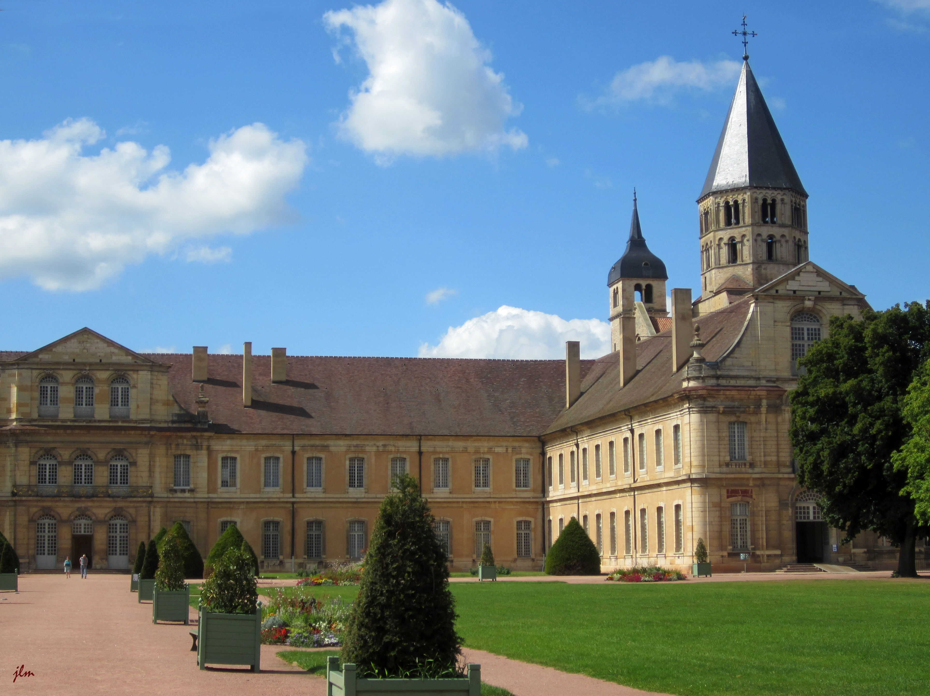
Attempts at Reform in the
Medieval Church
Cluney’s Abbey in Cluny, France
https://lamaisondesgardes.com/en/clunys-abbey/

Slide 19
Attempts at Reform
A religious reform movement began in around AD 910 in Cluny, France.
A monastery was started there with the intent of bringing reform to monastic practices by returning to the Rule first set forth by Benedict.
This monastery was led by a series of able and high-minded abbots who, over a period of two hundred years, turned Cluny into the center of a vast monastic reform.
Gonzalez, Justo L.. The Story of Christianity: Volume 1: The Early Church to the Dawn of the Reformation (pp. 328-329)

Slide 20
Attempts at Reform
One of the characteristics of the Cluniac reformation of monastic life was that all their houses had to have clear title to their property, thus freeing them from subjection to the whims of a feudal lord.
At first, the purpose of the monks of Cluny was simply to have a place where they could follow the Rule of Benedict in its entirety.
But then their horizons widened, and the abbots of Cluny, set out to reform other monasteries.
Soon there was an entire network of “second Clunys” which were directly under the abbot of the main monastery.
Gonzalez, Justo L.. The Story of Christianity: Volume 1: The Early Church to the Dawn of the Reformation (pp. 328-329)

Slide 21
Attempts at Reform
After reforming hundreds of monasteries, they set their sights on the reformation of the entire church.
All this monastic reform was happening during the darkest hour of the papacy.
In contrast with the corruption that reigned in the highest offices of the church, the Cluniac movement seemed to many a miracle, a divine intervention to bring about a new dawn.
Later, in the eleventh century, around the time that Hildebrand served as pope, a similar movement of reform took place within the papacy.
Just as Cluny had been able to carry on its great work because it was independent of all civil power, so the papal reformers of the eleventh century dreamed of a church whose leaders would be free from every obligation to civil authorities, be they kings or nobles.
Gonzalez, Justo L.. The Story of Christianity: Volume 1: The Early Church to the Dawn of the Reformation (pp. 330-331).

Slide 22
Attempts at Reform
What eventually lead to the downfall of both Cluniac monasticism and the general reformation that it inspired was its ambivalence towards the accumulated wealth of monasteries.
On one hand, they believed that a good monk should own nothing, and lead a simple life.
On the other hand, the monasteries could accumulate vast amounts of land and wealth through gifts and inheritances from the faithful who admired the monastic way of life, or who simply wished to earn merit toward their salvation, and they were okay with that.
Eventually, this made it difficult for monks to lead the simple life which the Rule required.
Gonzalez, Justo L.. The Story of Christianity: Volume 1: The Early Church to the Dawn of the Reformation (pp. 332-333).

Slide 23
Attempts at Reform
The next great movement of monastic reform, which came to be known as the Cistercian movement, began late in the eleventh century.
A leading figure of the Cistercian movement was Bernard of Clairvaux, who came to be known as “Doctor Mellifluous,” for the words from his mouth were like honey.
Examples of this are two hymns attributed to him and still popular: “O Sacred Head, Now Wounded (#137) ” and “Jesus, the Very Thought of Thee (#225).”
Bernard’s fame gave the Cistercian movement great impetus, and soon it came to play a role similar to that which Cluny had played more than a century before.
Gonzalez, Justo L.. The Story of Christianity: Volume 1: The Early Church to the Dawn of the Reformation (pp. 333-334).

Slide 24
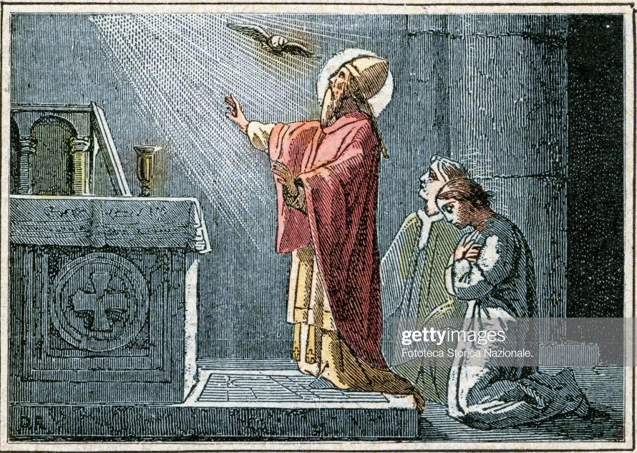
Pope Hildebrand (St. Gregory VII)
Pope Saint Gregory VII saying Mass
https://www.gettyimages.com/detail/news-photo/saint-gregory-vii-born-hildebrand-of-sovana-was-pope-from-news-photo/680967432

Slide 25

https://www.hopehelps.org/volunteer-appreciation-week-2018/

Slide 26

Class Discussion Time
https://www.weareteachers.com/moving-beyond-classroom-discussions/

Slide 27
*Class Discussion Time
We have seen how the Western Church became deeply corrupt during the Middle Ages and have discussed a number of things that caused this corruption. If you were to boil the various causes of corruption down to one main cause, what would you say that it was?
With the rise of monasticism, celibacy, especially among church leaders came to be seen as desirable, and eventually required. As we have just seen, this did not work out very well in the church, historically. Those who seek scriptural support for Christian celibacy often cite 1 Corinthians 7 where it says: The unmarried man is anxious about the things of the Lord, how to please the Lord. But the married man is anxious about worldly things, how to please his wife, and his interests are divided. (1Cor. 7:32-34). What are your thoughts about Christian celibacy as an ideal, for leadership or Christians in general?
Do you have a topic or question that you would like to see us to discuss?

