Slide 2
Review
In medieval Europe, how did the local secular lord or ruler end up being able to decide who would serve as leaders in the local church or monastery? And was that a good thing? Why or why not?
The local lord would build the local church buildings on his own land at his own expense; Consequently, the lord would often see it as his right to choose who would serve the local church as a priest or bishop.
This often resulted in church leaders who were chosen by an unbeliever, often for unspiritual reasons, and so it was a bad thing. Not to mention that, in Scripture, the instructions for choosing church leaders were directed to the local church (cf. 1Tim 3)
What were the major areas of church corruption that we discussed last week?
Worldliness
Simony
Nepotism
Concubinage

Slide 3
Review
By any biblical standard, what would we have to say about the spiritual condition of every Roman Catholic pope who served from AD 901–1046?
They were debauched unbelievers.
A religious reform movement began in around AD 910 in Cluny, France that brought about successful reform to hundreds of monasteries within the next 200 years by encouraging a return to Benedict’s Rule.
What ultimately led to the downfall of this reform movement?
Its ambivalence towards the accumulated wealth of monasteries.
What was the primary motivation for people giving large amounts of wealth to the churches and monasteries?
Some, because they admired the monastic way of life; others, because they wished to be prayed out of Purgatory by those in the monastery.

Slide 4
Pope Hildebrand (Gregory VII)
Pope Saint Gregory VII saying Mass
https://www.gettyimages.com/detail/news-photo/saint-gregory-vii-born-hildebrand-of-sovana-was-pope-from-news-photo/680967432

Slide 5
Pope Hildebrand (Gregory VII)
During the time of the corrupt Pope Benedict IX (that we looked at last week), the Holy Roman Emperor, Henry III came to Rome seeking to be officially crowned as Emperor by the pope. But when he arrived he found three rival popes!
Henry, a just and wise ruler, and dedicated reformer of Church and society, called a synod at Sutri, a small town just north of Rome; the synod deposed all three popes.
This act of Henry is known as “the cleansing of the papacy”.
Acting as a “sacred king”, the Holy Roman Emperor lifted the papacy out of its pit of spiritual corruption and put it in the hands of a party of committed reformers.
One of the more outstanding of theses reformers was a native of Tuscany (north-western Italy) named Hildebrand.
Needham, Nick. 2,000 Years of Christ's Power Vol. 2: The Middle Ages

Slide 6
Pope Hildebrand (Gregory VII)
In 1073, at the age of 50, Hildebrand himself was elected pope, and took the name Gregory VII.
Judged by the impact he made on Church and society, he was perhaps the greatest of all the popes in history.
What kind of man was Hildebrand? Physically he was not very impressive: a short man with a rather weak voice. But he had shining, piercing eyes.
He possessed a dominating force of will, an all-consuming devotion to justice and righteousness, and a burning zeal for the purity and reformation of the Church.
He also had a supreme talent for dividing opinion about himself into violent extremes of adoration and hatred; people either admired Hildebrand intensely as a heaven-sent spiritual hero, or detested him bitterly as an ambitious power-hungry schemer.
Needham, Nick. 2,000 Years of Christ's Power Vol. 2: The Middle Ages

Slide 7
Pope Hildebrand (Gregory VII)
In Hildebrand’s thinking, it was not the Christian king, but the pope who was God’s appointed agent for establishing His kingdom on earth.
It was around this time that Western Christianity began to speak of Christians on earth as “the Church Militant”, contrasted with those now in heaven as “the Church Triumphant”.
Previously it had been the custom to think of Christians on earth as “the pilgrim Church” and those in heaven as “the Church at rest”.
This change from the “pilgrim” to the “warrior” image reflects the new world-conquering aggression and self-confidence which the Hildebrandine reform movement brought to the Church.
Needham, Nick. 2,000 Years of Christ's Power Vol. 2: The Middle Ages

Slide 8
Pope Hildebrand (Gregory VII)
Soon after becoming pope, Hildebrand published in 1075 a “papal decree” which outlined his view of the papacy. Here are some of its claims:
The Roman Church was founded by God alone.
The pope alone can depose and reinstate bishops.
The pope is the only one whose feet all princes must kiss.
The pope may depose Emperors.
The pope may be judged by no-one.
The Roman Church has never erred, and (as Scripture testifies) it shall never err, to all eternity.
The Roman pope, if properly ordained according to Church law, is sanctified by the merits of Saint Peter.
He who is not in conformity with the Roman Church should not be considered a Catholic.
Needham, Nick. 2,000 Years of Christ's Power Vol. 2: The Middle Ages

Slide 9
Pope Hildebrand (Gregory VII)
As pope, Hildebrand was determined to destroy the political power that secular rulers exercised over Church affairs.
In 1075, Hildebrand decreed that the Holy Roman Emperor, Henry IV, must cease from his practice of appointing bishops and abbots, since he saw this as an unholy violation of the Church’s independence from state control.
Emperor Henry IV (1065-1105), was one of the most naturally gifted rulers and soldiers ever to wear the crown of the Holy Roman Empire.
Henry had been involved in a civil war with his own German nobles for many years; it was only in 1075, at the age of 25, that he managed to establish his own power over the whole of Germany.
Needham, Nick. 2,000 Years of Christ's Power Vol. 2: The Middle Ages

Slide 10
Pope Hildebrand (Gregory VII)
The German Church had strongly supported Henry in the civil war against his nobles.
So when Hildebrand issued his challenge to Henry, the German bishops supported the Emperor at first .
Henry defied Hildebrand’s demand to cease from investiture, by appointing a new archbishop of Milan.
When Hildebrand protested, Henry called a council at Worms (western-central Germany) in January 1076.
Here, most of the German bishops joined in condemning Hildebrand and rejecting him as pope.
Henry was trying to assert his authority as Emperor over the pope, just as his father Henry III had done in 1046 at the synod of Sutri when he had “cleansed” the papacy.
Needham, Nick. 2,000 Years of Christ's Power Vol. 2: The Middle Ages

Slide 11
Pope Hildebrand (Gregory VII)
After all, it was the cleansing of the papacy by Henry’s father (Henry III) which had put the Hildebrandine reformers in power in the first place; now, Henry IV thought it was time to cleanse the papacy again – by getting rid of Hildebrand!
Henry sent an official letter to Hildebrand from the council of Worms which shows what Henry thought of this new pope:
To Hildebrand, not pope but a false monk. How dare you, who have won your power by deceit, flattery, bribery, and force, stretch forth your hand against the Lord’s anointed, despising the command of the true pope, Saint Peter: ‘Fear God, honor the king’ (1 Peter 2: 17). You do not fear God, and you dishonor me whom He has appointed… I, Henry, king by the grace of God, with all my bishops, say to you – come down from the papal throne, and be damned through all ages!
Needham, Nick. 2,000 Years of Christ's Power Vol. 2: The Middle Ages

Slide 12
Pope Hildebrand (Gregory VII)
Hildebrand’s response to this threatening letter came like a bolt of lightning. He excommunicated Henry and released all Henry’s subjects from their obligation of loyalty to him.
Henry’s closest allies, the German bishops, afraid for their own position, obeyed Hildebrand and refused all further cooperation with the Emperor.
Henry’s German nobles seized this chance to rebel again, and in October 1076 they suspended Henry from his imperial office.
The Holy Roman Emperor, the most exalted king in Western Europe, had been toppled from his throne simply by the word of the pope!
Henry was desperate. With his family and a few loyal supporters, he journeyed down into Italy.
He found Hildebrand at Canossa in the north, in a castle with Hugh the Great, the abbot of Cluny.
Needham, Nick. 2,000 Years of Christ's Power Vol. 2: The Middle Ages

Slide 13
Pope Hildebrand (Gregory VII)
For three days in January 1077, Henry stood outside the castle gate with his wife and children, barefoot in the freezing snow, crying out to Hildebrand that he had repented, pleading for mercy.
Henry’s action had placed Hildebrand in a difficult position. As a priest, it was his duty to accept Henry’s repentance and restore him to Church membership.
Yet if Hildebrand did this, Henry would regain all his power in Germany – and then probably use it to destroy Hildebrand.
So for three days Hildebrand hesitated, as Henry outside the castle and Hugh inside begged him to show pity.
Finally, Hildebrand’s priestly conscience gave way. He allowed Henry into the castle.
Needham, Nick. 2,000 Years of Christ's Power Vol. 2: The Middle Ages

Slide 14
Pope Hildebrand (Gregory VII)
Weeping, the young Emperor promised to obey the pope’s demands to cease from the practice of lay investiture. Hildebrand received him back into the Church.
When Henry returned to Germany, a new civil war broke out. Henry’s foes elected Rudolf of Swabia as Emperor.
Both Henry and Rudolf looked to Hildebrand for support; for three years Hildebrand wavered between them, as the war raged.
At last in March 1080, provoked by a high-handed demand from Henry that Hildebrand must excommunicate Rudolf, the pope came down on Rudolf’s side and excommunicated Henry again.
This time, however, the German bishops stayed loyal to Henry; they did not recognize Rudolf’s claim to the throne, and saw Henry as the only hope for peace and stability in Germany.
Needham, Nick. 2,000 Years of Christ's Power Vol. 2: The Middle Ages

Slide 15
Pope Hildebrand (Gregory VII)
Henry called a council at Brixen (northern Italy) in June which deposed Hildebrand from the papacy, and appointed archbishop Guibert of Ravenna in his place.
In October Henry won the civil war when Rudolf was killed in battle.
The victorious Emperor invaded Italy in 1081, conquered the north, and finally in 1084 captured Rome itself.
Henry placed the archbishop of Ravenna on the papal throne as Pope Clement III;
Clement then crowned Henry as Holy Roman Emperor.
Hildebrand went into exile, to Salerno in southern Italy, and died there in 1085.
His last words were: “I have loved righteousness and hated iniquity; therefore I die in exile.”
Needham, Nick. 2,000 Years of Christ's Power Vol. 2: The Middle Ages

Slide 16
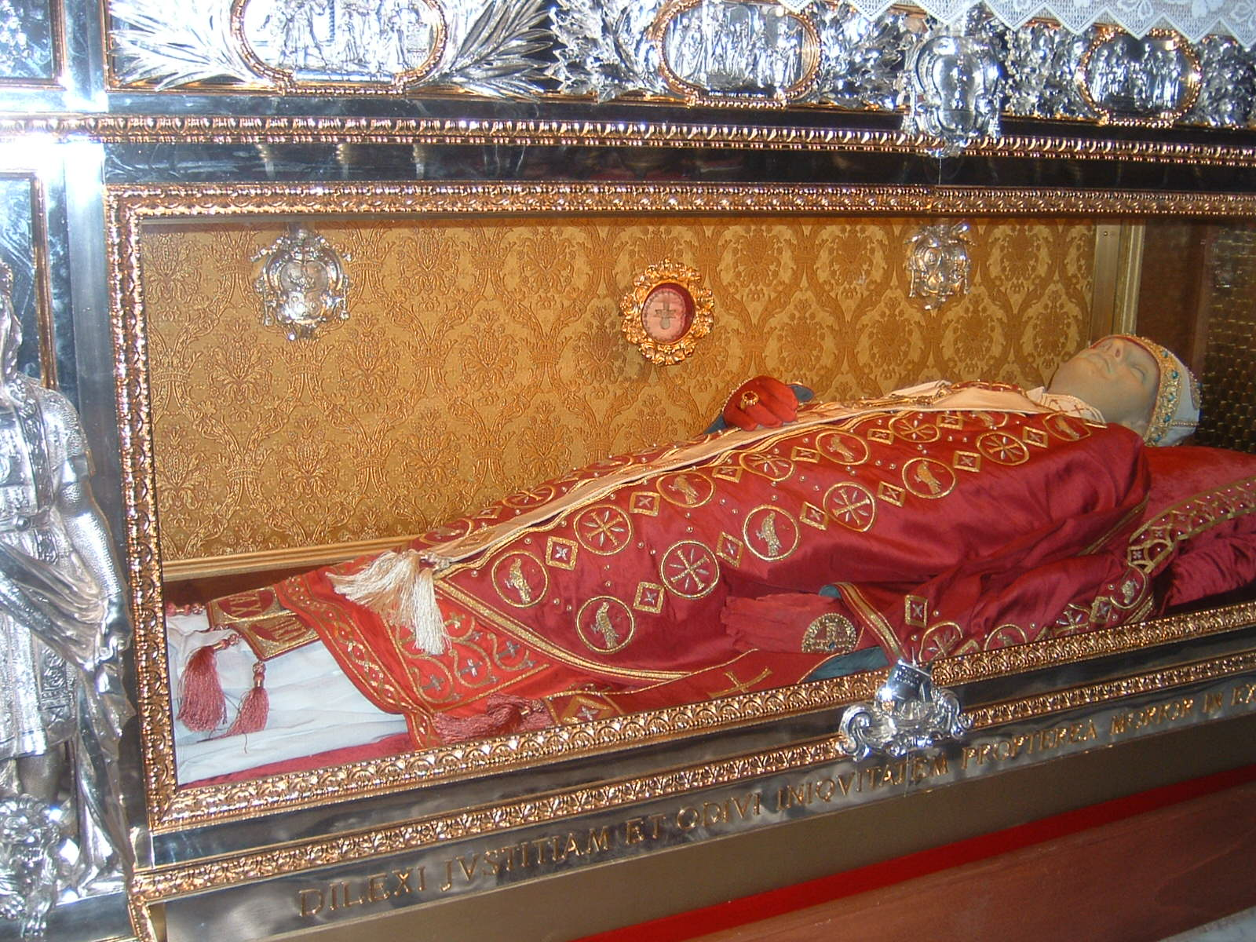
Tomb of Gregory VII Cathedral of Salerno (Italy)
Under the tomb the last words of the pope are imprinted:
"Dilexi iustitiam, odivi iniquitatem, propterea morior in esilio !"
(I loved justice and I hated iniquity, so I die in exile).
https://en.wikipedia.org/wiki/List_of_extant_papal_tombs#/media/File:Salerno_PopeGregoriousVIITomb.JPG

Slide 17
Pope Innocent III
Pope Innocent III’s Burial Monument in St. John Lateran Basilica, Rome
http://www.papalartifacts.com/portfolio-item/pope-innocent-iii/

Slide 18
Pope Innocent III
Innocent’s real name was Lothario Conti. Born in 1160, he belonged to one of Rome’s oldest aristocratic families.
In 1198, at the youthful age of 37, the other cardinals unanimously elected him pope, and he took the name “Innocent III”.
The claims and might of the papacy reached their high water mark during the reign of Pope Innocent III (1198-1216).
Innocent made Hildebrand’s lofty view of the papacy as the political and spiritual head of Western Europe into a far more effective reality than Hildebrand himself had ever achieved.
Needham, Nick. 2,000 Years of Christ's Power Vol. 2: The Middle Ages

Slide 19
Pope Innocent III
Innocent was the first pope who positively rejected the old papal title of “vicar of Peter”, and the first to refer to himself officially and regularly by the title “vicar of Christ”.
He declared: “We are the successor of Peter the prince of the apostles, but we are not his vicar, nor are we the vicar of any man or any apostle; we are the vicar of Jesus Christ Himself.”
Innocent claimed that he, as pope, was the visible manifestation of Christ on earth, exercising Christ’s supreme authority, not just over the spiritual kingdom of the Church, but over all human beings, all earthly kingdoms, and even the angels and demons.
Needham, Nick. 2,000 Years of Christ's Power Vol. 2: The Middle Ages

Slide 20
Pope Innocent III
Innocent famously wrote in one of his letters that as “the moon derives its light from the sun…Likewise, the kingly office derives its splendor from the papal authority”
The political circumstances of Western Europe at that time enabled Innocent to translate these elevated claims into a practical reality.
The papacy’s greatest rival, the Holy Roman Empire, had lost its grip on Italy due to the sudden death of the Emperor Henry VI in 1197.
A war between two rival rulers seeking to become Henry’s replacement then plunged Germany into utter confusion.
Needham, Nick. 2,000 Years of Christ's Power Vol. 2: The Middle Ages

Slide 21
Pope Innocent III
Innocent took advantage of the Empire’s descent into chaos to enlarge the political power of the papacy and its lands in Italy.
Innocent was able to re-establish the papal states in Italy as an independent political dominion, one which they retained until the 19th century.
Having restored the papacy’s independence in Italy, Innocent insisted on the absolute right of the papacy to control the beliefs and moral conduct of the entire Catholic world.
This had the gravest implications for secular rulers in all three of Western Europe’s great monarchies – Germany, England, and France, since it involved the pope’s right to depose a king or Emperor who broke the Church’s laws.
Needham, Nick. 2,000 Years of Christ's Power Vol. 2: The Middle Ages

Slide 22
Pope Innocent III
For example, Innocent had a dispute with King John of England in 1207 over who would be appointed as the archbishopric of Canterbury
Innocent wanted to set aside King John’s candidate and appoint one of his own cardinals as archbishop.
When John refused to accept Innocent’s choice, Innocent threatened to place England under an “interdict” – that is, to forbid all English clergyman to perform any of their sacramental or spiritual functions until King John submitted.
John swore he would expel all the clergy from England if Innocent dared to do this.
So Innocent called his bluff and placed all of England under an interdict in 1208.
For four years England went without any Church services.
Still, King John refused to submit or accept Innocent’s choice of archbishop.
Needham, Nick. 2,000 Years of Christ's Power Vol. 2: The Middle Ages

Slide 23
Pope Innocent III
So in 1212, Innocent used his ultimate weapon: he excommunicated John, released all English nobles from their oath of loyalty to him, and summoned the other kings of Europe to dethrone John in a crusade.
At that point, John gave up and surrendered his entire kingdom to Innocent – England became the property of the pope!
John also promised to pay a special annual tax to the papacy and, of course, agreed to accept Innocent’s choice as the archbishop of Canterbury.
Innocent removed the interdict which had, by now, put a stop to all religious services in England for six years.
The English monarchy, in many ways the most successful in all of Europe, now lay prostrate in the dust at the feet of Innocent III!
Needham, Nick. 2,000 Years of Christ's Power Vol. 2: The Middle Ages

Slide 24
“Holy Russia” Orthodoxy Among the Slavs
Cathedral of St. Basil the Blessed Moscow
https://www.britannica.com/topic/Russian-Orthodox-Church

Slide 25
https://www.hopehelps.org/volunteer-appreciation-week-2018/

Slide 26
Class Discussion Time
https://www.weareteachers.com/moving-beyond-classroom-discussions/

Slide 27
*Class Discussion Time
During the eleventh century, the Roman Catholic papacy went from a line of debauched scoundrels to a line of self-righteous authoritarians. Which is worse?
Does watching the see-sawing of power between popes and emperors in the Middle Ages give you a greater appreciation for the separation of church and state put in place by the American founding fathers?
In our day, it is unthinkable that any religious leader could exercise the kind of power over a governing authority that we see was exercised by Gregory VII or Innocent III. Has the pendulum swung too far the other way? Why or why not?
Do you have a topic or question that you would like to see us to discuss?

