Slide 2
Review
When Henry III came to Rome seeking to be officially crowned as Emperor by the pope and instead found three corrupt popes, how did he respond?
He called a synod that deposed all three popes. He then put the papacy in the hands of a party of committed reformers, one of those being Hildebrand.
As pope, Hildebrand decreed that the Holy Roman Emperor, Henry IV, must cease from his practice of appointing bishops and abbots. How did Henry respond?
Henry defied Hildebrand’s demand by appointing a new archbishop of Milan. He also sent an official letter condemning Hildebrand.
When Hildebrand excommunicated Henry and released all Henry’s subjects from their obligation of loyalty to him and Henry was suspended as emperor, how did he respond then?
For three days Henry stood outside Hildebrand’s castle gate with his wife and children, barefoot in the freezing snow, crying out to Hildebrand that he had repented, pleading for mercy.

Slide 3
Review
What title did Pope Innocent III take for himself when he rejected the old papal title of “vicar of Peter”?
Vicar of Christ
When Innocent III had a dispute with King John of England over who would be appointed as the archbishopric of Canterbury, how long were all church services in England suspended by Innocent in order to pressure John into acquiescing to Innocent’s demands?
Six years total
When King John finally capitulated to Innocent III, what all did he end up doing to satisfy him?
Agreed to accept Innocent’s choice as the archbishop of Canterbury
Surrendered his entire kingdom to Innocent
Promised to pay a special annual tax to the papacy

Slide 4
The Byzantine Empire
Hagia Sophia built by Emperor Constantine of the Byzantine Empire.
https://www.ancient-origins.net/ancient-places-europe/byzantine-empire-0012322

Slide 5
The Byzantine Empire
The Byzantine Empire, it is worth reminding ourselves, was the Eastern Roman Empire centered on Constantinople, which, unlike its Western counterpart, had not fallen beneath the weight of the Germanic invasions of the 4th and 5th centuries.
The Byzantines called themselves “Romans”, not “Byzantines” (a more recent term invented by Western historians).
As far as the Emperors and people of Byzantium were concerned, they were simply the ancient Roman Empire in all its glory, still full of life and strength, now sanctified by its adoption of the Christian faith.
Charlemagne and the Western Emperors might speak of themselves as the “Holy Roman Empire”, but the Byzantines felt that title more truly belonged to them.
Needham, Nick. 2,000 Years of Christ's Power Vol. 2: The Middle Ages

Slide 6
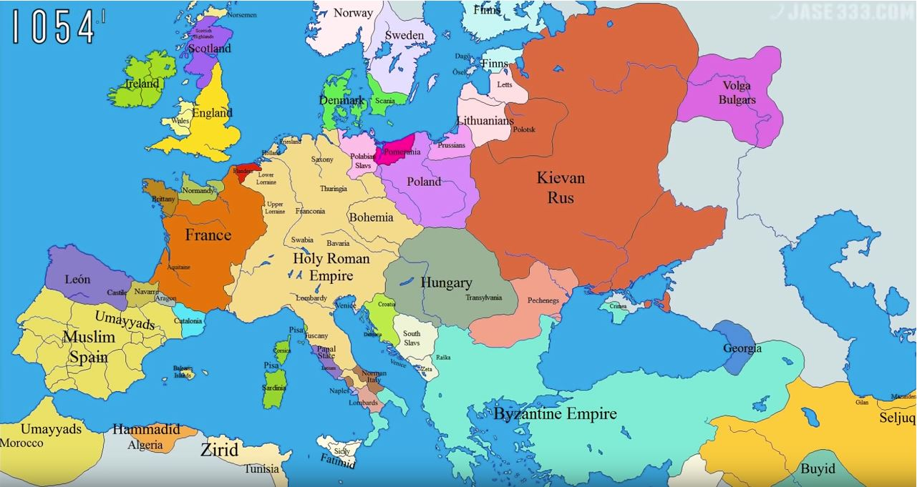
Europe in AD 1054
Kiev
Rome
Constantinople
https://www.youtube.com/watch?v=vjWVFZ5e_vo

Slide 7
Worship in the Eastern Church
Joy of All Sorrow – Russian Orthodox Church, San Francisco
http://anothercity.org/the-divine-liturgy-as-mystical-experience/

Slide 8
Worship in the Eastern Church
Eastern Orthodoxy has changed very little in its form of worship over the years.
Consequently, it is possible for us to see in most Orthodox churches today the same basic pattern of worship that was practiced in the Byzantine Empire a thousand years ago!
It is in many ways quite different from Western worship, both Protestant and Roman Catholic.
Eastern Orthodox church buildings have no pews, no pulpit, and no organ (or any other musical instrument).
There are no religious statues, but covering the walls is an abundance of flat two-dimensional images of Christ, Biblical characters, and Orthodox saints. These pictures are known as “icons”.
Needham, Nick. 2,000 Years of Christ's Power Vol. 2: The Middle Ages

Slide 9
Worship in the Eastern Church
The icons often have olive-oil lamps burning beneath them.
The idea behind the icons is that the worship of the congregation on earth is a joining and sharing in the worship of the glorified Church in heaven.
The icons are believed by the Orthodox to be a window into that heavenly worship, revealing the presence of the saints and angels.
They believe that it is in company with these heavenly saints and angels, and with the help of their prayers, that believers on earth approach and worship the Trinity.
Needham, Nick. 2,000 Years of Christ's Power Vol. 2: The Middle Ages

Slide 10
Worship in the Eastern Church
Those leading Orthodox worship give the Bible readings, sermon, and prayers before a large screen which is covered in icons and sits at the top of a set of stairs at the front of the church.
An Orthodox congregation will stand throughout most of the service, including holy communion when they receive the bread and wine.
An Orthodox priest serves communion from a special spoon, so that people receive the bread and wine at the same time, the bread soaked in the wine.
This method of serving communion seems to have had its origins in Syria, perhaps as early as the late 4th century.
Needham, Nick. 2,000 Years of Christ's Power Vol. 2: The Middle Ages

Slide 11
Worship in the Eastern Church
At some points in the service, the priest will spread incense about from a special container (a censer).
Worshippers are free during the service to go from one part of the church to another, in order to call upon Christ or different saints at different icons; they will make the sign of the cross, or bow, or kneel down, at different parts of the service, according to their own feelings of devotion.
Needham, Nick. 2,000 Years of Christ's Power Vol. 2: The Middle Ages

Slide 12
“Holy Russia” Orthodoxy Among the Slavs
Cathedral of St. Basil the Blessed Moscow
https://www.britannica.com/topic/Russian-Orthodox-Church

Slide 13
Orthodoxy Among the Slavs
We will soon be taking a look at the great East – West schism of 1054 that broke the one Catholic Church apart into two rival Churches:
The Western Church centered on Rome and the papacy
The Eastern Church centered on Constantinople
North and west of Constantinople, however, there stretched huge lands larger than Western Europe, inhabited by the Slavic peoples; and here, the Eastern Byzantine type of Christianity flourished outside the political boundaries of the Byzantine Empire.
This was especially the case in Russia, where the Eastern faith took the vast and majestic form of the Russian Orthodox Church.
Today, the Russian Orthodox Church is the largest Orthodox Church in the world.
Needham, Nick. 2,000 Years of Christ's Power Vol. 2: The Middle Ages

Slide 14
Europe in AD 1054
Kiev
Rome
Constantinople
https://www.youtube.com/watch?v=vjWVFZ5e_vo

Slide 15
Orthodoxy Among the Slavs
The most powerful and prosperous city in Russia in the 10th century was Kiev.
The rulers of Kiev were a tribal group called the Rus, who eventually gave their name to the whole of the surrounding country (“Russia” – land of the Rus).
The Pagan Rus, who may have been related to the Norsemen, were a race of aristocratic warriors, who had extended their dominion from Kiev to the neighboring Slavic tribes and towns.
The Rus encouraged trade with the nearby Byzantine Empire, and this opened Kiev to Christian influence.
By AD 945 a church had been established in the city. The Russian Princess Olga, who ruled Kiev from AD 945 to 964, was converted to Christianity, receiving baptism into the Eastern faith in Constantinople in AD 957.
Needham, Nick. 2,000 Years of Christ's Power Vol. 2: The Middle Ages

Slide 16
Orthodoxy Among the Slavs
Olga’s conversion did not, however, lead to the Christianization of Kiev.
Olga’s son, Svyatoslav, who ruled in his own right from AD 964, did not follow his mother’s religious example – he was afraid that his Pagan warriors would laugh at him if he became a Christian.
The whole-hearted acceptance of Christianity by Kievan Russia came through Olga’s grandson, Prince Vladimir (AD 980-1015).
Russian tradition says that Vladimir invited representatives of the four great religions of the world (Judaism, Islam, and Eastern and Western Christianity) to come to Kiev and expound the merits of their respective faiths.
Needham, Nick. 2,000 Years of Christ's Power Vol. 2: The Middle Ages

Slide 17
Orthodoxy Among the Slavs
Judaism and Islam did not impress Vladimir, but he found it difficult to decide between the two wings of the Christian Church.
So he sent delegates to Rome and Constantinople. When Vladimir's delegates arrived in Constantinople and witnessed Byzantine worship in the Church of Hagia Sophia, it overwhelmed them:
We did not know whether we were in heaven or on earth, for surely there is no such splendor or beauty anywhere on earth. We cannot describe it to you; all we know is that God dwells there among human beings.
Needham, Nick. 2,000 Years of Christ's Power Vol. 2: The Middle Ages

Slide 18
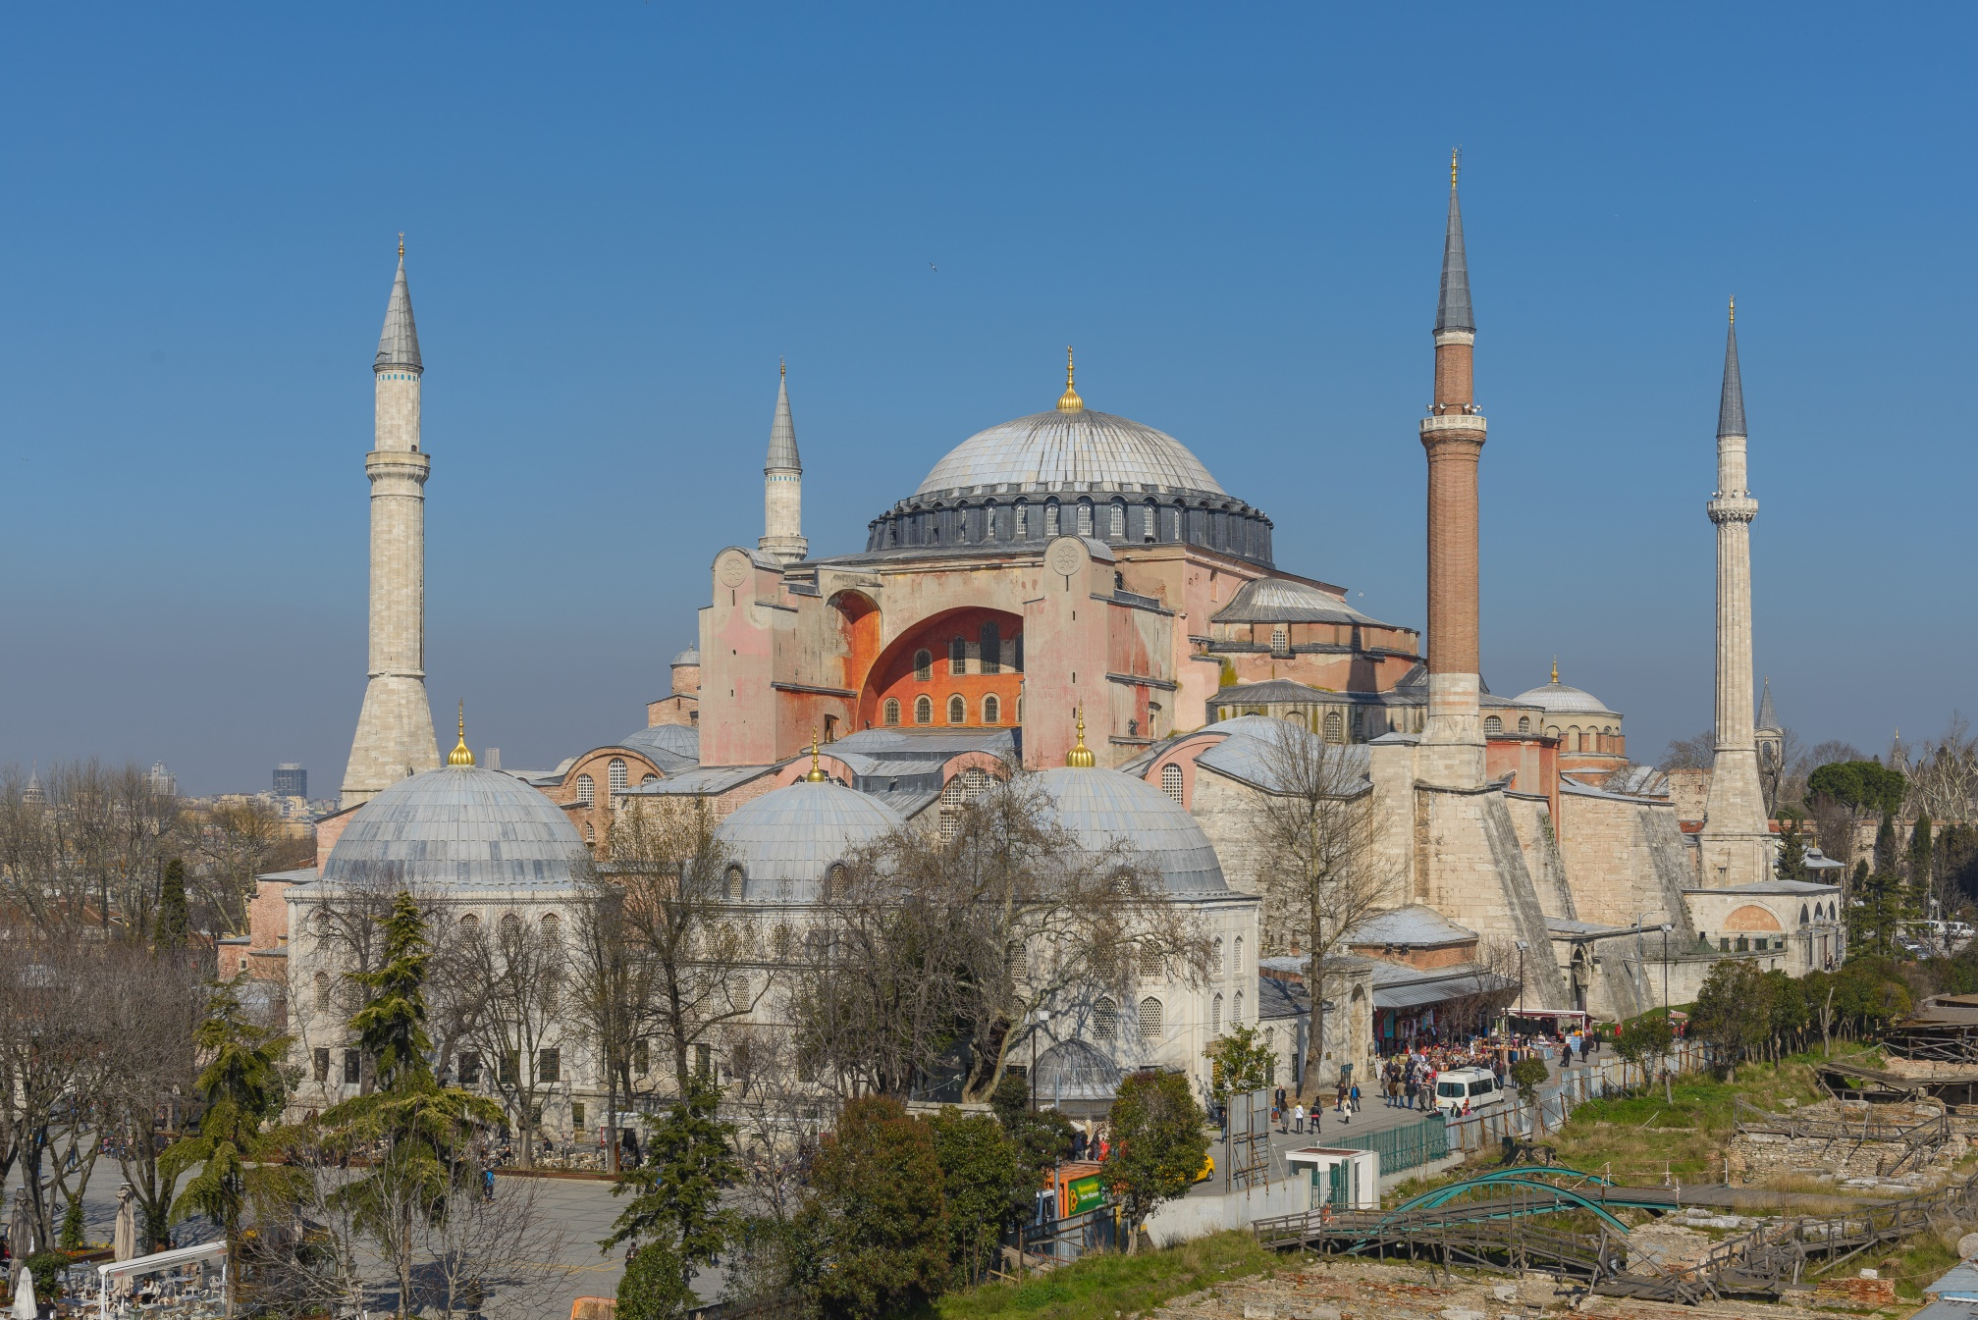
Hagia Sophia
https://upload.wikimedia.org/wikipedia/commons/2/22/Hagia_Sophia_Mars_2013.jpg

Slide 19
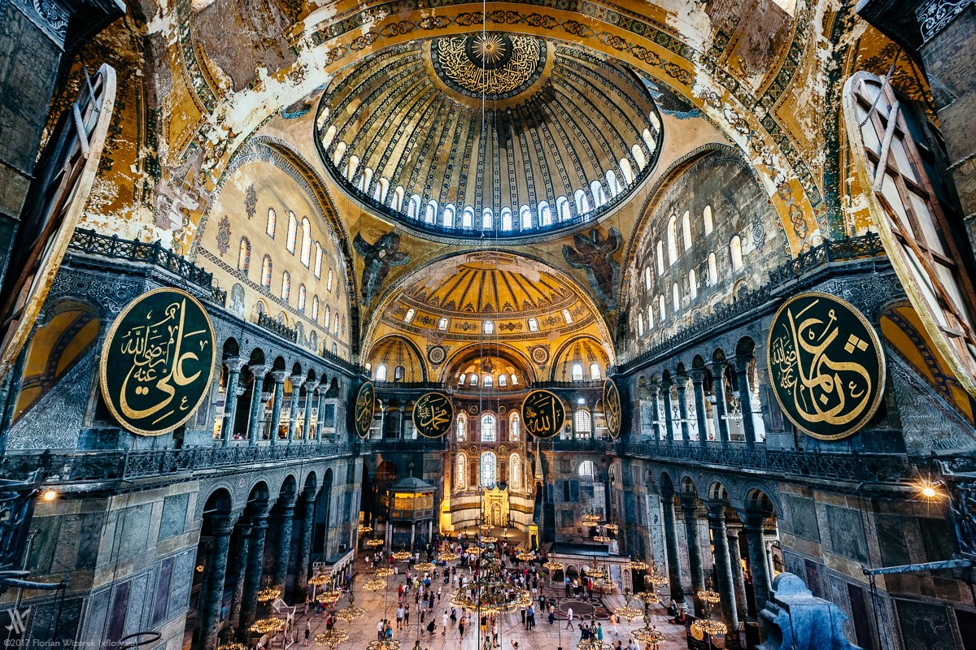
Hagia Sophia (Interior)
https://medium.com/@zeykes/hagia-sophia-the-holy-wisdom-a-basilica-mosque-or-museum-db70ac088ba8

Slide 20
Orthodoxy Among the Slavs
This report also reveals an important aspect of Orthodoxy as it took root in Russia: Russians tended to value their beautiful form of worship more highly than doctrinal orthodoxy or codes of morality.
The report of the Russian delegates from Constantinople persuaded Vladimir to embrace the Eastern Byzantine form of Christianity in AD 988.
Many of the Rus followed their leader’s example and were baptized in the river Dnieper.
The new converts hurled the idol of the Rus’s chief Pagan god, Perun, down the hilltop above Kiev.
Needham, Nick. 2,000 Years of Christ's Power Vol. 2: The Middle Ages

Slide 21
Orthodoxy Among the Slavs
Vladimir then set out to make Kiev into a Christian kingdom, modelled on the Byzantine Empire.
The patriarch of Constantinople appointed a metropolitan bishop in Kiev to lead the Russian Church (Constantinople was to nominate the metropolitans of Kiev for the next 500 years).
Vladimir married Anna, sister of the great Byzantine Emperor Basil II (AD 976-1025).
He invited Byzantine monks to settle in Kiev; the monks brought Byzantine culture and civilization with them, translating the Byzantine liturgy and other religious writings into Slavonic by means of the Cyrillic alphabet.
This gave Russians something that Western Christians did not have, for Western worship and theology were in Latin which, by this time, most Westerners did not understand.
Needham, Nick. 2,000 Years of Christ's Power Vol. 2: The Middle Ages

Slide 22
Orthodoxy Among the Slavs
A distinctive Russian style of church building came into existence too, marked out by an onion-shaped dome.
Further, Vladimir took very seriously his social responsibilities as a Christian ruler; he established a highly organized system of social services for the poor of Kiev – the best welfare system known to us anywhere in medieval Europe.
He also set up Christian schools which trained the younger generation of Russians in the new religion.
After Vladimir’s death in 1015, conflict broke out between his twelve sons.
Needham, Nick. 2,000 Years of Christ's Power Vol. 2: The Middle Ages

Slide 23
Orthodoxy Among the Slavs
Vladimir’s son, Yaroslav the Wise (1019-54), emerged as the ultimate victor, vanquishing all his rivals by 1036.
Yaroslav had the Bible translated into Slavonic, and in the middle of the 11th century a great monastic revival swept through Kiev.
Thus we see, Russian Christianity followed the Byzantine Christianity very closely.
Consequently, Russia naturally sided with Constantinople against Rome in the East West Schism of 1054.
Needham, Nick. 2,000 Years of Christ's Power Vol. 2: The Middle Ages

Slide 24
The East West Schism of 1054
https://www.britannica.com/event/East-West-Schism-1054

Slide 25
https://www.hopehelps.org/volunteer-appreciation-week-2018/

Slide 26
Class Discussion Time
https://www.weareteachers.com/moving-beyond-classroom-discussions/

Slide 27
*Class Discussion Time
We saw today where the “Russians tended to value their beautiful form of worship more highly than doctrinal orthodoxy or codes of morality.” In West, we tend to put more emphasis on doctrinal accuracy and Christian obedience than we do on having a “beautiful form of worship”. Is that a good priority? Why or why not?
What do you think of the Eastern Orthodox view “that the worship of the congregation on earth is a joining and sharing in the worship of the glorified Church in heaven”?
And what do you think of the use of icons, candles, incense, etc. in worship to facilitate a feeling that we are joining the heavenly hosts in their worship of God?
Do you have a topic or question that you would like to see us to discuss?

