Slide 2
Review
In the 8th and 9th centuries, a dispute over the use of religious images (icons) arose in the Byzantine Empire .
What objections did the Iconoclasts (“image breakers”) raise against veneration of icons?
The Old Testament prohibition against images in the Ten Commandments (Exodus 20:4) and the possibility of idolatry
What response did Iconodules (those who supported the veneration of religious icons) give to these objections?
That the 2nd Commandment forbids the making of Pagan icons and images of false gods, not icons of Christ who is the Truth.
That God positively sanctioned many icons in the Old Testament system of worship
That icons served as “books” for those who couldn’t read: they portrayed the people and stories of the Bible and early Church history, so that the illiterate could see and learn about them

Slide 3
Review
The Eastern and Western wings of the one universal Church had been drifting apart ever since the fall of the Roman Empire in the West in 410.
What was the difference between how the East and West viewed the leadership of the church?
The West saw the pope of Rome as the supreme leader of the church
The East saw a shared leadership by the Patriarchs of the five major cities: Rome, Constantinople, Antioch, Jerusalem, and Alexandria
What were some areas where East and West differed in Religious Practice ?
Celibacy of the Priesthood
Communion (leavened versus unleavened bread)
Facial Hair on men
Baptism (triple dunk versus pouring)
Date of Celebration of Easter and Christmas
Statues and Icons

Slide 4
Review
What were some areas where East and West Had theological differences?
Purgatory and Indulgences
Consequences of Original Sin
The Filioque Clause in the Nicene Creed

Slide 5
The Final Split Between East and West
http://wp.production.patheos.com/blogs/jappersandjanglers/files/2016/07/DebateBetweenCatholicsAndOrientalChristiansInThe13thCenturyAcre1290.jpg

Slide 6
The Final Split Between East and West
The final schism between East and West came in the eleventh century.¹
An archbishop in the Eastern Church accused the Western Church of being in error because they insisted that all priests be celibate, and because they used unleavened bread when celebrating communion.¹
When the dispute grew, Pope Leo sent ambassadors, led by Cardinal Humbert meet with Cerularius, the patriarch of Constantinople .²
Unfortunately, the meeting between Cerularius and Humbert was an utter disaster. ²
The patriarch and the cardinal were both stubborn, aggressive men, completely lacking in any of the graces required for diplomacy.²
Eventually Humbert decided that he had had it with Cerularius and his Eastern beliefs and practices.²
¹Gonzalez, Justo L.. The Story of Christianity: Volume 1: The Early Church to the Dawn of the Reformation (pp. 312-314)
²Needham, Nick. 2,000 Years of Christ's Power Vol. 2: The Middle Ages

Slide 7
The Final Split Between East and West
So one summer afternoon in the year 1054, as a service was about to begin in the Church of Hagia Sophia at Constantinople, Cardinal Humbert and two other representatives of Pope Leo IX entered the building and made their way up to the sanctuary.
They had not come to pray.
They placed a Bull (an official papal document) of Excommunication upon the altar and then turned around and marched out of the building.
As he passed through the western door, the cardinal shook the dust from his feet with the words, “Let God look and judge.”
A deacon ran after him in great distress and begged him to take back the Bull.
Humbert refused, and it was dropped in the street.
Shelley, Dr. Bruce L.. Church History in Plain Language: Fourth Edition (p. 150)

Slide 8
The Final Split Between East and West
In language of thunder, the document anathematized the Easterners along with all Arians, Manichees, a list of other heretics, and even “the devil and his angels”, and ended with a resounding “Amen, amen, amen!”
Cerularius responded by anathematizing Humbert and the other papal ambassadors.
The Western church approved of Humbert’s action thus breaking Eastern and Western Christianity apart into two separate Churches (referred to, from this point onwards, as the Western Catholic Church and the Eastern Orthodox Church).
Needham, Nick. 2,000 Years of Christ's Power Vol. 2: The Middle Ages

Slide 9
The Final Split Between East and West
Since both sides believed that there could only be one true Church, this East–West split meant that neither side regarded the other as true Christians any longer.
The Holy Spirit dwelt only in the true Church; therefore, in Eastern eyes, the West had cut itself off from all grace and salvation by excommunicating the Easterners, and in Western eyes the East had been cut off from grace by Humbert acting in the pope’s name.
It took some time for the consequences of 1054 to become clear in the practical relations between Easterners and Westerners at a local level.
It was the Crusades, and the outrages committed by the Western Crusaders against Eastern Christians, which made the great schism into a burning grass-roots reality.
Needham, Nick. 2,000 Years of Christ's Power Vol. 2: The Middle Ages

Slide 10
The Crusades
https://strangenotions.com/the-crusdades-urban-legends-and-truth/

Slide 11
What Were the Crusades?
The Crusades were a series of military expeditions to the Middle East by Western Catholics, inspired and blessed by the Catholic Church, with the aim of recapturing the Holy Land (especially Jerusalem) from the Muslims.
There were four main Crusades:
First Crusade: 1096-99
Second Crusade: 1147-49
Third Crusade: 1189-92
Fourth Crusade: 1202-4
There had, of course, been a long tradition of warfare between Christians and Muslims before the Crusades.
The Byzantine Empire and the Islamic Empire had been fighting each other in and around Asia Minor ever since the Muslim armies first came streaming out of Arabia in the 7th century.
Needham, Nick. 2,000 Years of Christ's Power Vol. 2: The Middle Ages

Slide 12
The Causes of the Crusades
It was the great Byzantine Emperor Alexius I Comnenus who triggered the Crusades.
In 1094, Alexius appealed to Pope Urban II (1088-99) for help in fighting the Seljuk Turks.
The Turks, the new rulers of the Muslim world in the East, had decisively beaten the Byzantines at the battle of Manzikert in 1071, and conquered the bulk of Asia Minor.
Alexius asked for Western troops to increase the strength of his own Byzantine army, so that he could reconquer Asia Minor.
What he got instead was the First Crusade.
Needham, Nick. 2,000 Years of Christ's Power Vol. 2: The Middle Ages

Slide 13
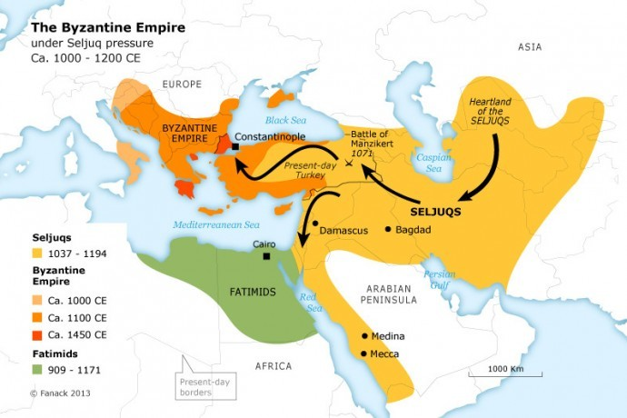
https://istanbulclues.com/battle-of-manzikert-seljuks-byzantines/

Slide 14
The Causes of the Crusades
Before Alexius made his appeal to Urban II for Western troops, Western Europe was already full of people who had gone on pilgrimages to the Holy Land, to visit the scenes of Jesus’s life and death.
Until the Seljuk Turks took control in 1055, the Muslim rulers of the Holy Land had always treated Christian pilgrims well.
The Turks, by contrast, treated them badly.
Western pilgrims came back from Palestine and filled Europe with terrible stories of Turkish hostility and persecution.
Catholic Europe was outraged.
Needham, Nick. 2,000 Years of Christ's Power Vol. 2: The Middle Ages

Slide 15
The Causes of the Crusades
In addition, there was a growing feeling in the West at this time that the forces of Christianity could defeat and expel the Muslims from Christian lands they had conquered.
Under King Ferdinand I of Castile (1035-65), the Christian reconquest of Muslim Spain had begun, which Spanish Catholics regarded as a Crusade in their own land.
Between 1060 and 1090, the Catholic Normans of southern Italy destroyed Muslim power in Sicily.
Perhaps it seemed natural to continue this successful drive against Islam into the East.
Needham, Nick. 2,000 Years of Christ's Power Vol. 2: The Middle Ages

Slide 16
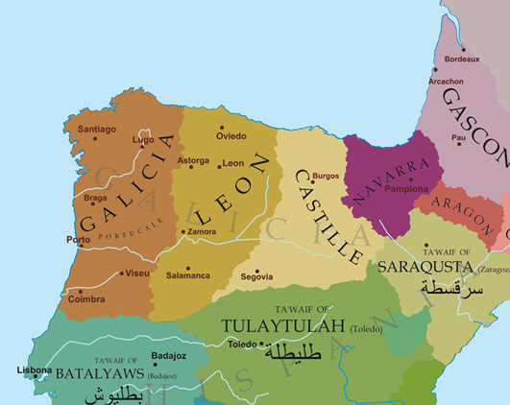
Eleventh Century Spain
https://en.wikipedia.org/wiki/Ferdinand_I_of_Le%C3%B3n#/media/File:Europe-south-west-kingdoms.png

Slide 17
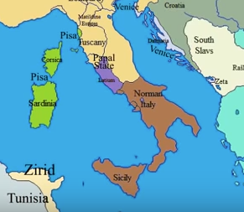
Italy in 1090
https://www.youtube.com/watch?v=vjWVFZ5e_vo

Slide 18
The Causes of the Crusades
In November 1095, Urban called together a council of clergy and nobles at Clermont in southern France to consider the situation in the East.
On the ninth day of this council, he preached one of the most epoch-making sermons in Christian history.
Urban called on the kings and nobles of Catholic Europe, especially the French, to stop fighting each other, unite, and rescue the Holy Land from the Turks.
The assembled crowds responded with an outburst of wild enthusiasm, crying out, “God wills it! God wills it!” (in Latin, “Deus vult!”)
This became the motto of the First Crusade.
Needham, Nick. 2,000 Years of Christ's Power Vol. 2: The Middle Ages

Slide 19
The Causes of the Crusades
Hundreds of thousands of Western European men sincerely wanted to free the tomb of Christ from the Muslims, as an act of devotion to their Savior.
In their view, the Crusades were simply pilgrimages carried out in the form of warfare.
The very name the Crusaders took for themselves suggests this religious motive, because the word “crusade” comes from the Latin crux, meaning “cross”.
A Crusading knight would have the sign of the cross sewn into his outer clothing as a token of his allegiance to Christ; the more zealous would brand it into their flesh.
Urban II encouraged this spirit by using the words of Christ in Mark 8:34 as a Crusade text – Whoever desires to come after Me, let him deny himself, and take up his cross, and follow Me.
Needham, Nick. 2,000 Years of Christ's Power Vol. 2: The Middle Ages

Slide 20
The Causes of the Crusades
The military power behind the Crusades was the nobility (or aristocracy) of Western Europe, a warrior class for whom fighting was a way of life.
They fought on horseback and were called “knights”; they were the backbone of Europe’s ruling class.
The Cluniac revival in the 10th and 11th centuries tried to bring the violence of this warrior class under control by creating a moral and spiritual code to govern their behavior.
This was called the code of “chivalry” (from the French chevalerie, “cavalry” – warriors on horses).
A book published in about 1090 offered a complete set of chivalric values for the Christian knight, including courage, justice, chastity, sobriety, loyalty, and prudence.
Needham, Nick. 2,000 Years of Christ's Power Vol. 2: The Middle Ages

Slide 21
The Causes of the Crusades
The code of chivalry often took Charlemagne as the supreme example of a true Christian knight.
In practice, it meant that when a young noble reached his maturity, the Church blessed his sword in a special ceremony, and he promised to use it to defend churches, women, orphans, the poor, and servants of God, and to fight against injustice and the enemies of Christianity.
Western Catholics therefore came to see the knight as a kind of spiritual figure, like a priest or a monk.
In these ways, then, the Catholic Church tried to Christianize the knights of Western Europe.
The Crusades provided a great outlet for the energies of these Christian warriors: by attacking the Muslims and freeing the Holy Land, they were doing the thing they enjoyed most (fighting), and also fulfilling the spiritual ideals of chivalry by acting as champions of the Christian faith.
Needham, Nick. 2,000 Years of Christ's Power Vol. 2: The Middle Ages

Slide 22
The Causes of the Crusades
Abbot Guibert of Nogent (1053-1125) in north-eastern France said: In our times God has instituted holy wars, so that knights may find a new way of gaining salvation. They do not have to abandon secular affairs completely by choosing the monastic life or any religious profession, as was once the custom, but they can in some degree attain to God’s grace by pursuing their own knightly careers, in the freedom and the armor which is their habit.
The spiritual nature of Crusade warfare was underlined by the fact that before every battle, a Crusader had to confess his sins to a priest and take holy communion.
The papacy also offered heavenly rewards to the Crusading knights, promising them complete pardon from all the “temporal penalties” of their sins.
This pardon was called an “indulgence”.
Needham, Nick. 2,000 Years of Christ's Power Vol. 2: The Middle Ages

Slide 23
The Causes of the Crusades
While the chief inspiration behind the Crusades was religious, the Crusades had other, less spiritual attractions for the Western nobility.
For example, the Western custom of inheritance, “primogeniture”, meant that the oldest son inherited all his father’s property.
Therefore the Crusades opened up an opportunity for younger sons to win land for themselves.
The Crusades were also attractive because they offered the noble warrior a chance to prove how good a fighter he was and achieve military glory for himself.
Needham, Nick. 2,000 Years of Christ's Power Vol. 2: The Middle Ages

Slide 24
The History of the Crusades
https://www.crisismagazine.com/2015/history-crusades-obama-read

Slide 25
https://www.hopehelps.org/volunteer-appreciation-week-2018/

Slide 26
Class Discussion Time
https://www.weareteachers.com/moving-beyond-classroom-discussions/

Slide 27
*Class Discussion Time
The Crusaders saw themselves as battling for the cause of Christ. Is this something that Christians are called to do?
Before you answer, consider this text:
For though we live in the world, we do not wage war as the world does. The weapons we fight with are not the weapons of the world. On the contrary, they have divine power to demolish strongholds. We demolish arguments and every pretension that sets itself up against the knowledge of God, and we take captive every thought to make it obedient to Christ. (2 Corinthians 10:3-5 NIV)
Can a Christian in good conscience serve as a soldier in defense of his own country?
Before you answer, consider this text:
Then some soldiers asked [John the Baptist], "And what should we do?" He replied, "Don't extort money and don't accuse people falsely--be content with your pay." (Luke 3:14 - NIV)
Do you have a topic or question that you would like to see us to discuss?

