Slide 2
The Rise of Universities
The University of Paris
https://www.newworldencyclopedia.org/entry/File:Universite_Paris_I_Pantheon-Sorbonne.jpg

Slide 3
The Rise of Universities
The 12th and 13th centuries saw a great flowering of knowledge, especially theology and philosophy, in Western Christendom.
It reached its high point in the 13th century, which many consider to be the “golden age” of Western Catholic civilization in the Middle Ages.
At the heart of this flowering of knowledge was the university.
The institution of the university came to the West from the Muslim world.
Needham, Nick. 2,000 Years of Christ's Power Vol. 2: The Middle Ages

Slide 4
The Rise of Universities
The most important Muslim university was al-Azhar University in Cairo, Egypt.
Al-Azhar was founded in AD 970; it still exists today and is one of the world’s oldest centers of learning.
These Islamic universities had a strong influence on the development of European education, for example in the use of Arabic rather than Roman numbers.
However, the greatest impact Islamic universities had on the West was simply the way they acted as channels for the Muslim world’s medical, scientific, mathematical and philosophical knowledge to flow into Western academic institutions. (At that time, the Islamic world far surpassed the West in intellectual achievement).
Needham, Nick. 2,000 Years of Christ's Power Vol. 2: The Middle Ages

Slide 5
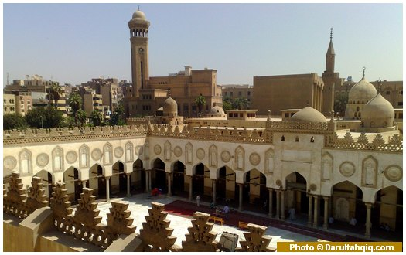
al-Azhar University in Cairo, Egypt
https://www.islamiclandmarks.com/egypt/al-azhar-university

Slide 6
The Rise of Universities
At that time, the Islamic world far surpassed the West in intellectual achievement.
Western universities began to appear in the 12th century.
They developed out of schools in the cities which were attached to cathedral churches and abbeys.
Many of these schools were originally founded to train boys for the Church, for example, to sing in choirs.
However, such schools also often provided a free general education to boys living in the neighborhood.
Needham, Nick. 2,000 Years of Christ's Power Vol. 2: The Middle Ages

Slide 7
The Rise of Universities
The first universities were those of Bologna (northern Italy) and Paris (northern France).
There had been a law school in Bologna since AD 890; this formed the basis of what became Bologna University, given official recognition by the Holy Roman Emperor, Frederick Barbarossa in 1155.
In Paris, there was a famous school attached to Notre Dame Cathedral, which by 1170 had taken on the features of a university.
The other Western universities were modelled on Bologna and Paris.
Needham, Nick. 2,000 Years of Christ's Power Vol. 2: The Middle Ages

Slide 8
University of Bologna, Italy
http://www.mladiinfo.eu/2018/02/09/phd-positions-scholarships-university-bologna-italy/

Slide 9
The Rise of Universities
Many universities sprang up in the period 1200-1500.
By 1500, there were about 80 universities in Western Europe. Some were celebrated for teaching particular subjects:
Paris was famous for theology,
Bologna for law,
Salerno (southern Italy) for medicine,
Oxford (southern England) for science and mathematics.
A fully developed university would have four departments or “faculties”, teaching theology, law, medicine, and arts.
The ideal was to make the university into a center for preserving and communicating the sum total of all human knowledge.
Needham, Nick. 2,000 Years of Christ's Power Vol. 2: The Middle Ages

Slide 10
The Rise of Universities
The normal age for entering a university was 14 or 15.
All a man needed was an education in the Latin language and the ability to pay his fees.
Women were not eligible for university education in the Middle Ages.
Latin was the only language spoken in universities; the Western world considered it the proper language of culture and civilization.
Almost all lecturers in all subjects were clergymen, and the few laymen who served as lecturers had to be celibate.
All students, too, had to be unmarried during their time at university.
It was a long academic year: 11 months, with just a few weeks off for Christmas and Easter.
Needham, Nick. 2,000 Years of Christ's Power Vol. 2: The Middle Ages

Slide 11
The Rise of Universities
The method of education used in universities was twofold:
The lecture;
The disputation.
In the lecture, the teacher would read out a set text to the students, and make his own comments on the text.
The students were expected to take very full notes of what the teacher said.
Books were scarce in the days before printing was invented, so we must not imagine that every student had his own copy of the textbook.
Probably the university had only one copy which was kept chained up in the library.
Needham, Nick. 2,000 Years of Christ's Power Vol. 2: The Middle Ages

Slide 12
The Rise of Universities
The disputation was a public event in which a teacher and a student would set out to solve a problem.
The problem would be two statements which appeared to contradict each other, but which were both found in authoritative texts.
To take a theological example, an early Church father might be quoted as saying, “God cannot die.”
But then another Church father might be quoted as saying, “God died on the cross.”
Needham, Nick. 2,000 Years of Christ's Power Vol. 2: The Middle Ages

Slide 13
The Rise of Universities
The student would have to give all the arguments for and against each statement, by quoting passages from the Bible and great theologians, and offering his own comments on these passages.
The teacher would then make remarks on what the student had said, and would offer a solution to the problem.
In the example we used, the teacher would probably have said: “Both statements are true, if interpreted properly. In His divine nature, God cannot die. But when He became a man, He took upon Himself a human nature which can die. Therefore on the cross, God suffered death in His human nature. But He remains incapable of dying in His divine nature.”
Needham, Nick. 2,000 Years of Christ's Power Vol. 2: The Middle Ages

Slide 14
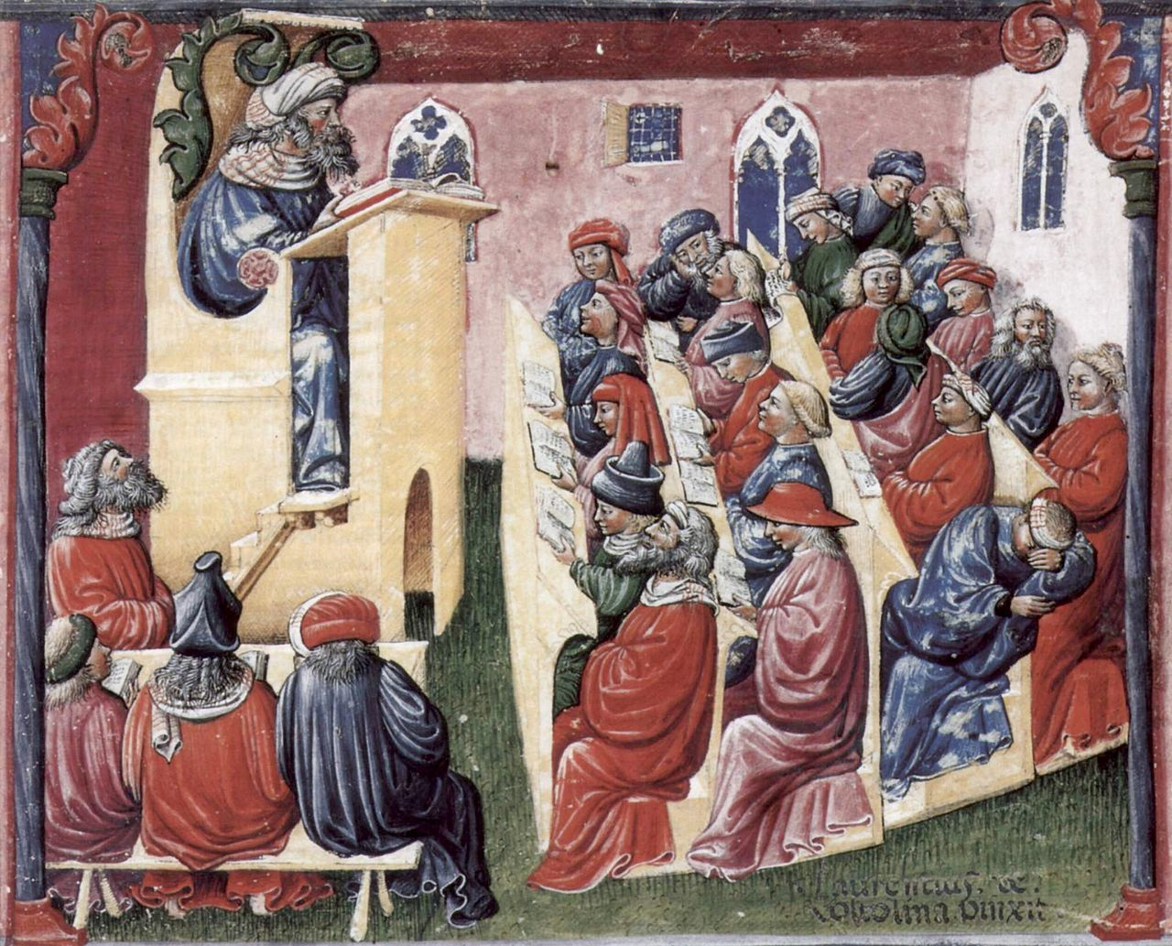
A University Classroom (Bologna - 1350s)
The students sat on the benches before the tables and worked, as the professor spoke from the pulpit. When the professor was commenting on a text, the text was presented by a reader seated in the special section just below the professor.
https://en.wikipedia.org/wiki/Medieval_university#/media/File:Laurentius_de_Voltolina_001.jpg

Slide 15
The Rise of Universities
The disputation was a powerful method for training the minds of students in the art of logical thinking and arguing, and enabled them to master the selected areas of knowledge on which they performed their disputations.
Lecturers also engaged in disputations over debated subjects; they would draw up a set of statements or “theses”, announce that they were going to defend them in debate, and challenge anyone to argue with them and disprove the theses.
When a student had finished his university course, he was awarded the degree of “bachelor”.
It normally took five or six years to become a bachelor.
Needham, Nick. 2,000 Years of Christ's Power Vol. 2: The Middle Ages

Slide 16
The Rise of Universities
To obtain the higher degree of “master” or “doctor”, which entitled its owner to give his own lectures in a university, took much longer – 14 years of study were necessary to become a doctor of theology.
The growth of the universities produced a theological revolution in Western Christendom.
Previously, the great monasteries had been the centers of learning; the leading theologians had been monks who studied theology within the setting of monastic life and worship.
The universities challenged this.
Theology now became an intellectual subject in its own right, and people studied it in the academic context of university life, outside the constraints of monastic discipline.
Needham, Nick. 2,000 Years of Christ's Power Vol. 2: The Middle Ages

Slide 17
The Rise of Universities
The great theologians were now university professors who earned their living by teaching doctrine.
In one way, this had a liberating effect on Western theology, releasing torrents of intellectual energy, debate, and writing, in the stimulating atmosphere of free academic discourse.
In another way, though, it introduced a certain element of division between spiritual life on the one hand, and intellectual and theological pursuits on the other.
Many have judged this division to be a deeply harmful feature of Western Christianity since the 1100s.
Needham, Nick. 2,000 Years of Christ's Power Vol. 2: The Middle Ages

Slide 18
The Rise of Scholasticism
https://churchlifejournal.nd.edu/articles/the-birth-of-scholasticism-from-a-series-of-fortunate-mistakes/

Slide 19
The Rise of Scholasticism
“Scholasticism” and “scholastic theology” are the names that historians give to the theological teaching which dominated the Western universities of the Middle Ages.
The term “scholastic” comes from the word for “school” and simply means “school theology” – the theology taught in the schools (in other words, in the universities).
The scholastic theologians are often called “the schoolmen”.
The schoolmen developed a distinctive approach to theology.
Needham, Nick. 2,000 Years of Christ's Power Vol. 2: The Middle Ages

Slide 20
The Rise of Scholasticism
We can summarize the style and outlook of Scholasticism as follows:
Faith and reason
Systematic theology
Philosophy and the writings of Aristotle
Needham, Nick. 2,000 Years of Christ's Power Vol. 2: The Middle Ages

Slide 21
The Rise of Scholasticism
Faith and reason
The scholastic theologians were deeply concerned about the relationship between faith and reason.
They wanted to see how far “pure reason” could discover or prove the doctrines of the Christian faith.
What could the human mind find out about God by investigating the created world, without referring to God’s special revelation in the Bible?
For example, what could unaided reason discover of the existence of God the Creator, the Trinity, or providence?
If reason alone could not discover or prove a particular doctrine, could it still be shown to be in harmony with reason?
Needham, Nick. 2,000 Years of Christ's Power Vol. 2: The Middle Ages

Slide 22
The Rise of Scholasticism
Faith and reason (continued)
For instance, even if we cannot discover the Trinity by pure reason, can we still demonstrate that the Trinity does not contradict reason?
Can something be false from the viewpoint of reason, but true according to divine revelation?
Different schoolmen gave different answers to these questions, but they were united in asking the same questions.
Needham, Nick. 2,000 Years of Christ's Power Vol. 2: The Middle Ages

Slide 23
The Rise of Scholasticism
Systematic theology
The scholastic theologians wanted to offer a complete, systematic account of Christian truth.
This meant examining a particular doctrine logically from every point of view.
But it meant more. A typical schoolman would try to bring all Christian doctrines together into a system of theology which set forth and explained the entire body of revealed truth.
They called such a system a summa (summary).
Needham, Nick. 2,000 Years of Christ's Power Vol. 2: The Middle Ages

Slide 24
The Rise of Scholasticism
Systematic theology (continued)
In their pursuit of a universal system of doctrine, the schoolmen often spent a great deal of time and effort inquiring into questions which most Christians in later ages would find pointless.
For example:
Could God have become incarnate as an animal, or as a woman?
Can one angel be in two places at the same time?
Can two angels be in the same place at the same time?
Who sinned most, Adam or Eve?
Needham, Nick. 2,000 Years of Christ's Power Vol. 2: The Middle Ages

Slide 25
Philosophy and the Writings of Aristotle
https://brewminate.com/the-science-and-biology-of-aristotle/

Slide 26
https://www.hopehelps.org/volunteer-appreciation-week-2018/

Slide 27
Class Discussion Time
https://www.weareteachers.com/moving-beyond-classroom-discussions/

Slide 28
*Class Discussion Time
The rise of universities introduced a certain element of division between spiritual life on the one hand, and intellectual and theological pursuits on the other. Many have judged this division to be a deeply harmful feature of Western Christianity. What do you think?
If something taught in divine revelation seems to contradict “reason”, which should you believe?
Can something be false from the viewpoint of “reason”, but true according to divine revelation?
Do you have a topic or question that you would like to see us to discuss?

