Slide 1


Slide 2

Review
In the 13th century, scholastic theology came to rely increasingly on the philosophy of what ancient philosopher?
  Aristotle.
What was it that made Aristotle suddenly available to the West in the 1100s?
  Aristotle's writings were all translated into Latin.
Give an example of something Aristotle taught that contradicted the Bible.
  Aristotle taught that the world had always existed.
Prior to the 13th century, what ancient philosopher had the Western Church found to be the most suitable ally of Christian theology?
  Plato

Slide 3
Review
Although Aristotle had been a student of Plato he sometimes came to different conclusions.
Describe the difference in the views of Plato and Aristotle on how we come to know what we know.
  Plato held that the human soul had a direct inner knowledge of a higher spiritual world, and that this knowledge did not depend on our experience of life in the outward physical world.
  Aristotle, on the other hand, taught that all human knowledge arose from experience mediated to the soul through the senses – through what we can see, hear and touch.
What proof for the existence of God was Anselm most known for?
  The Ontological proof for the existence of God
What was Anselm’s motto?
  Credo ut intelligam: I believe so that I may know.

Slide 4
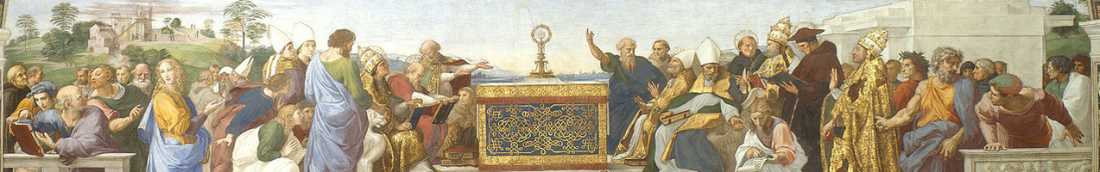
Great Scholastic Theologians
(Continued)
https://www.studium-scholasticum.org/

Slide 5
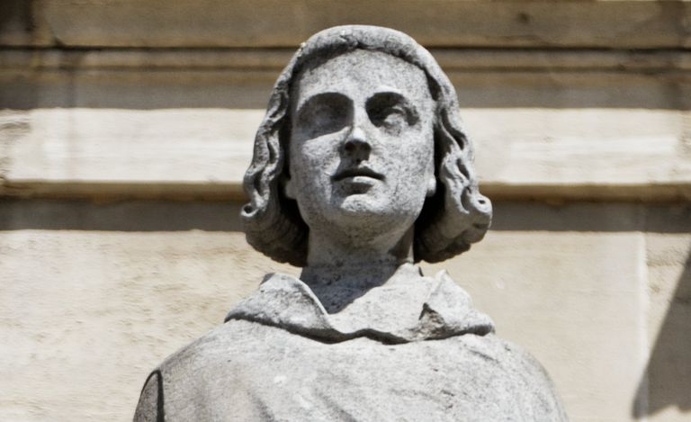
Peter Abelard
Statue of Peter Abelard at the Louvre Palace in Paris.
https://www.thoughtco.com/peter-abelard-profile-1788349

Slide 6
Peter Abelard
Peter Abelard (1079-1142) was one of the most brilliant Catholic thinkers of the 12th century.
He was also its most tragic figure because of the spectacular moral failings of his life and their painful consequences.
He was born in northern France, and studied at the famous cathedral school of Notre Dame in Paris which was developing into Paris University.
Abelard felt dissatisfied with the teaching of the school’s head, William of Champeaux. So he set up his own rival lectures.
The students deserted William to listen to Abelard.
Needham, Nick. 2,000 Years of Christ's Power Vol. 2: The Middle Ages

Slide 7
Peter Abelard
He soon became head of the Paris school himself, and students flocked from all over Western Europe to sit at his feet.
However, at the same time that Abelard was rising to these dizzy heights of intellectual fame, his moral downfall was looming.
Fulbert, who was on staff at Notre Dame Cathedral, had a 17-year-old niece, the highly intelligent and extremely beautiful Heloise.
Abelard fell wildly in love with her.
Abelard persuaded Fulbert to take him into his household and appoint him as Heloise’s private tutor.
Needham, Nick. 2,000 Years of Christ's Power Vol. 2: The Middle Ages

Slide 8
Peter Abelard
Heloise and Abelard, who was more than twice her age, did not confine themselves within the limits of a pupil-teacher relationship; their passion for each other is the most famous love-affair of the Middle Ages.
When the affair was discovered (Heloise became pregnant with Abelard’s child), Heloise’s uncle Fulbert exploded with rage.
Presumably acting on the principle that the punishment should fit the crime, Fulbert hired some thugs who burst into Abelard’s bedroom one night and castrated him.
A deeply chastened Abelard retired from the Paris school into the Benedictine monastery of Saint Denis, just north of Paris, and Heloise became a nun.
Needham, Nick. 2,000 Years of Christ's Power Vol. 2: The Middle Ages

Slide 9
Peter Abelard
Abelard’s most important writing came soon after these tragic events. In 1122 Abelard wrote a book called Sic et non (“Yes and no”).¹
In this book Abelard considered 158 theological questions.¹
He set alongside each other statements from the Bible, the early Church fathers, and other authoritative statements of Church teaching, which appeared to contradict each other.¹
Abelard’s aim was to provoke people to think for themselves and use reason as a tool for reconciling these apparently conflicting statements.¹
Abelard rejected Anselm’s motto, which was credo ut intelligam: I believe so that I may know.²
Abelard’s motto was intelligo ut credam: I know that I may believe. His concept is more man-centered.²
¹ Needham, Nick. 2,000 Years of Christ's Power Vol. 2: The Middle Ages
²James White 2016 Church History Series #46

Slide 10
Peter Abelard
Abelard had a stormy life. He was often in trouble with Church authorities, especially Bernard of Clairvaux, who regarded Abelard as a dangerously unsound thinker.
Nevertheless, Abelard’s lectures and writing had a great impact on the 12th century West.
They shook the minds of students awake, inspiring them to ask questions and to use reason as a way of investigating and determining the meaning of theological statements.
Needham, Nick. 2,000 Years of Christ's Power Vol. 2: The Middle Ages

Slide 11
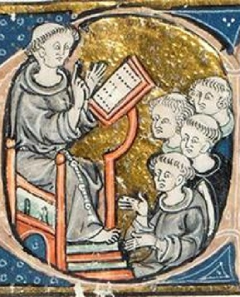
Peter Lombard
https://andywrasman.files.wordpress.com/2018/10/peter-lombard.jpg

Slide 12
Peter Lombard
Peter Lombard (1100-1160) has been called “the father of systematic theology”.
Born in Lombardy, northern Italy, he studied at Bologna and Paris (his teacher at Paris was probably Abelard).
From about 1140, he taught theology in Paris, and became bishop of Paris in 1159 but died the following year.
He is the author of what came to be the most widely used theological textbook of the Middle Ages: the Four Books of Sentences, which he produced between 1147 and 1151.
Needham, Nick. 2,000 Years of Christ's Power Vol. 2: The Middle Ages

Slide 13
Peter Lombard
In some ways Lombard’s Sentences was similar to Abelard’s Sic et non.
The difference was that Lombard offered solutions to all difficulties and apparent contradictions, using reason to judge between different authorities.
Lombard’s method was to state the teaching of the Church, prove it from the Bible, give the opinions of the early Church fathers, and then to resolve any seeming contradictions by the careful use of logic.
Lombard’s Sentences remained the standard theological textbook in Western universities until the Protestant Reformation of the 16th century.
Writing a commentary on the Sentences was a normal part of the process for obtaining a doctorate in theology during the Middle Ages.
Needham, Nick. 2,000 Years of Christ's Power Vol. 2: The Middle Ages

Slide 14
Peter Lombard
Lombard was the first Catholic theologian to define the number of the “sacraments” as seven: baptism, holy communion, confirmation, penance, marriage, ordination, and extreme unction.
  Confirmation is the ceremony in which a baptized person becomes a full member of the Church by the laying on of a bishop’s hands.
  Penance involves confessing one’s sin to a priest, receiving his “absolution” or forgiveness, and submitting to whatever act of discipline the priest imposes (e.g. fasting, abstaining from communion).
  Extreme unction is a ceremony in which the priest anoints a dying person with oil (the oil signifying the Holy Spirit) to prepare him for his journey to the next life; it is often called “the last rites”.
Needham, Nick. 2,000 Years of Christ's Power Vol. 2: The Middle Ages

Slide 15
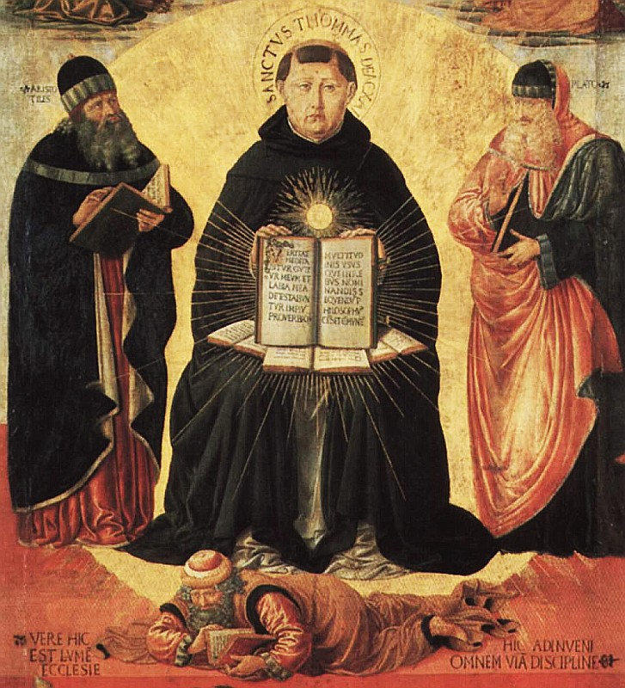
Thomas Aquinas
"Triumph of St. Thomas Aquinas over Averroes" by Benozzo Gozzoli (1420–97)
https://en.wikipedia.org/wiki/Thomas_Aquinas#/media/File:Benozzo_Gozzoli_004a.jpg

Slide 16
Thomas Aquinas
Thomas Aquinas (1225-74) was born in the castle of Roccasecca, near Aquino, in the territory of Naples (southern Italy), the son of a Lombard noble.
Against the wishes of his family, in 1244 he joined the new religious order of “preaching monks” called Dominicans.
However, Aquinas’s family were so opposed to his decision that they kidnapped him and imprisoned him in Roccasecca castle for over a year, to try to force him to change his mind.
They even hired a young woman of beautiful appearance but dubious morals to enter his prison cell and tempt him sexually!
Aquinas resisted all the pressure and his family finally gave up and allowed their heroically obstinate son to join the Dominican order.
Needham, Nick. 2,000 Years of Christ's Power Vol. 2: The Middle Ages

Slide 17
Thomas Aquinas
Aquinas studied at the universities of Naples, Paris, and Cologne (north-western Germany).
At Cologne, Aquinas’s teacher was the illustrious German Dominican schoolman, Albertus Magnus (“Albert the Great”, 1193-1280).
Albertus was one of the most important Western champions of Aristotle’s philosophy, writing commentaries on all Aristotle’s works.
Albertus and his pupil Aquinas became lifelong friends.
When other students mocked Aquinas for his slowness of speech and called him “the dumb ox”, Albertus responded, “This dumb ox will make such a roaring in theology that he will be heard through all the earth!”
Needham, Nick. 2,000 Years of Christ's Power Vol. 2: The Middle Ages

Slide 18
Thomas Aquinas
Aquinas became a famous lecturer during his lifetime, but it was only after his death that the Church recognized Aquinas’s greatness as a theologian.
As well as being the deepest of Catholic thinkers, he was also a man of humble and blameless life.
He never finished his masterpiece of systematic theology, the Summa Theologiae, because towards the end of his life (in December 1273) he abandoned writing entirely.
When asked why, he replied that everything he had written seemed like “a piece of straw”.
Some have traced this to a sort of nervous breakdown, others to a glorious spiritual experience Aquinas is alleged to have had during holy communion which (he said) made his writings appear worthless in comparison with the experience.
Needham, Nick. 2,000 Years of Christ's Power Vol. 2: The Middle Ages

Slide 19
Thomas Aquinas
Aquinas’s theology was based on his attempt to reconcile Catholic teaching with Aristotle’s philosophy.
Aquinas brought about an intimate blend between Aristotle and the Catholic faith, like water mixed with wine.
Human reason, Aquinas taught, could discover much that was true about the world and even about God. Aristotle’s philosophy was the supreme achievement of human reason, the best account of the universe that humanity’s unaided intelligence could give.
According to Aquinas, divine revelation did not overthrow Aristotle’s philosophy, but brought it to perfection by revealing truths like the Trinity which human reason alone could never have discovered.
Needham, Nick. 2,000 Years of Christ's Power Vol. 2: The Middle Ages

Slide 20
Thomas Aquinas
So for Aquinas, Aristotle’s philosophy laid the foundation for a rational knowledge of the universe; divine revelation then built the temple of Christian truth on that foundation.
This is not to say that Aquinas blindly accepted everything that Aristotle taught.
On points where Aquinas believed that Aristotle contradicted Christian teaching, for example Aristotle’s view that the world is eternal, Aquinas corrected the philosopher in the light of the Bible.
Needham, Nick. 2,000 Years of Christ's Power Vol. 2: The Middle Ages

Slide 21
Thomas Aquinas
One of the views Aquinas absorbed from Aristotle was his view of women: that women were “misbegotten men”.
He said that women were made in God’s image, but were a lesser form of perfection than men.
He felt women were weaker mentally, physically and spiritually. Hence they must be in subjection and should not be ordained.
This affected his view of sexuality. Thomas felt the only purpose for sex was procreation.
Aquinas said that the Fall accentuated lust, that if a couple engages in sex without the idea of procreation, one is sinning.
That is still pretty much Rome’s perspective today, which is why they believe that the use of contraceptives is sinful.
Needham, Nick. 2,000 Years of Christ's Power Vol. 2: The Middle Ages

Slide 22
Thomas Aquinas
Aquinas wrote a large number of books.
But his two greatest masterpieces were:
  The Summa contra Gentiles (“Handbook against the Pagans”);
  The Summa Theologiae (“Summary of Theology”).
Needham, Nick. 2,000 Years of Christ's Power Vol. 2: The Middle Ages

Slide 23
Thomas Aquinas – Summa contra Gentiles
The Summa contra Gentiles was intended to enable Christians to present Christianity to non-Christians, such as Jews and Muslims, and to refute their errors.
It was divided into four parts:
  In parts one to three, Aquinas argued on the basis of reason and philosophy to establish the existence of God, and the doctrines of creation and providence.
  In part four, he explained those truths which only divine revelation could make known – the Trinity, the incarnation, the resurrection.
Needham, Nick. 2,000 Years of Christ's Power Vol. 2: The Middle Ages

Slide 24

Thomas Aquinas – Summa Theologiae
A complete copy found in the catalog of the city of Lyon – dated 1624
https://www.edition-originale.com/en/antique-books-1455-1820/philosophy/thomas-daquin-summa-theologiae-1624-38709

Slide 25

https://www.hopehelps.org/volunteer-appreciation-week-2018/

Slide 26

Class Discussion Time
https://www.weareteachers.com/moving-beyond-classroom-discussions/

Slide 27
*Class Discussion Time
Compare Anselm’s motto, which was credo ut intelligam: I believe so that I may know with Abelard’s motto which was intelligo ut credam: I know that I may believe. Which of these do you agree with? Explain your answer.
Aquinas felt women were weaker mentally, physically and spiritually. Hence they must be in subjection and should not be ordained. Our tendency, in light of modern thinking, is to completely dismiss such an idea. But is there any truth to it? Consider these scriptural teachings:
  Husbands, live with your wives in an understanding way, showing honor to the woman as the weaker vessel (1Pet. 3:7)
  I do not permit a woman to teach or to exercise authority over a man; rather, she is to remain quiet. For Adam was formed first, then Eve; and Adam was not deceived, but the woman was deceived and became a transgressor. (1Tim. 2:12-14)
Do you have a topic or question that you would like to see us to discuss?

