Slide 2
Review
John Duns Scotus was opposed to many of the teachings of Thomas Aquinas. He began a revolutionary new trend in scholasticism by _____ theology from philosophy.
separating
Scotus said that Christ’s death had saving power, not because of any inherent worth or value possessed by Christ or His sacrifice, but simply because …
God sovereignly willed to accept it as a sufficient payment for sin.
What does the doctrine of the immaculate conception teach?
That Mary was conceived without original sin
Scotus reasoned that the immaculate conception was “_____” because it appeared to follow from other known doctrines and Scripture and Church tradition did not deny it.
probable

Slide 3
Review
William of Ockham taught that Popes could err but ecumenical councils and the Bible were both _____.
Infallible
“Occam's razor” was a philosophical principle that purports to help us determine the most likely solution to a problem. Give a short definition of “Occam's razor”.
the simplest solution is most likely the right one
Ockham argued that one should not say that God always does good, but rather that…
whatever God does, no matter what it might be, is good
Ockham taught that an unbeliever could merit God’s grace by…
“doing his best”

Slide 4
The Rise of Musical Instruments in Worship
https://www.pinterest.com/pin/474496510716734374/visual-search/

Slide 5
Worship in the Early Church
As we saw in earlier lessons, the early Church did not use instruments in its worship.
In one of the writings of Theodoret of Cyrrhus, an eminent Church father who lived in the early 5th century, we find the following typical statement:
Question: It was unbelievers who invented songs, and their intent was deceitful (Gen. 4:21). God then ordained songs under the Jewish Law because of the childish state of their minds. So why do Christians, to whom God has given the perfect teachings of grace (which are quite contrary to Pagan and Jewish customs), still sing in the churches, like childish Jews under the Law?
Answer: Simple singing is not childish. It is singing with lifeless organs, dancing, cymbals, etc., that is childish. So we Christians renounce these instruments and other things fit only for children. We retain only simple singing.
* Needham, Nick. 2,000 Years of Christ's Power Vol. 1: The Age of the Early Church Fathers

Slide 6
The Rise of Musical Instruments in Worship
The avoidance of musical instruments in worship prevailed in both East and West for many centuries; and in the Eastern Church, this is still the case today.
In the Western Church, however, signs of change began to appear in the Middle Ages.
We first hear of a musical instrument being used in Western worship in AD 757 when the Frankish king Pepin presented an organ to a church located north of Paris.
From the 8th century on, we occasionally find the harp, violin, and cithern depicted in some Western musical manuscripts.
Needham, Nick. 2,000 Years of Christ's Power Vol. 2: The Middle Ages

Slide 7
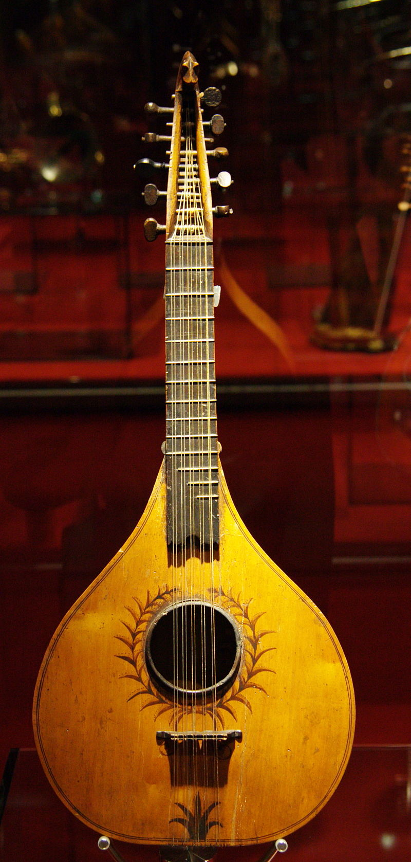
Cithern exhibited at the Music Museum of Barcelona
https://en.wikipedia.org/wiki/Cittern

Slide 8
The Rise of Musical Instruments in Worship
Beginning in the 900s, organs began to become common features of the great Western abbeys and cathedral churches.
We know, for instance, that archbishop Dunstan of Canterbury (born 909; archbishop 961-88) installed an organ in Malmesbury abbey and several other places in England.
At first, the organ was used simply to provide the right note for the monks and choirs before they would start to sing (like a tuning-fork).
Soon, however, new developments in Western Church singing lead to a more complex use of the organ and other instruments in worship.
Needham, Nick. 2,000 Years of Christ's Power Vol. 2: The Middle Ages

Slide 9
The Rise of Musical Instruments in Worship
Prior to the 900s, the established style of singing had been the Gregorian chant, which was “unison plainsong” – that is, all the singers sang the same words, to the same tune, at the same time.
Eventually, a new style called “part-singing” (or “polyphony”) began to become popular.
In part-singing, different singers sang the same words to a slightly variant tune.
More complicated forms of part-singing involved singing different words at the same time.
Needham, Nick. 2,000 Years of Christ's Power Vol. 2: The Middle Ages

Slide 10
The Rise of Musical Instruments in Worship
To help the singers sing their own parts, abbeys and cathedrals used an organ to accompany the words of one singer or group of singers, adding other instruments (e.g. pipes and cornets) to accompany the words of other singers.
In the early years (AD 900 and following) there was not a widespread use of instruments in ordinary parish churches and thus in normal Western Catholic worship.
Even in the great abbeys and cathedrals, the organ’s use was limited to the important Church festivals.
Churches did not begin to employ the organ in the celebration of ordinary masses until the 12th century.
Needham, Nick. 2,000 Years of Christ's Power Vol. 2: The Middle Ages

Slide 11
The Rise of Musical Instruments in Worship
An “organ controversy” appears to have arisen in the 13th century, which resulted in the Catholic Church’s once again condemning the use of musical instruments.
Thomas Aquinas (1225-74) seems to confirm this when he writes:
The Church does not use musical instruments such as the harp or lyre when praising God, in case she should seem to fall back into Judaism. As Aristotle says, “We must not introduce flutes into teaching, nor any artificial instrument such as the harp, nor anything of the kind, but only such things as make people morally good.” For musical instruments usually move the soul more to pleasure than to create inner moral goodness. But in the Old Testament, they used instruments of this kind… because the people were more coarse and carnal, and needed to be aroused by such instruments…
Needham, Nick. 2,000 Years of Christ's Power Vol. 2: The Middle Ages

Slide 12
The Rise of Musical Instruments in Worship
In fact, it was not until after Aquinas, in the 14th and 15th centuries, that the playing of musical instruments once again became a widespread feature of ordinary Western worship.
The first great church organist known to history was the Italian Francesco Landino (died 1390), of the Church of Saint Lorenzo in Florence.
But, as we’ve seen, it was in the 900s that the seeds for the use of musical instruments were planted in the worship of the Western Church.
The adoption of musical instruments in Western worship became one more barrier between East and West, Orthodoxy and Catholicism.
Needham, Nick. 2,000 Years of Christ's Power Vol. 2: The Middle Ages

Slide 13
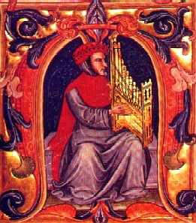
Francesco Landino playing a portative organ
illustration from the 15th-century Squarcialupi Codex
https://en.wikipedia.org/wiki/Francesco_Landini#/media/File:Landini.jpg

Slide 14
The Waldensians
https://politicaltheology.com/waldensians-women-and-preaching-as-a-political-act/

Slide 15
The Waldensians
The founder of the Waldensians was a wealthy French merchant of Lyons called Valdes or Waldes. (In later accounts he is given the first name Peter, and his surname is spelt “Waldo”)
The date of Valdes’s birth is uncertain; he died around 1205.
Some time between 1173 and 1176, Christ’s command to the rich young ruler deeply impressed Valdes: “If you would be perfect, go, sell what you possess and give to the poor, and you will have treasure in heaven; and come, follow me.” (Matt. 19:21).
Valdes obeyed this command literally, gave away all his wealth to the poor, and began a new life as a lay preacher, living only on voluntary contributions of food, clothing and money from others.
Needham, Nick. 2,000 Years of Christ's Power Vol. 2: The Middle Ages

Slide 16
The Waldensians
Valdes soon had a band of followers in Lyons, known as “the poor men of Lyons”.
However, the archbishop and clergy of Lyons were hostile; Church law only allowed ordained clergy to preach.
Valdes appealed to the 3rd Lateran Council of 1179 to change this law. But Valdes and his followers were still denied the right to preach without the approval of their local bishop.
Nevertheless, Valdes and his “poor men” refused to give up preaching, so the archbishop of Lyons excommunicated them and expelled them from the city in 1182.
Most of them went to the region of Languedoc (the south-eastern coastland of France) and Lombardy, Italy.
In 1184, Pope Lucius III excommunicated all Waldensians.
Needham, Nick. 2,000 Years of Christ's Power Vol. 2: The Middle Ages

Slide 17
The Waldensians
Forced out of the Catholic Church against their wishes, the Waldensians began thinking afresh about many matters of Christian belief.
Their most crucial decision was that the Bible, especially the New Testament, should be the supreme rule of Christian belief and practice.
Thus they rejected the infallible teaching authority of the papacy.
They gave up believing in transubstantiation, purgatory, prayers for the dead, and indulgences, but continued to venerate the Virgin Mary.
Needham, Nick. 2,000 Years of Christ's Power Vol. 2: The Middle Ages

Slide 18
The Waldensians
Waldensians also studied the Bible in translations in their own native tongues, and celebrated holy communion among themselves if a Catholic priest would not give it to them.
They set up schools to train preachers, sending out both male and female evangelists.
Some of their social attitudes were quite radical – they rejected oaths and military service (although some practiced armed self-defense if attacked).
The Waldensian movement spread out from its original homelands of Languedoc and Lombardy into Spain, Austria, and eastern Germany, and became one of the most widespread and influential non-Catholic groups in Western medieval Europe.
Needham, Nick. 2,000 Years of Christ's Power Vol. 2: The Middle Ages

Slide 19
The Waldensians
There were a large number of Catholics who sympathized with the Waldensians known as “friends” or “believers”; they gave financial support to Waldensian preachers and training schools, and attended Waldensian Bible studies, but they themselves remained members of the Catholic Church.
In some ways, the Waldensians were “Protestants before the Reformation”.
Many Waldensians died as martyrs, especially after the inquisition was established.
However, they survived in northern Italy and, in the 16th century, they linked up with the Protestant Reformation.
The Waldensian Church in Italy today is the oldest “Protestant” body in the world.
Needham, Nick. 2,000 Years of Christ's Power Vol. 2: The Middle Ages

Slide 20
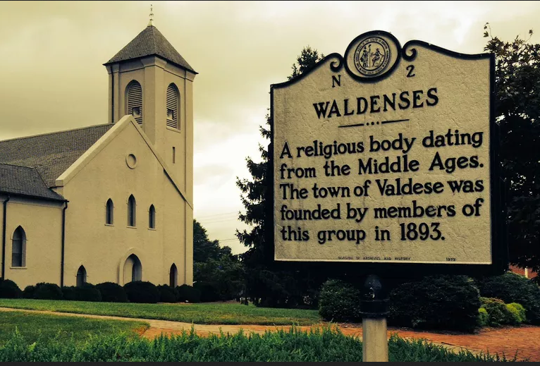
A Waldensian Church in Valdese, North Carolina
https://www.learnreligions.com/waldensians-history-beliefs-4588324

Slide 21
The Albigensian Crusade
https://en.wikipedia.org/wiki/Catharism#/media/File:Albigensian_Crusade_01.jpg

Slide 22
https://www.hopehelps.org/volunteer-appreciation-week-2018/

Slide 23
Class Discussion Time
https://www.weareteachers.com/moving-beyond-classroom-discussions/

Slide 24
*Class Discussion Time
The Church of Christ denomination prohibits the use of musical instruments in their church services. One Church of Christ web site defends this prohibition by saying: “The church of Christ sang a cappella in the days of the apostles, so the church of Christ sings a cappella today. It really is as simple as that.” Is this a valid argument? Why or why not?
Christ’s command to the rich young ruler deeply impressed Valdes: “If you would be perfect, go, sell what you possess and give to the poor, and you will have treasure in heaven; and come, follow me.” (Matt. 19:21). Valdes obeyed this command literally and gave away all his wealth to the poor. Do you believe Jesus’ statement to the rich young ruler implies that all Christians should give away all their money to the poor in order to follow Jesus? Why or why not?
Do you have a topic or question that you would like to see us to discuss?

