Slide 2
Review
Theodoret of Cyrrhus, an eminent Church father who lived in the early 5th century said that simple singing (in church) wasn’t childish. But what did he say was childish?
singing with lifeless organs, dancing, cymbals, etc.
In what century do we first hear of a musical instrument being used in Western worship?
In AD 757 (of the eighth century) when the Frankish king Pepin presented an organ to a church located north of Paris.
Prior to the 900s, the established style of singing was where all the singers sang the same words, to the same tune, at the same time – known to us as what?
the Gregorian chant
An “organ controversy” appears to have arisen in the 13th century, which resulted in the Catholic Church once again condemning the use of musical instruments. Whose quotation did we cite in this regard?
Thomas Aquinas

Slide 3
Review
What biblical text deeply impressed Valdez (a.k.a. Peter Waldo), founder of the Waldensians?
Christ’s command to the rich young ruler to sell all his possessions and give them to the poor. (Matt. 19:21).
Why did, Pope Lucius III excommunicate all Waldensians in 1184?
For allowing men who were not ordained to preach
When the Waldensians were forced out of the Catholic Church against their wishes, they began thinking afresh about many matters of Christian belief. What are some of the other areas where they ended up disagreeing with the Roman Catholic teaching of their day?
The infallibility of the pope.
Transubstantiation
Purgatory
Prayers for the dead
Indulgences

Slide 4
The Albigensian Crusade
https://en.wikipedia.org/wiki/Catharism#/media/File:Albigensian_Crusade_01.jpg

Slide 5
The Albigensian Crusade
The other great dissenting movement, and the most widespread, was the Cathars (Greek for “pure ones”).
The Cathars were divided up into many sects.
They originated in northern Europe in about 1140, but soon moved south and became strongest in Lombardy and Tuscany (northern Italy) and Languedoc (southern France).
By 1200, they had become a powerful force in southern France, enjoying the support and protection of many French nobles who sided with them out of a shared hostility to the Church – although in the case of the nobility, this was motivated less by serious religious idealism, more by the desire to refuse to pay tithes and to seize Church land for themselves.
Needham, Nick. 2,000 Years of Christ's Power Vol. 2: The Middle Ages

Slide 6
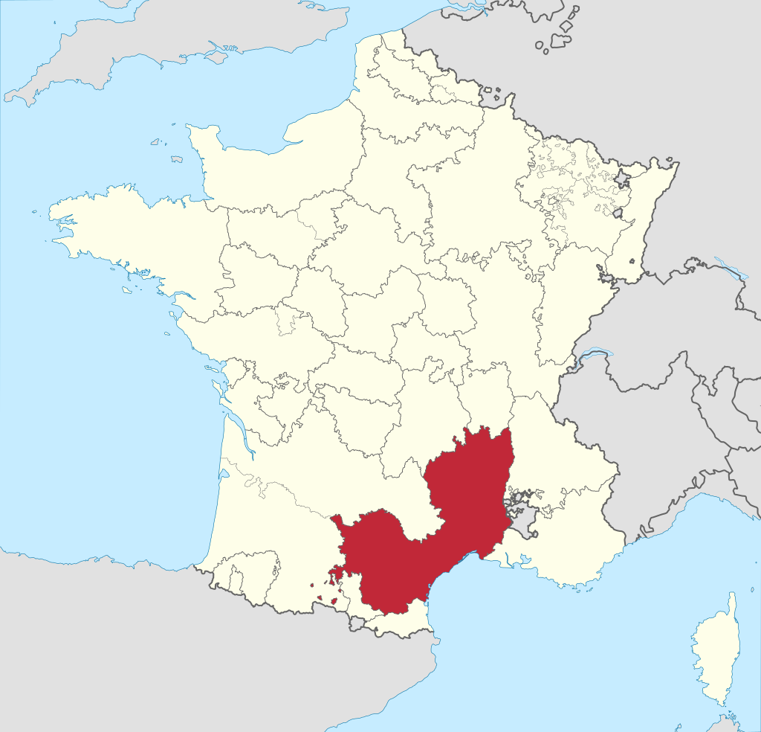
Languedoc
https://en.wikipedia.org/wiki/Languedoc#/media/File:Languedoc_in_France_(1789).svg

Slide 7
The Albigensian Crusade
French Cathars were called Albigensians, and it was the Albigensians that aroused the greatest anxiety and hostility from the Catholic Church.
The beliefs and practices of the Cathars were basically identical with those of the Gnostics from the early Church period.
They taught that the physical world of space, time and matter had been created by Satan, who was as eternal and powerful as God.
The soul, they said, was an angelic spirit, kidnapped by Satan from heaven and imprisoned in an evil physical body.
The ultimate sin was sexual reproduction, because it increased the number of evil bodies for Satan to use as prisons for kidnapped spirits.
Needham, Nick. 2,000 Years of Christ's Power Vol. 2: The Middle Ages

Slide 8
The Albigensian Crusade
They taught that Christ did not have a physical body, did not really die, and did not experience a bodily resurrection.
Salvation did not come through the cross, but through spiritual enlightenment (accepting and following the Cathar teachings).
The Cathars were divided into two classes, an outer group of “believers” and an inner group of “the perfect”.
To join the perfect, a believer had to renounce marriage and property, and abstain from meat, cheese, eggs, and milk, since these were the evil products of sexual reproduction.
Needham, Nick. 2,000 Years of Christ's Power Vol. 2: The Middle Ages

Slide 9
The Albigensian Crusade
Cathars held that they alone were the true Church of Christ; there was no salvation outside their number.
The Catholic Church, they claimed, was the great prostitute of Revelation 17, and the papacy was the Antichrist.
The missionary efforts of the Catholic Church failed to make any impression on the Cathars.
Their grip on southern France in particular (where, as we saw, they were called Albigensians) seemed unbreakable.
However, Pope Innocent III had one weapon left to him: the crusade.
Needham, Nick. 2,000 Years of Christ's Power Vol. 2: The Middle Ages

Slide 10
The Albigensian Crusade
Innocent proclaimed a crusade against the Albigensians in 1209 promising to all who took part, the same spiritual rewards that various popes had promised to Crusaders who fought the Turks in the Holy Land.
The nobility of northern France were eager to participate in Innocent’s crusade against the Albigensians, since it meant conquering fresh land for themselves.
The Albigensian Crusade lasted 20 years (1209-29). Led by the northern French noble Simon de Montfort, it brought horrific bloodshed and destruction to the south of France.
The Crusaders behaved with great savagery, slaughtering men, women, and children; they wiped out the Albigensians, and shattered the power of the southern nobility.
Needham, Nick. 2,000 Years of Christ's Power Vol. 2: The Middle Ages

Slide 11
The Albigensian Crusade
At the start of the Crusade, Languedoc (southern France) and the surrounding regions had been one of the most prosperous and cultured parts of Europe.
When the Crusaders had done their work, it was a desolate wasteland.
The Albigensian Crusade not only put an end to the Albigensians of southern France. It also destroyed the French Waldensians.
The Crusaders did not distinguish between one “heretic” and another.
Having been wiped out in their French homeland, the Waldensians, from that point forward, had their chief place of residence and influence in the Alpine valleys around Turin in northern Italy.
Needham, Nick. 2,000 Years of Christ's Power Vol. 2: The Middle Ages

Slide 12
Saint Francis of Assisi
https://www.eternitynews.com.au/world/catholics-commemorate-the-feast-of-st-francis-of-assisi/

Slide 13
Saint Francis of Assisi
Francis of Assisi (1182-1226) was the son of a wealthy cloth merchant in northern Italy.
After an early life as a soldier, Francis had a number of religious experiences in his twenties (including seeing visions and hearing heavenly voices) which led him to embrace a life of poverty.
He renounced his father, who thought Francis had gone mad, and determined that from that point on God alone would be his Father.
Then one day in 1209 he heard Matthew 10:7-10 (the sending out of the Twelve) read in a church, and took it as a call to himself from God to be a preacher.
Needham, Nick. 2,000 Years of Christ's Power Vol. 2: The Middle Ages

Slide 14
Saint Francis of Assisi
Francis was a highly attractive figure, and within months he had a small band of devoted followers.
In contrast to the complicated theological systems of the schoolmen, Francis emphasized the childlike simplicity of faith; a poet and singer, he found God in nature, and among the poor and the outcasts of society.
His whole life became a symbolic acting-out of his main message: Jesus is the loving Lord of the humble and the poor.
Needham, Nick. 2,000 Years of Christ's Power Vol. 2: The Middle Ages

Slide 15
Saint Francis of Assisi
As soon as he had a group of disciples, Francis wrote a rule for them in 1209 to govern their life together.
The rule exalted poverty, not as a means to a spiritual end, but as an end in itself.
Franciscans absolutely renounced the ownership of all property; they were spiritually married to “Lady Poverty”, and begged for their food.
Because Franciscans begged, they were called mendicants (from the Latin word for “beg”).
Needham, Nick. 2,000 Years of Christ's Power Vol. 2: The Middle Ages

Slide 16
Saint Francis of Assisi
In 1210, Francis went to Rome to ask Innocent III to give the new movement his backing.
After some hesitation, Innocent agreed, having been deeply influenced by a dream in which he saw Francis holding up the great church building of Saint John Lateran in Rome as it was about to collapse.
This was a historic decision by Innocent. It meant that the Franciscans would remain within the Catholic Church, and not be forced out as the Waldensians had been.
Under the supervision of the papacy, the Franciscans became a monastic organization which spread all over Catholic Europe.
They were called the “Little Brothers” or “Friars Minor” (“friar” comes from the Latin word frater, “brother”).
They were known popularly as the “Grey Friars” because they dressed in dark grey.
Needham, Nick. 2,000 Years of Christ's Power Vol. 2: The Middle Ages

Slide 17
Saint Francis of Assisi
There was also a Franciscan organization for women called the “Poor Clares”, named after Clare of Assisi (1193-1253), Francis’s friend and fellow worker.
Even during Francis’s lifetime, the Franciscans lost some of their original freshness, due to the conflict between Francis’s simplicity and idealism, and the desire of the papacy to turn the Franciscans into a proper monastic order.
In 1216 Pope Honorius III (1216-27) appointed Cardinal Ugolino (who became Pope Gregory IX in 1227) to oversee the Franciscans, and Ugolino’s influence became increasingly more important than that of Francis himself.
Needham, Nick. 2,000 Years of Christ's Power Vol. 2: The Middle Ages

Slide 18
Saint Francis of Assisi
Francis did not really want his followers to have any sort of fixed or disciplined organization, but by 1217 there were so many Franciscans, even outside Italy, that Francis had no choice but to appoint local leaders (“ministers”) for different areas.
Cardinal Ugolino was the inspiration behind a new rule for the Franciscans in 1221, revised in 1223.
The new rule set aside Francis’s ideal of absolute poverty, introduced traditional monastic discipline, and added the new duty of complete submission to the papacy.
Francis himself resigned as leader (“minister general”) of the Franciscans in 1220, having lost faith in the direction his movement was taking.
He retired from public affairs, lived something of a hermit’s life, and died, sick and blind, in 1226.
Needham, Nick. 2,000 Years of Christ's Power Vol. 2: The Middle Ages

Slide 19
Saint Francis of Assisi
However, on one point Francis had stood firm and made sure it remained part of the Franciscan order.
At his insistence, the Franciscan rules of 1221 and 1223 included something which had never before appeared in any monastic rule: “I firmly order the brothers to obey their ministers in all those things which they promised the Lord they would observe, as long as they are not contrary to their conscience or to our rule.”
This provision for the rights and freedom of the individual conscience was entirely new in monastic rules; it reflected Francis’s belief in the importance of individual human beings and their personal relationship with God.
Needham, Nick. 2,000 Years of Christ's Power Vol. 2: The Middle Ages

Slide 20
Saint Francis of Assisi
Francis was one of the first medieval Catholics to take any positive interest in missionary work among Muslims.
He toured Syria and Egypt in 1219, preaching to the Sultan al-Kamil and his soldiers.
Francis impressed the Sultan deeply but did not win any converts.
He was also the first known person who claimed to experience the stigmata (Latin for “marks”) – a mysterious bleeding from the hands, feet, and side, the places where Christ’s body was pierced.
Needham, Nick. 2,000 Years of Christ's Power Vol. 2: The Middle Ages

Slide 21
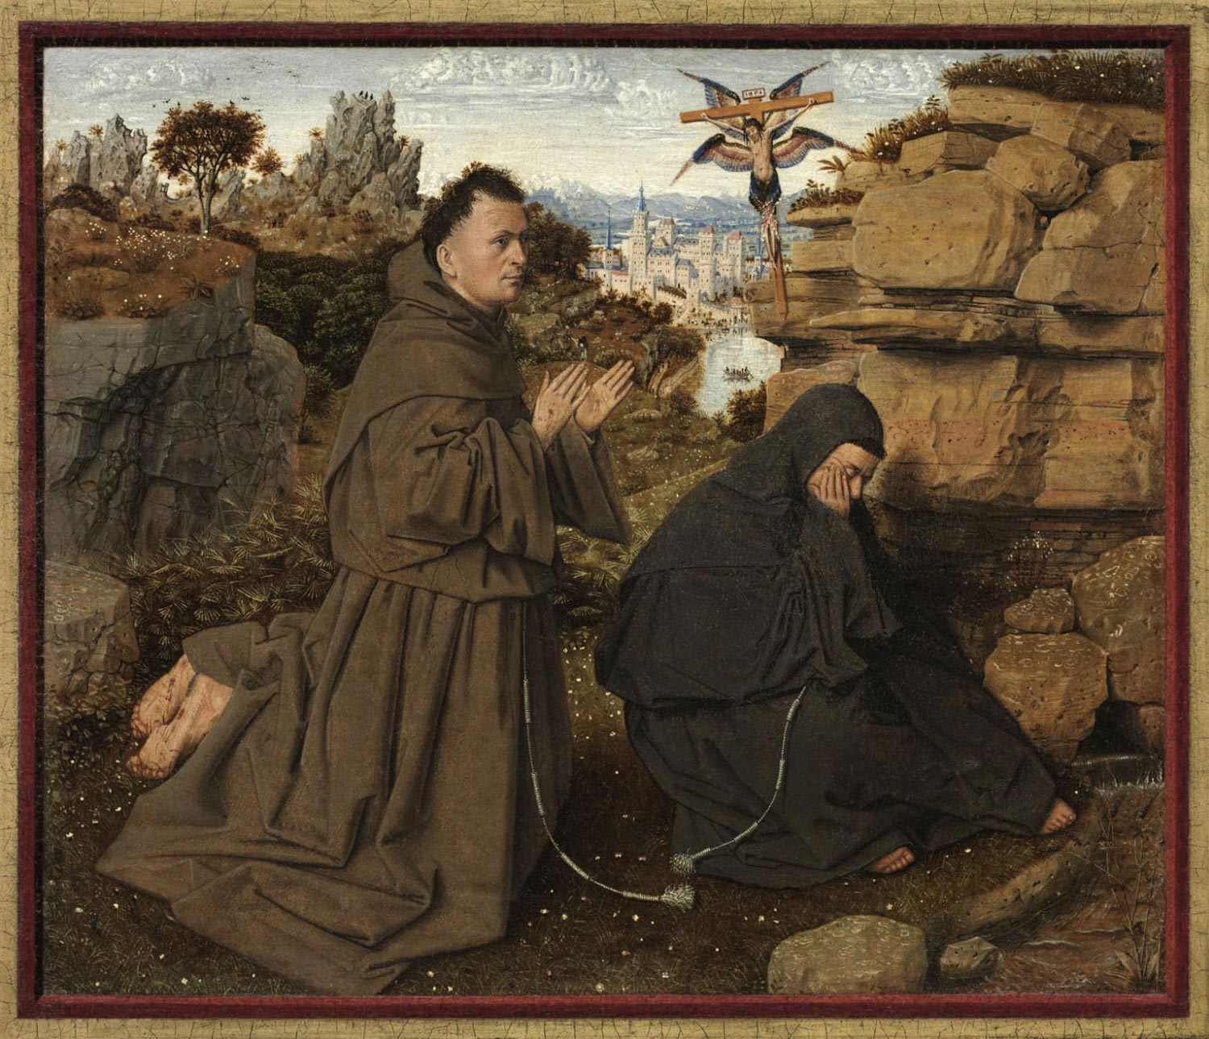
Saint Francis of Assisi Receiving the Stigmata
Painting by Jan van Eyck, c. 1430–32
https://upload.wikimedia.org/wikipedia/commons/2/2e/Saint_Francis_of_Assisi_Receiving_the_Stigmata.jpg

Slide 22
Saint Francis of Assisi
Francis claimed to receive the stigmata in 1224.
Since then, some 300 others are known to have undergone the experience, many of whom were later “canonized” (officially declared to be saints by the papacy).
The stigmata are a Roman Catholic phenomenon, unknown within Eastern Orthodoxy or Protestantism (although some Anglicans have more recently claimed to experience them).
After Francis’s death, the Franciscans drifted still further from Francis’s original ideals.
Needham, Nick. 2,000 Years of Christ's Power Vol. 2: The Middle Ages

Slide 23
Saint Francis of Assisi
Even the moderate renunciation of property required by the rule of 1223 did not seem practical to many in the order, so they compromised by having wealthy monasteries and churches that were (in theory) not owned by them, but by a “spiritual friend”.
Franciscans also abandoned their opposition to scholastic theology; some of the greatest schoolmen of the later 13th and 14th centuries were Franciscan friars, e.g. Alexander of Hales, Bonaventura, Duns Scotus, and William of Ockham.
Needham, Nick. 2,000 Years of Christ's Power Vol. 2: The Middle Ages

Slide 24
The Inquisition
http://churchandstate.org.uk/wordpressRM/wp-content/uploads/2016/04/Inquisition-1.jpg

Slide 25
https://www.hopehelps.org/volunteer-appreciation-week-2018/

Slide 26
Class Discussion Time
https://www.weareteachers.com/moving-beyond-classroom-discussions/

Slide 27
*Class Discussion Time
The Waldensians and other faithful Christian groups have often been forced to relocate to another geographical location in order to survive. Do you think a day could come in this country when, due to Christian persecution) you would be forced to relocate in order to survive? If so, where would you go?
Pope Innocent was deeply influenced by a dream he had about Francis of Assisi in a way that changed the course of history. At various other times in history, we see other people being impacted, sometimes in very dramatic ways, by a dreams that they had. What are we to make of this? Does God work through dreams? If so, how? Is there a danger in giving credence to dreams? If so, what?
Do you have a topic or question that you would like to see us to discuss?

