Slide 2
Review
During the progress of the Albigensian crusade, Pope Innocent III turned the investigation of heresy into a centrally controlled systematic operation, carried out by special papal agents. His actions laid the basis for what in 1227 became the “_____”
inquisition
Why is it that we know so little about the history of religious dissent in medieval Catholic Europe, compared with what we know of the history of the Catholic Church itself?
The inquisition forced dissenting groups to meet in secret and hide their teachings.
Inquisitors would arrive in a town and announce their presence, giving citizens a chance to...
admit to heresy
At first the Inquisition was only concerned with charges of heresy, but it soon expanded it’s authority to include other things including reading...
reading the Bible in the common language, or reading the Talmud of the Jews or the Koran of the Muslims.

Slide 3
Review
By publically torturing those who opposed the papal church, the Roman clergy hoped that the fear of the Inquisition would be burned into the minds and hearts of those watching. But this backfired in the case of those who had true faith. Describe how.
They were actually strengthened in their faith as they saw the courage of the martyrs and the grace of God that sustained them through their tortures.
Of all the offices of the Inquisition throughout the world, the Inquisition in Spain was the most active and sadistic. What king and queen presided over this inquisition and what else are they well known for having done in 1492?
Ferdinand II of Aragon and Isabella I of Castile who commissioned Columbus’ voyage to the new world.

Slide 4
Saint Dominic and the Dominicans
Portrait by El Greco, about 1600
https://en.wikipedia.org/wiki/Dominican_Order#/media/File:Santo_Domingo_en_oraci%C3%B3n.jpg

Slide 5
Saint Dominic and the Dominicans
Two of the most important religious developments in the Catholic Church during Innocent III’s reign were not Innocent’s doing – the founding of two new religious orders: the Franciscans and the Dominicans.
In a previous lesson we looked at the development of the Franciscan Order which was started by Saint Francis of Assisi.
This week we will look at the development of the Dominican Order which was founded by Dominic Guzman (1171-1221), a native of Castile, northern Spain.
Dominic was ordained as a priest when he was 25 and became a canon (a kind of traveling priest for parishes who did not have a priest) in the Spanish cathedral at Osma in Northern Spain.
Needham, Nick. 2,000 Years of Christ's Power Vol. 2: The Middle Ages

Slide 6
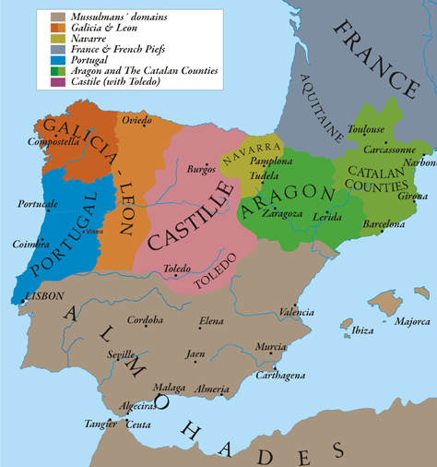
The Kingdom of Castile in 1210
https://en.wikipedia.org/wiki/Kingdom_of_Castile

Slide 7
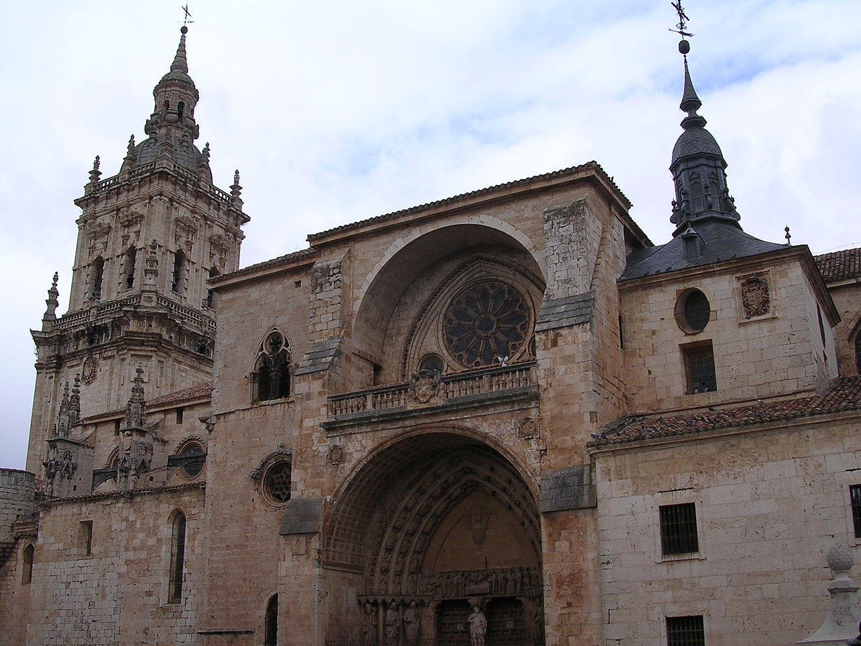
The Cathedral of Burgo de Osma
https://en.wikipedia.org/wiki/Burgo_de_Osma_Cathedral

Slide 8
Saint Dominic and the Dominicans
Dominic’s outstanding abilities prompted his superiors to send him in 1206 as a missionary to southern France, at a time when Waldensian and Albigensian influence were at their height.
Dominic soon noticed that the Albigensians’ main attraction to their religious system was the asceticism of their leaders, which stood in contrast to the easy life of many orthodox priests sent by the pope.
Dominic believed that the heretics would listen if the Roman Catholic preachers themselves were committed to poverty.
So to win the heretics, Dominic went forth among them as a poor man, barefoot and begging.
Shelley, Dr. Bruce L.. Church History in Plain Language: Fourth Edition (p. 220). Thomas Nelson.

Slide 9
Saint Dominic and the Dominicans
Dominic’s peaceful mission lasted only two years in southern France before it was forced aside by the “get tough” policy of Pope Innocent III.
However, the zealous Spaniard remained convinced that poverty and preaching belonged together.
He gathered a group of like-minded men and continued his work among the heretics in other places.
In 1220 the Dominican mission and lifestyle gained the official approval of the Roman Catholic Church.
The members of the new preaching order were called friars (or brothers), distinguishing them from monks because, unlike monks, they went forth to live among the people to preach and teach.
Shelley, Dr. Bruce L.. Church History in Plain Language: Fourth Edition (p. 220). Thomas Nelson.

Slide 10
Saint Dominic and the Dominicans
The Dominicans were known popularly as the “Black Friars”, because they wore black in distinction from the grey dress of the Franciscans.
The initial mission of the Dominicans was to preach chiefly to the religious dissenters of southern France, but under Dominic’s leadership they soon became an international organization devoted to evangelizing and teaching theology across the whole of Catholic Europe.
They were not as well-liked as the Franciscans; Francis of Assisi was above all a lover of people and indeed of all living creatures, whereas Dominic was first and foremost a servant of the Catholic Church.
However, the Dominicans enjoyed strong papal support; the Franciscan pope, Gregory IX (1227-41), granted them the unique right to preach anywhere and everywhere.
Needham, Nick. 2,000 Years of Christ's Power Vol. 2: The Middle Ages

Slide 11
Saint Dominic and the Dominicans
Unlike the Franciscans, the Dominicans were from the very outset committed to scholastic theology.
Theirs was to be an order which cultivated the study of theology above all else; to concentrate on this, they abolished the requirement for monks to do manual labor, which until then had been an essential feature of the monastic life.
Dominican influence was concentrated in academic centers like Bologna, Paris, and Rome, and they did indeed produce outstanding theologians, most famously Thomas Aquinas, greatest of the schoolmen.
Needham, Nick. 2,000 Years of Christ's Power Vol. 2: The Middle Ages

Slide 12
Saint Dominic and the Dominicans
Their preaching and teaching did much to keep the people of Western Europe loyal to the Catholic faith, especially in the cities.
There was also an order of Dominican nuns which later became well-known for providing education for girls.
Intense rivalry existed between the Dominican and Franciscan orders, for example over the doctrine of the immaculate conception of the Virgin Mary, which Dominicans opposed and Franciscans upheld.
One reason why the Dominicans were especially unpopular with Franciscans (and other religious orders) was because it was Dominicans who staffed the “holy office” of the inquisition.
This gave the Dominicans a fearsome power over other orders, which they exercised in (for instance) persecuting and martyring the spiritual Franciscans.
Needham, Nick. 2,000 Years of Christ's Power Vol. 2: The Middle Ages

Slide 13
The Carmelites and Augustinians
https://www.hamiltonbook.com/the-other-friars-the-carmelite-augustinian-sack-and-pied-friars-in-the-middle-ages-paperbound

Slide 14
The Carmelites and Augustinians
Not long after Innocent III’s reign, two more important orders of friars came into being:
The Carmelites in 1247
The Augustinians in 1256
The Carmelites had first been established in the Crusader kingdom of Jerusalem in 1154, on Mount Carmel.
The fall of the various Crusader states to the Turks brought many Carmelites into Western Europe, where they reorganized themselves as a mendicant order in 1247.
From their white dress the Carmelites were known popularly as the “White Friars”.
Needham, Nick. 2,000 Years of Christ's Power Vol. 2: The Middle Ages

Slide 15
The Carmelites and Augustinians
The Augustinians were originally a society of hermits, but soon abandoned their reclusive lifestyle to become an active mendicant order, basing their organization on the Dominicans.
Their monastic rule was that of Augustine of Hippo.
The most famous Augustinian friar was to be Martin Luther, the great Protestant Reformer.
The Franciscans, Dominicans, Carmelites, and Augustinians presented a new kind of monasticism to the world.
Rather than withdrawing from society to create communities of the spiritually minded, the whole purpose of the mendicant orders was to go out into society, preaching and winning disciples, both in Catholic Europe and in the unevangelized world of Muslims and Pagans
Needham, Nick. 2,000 Years of Christ's Power Vol. 2: The Middle Ages

Slide 16
The Carmelites and Augustinians
Other differences between the mendicant friars and traditional monks included:
The mendicant practice of begging for food rather than cultivating it themselves in their monastery,
Not being bound to a specific monastery by an oath of “stability”
Exemption from the authority of the local bishop (which often resulted in serious hostility between mendicants and bishops).
Most of the great Catholic preachers and theologians of the later Middle Ages came from the mendicant orders.
Ultimately, through Martin Luther, the Protestant Reformation itself came from this source.
Needham, Nick. 2,000 Years of Christ's Power Vol. 2: The Middle Ages

Slide 17
The Singing Nun
https://loredanacrupi.wordpress.com/2015/03/29/rip-the-singing-nun/

Slide 18
The Singing Nun
In 1961, a Belgian nun named Jeanne-Paule Marie "Jeannine" Deckers (aka. Sister Luc Gabriel ) recorded an album for Phillips Records in Brussels which included a single entitled “Dominique”.
Dominique soon became an international hit, and in 1962 her album sold nearly two million copies.
Sister Luc Gabriel soon became an international celebrity.
She gave several live concerts and appeared on The Ed Sullivan Show on television on January 5, 1964.
https://en.wikipedia.org/wiki/The_Singing_Nun

Slide 19
The Singing Nun
"Dominique" was the first, and remains the only, song by a Belgian artist to be a number one hit single in the United States.
In 1966, a biographical film loosely based on Sister Luc Gabriel was released called The Singing Nun and starring Debbie Reynolds in the central role.
Sister Luc Gabriel reportedly rejected the film as "fiction."
https://en.wikipedia.org/wiki/The_Singing_Nun

Slide 20
Dominique by Jeannine Deckers, better known as The Singing Nun
French | English Translation
Refrain : Dominique, nique, nique S'en allait tout simplement Routier pauvre et chantant En tous chemins, en tous lieux, Il ne parle que du bon Dieu, Il ne parle que du bon Dieu. | Refrain : Dominique -inique -inique Went about simply, A poor singing traveler. On every road, in every place, He talks only of the Good Lord, He talks only of the Good Lord.
À l'époque ou Jean-sans-Terre D'Angleterre était le roi Dominique, notre père, Combattit les Albigeois. | At the time when King John Lackland Was the sovereign of England Dominic, our father, Fought against the Albigensians.
Certain jour, un hérétique, Par des ronces le conduit, Mais notre père Dominique, Par sa joie le convertit. | One day, a heretic, Through the brambles him leads, But our father Dominic, With his cheer him does convert.
French | English Translation
Refrain : Dominique, nique, nique S'en allait tout simplement Routier pauvre et chantant En tous chemins, en tous lieux, Il ne parle que du bon Dieu, Il ne parle que du bon Dieu. | Refrain : Dominique -inique -inique Went about simply, A poor singing traveler. On every road, in every place, He talks only of the Good Lord, He talks only of the Good Lord.
Ni chameau, ni diligence, Il parcout l'Europe à pied Scandinavie ou Provence Dans la sainte pauvreté. | With neither camel nor haste, Throughout Europe he goes on foot Scandinavia and Provence In holy poverty.
Enflamma de toute école Filles et garçons pleins d'ardeur Et pour semer la Parole Inventa les Frères-Prêcheurs. | He sets alight at every school Girls and boys full of ardor, And to spread the Word The Dominican Friars he did found.
French | English Translation
Refrain : Dominique, nique, nique S'en allait tout simplement Routier pauvre et chantant En tous chemins, en tous lieux, Il ne parle que du bon Dieu, Il ne parle que du bon Dieu. | Refrain : Dominique -inique -inique Went about simply, A poor singing traveler. On every road, in every place, He talks only of the Good Lord, He talks only of the Good Lord.
Chez Dominique et ses frères Le pain s'en vint à manquer Et deux anges se présentèrent Portant de grands pains dorés. | For Dominique and his brothers Bread did become sparse When two angels did appear With them great chunks of eggy bread.
Dominique vit en rêve Les prêcheurs du monde entier Sous le manteau de la Vierge En grand nombre rassemblés. | Dominique sees in a dream Preachers all around the world Under the cloak of the Virgin In great number assembled.
French | English Translation
Refrain : Dominique, nique, nique S'en allait tout simplement Routier pauvre et chantant En tous chemins, en tous lieux, Il ne parle que du bon Dieu, Il ne parle que du bon Dieu. | Refrain : Dominique -inique -inique Went about simply, A poor singing traveler. On every road, in every place, He talks only of the Good Lord, He talks only of the Good Lord.
Dominique, mon bon père, Garde-nous simples et gais Pour annoncer à nos frères La Vie et la Verité | Dominique, my dear father, Keep us simple and jolly To call to our brothers The Way and the Truth
https://lyricstranslate.com/en/dominique-dominique.html

Slide 21
Missionary Expansion
https://www.tasteiran.net/stories/10048/iran-marco-polo-adventure

Slide 22
https://www.hopehelps.org/volunteer-appreciation-week-2018/

Slide 23
Class Discussion Time
https://www.weareteachers.com/moving-beyond-classroom-discussions/

Slide 24
*Class Discussion Time
Dominic noticed that the Albigensians that he sought to evangelize were impressed by the asceticism of their own teachers and were turned off by the wealth and easy lifestyles of the Roman Catholics sent by the pope to evangelize them. Therefore Dominic decided that he would live a life of asceticism in his efforts to reach the Albigensians. Missionaries in later years would make similar cultural adaptations as a part of their efforts to reach the people they sought to evangelize (like Hudson Taylor who, in 1855, controversially adopted the Chinese style of dress in order to better reach his Chinese audience). What do you think about missionaries who make these kinds of changes? Do you think it is a good idea?
The mendicant orders were more effective in reaching the everyday people of the cities than the monks who secluded themselves in monasteries, because they lived and worked among the people that they needed to reach. Do you think there is a lesson in this historical example for Christians in our day who tend to separate themselves from society and live in what some refer to as a “Christian bubble”?
Do you have a topic or question that you would like to see us to discuss?

