Slide 2
Review
What are the two major divisions of the Early Church period that I presented last week?
The Persecuted Church AD 33 – 313
The Imperially Sanctioned Church AD 313 – 600
What event did I take as the point at which the Middle Ages began?
The Papacy of Gregory the Great AD 590 – 604.
What are the three major divisions of the Middle Ages that I presented last week?
Bonus question: give the year ranges for the above divisions and give at least one characteristic of each period.
The Early Middle Ages (AD 600-1000)
The Rise and Spread of Islam
The Spread and Corruption of the Church
The Rise of the “Holy Roman Empire”
The High Middle Ages (AD 1000-1300)
The Height of Papal Power
Physical Attacks on “Enemies” of the Church
The Rise of Scholasticism and the University
The Late Middle Ages (AD 1300-1500)
The Weakening and Division of the Papacy
Wars and Plagues
The Rise of Nationalism
Forerunners to the Reformation

Slide 3
Review
Which of Wycliff’s views made him useful (at first) to the king of England in his battle with the pope.
He taught that any supposed ecclesiastical authority that collects taxes for its own benefit, or seeks to extend its power beyond the sphere of spiritual matters, is illegitimate.
Why was the Roman Catholic church opposed to Wycliff translating the Bible into the language of the common man in England?
The considered English to be a vulgar language and they were threatened by the fact that the common man would be able to see for himself what God’s Word taught.
How did Wycliff use the example of the Eastern Church to counter the Western Catholic views on such things as transubstantiation and the ability of the clergy to marry?
When Catholics claimed to have a monopoly on the ancient beliefs of the church, he could point to the Eastern church and say that they were just as ancient and yet believed differently.

Slide 4
The Dawn of the Reformation
http://www.redlightdawn.com/

Slide 5
John Huss
https://en.wikipedia.org/wiki/Jan_Hus#/media/File:Jan_Hus_2.jpg

Slide 6
John Huss
Wycliff’s ideas had a far greater success in the Holy Roman Empire than they did in England.
King Richard II of England had married Anne of Luxembourg, the sister of the king of Bohemia in the east of the Empire (today Bohemia is known as the Czech Republic).
This brought about close relations between England and Bohemia, at the very time when Wycliff and the early Lollards were active and flourishing.
A number of Bohemian students studied theology at Oxford University and took Wycliff’s views and writings with them back to Bohemia, especially to the University of Prague, Bohemia’s capital city.
There was already a religious reform movement in Bohemia, aimed at purifying the Church from worldliness and returning to the Bible; Wycliff’s ideas spread rapidly in such a setting.
Needham, Nick. 2,000 Years of Christ's Power Vol. 2: The Middle Ages

Slide 7
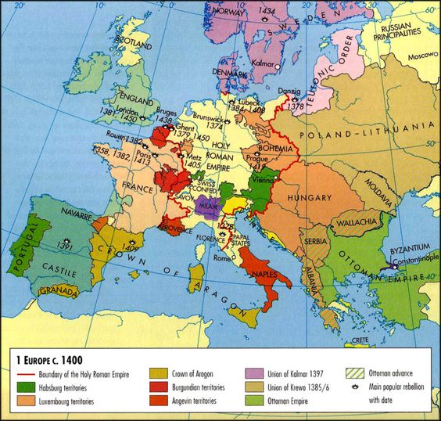
Europe in AD 1400
https://www.pinterest.com/pin/7459155607642946/

Slide 8
John Huss
The most outstanding of the Bohemian reformers was John Huss (1372-1415).
Hus was born to peasant parents in “Goosetown,” that is, Husinec, in the south of today's Czech Republic.
In his twenties, he shortened his name to Hus—"goose,” and he and his friends delighted in making puns on his name; it was a tradition that continued, especially with Luther, who reminded his followers of the “goose” who had been “cooked” for defying the pope.
To escape poverty, Huss trained for the priesthood; He earned a bachelor's, master's, and then finally a doctorate.
Along the way he was ordained and became the preacher at Prague's Bethlehem Chapel (which held 3,000), the most popular church in one Europe's largest cities.
Galli, Mark. 131 Christians Everyone Should Know (pp. 369-370)

Slide 9
John Huss
Huss studied and greatly admired Wycliff’s writings – some of Huss’s own works reproduce Wycliff’s almost word-for-word.
However, Huss was more moderate than Wycliff in his criticisms of prevailing conditions in the Catholic Church; Huss, for instance, continued to accept the doctrine of transubstantiation.
The campaign for reform which Huss championed took on the features of a Bohemian nationalist movement, with the support of the Bohemian King Wenceslas (1373-1419), the Bohemian nobility, Prague University, and ordinary Bohemians.
This nationalism sprang from the fact that Bohemians belonged to the Slavic race, and wanted to assert their Slavic identity against the overwhelmingly German character of the Holy Roman Empire.
Needham, Nick. 2,000 Years of Christ's Power Vol. 2: The Middle Ages

Slide 10
John Huss
Dark clouds began gathering around Huss in 1411 when he launched an attack on indulgences, declaring them useless since God Himself bestowed His forgiveness freely on all who truly repented.
Pope John XXIII, the pope supported by Bohemia during the Great Schism, was stung into taking action; he was himself selling indulgences on a massive scale to finance a war against his rival, Pope Gregory XII.
John excommunicated Huss and threatened to place Prague under an interdict.
To save the city, Huss retired from Prague into southern Bohemia, protected by friendly Bohemian nobles.
Needham, Nick. 2,000 Years of Christ's Power Vol. 2: The Middle Ages

Slide 11
John Huss
But Huss continued to propagate his views.
His assault on the theology of indulgences made enemies for him in Bohemia, especially in Prague University.
Many who had supported his demands for moral and spiritual reform drew back when he started attacking basic doctrines of the Catholic Church.
Two religious parties now came into being in Bohemia, a traditionalist Catholic group and the Hussites (although for a long time Huss and his followers were called “Wycliffites”).
Needham, Nick. 2,000 Years of Christ's Power Vol. 2: The Middle Ages

Slide 12
John Huss
The quarrel between the two parties centered on their doctrine of the Church.
Huss argued that the Church was the entire body of the elect in all ages, known to God alone, who had predestined them to belong to Himself by His free grace; and of this Church, Christ alone was the head, not the pope.
Popes were not infallible, said Huss; they had erred many times.
One of Huss’s arguments for denying the pope’s supremacy over the Church was that the Eastern Orthodox were true Christians who managed to exist perfectly well without the papacy – another example of a Western reformer appealing to the practice of the Eastern Church in order to refute the arguments of the pope and the Western church (as Wycliff had done).
Needham, Nick. 2,000 Years of Christ's Power Vol. 2: The Middle Ages

Slide 13
John Huss
Huss further taught that Christians should not follow or obey immoral and unworthy clergy.
The Christian secular rulers of the state should step in and reform the Church, if the Church was not willing to reform itself.
Finally, Huss also accepted Wycliff’s view that preaching, not celebrating the sacraments, was the true heart of the ordained ministry.
To traditional Catholics, of course, these Hussite views were diabolical heresy.
When the Council of Constance met in 1414, the religious turmoil in Bohemia was one of the issues it had to settle.
The Council summoned Huss to appear before it.
Needham, Nick. 2,000 Years of Christ's Power Vol. 2: The Middle Ages

Slide 14
John Huss
Huss knew he was in danger of being condemned and burnt as a heretic.
However, Huss was given a promise of safe-conduct by the Holy Roman Emperor Sigismund, brother of Bohemian King Wenceslas.
Huss therefore went to Constance.
But the Council ignored the safe-conduct and threw Huss in prison almost immediately on his arrival.
He was kept captive for six months in the most horrific conditions which destroyed his health – he became subject to headaches, fever, bleeding, and vomiting.
Needham, Nick. 2,000 Years of Christ's Power Vol. 2: The Middle Ages

Slide 15
John Huss
Finally, in June 1415, the Church authorities brought the sick Bohemian reformer before the Council. ¹
They refused to allow him to defend himself, bullied him mercilessly for three days in an attempt to force him to renounce his “heresies”, and finally condemned him and deposed him from the priesthood. ¹
When he saw he wasn't to be given a forum for explaining his ideas, let alone a fair hearing, Huss finally said, “I appeal to Jesus Christ, the only judge who is almighty and completely just. In his hands I plead my cause, not on the basis of false witnesses and erring councils, but on truth and justice.” ²
In a humiliating ceremony, six bishops stripped off Huss’s priestly vestments, put on his head a cap covered in pictures of red demons, and solemnly committed Huss’s soul to the devil. ¹
¹ Needham, Nick. 2,000 Years of Christ's Power Vol. 2: The Middle Ages
² Galli, Mark. 131 Christians Everyone Should Know (p. 371).

Slide 16
John Huss
The Council then handed Huss over to Emperor Sigismund, the man who had promised him safe-conduct; Sigismund’s soldiers burnt Huss at the stake on July 6th 1415.
Huss died with serene courage, refusing a last minute offer of pardon if he would abandon his beliefs: “I shall die with joy today in the faith of the Gospel which I have preached.”
Huss’s martyrdom created an uproar in Bohemia. He became a popular national hero.
The Bohemians were further enraged when, at Emperor Sigismund’s insistence, the Council also burnt Huss’s foremost disciple, the noble and learned layman Jerome of Prague, in 1416.
Needham, Nick. 2,000 Years of Christ's Power Vol. 2: The Middle Ages

Slide 17
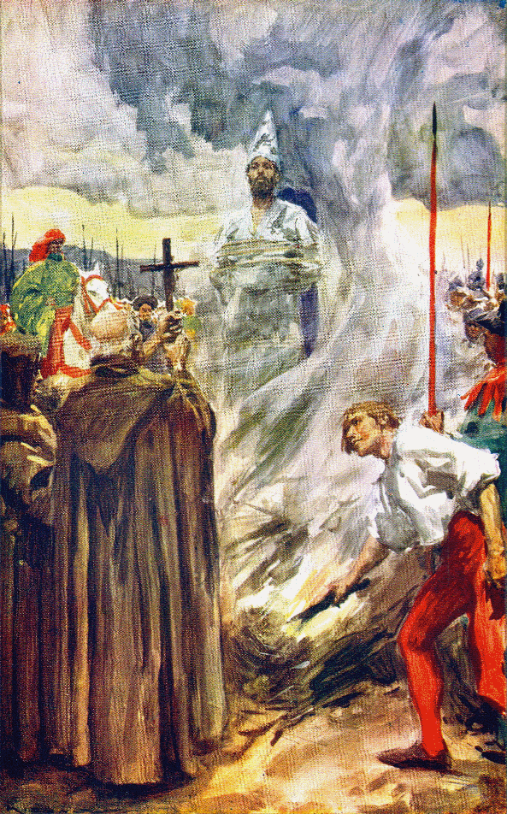
John Huss Burned at the Stake
https://www.pinterest.com/pin/56365432807229981/

Slide 18
John Huss
Jerome’s martyrdom made an even greater impression than Huss’s.
An eyewitness, who was not a Hussite, wrote:
It was wonderful to see with what words, how persuasively, with what arguments, what a spirit, and what calmness Jerome answered his enemies, and how fairly he put his case. He stood there utterly fearless, not just scorning death but seeking it. He went to his fate with a joyful and willing spirit. When the executioners wanted to start the fire behind his back so that Jerome would not see it, he told them, “Come here and light the fire in front of me. Had it frightened me, I would not have come to this place.”
Many onlookers wept, overcome by the spectacle of the martyr’s peaceful boldness.
Needham, Nick. 2,000 Years of Christ's Power Vol. 2: The Middle Ages

Slide 19
The Hussites Fight Back
https://alchetron.com/Hussites#hussites-5930f8f6-cc90-4bc4-bce7-3352af717b0-resize-750.jpg

Slide 20
The Hussites Fight Back
Bohemia was now smoldering with rage, ready to blaze up against any further provocation.
The spark which ignited the blaze came in 1419, when King Wenceslas died.
Wenceslas’s brother, the Holy Roman Emperor Sigismund, should by rights have succeeded Wenceslas to the Bohemian throne, but he was the most hated man in Bohemia, stained with the holy blood of Huss and Jerome.
Passions boiled over, and civil war erupted between the nation and its monarch.
Pope Martin V came to Sigismund’s aid, declaring a crusade against the heretical Bohemians, but to the astonishment and fury of their foes, the Bohemians defeated the crusading armies again and again.
Needham, Nick. 2,000 Years of Christ's Power Vol. 2: The Middle Ages

Slide 21
The Hussites Fight Back
By 1433, after 14 years of fierce warfare, it had become clear that the Catholics could not defeat the Hussites on the field of battle.
So for the first time in its history, the Catholic Church was forced to sit down and negotiate with a dissenting group.
They managed to reach a compromise agreement with the Hussites, called the Four Articles of Prague.
Needham, Nick. 2,000 Years of Christ's Power Vol. 2: The Middle Ages

Slide 22
The Hussites Fight Back
These Articles stated that the Hussites would remain within the Catholic Church, on condition that four principles were recognized:
Hussites must be allowed to receive both bread and wine in communion;
Hussite priests could preach the Word of God freely without interference;
All clergy were under obligation to live simple, humble lives, devoted to the Gospel, and not be rich political figures;
Mortal sins should be punished by the secular courts.
The Bohemians remained within the Catholic Church, although as a distinct body with their own Hussite traditions and practices.
Needham, Nick. 2,000 Years of Christ's Power Vol. 2: The Middle Ages

Slide 23
The Hussites Fight Back
A group within the Bohemians who repudiated this last compromise formed a group called the “Union of Brethren”, which became the foundation for the Moravian Brethren (Moravia is a region in the Czech Republic), who would play an influential role in the conversion of the Wesley brothers, among others.¹
Relations between Hussite Bohemia and the papacy remained uneasy.²
With the advent of the Protestant Reformation in the 16th century, most Bohemians welcomed it, and the Hussite movement flowed into the mightier ocean of Protestantism.²
¹ Galli, Mark. 131 Christians Everyone Should Know (p. 371).
² Needham, Nick. 2,000 Years of Christ's Power Vol. 2: The Middle Ages

Slide 24
Events That Laid the Groundwork for the Reformation
https://www.intellectualtakeout.org/article/5-causes-protestant-reformation-besides-indulgences/

Slide 25
https://www.hopehelps.org/volunteer-appreciation-week-2018/

Slide 26
Class Discussion Time
https://www.weareteachers.com/moving-beyond-classroom-discussions/

Slide 27
*Class Discussion Time
Huss and his foremost disciple Jerome were able to continue giving a clear testimony of their scriptural views, even in the face of the most humiliating and painful treatment, never reviling those who mistreated them. Have you ever thought about how you would respond if you were to be faced with a similar circumstance?
Ultimately the Hussites were able to enjoy religious freedom by physically fighting back against their Catholic oppressors. We will see that the same is true for the Reformers. Is there a place for fighting back against religious oppression? Is a government that protects religious freedom worth fighting for? Or is God more glorified when Christian after Christian is tortured and put to death for their beliefs?
Do you have a topic or question that you would like to see us to discuss?

