Slide 2
Review
Huss studied and greatly admired Wycliff’s writings. However, Huss was more moderate than Wycliff in his criticisms of the Catholic Church. Give an example of a Catholic doctrine that Wycliff rejected, but Huss continued to accept.
Transubstantiation.
On what basis did Huss claim that indulgences were useless?
Because God freely bestowed His forgiveness on all who truly repented.
Huss’s teaching on indulgences were especially embarrassing to Pope John XXIII. Why?
the pope was selling indulgences on a massive scale to finance a war against his rival, Pope Gregory XII.

Slide 3
Review
What ultimately happened to Huss as a result of his teaching against indulgences and other cardinal Catholic doctrines?
He was condemned by the council of Constance and handed over to Emperor Sigismund, the man who had promised him safe-conduct; Sigismund’s soldiers burnt Huss at the stake.
Huss’s martyrdom created an uproar in Bohemia. He became a popular national hero. What happened when King Wenceslas died and his brother Sigismund was about to succeed him to the Bohemian throne?
Passions boiled over, and civil war erupted between the nation and its monarch.
What was the outcome of that civil war?
Pope Martin V came to Sigismund’s aid, declaring a crusade against the “heretical” Bohemians. But the Bohemians defeated the crusading armies again and again, forcing the Catholics to negotiate a settlement.

Slide 4
Events That Laid the Groundwork for the Reformation
https://www.intellectualtakeout.org/article/5-causes-protestant-reformation-besides-indulgences/

Slide 5
The Renaissance
The Renaissance was a fervent period of European cultural, artistic, political and economic “rebirth” following the Middle Ages.
Generally described as taking place from the 14th century to the 17th century, the Renaissance promoted the rediscovery of classical philosophy, literature and art.
Some of the greatest thinkers, authors, statesmen, scientists and artists in human history thrived during this era, while global exploration opened up new lands and cultures to European commerce.
The Renaissance is credited with bridging the gap between the Middle Ages and modern-day civilization.
https://www.history.com/topics/renaissance/renaissance

Slide 6
The Renaissance
Those who first used the name of “Renaissance” (= “rebirth”) to describe the intellectual and artistic movement that sprang up in Italy and spread to the rest of Western Europe in the fourteenth and fifteenth centuries, were, in a sense, casting a negative judgement on the centuries immediately preceding them, and claiming that what was taking place was a glorious rebirth of theretofore forgotten antiquity.
They called the thousand years since the Fall of Rome the “Middle Ages,” because they saw in them little more than a negative intermission between classical antiquity and their own time.
The truth is that the Renaissance, while drinking from the sources of antiquity, also drew from the centuries immediately preceding it.
Gonzalez, Justo L.. The Story of Christianity: Volume 1: The Early Church to the Dawn of the Reformation (pp. 436-437)

Slide 7
Humanism
“Humanism” is the name given to a movement that became very prominent during the Renaissance period.
This is a term often used in our day to describe the tendency to place humans at the center of the universe, and to make them the measure for all things.
But the term can also be used to refer to the study of the humanities—what we call liberal arts today.
It is in this last sense, that it was employed by many scholars at the end of the Middle Ages, who referred to themselves as “humanists” because they were devoted to the study of liberal arts.
Gonzalez, Justo L.. The Story of Christianity: Volume 1: The Early Church to the Dawn of the Reformation (pp. 437-438)

Slide 8
Humanism
It is true that the scholars at the end of the Middle Ages who called themselves humanists did tend to place humans at the center of the universe, because their study of classical antiquity produced in them a sense of awe for human creativity.
But this was not always the case, for many of the humanists had a profound sense of sin and of the limits of human achievement.
Therefore, when we speak of humanism, this simply means a literary movement that sought to return to the sources of classical literature, and to imitate its style.
Gonzalez, Justo L.. The Story of Christianity: Volume 1: The Early Church to the Dawn of the Reformation (pp. 437-438)

Slide 9
Ad fontes! The Revival of Antiquity
The revival of antiquity had many advocates, first in Italy, and then throughout Western Europe.
There was a renewed interest at this time in copying and circulating manuscripts of ancient Latin authors.
Others visited Constantinople, and returned with copies of the works of Greek writers.
When Constantinople fell to the Turks in 1453, Byzantine exiles flooded Italy with their knowledge of classical Greek literature.
The result was a literary awakening that began in Italy and then spread beyond the Alps.
Gonzalez, Justo L.. The Story of Christianity: Volume 1: The Early Church to the Dawn of the Reformation (pp. 437-438)

Slide 10
Ad fontes! The Revival of Antiquity
This interest in antiquity also manifested itself in the arts.
Painters, sculptors, and architects sought their inspiration, not in the Christian art of the centuries immediately preceding them, but rather in the pagan art of the classical age.
Naturally, they did not entirely abandon their own traditions, and for that reason Gothic art did influence their works.
But the ideal of many Italian artists of the Renaissance was to rediscover the classical canons of beauty, and to apply them to their work.
Gonzalez, Justo L.. The Story of Christianity: Volume 1: The Early Church to the Dawn of the Reformation (pp. 437-438)

Slide 11
The Invention of the Printing Press
This awakening of interest in classical learning coincided with Johan Gutenberg’s invention of the movable-type printing press in 1439.
Gutenberg’s invention had a profound impact on humanism.
At first, the printing press was not seen as a means of popularizing literature.
Gutenberg himself did not publicize his invention, for his purpose was to produce large numbers of books that he could then sell as expensive manuscripts.
To that end, rather than simplifying the printed page, he made it as elaborate as any traditional manuscript.
Gonzalez, Justo L.. The Story of Christianity: Volume 1: The Early Church to the Dawn of the Reformation (pp. 437-438)

Slide 12
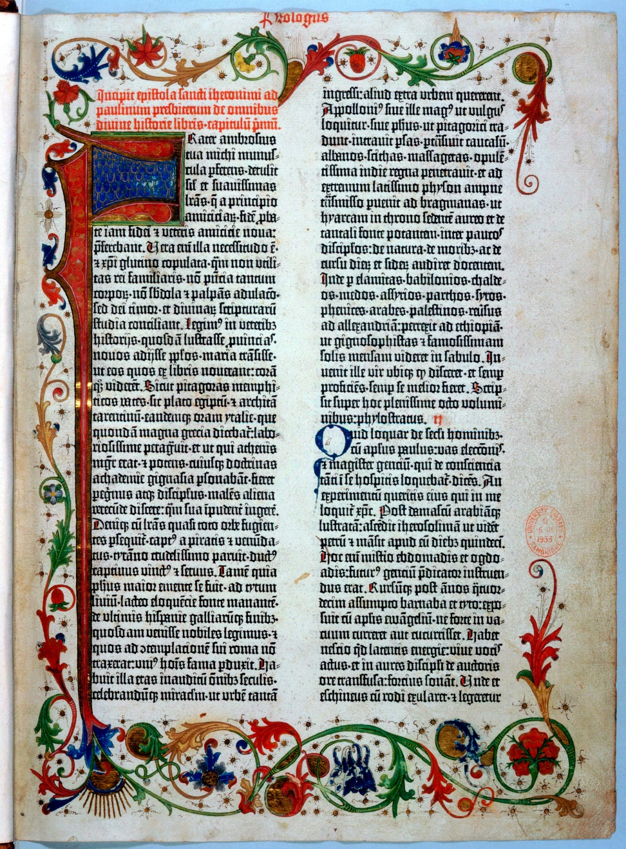
A page from the Gutenberg Bible
https://time.com/3987590/gutenberg-bible-page

Slide 13
The Invention of the Printing Press
For the early humanists, the printing press was an excellent medium for communication among scholars, or for duplicating the writings of antiquity, but not for popularizing their ideas.
Those ideas remained the exclusive property of an intellectual aristocracy.
With minor exceptions, the printing press was not used for communication to the masses until the time of the Reformation eighty years later.
Gonzalez, Justo L.. The Story of Christianity: Volume 1: The Early Church to the Dawn of the Reformation (pp. 437-438)

Slide 14
Awareness of Manuscript Corruption
Books were now more accessible, and scholars became increasingly aware of the degree to which various manuscripts of the same work differed.
Although earlier generations had been aware of these divergences, all they could do was to be very careful in the copying of manuscripts.
But now it was possible to produce several hundreds of copies of a book, without any new errors creeping into them.
If a scholar, by comparing several manuscripts, produced a reliable text of an ancient writing, and supervised its printing, that work would be of permanent value, for it would not have to be entrusted again to a multitude of copyists who might introduce new errors.
Gonzalez, Justo L.. The Story of Christianity: Volume 1: The Early Church to the Dawn of the Reformation (pp. 438-439)

Slide 15
Awareness of Manuscript Corruption
Thus the discipline of textual criticism arose, whose purpose was to compare existing manuscripts, and to apply all the resources of historical research to the task of restoring the works of antiquity.
Soon there were scholars working on “critical editions” of Cicero, Jerome, and the New Testament.
Gonzalez, Justo L.. The Story of Christianity: Volume 1: The Early Church to the Dawn of the Reformation (pp. 438-439)

Slide 16
Questioning Textual Authenticity
The discovery of the extent to which mistakes had crept into ancient texts led to doubts as to the authenticity of some of the texts themselves.
Since the manuscripts were not entirely trustworthy, was it not possible that some of the writings that supposedly were very old were in truth the product of a later age?
Some of the most respected documents of the Middle Ages, when measured by the tools of historical research, were found to be spurious.
Such was the case with the Donation of Constantine, in which the great emperor supposedly gave the popes jurisdiction over the West.
The scholar Lorenzo Valla studied this document and came to the conclusion that its style and vocabulary proved that it was written long after the time of Constantine.
Gonzalez, Justo L.. The Story of Christianity: Volume 1: The Early Church to the Dawn of the Reformation (pp. 439-440)

Slide 17
Questioning Textual Authenticity
Likewise, Valla offered strong arguments against the legend according to which the Apostles’ Creed was composed by the apostles, each contributing a clause.
The consequences of these studies to the life of the church were not as immediate or as drastic as one might expect.
Valla was a secretary to the pope, who does not seem to have minded Valla’s studies and conclusions.
The reason for this was that the results of such studies were circulated only among an intellectual aristocracy whose members were not interested in influencing the masses with their newly found knowledge.
It would take some time for the notion to spread, that Christianity as it then existed was not what it had always been, and that a return to its roots was necessary.
This notion would be a contributing factor to the Protestant Reformation.
Gonzalez, Justo L.. The Story of Christianity: Volume 1: The Early Church to the Dawn of the Reformation (pp. 439-440)

Slide 18
A New Vision of Reality
Italy was going through a period of prosperity.
In its principal cities there were financial resources for erecting great buildings and for adorning them with works of art.
Sculptors, painters, and architects flocked to such places.
Since the nobles and the rich bourgeoisie were the patrons of the arts, most of the works of this period were not created to extol the glories of heaven but rather of those who paid for them.
Therefore art, which had up until that time been devoted almost exclusively to religious instruction and to the glory of God, turned its attention to human splendor.
In the classical works of Greece and Rome, there had been an admiration for the human creature that medieval art seemed to forget, and which the painters and sculptors of the Renaissance now expressed in paint and stone.
Gonzalez, Justo L.. The Story of Christianity: Volume 1: The Early Church to the Dawn of the Reformation (pp. 440-441)

Slide 19
A New Vision of Reality
The Adam that Michelangelo painted in the Sistine Chapel, receiving from God’s finger the power to rule over creation, is very different from the frail Adam of medieval manuscripts.
Michelangelo embodies the Renaissance view of what it means to be fully human, born to create, to leave one’s imprint on the world.
Gonzalez, Justo L.. The Story of Christianity: Volume 1: The Early Church to the Dawn of the Reformation (pp. 440-441)

Slide 20
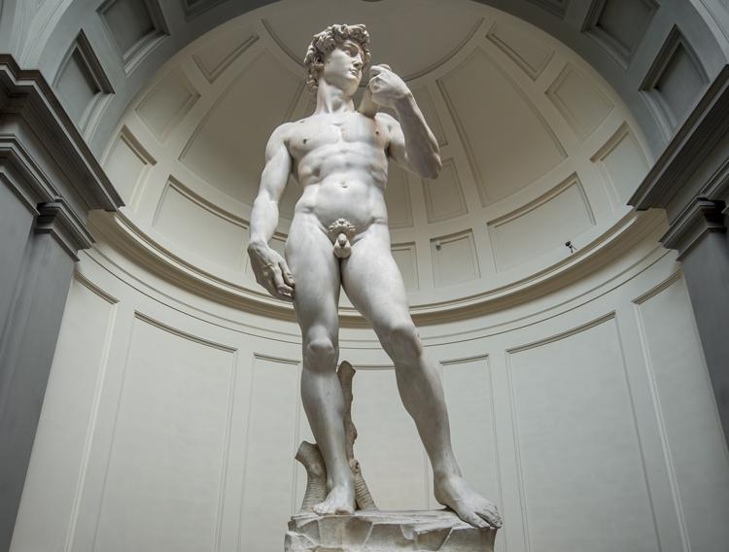
Michelangelo
Adam Receiving Power from the Finger of God
The Sistine Chapel
David

Slide 21
A New Vision of Reality
This vision took on new life in Leonardo da Vinci.
Although today Leonardo is known primarily as a painter and sculptor, there were few areas of human endeavor into which he did not delve.
He did significant research and work in engineering, jewelry making, ballistics, and anatomy – but because he had so many pursuits, many of his ideas were never fully developed.
Many of his paintings remained unfinished, or did not go beyond the stage of preliminary sketches which are now valued as great artistic treasures.
But in spite of the often fragmentary and unfinished nature of his work, Leonardo became the embodiment and symbol of the universal man that characterized the Renaissance.
Gonzalez, Justo L.. The Story of Christianity: Volume 1: The Early Church to the Dawn of the Reformation (pp. 440-441)

Slide 22
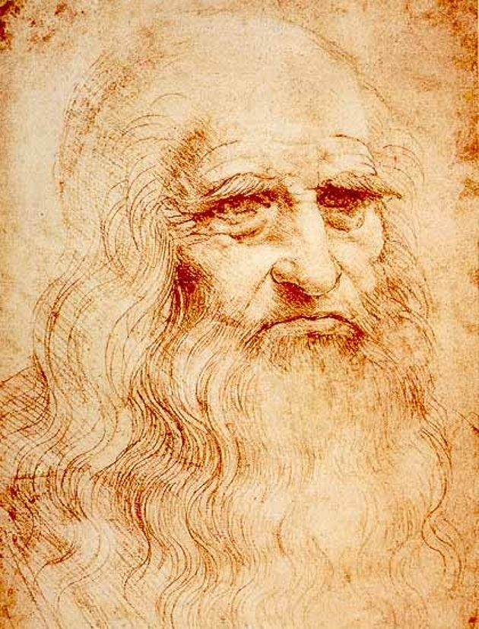
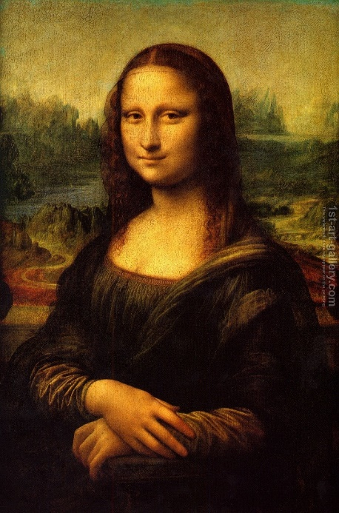
Leonardo da Vinci
Self Portrait
The Vitruvian Man
The Last Supper
Mona Lisa

Slide 23
Renaissance Geniuses
Rene Descartes (1596–1650): French philosopher and mathematician regarded as the father of modern philosophy. Famous for stating, “I think; therefore I am.”
Nicolaus Copernicus (1473–1543): Mathematician and astronomer who made first modern scientific argument for the concept of a heliocentric solar system.
Galileo (1564-1642): Italian astronomer, physicist and engineer whose pioneering work with telescopes enabled him to describes the moons of Jupiter and rings of Saturn. Placed under house arrest for his views of a heliocentric universe.
Niccolo Machiavelli (1469–1527): Italian diplomat and philosopher famous for writing “The Prince” and “The Discourses on Livy.”
John Milton (1608–1674): English poet and historian who wrote the epic poem “Paradise Lost.”
William Shakespeare (1564–1616): England’s “national poet” and the most famous playwright of all time, celebrated for his sonnets and plays like “Romeo and Juliet.”
https://www.history.com/topics/renaissance/renaissance

Slide 24
Desiderius Erasmus
https://quotes.thefamouspeople.com/desiderius-erasmus-3781.php

Slide 25
https://www.hopehelps.org/volunteer-appreciation-week-2018/

Slide 26
Class Discussion Time
https://www.weareteachers.com/moving-beyond-classroom-discussions/

Slide 27
*Class Discussion Time
The Renaissance was period of history when many began to put great value on going to the “sources” in their search for truth, recognizing that later traditional ideas contained many corruptions. Do you agree with this idea?
Would this idea have application to the idea of Sola Scriptura as opposed to following church tradition (whether it be Roman Catholic, Southern Baptist, or whatever)? Is there a downside to ignoring traditional beliefs and teachings?
During the Renaissance, art, which had up until that time been devoted almost exclusively to religious instruction and to the glory of God, turned its attention to human splendor. Was this a bad thing? Why or why not?
Do you have a topic or question that you would like to see us to discuss?

