Slide 1


Slide 2

Review
What does the word Renaissance mean?
  “rebirth”
Give a brief description of the Renaissance period.
  The Renaissance was a fervent period of European cultural, artistic, political and economic “rebirth” taking place from the 14th century to the 17th century; the Renaissance promoted the rediscovery of classical philosophy, literature and art.
What did the term “humanism” mean as it was used in the late Middle Ages?
  It was a literary movement that sought to return to the sources of classical literature, and to imitate its style; this study of classical antiquity produced in its adherents a sense of awe for human creativity.
During the Renaissance there was a renewed interest in ancient manuscripts. How did the fall of Constantinople give a “shot in the arm” to this pursuit?
  When Constantinople fell to the Turks in 1453, Byzantine exiles flooded Italy with their knowledge of classical Greek literature.

Slide 3
Review
At first, Johan Gutenberg did not publicize his invention of the printing press. What purpose did he originally have for his new invention?
  To produce a large numbers of books that he could then sell as expensive manuscripts.
The printing press made scholars increasingly aware of the degree to which various manuscripts of the same work differed, which then caused them to question other aspects of manuscript authenticity.
Name at least one of the false claims that that Lorenzo Valla exposed concerning certain ancient documents in his day.
  The Donation of Constantine (part of the Pseudo-Isidorean Decretals), claimed that Constantine had given the popes jurisdiction over the West
  There was a legend claiming that the Apostles’ Creed was composed by the apostles, each contributing a clause.

Slide 4

The Dawn of the Reformation
http://www.redlightdawn.com/

Slide 5
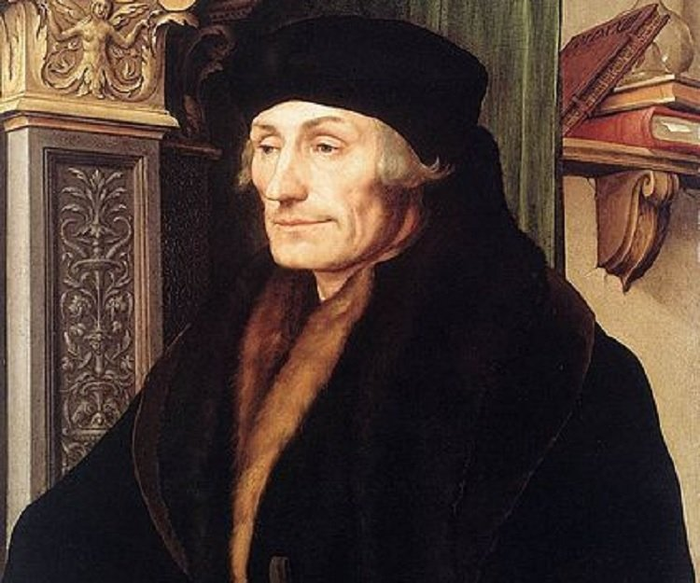
Desiderius Erasmus
https://quotes.thefamouspeople.com/desiderius-erasmus-3781.php

Slide 6
Desiderius Erasmus
By far the most famous, gifted, and influential of all the Christian humanists was Desiderius Erasmus (1466-1536).
He was born in Rotterdam, the Netherlands, and more than any other Renaissance figure he shaped humanism into a positive program for the reform of society.
Brilliant at communicating his views in writing, he was the first thinker in history to see his own ideas become internationally famous in his own lifetime.
He wrote some 226 works; two and a half million copies of them were circulated.
He was called “the schoolmaster of Europe”.
Almost single-handedly, Erasmus created a new atmosphere in Western culture.
Needham, Nick. 2,000 Years of Christ's Power Vol. 3: Renaissance and Reformation

Slide 7
Desiderius Erasmus
The illegitimate son of a Dutch priest, Erasmus was educated in the Netherlands at a school run by a religious community, known as the Brothers of the Common Life. ¹
The Brothers stressed a return to Bible reading, meditation, and the pursuit of holiness. Members adopted a simple, self-supporting lifestyle, living from a common fund, and often earned their livelihood through copying manuscripts. ²
This early contact with the Brothers gave Erasmus a lifelong concern for a simple Christ-centered faith and a practical religion. ¹
He then spent some time in a monastery, but found it highly disagreeable; in fact, Erasmus came to detest everything that monasticism stood for. ¹
¹ Needham, Nick. 2,000 Years of Christ's Power Vol. 3: Renaissance and Reformation
² Ferguson, Sinclair B.. Church History 101: The Highlights of Twenty Centuries

Slide 8
Desiderius Erasmus
The great turning point in Erasmus’s life was his visit to England in 1499, where he became a close friend of the leading English humanists, John Colet and Sir Thomas More.
Inspired by their Christian humanist vision, Erasmus published many new editions of the writings of the church fathers, helping to renew people’s interest in them.
Erasmus’s own favorite among the fathers was Jerome, whom in many ways Erasmus took as a model for his own life – the celibate scholar, devoted to acquiring knowledge and spreading it in the cause of Christianity and reforming the lives of believers.
Erasmus wanted to use humanism as an instrument for reforming the whole of Western society.
Needham, Nick. 2,000 Years of Christ's Power Vol. 3: Renaissance and Reformation

Slide 9
Erasmus’ Criticisms of Catholic Europe
Erasmus believed that a number of things had gone seriously wrong with the religious life of Catholic Europe:
  Scholastic theology
  External religion
  The clergy, the monks, and the papacy
Needham, Nick. 2,000 Years of Christ's Power Vol. 3: Renaissance and Reformation

Slide 10
Erasmus on Scholastic Theology
Erasmus rejected the methods and conclusions of scholasticism.
He thought that scholastic theologians had corrupted the Christian message by marrying it to the philosophy of Aristotle. “What has Christ to do with Aristotle?” he asked.
For Erasmus, theology was not a matter of logic or philosophy, but of the New Testament and following Christ.
Erasmus’s hostility to scholasticism meant that its practitioners (especially monks) were always accusing him of heresy.
Needham, Nick. 2,000 Years of Christ's Power Vol. 3: Renaissance and Reformation

Slide 11
Erasmus on External Religion
Erasmus kept up a constant, often cuttingly sarcastic criticism of the kind of religion that glorified external things: images, relics, ceremonies, indulgences, etc.
True religion, he insisted, was an inward and spiritual reality; it came from the heart.
Erasmus’s dislike of a merely external religion meant that he placed huge emphasis on a spiritual participation in the sacraments: eating the bread of the eucharist was useless unless it was accompanied by a loving communion with Christ and one’s fellow Christians.
Needham, Nick. 2,000 Years of Christ's Power Vol. 3: Renaissance and Reformation

Slide 12
Erasmus on External Religion
Erasmus views on the eucharist might easily have lead his readers into a purely symbolic view of the sacramental bread and wine.
Erasmus himself never took this step, although he was somewhat ambivalent and even self-contradictory on the physical presence of Christ’s body in the mass: “Of the reality of the Lord’s body, nothing is uncertain. Of the method of the presence, it is permitted in a certain way to be uncertain.”
Although Erasmus did not reject infant baptism, he did suggest that baptism could be given again once a person had reached the age of puberty and could now understand the significance of the ritual – an attitude that may have pushed some of Erasmus’s disciples into Anabaptism.
Needham, Nick. 2,000 Years of Christ's Power Vol. 3: Renaissance and Reformation

Slide 13
Erasmus on the Clergy, Monks, and the Papacy
Erasmus attacked the immorality and ignorance of priests, monks, and popes with devastating effect.
His weapon was not righteous anger, but humor: he held up corrupt Church leaders to ridicule, mocked them, and set all Western Europe laughing at them.
His most famous writing in this style was his Praise of Folly (1509), which poured scornful laughter on contemporary abuses in Church and society; one great historian has called it “the most severe attack on the medieval Church that had, up to that time, been made”.
Needham, Nick. 2,000 Years of Christ's Power Vol. 3: Renaissance and Reformation

Slide 14
Erasmus on the Clergy, Monks, and the Papacy
More light-hearted, although perhaps more scandalous, was Erasmus’s Julius Excluded from Heaven (1517), which depicted Pope Julius II (1503-13) being refused admission into heaven after his death. (Julius won his election to the papacy by bribes, and spent much of his reign fighting wars to expand the papal states.)
Julius Excluded was a best seller; it went through thirteen editions in four years, and was translated into English, French, and German.
Erasmus never admitted writing it, but never denied it, and most of his contemporaries ascribed it to him, as do most modern scholars.
Needham, Nick. 2,000 Years of Christ's Power Vol. 3: Renaissance and Reformation

Slide 15
Excerpt from Erasmus’s Julius Excluded from Heaven
Julius: [Arriving at the gate of heaven] What the devil’s going on here? Doors won’t open, eh? Looks as if the lock’s been changed, or at least tampered with.
Julius’s guardian spirit: You’d better check and see that you didn’t bring the wrong key with you. You don’t open this door, you know, with the same key that opens your money-box!
Julius: I’m getting fed up. I’ll pound on the door. Hey! Hey! Someone open this door at once! What’s wrong? Isn’t anyone there? What’s keeping that doorman? I suppose he’s drunk and sleeping it off.
Julius’s spirit: He judges everyone by his own standard.
Peter: Well, it’s a good thing we have a gate like iron! Otherwise this fellow (whoever he is) would have broken the doors down. Some giant or tyrant, a wrecker of cities, must have arrived. But eternal God, what a sewer I smell here! I won’t open the door directly; I’ll just peep through the bars of the window and see what monster this is. Who are you? What do you want?
Needham, Nick. 2,000 Years of Christ's Power Vol. 3: Renaissance and Reformation

Slide 16
Excerpt from Erasmus’s Julius Excluded from Heaven
Julius: Unless you’re just plain blind, I trust you recognize this key? That’s if you don’t know the golden oak [Julius’s family symbol]. Can’t you see my triple crown, and my robe shining all over with jewels and gold?
Peter: I vaguely recognize the silver key – although it’s the only one you have, and it’s quite unlike the keys the true Shepherd of the Church, Christ, once entrusted to me. But that arrogant crown you’re wearing – how am I supposed to recognize that? No barbarian tyrant, even, has ever dared to flaunt such a thing, let alone anyone who expects to be allowed in here! As for the robe, that doesn’t impress me in the slightest. I have always trampled on and despised jewels and gold like so much rubbish. But what’s this? I notice that all your equipment – key, crown, and robe – bear the signs of that vile conman and imposter who had my name but not my nature, Simon [Magus, cf. Acts 8:18-19], whom I humbled long ago with Christ’s help.
Julius: Cut out the nonsense and open the door. Unless, that is, you’d rather have it battered down! In a word, do you see what a body of followers I have?
Needham, Nick. 2,000 Years of Christ's Power Vol. 3: Renaissance and Reformation

Slide 17
Excerpt from Erasmus’s Julius Excluded from Heaven
Peter: Well, I can see a lot of hardened bandits. But in case you didn’t realize, these doors have to be stormed with different weapons.
Julius: I’ve had enough of all this talk. Unless you obey me right this minute, I will hurl even against you the thunderbolt of excommunication, with which I once terrified the mightiest kings and entire kingdoms! Behold the Bull I’ve already drawn up for the purpose.
Peter: What is this wretched thunderbolt, this thunder, these Bulls? What high-sounding drivel are you prating to me about, for goodness’ sake? We never heard about any of these things from Christ!
Julius: Well, you’ll feel them if you don’t obey.
Peter: Perhaps you did once terrify some people with this hot air, but up here it doesn’t mean a thing. Here you have to operate with truth.
Needham, Nick. 2,000 Years of Christ's Power Vol. 3: Renaissance and Reformation

Slide 18
Erasmus’ Suggested Remedies
To remedy these corruptions, Erasmus proposed a threefold programmed of reform:
  Moral reform
  Cultural reform
  Scriptural reform
Needham, Nick. 2,000 Years of Christ's Power Vol. 3: Renaissance and Reformation

Slide 19
Erasmus on Moral Reform
To Erasmus, the essence of Christianity was the Sermon on the Mount and living a pure Christlike life.
Erasmus had a great longing for innocence, simplicity, and peace, and a hatred of complicated theology and ceremonial religion.
He always took a very minimal attitude to doctrine, stressing the humanity of Christ as teacher and role-model.
Perhaps Erasmus offered his view of the true Christian life most effectively in his Dagger of the Christian Soldier (1503), where he presented Christianity not as theology or ritual, but as a practical lifestyle, based on the imitation of Christ and the movement of the soul away from visible material things to unseen spiritual realities.
Needham, Nick. 2,000 Years of Christ's Power Vol. 3: Renaissance and Reformation

Slide 20
Erasmus on Cultural Reform
Erasmus believed that education was the royal route to solving mankind’s problems.
Indeed, Erasmus created the impression that the school and the teacher, not the church and the clergyman, were the real agents for fashioning people to live excellent lives.
He wanted children to be given a good humanist education in Greek, Latin, the Pagan classics, and the New Testament.
They would then, he hoped, grow up as enlightened Christian citizens, and the whole of society would be leavened, renewed, and Christianized by their influence.
Needham, Nick. 2,000 Years of Christ's Power Vol. 3: Renaissance and Reformation

Slide 21
Erasmus on Scriptural Reform
Erasmus saw Scripture as the supreme source of divine wisdom for human living.
If people were to understand the true message of Scripture, however, they had to study it in its original languages, not the Latin of the Vulgate. So Erasmus placed a strong emphasis on learning Greek.
Erasmus did not stress Hebrew because he was not very interested in the Old Testament; he found it a rather crude and violent sort of book.
In 1516, Erasmus published his own scholarly edition of the Greek New Testament (known as the Novum Istrumentum) – the first ever printed edition – accompanied by a Latin translation and his own notes.
Needham, Nick. 2,000 Years of Christ's Power Vol. 3: Renaissance and Reformation

Slide 22
Erasmus’ Influence on the Reformation
Christian humanism in general, and Erasmus in particular, have gained a special importance they might not otherwise have had in Church history, because in so many ways they sowed the seeds of the Protestant Reformation.
People in the 16th century used to say, “Erasmus laid the egg and Luther hatched it.”
By demanding that the Bible be studied in Greek and Hebrew, through the grammatical-historical method, free from the control of scholastic theology, and by exalting the early Church fathers above the schoolmen as interpreters of the gospel, the Christian humanists prepared people’s minds to accept that the Catholic Church of the Middle Ages had gone disastrously wrong, and needed the drastic remedy of the Reformation.
Needham, Nick. 2,000 Years of Christ's Power Vol. 3: Renaissance and Reformation

Slide 23
Erasmus’ Influence on the Reformation
But in 1524 a significant conflict between Luther and Erasmus erupted.
In that year Erasmus wrote the Diatribe on Free Will which made clear the cardinal differences between the two men.
Luther believed that the human will was enslaved, totally unable, apart from an enabling grace, to love or serve God.
But Erasmus considered this a dangerous doctrine since it threatened to relieve man of his moral responsibility.
The Reformers preached the original sin of man and looked upon the world as fallen from God’s intended place.
The Renaissance, on the other hand, had a positive estimate of human nature and the universe itself.
Shelley, Dr. Bruce L.. Church History in Plain Language: Fourth Edition (p. 325)

Slide 24
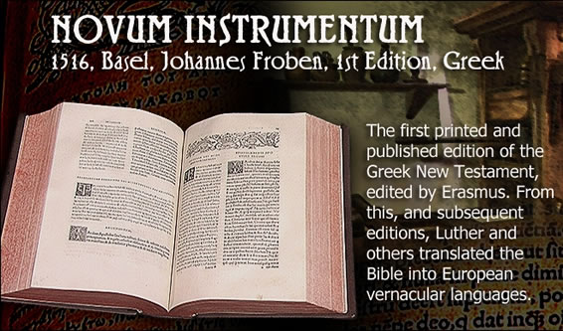
https://www.tyndalesploughboy.org/novum-instrumentum/

Slide 25

https://www.hopehelps.org/volunteer-appreciation-week-2018/

Slide 26

Class Discussion Time
https://www.weareteachers.com/moving-beyond-classroom-discussions/

Slide 27
*Class Discussion Time
We saw where Erasmus’ way of attacking the false beliefs and practices in his day was not righteous anger, but humor: he held up corrupt Church leaders to ridicule, mocked them, and set all Western Europe laughing at them. Christians in our day sometimes object to those who mock and ridicule their opponents. Can mockery and ridicule be a legitimate way of countering our opponents? Explain your view.
Erasmus believed that education was the royal route to solving mankind’s problems. Do you agree? What do you see as the value of education? What are the limits to what education can do?
Do you have a topic or question that you would like to see us to discuss?

