Slide 2
Review
In his formative years, Erasmus was influenced by a religious group known as the Brothers of the Common Life. Describe the basic values of this group.
The Brothers stressed a return to Bible reading, meditation, and the pursuit of holiness. Members adopted a simple, self-supporting lifestyle, living from a common fund, and often earned their livelihood through copying manuscripts.
The great turning point in Erasmus’s life was his visit to England in 1499, where he became a close friend of the leading English humanists, John Colet and …?
Sir Thomas More
Erasmus thought scholasticism had corrupted the Christian message by marrying it to the philosophy of Aristotle. What was the question he asked to illustrate the absurdity of marrying Christianity with Greek philosophy?
“What has Christ to do with Aristotle?”

Slide 3
Review
Briefly describe what we saw depicted in the excerpt that we read last week from Erasmus’s Julius Excluded from Heaven.
Julius tries to bully his way into heaven by his display of riches and threats of violence and condemnation – but Peter will have none of it and denies Julius entrance.
What did Erasmus believe was the royal route to solving mankind’s (cultural) problems?
Education
Because in so many ways Erasmus sowed the seeds of the Protestant Reformation, the people in the 16th century had a saying about Erasmus and Luther. What was it?
“Erasmus laid the egg and Luther hatched it.”
What was the issue that Erasmus and Luther debated through a series of books?
The freedom of man’s will (Erasmus) versus the total bondage of man’s will to sin (Luther)

Slide 4
https://www.tyndalesploughboy.org/novum-instrumentum/

Slide 5
Erasmus’ Novum Instrumentum
Novum Instrumentum was the first published Greek New Testament. Published in 1516, it was prepared by Desiderius Erasmus and printed by Johann Froben of Basel.
There was another Greek New Testament that existed at that time, it was part of a publication known as the Complutensian Polyglot.
The Polyglot, which included both New and Old Testament, was initiated and financed by Cardinal Francisco Jiménez de Cisneros. It was not published until 1520.
Five editions of Novum Instrumentum were published from 1516-1535, though, with the second edition, its title was changed to Novum Testamentum.
The Erasmian Greek texts went on to become the basis for the majority of translations of the New Testament in the 16–19th centuries.
https://www.wikiwand.com/en/Novum_Instrumentum_omne
https://en.wikipedia.org/wiki/Complutensian_Polyglot_Bible

Slide 6
The First Edition (1516)
Erasmus traveled to Basel (located today in Switzerland) and began work on his first edition of the Greek New Testament in July of 1515.
Erasmus did not take any Greek manuscripts to Basel, hoping instead to find what he needed there.
Erasmus ended up using seven manuscripts in his first edition.
Erasmus borrowed two manuscripts from Johannes Reuchlin, a German-born Catholic humanist and a scholar of Greek and Hebrew.
The rest of the manuscripts he borrowed from Dominicans.
https://www.wikiwand.com/en/Novum_Instrumentum_omne

Slide 7
The First Edition (1516)
Manuscript | Content | Date
Minuscule 1^{eap} | the entire NT except Revelation | 12th century
Minuscule1^{rK} | Book of Revelation | 12th century
Minuscule 2e | Gospels | 12th century
Minuscule 2^{ap} | Acts and Epistles | 12th century
Minuscule 4^{ap} | Pauline epistles | 15th century
Minuscule 7^{p} | Pauline epistles | 12th century
Minuscule 817 | Gospels | 15th century
https://www.wikiwand.com/en/Novum_Instrumentum_omne

Slide 8
The First Edition (1516)
Erasmus had three manuscripts of the Gospels and Acts, four manuscripts of the Pauline epistles, but only one manuscript with the Book of Revelation.
So for every book of the New Testament he was able to compare three or four manuscripts, except for the Book of Revelation.
On top of that, the manuscript for Revelation was not complete – it lacked the final leaf, which contained the last six verses of the book.
Instead of delaying the publication, on account of the search for another manuscript, he decided to translate the missing verses from the Latin Vulgate into Greek.
Erasmus’ first edition was a bilingual edition: the Greek text was in a left column, Latin in a right column
It is clear, the main purpose of the first edition was the correction the Latin Vulgate – not the publication of a Greek text.
https://www.wikiwand.com/en/Novum_Instrumentum_omne

Slide 9
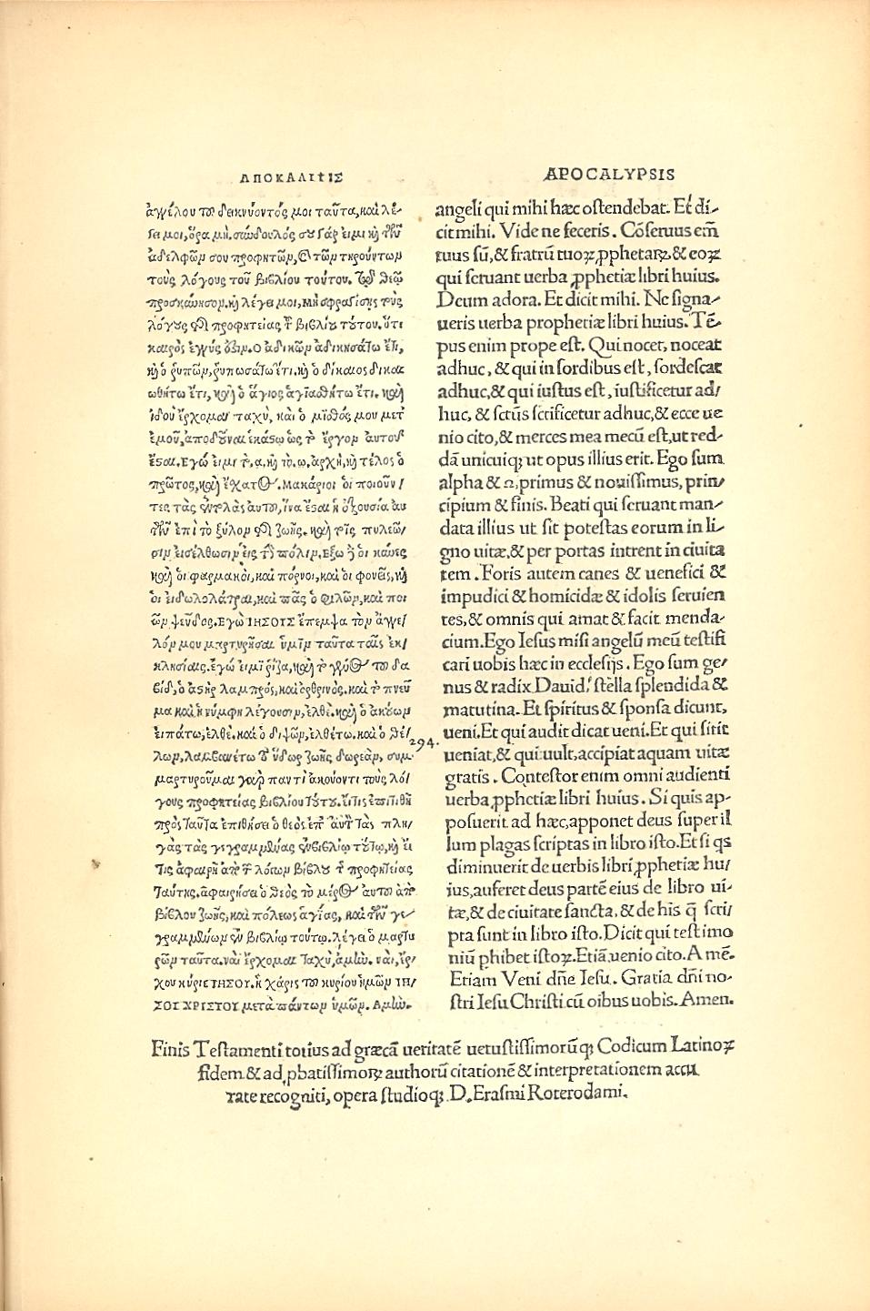
The last page of the Erasmian New Testament (Rev 22:8-21)
https://www.wikiwand.com/en/Novum_Instrumentum_omne

Slide 10
The Second Edition (1519)
In the second edition Erasmus also used an additional manuscript: Minuscule 3 (a 12th century manuscript which contained the entire NT except Revelation).
The text was changed in about 400 places, with most—though not all—of the typographical errors corrected.
One of the editors of Complutensian Polyglot, criticized Erasmus because his Greek text did not include part of 1 John 5:7-8 (also known as the Comma Johanneum):
⁷ For there are three that bear record in heaven, the Father, the Word, and the Holy Ghost: and these three are one. ⁸ And there are three that bear witness in earth, the Spirit, and the water, and the blood: and these three agree in one. (1 John 5:7-8 KJV)
Erasmus replied that he had not found it in any Greek manuscript. But the editor countered that (in his view) Latin manuscripts are more reliable than Greek.
https://www.wikiwand.com/en/Novum_Instrumentum_omne

Slide 11
The Second Edition (1519)
In 1520, Edward Lee (who would later become archbishop of York) complained to Erasmus that leaving out the Comma Johanneum, would lead to Arianism.
Erasmus again replied that he had not found any Greek manuscript that contained these words, therefore this was not a case of omission, but simply of non-addition.
Erasmus went on to show that even some Latin manuscripts did not contain these words.
Another attack was made in 1521 by the prefect of the Vatican Library, because Erasmus’ Greek text had departed from some of the common readings of the Vulgate.
Erasmus’ second edition became the basis for Luther's German translation.
https://www.wikiwand.com/en/Novum_Instrumentum_omne

Slide 12
The Third Edition (1522)
With the third edition of Erasmus's Greek text, the Comma Johanneum was included.
An often repeated story is that Erasmus included it, because he felt bound by a promise to include it if a manuscript was found that contained it. When a single 16th-century Greek manuscript subsequently had been found to contain it (Codex Montfortianus), Erasmus included it, though he expressed doubt as to the authenticity of the passage in his Annotations.
The third edition differed in 118 places from the second.
This edition was used by:
William Tyndale for the first English New Testament (1526),
Robert Estienne (aka. Stephanus) as a base for his editions of the Greek New Testament (1546 and 1549)
The translators of Geneva Bible (1560)
The translators of King James Version (1611)
https://www.wikiwand.com/en/Novum_Instrumentum_omne

Slide 13
The Fourth Edition (1527)
Shortly after the publication of his third edition, Erasmus had opportunity to study the Complutensian Polyglot, and used its text for improvement of his own text.
In the Book of Revelation, he altered his fourth edition in about 90 passages on the basis of the Complutensian text.
Unfortunately Erasmus had forgotten what places of the Apocalypse he translated from Latin and he did not correct all of them!
Except for Revelation, the fourth edition differed only in about 20 places from his third.
The fourth edition was printed in three parallel columns, they contain the Greek, Erasmus' own Latin version, and the Vulgate.
https://www.wikiwand.com/en/Novum_Instrumentum_omne

Slide 14
The Final Edition (1535)
The fifth edition of Erasmus, published in 1535, the year before his death, discarded the Vulgate.
The fifth edition differed only in four places from the fourth.
Popular demand for Greek New Testaments led to a flurry of further authorized and unauthorized editions in the early sixteenth century; almost all of which were based on Erasmus's work and incorporated his particular readings, although typically also making a number of minor changes of their own.
https://www.wikiwand.com/en/Novum_Instrumentum_omne

Slide 15
The Reformation 1517-1648
https://www.history.com/topics/reformation/reformation

Slide 16
The Reformation
The Reformation broke out with surprising intensity in the sixteenth century, giving birth to Protestantism and shattering the papal leadership of western Christendom.
Four major traditions marked early Protestantism:
Lutheran
Reformed
Anabaptist
Anglican
After a generation, the Church of Rome itself, led by the Jesuits, recovered its moral fervor.
Bloody struggles between Catholics and Protestants followed, and Europe was ravaged by war before it became obvious that western Christendom was permanently divided and a few pioneers pointed toward a new way: the denominational concept of the church.
Shelley, Dr. Bruce L.. Church History in Plain Language: Fourth Edition (p. 245).

Slide 17
A Wild Boar in the Vineyard
https://www.thedailymeal.com/drink/italy-s-chianti-vineyards-are-currently-under-attack-wild-boars/030816

Slide 18
A Wild Boar in the Vineyard
In the Summer of 1520 a document bearing an impressive seal circulated throughout Germany in search of a remote figure. “Arise, O Lord,” the writing began, “and judge Thy cause. A wild boar has invaded Thy vineyard.”
The document, a papal bull, took three months to reach Martin Luther, the “wild boar”.
Long before it arrived in Wittenberg where Luther was teaching, he knew its contents.
Forty-one of his beliefs were condemned as “heretical, or scandalous, or false, or offensive to pious ears, or seductive of simple minds, or repugnant to Catholic truth.”
Shelley, Dr. Bruce L.. Church History in Plain Language: Fourth Edition (p. 247).

Slide 19
A Wild Boar in the Vineyard
The bull called on Luther to repent and repudiate his errors or face the dreadful consequences.
Luther received his copy on the tenth of October.
At the end of his sixty-day period of grace, he led a throng of eager students outside Wittenberg and burned copies of the Canon Law and the works of some medieval theologians.
Perhaps as an afterthought Luther added a copy of the bull condemning him. That was his answer. “They have burned my books,” he said; “I burn theirs.”
Those flames in early December 1520 were a fit symbol of the defiance of the pope raging throughout Germany.
Shelley, Dr. Bruce L.. Church History in Plain Language: Fourth Edition (p. 247).

Slide 20
A Wild Boar in the Vineyard
The Church of the popes no longer hurls anathemas at Protestants, and Lutherans no longer burn Catholic books, but the divisions of Christians in Western Christianity remain.
Behind today’s differences between Catholics and Protestants lie the events of the age of Luther, a period of church history we call the Reformation (1517– 1648).
Shelley, Dr. Bruce L.. Church History in Plain Language: Fourth Edition (p. 247).

Slide 21
Martin Luther
https://www.vision.org/biography-martin-luther-fearful-philosopher-394

Slide 22
Young Luther
Martin Luther (1483-1546) was the son of a copper miner from Eisleben in Saxony.
Luther later described himself as a “tough Saxon” of peasant blood.
Soon after his birth the family moved to Mansfeld, the center of Germany’s mining industry, where Luther’s father, Hans, eventually became joint-owner of six mining shafts and two smelting furnaces, which raised the family’s quality of life to new heights of prosperity.
It was a large family, by modern Western standards: by 1505, Hans had four sons and four daughters, Martin being the second son.
Needham, Nick. 2,000 Years of Christ's Power Vol. 3: Renaissance and Reformation

Slide 23
Young Luther
Events that educated people today think of as “natural” were routinely ascribed to evil spirits in that day: for example thunder and lightning.
It was common to think that certain places were the home of dark powers. Luther shared this outlook and never outgrew it.
Luther’s struggles with Satan were intensified by his demon-haunted view of the world.
It was offset, though, by a belief in supernatural forces of good – saints and angels – and the power of God channeled through the Church.
Needham, Nick. 2,000 Years of Christ's Power Vol. 3: Renaissance and Reformation

Slide 24
Young Luther
Luther was educated at the town school in Mansfeld, and was then sent at the age of twelve to a boarding school.
In 1501, aged eighteen, he went to the University of Erfurt (central Germany), intending to become a lawyer in obedience to his father’s wishes.
There he studied the trivium (grammar, rhetoric, and logic), then the quadrivium (arithmetic, geometry, music, and astronomy): the traditional form of medieval education.
We know little of Luther’s university life, but we do know he was a good student: he graduated early in 1505, coming second in a class of seventeen.
The plan was that he should then study for a further two years at Erfurt in order to qualify as a lawyer.
But God had other plans…
Needham, Nick. 2,000 Years of Christ's Power Vol. 3: Renaissance and Reformation

Slide 25
Luther Becomes a Monk
https://store.faithink.com/collections/luther-resources

Slide 26
https://www.hopehelps.org/volunteer-appreciation-week-2018/

Slide 27
Class Discussion Time
https://www.weareteachers.com/moving-beyond-classroom-discussions/

Slide 28
*Class Discussion Time
King James Only advocates in our day, disdain the use of new manuscript evidence to make corrections to the Greek text, which sometimes result in minor translation changes. In light of how Erasmus’ Greek text (which is the basis for the King James NT) was prepared, Do you see an irony in their complaint ?
The Reformation ultimately resulted in the Christian Church breaking into a number of denominations. Is this a good thing or a bad thing? Explain you view.
Events that educated people today think of as “natural” were routinely ascribed to evil spirits in Luther’s day: for example thunder and lightning. Luther himself subscribed to this view. Was Luther naive for doing so, or is it educated people in our day who get it wrong? Explain your view.
Do you have a topic or question that you would like to see us to discuss?

