Slide 2
Review
Several months before Luther nailed his famous 95 theses to the door of the Wittenberg castle church, he produced 97 theses. What subject did the 97 theses pertain to and how widespread and popular did they become?
They were attacking Scholasticism and their integration of Aristotelian philosophy with their theology.
The 97 theses had very little impact. No one seemed to even care about them.
What subject did the 95 theses pertain to and how widespread and popular did they become?
They were attacking indulgences as preached by Johann Tetzel.
They became immensely popular.
Pope Leo X had sent Johann Tetzel out at that time to sell indulgences to be used for what purpose?
Building St. Peter’s Basilica.

Slide 3
Review
Luther’s theology and it’s gradual departure from cardinal Roman Catholic doctrines occurred slowly over a period of time. He started off just criticizing indulgences as preached by Johann Tetzel. What other Roman Catholic doctrines did Luther gradually end up rejecting?
The Roman Catholic teaching on indulgences
The belief that someone excommunicated from the Roman Catholic Church was eternally damned
The infallibility of the pope. Luther eventually came to suspect that the pope might be the Antichrist!
The belief that ecumenical councils were infallible
What previous historical figure was Luther often compared to that led many to the conclusion the he too should be burned at the stake?
Johann Huss

Slide 4
http://www.menwithchests.com/sola-scriptura/

Slide 5
Sola Scriptura
At this point it is crucial to understand what the Protestant Reformers did and did not mean by “Scripture alone”.
They did mean that only the canonical Scriptures possess infallible authority as a source of Christian teaching.
All other sources, however useful or even indispensable they may be in helping Christians to understand Scripture, are subordinate to Scripture.
However, they did not mean that a Christian could ignore or despise all other sources and authorities.
Needham, Nick. 2,000 Years of Christ's Power Vol. 3: Renaissance and Reformation

Slide 6
Sola Scriptura
For example, most of the Protestant Reformers had high regard for what we in the West know as “the Apostles’ Creed”.
Although they would not have ascribed divine inspiration or infallibility to the Creed, they still saw it as a true and indispensable summary of the basic contents of Scripture.
The Protestant Reformers also granted a subordinate authority to the creeds of the ecumenical Councils, especially the Nicene Creed and the Creed of Chalcedon.
These, they maintained, were providential landmarks in the history of God’s people, that proclaimed biblical truths which Christians had always received.
Needham, Nick. 2,000 Years of Christ's Power Vol. 3: Renaissance and Reformation

Slide 7
Sola Scriptura
The position taken by the Protestant Reformers has been described as “Tradition 1” – a critical reverence for the history and traditions of the Church.
The Reformers treated Christian theological tradition with deep care and respect, although they did not give it a blind or uncritical allegiance.
This has been contrasted with “Tradition 2”, the view held by the hardline defenders of Roman Catholicism – who held an authoritarian reverence for the history and traditions of the Church.
These Roman Catholics elevated theological tradition (or, as the Reformers claimed, a biased reading of it) into an untouchable status.
Needham, Nick. 2,000 Years of Christ's Power Vol. 3: Renaissance and Reformation

Slide 8
Sola Scriptura
“Tradition 2” was a kind of “all or nothing” approach.
It permitted no one to subject any development of doctrine to critical scrutiny, and therefore nothing could be corrected.
Reformation on this model of course became impossible: one simply had to accept everything, no matter how far it may have drifted from Scripture or the early Church fathers.
Needham, Nick. 2,000 Years of Christ's Power Vol. 3: Renaissance and Reformation

Slide 9
Sola Scriptura
Alongside Tradition 1 and Tradition 2, the 16th century also offered a third option: “Tradition 0”.
This tradition is associated with the Radical Reformation, which had little or no respect for the Church’s history or traditions: a Christian must read the Bible with fresh eyes, as if no one else had ever read it before.
Modern evangelicalism often interprets “Scripture alone” in this Tradition 0 sense, but we must recognize that this was not what the Protestant Reformers believed.
Needham, Nick. 2,000 Years of Christ's Power Vol. 3: Renaissance and Reformation

Slide 10
Charles V Holy Roman Emperor
https://en.wikipedia.org/wiki/Charles_V,_Holy_Roman_Emperor#/media/File:Barend_van_Orley_-_Portrait_of_Charles_V_-_Google_Art_Project.jpg

Slide 11
Charles V
In June 1519, halfway through the Leipzig disputation (where Luther debated Johann Eck), Charles V of Spain was elected Emperor of the Holy Roman Empire.
Charles belonged to the great German family of Habsburg, the most powerful family in Europe, which had in fact occupied the Holy Roman Empire’s throne since 1438.
With the far-flung lands of the Habsburgs in his possession, Charles V ruled the largest domain of any Western European king since Charlemagne – Spain, southern Italy, the Netherlands, Germany, and Bohemia.
Needham, Nick. 2,000 Years of Christ's Power Vol. 3: Renaissance and Reformation

Slide 12
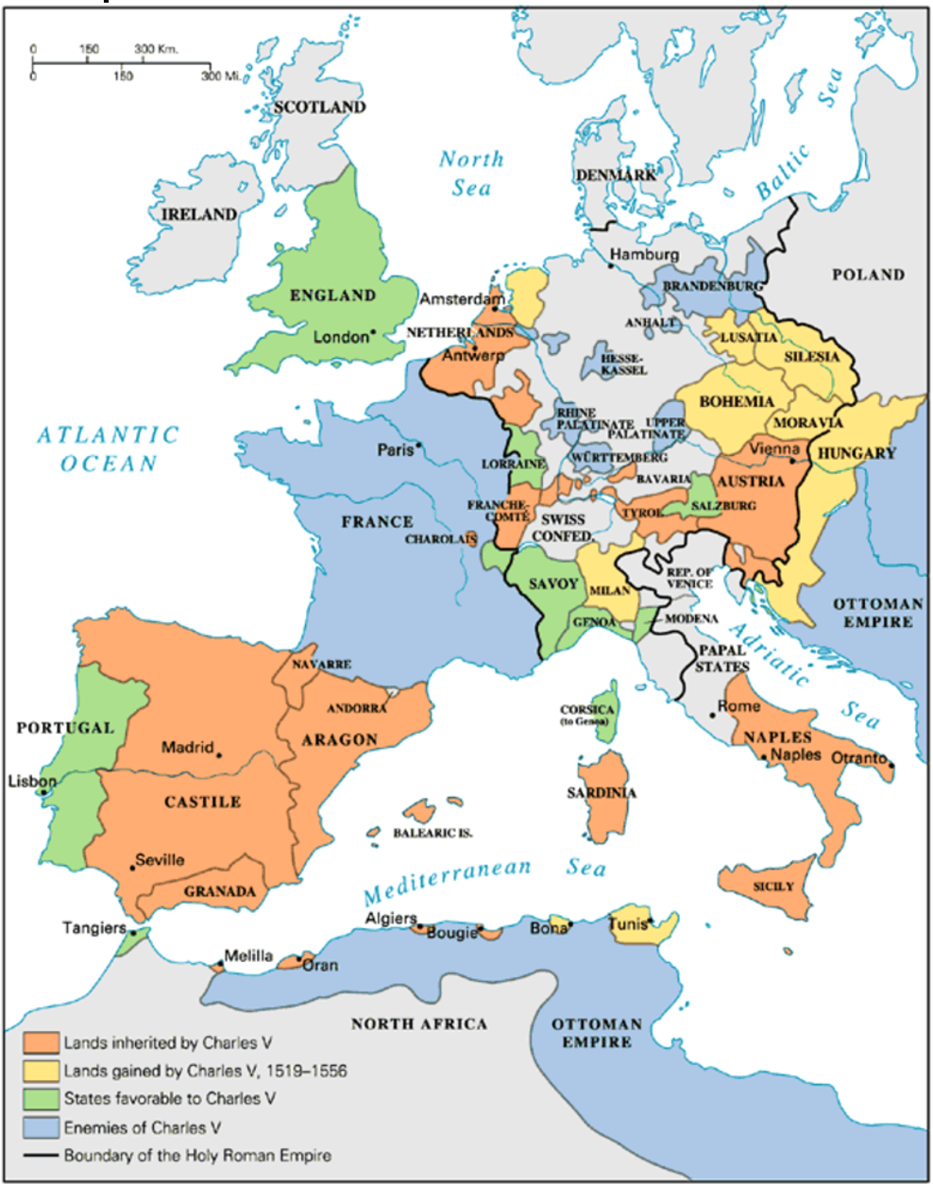
The Empire of Charles V
https://fbbcts.instructure.com/courses/744/pages/political-leaders-of-the-reformation-era

Slide 13
Charles V
Charles V was in many ways a just and honorable ruler, but in matters of religion he remained firmly (though not fiercely) loyal to Rome.
Both sides in the Luther controversy appealed to the new Emperor.
Charles summoned an formal deliberative assembly or “diet” to meet at Worms (a city in western Germany) in January 1521, where among other things, Luther’s case would be heard.
Needham, Nick. 2,000 Years of Christ's Power Vol. 3: Renaissance and Reformation

Slide 14
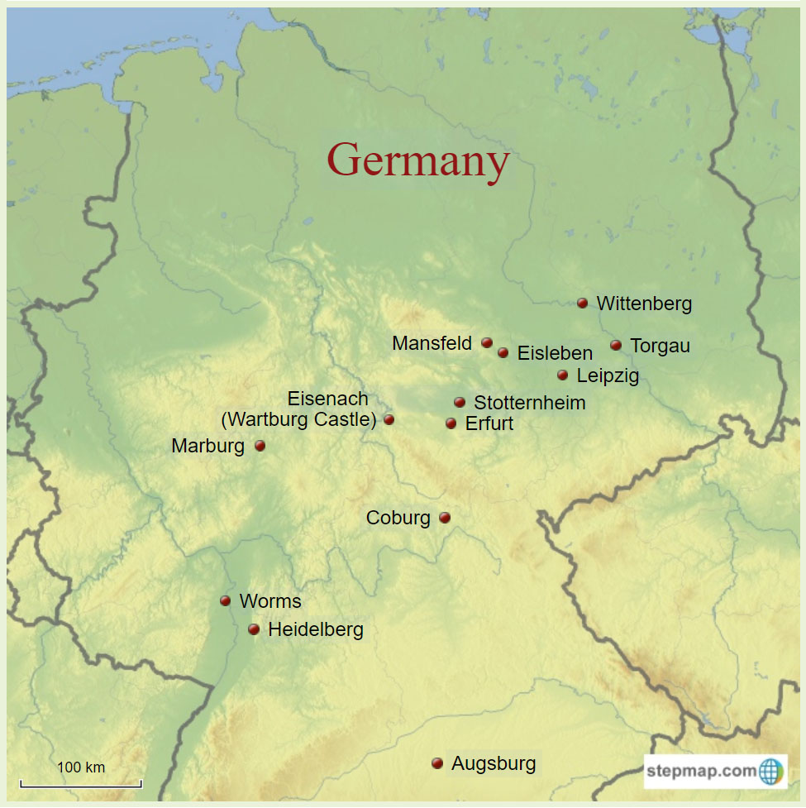
Map of Luther’s Germany
https://havegermanwilltravel.com/images/map-of-luthers-germany.jpg

Slide 15
Diet of Worms
https://lutheranreformation.org/wp-content/uploads/2015/10/deitofworms.jpg

Slide 16
Diet of Worms
Luther and the papacy had finally come to a decisive break with each other.
Luther had studied some of John Huss’s writings and concluded that the Hussites had been in the right in their conflict with Rome.
“We are all Hussites without knowing it,” Luther declared. “Saint Paul and saint Augustine are Hussites!”
Luther also came across Lorenzo Valla’s treatise which proved that the “Donation of Constantine” – a document that claimed the great emperor had given the popes jurisdiction over the West – was a fake.
A terrible certainty now gripped Luther that the papacy was indeed the Antichrist, the Man of Sin prophesied by the apostle Paul (2 Thess. 2).
Needham, Nick. 2,000 Years of Christ's Power Vol. 3: Renaissance and Reformation

Slide 17
Diet of Worms
For his part, Pope Leo was now convinced that Luther was a dangerous heretic to whom patience and tolerance could no longer be shown.
On June 15, 1520, Leo issued a papal bull ordering Luther to submit within sixty days or be excommunicated and burnt as a heretic.
The bull listed forty-one of Luther’s errors; these included
Rejection of papal supremacy
Denial of the pope’s power to excommunicate from the true spiritual Church of believers
Demand that the wine be given to the laity in communion
Teaching that the fall of Adam had destroyed human free will in spiritual matters
Needham, Nick. 2,000 Years of Christ's Power Vol. 3: Renaissance and Reformation

Slide 18
Diet of Worms
When the bull arrived in Wittenberg, Luther announced that he would burn it in public, which he did on December 10, 1520 in the presence of a large crowd of students and citizens of Wittenberg who cheered him on.
Popes and ecumenical councils, Luther declared, had failed to reform the Church. Therefore it was the duty of the secular rulers to step in.
Luther’s fate now depended on the new Holy Roman Emperor, Charles V.
Charles was a faithful adherent of the papacy who had no sympathy for Luther’s “heresies”.
But he was also a good politician, and knew that Luther had the backing of most of Germany.
Needham, Nick. 2,000 Years of Christ's Power Vol. 3: Renaissance and Reformation

Slide 19
Diet of Worms
When the imperial diet met at Worms in January 1521, the pope’s ambassador argued that the Church had already excommunicated Luther, so there was nothing for the diet to discuss.
They must simply condemn Luther and have him burnt as a heretic.
However, Luther’s prince, Frederick the Wise, demanded that Luther be given a free and fair hearing by the diet.
Charles V finally agreed and summoned Luther to Worms with a guarantee of safe-conduct.
People remembered that John Huss had gone to the Council of Constance in 1415 under a promise of “safe-conduct” from the Emperor Sigismund, but Sigismund had still burnt Huss at the stake.
Needham, Nick. 2,000 Years of Christ's Power Vol. 3: Renaissance and Reformation

Slide 20
Diet of Worms
Luther was cheered all the way on his journey from Wittenberg to Worms, a popular national hero.
The pope’s ambassador, Aleander, reported back to Rome that:
The whole of Germany is in full revolt. Nine-tenths raise the battle-cry, “Luther!,” while the other tenth care nothing for Luther but cry out, “Death to the court of Rome!”
The great German nationalist knight, Ulrich von Hutten, was also writing very violent pamphlets and poems in favor of Luther, and threatening to wash his hands in the blood of the pope and his cardinals.
Luther arrived at Worms on April 16, 1521. The next day he appeared before the diet.
On a table before him lay a collection of his writings.
Needham, Nick. 2,000 Years of Christ's Power Vol. 3: Renaissance and Reformation

Slide 21
Diet of Worms
An official of the archbishop of Trier, surnamed Eck (but no relation of the Eck who had debated with Luther at Leipzig), asked the German friar if the writings were his.
Yes, Luther said. Eck asked him if he still defended them, or if he would give up his heresies.
Luther asked for time to think about it. He was granted one day.
The following afternoon he appeared before the diet again.
Luther made a speech in German, justifying what he had written, and promised that if his opponents could prove he was mistaken from the Scriptures, he would be the first to throw his books into the fire.
Needham, Nick. 2,000 Years of Christ's Power Vol. 3: Renaissance and Reformation

Slide 22
Diet of Worms
Eck commanded Luther to give a straightforward answer to a simple question: would he abandon his heretical views, which were nothing but the long-condemned errors of Wyclif and Huss?
Luther replied with the most famous words in the history of Western Christianity:
Unless I am refuted and convicted by testimonies of Scripture or by clear reason – since I believe neither the popes nor the councils by themselves, for it is clear that they have often erred and contradicted themselves – I am conquered by the holy Scriptures I have quoted, and my conscience is captive to the Word of God. I cannot and will not withdraw anything, since it is neither safe nor right to do anything against one’s conscience. Here I stand. God help me. Amen.
Then Luther left, hissed by his enemies but greeted outside by a crowd of admirers, and Charles V broke up the Diet amid general confusion.
Needham, Nick. 2,000 Years of Christ's Power Vol. 3: Renaissance and Reformation

Slide 23
Luther as Heretic and Outlaw
https://www.alamy.com/stock-photo/luther-kidnapped.html

Slide 24
Class Discussion Time
https://www.weareteachers.com/moving-beyond-classroom-discussions/

Slide 25
*Class Discussion Time
Sola Scriptura states that only the canonical Scriptures possess infallible authority as a source of Christian teaching – all other religious sources and authorities are subordinate to Scripture.
While accepting the above as a given, which view comes closest to your view of all other non-scriptural sources and authorities:
The view of the Reformers that they are not to be despised or ignored as they can be useful and even indispensable in helping Christians to understand Scripture.
The view of the Radical Reformers who had little or no respect for the Church’s history or traditions, believing that a Christian must read the Bible with fresh eyes, as if no one else had ever read it before.
Do you have a topic or question that you would like to see us to discuss?

