Slide 2
Review
Sola Scriptura says that the only thing that possesses infallible authority as a source of Christian teaching is…
The canonical scriptures
The Reformers believed that all other religious sources and authorities are subordinate to Scripture, but that they are not to be despised or ignored as they can be useful and even indispensable in helping Christians to understand Scripture. What did the Radical Reformers believe in this regard?
They had little or no respect for the Church’s history or traditions, believing that a Christian must read the Bible with fresh eyes, as if no one else had ever read it before.

Slide 3
Review
What made the newly chosen Holy Roman Emperor, Charles V hesitant to simply burn Luther at the stake?
He knew that Luther had the backing of most of Germany and Luther’s prince, Frederick the Wise, demanded that Luther be given a free and fair hearing.
In his famous statement given at Wittenberg, defending his writings, what reason did Luther give as to why we cannot trust popes or counsels?
It is clear that they have often erred and contradicted themselves…

Slide 4
Luther as Heretic and Outlaw
https://www.alamy.com/stock-photo/luther-kidnapped.html

Slide 5
Luther as Heretic and Outlaw
Luther had made a bad impression on the Emperor and the bishops, especially by his assertion that even ecumenical councils could make mistakes.
Luther seemed to be saying that he, a single university professor, was right, and the rest of the Church was wrong. (In his darkest moments, Luther wondered whether he was guilty of this.)
Some zealous traditionalists urged Emperor Charles V to break his promise of safe-conduct and have Luther burnt as a heretic, but Charles had a high sense of personal honor, and refused to go back on his word.
After several days of fruitless discussions between Luther and a committee of the diet, the Emperor allowed the Reformer to leave Worms on April 26, 1521.
Needham, Nick. 2,000 Years of Christ's Power Vol. 3: Renaissance and Reformation

Slide 6
Luther as Heretic and Outlaw
On May 26, the diet officially condemned him as a heretic and outlaw (only a minority of delegates were left, most of Luther’s supporters having gone home), and placed him under the ban of the Empire.
This meant that anyone giving shelter or hospitality to Luther would be committing a crime. However, issuing the ban was one thing; enforcing it was another.
The Holy Roman Empire was not a centralized monarchy, but a loose federation of several hundred German states, including large domains like Luther’s Saxony, the imperial cities like Strasbourg, and many small territories controlled by lesser nobles.
If local German authorities chose to protect Luther, there was little Charles V could do to stop them.
And Luther’s own prince, Frederick the Wise, was determined to protect the popular hero.
Needham, Nick. 2,000 Years of Christ's Power Vol. 3: Renaissance and Reformation

Slide 7
Luther as Heretic and Outlaw
As Luther journeyed home from Worms to Wittenberg, Frederick sent a party of knights to intercept him.
They carried him off to the Wartburg castle in Eisenach, where he was kept in secrecy and safety for eleven months.
To disguise himself, Luther got rid of his friar’s gown, dressed like a gentleman, grew long hair and a beard, and assumed the name “Sir George”.
When he went out of the castle for fresh air and exercise, he engaged people in conversation and asked them whether anyone had discovered Luther’s whereabouts yet!
Needham, Nick. 2,000 Years of Christ's Power Vol. 3: Renaissance and Reformation

Slide 8
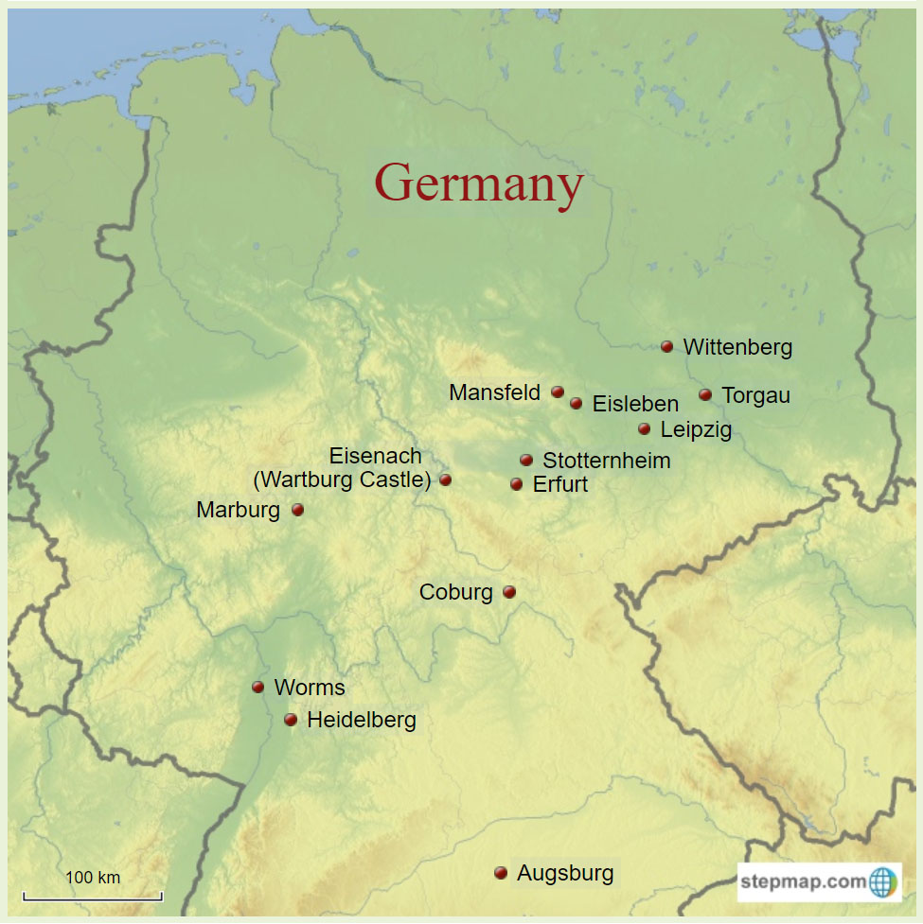
Map of Luther’s Germany
https://havegermanwilltravel.com/images/map-of-luthers-germany.jpg

Slide 9
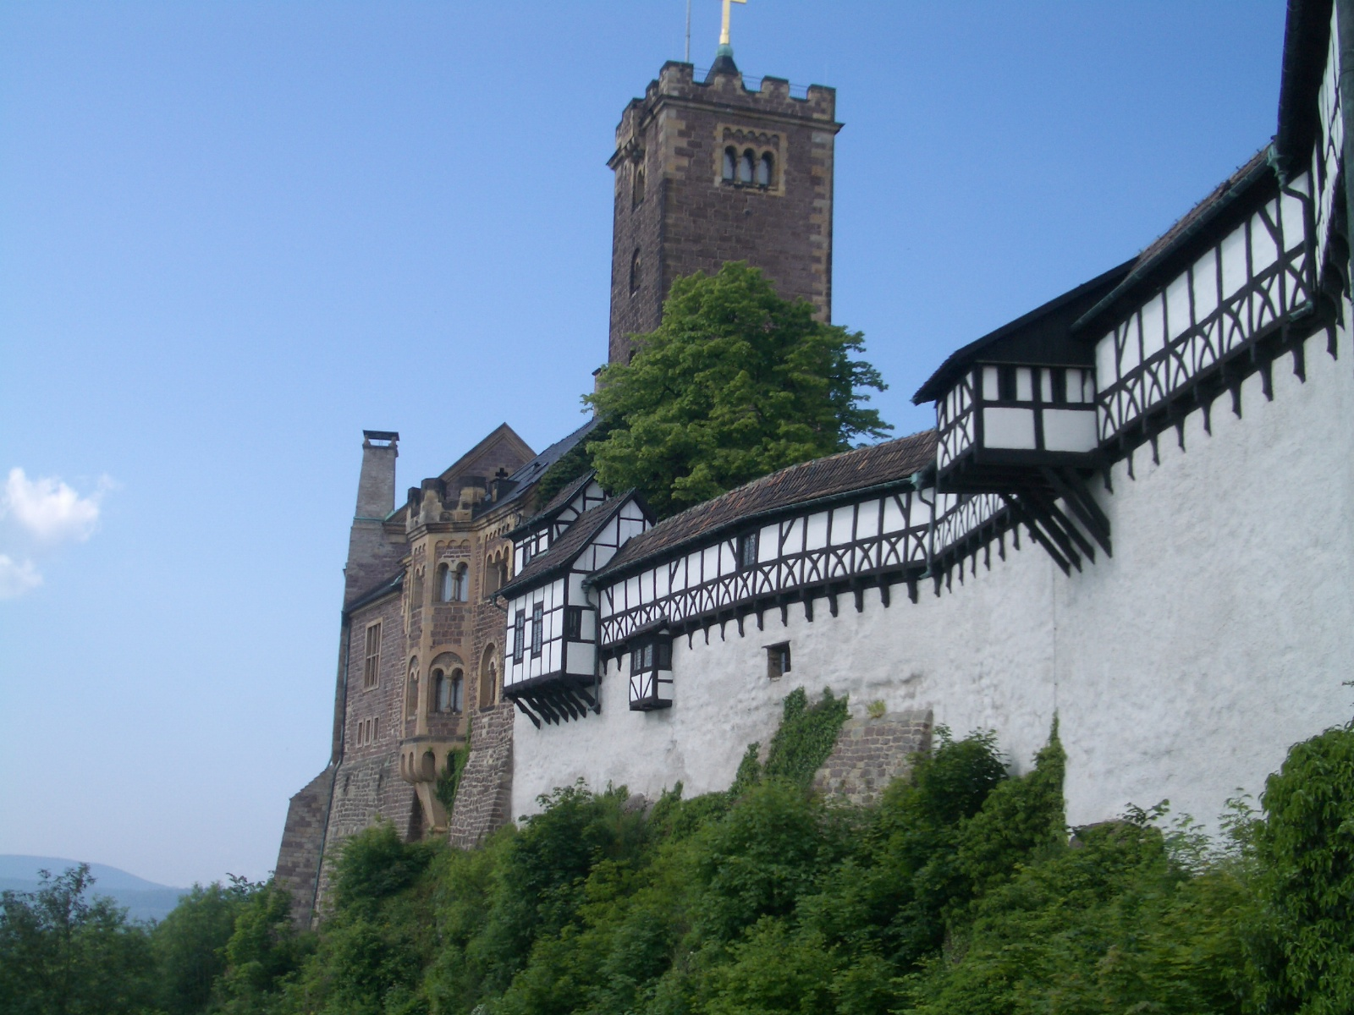
Wartburg Castle
https://billpetro.com/history-of-martin-luther-part-5

Slide 10
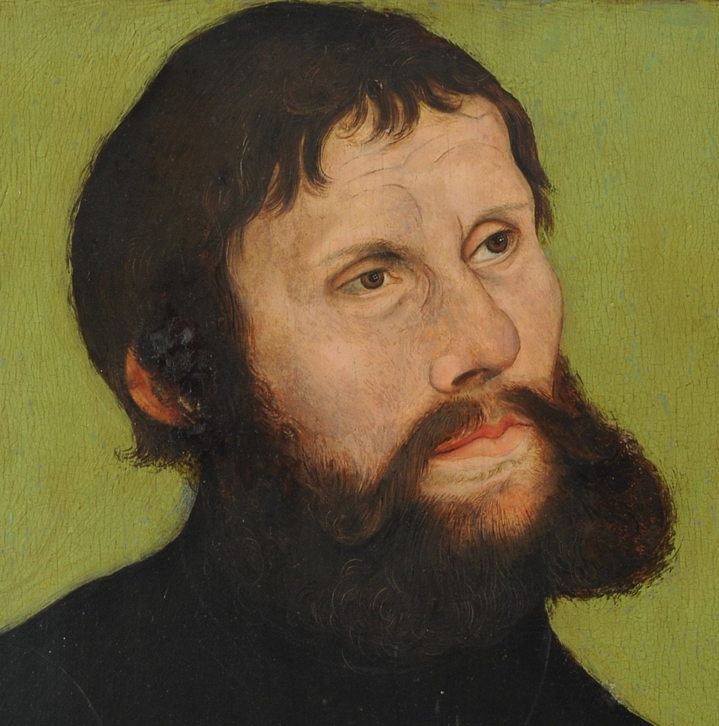
Luther as “Sir George”
https://billpetro.com/history-of-martin-luther-part-5

Slide 11
Luther as Heretic and Outlaw
Luther’s stay at the Wartburg was the most creative year of his life.
He translated the entire New Testament into German, finishing in February 1522 (it was published in September).
Working from Erasmus’s Greek New Testament, Luther produced a translation which was and still is a masterpiece of the German language.
There had been other German Bibles before Luther’s, but they were translated from the Latin Vulgate, and used an awkward and difficult style of German.
Luther’s New Testament, translated directly from the Greek, was in a lively popular style that every German could understand.
Its impact transformed the religious life of Germany, and even shaped the future development of the German language.
Needham, Nick. 2,000 Years of Christ's Power Vol. 3: Renaissance and Reformation

Slide 12
Luther as Heretic and Outlaw
In 1534 the whole Bible (both Old and New Testament) was published in German, translated by Luther and his colleagues at Wittenberg University.
Meanwhile, a host of popular writers throughout Germany took up Luther’s cause, writing countless tracts condemning the papacy and supporting Luther.
All the chief agents of communication in Germany propagated “Lutheranism”: printers, artists, students, preachers, lawyers, teachers in city schools, and merchants who could travel about spreading Lutheran ideas and books.
Most of Germany was now in open revolt against the papacy, and the papacy seemed powerless to stop it.
Needham, Nick. 2,000 Years of Christ's Power Vol. 3: Renaissance and Reformation

Slide 13
The Dawn of the Radical Reformation
https://fineartamerica.com/featured/luther-challenging-carlstadt-to-write-against-him-english-school.html

Slide 14
The Dawn of the Radical Reformation
In Wittenberg, Luther’s home town, his followers undertook the task of reforming the church locally while Luther was still in hiding in the Wartburg castle.
Carlstadt and Zwilling spearheaded the Wittenberg Reformation, attacking images of Christ and the saints, condemning instrumental music in worship, offering the wine as well as the bread to the laity in communion, and trying to force laypeople to touch and handle the bread because Christ had said “Take, eat”. (In the medieval Catholic mass, the laity did not touch the wafer; the priest inserted it into their mouths.)
They exhorted priests and monks to abandon their vows of celibacy and get married; Carlstadt took a wife and wanted to compel all the clergy to follow his example, denouncing celibacy as an evil practice.
Needham, Nick. 2,000 Years of Christ's Power Vol. 3: Renaissance and Reformation

Slide 15
The Dawn of the Radical Reformation
Events spun completely out of control when three preachers from Zwickau (a town south of Wittenberg) arrived in the city in December.
They claimed to be in direct contact with God who, they said, spoke to them in private revelations.
Luther called them the “Zwickau prophets”.
They opposed infant baptism (and perhaps all water baptism), and proclaimed that the end of the world would shortly take place.
Carlstadt and Zwilling sided with them.
Carlstadt, Zwilling, and the Zwickau prophets were the first of the Radical Reformers.
Needham, Nick. 2,000 Years of Christ's Power Vol. 3: Renaissance and Reformation

Slide 16
The Dawn of the Radical Reformation
Under the influence of Carlstadt, Zwilling, and the Zwickau prophets, the religious life of Wittenberg became chaotic.
Violence erupted. Mobs went round smashing altars, shrines, and images – chiefly statues and stained-glass windows depicting Christ and the saints, which often adorned the tombs of the upper classes.
They insulted and intimidated those who stayed loyal to Rome.
The town magistrates, incapable of controlling the situation themselves, and fearing a descent into anarchy, could think of only one thing to do: they appealed to Luther to return from his secret refuge in the Wartburg castle and re-establish order.
Needham, Nick. 2,000 Years of Christ's Power Vol. 3: Renaissance and Reformation

Slide 17
The Dawn of the Radical Reformation
Despite the fact that he was under the ban of the Empire and his life was in danger, Luther heeded their plea and boldly journeyed back to Wittenberg, arriving in March of 1522, thus ending his eleven months of hiding.
Then, in a series of potent sermons preached over eight days, he managed to restore peace and calm to the disturbed city.
It deeply troubled Luther that many ordinary people, instead of finding peace with God through the gospel, were just becoming inflamed with a hate-filled hostility towards the Roman Catholic Church.
Needham, Nick. 2,000 Years of Christ's Power Vol. 3: Renaissance and Reformation

Slide 18
The Dawn of the Radical Reformation
This, he bluntly told the people of Wittenberg, was not the fruit of the Spirit. He counselled patience to the reforming hot-heads:
Give people time! It took me three years of constant study, reflection, and discussion to arrive where I am now. Can the ordinary man, who has no education in such matters, be expected to move the same distance in three months? You are wrong to think that you get rid of an abuse by destroying the object which is misused. Men can go astray with wine and women. Shall we outlaw wine and abolish women? Sun, moon, and stars have been worshipped. Shall we pluck them out of the sky? Your haste and violence reveal a lack of trust in God. See how much He has accomplished through me. I did nothing more than pray and preach. The Word did it all. If I had wished, I could have started a riot at Worms. But while I sat still and drank beer with Melanchthon and Amsdorf, God dealt the papacy a mighty blow!
Needham, Nick. 2,000 Years of Christ's Power Vol. 3: Renaissance and Reformation

Slide 19
The Peasant’s Revolt of 1525
https://www.akg-images.com/archive/The-Peasants%E2%80%99-War-2UMDHURG8COF.html

Slide 20
The Peasant’s Revolt of 1525
For decades the conditions of the German peasantry had been worsening. As a result, there had been rebellions in 1476, 1491, 1498, 1503, and 1514.
But none of these was as widespread or as devastating as the uprisings of 1524 and 1525.
One of the elements making these rebellions particularly severe was that they took on religious overtones, for many among the peasantry believed that the teachings of the reformers supported their economic demands.
Although Luther himself refused to extend the application of his teachings to the political realm in terms of revolution, there were others who disagreed with him on that point.
González, Justo L. . The Story of Christianity: Volume 2: The Reformation to the Present Day (pp. 41-42)

Slide 21
The Peasant’s Revolt of 1525
Foremost among these was Thomas Müntzer, a native of Zwickau, whose early teachings were similar to those of the “prophets” from his village who had earlier created such a stir in Wittenberg.
Müntzer claimed that what was most important was not the written word of Scripture but the present revelation of the Spirit.
Even apart from Müntzer’s participation, this uprising had a measure of religious inspiration.
In their Twelve Articles, the peasants made both economic and religious demands.
They sought to base their claims on the authority of Scripture, and concluded by declaring that, if any of their demands was shown to be contrary to Scripture, it would be withdrawn.
González, Justo L. . The Story of Christianity: Volume 2: The Reformation to the Present Day (pp. 41-42)

Slide 22
The Peasant’s Revolt of 1525
Luther was at a loss as to what his attitude should be. When he first read the Twelve Articles, he addressed the princes, telling them that what was demanded of them in the articles was just, for the peasants were sorely oppressed.
But when the uprising broke out, and the peasants took up arms, Luther tried to persuade them to follow a more peaceful course, and finally called on the princes to suppress the movement.
Later, when the rebellion was drowned in blood, he urged the victorious princes to be merciful. But his words were not heeded, and it is said that more than a hundred thousand peasants were killed.
These events had fateful consequences for the Reformation. Catholic princes blamed Lutheranism for the rebellion.
Vast numbers of peasants, convinced that Luther had betrayed them, either returned to the old faith (Catholicism) or became Anabaptists.
González, Justo L. . The Story of Christianity: Volume 2: The Reformation to the Present Day (pp. 42-43)

Slide 23
The Peasant’s Revolt of 1525
The Lutheran princes became determined that they must strictly control the Reformation in order to stop it from turning into a popular social movement which could challenge their authority.
Luther himself encouraged the princes in this policy. The Peasants’ Revolt had destroyed his trust in the ordinary German people; he felt that too many of them had diabolically perverted his gospel message of spiritual freedom through Christ into a worldly message of political freedom through armed revolution.
In the period 1517-21, when Luther had stood up against the papacy at the peril of his own life, he had defended religious liberty and toleration, arguing that the state should not execute people for heresy.
However, after the Peasants’ Revolt, Luther accepted that the state should silence and banish Radicals.
Needham, Nick. 2,000 Years of Christ's Power Vol. 3: Renaissance and Reformation

Slide 24
Luther Gets Married
https://leben.us/katie-luther-part-ii/

Slide 25
Class Discussion Time
https://www.weareteachers.com/moving-beyond-classroom-discussions/

Slide 26
*Class Discussion Time
The town of Wittenberg was in chaos when Luther was called in to bring order. Through a series of potent sermons preached over eight days, Luther managed to restore peace and calm to the disturbed city. Is there a lesson here for preachers about the potential power of a series of well delivered sermons?
Luther counselled patience to the reforming hot-heads of Wittenberg, pointing out that even he, with years of study under his belt, took three years to come to the understanding that he did. Is there a lesson for us in Luther’s advice as we minister to people in our present day?
As a result of the Peasant’s Revolt, Luther went from defending toleration and religious liberty to believing that the state needed to silence and banish Radicals. Was this change in Luther’s outlook a good thing or a bad thing? Why or why not?
Do you have a topic or question that you would like to see us to discuss?

