Slide 1


Slide 2

Review
How did Luther meet his wife?
  When a group of nuns in a nearby convent sent word that they had been convinced by Luther’s arguments, and sought his help in escaping from the convent, Luther arranged for their escape. One of the nuns, Katharine von Bora, expressed an interest in Luther. At first Luther was reluctant, but eventually he agreed to marry her.
Describe Luther’s marriage and family.
  Their marriage was quite happy and there are many hints at humor in their relationship. Luther and Kathrine had six children, and they worked jointly at providing a home for them as well as for a number of orphans and students. Luther’s family life became the model that many devout Germans would follow for generations.
In what context did Melanchthon produce the Augsburg Confession?
  In view of recent events, the emperor Charles V requested that the Lutherans provide him with a written explanation of their religious convictions

Slide 3
Review
In order to distance himself from Luther’s “extreme” views, Erasmus, with the encouragement of his moderate friends published a book attacking Luther on what topic?
  His book, entitled The Freedom of the Will, attacked Luther’s view that the fallen human will was in helpless bondage to sin and only God by His sovereign grace could set the will free to embrace and follow Christ.
How did Luther respond?
  He published his own book (The Bondage of the Will) refuting Erasmus’ book. In his book Luther praised Erasmus for going to the heart of the matter instead of going after him on extraneous issues like indulgences and the papacy.
Luther replaced the medieval Catholic practice of a choir singing in Latin with what type of singing?
  The normal Protestant practice of the whole congregation singing in its native tongue.

Slide 4
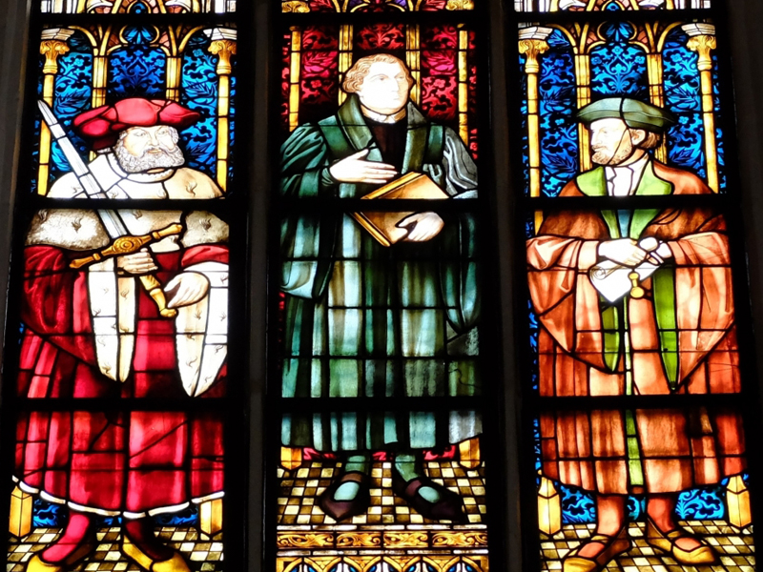
Lutheran Worship
(continued)
https://lutheranreformation.org/wp-content/uploads/2015/10/ref-luthertours.jpg

Slide 5
Lutheran Worship
The congregational model of Lutheran worship was undergirded by the doctrine of the priesthood of all believers.
The whole Christian congregation is a priestly body, and therefore its worship must be corporate and congregational in nature, rather than a performance by a professional worshipper (i.e. the priest) watched by a congregation of passive people.
The move toward more congregational participation in the worship service was the driving force behind the Lutheran practice of giving the communion wine as well as the bread to the laity.
Needham, Nick. 2,000 Years of Christ's Power Vol. 3: Renaissance and Reformation

Slide 6
Lutheran Worship
Those who embraced Luther’s teaching called themselves “Evangelicals” (from the Greek euaggelion, “good news”); their enemies simply called them “Lutherans”.
Evangelicals themselves later adopted the name Lutheran, despite Luther’s own protests:
  Who is this Luther? My teaching is not my own, and I have not been crucified for anyone. Why should it happen to me, miserable stinking bag of maggots that I am, that the children of Christ should be called by my insignificant name? I am, and will be, no one’s master. With the one Church I hold in common the teaching of Christ, who alone is our Master.
The break with the papacy also led to a reformation of Church government. Luther held that a Christian congregation had the right to elect its own pastor (a view which, like congregational worship, flowed from the doctrine of the priesthood of all believers).
Needham, Nick. 2,000 Years of Christ's Power Vol. 3: Renaissance and Reformation

Slide 7
Lutheran Worship
Another change that Luther made to the worship service from the practice of his Medieval predecessors was that Luther exalted preaching to a central position in worship.
On other matters such as altars, candles, priestly robes, etc., Luther did not really care whether they were kept or abolished; to his thinking they were matters of indifference.
The Lutheran Churches of northern Germany and Scandinavia retained them; the Lutheran Churches of southern Germany did away with them.
Needham, Nick. 2,000 Years of Christ's Power Vol. 3: Renaissance and Reformation

Slide 8
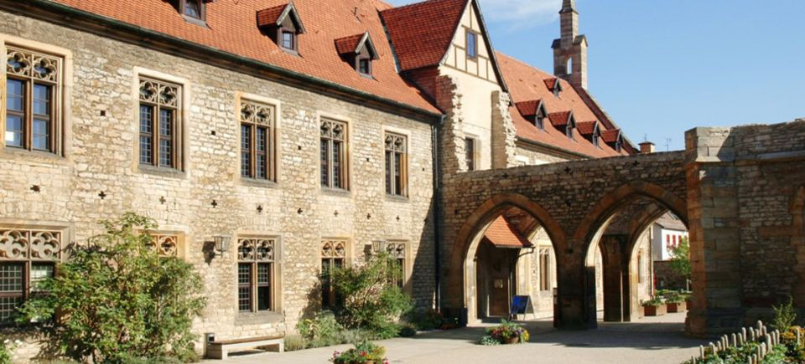
Luther’s View on Monasteries
https://worldlysaints.wordpress.com/2017/01/03/martin-luther-life-in-the-monastery-a-d-1505-1509/erfurt/

Slide 9
Luther's View on Monasteries
This reconstruction of Church worship was far-reaching.
But the Reformation in Germany, and elsewhere, caused another major change in the ordinary life of Church and society: the marginalizing of monasticism in some Protestant lands and its complete disappearance in others.
Monasteries had now been an integral and central part of Christian social life for over 1,000 years.
Under the impact of Evangelical teaching, however, most monks and nuns deserted their convents, married, and took up new positions in society.
Needham, Nick. 2,000 Years of Christ's Power Vol. 3: Renaissance and Reformation

Slide 10
Luther's View on Monasteries
Luther argued that when people lived their lives to the glory of God, all vocations were “religious” – whether they be farmers, shopkeepers, teachers, housewives, etc.
Christians were to exist “in the world” as salt and light (Matt. 5:13-14), serving their neighbor sacrificially in Christlike love, not hidden away from the world in the hope of keeping their own souls pure.
Besides, the lifelong oath of celibacy which every monk and nun had to swear was, Luther now maintained, a dangerous violation of God’s will.
Celibacy was a spiritual gift from God. If people had the gift, they did not need to swear an oath; and if they did not have the gift, their oath was sinful – they must marry to safeguard their chastity. (Monks and nuns were not famed for chastity at that period.)
Needham, Nick. 2,000 Years of Christ's Power Vol. 3: Renaissance and Reformation

Slide 11
Luther's View on Monasteries
However, the Lutheran Reformation did not abolish all monasteries; monasticism did not completely die out in Lutheranism until the age of Pietism and Rationalism in the 18th century.
What Luther vociferously opposed was the common idea of his time that there was something intrinsically holier about monastic life than ordinary life in the world, or that through monastic life a person could become holier before God.
In fact, Luther believed that ordinary life as a husband, wife, father or mother was holier than monastic life, since the former (husband, wife, father or mother) were directly instituted by God and had His blessing upon them, while the latter (monasticism) had no divine institution.
Needham, Nick. 2,000 Years of Christ's Power Vol. 3: Renaissance and Reformation

Slide 12
Luther's View on Monasteries
Nevertheless, Luther believed monasteries could be permitted, even encouraged, when they served to educate people for the normal vocations of the world which God had instituted.
Luther wrote that “if monasteries are unwilling to serve this purpose, it would be better to abandon them or tear them down rather than preserve them.”
Needham, Nick. 2,000 Years of Christ's Power Vol. 3: Renaissance and Reformation

Slide 13
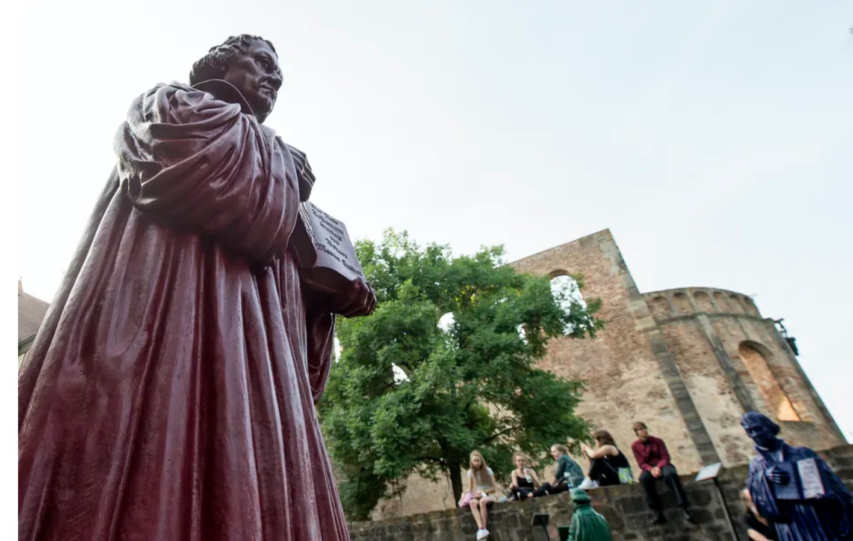
Luther’s Lasting Influence
https://theconversation.com/the-lasting-impact-of-luthers-reformation-4-essential-reads-105953

Slide 14
Luther’s Lasting Influence
After Augsburg (1530), Luther continued to preach and teach the Bible in Wittenberg, but even sympathetic biographers have found it hard to justify some of the actions of his declining years.
Luther denounced reformers who disagreed with him in terms that he had once reserved for the papacy.
His statements about the Jews would sound excessive on the tongue of Hitler.
By the time of his death in 1546, Luther was “an irascible old man, petulant, peevish, unrestrained, and at times positively coarse.”
Fortunately, the personal defects of an aging rebel do not in any way detract from the grandeur of his achievement, which ultimately transformed not only Christianity but all of Western civilization.
Shelley, Dr. Bruce L.. Church History in Plain Language: Fourth Edition (pp. 256-257)

Slide 15
Luther’s Lasting Influence
Lutheranism became a state religion in large portions of the empire. From Germany it spread to Scandinavia.
Luther’s greatest contribution to history, however, was not political – it was theological.
He took four basic Catholic concerns and offered invigorating new answers:
  To the question, how is a person saved? Luther replied, “not by works but by faith alone.”
  To the question, where does religious authority lie? he answered, “not in the visible institution called the Roman church but in the Word of God found in the Bible.”
  To the question, what is the church? he responded, “the whole community of Christian believers, since all are priests before God.”
  And to the question, what is the essence of Christian living? he replied, “serving God in any useful calling, whether ordained or lay.”
To this day any classical description of Protestantism must echo those central truths.
Shelley, Dr. Bruce L.. Church History in Plain Language: Fourth Edition (pp. 256-257)

Slide 16
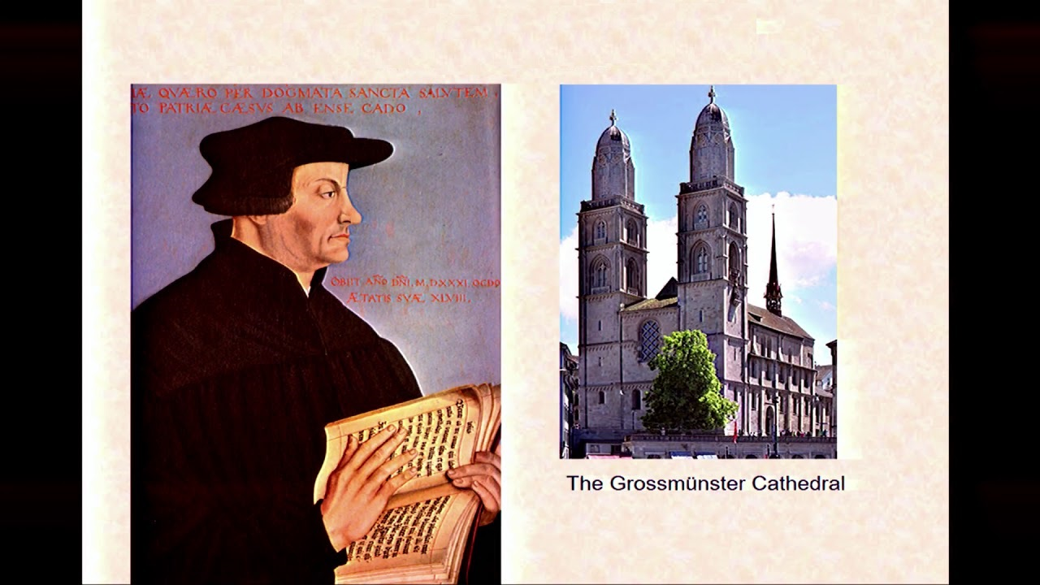
Zwingli and the Swiss Reformation
https://calvin.edu/centers-institutes/meeter-center/swiss-reformation-conference/

Slide 17
Zwingli and the Swiss Reformation
Ulrich Zwingli was born in a small Swiss village in January 1484, less than two months after Luther.
After learning his first letters from an uncle, he studied in Basel and Bern, where humanism was thriving.
He then went to the University of Vienna, and again studied in Basel.
After receiving a Master of Arts degree in 1506, he became a priest in the Swiss village of Glarus.
There he continued his humanistic studies, and became proficient in Greek.
González, Justo L. . The Story of Christianity: Volume 2: The Reformation to the Present Day (pp. 57-58)

Slide 18
Zwingli and the Swiss Reformation
Zwingli’s combination of priestly duties with humanistic studies was exceptional in his day – many parish priests in Switzerland at that time were ignorant; some had never even read the entire New Testament.
In contrast, when Erasmus published his Greek New Testament, Zwingli made a copy of it which he carried with him in order to memorize as much of it as possible.
Zwingli was not only a pastor and a scholar, but also a patriot.
At that time large contingents of Swiss mercenaries were being hired by various warring factions, to the point that this had become an important source of income for the Swiss cantons.
González, Justo L. . The Story of Christianity: Volume 2: The Reformation to the Present Day (pp. 57-58)

Slide 19
Zwingli and the Swiss Reformation
In 1512, and again in 1515, Zwingli went on Italian campaigns with mercenary soldiers from his district.
The first expedition was successful, and the young priest saw his parishioners brutally looting the conquered region.
The outcome of the second was the opposite, and he now had occasion to see the impact of war on the defeated.
This convinced him that one of the great evils of Switzerland was that mercenary service destroyed the moral fiber of society—or, as he would say, that the Swiss were selling blood for gold.
González, Justo L. . The Story of Christianity: Volume 2: The Reformation to the Present Day (pp. 57-58)

Slide 20
Zwingli and the Swiss Reformation
After spending ten years at Glarus, Zwingli was made a priest of an abbey to which many went on pilgrimage.
He soon drew attention to himself by preaching against the notion that going on a pilgrimage could put someone in good standing with God, declaring that he found nothing in the New Testament to support such practices.
His fame grew to the point that in 1518 he was transferred to Zürich. By that time he had reached conclusions similar to those of Luther.
His route to such conclusions had not been the anguished quest of the German Reformer, but rather the study of Scripture according to the method of the humanists, and his zealous outrage against the superstition that passed for Christianity.
González, Justo L. . The Story of Christianity: Volume 2: The Reformation to the Present Day (pp. 59)

Slide 21
Zwingli and the Swiss Reformation
Zwingli’s preaching, devotion, and learning soon won him the respect of his parishioners in Zürich.
In 1519, the city suffered a plague that killed over a quarter of the population, and infected Zwingli as he tended to his flock; he barely survived.
When a seller of indulgences arrived, Zwingli convinced the government that he should be expelled from the city before he could peddle his wares.
Then Francis I of France, who was at war with Charles V, requested mercenary contingents from the Swiss Confederation, and all cantons sent their soldiers—except Zürich.
González, Justo L. . The Story of Christianity: Volume 2: The Reformation to the Present Day (pp. 59-60)

Slide 22
Zwingli and the Swiss Reformation
The pope, an ally of Francis, insisted that Zürich had an obligation to the papacy, and insisted the government send mercenary soldiers to serve under Francis.
That incident drew Zwingli’s attention to the abuses of the papacy, and his unjust use of power.
This was around the time when Luther was creating a stir in Germany, daring to oppose the emperor’s will at the Diet of Worms.
So Zwingli’s enemies began to spread the word that his teachings were the same as those of the German “heretic”.
González, Justo L. . The Story of Christianity: Volume 2: The Reformation to the Present Day (pp. 59-60)

Slide 23
Zwingli and the Swiss Reformation
Later, Zwingli would declare that, even before having heard of Luther’s teachings, he had come to similar conclusions through his study of the Bible.
Thus, Zwingli’s reformation was not a direct result of Luther’s; rather, it was a parallel movement that soon established links with its counterpart in Germany.
By 1522, the year after the Diet of Worms, Zwingli was ready to undertake the great task of reformation, and the Council of Government of Zürich was ready to support him in this endeavor.
González, Justo L. . The Story of Christianity: Volume 2: The Reformation to the Present Day (pp. 59-60)

Slide 24
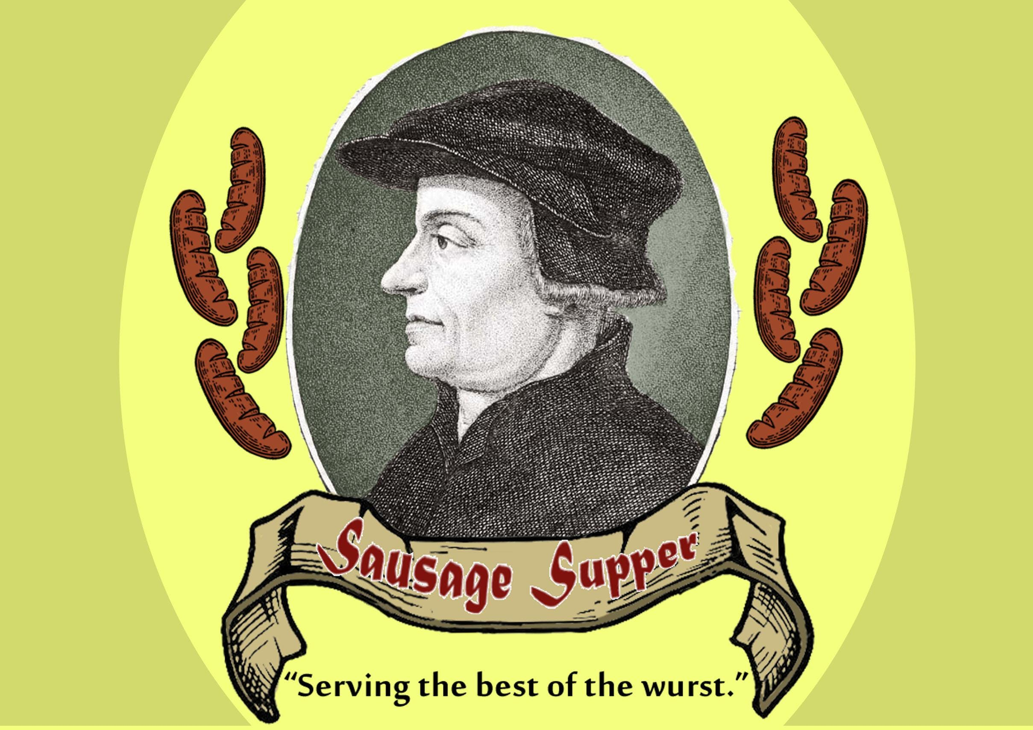
Zwingli Breaks with Rome
https://www.evensi.us/zwingli-sausage-supper-mission-orthodox-presbyterian-church-opc/293729967

Slide 25

Class Discussion Time
https://www.weareteachers.com/moving-beyond-classroom-discussions/

Slide 26
*Class Discussion Time
Luther held that a Christian congregation had the right to elect its own pastor. Is there a biblical basis for this idea? If so, what passage(s) would you turn to in order to demonstrate this idea?
One of the changes that Luther made to the worship service from the practice of his Medieval predecessors was that Luther exalted preaching to a central position in worship. Do you think this was a good change. Why or why not?
Luther, like many historically influential figures, did many great things, but then at the end of his life took a turn for the worse. Does Luther’s failings in later years nullify the admiration we should have for him in his positive accomplishments?
Zwingli, independent of any influence from Luther, came to many of the same theological conclusions as Luther. What does this say about the clarity of biblical teaching?
Do you have a topic or question that you would like to see us to discuss?

