Slide 1


Slide 2

Review
What did Luther believe concerning the lifelong oath of celibacy which every monk and nun in the Roman Catholic Church had to swear?
  Luther believed it was a dangerous violation of God’s will. Celibacy was a spiritual gift from God. If people had the gift, they did not need to swear an oath; and if they did not have the gift, their oath was sinful – they must marry to safeguard their chastity.
Luther did not oppose monasteries, per se. But what common belief concerning monasteries did Luther oppose?
  Luther opposed was the common idea of his time that there was something intrinsically holier about monastic life than ordinary life in the world.
Lutheranism became a state religion in large portions of the empire. From Germany it spread to where?
  Scandinavia

Slide 3
Review
To the question, how is a person saved? What was Luther’s answer (in contrast to the Roman Catholic view)?
  not by works but by faith alone
In what way was Ulrich Zwingli different from other parish priests of his day?
  Many parish priests at that time were ignorant; some had never even read the entire New Testament. In contrast, Zwingli made a copy of Erasmus’ Greek New Testament which he carried with him in order to memorize as much of it as possible.
At one point, Zwingli’s enemies began to spread the word that his teachings were the same as those of Luther, implying that he had gotten them from Luther. How did Zwingli respond to this charge?
  Zwingli declared that, even before having heard of Luther’s teachings, he had come to similar conclusions through his study of the Bible.

Slide 4
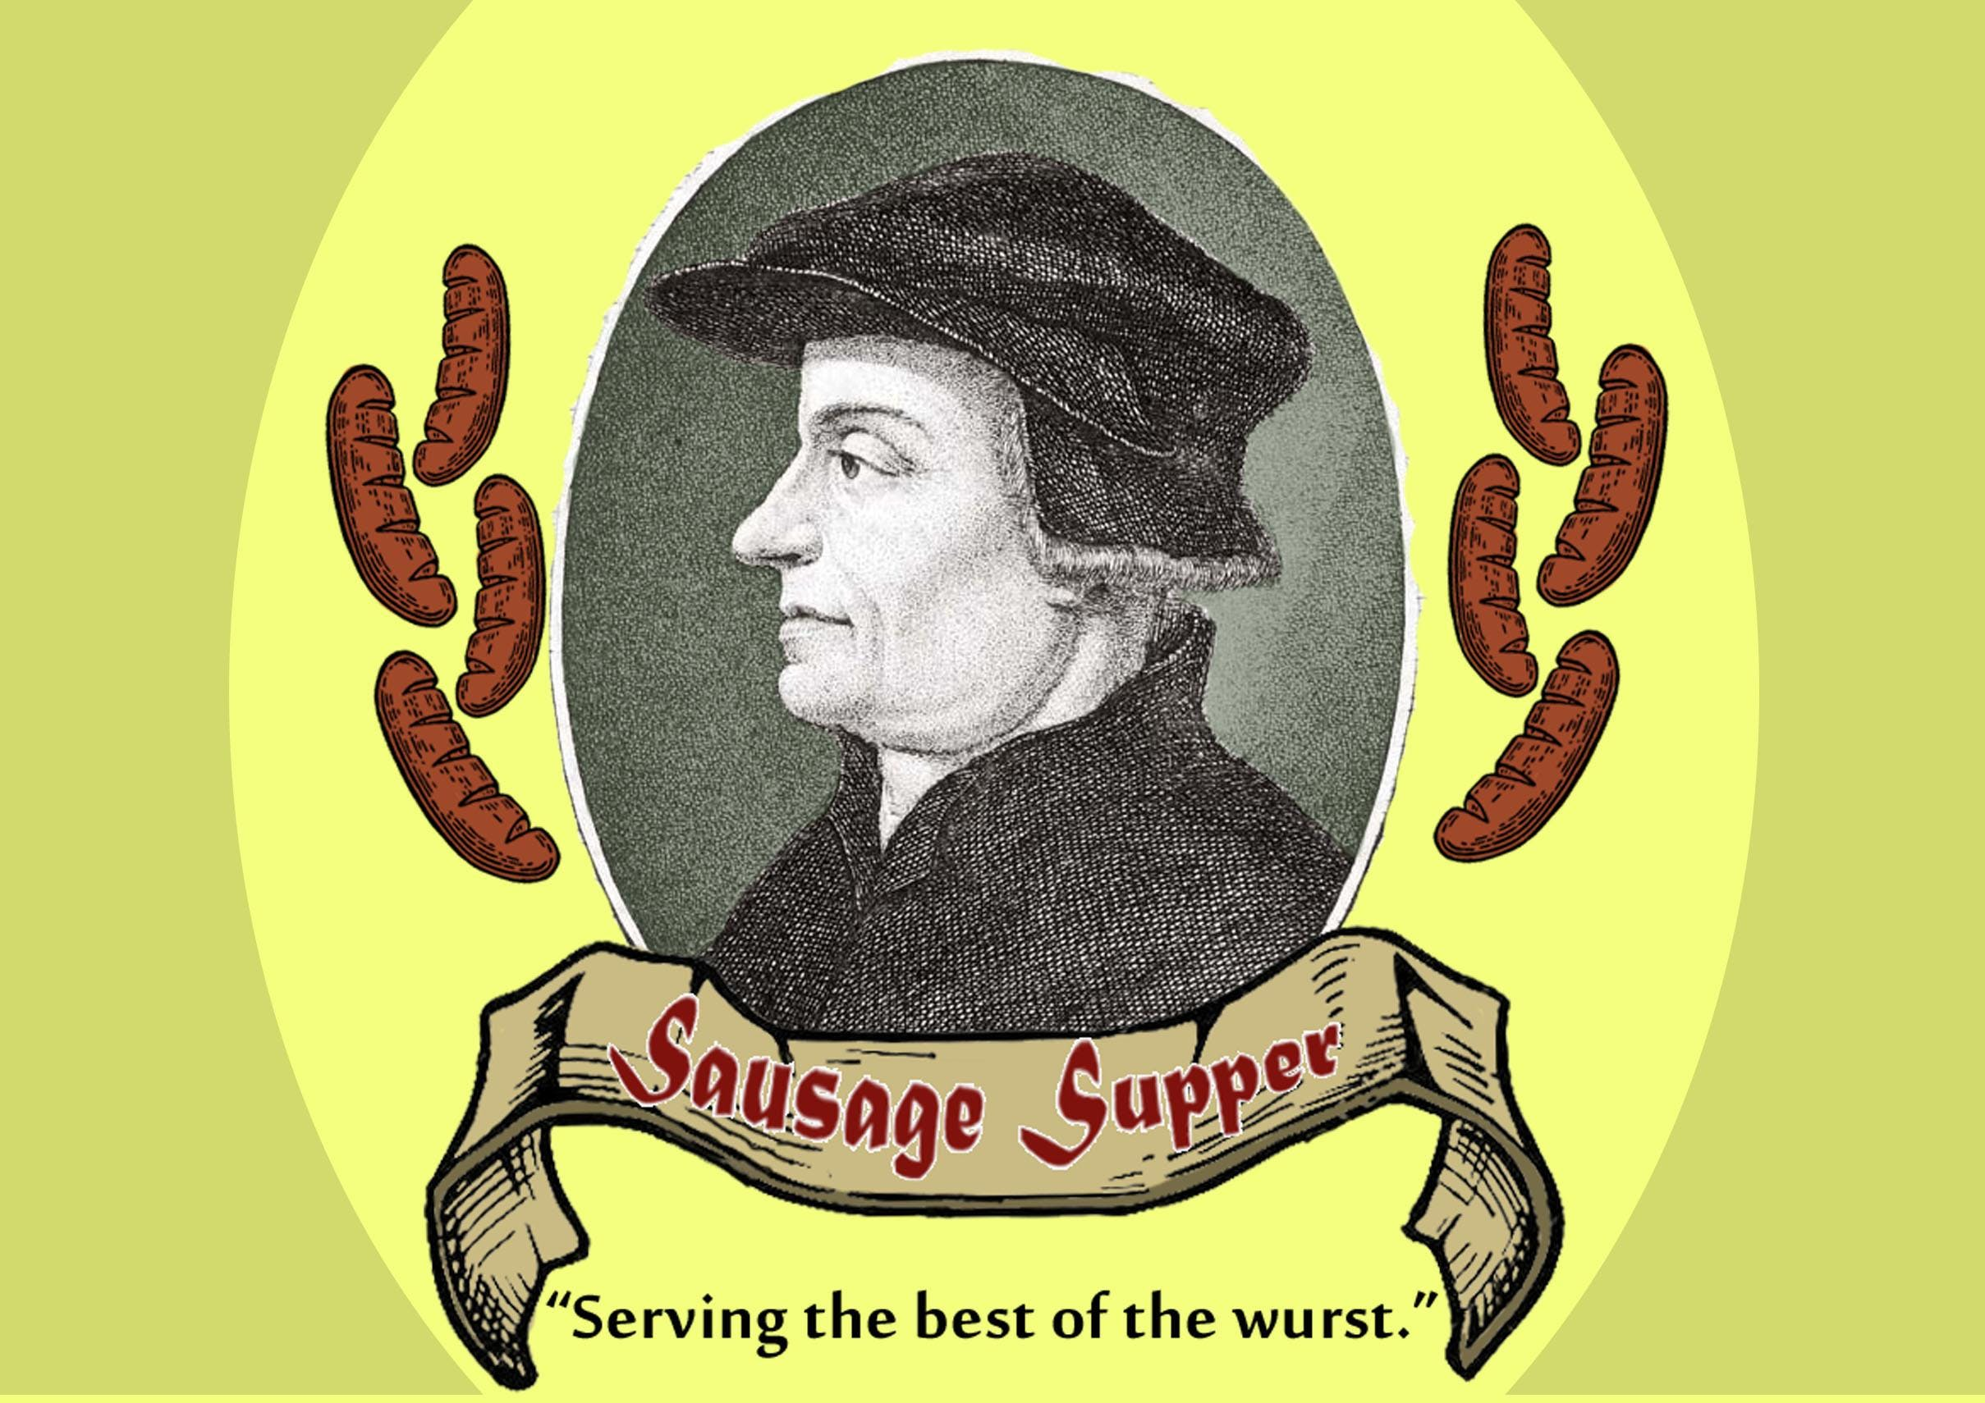
Zwingli Breaks with Rome
https://www.evensi.us/zwingli-sausage-supper-mission-orthodox-presbyterian-church-opc/293729967

Slide 5
Zwingli Breaks with Rome
Zürich was under the ecclesiastical jurisdiction of the bishop of Constance, who expressed concern over what was taking place in Zürich.
In 1522, when Zwingli preached against the laws of fasting and abstinence, and some of his parishioners gathered to eat sausages during Lent, the bishop of Constance accused the preacher before the Council of Government.
But Zwingli defended his preaching on the basis of Scripture, and he was allowed to continue preaching.
González, Justo L. . The Story of Christianity: Volume 2: The Reformation to the Present Day (p. 60)

Slide 6
Zwingli Breaks with Rome
It was in this year (1522), that Zwingli began making his first moves towards openly breaking with Rome.
This came especially through a treatise he published in September 1522 in which Zwingli rejected the infallible authority of:
  The Papacy
  Ecumenical Councils
  Church tradition
In their place he set the Holy Spirit and Holy Scripture.
Zwingli argued that Christ gave the Holy Spirit to all the elect so that a Christian gained the assurance of divine truth from the Spirit of God speaking to his mind through the Word of God.
Needham, Nick. 2,000 Years of Christ's Power Vol. 3: Renaissance and Reformation

Slide 7
Zwingli Breaks with Rome
Though Zwingli clearly broke with the papacy in 1522, Rome did nothing to stop him.
Because Rome still relied on Swiss mercenaries in its struggle for political independence against French influence in Italy, and so it could not afford to antagonize Zurich by condemning Zwingli.
Thus, while the papacy excommunicated Luther, it left Zwingli in peace to carry out the Swiss revolt against Rome.
Needham, Nick. 2,000 Years of Christ's Power Vol. 3: Renaissance and Reformation

Slide 8
Zwingli Breaks with Rome
It was also in 1522 that Zwingli started living with Anna Reinhart, a widow related to the nobility of Zurich.
They could not legally marry; Western Church law insisted on the celibacy of the clergy.
Zwingli and Anna, however, ignoring a Church law they did not believe in, entered into a secret and private marriage covenant with one another.
They did not publicly marry until 1524, when Reformation sentiment was advanced enough in Zurich to look with favor on such an action.
Needham, Nick. 2,000 Years of Christ's Power Vol. 3: Renaissance and Reformation

Slide 9
Zwingli Breaks with Rome
In a public disputation in Zurich in 1523, Zwingli affirmed in sixty-seven theses that:
  Salvation came exclusively through faith in Christ
  Good works had no merit in justifying sinners
  Purgatory did not exist
  The Lord’s Supper was not a sacrifice
  Christ alone (not the pope) was the head of the Church
The disputation was held in the presence of the Zurich city council.
Needham, Nick. 2,000 Years of Christ's Power Vol. 3: Renaissance and Reformation

Slide 10
Zwingli Breaks with Rome
Zwingli believed in a careful, gradual approach to reformation, and he always made sure he had the backing of the city council for each new step he took.
He accepted that Zurich was a Christian community, and that its elected Christian rulers on the city council were responsible for regulating the community’s spiritual life.
The outcome of the disputation was that the city council expressed approval of Zwingli’s preaching, promised him protection, and instructed all the clergy of Zurich to preach from the Bible alone.
The really revolutionary thing about this was that the city council, Zurich’s secular government, publicly established its right to control the religious life of the city.
So just as in Luther’s Germany, in Zwingli’s Zurich the local political authorities began transferring religious authority from the papacy to themselves.
Needham, Nick. 2,000 Years of Christ's Power Vol. 3: Renaissance and Reformation

Slide 11
Zwingli Breaks with Rome
Despite their shared Augustinianism and statism, Zwingli’s attitude to reforming the Church was fundamentally different from Luther’s.
Luther held that traditional Catholic worship should be left as it was, unless Scripture absolutely required that it be changed.
Zwingli argued that nothing should be done in worship unless God positively authorized it in the New Testament.
Zwingli’s outlook produced in Switzerland a much more obvious, visible break with the traditional worship of the Middle Ages than occurred in Lutheran Germany.
Needham, Nick. 2,000 Years of Christ's Power Vol. 3: Renaissance and Reformation

Slide 12
Zwingli Breaks with Rome
By April 1525, the Zurich Reformer had secured the removal from Zurich’s churches of all religious pictures, statues, crucifixes, candles, altars, and relics, and the abolition of the organ, the choir, priestly robes, religious processions, and the monasteries.
None of these things, Zwingli argued, were authorized by the New Testament.
The campaign against images was a particularly key aspect of the Swiss Reformation, and was to be repeated across Europe wherever this style of Protestantism took off.
Needham, Nick. 2,000 Years of Christ's Power Vol. 3: Renaissance and Reformation

Slide 13
Zwingli Breaks with Rome
Zwingli also introduced the exclusive use of the native language in worship (a Swiss dialect of German), and a communion service in which the laity received the wine.
In the Zurich communion service, the laity received the bread and wine sitting in their pews – a common Protestant practice today, but first pioneered by Zwingli.
Needham, Nick. 2,000 Years of Christ's Power Vol. 3: Renaissance and Reformation

Slide 14
Zwingli Breaks with Rome
Zwingli did retain the liturgical form of worship, with set prayers and the congregational reciting of the Apostles’ Creed.
Singing was not a part of worship in Zwinglian Zurich; instead, the congregation simply read out the Psalms and the Gloria in excelsis Deo with half the congregation reading one line, the other half reading the next line, and so on.
Zwingli seems to have divided the lines between men and women, which implies they were seated on different sides of the church building.
Needham, Nick. 2,000 Years of Christ's Power Vol. 3: Renaissance and Reformation

Slide 15
Zwingli Breaks with Rome
The normal Sunday morning worship in Zwinglian Zurich was essentially a preaching service, consisting of Bible readings, prayers, and a sermon.
Zwingli was unique among the Reformers in not regarding the Lord’s Supper as integral to Sunday worship; he was happy that it should be celebrated four times a year.
This infrequency of the Zwinglian Supper may be related to Zwingli’s low view of what actually happened in the Supper, since for most of his reforming career he saw it as little more than an act of pious commemoration.
Again, in this Zwingli was virtually alone among the Reformers; as we shall see, Luther opposed him strongly on this issue, and after Zwingli’s death, Martin Bucer and John Calvin guided the Reformed Churches into a much “higher” doctrine of holy communion.
Needham, Nick. 2,000 Years of Christ's Power Vol. 3: Renaissance and Reformation

Slide 16
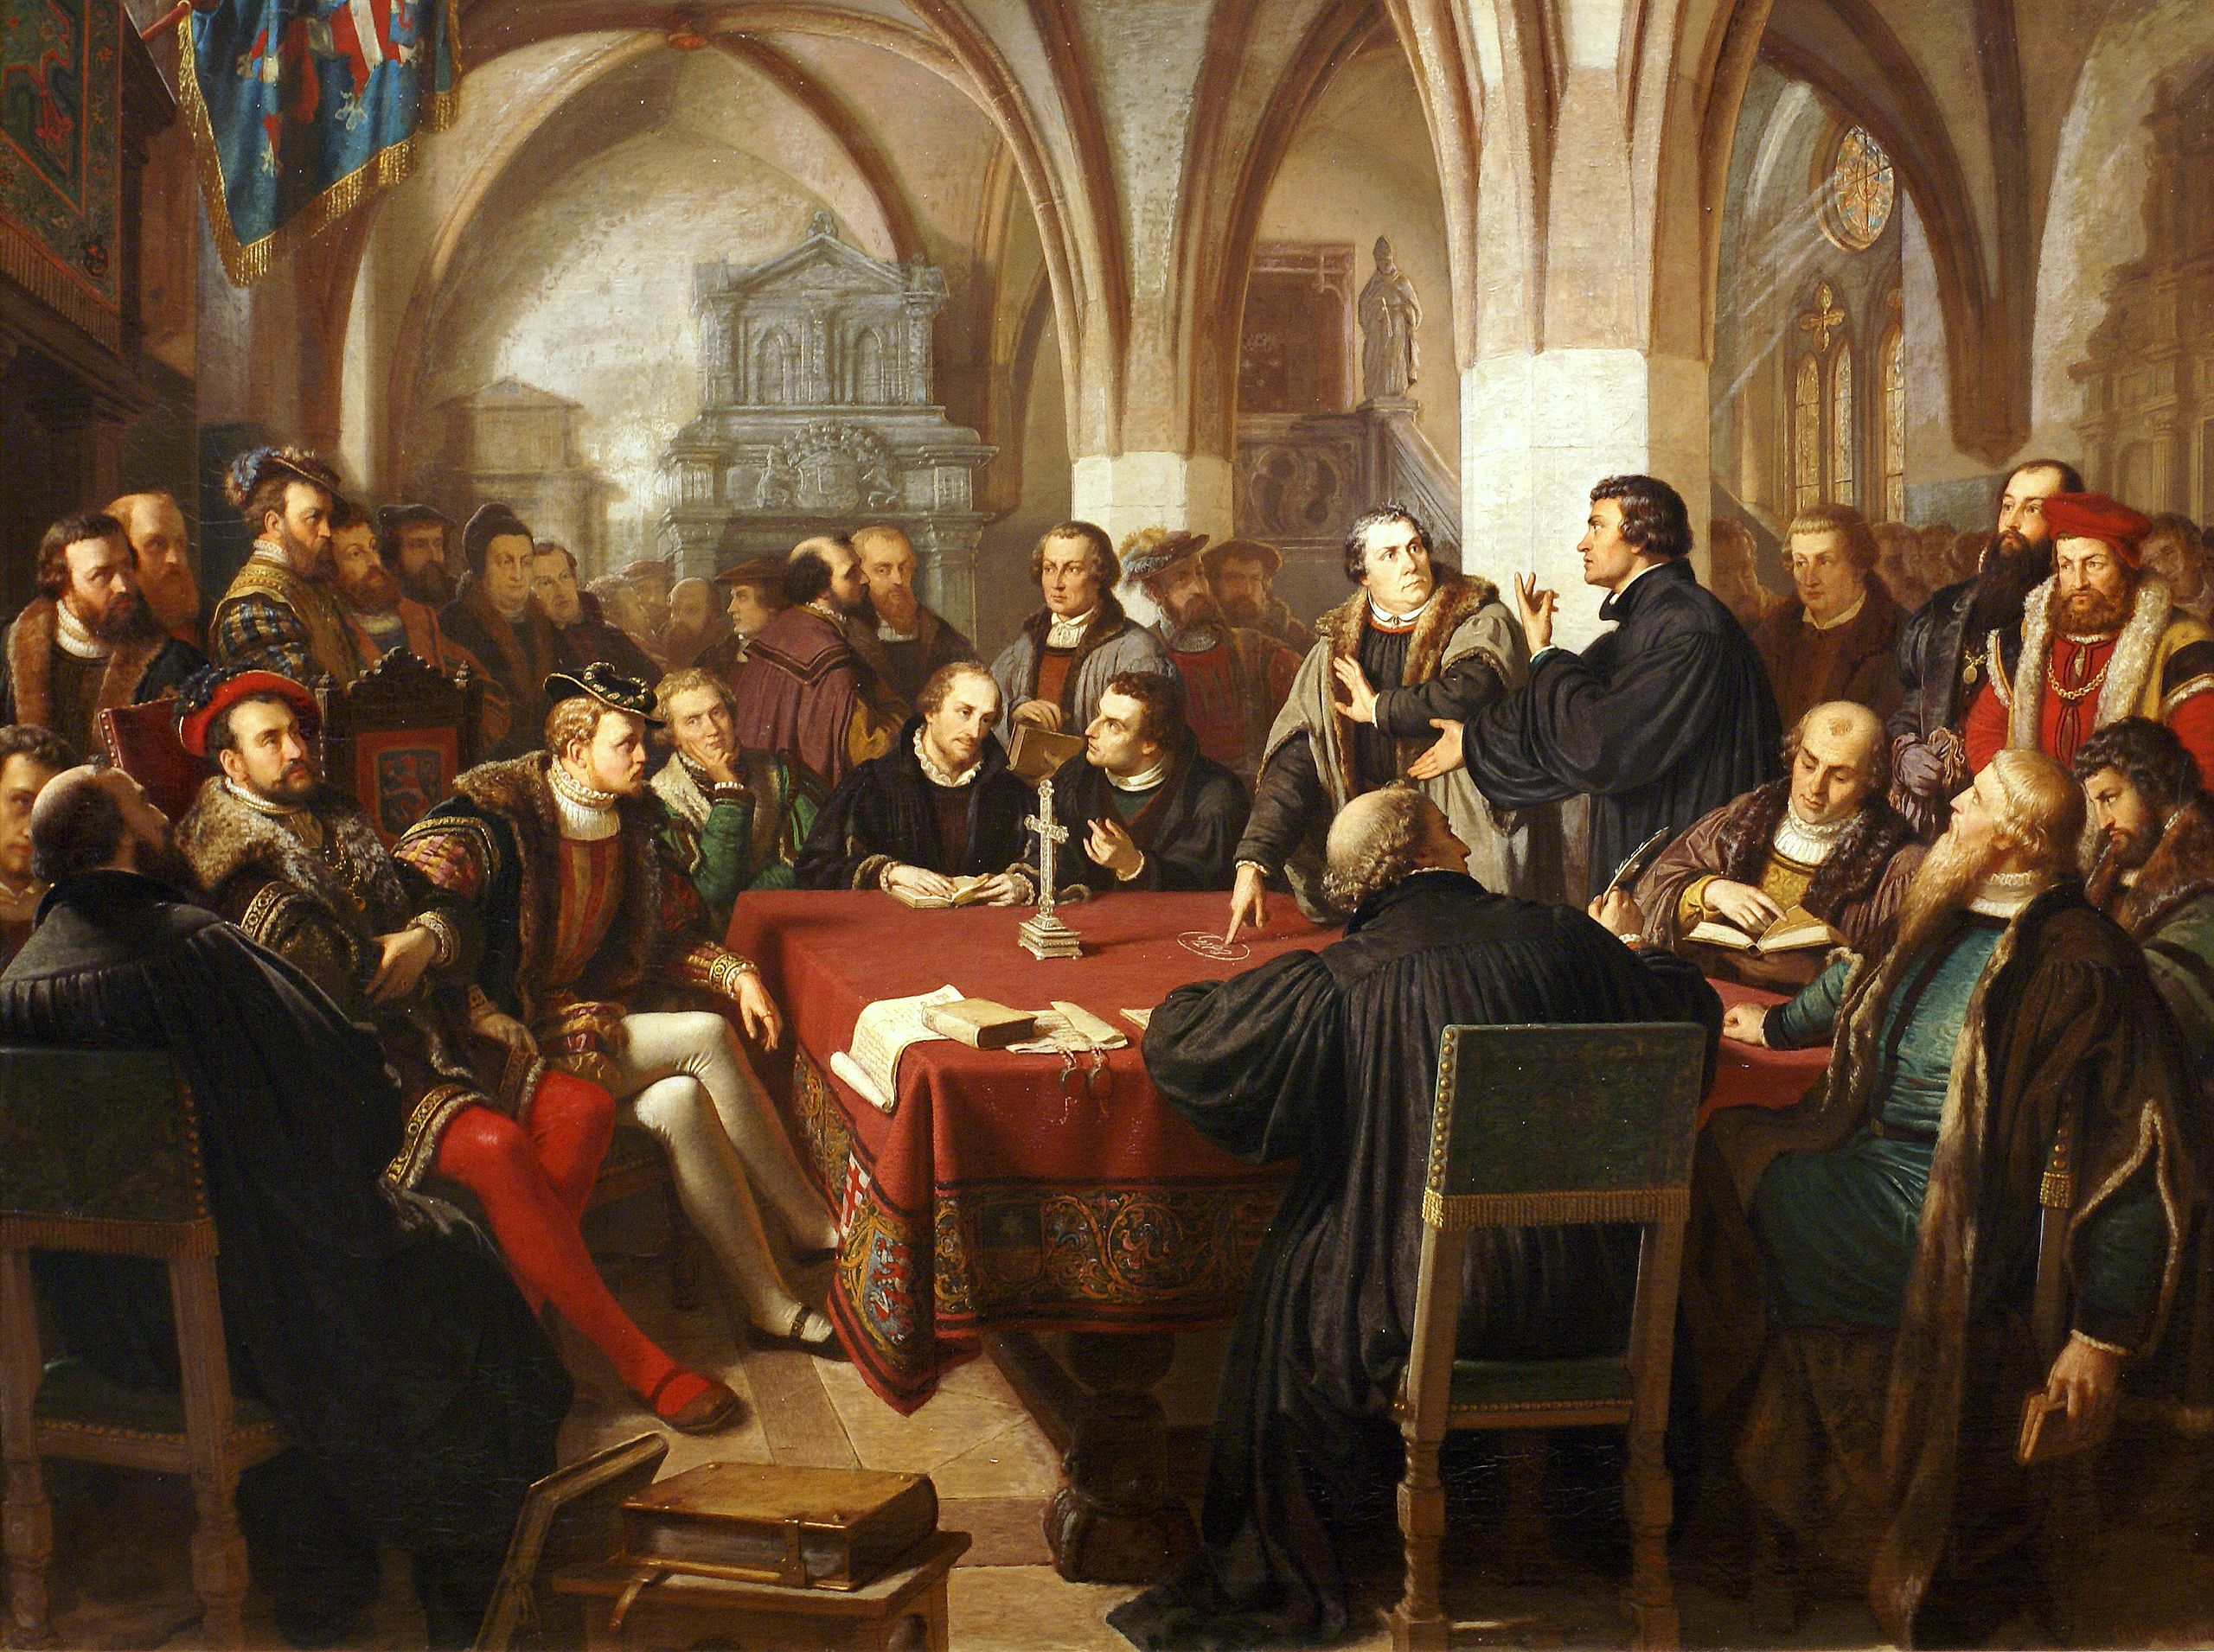
The Marburg Colloquy
https://en.wikipedia.org/wiki/Marburg_Colloquy#/media/File:Religionsgespr%C3%A4ch_zu_Marburg_1529_August_Noack.jpg

Slide 17
The Marburg Colloquy
By the close of the 1520s, the anti-Roman “Magisterial Reformers” (i.e. those who believed in the union of church and state) had divided theologically into two parties:
  The Lutherans (or “Evangelicals” as they called themselves)
  The Zwinglians (or “Reformed” as they called themselves)
The primary issue over which the Lutherans and Zwinglians were divided was the issue of the Lord’s Supper.
This is not to say they differed entirely on the subject – there were many areas of agreement.
Needham, Nick. 2,000 Years of Christ's Power Vol. 3: Renaissance and Reformation

Slide 18
The Marburg Colloquy
Both Luther and Zwingli had indeed abandoned the later medieval concept of the mass, and were united on the following points:
  They both rejected transubstantiation and the special power of the priest to perform this so-called miracle.
  They both rejected the idea that the eucharist was a sacrifice which had the power to secure God’s grace for those for whom it was offered, even when they did not take part (e.g. souls in purgatory).
  They both rejected the medieval Catholic practice of adoring the sacramental bread after the priest had pronounced the words “This is My body.”
  They both demanded that the cup be given to the laity.
Needham, Nick. 2,000 Years of Christ's Power Vol. 3: Renaissance and Reformation

Slide 19
The Marburg Colloquy
Despite these broad areas of agreement, Luther and Zwingli divided over the question of how exactly Christ was present in the eucharist.
Luther held that Christ’s flesh and blood were objectively present in the bread and wine, although without converting or abolishing their essence, the body and blood of the Savior were mysteriously present “in, with, and under” the bread and wine, and were eaten and drunk by everyone who took part in communion, whether they had faith in Christ or not.
Zwingli disagreed very strongly with Luther on this matter.
The Swiss Reformer maintained that the word “is” in “This is My body” meant “represents” – “This represents My body.”
Christ’s flesh and blood, Zwingli argued, were in no sense physically present in the bread and wine; His risen body was in heaven, not on earth.
Needham, Nick. 2,000 Years of Christ's Power Vol. 3: Renaissance and Reformation

Slide 20
The Marburg Colloquy
In 1529, Philip of Hesse, a young Lutheran prince in western Germany, made an effort to reconcile the German and the Swiss reformers.
Philip had sympathies with Zwingli’s doctrine of communion.
He also believed strongly in the need for a political alliance between German and Swiss Protestants, especially after the Diet of Speyer in March 1529, where Holy Roman Emperor Charles V had cancelled religious freedoms previously granted to German Lutherans.
At Philip’s insistence, therefore, the Swiss and German Reformers met at Philip’s castle in Marburg in October 1529, to hold a “colloquy” (conference) on the doctrine of holy communion.
Needham, Nick. 2,000 Years of Christ's Power Vol. 3: Renaissance and Reformation

Slide 21
The Marburg Colloquy
It was one of the greatest gatherings of Reformation theologians.
The German delegation was led by Luther, Melanchthon, and Justus Jonas from Wittenberg, and three other distinguished Lutheran Reformers.
The Reformed delegation was led by Zwingli from Zurich, Oecolampadius from Basel, and three eminent Reformers from the south German imperial city of Strasbourg.
But, in the end, the colloquy achieved nothing.
Needham, Nick. 2,000 Years of Christ's Power Vol. 3: Renaissance and Reformation

Slide 22
The Marburg Colloquy
At its very outset, Luther took a piece of chalk and wrote hoc est corpus meum ("This is my body") in chalk on a wooden table and pounded it with his fist.¹
He then informed Zwingli and his colleagues that he would understand these words literally, unless the Swiss could prove beyond doubt that “is” did not mean “is” but “represents”.²
Zwingli pointed out that Jesus frequently referred to himself metaphorically (I am the vine, I am the door for the sheep), which Luther had to concede, but insisted that this passage was different. ¹
Philip of Hesse and Zwingli were bitterly disappointed.²
Zwingli begged with tears in his eyes that the two parties should unite in spite of their disagreement, but Luther refused even to admit that the Swiss Reformers were Christians. ²
¹ https://everything2.com/title/Hoc+est+enim+corpus+meum
² Needham, Nick. 2,000 Years of Christ's Power Vol. 3: Renaissance and Reformation

Slide 23
The Marburg Colloquy
The controversy between German Lutherans and Swiss Reformed became extremely bitter.
Luther refused to recognize the Protestants of Switzerland as fellow Christians; they were depraved heretics to be resisted at all costs.
Luther had the sort of personality that sees life in starkly black-and-white terms: something was either of God or of Satan – there could be nothing in between.
On top of this, Luther remembered that his Radical enemy, Andreas Carlstadt, held the view of communion that Zwingli was now teaching.
So, the religious chaos Carlstadt had unleashed in Wittenberg in 1522 haunted Luther’s mind.
Zwingli, then, simply became a “Swiss Carlstadt” in Luther’s eyes.
Needham, Nick. 2,000 Years of Christ's Power Vol. 3: Renaissance and Reformation

Slide 24
The Marburg Colloquy
Luther therefore condemned the Swiss Reformer in the most forthright words:
  I cannot regard Zwingli or any of his teaching as Christian at all. He neither holds nor teaches any part of the Christian faith rightly, and is now seven times more dangerous than when he was a papist.
Luther warned people to shun Zwingli’s books as “the poison of the prince of hell”, and even said he would rather drink blood with the papists than wine with the Zwinglians!
Luther’s attitude stirred Zwingli, Oecolampadius, and the Swiss Reformers to deep anger.
The Swiss recognized the Lutherans as fellow Christians, and were appalled that Luther would willingly split the Reformation movement while they faced a common enemy in Rome.
Roman Catholics, meanwhile, began laughing at the Reformation as a movement doomed to self-destruction.
Needham, Nick. 2,000 Years of Christ's Power Vol. 3: Renaissance and Reformation

Slide 25
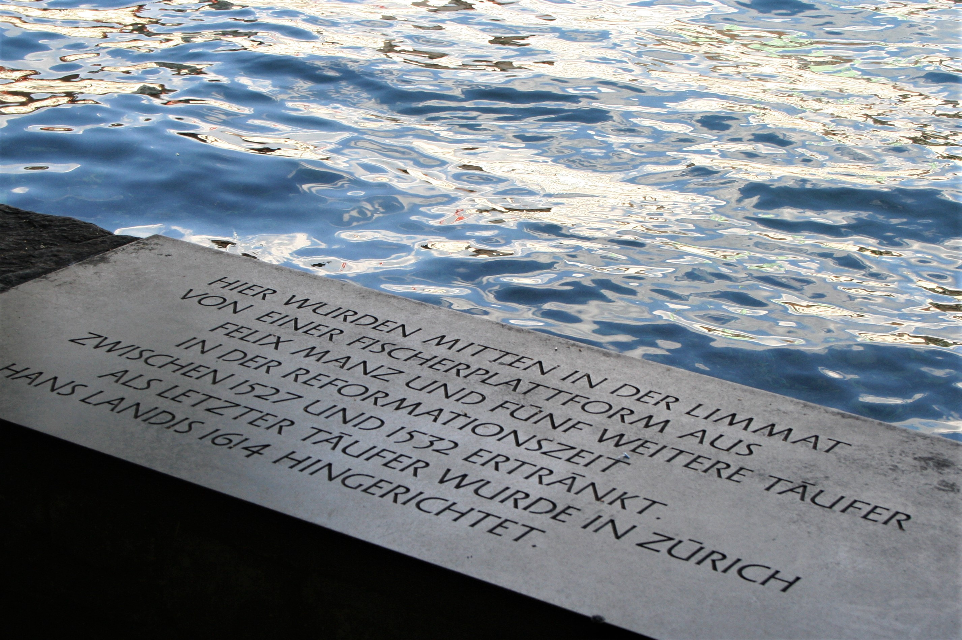
Zwingli and the
Radical Reformers
https://medium.com/christian-citizen/reformation-and-resolutions-baptist-gather-in-zurich-respond-to-crisis-on-the-u-s-6040a95d3870

Slide 26

Class Discussion Time
https://www.weareteachers.com/moving-beyond-classroom-discussions/

Slide 27
*Class Discussion Time
Luther held that traditional Catholic worship should be left as it was, unless Scripture absolutely required that it be changed. Zwingli, on the other hand, argued that nothing should be done in worship unless God positively authorized it in the New Testament. This echoes a disagreement that persists in Protestant circles today – in deciding what should or should not be allowed in worship: Are we limited to only that which scripture prescribes that we do in worship or do we have freedom to do anything in worship, so long as scripture does not forbid it?
Luther had the sort of personality that sees life in starkly black-and-white terms: something was either of God or of Satan – there could be nothing in between. Have you seen people who operate in this way in your life? Can you relate to feeling this way about others? What do you think causes people to have this kind of outlook?
It has been my observation that we are sometimes more angry with people who are very close to agreeing with us on just about everything but differ on one or two minor points, than we are with people who differ on many points. Have you found this to be the case? If so, why do you think that is?

