Slide 1
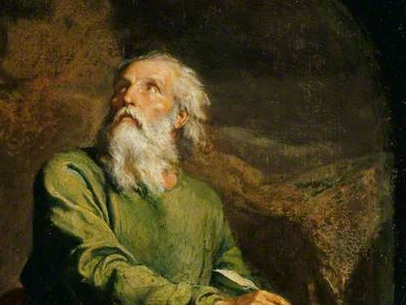
Highlights From the Book of Isaiah
To Download this lesson go to:
http://www.purifiedbyfaith.com/Isaiah/Isaiah.htm
https://www.wikiart.org/en/ernest-meissonier/isaiah

Slide 2
Introduction to the Book of Isaiah

Slide 3
When Was the Book of Isaiah Written?
The book of Isaiah tells us that Isaiah prophesied “in the days of Uzziah, Jotham, Ahaz, and Hezekiah, kings of Judah” (1:1).
His call to ministry came “in the year that King Uzziah died” (6:1), around 740 B.C.
Most of the events referred to in chapters 1-39 occurred during Isaiah’s ministry (6:1; 14:28; 36:1), so these chapters may have been completed not long after 701 BC, the year the Assyrian army was destroyed.
The prophet lived until at least 681 BC and may have written chapters 40-66 during his later years.
ESV Study Bible (p. 5422). Crossway.

Slide 4
Who Wrote the Book of Isaiah?
Isaiah, son of Amoz, is often thought of as the greatest of the writing prophets.
His name means “The LORD is salvation.” He was a contemporary of Amos, Hosea and Micah, beginning his ministry in 740 BC, the year King Uzziah died (Isa 6: 1).
Isaiah was married and had at least two sons, Shear-Jashub (Isa 7: 3) and Maher-Shalal-Hash-Baz (Isa 8: 3).
He probably spent most of his life in Jerusalem, enjoying his greatest influence under King Hezekiah (Isa 37:1-2).
Isaiah is also credited with writing a history of the reign of King Uzziah (2Ch 26: 22).
Exactly when Isaiah was put to death is not known. According to an unsubstantiated Jewish tradition (The Ascension of Isaiah), he was sawed in half during the reign of Manasseh (cf. Heb 11: 37).
NIV Study Bible, Fully Revised Edition (pp. 5096-5097). Zondervan.

Slide 5
Who Wrote the Book of Isaiah?
Some (liberal) scholars theorize that more than one author was responsible for writing the book of Isaiah.
According to them what we have in the book of Isaiah is really three books:
First Isaiah (Isa 1-39), which is largely the work of Isaiah
Second Isaiah (Isa 40-55), is the work of an anonymous prophet living during the Babylonian exile, over a century after Isaiah.
Third Isaiah (Isa 56-66), was composed by yet another anonymous prophet sometime in the fifth century BC.
ESV Study Bible (pp. 5422-5424). Crossway.

Slide 6
Who Wrote the Book of Isaiah?
The primary reasons offered for not attributing chapters 40-66 to Isaiah the son of Amoz are:
The writing in chapters 40-66 seems to differ (at times) in style from the writing in chapters 1-39.
There are prophesies in chapters 40-66 which accurately describe things that happened over 100 years after Isaiah died, therefore they assume those things couldn’t have been written by Isaiah!
ESV Study Bible (pp. 5422-5424). Crossway.

Slide 7
Who Wrote the Book of Isaiah?
But this claim that there were multiple authors of the book of Isaiah just doesn’t stand up to serious scrutiny.
There is unified testimony from the ancient world for single authorship for the book of Isaiah.
The intertestamental book of Sirach (48:24-25) and the first-century Jewish historian Josephus (Jewish Antiquities 11.5-6) both attest to Isaiah’s authorship of the whole book.
The NT refers to passages throughout the book as the work of Isaiah and never suggests that there are any other authors (see Matt 3:3; 4:14-16; 8:17; 12:17-21; 13:14-15; 15:7-9; Mark 7:6-7; Luke 3:4-6; 4:17-19; John 1:23; 12:37-41; Acts 8:27-35; 28:25-27; Rom 9:27-29; 10:16, 20-21; 15:12).
ESV Study Bible (pp. 5422-5424). Crossway.

Slide 8
Who Wrote the Book of Isaiah?
Any “differences of style” within the book can be explained by the different topics covered and by the fact that the various parts of the book were probably written at different stages in Isaiah’s life.
The accurate prophesies given in chapters 40-66 are not only not a problem, they are evidence of the Lord’s sovereign control over history.
In fact, there is within these very chapters an appeal to the fact that the Lord can accurately predict the future, while the pagan gods and idols cannot:
“Present the case for your idols,” says the LORD. “Let them show what they can do,” says the King of Israel. “Let them … tell us what the future holds, so we can know what's going to happen. Yes, tell us what will occur in the days ahead. Then we will know you are gods. (Isaiah 41:21-23a NLT)
ESV Study Bible (pp. 5422-5424). Crossway.

Slide 9
Historical Background to the Book of Isaiah

Slide 10
Brief History of Israel Prior to Isaiah
The Israelites were the descendants of Abraham, Isaac, and Jacob who, after a period of serving as slaves in Egypt were rescued by God (through Moses) and given the land of Canaan.
Eventually, Israel, wanting to “be like other nations” (1 Sam 8:5), asked God for a king.
The first three kings of Israel were:
Saul
David
Solomon
During the reign of Solomon’s son, Rehoboam, the people revolted against the heavy taxes levied by Solomon and Rehoboam and became a divided kingdom.
https://www.thechurchnews.com/1994/7/16/23256798/israel-divided-into-two-kingdoms

Slide 11
Brief History of Israel Prior to Isaiah
The tribe of Judah and the majority of the tribe of Benjamin accepted Rehoboam as their king.
They became the kingdom of Judah, or the Southern Kingdom, with its capital at Jerusalem.
The other 10 tribes and the remainder of the tribe of Benjamin chose Jeroboam as their king.
These ten tribes retained the title of Israel, and became the Northern Kingdom, with headquarters at Shechem in Samaria.
About 200 years after this division, Isaiah became one the prophets God sent to minster to the Southern Kingdom.
https://www.thechurchnews.com/1994/7/16/23256798/israel-divided-into-two-kingdoms

Slide 12
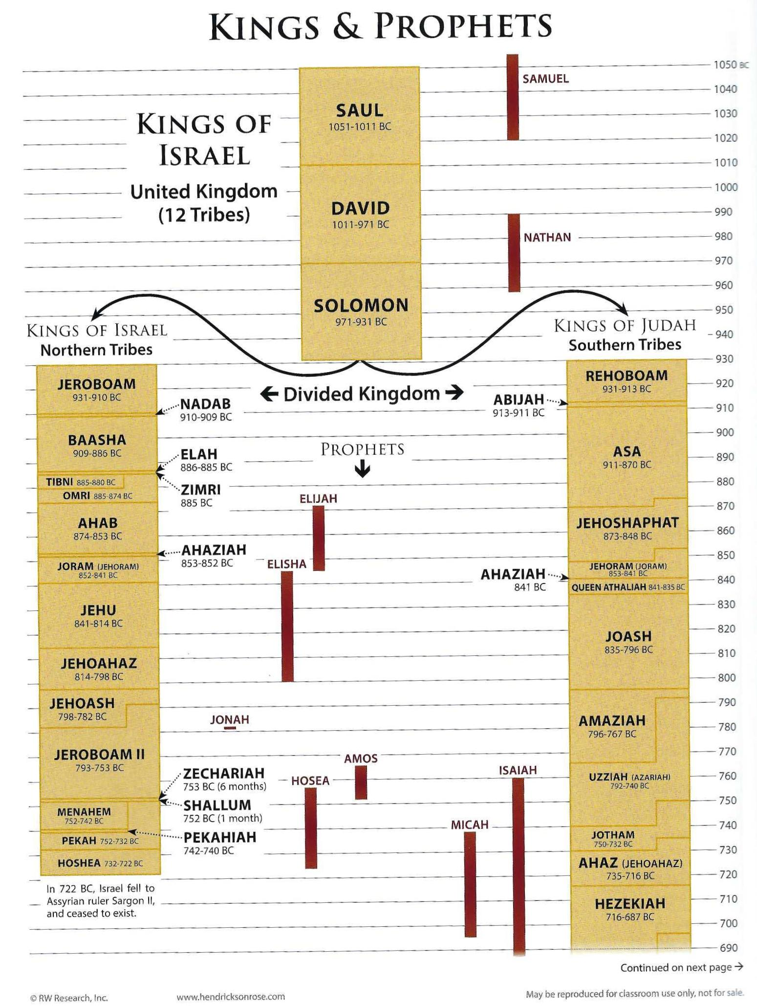
Kings and Prophets
Rose Book of Bible Charts, Maps and Time Lines; Rose Publishing; p.110-111

Slide 13
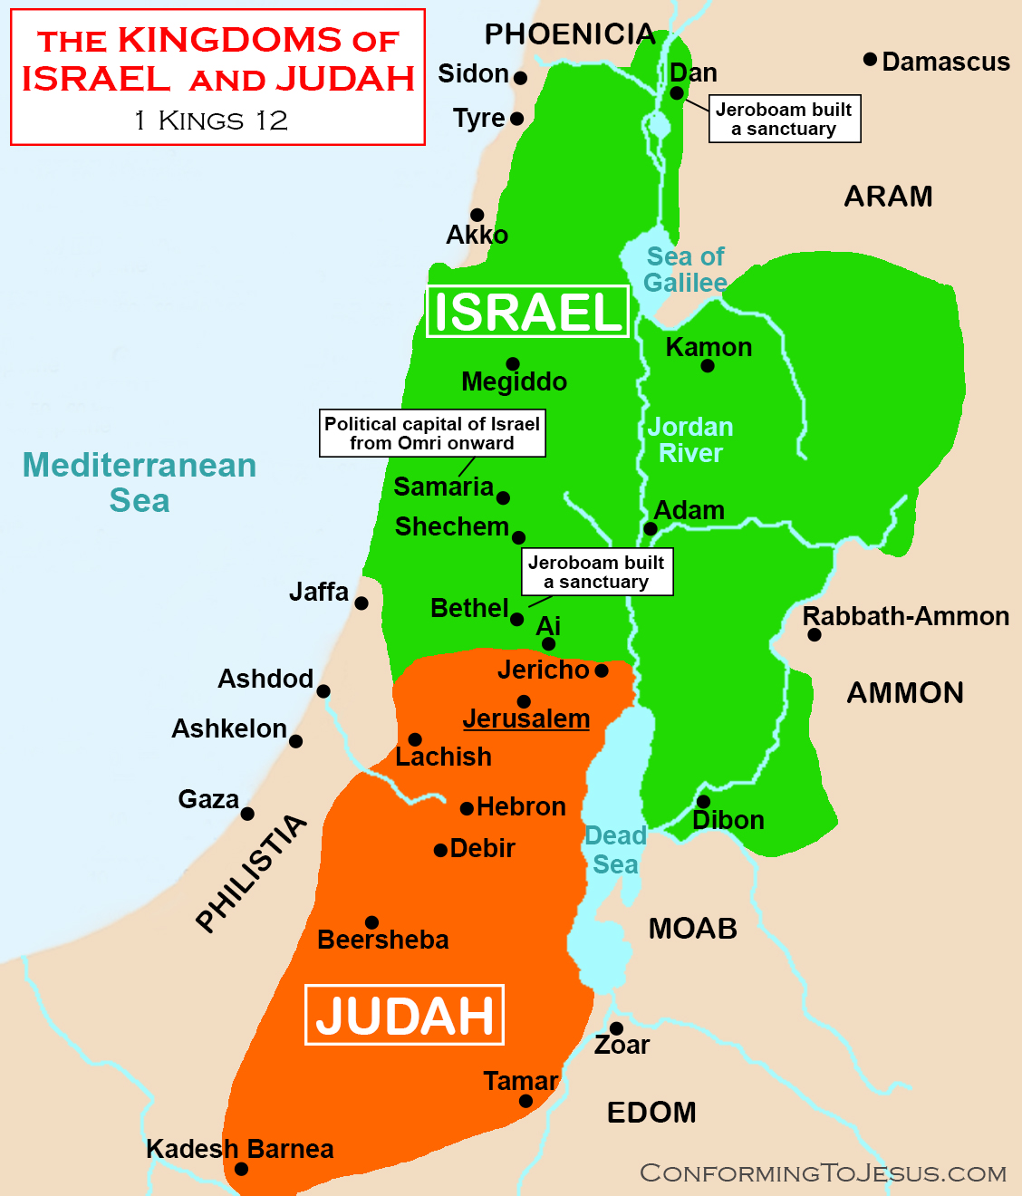
The Divided Kingdom
https://www.conformingtojesus.com/charts-maps/en/israel_and_judah_map.htm

Slide 14
Historical Background of Isaiah
Isaiah lived during the stormy period of the expansion of the Assyrian Empire and the decline of Israel.
Under the Assyrian King Tiglath-Pileser III (745-727 BC) the Assyrians swept westward into Aram (Syria) and Canaan.
In about 733 BC the kings of Aram and Israel tried to pressure Ahaz, king of Judah, into joining a coalition against Assyria.
Ahaz chose instead to ask the Assyrian king Tiglath-Pileser for help, a decision condemned by Isaiah.
Assyria did assist Judah and conquered the northern kingdom in 722 BC.
Zondervan,. NIV Study Bible, Fully Revised Edition (pp. 5099-5100).

Slide 15
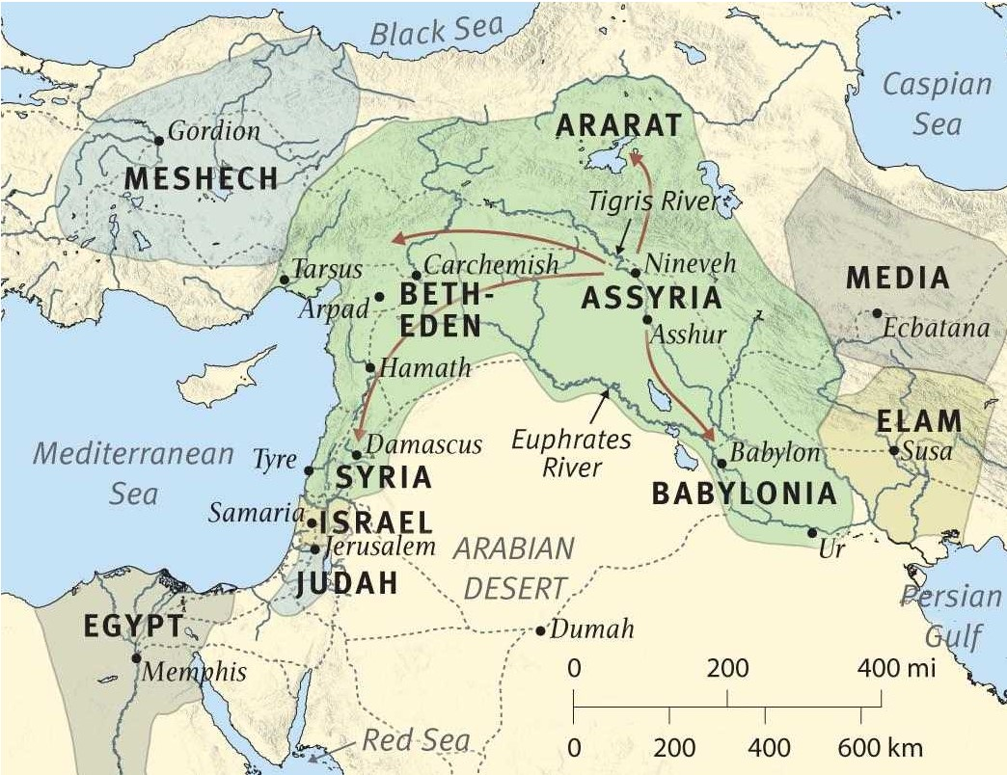
Near East at the Time Isaiah Began His Ministry (740 BC)
ESV Study Bible (p. 5434). Crossway.

Slide 16
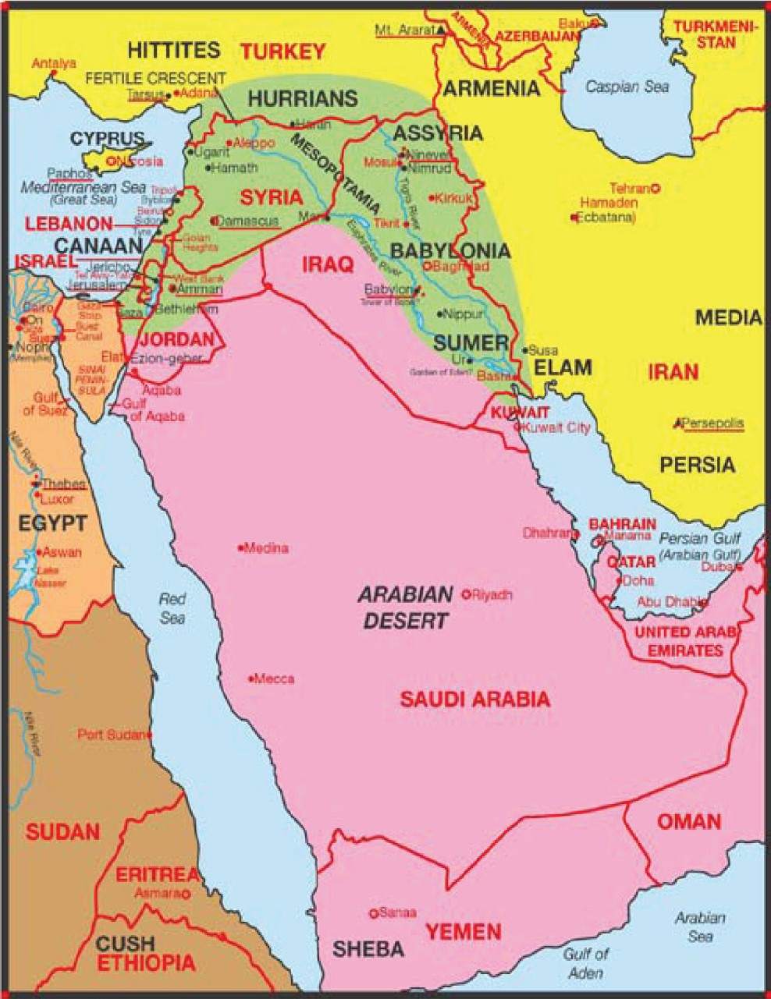
The Middle East Today
Rose Bible eCharts Maps

Slide 17
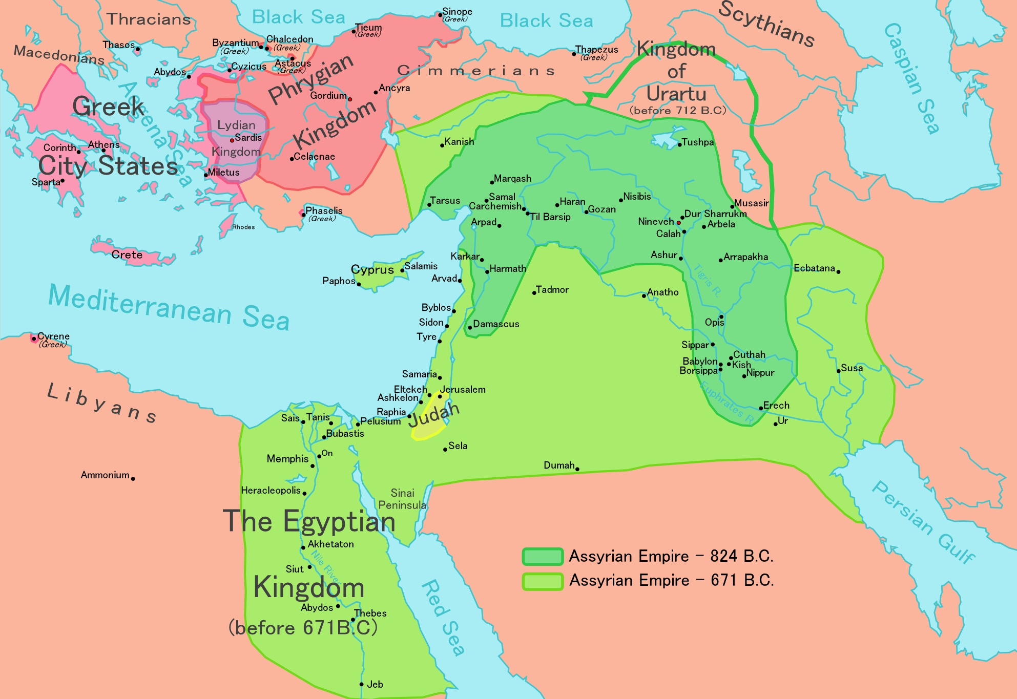
Assyrian Empire
https://en.wikipedia.org/wiki/Assyrian_conquest_of_Egypt#/media/File:Neo-Assyrian_map_824-671_BC.png

Slide 18
Historical Background of Isaiah
Assyria’s conquest of the northern kingdom made Judah even more vulnerable, and in 701 BC King Sennacherib of Assyria threatened Jerusalem itself.
The godly King Hezekiah prayed earnestly, and Isaiah predicted that God would force the Assyrians to withdraw from the city – which he did.
Nevertheless, Isaiah warned Judah that their sin would eventually bring captivity at the hands of Babylonia.
The visit of the Babylonian king’s envoys to Hezekiah set the stage for this prediction.
In 586 BC, Jerusalem was conquered by the Babylonian Empire and carried into exile.
Zondervan,. NIV Study Bible, Fully Revised Edition (pp. 5099-5100).

Slide 19
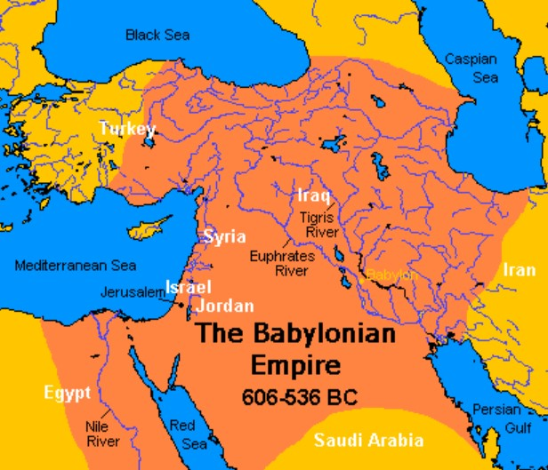
Babylonia Empire
https://owlcation.com/humanities/The-Formation-of-Ancient-Babylon

Slide 20
Historical Background of Isaiah
The fall of Jerusalem took place nearly a hundred years after the death of Isaiah, but as a prophet of God he not only knew of the future destruction of Judah, but he went on to predict the restoration of the Jewish people from captivity.
God would redeem his people from Babylonia, just as he had rescued them from Egypt.
Isaiah predicted (by name!) the rise of Cyrus the Persian, who would unite the Medes and Persians and conquer Babylon in 539 BC.
The decree of Cyrus would allow the Jews to return home in 538 BC, a deliverance that prefigured the greater salvation from sin through Christ.
Zondervan,. NIV Study Bible, Fully Revised Edition (pp. 5099-5100).

Slide 21
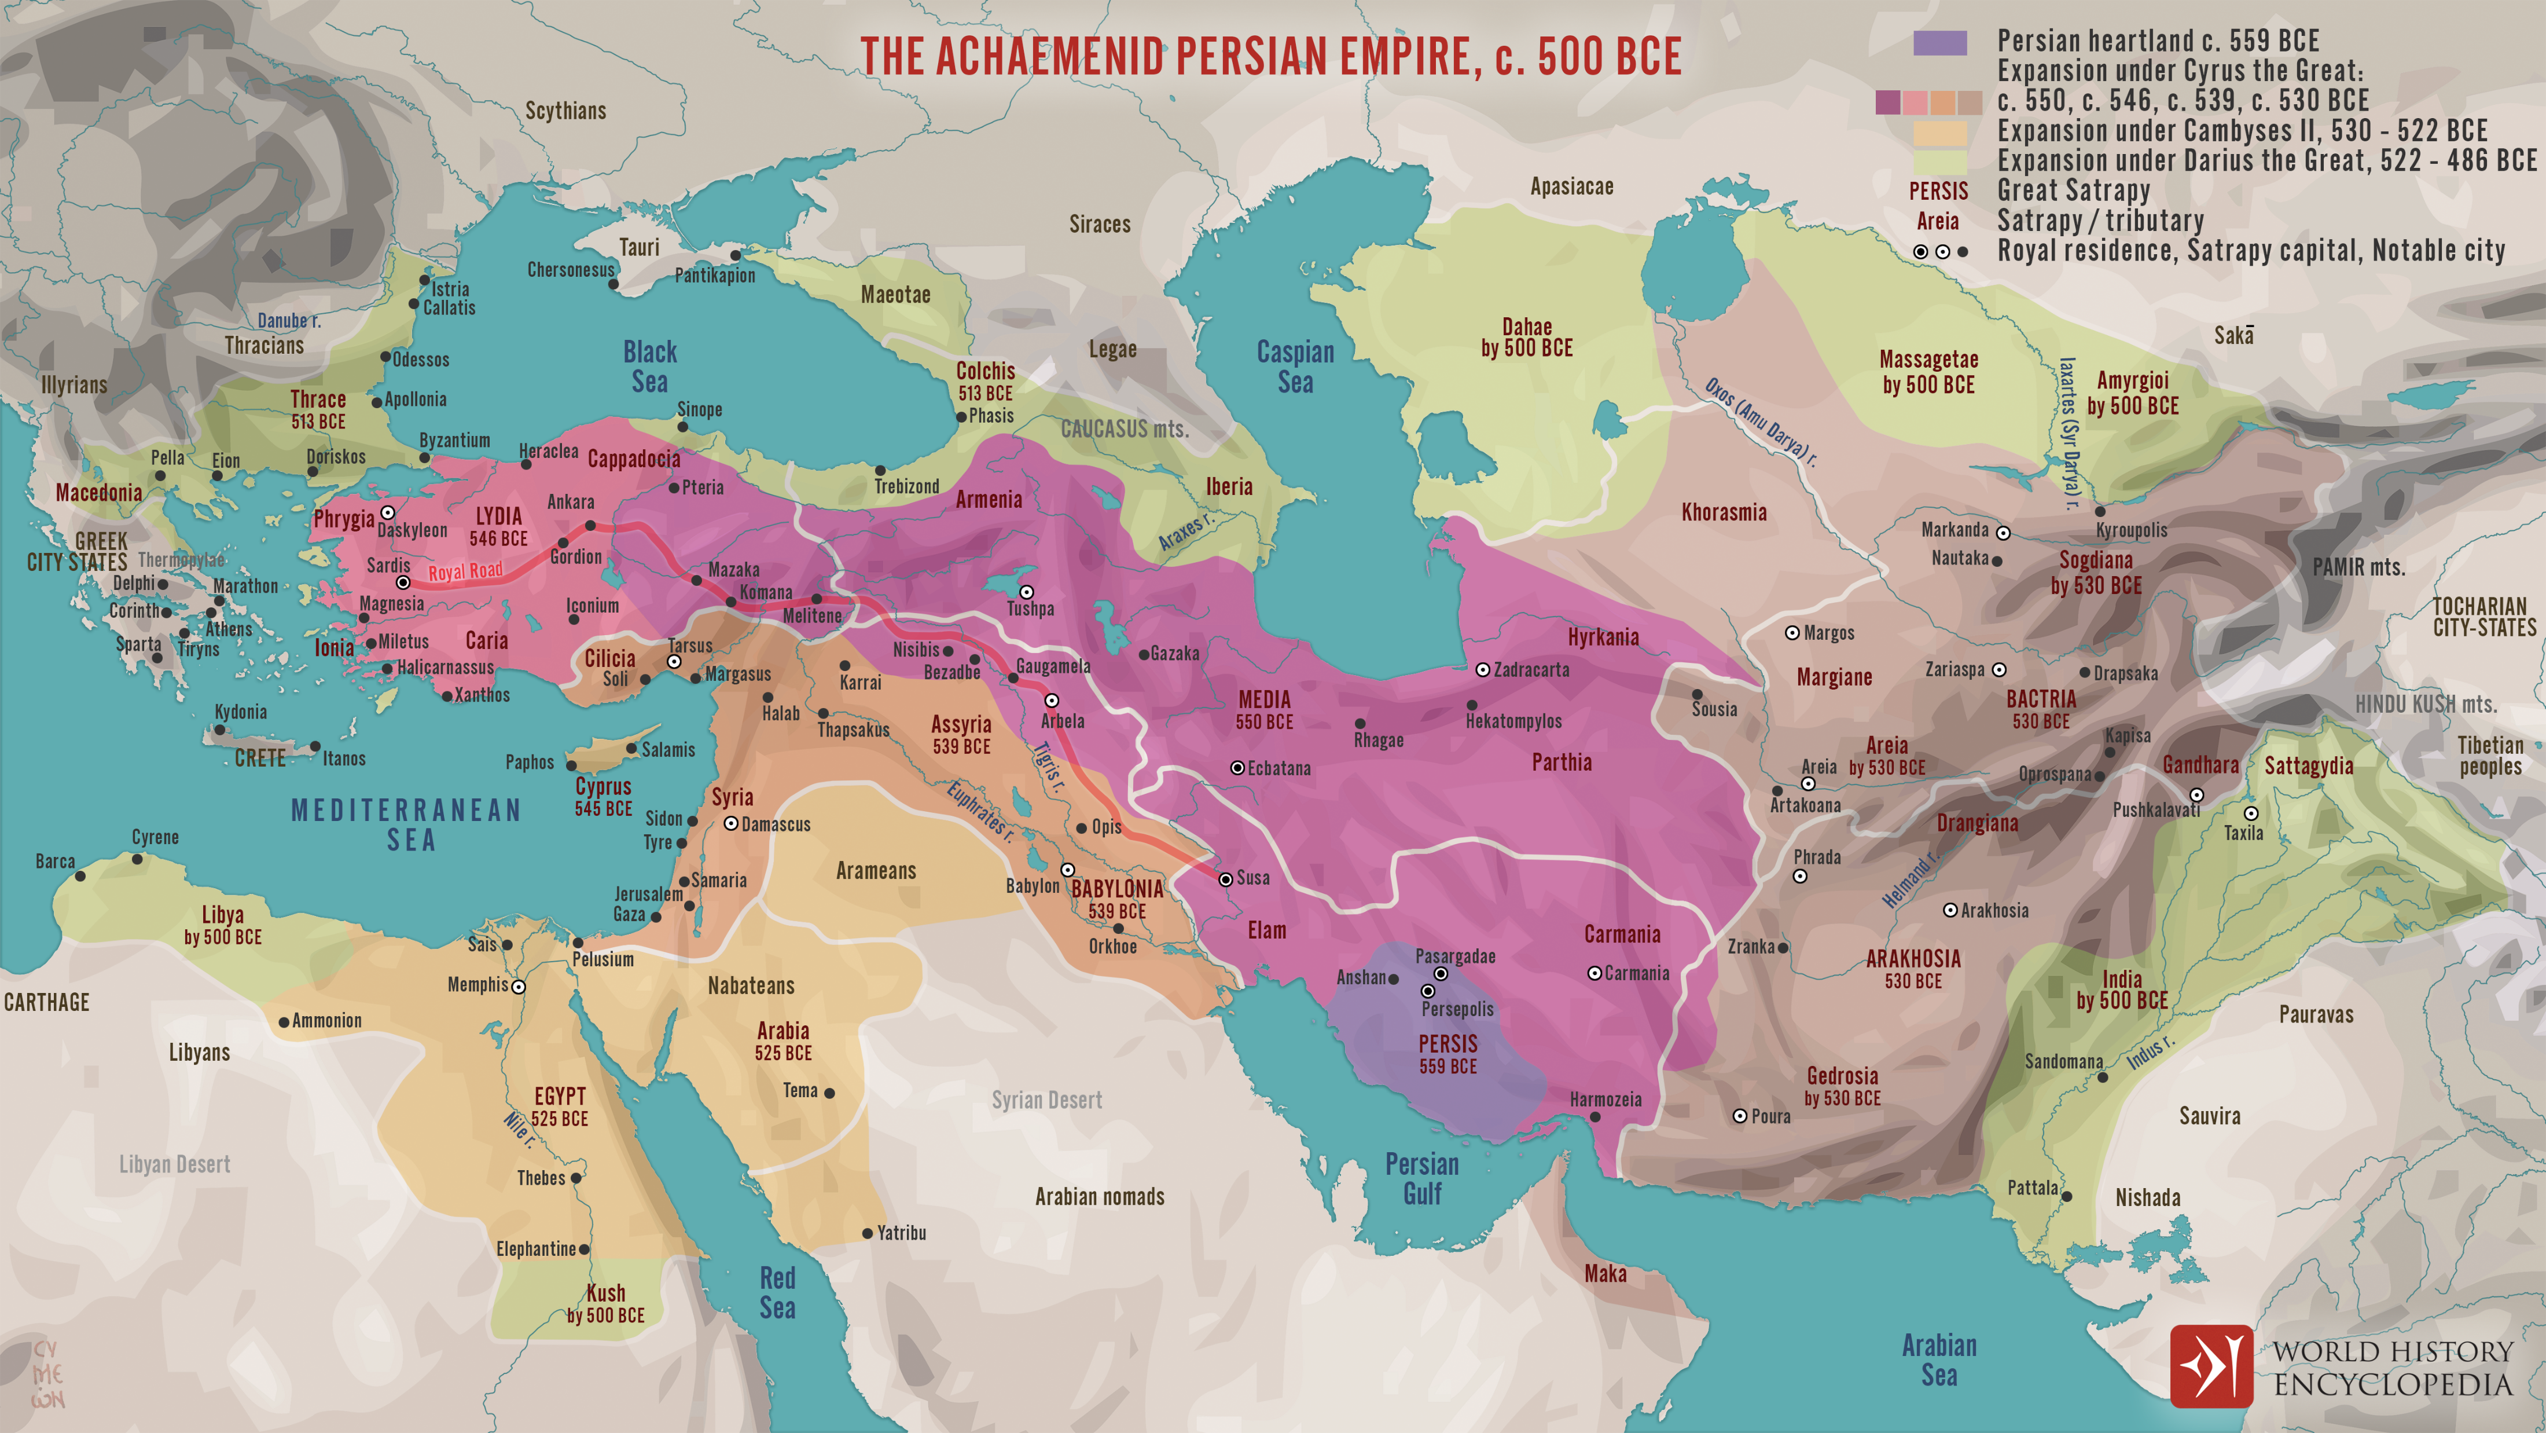
Persian Empire
https://www.worldhistory.org/uploads/images/16107.png?v=1673278143

Slide 22
Isaiah Timeline
722 B.C. – Assyria Conquers the Northern Kingdom
586 B.C. – Babylon Conquers the Southern Kingdom
539 B.C. – The Medes and Persians Conquer Babylon
800 BC
700 BC
600 BC
500 BC
538 B.C. – Cyrus Issues Decree to Restore Jews to Their Land
Isaiah’s Ministry 740-681 BC

Slide 23
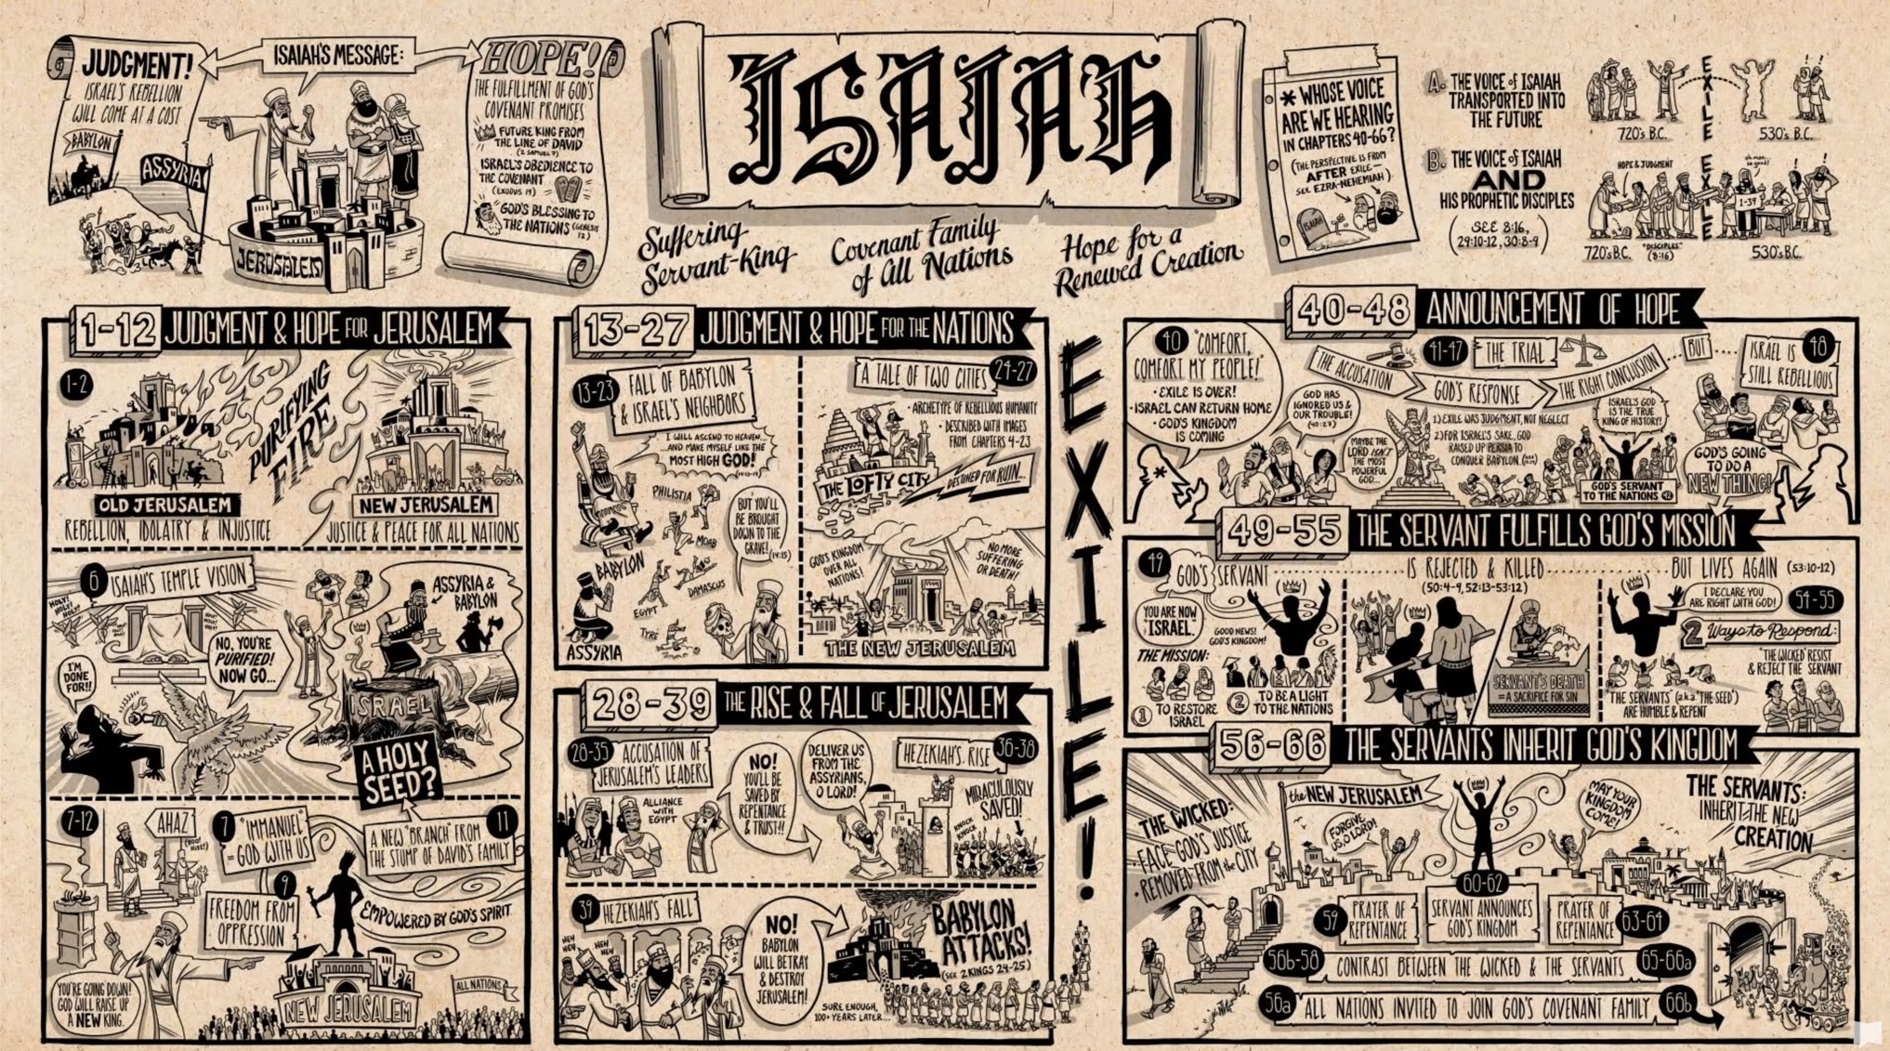
A Quick High Level Summary of the Book of Isaiah
Part 1: https://www.youtube.com/watch?v=d0A6Uchb1F8
Part 2: https://www.youtube.com/watch?v=_TzdEPuqgQg

