Slide 1
Highlights From the Book of Isaiah
To Download this lesson go to:
http://www.purifiedbyfaith.com/Isaiah/Isaiah.htm
https://www.wikiart.org/en/ernest-meissonier/isaiah

Slide 2
The Future Glory of Jerusalem (Isaiah 2:1-5)
¹ Here is the message about Judah and Jerusalem that was revealed to Isaiah son of Amoz. ² In future days the mountain of the Lord’s temple will endure as the most important of mountains and will be the most prominent of hills. All the nations will stream to it; ³ many peoples will come and say, “Come, let us go up to the Lord’s mountain, to the temple of the God of Jacob, so he can teach us his requirements, and we can follow his standards.” For Zion will be the center for moral instruction; the Lord’s message will issue from Jerusalem. ⁴ He will judge disputes between nations; he will settle cases for many peoples. They will beat their swords into plowshares, and their spears into pruning hooks. Nations will not take up the sword against other nations, and they will no longer train for war. ⁵ O descendants of Jacob, come, let us walk in the Lord’s guiding light.
(New English Translation)

Slide 3
The Future Glory of Jerusalem (Isaiah 2:1-5)
After the grim ending of chapter 1 and indeed the generally grim tone of that entire chapter, these verses come as a shock.
They do not speak of the stubborn and rebellious Israelites worshiping in disobedience and self-adoration.
Instead, we have all the nations streaming to “the Lord’s mountain”— that is, to his house, his temple, in Zion— to learn his ways.
They go there because that is the place where the Lord’s “moral instruction” and “message” go forth (Isaiah 2:3).
Oswalt, John . Isaiah (The NIV Application Commentary) (p. 88).

Slide 4
^{2:1} Here is the message about Judah and Jerusalem that was revealed to Isaiah son of Amoz.
This heading and the subsequent heading in Isaiah 13:1 (“This is an oracle about Babylon that Isaiah son of Amoz saw...” ) mark off chapters 2-12 as a distinct section of Isaiah’s prophesy.
This particular section is thought by many commentaries to have been written in the years shortly after 715 BC when Hezekiah began to rule on his own.
However, Isaiah deliberately presents this material without telling us much about when it was written.
Because, no matter who was on the throne, the internal condition of Judah didn’t change much spiritually, and so what Isaiah might say at any given point of time continued to be of relevance to a community which stubbornly remained in rebellion against Yahweh.
Mackay, John L. – A Study Commentary on Isaiah Volume I: Chapters 1-39 ( p. 75)

Slide 5
^{2:1} Here is the message about Judah and Jerusalem that was revealed to Isaiah son of Amoz.
In chapter 1 Isaiah briefly described God’s plan for restoring Israel, saying things like:
Though your sins have stained you like the color red, you can become white like snow… If you have a willing attitude and obey, then you will again eat the good crops of the land… I will reestablish honest judges as in former times, wise advisers as in earlier days. Then you will be called, “The Just City, Faithful Town.” Zion will be freed by justice and her returnees by righteousness. (Isaiah 1:18-19,26-27)
Wegner, Paul D. – Isaiah An Introduction and Commentary - Tyndale OT Commentaries

Slide 6
^{2:1} Here is the message about Judah and Jerusalem that was revealed to Isaiah son of Amoz.
In Chapters 2–4 Isaiah develops this theme of the Lord’s restoration of Israel more fully by means of a structure that begins (2:2–5) and ends (4:2–6) with a description of the future, glorified Zion.
In between these two glimpses of a restored Zion is a description of Israel’s current state, and the purging judgment that will be necessary to transform them into that righteous nation – a process that would take much longer and be more painful than the recipients of this prophesy may have imagined.
Wegner, Paul D. – Isaiah An Introduction and Commentary - Tyndale OT Commentaries

Slide 7
^{2:2} In future days the mountain of the Lord’s temple will endure as the most important of mountains and will be the most prominent of hills. All the nations will stream to it;
The words of Isaiah 2:2-4 are also found, with very little variation, in Micah 4:1-3.
There are many theories as to why this might be the case:
Micah is quoting Isaiah
Isaiah is quoting Micah
Both prophets are quoting another common source
There is really no way to know for sure which of these is true.
It could be that they both adopted a saying that was well-known among the people in their day, or that both received the words directly from the Holy Spirit.
So long as both passages as authentic and inspired, it really doesn’t matter what their literary history is.
Alexander, Joseph A. – Commentary on Isaiah (p. 22)

Slide 8
^{2:2} In future days the mountain of the Lord’s temple will endure as the most important of mountains and will be the most prominent of hills. All the nations will stream to it;
“In future days” (literally, “in the last days” – cf. KJV, ESV, NIV) translates a Hebrew phrase that often occurs in the Old Testament.
In some OT passages this phrase simply refers to future events that occur at some later time (see Gen 49:1; Num 24:14; Deut 31:29; Jer 23:20; 30:24).
But the events described here seem to be a reference to the New Testament age when the “nations… stream” to Zion to learn the ways of her God through his incarnation in Christ.
Oswalt, John N. – The Book of Isaiah, Chapters 1–39 (The NIC on the OT) (pp. 116-117).

Slide 9
^{2:2} In future days the mountain of the Lord’s temple will endure as the most important of mountains and will be the most prominent of hills. All the nations will stream to it;
In fact, New Testament writers use this very phrase (“in the last days”) and other similar phrases to describe events taking place in the New Testament:
And in the last days … I will pour out my Spirit on all people [= all nations, not just Israel]… (Acts 2:17)
After God spoke long ago… through the prophets, in these last days he has spoken to us in a son… (Heb 1:1-2)
Children, it is the last hour, and just as you heard that the antichrist is coming, so now many antichrists have appeared. We know from this that it is the last hour. (1 Jn 2:18)
In the last days blatant scoffers will come…saying, “Where is his promised return? For ever since our ancestors died, all things have continued as they were from the beginning of creation.” (1 Pet 3:3-4)
Albert Barnes Commentary

Slide 10
The “Last Days”
Old Testament Perspective:
The Coming of Messiah
The Mosaic Covenant
“The Last Days”
New Testament Perspective:
The First Coming of Jesus
The Second Coming of Jesus
The Old Covenant
New Covenant = “The Last Days”
Young, Edward J. – The Book of Isaiah; Eerdmans; p. 99

Slide 11
^{2:2} In future days the mountain of the Lord’s temple will endure as the most important of mountains and will be the most prominent of hills. All the nations will stream to it;
“the mountain of the Lord’s temple ” – refers to Mount Moriah, where the temple was located as the focus of divine contact with humanity. ¹
This was actually separated from Ophel or the original City of David (Zion). ²
But in the scriptures, the one word “Zion” designates both without necessarily making a distinction: ²
God has revealed himself in Judah; in Israel his reputation is great. He lives in Salem [short for Jerusalem]; he dwells in Zion. (Ps 76:2)
¹ Mackay, John L. – A Study Commentary on Isaiah Volume I: Chapters 1-39 ( p. 78)
² Young, Edward J. – The Book of Isaiah; Eerdmans; p. 99

Slide 12
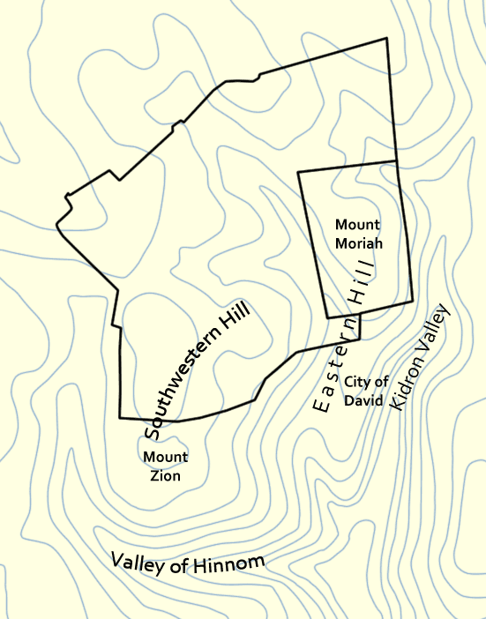
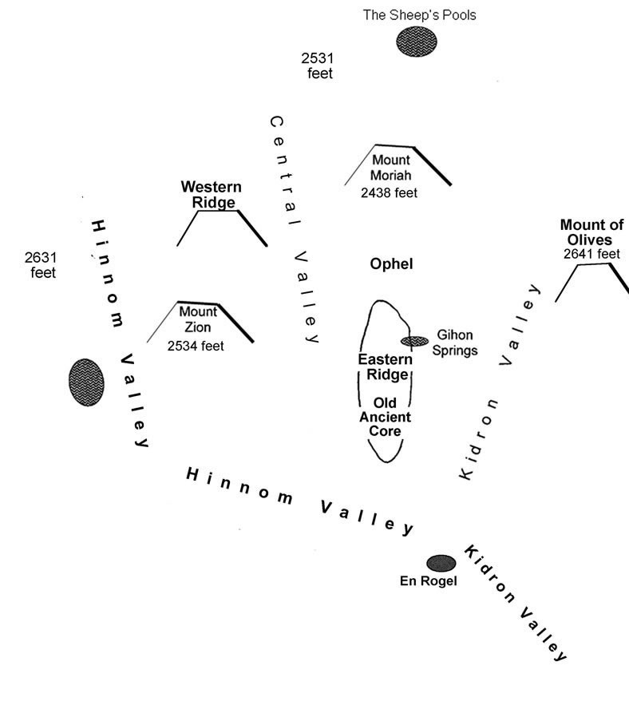
“The Mountain of the Lord’s Temple”
https://en.wikipedia.org/wiki/Mount_Zion#/media/File:JerusalemTopography.png
https://www.generationword.com/jerusalem101-photos/BOOK-PHOTOS/topography-jerusalem.jpg

Slide 13
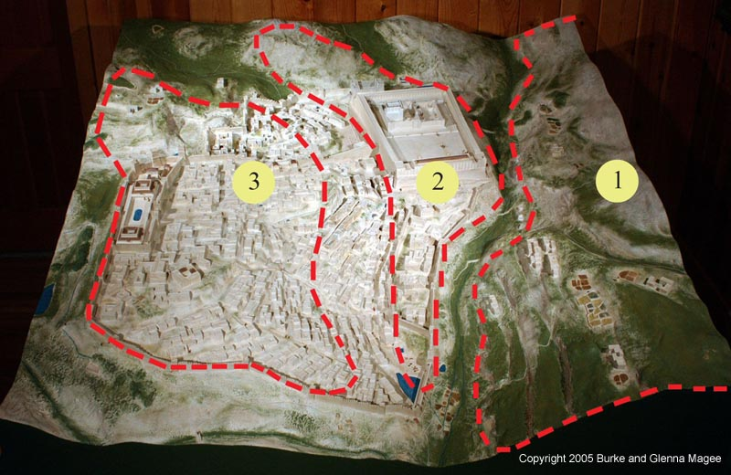
“The Mountain of the Lord’s Temple”
1 - Mount of Olives 2 - Mount Moriah 3 - Mount Zion
https://www.returntogod.com/jerusalem/mountains.htm

Slide 14
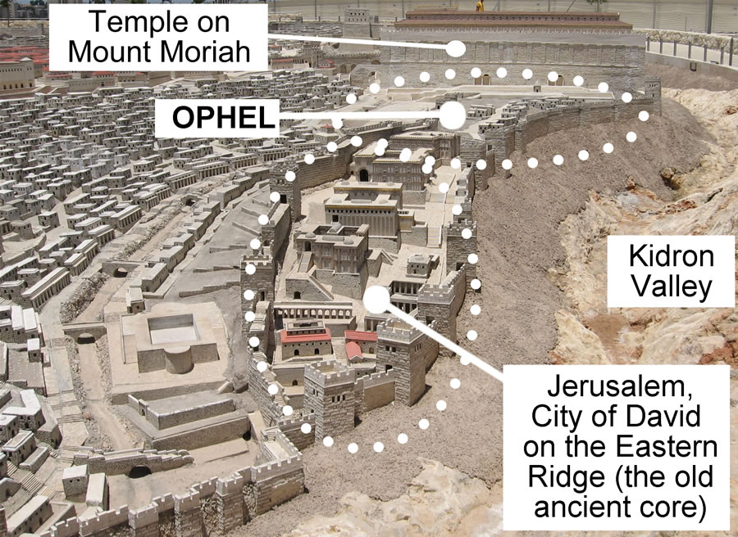
The Mountain of the Lord’s Temple
https://www.generationword.com/jerusalem101-photos/ophel/ophel-labeled-2.jpg

Slide 15
^{2:2} In future days the mountain of the Lord’s temple will endure as the most important of mountains and will be the most prominent of hills. All the nations will stream to it;
Mount Moriah was not a particularly high mountain (2,438 feet), and was surrounded by higher peaks, such as the Mount of Olives (2,641 feet).
Nevertheless it was the Lord’s earthly dwelling place, situated in his royal capital of Jerusalem.
In Isaiah’s day, this glorious reality was not grasped by other nations.
However, in time to come its exclusive splendor would be seen by “all the nations” as they assess not its topological or political significance, but its spiritual pre-eminence as the place where Yahweh was pleased to reveal himself.
Mackay, John L. – A Study Commentary on Isaiah Volume I: Chapters 1-39 ( p. 78)

Slide 16
^{2:2} In future days the mountain of the Lord’s temple will endure as the most important of mountains and will be the most prominent of hills. All the nations will stream to it;
The phrase “will endure” does not describe a temporary phenomenon, but something that will continue unshaken by earthly turmoil because the Lord has securely established “the mountain of the Lord’s temple… as the most important of mountains and… the most prominent of hills”. ¹
In the ancient world, mountains were often held to be the homes of the gods. ²
Therefore, the exaltation of “the mountain of the Lord’s temple”, the mountain where he lives, signifies a supernatural triumph of the Lord over all gods. ²
¹ Mackay, John L. – A Study Commentary on Isaiah Volume I: Chapters 1-39 ( p. 78)
² Motyer, J. Alec. The Prophecy of Isaiah (p. 54). InterVarsity Press.

Slide 17
^{2:2} In future days the mountain of the Lord’s temple will endure as the most important of mountains and will be the most prominent of hills. All the nations will stream to it;
“All the nations will stream to it” – a strange picture is painted here where the nations of the world are depicted as rivers flowing up the mountain where the Lord dwells.
By means of this picture, Isaiah wishes to teach the truth that the worship of the Lord will triumph over all other religions and forms of worship.
In Isaiah’s day, the nations regarded the LORD as the God of merely Israel, a local deity.
But in the latter days, this religion of Israel would be known throughout the world.
Young, Edward J. – The Book of Isaiah; Eerdmans; p. 101

Slide 18
^{2:2} In future days the mountain of the Lord’s temple will endure as the most important of mountains and will be the most prominent of hills. All the nations will stream to it;
In the light of the New Testament we can now see that the reference of this prophesy is to the church which Jesus Christ founded.¹
Beginning at Jerusalem the disciples went throughout the world proclaiming the true salvation. ¹
And so, through the preaching of the apostles and by the spread of the gospel, this prophecy will reach its final fulfillment. ²
¹ Young, Edward J. – The Book of Isaiah; Eerdmans; p. 102
² Albert Barnes Commentary

Slide 19
^{2:3} many peoples will come and say, “Come, let us go up to the Lord’s mountain, to the temple of the God of Jacob, so he can teach us his requirements, and we can follow his standards.” For Zion will be the center for moral instruction; the Lord’s message will issue from Jerusalem.
This verse takes us down into the many crowds that are approaching the “Lord’s mountain”.
It allows us to overhear what they are saying and so to understand their purpose.
They are mutually encouraging one another to press on in their pilgrimage.
After saying their goal is to “go up to the Lord’s mountain,” they continue, that more precisely it is “the temple of the God of Jacob”.
This points to the spiritual values that Israel has been given by God.
These nations now want to have a share in these values.
Leupold, H. C. – Exposition of Isaiah; Volume I: Chapters 1-39 ( p. 76)

Slide 20
^{2:3} many peoples will come and say, “Come, let us go up to the Lord’s mountain, to the temple of the God of Jacob, so he can teach us his requirements, and we can follow his standards.” For Zion will be the center for moral instruction; the Lord’s message will issue from Jerusalem.
Further attention to what these people are saying shows us that they want to be instructed by Yahweh concerning “his requirements”. ¹
Furthermore, these pilgrims will not be content with simply gathering information; they intend to put their knowledge into practice in their lives as they “follow his standards.” ²
With this significant remark their words come to an end.
¹ Leupold, H. C. – Exposition of Isaiah; Volume I: Chapters 1-39 ( p. 76).
² Mackay, John L. – A Study Commentary on Isaiah Volume I: Chapters 1-39 ( p. 78)

Slide 21
^{2:3} many peoples will come and say, “Come, let us go up to the Lord’s mountain, to the temple of the God of Jacob, so he can teach us his requirements, and we can follow his standards.” For Zion will be the center for moral instruction; the Lord’s message will issue from Jerusalem.
Isaiah himself now speaks and says, “Zion will be the center for moral instruction; the Lord’s message will issue from Jerusalem”. ¹
Because of the parallel construction used here, we see that “Zion” is used here for “Jerusalem”.
And so what he is saying is that this “message” of mercy that goes out to “all the nations” (verse 2) will be spread “from Jerusalem”.²
¹ Leupold, H. C. – Exposition of Isaiah; Volume I: Chapters 1-39 ( p. 76).
² Albert Barnes Commentary

Slide 22
^{2:3} many peoples will come and say, “Come, let us go up to the Lord’s mountain, to the temple of the God of Jacob, so he can teach us his requirements, and we can follow his standards.” For Zion will be the center for moral instruction; the Lord’s message will issue from Jerusalem.
We see the beginnings of the fulfillment of this passage in Luke 24:47, when Jesus, perhaps referring to this very passage, tells his disciples that “repentance for the forgiveness of sins would be proclaimed in his name to all nations, beginning from Jerusalem.”¹
This is why the Apostle Paul can tell the Christians in Rome that the Gentiles “are indebted to the Jerusalem saints. For if the Gentiles have shared in their spiritual things, they are obligated also to minister to them in material things” (Rom 15:27)
¹ Albert Barnes Commentary

Slide 23
^{2:4} He will judge disputes between nations; he will settle cases for many peoples. They will beat their swords into plowshares, and their spears into pruning hooks. Nations will not take up the sword against other nations, and they will no longer train for war.
This verse probes the causes and cures for war and conflict.
What is it that causes war and violence?
Quite often a war occurs when a person, or a nation, decides to try and meet what they claim are their own needs and so they will trample on a weaker person or nation, resulting in war and violence.
Peace, on the other hand, comes about when there is the recognition that God is the source of all good, and that our needs and our destiny can be submitted to his judgment, and from the knowledge that he will provide for us.
Oswalt, John N. – The Book of Isaiah, Chapters 1–39 (The NIC on the OT) (pp. 118).

Slide 24
^{2:4} He will judge disputes between nations; he will settle cases for many peoples. They will beat their swords into plowshares, and their spears into pruning hooks. Nations will not take up the sword against other nations, and they will no longer train for war.
Those who have learned such truths and are walking in them (v. 3) can know peace, or “well-being.”
And when two people are walking in this way they can know such peace together because both can know that their interests are being cared for by God, and both know that the other will submit his or her needs to God rather than attempt to satisfy them by force (John 14:27).
When these principles are extended to the nations, peace between nations can result.
Oswalt, John N. – The Book of Isaiah, Chapters 1–39 (The NIC on the OT) (pp. 118).

Slide 25
^{2:4} He will judge disputes between nations; he will settle cases for many peoples. They will beat their swords into plowshares, and their spears into pruning hooks. Nations will not take up the sword against other nations, and they will no longer train for war.
However, the thought of producing peace on any other ground is folly (Jer 6:14; 8:11).
Until persons and nations have come to God to learn his ways and walk in them, peace is an illusion.
Jesus tells us not to be alarmed when there are “wars and rumors of wars” for such things will continue until he returns again. (Mat 24:6-7)
This does not mean that the Church merely waits for the second coming to look for peace.
But neither does it mean that the Church should promote peace talks before it seeks to bring the parties to a point where they will submit their needs to God.
Oswalt, John N. – The Book of Isaiah, Chapters 1–39 (The NIC on the OT) (pp. 118).

Slide 26
^{2:5} O descendants of Jacob, come, let us walk in the Lord’s guiding light.
As a final appeal, Isaiah reminds Judah that it’s not just any god who will do these things, but the “God of Jacob” (see verse 3).
He is the God who has revealed himself in the context of the history of a particular people.
He has condescended to be their God in order that the world may know him and be redeemed.
Which is all the more reason why the family (“descendants”) of Jacob should walk in the light of the Lord.
After all, if even the nations of the world will one day seek out God’s ways so that they can walk in them, surely God’s chosen nation ought to be walking in those ways now!
Oswalt, John . Isaiah (The NIV Application Commentary) (pp. 89-90). Zondervan Academic.

Slide 27
Next Time
I plan to cover Isaiah 6:1-13 which talks about Isaiah’s Commission.
I would like to cover this entire passage in one lesson, but I most likely end up covering it in two lessons:
Isaiah’s Vision of the Lord – 6:1-7
Isaiah’s Commission from the Lord – 6:8-13

Slide 28
Class Discussion Time
https://www.weareteachers.com/moving-beyond-classroom-discussions/

Slide 29
*Class Discussion Time
Theologians who are of a Dispensationalist persuasion see the things described in the text we covered today (Isaiah 2:1-5) such as the nations of the world “streaming” to Jerusalem, the cessation of war, etc. as occurring during a future literal “one thousand year” Millennium which they believe will occur after the second coming of Christ.
The text they use to support their view is Revelation 20:2-8:
Then I saw an angel descending from heaven, holding in his hand the key to the abyss and a huge chain. ² He seized the dragon—the ancient serpent, who is the devil and Satan—and tied him up for a thousand years. ³ The angel then threw him into the abyss and locked and sealed it so that he could not deceive the nations until the one thousand years were finished. (After these things he must be released for a brief period of time.) ⁴ Then I saw thrones and seated on them were those who had been given authority to judge. I also saw the souls of those who had been beheaded because of the testimony about Jesus and because of the word of God. These had not worshiped the beast or his image and had refused to receive his mark on their forehead or hand. They came to life and reigned with Christ for a thousand years. ⁵ (The rest of the dead did not come to life until the thousand years were finished.) This is the first resurrection. ⁶ Blessed and holy is the one who takes part in the first resurrection. The second death has no power over them, but they will be priests of God and of Christ, and they will reign with him for a thousand years. ⁷ Now when the thousand years are finished, Satan will be released from his prison ⁸ and will go out to deceive the nations at the four corners of the earth…

Slide 30
*Class Discussion Time
I have tried to demonstrate today that the New Testament writers see the fulfillment of this text in events of the New Testament where the gospel goes out from Jerusalem to all the nations of the world. Do you think I have made a good case for that?
Do you see any reason to think that the Dispensationalists are right in thinking that this text is predicting things that will occur in some future literal thousand year Millennium that occurs after the second coming of Christ?

