Slide 1
Highlights From the Book of Isaiah
To Download this lesson go to:
http://www.purifiedbyfaith.com/Isaiah/Isaiah.htm
https://www.wikiart.org/en/ernest-meissonier/isaiah

Slide 2
An Oracle Concerning Babylon (Isaiah 13:1-14:23)
The Oracle to Babylon breaks up into three major sections:
13:1-22 – An “oracle” announcing that judgment is coming to Babylon
14:1-2 – A contrasting announcement of the future salvation and restoration of Israel
14:3-23 – A “taunt” against the King of Babylon
Webb, Barry G. The Message of Isaiah (The Bible Speaks Today Series) (p. 80). InterVarsity Press

Slide 3
The Overthrow of Babylon Isaiah 13:19-22
^{13:19} Babylon, the most admired of kingdoms, the Chaldeans’ source of honor and pride, will be destroyed by God just as Sodom and Gomorrah were. ²⁰ No one will live there again; no one will ever reside there again. No bedouin will camp there, no shepherds will rest their flocks there. ²¹ Wild animals will rest there, the ruined houses will be full of hyenas. Ostriches will live there, wild goats will skip among the ruins. ²² Wild dogs will yip in her ruined fortresses, jackals will yelp in the once-splendid palaces. Her time is almost up, her days will not be prolonged.

Slide 4
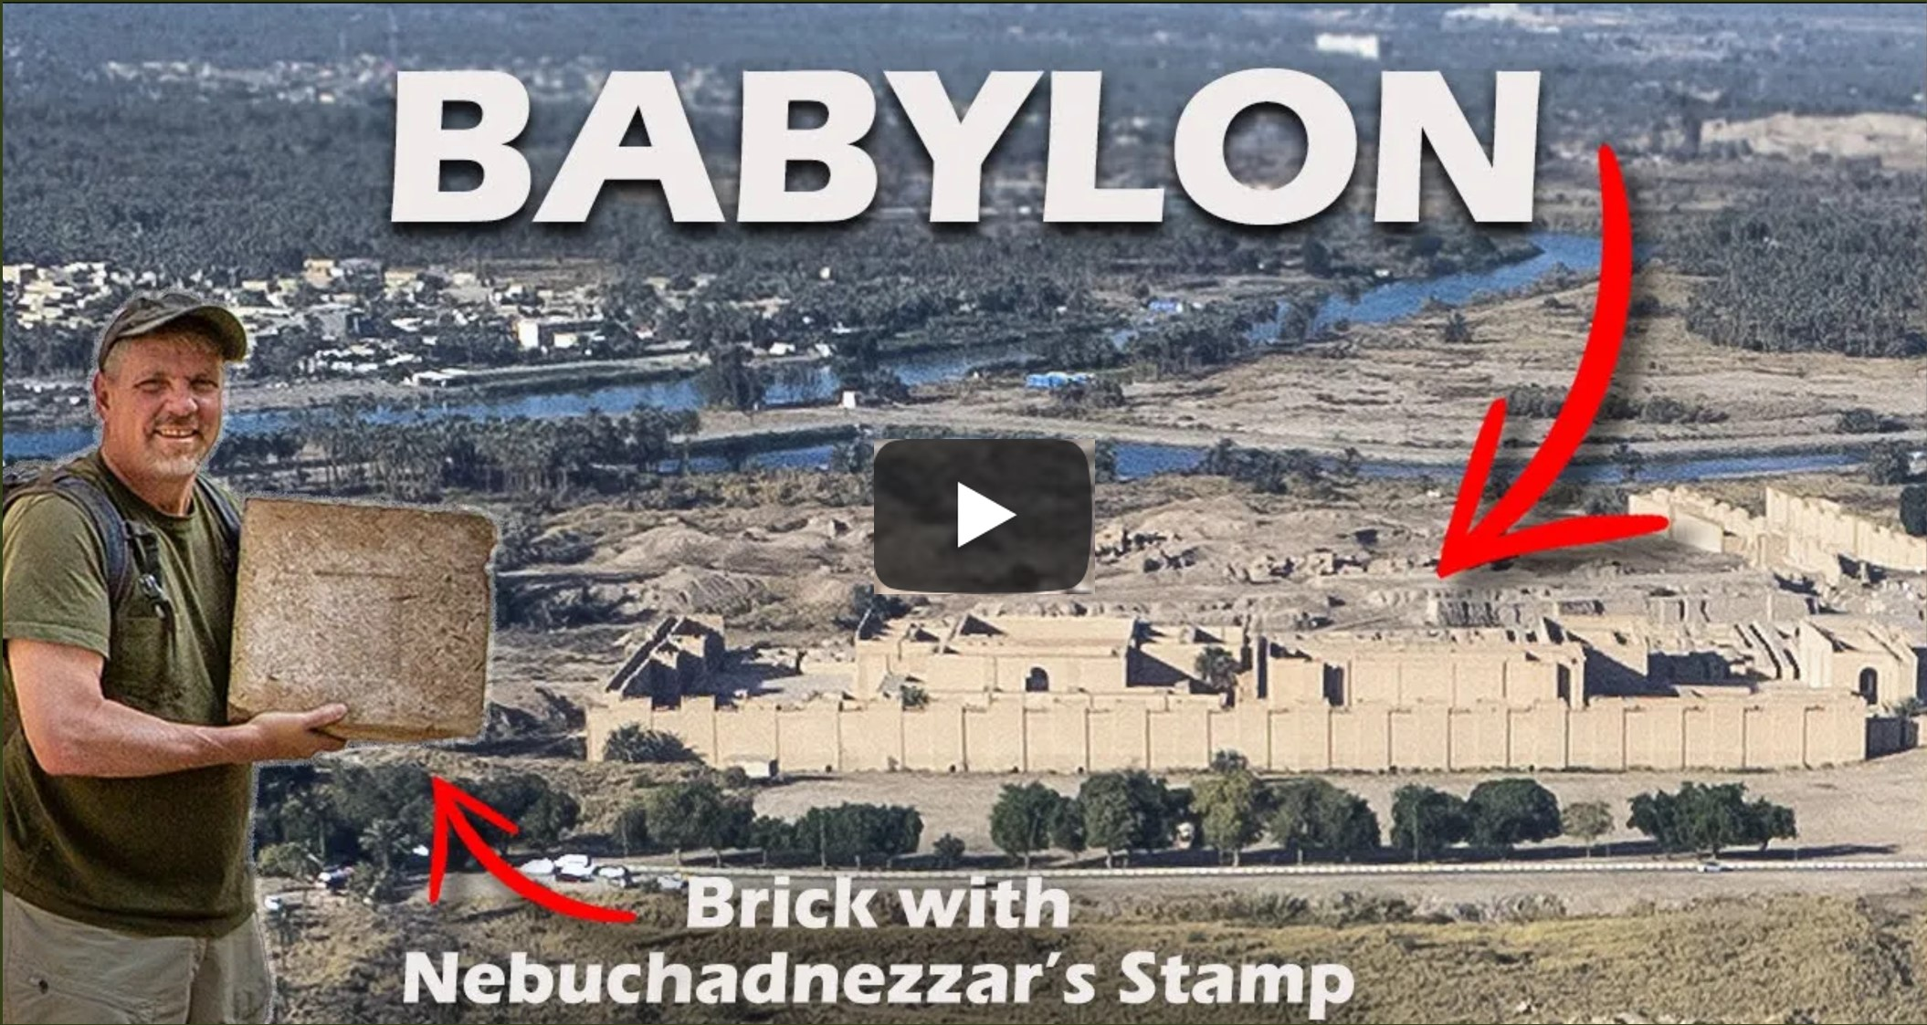
Exploring Babylon and the Prophecies Against Her
https://www.youtube.com/watch?v=QtUNHjDmGOY

Slide 5
The Future Salvation and Restoration of Israel (Isaiah 14:1-2)
^{14:1} The LORD will certainly have compassion on Jacob; he will again choose Israel as his special people and restore them to their land. Resident foreigners will join them and unite with the family of Jacob. ² Nations will take them and bring them back to their own place. Then the family of Israel will make foreigners their servants as they settle in the LORD’s land. They will make their captors captives and rule over the ones who oppressed them.

Slide 6
^{14:1} The LORD will certainly have compassion on Jacob; he will again choose Israel as his special people and restore them to their land. Resident foreigners will join them and unite with the family of Jacob.
This verse talks about a coming day when the LORD will have “compassion on Jacob [i.e. Israel]” – a day when He will “again choose Israel as His special people”.
It says the LORD will choose them “again”, because previously the LORD had “compassion” and “choose Israel as His special people” when they were suffering under the oppression of Egypt.
Young, Edward J. – The Book of Isaiah; Eerdmans; pp. 431-436

Slide 7
^{14:1} The LORD will certainly have compassion on Jacob; he will again choose Israel as his special people and restore them to their land. Resident foreigners will join them and unite with the family of Jacob.
There is coming a day when Israel will be in captivity once again.
But their captivity to another nation is, in a sense, a symbol of the deeper problem that has plagued Israel all along:
The greatest bondage under which the nation Israel (and all of humanity) has been held captive is bondage to sin.
As Jesus will tell them centuries later: “Everyone who practices sin is a slave of sin” (John 8:34)
Later in this book, Isaiah will tell them that deliverance from that bondage must come through the suffering servant (cf. Isaiah 53).
Young, Edward J. – The Book of Isaiah; Eerdmans; pp. 431-436

Slide 8
^{14:1} The LORD will certainly have compassion on Jacob; he will again choose Israel as his special people and restore them to their land. Resident foreigners will join them and unite with the family of Jacob.
And so there must be a second beginning.
When they were in bondage to Egypt, God delivered them and formed His people into a theocratic nation.
But because of their sin, nation of Israel must once again be disbanded.
And once again the people of Israel will find themselves in bondage to a foreign power – this time to the nation of Babylon.
Young, Edward J. – The Book of Isaiah; Eerdmans; pp. 431-436

Slide 9
^{14:1} The LORD will certainly have compassion on Jacob; he will again choose Israel as his special people and restore them to their land. Resident foreigners will join them and unite with the family of Jacob.
As we saw last week, Babylon often serves in scripture as a type of the great enemy of God and his people.
And so there must be another deliverance and a new beginning.
The beginning this time, however will not be under Moses.
It will consist instead of a return to the land of promise, and this will be followed by a period of “gloom” and “darkness” (Isaiah 8:22; 9:1).
But then, centuries later, when the nation had all but lost its understanding of the purposes of God, Messiah will come and he will “rule on David’s throne” (Isaiah 9:6-7).
Young, Edward J. – The Book of Isaiah; Eerdmans; pp. 431-436

Slide 10
^{14:1} The LORD will certainly have compassion on Jacob; he will again choose Israel as his special people and restore them to their land. Resident foreigners will join them and unite with the family of Jacob.
When Isaiah says here that the LORD will “restore them to their land”, he is of course, at one level, speaking of a time after their (yet future) Babylonian exile when God will bring many of the Israelites back to the land of Palestine that he had given them centuries earlier.
But I believe it’s possible that something more is being hinted at than just a mere return to the land Palestine.
Young, Edward J. – The Book of Isaiah; Eerdmans; pp. 431-436

Slide 11
^{14:1} The LORD will certainly have compassion on Jacob; he will again choose Israel as his special people and restore them to their land. Resident foreigners will join them and unite with the family of Jacob.
A literal Hebrew reading of “restore them to their land” is that the LORD “will give them rest in their own land”.
The idea of giving them “rest” points to a fulfillment of the covenant pledge that in the promised land the LORD would give his people rest from all the enemies that surrounded them (cf. Isaiah 63:14; Deut 25:19).
This rest after the Exodus and after the exile brings to mind the messianic era that we saw in Isaiah 11:11ff:
At that time the Lord will again lift his hand to reclaim the remnant of his people from Assyria, Egypt, Pathros, Cush, Elam, Shinar, Hamath, and the seacoasts
Mackay, John L. – A Study Commentary on Isaiah Volume I: Chapters 1-39 (pp. 321-322)

Slide 12
^{14:1} The LORD will certainly have compassion on Jacob; he will again choose Israel as his special people and restore them to their land. Resident foreigners will join them and unite with the family of Jacob.
The age to come is also seems to be anticipated in the last portion of this verse which anticipates the ultimate fulfillment of the promise to Abraham that “all the families of the earth may receive blessing through you” (Gen 12:3).
The LORD’s blessings to Israel will become so obvious that it will attract “resident foreigners”, a term that in Isaiah’s day referred to Gentiles from other nations who came and stayed among the Jews and were given certain rights.
They had to observer the Sabbath (Ex 20:10), but were exempted from the food laws (Deut 14:21).
Mackay, John L. – A Study Commentary on Isaiah Volume I: Chapters 1-39 (pp. 321-322)

Slide 13
^{14:1} The LORD will certainly have compassion on Jacob; he will again choose Israel as his special people and restore them to their land. Resident foreigners will join them and unite with the family of Jacob.
Here these foreigners are identified as more than economic migrants because they “join them and unite with the family of Jacob”.
This indicates that they had changed their attitude towards Israel and her God, adopting her beliefs and seeking to be incorporated into the people of God because they appreciate the spiritual benefits that have been given to them.
Mackay, John L. – A Study Commentary on Isaiah Volume I: Chapters 1-39 (pp. 321-322)

Slide 14
^{14:2} Nations will take them and bring them back to their own place. Then the family of Israel will make foreigners their servants as they settle in the LORD’s land. They will make their captors captives and rule over the ones who oppressed them.
Furthermore, Isaiah tells us that at this time when the LORD has “compassion” on his people, the “nations” will take the Jews and bring them to their homeland.
We know historically that it was the Babylonians who did this.
Furthermore, we see that at this time the relationship between the captive and the captor will be reversed.
Young, Edward J. – The Book of Isaiah; Eerdmans; pp. 431-436

Slide 15
^{14:2} Nations will take them and bring them back to their own place. Then the family of Israel will make foreigners their servants as they settle in the LORD’s land. They will make their captors captives and rule over the ones who oppressed them.
Israel will bring Gentile foreigners into “the LORD’s land” and cause them to inherit it.
Historically, this promise was not fulfilled at the time that the Jews returned from Babylonian bondage.
But it is spiritually fulfilled after the coming of Christ when as Gentiles who oppose God were “conquered” by the “family of Israel”, the church, which is the true “Israel of God”, (cf. Gal 6:16), and were subdued by the Holy Spirit and made heirs of the promises.
Young, Edward J. – The Book of Isaiah; Eerdmans; pp. 431-436

Slide 16
^{14:2} Nations will take them and bring them back to their own place. Then the family of Israel will make foreigners their servants as they settle in the LORD’s land. They will make their captors captives and rule over the ones who oppressed them.
The enemy will “settle in the LORD’s land” as “servants”.
Israel will not serve them, but they will serve her, and through her will serve her God.
They led her captive, but now Israel will act toward them as “captors”.
Once they had “oppressed” Israel, but now she will rule over her former oppressors.
Through Christ the heathen are being spiritually subdued; that is to say, through Christ working by means of His ministers and missionaries, are being subdued.
Only in that last great day will everything be fully subject to Him.
Young, Edward J. – The Book of Isaiah; Eerdmans; pp. 431-436

Slide 17
^{14:2} Nations will take them and bring them back to their own place. Then the family of Israel will make foreigners their servants as they settle in the LORD’s land. They will make their captors captives and rule over the ones who oppressed them.
As you’ll recall, the New Testament picks up many of these Old Testament references to Israel “ruling” and “conquering” the “nations” and applies them to what takes place in the New Testament as Gentiles are brought into God’s kingdom:
The root of Jesse will come, even he who arises to rule the Gentiles; in him will the Gentiles hope (Romans 15:12)

Slide 18
Next Time
I plan to cover the remainder of the Oracle Against Babylon in Isaiah 14:4b-23, where we see a “taunt” against the King of Babylon.

Slide 19
Class Discussion Time
https://www.weareteachers.com/moving-beyond-classroom-discussions/

Slide 20
Class Discussion Time
As the video demonstrates, many of Isaiah’s prophecies were physically fulfilled in a remarkable way.
And yet, as today’s text demonstrates (and many that we have looked at previously), many prophecies would not be completely fulfilled until the coming of the New Testament and/or ultimately in the age to come – at which time there is a spiritual fulfillment.
It’s as though there are sort of “layers” to the fulfillment of these prophesies.
Can you see how these things fit together? Does this help you to gain a deeper appreciation for the things that Isaiah prophesied?

