Slide 1
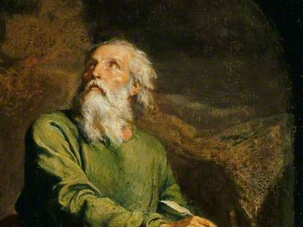
Highlights From the Book of Isaiah
To Download this lesson go to:
http://www.purifiedbyfaith.com/Isaiah/Isaiah.htm
https://www.wikiart.org/en/ernest-meissonier/isaiah

Slide 2
Outline of the Book of Isaiah
Isaiah’s Warning of Judgment on Israel (1-39)
Judgement and Hope for Jerusalem (1-12)
Judgement and Hope for the Nations (13-27)
True Deliverance Is Found, Not in Egypt, But in the Lord (28-35)
The Lessons of History (36-39)
The Deliverance of Jerusalem (36-37)
Hezekiah’s Sickness and Recovery (38)
A Visit From the Envoys of Babylon (39)
The Promise of Future Hope in the New Jerusalem (40-66)

Slide 3
The Deliverance of Jerusalem (36-37)
The deliverance of Jerusalem unfolds as follows:
The Assyrian Chief Adviser Addresses Hezekiah Though His Envoys (36:1-10)
The Assyrian Chief Adviser Appeals to the People Sitting on the Wall (36:11-20)
Reactions to the Assyrian Ultimatum (36:21-37:7)
The King of Assyria’s Letter to Hezekiah (37:8-13)
Hezekiah’s Prayer (37:14-20)
The LORD’s Response to the Prayer of Hezekiah (37:21-35)
The LORD Destroys the Assyrian Army (37:36-38)
Oswalt, John . Isaiah (The NIV Application Commentary) (pp. 398-399).

Slide 4
The Chief Adviser Appeals to the People Sitting on the Wall (36:11-21)
^{36:11} Eliakim, Shebna, and Joah said to the chief adviser, “Speak to your servants in Aramaic, for we understand it. Don’t speak with us in the Judahite dialect in the hearing of the people who are on the wall.” ¹² But the chief adviser said, “My master did not send me to speak these words only to your master and to you. His message is also for the men who sit on the wall, for they will eat their own excrement and drink their own urine along with you!”

Slide 5
The Chief Adviser Appeals to the People Sitting on the Wall (36:11-21)
^{36:13} The chief adviser then stood there and called out loudly in the Judahite dialect, “Listen to the message of the great king, the king of Assyria. ¹⁴ This is what the king says: ‘Don’t let Hezekiah mislead you, for he is not able to rescue you! ¹⁵ Don’t let Hezekiah talk you into trusting in the LORD by saying, “The LORD will certainly rescue us; this city will not be handed over to the king of Assyria.” ¹⁶ Don’t listen to Hezekiah!’ For this is what the king of Assyria says, ‘Send me a token of your submission and surrender to me. Then each of you may eat from his own vine and fig tree and drink water from his own cistern, ¹⁷ until I come and take you to a land just like your own—a land of grain and new wine, a land of bread and vineyards.

Slide 6
The Chief Adviser Appeals to the People Sitting on the Wall (36:11-21)
^{36:18} Hezekiah is misleading you when he says, “The LORD will rescue us.” Have any of the gods of the nations rescued their lands from the power of the king of Assyria? ¹⁹ Where are the gods of Hamath and Arpad? Where are the gods of Sepharvaim? Indeed, did any gods rescue Samaria from my power? ²⁰ Who among all the gods of these lands have rescued their lands from my power? So how can the LORD rescue Jerusalem from my power?’”

Slide 7
^{36:11} Eliakim, Shebna, and Joah said to the chief adviser, “Speak to your servants in Aramaic, for we understand it. Don’t speak with us in the Judahite dialect in the hearing of the people who are on the wall.”
Hezekiah’s royal couriers cringed to think of the impact that the chief adviser’s words might be having on those gathered on the city wall to observe the events.
So as soon as the Assyrian stopped speaking, they protested that by delivering a message that was supposed to be addressed to their king in such a way that others understood it, the chief adviser was violating established protocol.
These three men, being nearer to the Assyrians, probably uttered these words in hushed tones.
They probably spoke in Aramaic, and their speech was couched in respectful tones – referring to themselves as “your servants”.
Mackay, John L. – A Study Commentary on Isaiah Volume I: Chapters 1-39 (pp. 715)

Slide 8
^{36:11} Eliakim, Shebna, and Joah said to the chief adviser, “Speak to your servants in Aramaic, for we understand it. Don’t speak with us in the Judahite dialect in the hearing of the people who are on the wall.”
At this point in history, “Aramaic” was the language of international diplomacy.
The couriers themselves could speak “Aramaic” and were sure that the “chief adviser” could also.
But the ordinary people of Judah would not have understood “Aramaic”.
It was not until after the return from the exile nearly two centuries later that “Aramaic” became commonly used in Judah (cf. John 5:2; 19:13,17,20; 20:16; Acts 22:2; 26:14).
Mackay, John L. – A Study Commentary on Isaiah Volume I: Chapters 1-39 (pp. 715)

Slide 9
^{36:12} But the chief adviser said, “My master did not send me to speak these words only to your master and to you. His message is also for the men who sit on the wall, for they will eat their own excrement and drink their own urine along with you!”
The request of the couriers is brutally and derisively dismissed by the chief adviser.
It was not by chance that a Hebrew-speaking negotiator had been sent to Jerusalem.
The Assyrians were engaging in propaganda warfare, and they intended to maximize its impact on the general population.
Even though the Assyrians were confident in their ability to conquer Jerusalem, it took time and resources to lay siege to a city, and if the population could be made to turn against their rulers and surrender, this was to the Assyrian’s advantage.
Mackay, John L. – A Study Commentary on Isaiah Volume I: Chapters 1-39 (p. 715-716)

Slide 10
^{36:12} But the chief adviser said, “My master did not send me to speak these words only to your master and to you. His message is also for the men who sit on the wall, for they will eat their own excrement and drink their own urine along with you!”
If the chief adviser’s proposals are rejected, he will besiege the city and cause its citizens to experience all the horrors that ancient siege warfare involved.
Ordinary food will become so scarce that men will be compelled to “eat their own excrement and drink their own urine”.
These expressions are revolting, but the chief adviser probably chose them on purpose in order to paint the famine in its most disgusting and revolting form.
Since no one would be exempted from the deprivation of a long siege, the people had an interest in knowing what was going to happen to them.
The chief adviser makes tells them that in order to avoid that kind of outcome, they should rebel against Hezekiah and submit to Assyria.
Mackay, John L. – A Study Commentary on Isaiah Volume I: Chapters 1-39 (p. 715-716)

Slide 11
^{36:13} The chief adviser then stood there and called out loudly in the Judahite dialect, “Listen to the message of the great king, the king of Assyria. ¹⁴ This is what the king says: ‘Don’t let Hezekiah mislead you, for he is not able to rescue you!
The chief adviser is not interested in the niceties of diplomatic etiquette, but is ruthlessly out for results.
If he manages to convince this city to surrender without the need for a siege, it will add to his personal favor with the Assyrian king .
So he speaks over the heads of the couriers and harangues the people on the wall in their own language.
He reminds them of the status and power of the “great king”, but refuses to even refer to Hezekiah as a king.
For the chief adviser there is only one who is truly worthy of the title “the king”.
In Sennacherib’s name the chief adviser calls on the people to abandon their loyalty to Hezekiah, and accuses him of misinforming them and making promises that he is unable to fulfill.
Mackay, John L. – A Study Commentary on Isaiah Volume I: Chapters 1-39 (p. 716-717)

Slide 12
^{36:15} Don’t let Hezekiah talk you into trusting in the LORD by saying, “The LORD will certainly rescue us; this city will not be handed over to the king of Assyria.”
This exhortation of the chief adviser testifies to Hezekiah’s policy at this time.
Hezekiah recognized that the only hope of deliverance for Jerusalem came from the LORD, and he was urging people to put their trust in him.
But to Assyrian ears, “The LORD will certainly rescue us” was already an admission of defeat.
The Assyrians considered “the LORD” to be unreliable and ineffective as a source of help.
What had “the LORD” been able to do for the other cities of Judah?
To say that the LORD would rescue the city from Sennacherib was just part of Hezekiah’s deceitful propaganda, which the citizens should ignore.
Mackay, John L. – A Study Commentary on Isaiah Volume I: Chapters 1-39 (p. 716-717)

Slide 13
^{36:16} Don’t listen to Hezekiah!’ For this is what the king of Assyria says, ‘Send me a token of your submission and surrender to me. Then each of you may eat from his own vine and fig tree and drink water from his own cistern, ¹⁷ until I come and take you to a land just like your own—a land of grain and new wine, a land of bread and vineyards.
The king of Assyria promises to let the people currently penned up inside the city return to their own property for awhile before he deports them to an equally good land.
A siege, as implied in v. 12, was a terrible experience.
At this point, thousands of people from outlying regions had already crowded into the rather small area contained within the city wall.
Oswalt, John N.. The Book of Isaiah, Chapters 1–39 (The NIC on the OT) (pp. 639-640).

Slide 14
^{36:16} Don’t listen to Hezekiah!’ For this is what the king of Assyria says, ‘Send me a token of your submission and surrender to me. Then each of you may eat from his own vine and fig tree and drink water from his own cistern, ¹⁷ until I come and take you to a land just like your own—a land of grain and new wine, a land of bread and vineyards.
Unless very careful plans had been laid and a great deal of money had been spent in advance, life would swiftly become intolerable within the crowded confines of the city walls.
Starvation, disease, and violence would soon do their terrible work, and all the while the enemy would be pounding away at the walls outside.
To people in those circumstances, the Assyrian offer to let people go back to their homes, to peace, privacy, and plenty, must have been like holding a cup of water before a man dying of thirst.
Oswalt, John N.. The Book of Isaiah, Chapters 1–39 (The NIC on the OT) (pp. 639-640).

Slide 15
^{36:16} Don’t listen to Hezekiah!’ For this is what the king of Assyria says, ‘Send me a token of your submission and surrender to me. Then each of you may eat from his own vine and fig tree and drink water from his own cistern, ¹⁷ until I come and take you to a land just like your own—a land of grain and new wine, a land of bread and vineyards.
Perhaps it was only a skepticism about Assyria’s trustworthiness that saved Hezekiah from his people at that moment.
“Send me a token of your submission” is an idiom that refers to the making of a covenant.
“until I come and take you to a land” refers to the normal Assyrian policy of deporting the more influential people of a conquered territory to some distant place where their influence would be diluted and their patriotism nullified.
In their place, people believed to be docile would be brought in.
Since this practice was well known, the chief adviser apparently decided not to ignore it, but to try to make it seem like a benefit.
Oswalt, John N.. The Book of Isaiah, Chapters 1–39 (The NIC on the OT) (pp. 639-640).

Slide 16
^{36:18} Hezekiah is misleading you when he says, “The LORD will rescue us.” Have any of the gods of the nations rescued their lands from the power of the king of Assyria?
Hezekiah evidently had a strong grip on the loyalty of his people for the chief adviser feels compelled to warn them again that they should not let him mislead them by reassuring them of the LORD’s intervention and deliverance.
Here he argues in terms of what happened to other nations.
Their gods were viewed as the patrons and protectors of those who worshipped them, but the gods to whom they offered so much had been unable to deliver their followers from the might of Assyria.
The chief adviser considers the LORD to be just another of god, and he can see no reason why their god should succeed where others had failed.
Mackay, John L. – A Study Commentary on Isaiah Volume I: Chapters 1-39 (p. 719)

Slide 17
^{36:19} Where are the gods of Hamath and Arpad? Where are the gods of Sepharvaim? Indeed, did any gods rescue Samaria from my power?
“Hamath” was a major Syrian city located on the Orontes River about one hundred fifty miles north of Damascus and two hundred seventy-five miles northeast of Jerusalem.
It is mentioned several times in the Bible, first in the Table of Nations (Gen 10:18).
It had been conquered by the Assyrians several times, but most recently by Sargon II, who had devastated it for rebellion.
“Arpad”, another of the Syrian or Aramean city-states, was situated about eighty-five miles north of Hamath, about midway between the Mediterranean and the Euphrates.
Oswalt, John N.. The Book of Isaiah, Chapters 1–39 (The NIC on the OT) (pp. 641-642).

Slide 18
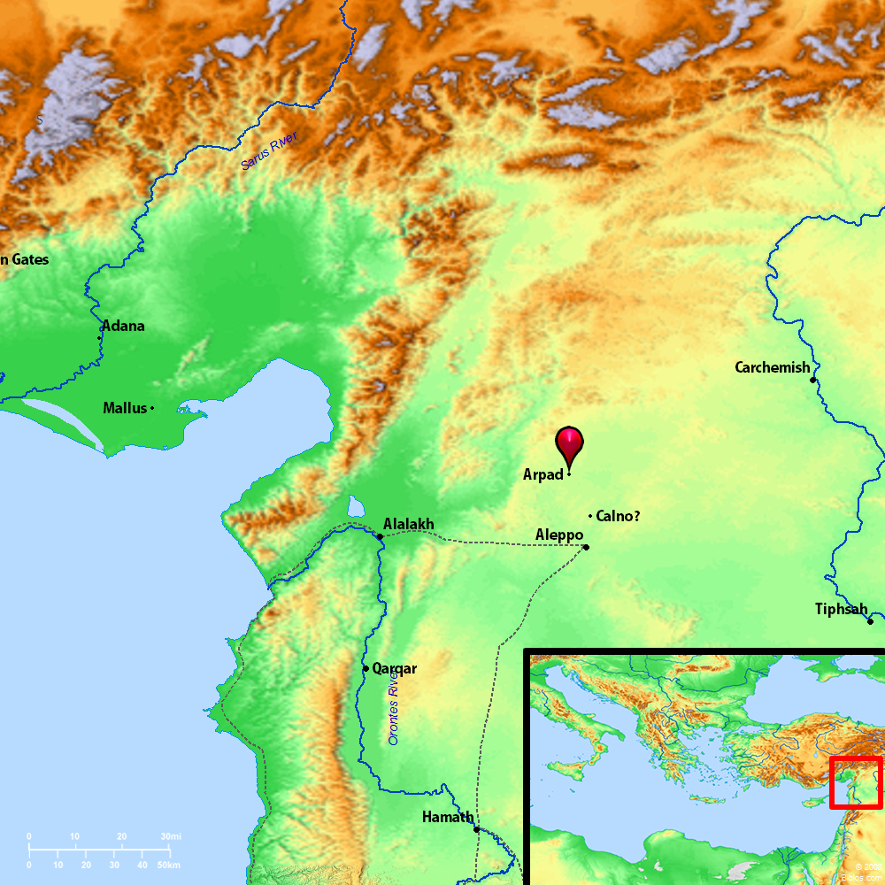
Hamath and Arpad
https://bibleatlas.org/full/arpad.htmhttps://bibleatlas.org/full/arpad.htm

Slide 19
^{36:19} Where are the gods of Hamath and Arpad? Where are the gods of Sepharvaim? Indeed, did any gods rescue Samaria from my power?
The location of “Sepharvaim” is presently unknown.
Some scholars believe it to have been located between Hamath and Damascus.
In any case, the point is clear: If the gods of these great places could not save their cities, how could the LORD save Jerusalem and Judah?
It is interesting to note that the Assyrians apparently did not think “Samaria” (i.e. the Northern Kingdom) worshiped the same God as Jerusalem did.
Otherwise, it’s hard to imagine that the chief adviser would have missed an opportunity to point out that the LORD had not been able to save Samaria, so why Jerusalem?
The people of Northern Israel may have told themselves they were worshiping the LORD, but their neighbors knew better.
Oswalt, John N.. The Book of Isaiah, Chapters 1–39 (The NIC on the OT) (pp. 641-642).

Slide 20
^{36:20} Who among all the gods of these lands have rescued their lands from my power? So how can the LORD rescue Jerusalem from my power?’”
The argument was clear.
The other gods had not succeeded, and there was no reason to suppose the LORD would prove any different.
This was the blasphemy that Isaiah had earlier known was in the heart of the Assyrians when he wrote:
[Assyria says:] “I overpowered kingdoms ruled by idols, whose carved images were more impressive than Jerusalem’s or Samaria’s. As I have done to Samaria and its idols, so I will do to Jerusalem and its idols.” But when the Lord finishes judging Mount Zion and Jerusalem, then he will punish the king of Assyria for what he has proudly planned and for the arrogant attitude he displays. (Isaiah 10:10-12)
Blinded by their own power the Assyrians were unable to recognize that the LORD was at work determining the destiny of nations and providing deliverance for his people.
Mackay, John L. – A Study Commentary on Isaiah Volume I: Chapters 1-39 (p. 720)

Slide 21
Next Time
I plan to look at the reactions to the Assyrian ultimatum talked about in Isaiah 36:21-37:7.

Slide 22
Class Discussion Time
https://www.weareteachers.com/moving-beyond-classroom-discussions/

Slide 23
Class Discussion Time
In our present day, we are not facing the threat of a military attack like the one faced by the people of Jerusalem (though that could change sometime in the near future).
But we do face daily attacks in our culture, where our trust in the LORD is mocked, and we are pressured to “surrender” to the ungodly thinking that is so common in our age.
Do you sometimes feel like those people sitting on the walls of Jerusalem must have felt as you listen to the daily barrage in mainstream news and/or on social media where historic Christian teaching is reviled and characterized as bigoted hate-speech?

