Slide 1
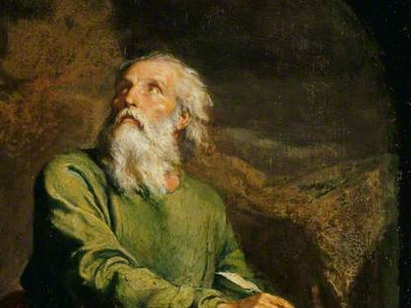
Highlights From the Book of Isaiah
To Download this lesson go to:
http://www.purifiedbyfaith.com/Isaiah/Isaiah.htm
https://www.wikiart.org/en/ernest-meissonier/isaiah

Slide 2
Outline of the Book of Isaiah
Isaiah’s Warning of Judgment on Israel (1-39)
Judgement and Hope for Jerusalem (1-12)
Judgement and Hope for the Nations (13-27)
True Deliverance Is Found, Not in Egypt, But in the Lord (28-35)
The Lessons of History (36-39)
The Deliverance of Jerusalem from Assyria (36-37)
Hezekiah’s Illness and Recovery (38)
A Visit From the Envoys of Babylon (39)
The Promise of Future Hope in the New Jerusalem (40-66)

Slide 3
Hezekiah’s Healing (38:21-22)
^{38:21} (Isaiah ordered, “Let them take a fig cake and apply it to the ulcerated sore and he will get well.” ²² Hezekiah said, “What is the confirming sign that I will go up to the Lord’s temple?”)

Slide 4
^{38:21} Isaiah ordered, “Let them take a fig cake and apply it to the ulcerated sore and he will get well.”
These concluding verses are added after Hezekiah’s “Psalm” (38:9-20) to round off the entire narrative, and to bring out in summary fashion the key points of the LORD’s intervention.
We are told here that Isaiah prescribed a “fig cake” as a remedy for Hezekiah’s ailment.
The LORD used the “fig cake” and the services of “them” (probably Hezekiah’s medical attendants) to bring about his cure.
Mackay, John L. – A Study Commentary on Isaiah Volume I: Chapters 1-39 (pp. 817–818)

Slide 5
^{38:21} Isaiah ordered, “Let them take a fig cake and apply it to the ulcerated sore and he will get well.”
By itself, it is doubtful that applying a “fig cake” to the “ulcerated sore ” would have brought about the king’s recovery.
The effectiveness of this remedy came from the divine power that was at work as the remedy was applied.
Certainly Hezekiah’s illness was serious.
In the Old Testament an “ulcerated sore ” (or “boil” or “ulcer” – cf. Exod 9:9-11; Deut 28:27, 35; Job 2:7) is often seen as an outward symptom of a life-threatening disease.
Mackay, John L. – A Study Commentary on Isaiah Volume I: Chapters 1-39 (pp. 817–818)

Slide 6
^{38:22} Hezekiah said, “What is the confirming sign that I will go up to the Lord’s temple?”
Hezekiah’s question here is apparently a question he asked concerning his healing.
No doubt, he asked this question in response to the promise of Isaiah (recorded in 2 Kings 20:5):
This is what the Lord God of your ancestor David has said: “I have heard your prayer; I have seen your tears. Look, I will heal you. The day after tomorrow you will go up to the Lord’s temple.
The question was not evidence of a lack of faith on the part of Hezekiah, but the opposite.
Having heard the promise, Hezekiah asks what sign the LORD will provide to confirm that the promise will be fulfilled.
Young, Edward J. – The Book of Isaiah – Volume 2; Eerdmans; p. 530

Slide 7
Outline of the Book of Isaiah
Isaiah’s Warning of Judgment on Israel (1-39)
Judgement and Hope for Jerusalem (1-12)
Judgement and Hope for the Nations (13-27)
True Deliverance Is Found, Not in Egypt, But in the Lord (28-35)
The Lessons of History (36-39)
The Deliverance of Jerusalem from Assyria (36-37)
Hezekiah’s Illness and Recovery (38)
A Visit From the Envoys of Babylon (39)
The Promise of Future Hope in the New Jerusalem (40-66)

Slide 8
A Visit From the Envoys of Babylon (39:1-8)
In this brief chapter, the LORD reveals through Isaiah that an incident in Hezekiah’s reign ominously foreshadows a misfortune that will come upon Judah in years to come.
The LORD enables Isaiah to look forward to a time when the threat to the existence of Judah will come not from Assyria, but from Babylon.
In the remaining sections of his prophecy, Isaiah speaks and writes with an awareness of that threat and an anticipation of the LORD’s deliverance of his people from Babylonian domination.
Mackay, John L. – A Study Commentary on Isaiah Volume I: Chapters 1-39 (pp. 820–822)

Slide 9
A Visit From the Envoys of Babylon (39:1-8)
As I pointed out in an earlier lesson, the events of chapters 36-39 are not in chronological order.
I suspect that one of the reasons Isaiah did this was so that the incident recorded in chapter 39 could serve as a bridge into the remaining revelation given to him in chapters 40-66.
For this lesson I have divided chapter 39 into three parts:
Reception of the Envoys (39:1-2)
Prophetic Interrogation (39:3-4)
Prophetic Denunciation (39:5-8)
Mackay, John L. – A Study Commentary on Isaiah Volume I: Chapters 1-39 (pp. 820–822)

Slide 10
Reception of the Envoys (39:1-2)
^{39:1} At that time Merodach Baladan son of Baladan, king of Babylon, sent letters and a gift to Hezekiah, for he heard that Hezekiah had been ill and had recovered. ² Hezekiah welcomed them and showed them his storehouse with its silver, gold, spices, and high-quality olive oil, as well as his whole armory and everything in his treasuries. Hezekiah showed them everything in his palace and in his whole kingdom.

Slide 11
^{39:1} At that time Merodach Baladan son of Baladan, king of Babylon, sent letters and a gift to Hezekiah, for he heard that Hezekiah had been ill and had recovered.
“At that time ” indicates that what takes place here is a result of Hezekiah’s illness and healing described in the previous chapter.
The supposed reason for the diplomatic mission sent by the “king of Babylon” is to express consolation and congratulations to Hezekiah for his recovery from his illness.
The author of 2 Chronicles mentions that the Babylonians were also interested in the prophetic sign given for Hezekiah’s healing in which the movement of the sun’s shadow had been reversed (2 Chr 32:31).
Mackay, John L. – A Study Commentary on Isaiah Volume I: Chapters 1-39 (pp. 822–823)

Slide 12
^{39:1} At that time Merodach Baladan son of Baladan, king of Babylon, sent letters and a gift to Hezekiah, for he heard that Hezekiah had been ill and had recovered.
There can be little doubt that both of these reasons given for the visit were largely cover stories, and “Merodach Baladan, king of Babylon” was in fact encouraging, if not bribing, Hezekiah to rebel against Assyria so as to relieve pressure on himself.
It is probable that the small diplomatic entourage entered Judah from the south, having travelled from Babylon along the caravan routes through the desert rather than risk coming through Assyrian-controlled territory.
Mackay, John L. – A Study Commentary on Isaiah Volume I: Chapters 1-39 (pp. 822–823)

Slide 13
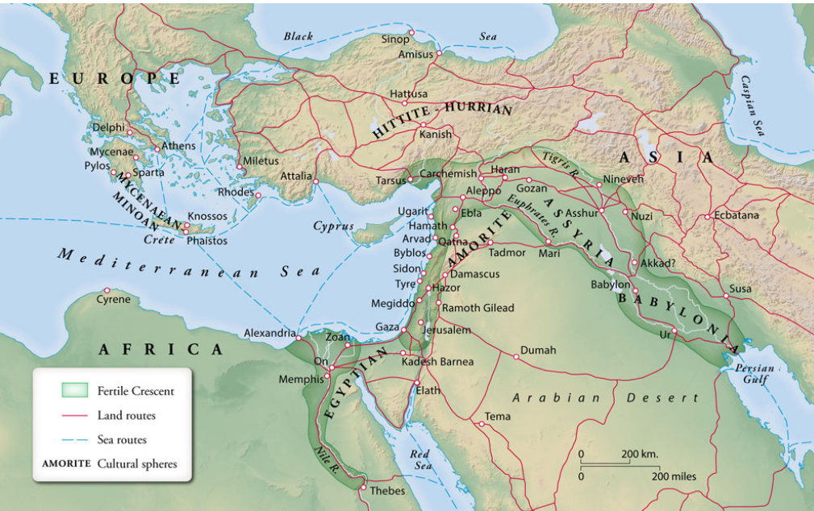
The Ancient Near East
Zondervan Atlas of the Bible

Slide 14
^{39:2} Hezekiah welcomed them and showed them his storehouse with its silver, gold, spices, and high-quality olive oil, as well as his whole armory and everything in his treasuries. Hezekiah showed them everything in his palace and in his whole kingdom.
That Hezekiah “welcomed them” is completely understandable from a human point of view.
For little Judah to get favorable attention from Babylon was an opportunity that didn’t come along every day.
Furthermore, Hezekiah would have been very glad to have the support of Babylon as he contemplated the impending arrival of the Assyrian army.
However, this kind of reliance upon, and delight in, human power and glory is exactly what the first half of the book of Isaiah is warning against:
Tell those who panic, “Be strong! Do not fear! Look, your God comes to avenge; with divine retribution he comes to deliver you. (Isaiah 35:4)
Oswalt, John N. The Book of Isaiah, Chapters 1–39 (The NIC on the OT) (pp. 694-695). Eerdmans.

Slide 15
^{39:2} Hezekiah welcomed them and showed them his storehouse with its silver, gold, spices, and high-quality olive oil, as well as his whole armory and everything in his treasuries. Hezekiah showed them everything in his palace and in his whole kingdom.
This is not to say that Hezekiah had to turn the Babylonian envoys out on the street, but it is instructive to compare this with how Jesus treated the flattering statements by Nicodemus (John 3) and the man called “the rich young ruler” (Mark 10).
Jesus was not at impressed by their flattery – instead, he plunged directly past the flattery to their real reasons for coming.
The fact that Hezekiah “showed them his storehouse …and everything in his treasuries.” indicates that the visit was not merely a courtesy call, but was in fact related to diplomatic business.
Oswalt, John N. The Book of Isaiah, Chapters 1–39 (The NIC on the OT) (pp. 694-695). Eerdmans.

Slide 16
^{39:2} Hezekiah welcomed them and showed them his storehouse with its silver, gold, spices, and high-quality olive oil, as well as his whole armory and everything in his treasuries. Hezekiah showed them everything in his palace and in his whole kingdom.
Here was a ready-made opportunity for Hezekiah to glorify God before the pagan Babylonians, to tell of his greatness and of his grace.
Instead, he succumbed to the temptation to glorify himself and to prove to the Babylonians that he was a worthy partner for any sort of coalition they might have in mind.
There is no indication that the Babylonians were even interested in such an alliance.
Much more likely they simply wished to encourage Hezekiah to stand up to the Assyrians without making any commitment on their part to support him.
Oswalt, John N. The Book of Isaiah, Chapters 1–39 (The NIC on the OT) (pp. 694-695). Eerdmans.

Slide 17
^{39:2} Hezekiah welcomed them and showed them his storehouse with its silver, gold, spices, and high-quality olive oil, as well as his whole armory and everything in his treasuries. Hezekiah showed them everything in his palace and in his whole kingdom.
Here we see Hezekiah scuttling about showing off all his wealth before the politely approving gaze of the Babylonians, who have in fact seen wealth many times the value of the Judean’s little horde in their own homeland. ¹
It was a foolish move, and some of this treasure would soon be sent to the Assyrians as a tribute in hopes of keeping them from taking military action against them (2 Kings 18:13-16). ²
¹ Oswalt, John N. The Book of Isaiah, Chapters 1–39 (The NIC on the OT) (pp. 694-695).
² Young, Edward J. – The Book of Isaiah – Volume 2; Eerdmans; p. 534

Slide 18
Prophetic Interrogation (39:3-4)
^{39:3} Isaiah the prophet visited King Hezekiah and asked him, “What did these men say? Where do they come from?” Hezekiah replied, “They come from the distant land of Babylon.” ⁴ Isaiah asked, “What have they seen in your palace?” Hezekiah replied, “They have seen everything in my palace. I showed them everything in my treasuries.”

Slide 19
^{39:3} Isaiah the prophet visited King Hezekiah and asked him, “What did these men say? Where do they come from?” Hezekiah replied, “They come from the distant land of Babylon.”
As is often the case with other kings, the prophet arrived uninvited (2 Sam 12: 1; 1 Kings 13:1; 18:16-17; etc.).
An Israelite king always had to operate with the knowledge that, at any point, a prophet who belonged to neither the royal nor the priestly establishments might stand up to rebuke him in the name of One who calls all human beings to account – whether they be a king or a commoner.
So Isaiah appears here.
Regardless of what the Babylonians may have thought of Hezekiah’s performance, the real issue is, what did God think of it?
Oswalt, John N. The Book of Isaiah, Chapters 1–39 (The NIC on the OT) (pp. 694-695). Eerdmans.

Slide 20
^{39:3} Isaiah the prophet visited King Hezekiah and asked him, “What did these men say? Where do they come from?” Hezekiah replied, “They come from the distant land of Babylon.”
Isaiah’s questions have an ominous simplicity about them.
He makes no pronouncements. Instead he invites the king to judge himself with his own mouth.
Interestingly, Hezekiah does not answer the question, “What did these men say?”
Evidently Hezekiah knows enough of Isaiah’s (and God’s) position on foreign alliances to know that he’s not going to win any points by telling Isaiah what was actually said.
His only hope is to make it appear like he was simply being hospitable to travelers from a famous and distant land.
Oswalt, John N. The Book of Isaiah, Chapters 1–39 (The NIC on the OT) (pp. 694-695). Eerdmans.

Slide 21
^{39:4} Isaiah asked, “What have they seen in your palace?” Hezekiah replied, “They have seen everything in my palace. I showed them everything in my treasuries.”
But Isaiah refuses to be taken in by that ploy.
He does not respond to Hezekiah’s answer, but moves ahead to the more ominous question: “What have they seen in your palace?”
Now Hezekiah’s answer seems to have something of a defiant ring. “Everything,” he says, “I showed them everything in my treasuries.”
It is as though he knows he cannot win and has decided therefore to just be brazen about it.
None of this is to deny the other biblical statements that Hezekiah was a generally good and godly king, but it is to point out that he was, in fact, not infallible.
He was not the Messiah, and like the nation he represented, he needed to discover that trust is a way of life, not a magic technique to be used only in crises.
Oswalt, John N. The Book of Isaiah, Chapters 1–39 (The NIC on the OT) (pp. 695-696). Eerdmans.

Slide 22
Prophetic Denunciation (39:5-8)
^{39:5} Isaiah said to Hezekiah, “Listen to the message of the LORD of Heaven’s Armies: ⁶ ‘Look, a time is coming when everything in your palace and the things your ancestors have accumulated to this day will be carried away to Babylon; nothing will be left,’ says the LORD. ⁷ ‘Some of your very own descendants whom you father will be taken away and will be made eunuchs in the palace of the king of Babylon.’” ⁸ Hezekiah said to Isaiah, “The LORD’s message that you have announced is appropriate.” Then he thought, “For there will be peace and stability during my lifetime.”

Slide 23
^{39:5} Isaiah said to Hezekiah, “Listen to the message of the LORD of Heaven’s Armies: ⁶ ‘Look, a time is coming when everything in your palace and the things your ancestors have accumulated to this day will be carried away to Babylon; nothing will be left,’ says the LORD.
Having stirred up the king’s awareness of what he’s done, Isaiah now proceeds to pronounce God’s rebuke on his behavior.
He reminds the king, who has allowed himself to be distracted by the forces of world politics, that Isaiah speaks in the name of “the LORD of Heaven’s Armies”, the one who holds universal sway and whose purposes cannot be overthrown.
He alone is able to predict authoritatively what will happen in days to come.
Mackay, John L. – A Study Commentary on Isaiah Volume I: Chapters 1-39 (pp. 826–827)

Slide 24
^{39:5} Isaiah said to Hezekiah, “Listen to the message of the LORD of Heaven’s Armies: ⁶ ‘Look, a time is coming when everything in your palace and the things your ancestors have accumulated to this day will be carried away to Babylon; nothing will be left,’ says the LORD.
Since Hezekiah has been so enamored with what Babylon thinks of him and has given it first place in his thinking, it’s fitting for him to know that “everything in [his] palace” will be “carried away to Babylon”.
Mention of “your ancestors” shows that again it is the future of the Davidic dynasty that is at stake (cf. 7:13).
The fact that the plunder is carried off to Babylon rather than Assyria, demonstrates that this prediction did not arise from human insight, but from the One who knows how the alliances of today will become the hostilities of tomorrow.
Just as Ahaz’s reliance on Assyria brought disaster from that power, so Hezekiah’s attitude towards Babylon would lead to disaster from that nation.
Mackay, John L. – A Study Commentary on Isaiah Volume I: Chapters 1-39 (pp. 826–827)

Slide 25
^{39:7} ‘Some of your very own descendants whom you father will be taken away and will be made eunuchs in the palace of the king of Babylon.’”
Not only will Hezekiah’s treasure belong to the Babylonians but so also will some of his descendants.
And they will not be mere captives, but they will be made the king’s eunuchs, men who have been emasculated so that they no longer have thoughts of their own line and authority but are content to do their master’s bidding.
How the house of David will have fallen in that day, because of decades of being blinded by human glory and a continued refusal to trust in God.
Oswalt, John N. The Book of Isaiah, Chapters 1–39 (The NIC on the OT) (pp. 696-697). Eerdmans.

Slide 26
^{39:8} Hezekiah said to Isaiah, “The LORD’s message that you have announced is appropriate.” Then he thought, “For there will be peace and stability during my lifetime.”
Commentators are divided over the proper interpretation of this verse.
Does it portray Hezekiah in a favorable or an unfavorable light?
Many commentataries take it as a positive statement.
Calvin, for example, understands Hezekiah as being submissive and repentant when he confesses that “The LORD’s message … is appropriate”.
But to me that view seems rather questionable in light of this statement: “For there will be peace and stability during my lifetime.”
Oswalt, John N. The Book of Isaiah, Chapters 1–39 (The NIC on the OT) (pp. 696-697). Eerdmans.

Slide 27
^{39:8} Hezekiah said to Isaiah, “The LORD’s message that you have announced is appropriate.” Then he thought, “For there will be peace and stability during my lifetime.”
No doubt, Hezekiah is humbly thankful for God’s grace in not bringing the deserved punishment upon him immediately.
But it’s hard to avoid the implication that the real reason for his saying that God’s word is “appropriate” is his relief that he personally is not going to be destroyed.
The fact that his descendants are to be consumed doesn’t seem to bother him.
Furthermore, his reaction was quite different when his own demise was imminent (38:3).
All this leads me to believe that the picture here is essentially negative.
Oswalt, John N. The Book of Isaiah, Chapters 1–39 (The NIC on the OT) (pp. 696-697). Eerdmans.

Slide 28
^{39:8} Hezekiah said to Isaiah, “The LORD’s message that you have announced is appropriate.” Then he thought, “For there will be peace and stability during my lifetime.”
Hezekiah is not the promised “child” of Isaiah 9; he is not infallible.
Judah’s hope rests in One who is yet to come.
To be sure, Hezekiah was, at times, used to demonstrate that God can be trusted.
But he is also the demonstration that we can’t trust put our ultimate trust in good human beings any more than we can in bad ones.
Our trust must ultimately be in God alone.
Oswalt, John N. The Book of Isaiah, Chapters 1–39 (The NIC on the OT) (pp. 696-697). Eerdmans.

Slide 29
Next Time
I plan to look at “God’s Promised Deliverance” in Isaiah 40:1-11.

Slide 30
Class Discussion Time
https://www.weareteachers.com/moving-beyond-classroom-discussions/

Slide 31
Class Discussion Time
In our text today, we see Hezekiah being caught up in wanting to impress those people in his day who he views as being influential and important and in the process he shows a lack of trust in God.
Can you think of an example of where you (or perhaps someone in your circle of Christian friends) faced a similar temptation in your Christian life? What was the outcome?
When Isaiah confronts Hezekiah about what he has done, Hezekiah’s initial response was to put a positive spin on what he had done rather than own up to the fact that what he had done was displeasing to the LORD.
Do you think the “spin” that Hezekiah gave Isaiah was just an attempt to deceive, or is it possible that what Hezekiah told Isaiah is what he had been telling himself, thereby making it easier to take the wrong course of action that he did? Are there any lessons that we can learn from this?

