Slide 1
Highlights From the Book of Isaiah
To Download this lesson go to:
http://www.purifiedbyfaith.com/Isaiah/Isaiah.htm
https://www.wikiart.org/en/ernest-meissonier/isaiah

Slide 2
The Future Glory of Zion (Isaiah 54:11-17)
The poetic imagery now shifts from a restored wife that we looked at last week in Isaiah 54:1-10 to a rebuilt city.
While they are two completely different word pictures, both of these metaphors are intended to illustrate the same idea.
Isaiah is using these two images to give us a picture of the glorious future that is promised to the people of God.
However bad their present condition might be, the future that lies ahead of them is incredibly bright and secure.
Oswalt, John N.. The Book of Isaiah, Chapters 40–66 (The NIC on the OT) (p. 426). Eerdmans.

Slide 3
The Future Glory of Zion (Isaiah 54:11-17)
It also anticipates the description of the rebuilt city of the LORD (Isaiah 60:10–14) and forms the basis for the description of the new Jerusalem in Revelation 21:10–21.
The imagery goes far beyond anything that took place in the physical rebuilding of Jerusalem after the exile.
In fact, Jerusalem is not specifically named in this text because the focus is on the splendor of the provision made for the people of God and their spiritual exaltation in the eternal city.
All of this has been has planned and brought about by the LORD through the Servant.
Mackay, John L. – A Study Commentary on Isaiah Volume 2: Chapters 40-66 – p. 380.

Slide 4
The Future Glory of Zion (Isaiah 54:11-17)
It is important to keep in mind that the language being used here is metaphorical.
Not only the extravagant language, but also the recurring emphasis on the condition of the people show that the prophet is not talking about the actual rebuilding of the physical structures in Jerusalem but about the restoration of the people in his care.
The thought in this passage moves from
The Beauty of the City (54:11-12)
The Blessedness of the City’s Inhabitants (54:13-14)
The Security and Stability of the City (54:14-17)
Oswalt, John N.. The Book of Isaiah, Chapters 40–66 (The NIC on the OT) (p. 426). Eerdmans.

Slide 5
The Beauty of the City (54:11–12)
^{54:11} “O afflicted one, [storm-tossed], and unconsoled! Look, I am about to set your stones in antimony and lay your foundation with lapis lazuli. ¹² I will make your pinnacles out of gems, your gates out of beryl, and your outer wall out of beautiful stones.

Slide 6
^{54:11} O afflicted one, [storm-tossed], and unconsoled! Look, I am about to set your stones in antimony and lay your foundation with lapis lazuli.
This segment begins with a description of the present wretched condition of the people and moves immediately to paint a contrast with that condition in glowing colors.
The people are currently said to be poverty stricken (“afflicted”), without stability of any sort (“storm-tossed”), and they are in despair (“unconsoled”).
On the one hand, this threefold description speaks of God’s intimate awareness of the feelings of his people and of his compassion for them.
He does not lightly dismiss our brokenness and the emotions surrounding it, even when he tells us that those conditions need not be permanent.
On the other hand, this description tells us that the glorious hopes of the people of God are not given in ignorance of the realities of the present situation.
Oswalt, John N.. The Book of Isaiah, Chapters 40–66 (The NIC on the OT) (pp. 426-427).

Slide 7
^{54:11} O afflicted one, [storm-tossed], and unconsoled! Look, I am about to set your stones in antimony and lay your foundation with lapis lazuli.
Here the creation of a people who are blessed in every respect, is described in terms of the building of a glorious city.
The imagery is clearly designed to convey feelings of richness, abundance, completeness, and glorious variety.
Although some of the terminology is uncertain to us today, the overall meaning is clear.
“I am about to set your stones in antimony” probably speaks of the black mortar that was used to set off colored paving stones.
Underneath these stones, God lays a foundation of “lapis lazuli”, a blue stone that was highly prized for decoration all over the ancient world.
Oswalt, John N.. The Book of Isaiah, Chapters 40–66 (The NIC on the OT) (pp. 426-427).

Slide 8
^{54:12} I will make your pinnacles out of gems, your gates out of beryl, and your outer wall out of beautiful stones.
From the blue foundations the poet’s mind soars to the pointed “pinnacles” glowing in the sun, and they seem to be made of rosy jasper (some translations say “rubies”).
Then his eye drops to gates made of “beryl” (crystal or sparkling jewels) and “outer wall ” of precious stones.
The contrast with the opening description in v. 11 could hardly be more stunning:
In place of poverty there is wealth from top to bottom, inside and out.
In place of the insecurity of a “storm-tossed” ship, there is the stability of a God-founded city.
In place of despair, there is the confidence of endless resources.
The hope of God’s people is not in her own inner resources – it is in God, the God who is both infinitely stronger and infinitely more trustworthy than any humanly made god the world has ever known.
Oswalt, John N.. The Book of Isaiah, Chapters 40–66 (The NIC on the OT) (pp. 426-427).

Slide 9
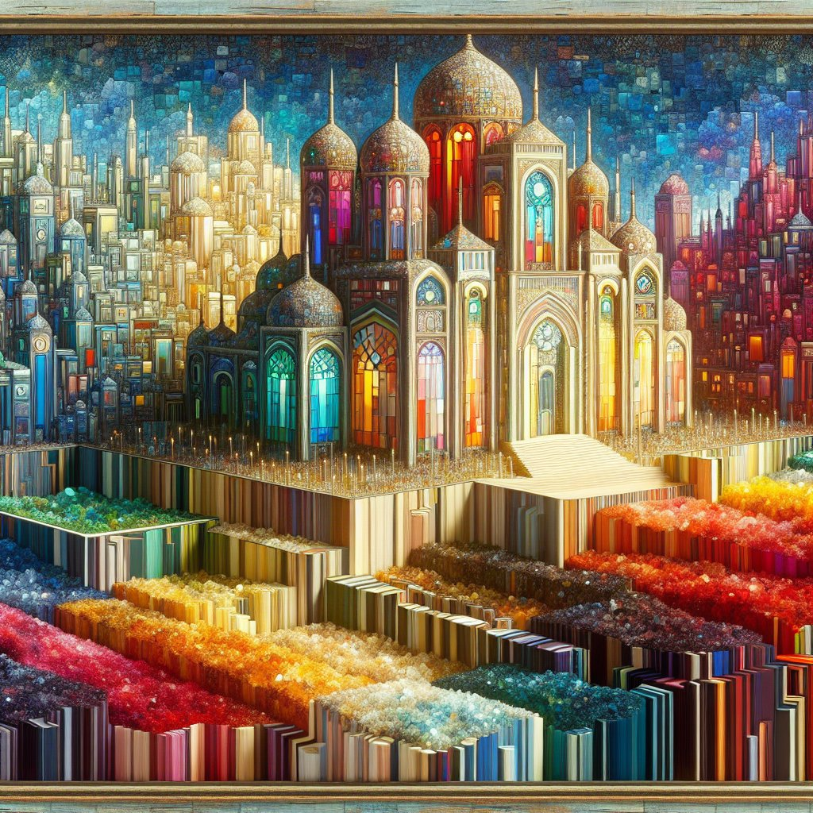
Artist’s Conception of the City of Isaiah 54:11-12
https://bible.art/gallery/isaiah-54:12

Slide 10
The Blessedness of the City’s Inhabitants (54:13-14)
^{54:13} All your children will be followers of the LORD, [and great will be the peace of your sons.]. ¹⁴ You will be reestablished when I vindicate you. You will not experience oppression; indeed, you will not be afraid. You will not be terrified, for nothing frightening will come near you.

Slide 11
^{54:13} All your children will be followers of the LORD, [and great will be the peace of your sons.].
The LORD’s achievement culminates not in the economic or political glory of the city, but in the spiritual reformation of those who had been rebellious children (cf. 1:2).
Now “All your children will be followers of the LORD”), and in this they will be like the Servant (“he makes me alert so I can listen attentively as disciples do” Isaiah 50:4).
God will instruct them in his ways, and they will live according to his stated will:
I will put my law within them and write it on their hearts and minds. I will be their God and they will be my people. (Jer 31:33)
It is written in the prophets, “And they will all be taught by God.” (John 6:45).
Through their knowledge and practice of the divine word those who have become citizens of the heavenly city will personally enjoy the “great … peace” purchased for them by the Servant.
Anything that might mar their fellowship with one another and/or with the LORD himself will be absent.
Mackay, John L. – A Study Commentary on Isaiah Volume 2: Chapters 40-66 – p. 382.

Slide 12
^{54:14} You will be reestablished when I vindicate you. You will not experience oppression; indeed, you will not be afraid. You will not be terrified, for nothing frightening will come near you.
The LORD now turns from setting out the future glory of Zion to describing how he will protect his people from all adversaries.
“You will not experience oppression” vividly describes what is guaranteed.
“Oppression” is the internal disruption of social harmony through the misuse of power.
This will not happen in that city, because God’s presence with them will ensure the removal of every source of disturbance.
“terrified” here it is used of extreme emotional agitation which undermines an individual’s mental and social health.
All that might cause such an experience in the life of the city – whether from within or without – will be banished.
Mackay, John L. – A Study Commentary on Isaiah Volume 2: Chapters 40-66 – p. 384.

Slide 13
The Security and Stability of the City (54:15-17)
^{54:15} If anyone dares to challenge you, it will not be my doing! Whoever tries to challenge you will be defeated. ¹⁶ Look, I create the craftsman, who fans the coals into a fire and forges a weapon. I create the destroyer so he might devastate. ¹⁷ No weapon forged to be used against you will succeed; you will refute everyone who tries to accuse you. This is what the LORD will do for his servants – I will vindicate them,” says the LORD.

Slide 14
^{54:15} If anyone dares to challenge you, it will not be my doing! Whoever tries to challenge you will be defeated.
The reason why terror will not come to the people now is the very same reason why it came to them in the first place: the lordship of God in history.
Just as the Assyrians did not come as an accident of history, neither will the survival of the people of Israel with their faith and identity strengthened be an accident.
Any trouble that comes to them, will not be a result of God’s judgment.
And yet, we still live in a fallen world where trouble comes to all people.
Oswalt, John N.. The Book of Isaiah, Chapters 40–66 (The NIC on the OT) (pp. 429-430).

Slide 15
^{54:15} If anyone dares to challenge you, it will not be my doing! Whoever tries to challenge you will be defeated.
But those who decide to make trouble for the people of God better think twice!
God does not promise us that trouble will not come.
Indeed, Jesus promised his disciples just the opposite (Matt 10:25), and both Peter (1 Pet 4:12) and Paul (Rom 8:17) echoed that teaching.
But he does promise his presence in the trouble, and he promises us that he will not allow it to tear us from his embrace.
Those who make the trouble have another kind of assurance: they will fall and the fall will be great.
Oswalt, John N.. The Book of Isaiah, Chapters 40–66 (The NIC on the OT) (pp. 429-430).

Slide 16
^{54:16} Look, I create the craftsman, who fans the coals into a fire and forges a weapon. I create the destroyer so he might devastate.
Since God is the Creator who creates not only the warrior (“the destroyer”) but the weapon in his hand, and not only the weapon but even the blacksmith who made the weapon.
We should not think that anything can come to us that will contradict God’s purposes for us.
Isaiah is saying that no part of the universe is exempt from the purposes of God.
The phrase “I create ”, used twice in this verse, drive this point home.
If armies are in the world, they are here because of the creative purposes of God.
Things do not happen simply because they are “fated” to do so by some mindless cosmos, but all things will serve the purposes of a Creator who is himself our Redeemer.
Oswalt, John N.. The Book of Isaiah, Chapters 40–66 (The NIC on the OT) (pp. 429-430).

Slide 17
^{54:17} No weapon forged to be used against you will succeed; you will refute everyone who tries to accuse you. This is what the LORD will do for his servants – I will vindicate them,” says the LORD.
On the basis of Yahweh’s sovereignty as Creator, he assures Zion that “no weapon”, no matter how sophisticated or awe-inspiring, will be able to prosper against her.
Likewise, the verbal accusations of adversaries may seem plausible, but the community of God’s people will be able to “refute” them, proving how false are the accusations of “everyone who tries to accuse you”.
In the NET Bible the second half of this verse reads “This is what the LORD will do for his servants – I will vindicate them, says the LORD.”
While this is a legitimate translation grammatically, I believe, given the context, a better translation would be: “This is the inheritance of the servants of the LORD, and their righteousness from me, says the LORD.”
Mackay, John L. – A Study Commentary on Isaiah Volume 2: Chapters 40-66 – pp. 385–386.

Slide 18
^{54:17} No weapon forged to be used against you will succeed; you will refute everyone who tries to accuse you. This is the inheritance of the servants of the LORD, and their righteousness from me, says the LORD.
The second half of the verse indicates that Israel’s “inheritance” is not merely assurance of survival, but also that peace that results from being established in “righteousness” as the Lord’s disciples in the city of God.
When we put the ideas that we have covered this morning in verses 11-17 together with the ideas that we covered last week in vv. 1-10 (since these two sections are conveying a similar idea using different analogies) we see that Israel’s “inheritance” also includes restoration as the bride of the Lord.
Oswalt, John N.. The Book of Isaiah, Chapters 40–66 (The NIC on the OT) (pp. 430-432).

Slide 19
^{54:17} No weapon forged to be used against you will succeed; you will refute everyone who tries to accuse you. This is the inheritance of the servants of the LORD, and their righteousness from me, says the LORD.
Everywhere else, the word “inheritance” is used in the Old Testament, it refers to the Israel’s inheritance of the land, and it would be quite appropriate to use it that way here if we were still talking about the return from Babylonian exile.
But we are talking about something very different in this context.
The “inheritance of the servants of the LORD” here is primarily expressed here in relational terms, and the relationship in view is a restored relationship with God.
Oswalt, John N.. The Book of Isaiah, Chapters 40–66 (The NIC on the OT) (pp. 430-432).

Slide 20
^{54:17} No weapon forged to be used against you will succeed; you will refute everyone who tries to accuse you. This is the inheritance of the servants of the LORD, and their righteousness from me, says the LORD.
The plural expression, “servants of the LORD”, points to a new development in the book of Isaiah.
From here on, for the remainder of the book, the word “servant” occurs only in the plural.
No longer is “the Servant” alone in enjoying divine favor.
He is joined by all those who have put their trust in him and enjoy the privileges which his saving work has procured for them.
This preeminently includes “righteousness”, a right standing before the LORD which constitutes them members of the new Israel and challenges them to live in accordance with the status which they now enjoy.
Mackay, John L. – A Study Commentary on Isaiah Volume 2: Chapters 40-66 – pp. 385–386.

Slide 21
Jesus’ Citation of Isaiah 54:13 in John 6:45

Slide 22
^{Isaiah 54:13} All your children shall be taught by the LORD, and great shall be the peace of your children. (ESV)
^{John 6:44} No one can come to me unless the Father who sent me draws him. And I will raise him up on the last day. ⁴⁵ It is written in the Prophets, “And they will all be taught by God.” Everyone who has heard and learned from the Father comes to me-- ⁴⁶ not that anyone has seen the Father except he who is from God; he has seen the Father. (ESV)

Slide 23
They will all be taught by God
Jesus cites Isaiah 54:13 (in John 6:45) in a discourse recorded in the Gospel of John commonly known as the Bread of Life Discourse (John 6:22-66).
This discourse takes place right after Jesus’ feeding of the five thousand.
After this miraculous event, Jesus, sensing that the people were “going to come and seize him by force to make him king withdrew again up the mountainside alone.” (John 6:15)
Eventually the people catch up with Jesus and he rebukes them because their motive for seeking him is all wrong.
Instead just looking to fill their bellies, they should believe in him as the One whom God has sent, the real food, which produces and sustains everlasting life.

Slide 24
They will all be taught by God
When Christ demanded faith in himself as the One sent by the Father, the Jews asked to see his credentials:
So they said to him, "Then what miraculous sign will you perform, so that we may see it and believe you? What will you do? Our ancestors ate the manna in the wilderness, just as it is written, ‘He gave them bread from heaven to eat.’ (John 6:30-31)
In other words, sure, Jesus had miraculously given them bread, but it was just regular earthly bread.
If Jesus wants to be greater than Moses, then he needs to give them bread from heaven like Moses did!

Slide 25
They will all be taught by God
Jesus then annihilates their comparison:
I tell you the solemn truth, it is not Moses who has given you the bread from heaven, but my Father is giving you the true bread from heaven. For the bread of God is the one who comes down from heaven and gives life to the world. (John 6:32-33)
In other words:
Moses, as God’s agent, merely gave directions to the people as to how to collect the manna – it was the Father in heaven who actually provided the manna.
Even if Moses was the one who gave the manna, he did not give the real bread out of heaven.
The manna provided through Moses was only a picture that prefigured the real bread from heaven which God has now provided in Jesus.
The manna only provided temporary nourishment – Jesus as the true bread from heaven provides eternal life.

Slide 26
They will all be taught by God
Jesus further explains: “I am the bread of life. The one who comes to me will never go hungry, and the one who believes in me will never be thirsty. (John 6:35)
In other words, Jesus is the one who both imparts and sustains life.
It is through faith, and through intimate union with him, receiving him spiritually as physical bread is taken in physically, that man attains to everlasting life.

Slide 27
They will all be taught by God
Skipping down to verse 41 we read:
Then the Jews who were hostile to Jesus began complaining about him because he said, “I am the bread that came down from heaven,” and they said, “Isn't this Jesus the son of Joseph, whose father and mother we know? How can he now say, ‘I have come down from heaven’?” (John 6:41-42)
They got the point: Jesus is saying here that his birth was unlike like the birth of any other human being.
The inference is clear, he was born of a virgin and never had a human father (in the ordinary sense of the term) – he came down out of heaven!
These hostile Jews regard this as outright blasphemy on Jesus’ part.
They’re thinking: “We have known him since the days of his childhood; his father, his mother, his family. Yet now that he is grown up, look what happens! He makes extravagant claims. Does he actually expect us to believe them?”

Slide 28
They will all be taught by God
Jesus then responds:
Do not complain about me to one another. No one can come to me unless the Father who sent me draws him, and I will raise him up at the last day. (John 6:43-44)
Here Jesus tells them that, though they are culpable for their rejection of him, ultimately their rejection of him is a result of God’s sovereign decree.
The word “draw” here is a very strong term – it is often translated by a stronger term like “drag” or “haul”:
A net full of big fishes is “hauled” ashore (John 21:6, 11)
Paul and Silas are “dragged” before the authorities (Acts 16:19)
Paul is “dragged” out of the temple (Acts 21:30)
The rich “drag” the poor into court (James 2:6)
No can come to Christ unless the Father powerfully and irresistibly changes their heart and mind so that they are “drawn” to Christ.

Slide 29
They will all be taught by God
Jesus then gives Old Testament confirmation of this idea that people only come to him when they have been “drawn” by the Father, by citing Isaiah 54:13:
It is written in the Prophets [specifically in the prophet Isaiah], “And they will all be taught by God.” Everyone who has heard and learned from the Father comes to me—
The “hearing” and “learning” and being “taught” by God that was foreseen by Isaiah and other Old Testament prophets during the New Covenant era was a profound internal renovation of the minds of those whom the LORD would call to himself.

Slide 30
Next Time
I plan to begin looking at “An Invitation to Seek the LORD” (Isaiah 55:1-13)

Slide 31
Class Discussion Time
https://www.weareteachers.com/moving-beyond-classroom-discussions/

Slide 32
Class Discussion Time
We saw earlier in Isaiah 54:1ff that while the LORD was painting a glorious vision of the future he has in store for us as his people, he is, at the same time, fully aware of the troubles that we currently face in this fallen world and he has compassion on us and what we’re going through.
As the writer of Hebrews puts it: “For we do not have a high priest incapable of sympathizing with our weaknesses, but one who has been tempted in every way just as we are, yet without sin. ” (Heb 4:15)
Do you find this comforting? Do you sometimes forget this when you are going through a time of great difficulty?

Slide 33
Class Discussion Time
What do you think of Jesus’ statement that no one can come to him unless the Father first draws (drags, hauls) him?
Are you offended by this idea (like Jesus’ original audience was) or do you find this comforting? Why or why not?
Why might some people be offended by this idea?

