Slide 1


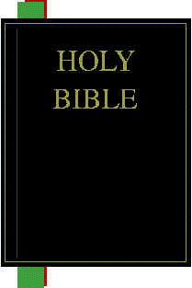

How God Provides Us With His Word
God
Revelation
Prophet
or Apostle
Illumination
Application
Inspiration
Christians
Today
Observation
and
Interpretation
Original
Manuscript
Manuscript
Copies
Preservation
Translation

Slide 2
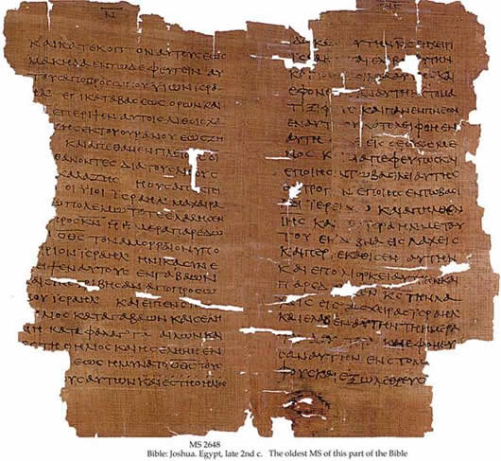
Preservation
How God Preserved the Original Text of Scripture Down through the Ages

Slide 3
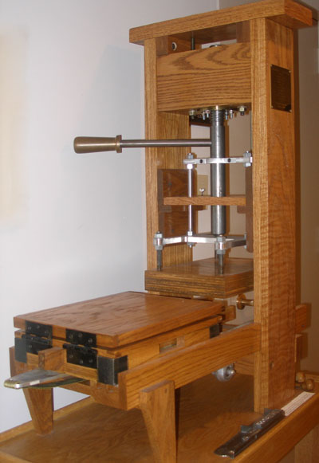
Preservation of Ancient Literature
Today - We are spoiled today by our ability to copy information – because of recent technology we are able to flawlessly copy large amounts of information with just a few mouse clicks.
Photocopiers - Even before computers were so readily available to the general public, “copy machines” (introduced by Xerox in the 1960s) made it easy to create a perfect copy of printed materials.
The Printing Press - The ability to make perfect copies of written information dates back to the invention of the printing press (1440 – the Gutenberg Press)

Slide 4
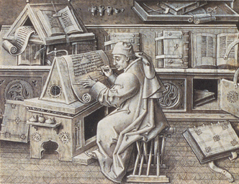
Preservation of Ancient Literature
Before the Printing Press - All copies of written information prior to 1440 involved handwritten copies on perishable materials which resulted in the loss of written information over time due to:
  Copying Mistakes
  The eventual destruction of the original manuscript (and perhaps subsequent copies)
Like most manuscripts written before 1440, the original manuscripts of the Bible composed by the OT prophets and the NT apostles are no longer available. All that we have today are handwritten copies of copies of the original.

Slide 5
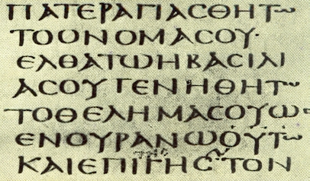
Preservation of Ancient Literature
BUT :
  Copying of the NT began early – first century Christians were eager to have the Word of God and there is evidence that they began to share the scriptures among themselves even while the apostles were still alive (cf. Col 4:16; 2 Tim 4:13, 2 Pet 3:16)
  Numerous good copies have survived – we have more copies and earlier copies of the scriptures than we do of any other ancient literature!

Slide 6
Number of Copies of the NT Compared to Other Ancient Literature*
“There is no body of ancient literature in the world which enjoys such a wealth of good textual attestation as the New Testament” (F.F. Bruce)
*Josh McDowell, The New Evidence that Demands a Verdict, 1999, pp. 37-38

Slide 7
Time Gap Between Original and Earliest Existing Copies*
“In no other case is the interval of time between the composition of the book and the date of the earliest extant manuscripts so short as in that of the New Testament”
(Fredric G. Kenyon, director and principle librarian of the British Museum, 1901)
*Josh McDowell, The New Evidence that Demands a Verdict, 1999, pp. 37-38

Slide 8
Preservation of Ancient Literature
We have at least a dozen manuscripts within the first 100 years after the writing of the NT; they represent a majority of the books of the NT and about 4/10th of the text.

Slide 9
Manuscripts Dated Within 100 Years of the Writing of the NT
Manuscript | Contents
P4/P64/P67 (all one manuscript) | Gospels
P32 | Pauline Epistles
P46 | Pauline Epistles
P52 | Gospels
P66 | Gospels
P75 | Gospels
P77 | Gospels
P87 | Pauline Epistles
P90 | Gospels
P98 | Revelation
P104 | Gospels
P108 | Gospels
P109 | Gospels
http://www.aomin.org/aoblog/index.php?itemid=3092

Slide 10
Preservation of Ancient Literature
We have more than 120 manuscripts within the first 300 years after the writing of the NT.
Another key fact that allows us to have great confidence that the New Testament manuscripts that we possess today accurately reflect the original inspired writings is that these documents have come to us through multiple lines of transmission.

Slide 11
Multiple Lines of Transmission
Original
Manuscript
Copies:

Slide 12
Bible Manuscripts That We Have Access To Today

Slide 13
Old Testament Manuscripts
Name | When Discovered | Estimated Age | Description
Principal Masoretic |  | 6th – 10th Century | Written by Jewish scribes in the 6th to 10th century who labored to preserve and transmit the text of the OT.
Samaritan Pentateuch | 1616 | 11th Century | A somewhat controversial set of manuscripts which differ in numerous places from the other Hebrew manuscripts. The Samaritans who accept the Pentateuch alone as canonical preserved these manuscripts.
Cairo Genizah Fragments | 1897 | 6th – 9th Century | Found in a storeroom of an old synagogue (built in 882 AD) in Old Cairo, Egypt. Consists of thousands of parchment fragments dated slightly before the Masoretic texts.
Nash Papyrus | 1902 | 2nd Century BC | Prior to the Dead Sea Scrolls was the oldest known manuscripts. Contains the ten commandments and the “Shema” (Deut. 6:4ff)
Dead Sea Scrolls | 1947 | 3rd Century BC to 1st Century AD | The oldest manuscripts known to date – found in caves near the Dead sea. Contains thousands of manuscript fragments – at least one from every OT book except Esther.
International Standard Bible Encyclopedia (ISBE), , Eerdmans, 1988, Text and MSS of the OT, pp.798-814

Slide 14
New Testament Manuscript Types
Name | Number of Manuscripts | Age | Description
Papyri | 80 | 2nd – 8th Century | Written in all capital letters on material made from the papyrus plant
Uncials (vellum) | 260 | 4th – 10th Century | Written in all capital letters on specially treated leather known as vellum. Vellum manuscripts tended to last longer than those made of papyri.
Minuscule | 2,700 | 9th – 15th Century | A form of handwriting more formal than regular cursive. Takes up less space and is faster to write than Uncial.
Lectionaries | 2,100 |  | Church reading books containing select portions of the Scriptures to be read on select days according to the Church calendar.
Versions (translations) |  |  | The NT was translated into other languages as early as the 2nd century. The most significant versions are the Latin, Syriac, and Coptic.
Patristic Quotations |  |  | The early church fathers cited the Bible so often that the text of the entire Greek NT could probably be recovered just from the quotations found in their writings!
ISBE, Text and MSS of the NT, pp. 814-821

Slide 15

Papyrus Plant

Slide 16
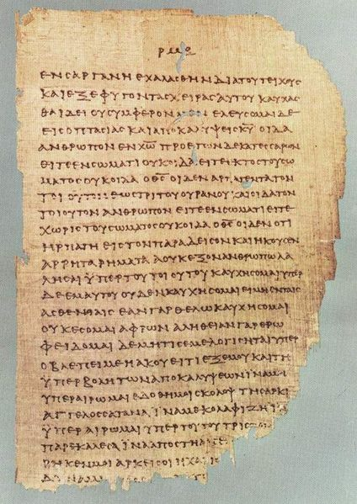
Papyrus Manuscript
One of 86 leaves from P⁴⁶ - a manuscript dated at 200 AD which contains most of the Pauline epistles.

Slide 17

Uncial (Vellum) Manuscript
א Aleph is a 4th century uncial manuscript of the Greek Bible, written between 330–350 AD

Slide 18
Uncial Lettering
ITSURESEEMSLIKEITWOULDHAVEBEENHARDTOREADADOCUMENTWHERETHEYUSEDALLCAPITALLETTERSANDNOSPACESORPUNCTUATIONMARKSBUTASYOUCANSEEITCANBEDONE

Slide 19
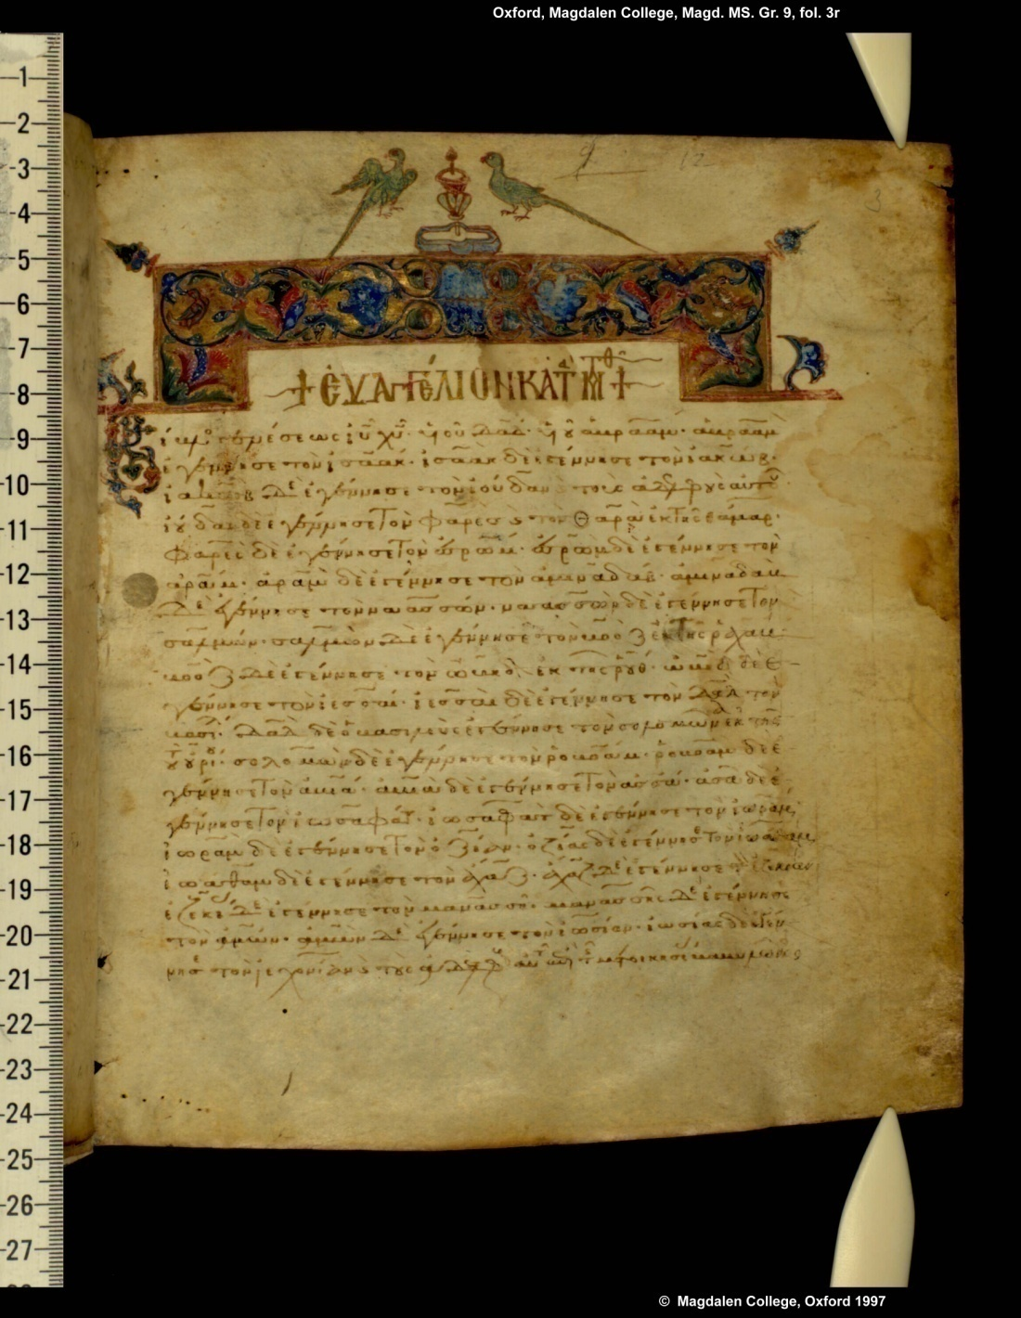
Minuscule Manuscript
Manuscript 57 – 12th century - Includes the Gospels, Acts, CE, Paul [also Pss, Cant.]

Slide 20
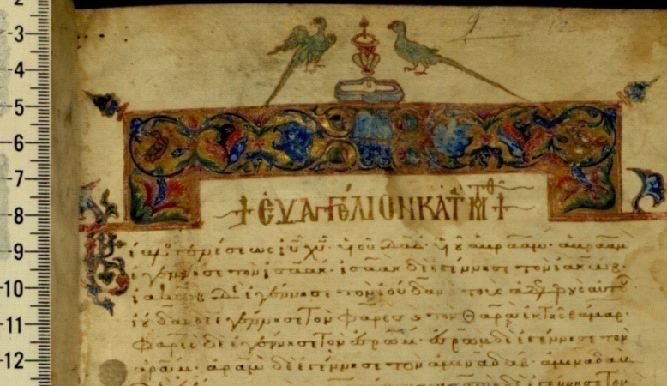
A closer view

Slide 21
NT Manuscripts Broken Down by Century
The King James Only Controversy, James White, Bethany House, p.188

Slide 22
Labeling New Testament Manuscripts
The manuscript copies of the New Testament that still exist today are kept in various places around the world.
These manuscripts have all been given names or labels so that we can identify them and distinguish them from one another.

Slide 23
Labels Used for Various NT Manuscript Types
Text Type | Labels Used
Papyri | Papyrus MSS are designated by the letter P followed by a number (e.g. P¹², P⁴⁰, P⁴¹, etc.)
Uncials (vellum) | Uncial MSS were (and often still are) designated by English capital letters, Greek capital letters that differ from English letters, and the Hebrew letter א (aleph) (e.g. א, A, B, C, D, W, Ψ, etc.). In 1890, uncial manuscripts began to be designated by a number preceded by a zero (e.g. 01, 02, 03, etc.)
Minuscule | Minuscule MSS are designated by Arabic Numbers (e.g. 1, 33, 565, etc.)
ISBE, Text and MSS of the NT, pp. 814-816

Slide 24
Labels Used for Various NT Manuscript Types
Text Type | Labels Used
Lectionaries | Lectionaries are designated by an italic l or by the abbreviation “Lect.” and an Arabic number (e.g. l 25, Lect. 299)
Versions (translations) | Versions are identified by their name abbreviated in lower case. The most significant versions used in NT textual criticism are the Latin Vulgate, Syriac, and Coptic (abbreviated: vg, syr, cop)
Patristic Quotations | Patristic Quotations are simply identified by the church father’s name (e.g. Clement, Chrysostom, Ambrose, etc.)
ISBE, Text and MSS of the NT, pp. 814-816

Slide 25
Some Examples of NT Papyri Manuscripts
Name | Content | Current Location | Date
P²⁵ | Gospels | Berlin | Late 4th century
P³⁸ | Acts | Ann Arbor, Michigan | About 300
P⁴⁵ | Gospels and Acts | Dublin; Vienna | 3rd century
P⁴⁶ | Pauline Letters | Dublin; Ann Arbor, Michigan | About A.D. 200
P⁵² | Gospels | Manchester | About A.D. 125
P⁵³ | Gospels and Acts | Ann Arbor, Michigan | 3rd century
P⁷⁴ | Acts and General Letters | Cologny | 7th century
ISBE, Text and MSS of the NT, pp. 814-816

Slide 26
Some Important NT Uncial Manuscripts
Name | Content | Current Location | Date | Brief Description
א (01) | Entire NT | London | 4th century | Codex Sinaiticus, found by Tischendorf at Catherine's Monastery on Mt. Sinai.
A (02) | Entire NT | London | 5th century | Codex Alexandrinus, so named since it was supposed to have come from Alexandria.
B (03) | Entire NT minus Revelation | Vatican City | 4th century | Codex Vaticanus, universally esteemed to be the oldest and best manuscript of the Greek New Testament;
C (04) | Entire NT | Paris | 5th century | Codex Ephraemi Rescriptus
D (05) | Gospels and Acts | Cambridge | 5th century | Codex Bezae, is the early known manuscript which Theodore Beza obtained in 1562 from the monastery of Irenaeus at Lyons.
ISBE, Text and MSS of the NT, pp. 814-816

Slide 27

Review Questions

Slide 28
Review Questions
When was the printing press invented?
  In 1440 (the Gutenberg Press)

Slide 29
Review Questions
Prior to 1440 what method was used to reproduce ancient documents?
  Hand copying

Slide 30
Review Questions
When looking at the body of manuscript evidence for an ancient document, what are two characteristics that we hope to find in that body of evidence so as to improve our ability to accurately reconstruct what the original document said?
  A Large Number of Copies – especially if those copies represent multiple lines of transmission
  Older Copies - that is, copies that are close in age to the original

Slide 31
Review Questions
How does the manuscript evidence for the New Testament compare with all other ancient documents in terms of:
  The Number of Existing Copies?
  The Oldest Copies?

Slide 32
Number of Copies of the NT Compared to Other Ancient Literature*
“There is no body of ancient literature in the world which enjoys such a wealth of good textual attestation as the New Testament” (F.F. Bruce)
*Josh McDowell, The New Evidence that Demands a Verdict, pp. 37-38

Slide 33
Time Gap Between Original and Earliest Existing Copies*
“In no other case is the interval of time between the composition of the book and the date of the earliest extant manuscripts so short as in that of the New Testament”
(Fredric G. Kenyon, director and principle librarian of the British Museum, 1901)
*Josh McDowell, The New Evidence that Demands a Verdict, pp. 37-38

Slide 34
The Oldest NT Manuscripts
We have at least a dozen manuscripts within the first 100 years after the writing of the NT; they represent a majority of the books of the NT and about 4/10th of the text.
We have more than 120 manuscripts within the first 300 years after the writing of the NT.

Slide 35
Manuscript Variation

Slide 36
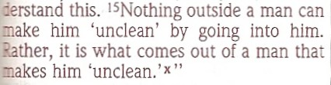
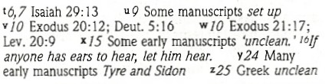
Manuscript Variation
Example of manuscript variation: Mark 7:16
(NIV Study Bible)
Main Text:
Footnote:

Slide 37

Manuscript Variation
A second example: Mark 7:24
Main Text:
(NIV Study Bible)
Footnote:

Slide 38
Manuscript Variation
Bart Ehrman, a well know Christian apostate, likes to try to shock his audience by stating that there are more manuscript variations in the New Testaments than there are words in the New Testament.
This statement is true, but it is also very misleading.
The impression left by the statement is that every word of the New Testament is hopelessly in doubt.
In reality, the exact opposite is true!

Slide 39
Why are there variations between manuscripts?
Manuscript variations are an inescapable, natural result of hand copying.
The more manuscripts you have, the more variants you will have.
If you only have a small number of manuscripts, you will have fewer variants; you likewise have less certainty of the original readings. These go hand in hand.
Therefore the fact that we have many variants within the NT is a good thing – it indicates that we have rich manuscript evidence!

Slide 40
Why are there variations between manuscripts?
Contrast the NT manuscript evidence with the Muslim Quran:
  There is very little manuscript variance in the Muslim Quran.
  This is because Muslim leaders (such as Uthman, the third Caliph) are known to have destroyed all evidence of manuscript variations so as to have only one reading!

Slide 41
Why are there variations between manuscripts?
In contrast to the Quran, there was never a time when any one man or group of men, had control over the text of the New Testament. There was never a Christian Uthman.
Therefore it is bogus to claim that we are missing parts of the New Testament because early scribes changed the Bible to match their own theology.
The early Christian church was a persecuted minority and did not have the power to enforce the kind of uniform textual transmission that occurred in the history of Islam.

Slide 42
Causes of Manuscript Variation
Unintentional Errors – the scribe made a mistake in copying:
  Errors of the Eye - Due to the eye are repetitions, transpositions, omissions, mistaking one letter for another, and so forth.
  Errors of the Ear - Errors due to the ear would arise when one scribe was dictating to another. Examples:
    Rom 5:1 echomen vs. echomen (“we have” vs. “let us have” – i.e., an omicron vs. an omega for the “o”)
    Rev 1:5 lousanti vs. lusanti (“washed us” vs. “freed us”)
    1 Jn 1:4 hemeis vs. humeis (“our joy” vs. “your joy”)
  Errors of Memory - Failure of memory in copying would explain the occurrence of synonymous words in parallel passages.

Slide 43
Causes of Manuscript Variation
Intentional Changes – the scribe tries to correct what he believes is an error:
  Attempts to correct spelling or grammar
  Attempts to correct what he perceives to be a previous error in copying
  Attempts to make doctrinal corrections

Slide 44
Manuscript Variation
A Word of Comfort – The vast majority of NT variants that are either:
  Non-meaningful – the variation in meaning between the two readings is so little that whichever option you go with it will not significantly effect the overall meaning of the text.
  Non-viable – they have so little manuscript support that no one would think of them as rivals.

Slide 45
Manuscript Variation
Some Examples of Non-Meaningful Variation:
  Errors that can’t even be translated into English:
  Spelling Errors
  The “movable nu” in Greek - an “n” at the end of a word when the next word starts with a vowel
  The use of the Greek article in ways that don’t translate into English
  Changes in the word order of the Greek that does not affect the translation into English
Debate between Bart Ehrman and Daniel Wallace – October 2011

Slide 46
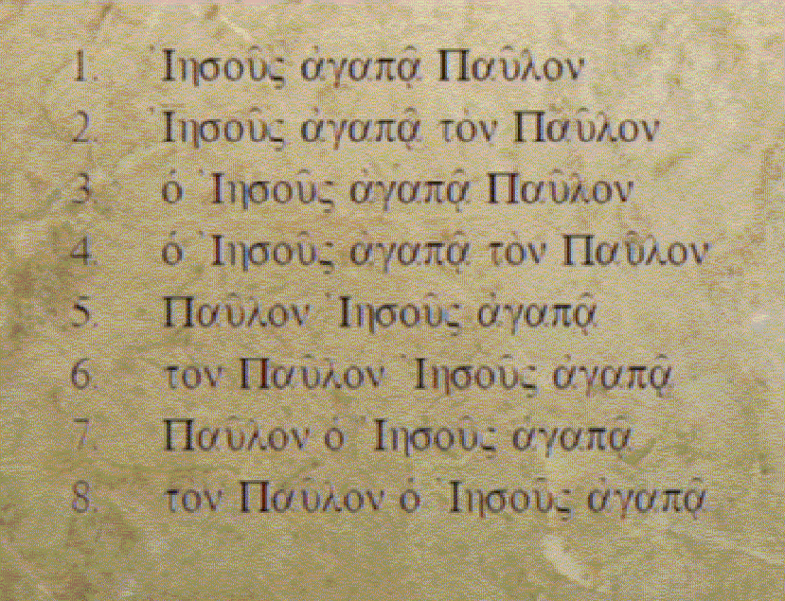
Manuscript Variation
Some Examples of Non-Meaningful Variation:
  Eight ways to say “Jesus loves Paul” in Greek:
Debate between Bart Ehrman and Daniel Wallace – October 2011

Slide 47
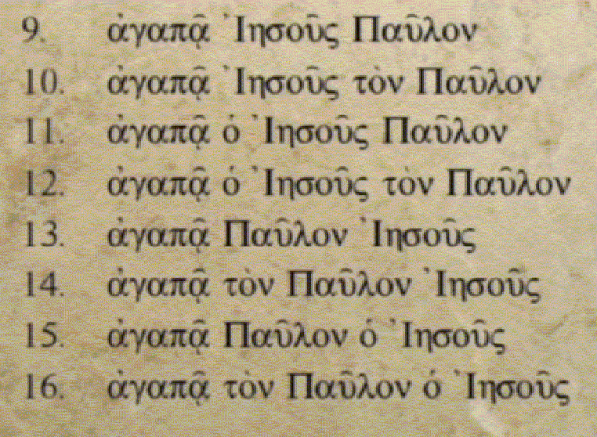
Manuscript Variation
Some Examples of Non-Meaningful Variation:
  Eight more ways to say “Jesus loves Paul” in Greek:
Debate between Bart Ehrman and Daniel Wallace – October 2011

Slide 48
Manuscript Variation
Some Examples of Non-Meaningful Variation:
Reference | Nestle-Aland/UBS | Byzantine Text
Matthew 4:18 | He | Jesus
Matthew 12:25 | He | Jesus
Mark 2:15 | He | Jesus
Mark 10:52 | He | Jesus
Luke 24:36 | He | Jesus
Acts 19:10 | The Lord | The Lord Jesus
1 Corinthians 16:22 | The Lord | The Lord Jesus Christ
Acts 19:4 | Jesus | Christ Jesus
1 Corinthians 9:1 | Jesus | Jesus Christ
2 Corinthians 4:10 | Jesus | Lord Jesus
Hebrews 3:1 | Jesus | Christ Jesus
The King James Only Controversy, James White, Bethany House, p.45-46

Slide 49
Here’s the Good News About Manuscript Variation:
Only *1% of the NT text contains meaningful, viable variants which must be studied carefully in order to determine the original reading.
Note: None of these variants affect the outcome of any major teaching of the New Testament.
*Estimate given by James White in presentation at debate with Bart Ehrman – aomin.org

Slide 50
More Good News:
The “Tenacity of the Text”
Scholars* who study manuscript variations have noticed that once a particular reading occurs in the text, it tends to stay there in all subsequent copies.
Why would this be good? Because that means the original readings are still there as well.
This is the key! When we have a variant with three possibilities: A, B, and C, we do not have to worry about D: “None of the above”
*Kurt and Barbara Aland, The Text of the New Testament, pp. 56, 286ff – cited by James White in the King James Only Controversy, p.51, fn 26

Slide 51
The “Tenacity of the Text”
Original
Manuscript
Copies:

Slide 52
Worst Case Scenarios:
The “Big Three”
When attacking the integrity of the New Testament, there are three textual variations that skeptics like Bart Ehrman like to emphasize (because they hope it will shock their audience):
  Mark 16:9-20 – The last chapter of Mark
  John 7:53-8:11 – Jesus forgives the adulteress
  1 John 5:7-8 – The Trinity verse
The reason these are cited is because they are the worst case scenarios – most other variations are minor in comparison.

Slide 53
Review Questions

Slide 54
Review Question
Bart Ehrman likes to say there are more manuscript variations in the New Testaments than there are words in the New Testament.
Is this a true statement?
    Yes – there are 140,000 words in the NT and there are an estimated 300,000 – 400,000 manuscript variations.
Is this a misleading statement – if so why?
  Yes, it gives the impression that the NT text is hopelessly in doubt – but the exact opposite is true!

Slide 55
Review Question
Why are there so many variations in the NT manuscripts and why is that actually good thing?
  Copying errors are unavoidable when copying by hand – which is all that was possible during the time the NT was written
  The reason we have so many variations is because we have so much manuscript evidence which gives us a much better chance of determining the original reading.

Slide 56
Review Question
What percentage of NT manuscript variations have no meaningful effect on our ability to get back to the original text?
  99%
  Either they do not significantly affect how the text reads:
    Spelling errors which don’t change the meaning
    Differences in the Greek that don’t even translate into English – such as the Greek article, or Greek word order
    Differences that don’t matter such as: “Lord Jesus” versus “Jesus Christ”
  Or they are differences found in so few manuscripts that scholars have no doubt that they are not original

Slide 57
Review Question
Of the 1% of manuscript variations that do effect the reading of the text how many affect the outcome of any major teaching of the New Testament?
  None – as even Bart Ehrman admits in his recent book Misquoting Jesus (p.252 – cited by Dan Wallace in the Ehrman Wallace debate, October 2011)

Slide 58
Review Question
What are the three most dramatic textual variations that skeptics like Bart Ehrman like to emphasize (because they hope it will shock their audience)?
  Mark 16:9-20 – The last chapter of Mark
  John 7:53-8:11 – Jesus forgives the adulteress
  1 John 5:7-8 – The Trinity verse

Slide 59
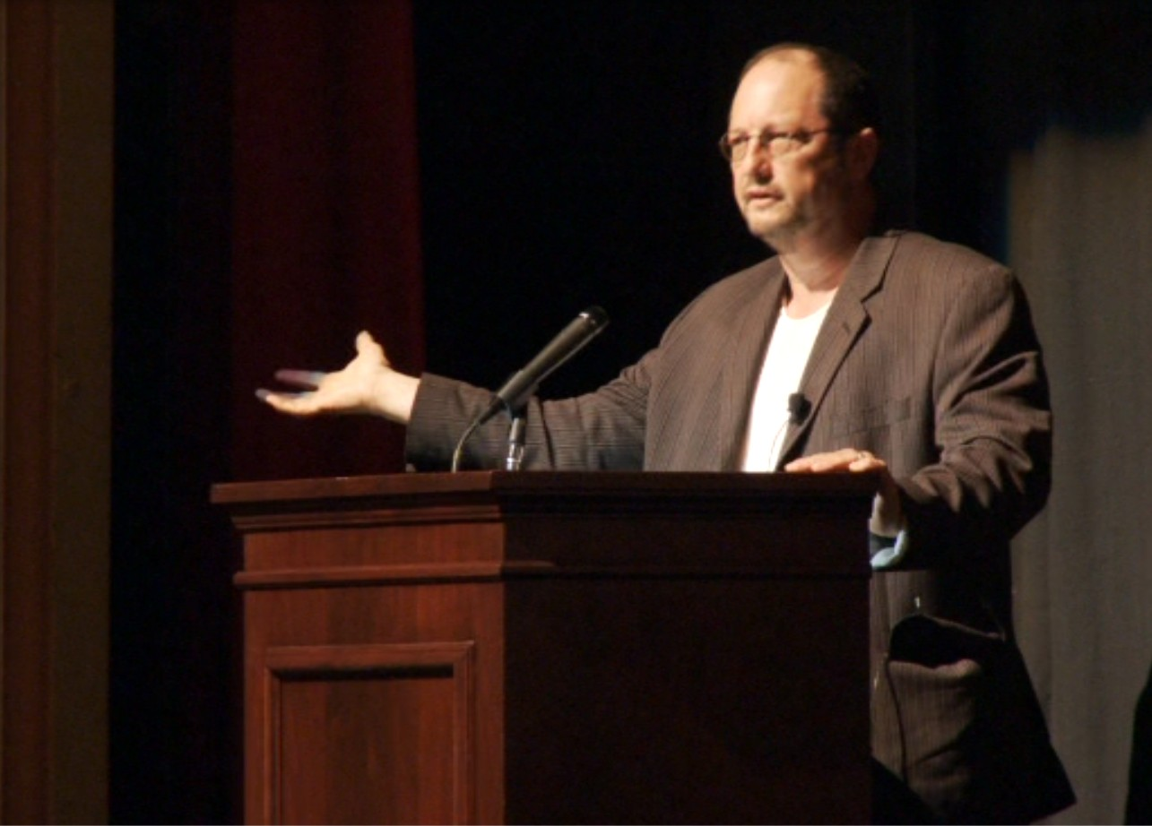
Arguments From Bart Ehrman

Slide 60
12:53
Copies of the Copies of the Copies
“Now I don’t know if you’ve ever tried to write out a copy of one of the books of the NT, like the gospel of Mark. But I could guarantee you if you do that you’re going to make a mistake. You might make lots of mistakes. And you are much more highly educated and literate than the vast majority of early Christians. Mistakes happen when people copy text. And the problem is when someone copies a text and makes a mistake, the next person who copies the copy replicates the mistakes of his predecessor. And he makes mistakes of his own. And then somebody comes along and copies that copy. And when they copy that copy, they replicate the mistakes of both of their predecessors and they make their own mistakes. And then somebody copies that copy. And it goes on like that for year after year after year. The only time mistakes get corrected is when a scribe is copying a text and he’ll realize, “Oh, this copy has a mistake”. And they try to correct the mistake. But they don’t know what the original says - they’re just trying to make it right. It’s possible that when somebody tries to correct a mistake, they correct it incorrectly. In which case you’ve got the original copy, you’ve got the mistake and you’ve got the mistaken correction of the mistake. Three forms of the text and then somebody copies that form of the text. And it goes on like that – month after month, year after year, decade after decade. And so you get copies of the copies of the copies.”

Slide 61
Multiple Lines of Transmission
Original
Manuscript
Copies:

Slide 62
28:13
Problems With the Early Manuscripts
“There probably were even more accidental changes in the years before we have surviving manuscripts. My reason for thinking that is this: by the time you get to the middle ages, who was copying manuscripts? The people copying manuscripts in the Middle Ages are the highly educated literate people who are monks in monasteries who are trained to copy manuscripts. Those are the people who copied manuscripts in the middle ages. Well you didn’t have monks in the fourth century, so when you first start getting complete manuscripts, who was copying them then if you don’t have monks in monasteries yet? … The fourth century manuscripts we have are pretty good, so they’re written by highly literate people who appear to be trained to copy manuscripts in the fourth century. But things start changing when you start getting earlier. The manuscripts in the third century aren’t nearly as good as manuscripts from the fourth century. The scribes don’t appear to be trained. When you get to the second century, we don’t have much – just fragments here and there – they’re not nearly as good as fourth century manuscripts. Who was copying the manuscripts to begin with? The reality is that most people in the ancient world were illiterate. This seems strange to us today because almost everybody we know is basically literate. Illiteracy is still a big problem in this country, but 99% of the population in the United States can at least read the sports page.

Slide 63
“In the ancient world maybe 10% of the population could read the sports page… Most people couldn’t read. Most people couldn’t write. Who copied the manuscripts? In the early Christian churches whoever the guy was in the church who at least could read something was probably the person who copied the manuscript. Was he trained as a scribe? No! Well then, how good was he? Probably not very good. He probably made accidental mistakes. That got replicated and replicated and replicated until the surviving manuscripts. Probably – I mean I don’t know! Nobody knows! Dan doesn’t know. Now he’s going to tell you he knows, but I’m telling you he doesn’t know.”

Slide 64
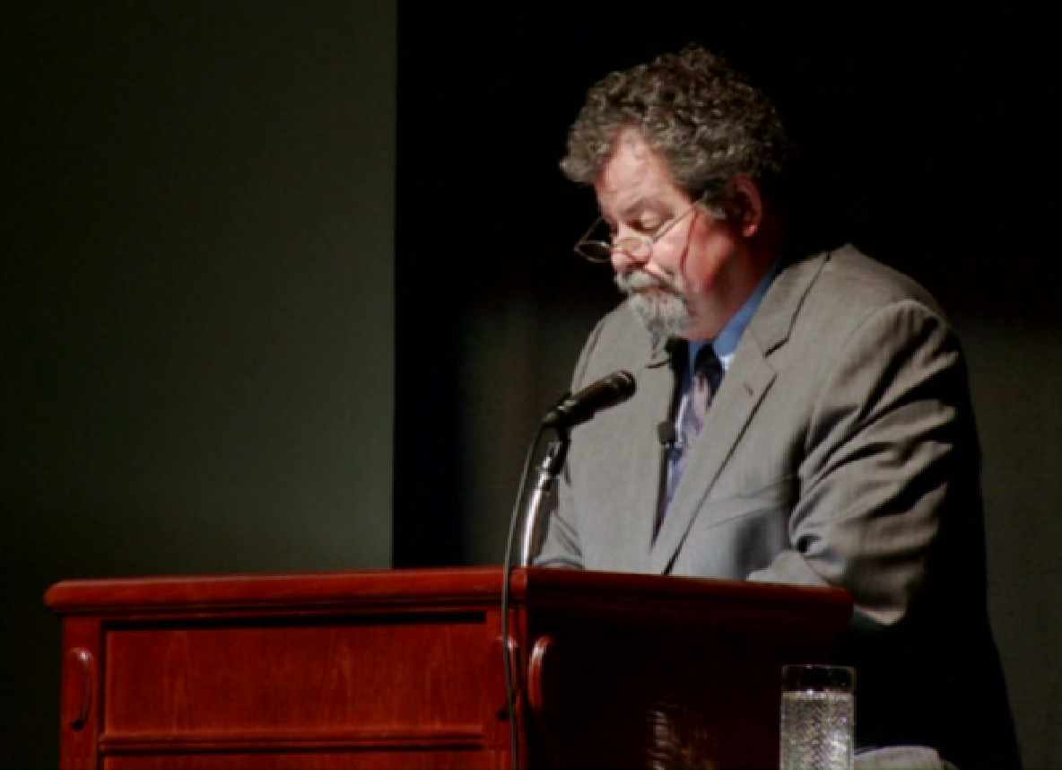
Response From Dan Wallace
(in the debate)
  Bart claims that the first two centuries of copying were wild. This is not the whole story. The standard introduction to NT textual criticism puts things in perspective:
    “It would be a mistake to think that the uncontrolled copying practices that led to the formation of the Western textual tradition were followed everywhere that texts were reproduced in the Roman Empire. In particular, there is solid evidence that in at least one major see of early Christendom, the city of Alexandria, there was conscientious control exercised in the copying of the books of the NT. Textual witnesses connected to Alexandria attest to a high quality of textual transmission from the earliest times. It was there that a very ancient line of text was copied and preserved…” (Fourth Edition of the Text of the NT by Bruce Metzger and Bart Ehrman)
    P75 and Codex Vaticanus (also known as B) are two examples of this kind of quality of text. These two texts descend from a much earlier ancestor of the two in the second century and yet the two are very similar in their wording.

Slide 65
Multiple Lines of Transmission
Original
Manuscript
Copies:

Slide 66
How God Provides Us With His Word
God
Revelation
Prophet
or Apostle
Illumination
Application
Inspiration
Christians
Today
Observation
and
Interpretation
Original
Manuscript
Manuscript
Copies
Preservation
Translation

Slide 67

Review Questions

Slide 68
Review Questions
As Bart Ehrman attempts to cast doubt on the reliability of our New Testament manuscripts, what unproven assumption does he always seem to make about how the New Testament documents were copied?
  He seems to assume that there was only one line of transmission, that is, one copy was made of the original (and mistakes were made), and then one copy was made of that copy (and more mistakes were made) etc.

Slide 69
Review Questions
Given the environment in which the NT was copied – that early Christians all wanted copies of the NT – what is a more likely way that the NT manuscripts were copied?
  There were probably multiple lines of transmission – that is, numerous copies would have been made of each of the originals and then numerous copies of those copies would have been made, etc.

Slide 70
Review Questions
How does having multiple lines of transmission give us confidence that we can still get back to the original wording of the New Testament even though we no longer have the original copies?
  Because, although every copy has some mistakes, the other copies of that same original are very unlikely to contain the exact same mistakes.
  Therefore we are assured that the original wording can still be found among our existing copies.

Slide 71
Multiple Lines of Transmission
Original
Manuscript
Copies:

Slide 72
1:52:32
Q & A
Question: (directed to Bart Ehrman) Between what we have, the strong evidence we have that’s been presented, and the original autographs, what would it be in between that that would convince you that it’s trustworthy – other than the autographs?
Answer: Well if we had early copies – suppose next week there is an archaeological find in Rome and we have reason to think that these ten manuscripts that are discovered were all copied within a week of the original copy of Mark and they disagree in .001% of the textual variation, then I would say, “That’s good evidence!” and that’s precisely what we don’t have.

Slide 73
1:53:24
Question: There is one argument that Dr. Wallace presented that was not addressed – not specifically. He mentioned that the NT has more manuscripts than any average classical piece of work that we have today. Following the question that the young man in front of me asked, what type of evidence would convince you and you answered that, so with that type of standard of requirement for evidence how then in your opinion should we regard classical pieces of work today of which we don’t have original autographs or not even half near the number of manuscripts for them like the Odyssey and things like that that we were required to read in High School.

Slide 74
Answer: Right, yeah, so you wasted your time, I’m sorry! (laughter) I tried to address that, I’m sorry if it didn’t come through clearly; I certainly wanted to address it and tried to address it. Is that it’s absolutely true. We have far more manuscripts of the NT than we have of Homer, or Plato, or Euripides… that’s absolutely true. But that does not mean though that we have the original NT. What it means is that we have more manuscripts of the NT than these other works and it’s harder to reconstruct these other works even than it is of the NT. And this isn’t a disputed point, I mean classicists agree that in many places we have problems. One difference is, that most of these classical authors’ scribes did not make intentional changes because of their particular belief, so there are more intentional changes in the NT manuscripts because people wanted to make sure it said what they wanted it to say and so they changed it in places. That simply didn’t happen all that much in Homer. But scholars have known about problems in Homer for over 2000 years. There were scholars devoted to the problem of trying to reconstruct the text of Homer realizing that in fact ultimately it was an impossible task. So yes, it’s an impossible task with the classics but that doesn’t mean that therefore it’s possible with the NT.

Slide 75
A Final Observation About Bart’s Skepticism
Dan Wallace pointed out in the debate that the vast majority of NT scholars believe that we have recovered the wording of the original New Testament it in most places – total skepticism in this regard is unwarranted.

Slide 76
A Final Observation About Bart’s Skepticism
Dan then pointed out the titles of Bart’s latest books demonstrate that even Bart believes that he can know what the original text of the New Testament says:
  Orthodox Corruption of Scripture: The Effect of Early Christological Controversies on the Text of the New Testament
  Misquoting Jesus: The Story Behind Who Changed the Bible and Why
  Jesus, Interrupted: Revealing the Hidden Contradictions in the Bible (And Why We Don't Know About Them)
  The Text of the NT: Its Transmission, Corruption, and Restoration
  Forged: Writing in the Name of God – Why the Bible’s Authors Are Not Who We Think They Are
    In this book Bart argues that Paul did not write the Pastoral Epistles because he does not use the same vocabulary as he uses in his “authentic” letters.
    In order for him to make that claim, he has to know what the words are in Paul’s other letters as well as what the words are in the pastoral letters!

Slide 77
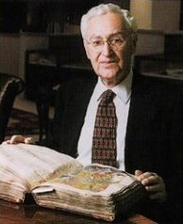
Textual Criticism
Bruce Metzger

Slide 78
Textual Criticism
Over the years, scholars have developed a set of methods for carefully analyzing the New Testament manuscript evidence in order to determine the most likely original reading of the text.
Often a committee of scholars will end up producing a “critical Greek text” of the NT which they believe best approximates the original reading.

Slide 79
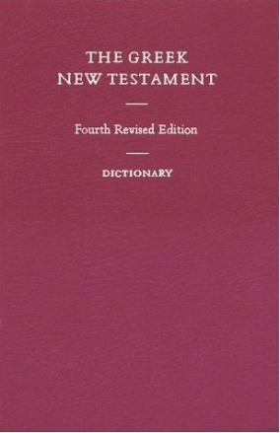
Textual Criticism
A recent critical Greek text done by a committee of scholars is The Greek New Testament by the United Bible Societies. It gives:
  All meaningful, viable variants in the NT manuscripts
  Which variant was preferred by the committee in each case, as well as the major alternate readings
  A rating describing the confidence the committee had in selecting a particular reading*:
    A = the text is certain
    B = the text is almost certain
    C = the committee had difficulty deciding on the text
    D = the committee had great difficulty deciding on the text
*These ratings are described in the UBS Greek NT, p.3

Slide 80
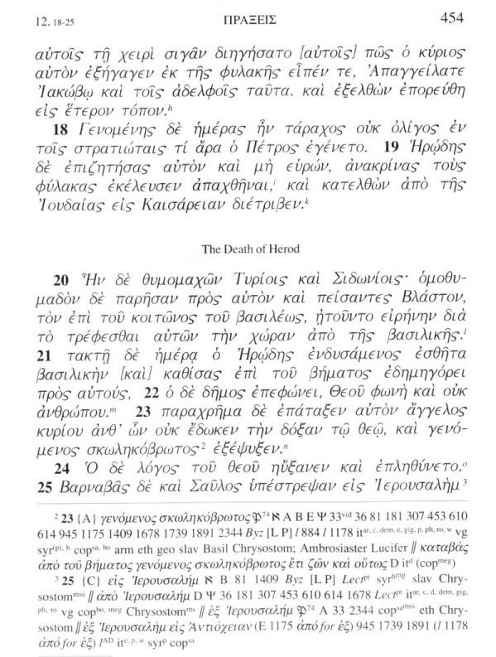
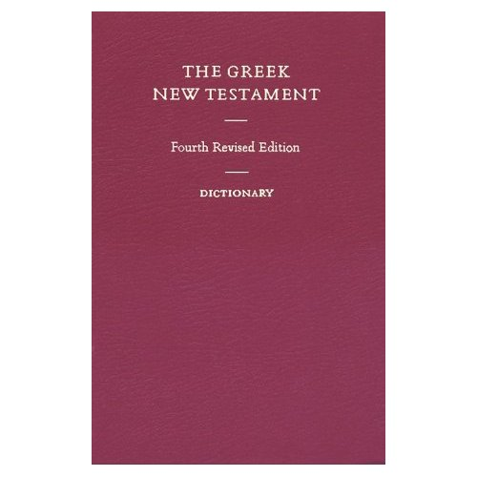
Format of the critical text of
The Greek New Testament by the
United Bible Society
The Greek Text
Footnotes

Slide 81

Format of the Footnote
Footnote number and verse number (from the text above the footnote)

Slide 82
Format of the Footnote
The Greek text of the reading selected by the UBS committee as the most likely reading – preceded by a rating (A, B, C or D) that tells how much confidence the committee had in the selected reading

Slide 83
Format of the Footnote
A list of the manuscripts that have the reading that was selected by the UBS committee

Slide 84
Format of the Footnote
Greek text showing an alternate reading of the text that was rejected by the UBS committee

Slide 85
Format of the Footnote
List of NT manuscripts that contain the alternate reading that was rejected by the committee

Slide 86
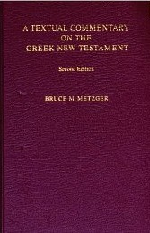
A Helpful Commentary
United Bible Societies also provides a useful companion book to be used with their critical text of the Greek New Testament: A Textual Commentary on the Greek New Testament by Bruce Metzger.
This book lists each of the major textual variants noted in their critical text along with an explanation of:
  How the committee decided which reading to choose for that variant
  How they decided on their rating (A, B, C or D) for that reading.

Slide 87
Textual Criticism
Two kinds of evidence are considered when deciding which reading of a text is correct:
  External Evidence – which takes into consideration the quality of the manuscript evidence for a reading, including its age and reliability
  Internal Evidence – which takes into consideration things like:
    The kind of change made and what is most likely to have caused it
    Which reading best fits the context, the author’s style, etc.

Slide 88
Examples of Internal Evidence
The reading that best fits with the immediate context of the passage is considered most likely to be the original reading (Rom 5:1 “since we have been justified by faith, we have peace with God” versus “… let us have peace with God”)
A reading that best accords with the author’s style is probably original. This applies only to longer passages. (John 7:53-8:11; Mark 16:9-10)
A reading that disagrees with a parallel passage is more likely original than a reading that harmonizes the parallels (Luke 11:2 “Our Father who is in heaven” cf. Mat 6:9)
A reading that at first seems more difficult to understand, but on further examination proves to make good sense is considered more likely to be the original reading. (Jn 1:18 “only begotten God” versus “only-begotten Son”)
(Source: ISBE 1988; p.819)

Slide 89
External Evidence
An earlier text is more likely to have the original reading than a later text.
A reading that is found in a wider variety of manuscripts is more likely to be the original reading.
A manuscript that has proven to be more reliable is given greater weight when deciding which reading should be considered original.
(Source: ISBE 1988; p.819)

Slide 90
Working Through an Actual Example!
Bruce Metzger

Slide 91
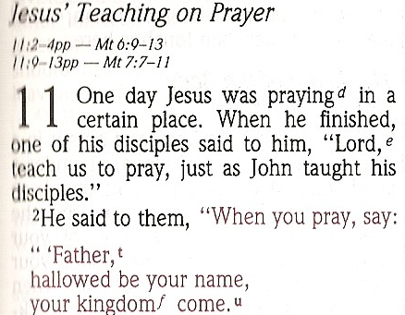
NIV Study Bible – Luke 11:2
Main Text:
Footnote:

Slide 92
Codex Sinaiticus (Symbol: א)*
*Codex Sinaiticus (א) is a 4th century uncial manuscript of the Greek Bible, written between 330–350 AD

Slide 93
Uncial Lettering
ITSURESEEMSLIKEITWOULDHAVEBEENHARDTOREADADOCUMENTWHERETHEYUSEDALLCAPITALLETTERSANDNOSPACESORPUNCTUATIONMARKSBUTASYOUCANSEEITCANBEDONE

Slide 94
Review Questions on
Textual Criticism

Slide 95
Review Questions
What is Textual Criticism?
  A set of methods developed by scholars for carefully analyzing the New Testament manuscript evidence in order to determine the most likely original reading of the text.

Slide 96
Review Questions
What are the two kinds of manuscript evidence that textual critical scholars consider when trying to decide which reading of the New Testament text is the original?
  External Evidence – which takes into consideration the quality of the manuscript evidence for a reading, including its age and reliability
  Internal Evidence – which takes into consideration things like:
    The kind of change made and what is most likely to have caused it
    Which reading best fits the context, the author’s style, etc.

Slide 97
Review Questions
Describe what a “critical Greek text” of the New Testament is.
  It is a Greek text of the New Testament produced (usually) by a committee of scholars which they believe best approximates the original reading of the New Testament text.

Slide 98
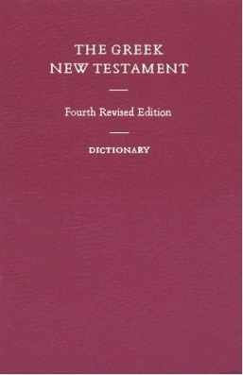
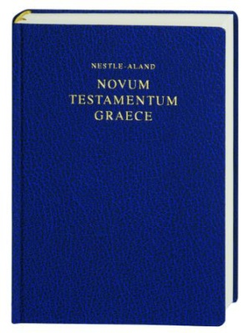
Review Questions
What modern “critical Greek text” did I recommend to you last week in class?
  United Bible Society's Greek New Testament (UBS4).
  There is one other modern critical Greek text that I recommend, but failed to mention last week in class: Novum Testamentum Graece Nestle-Aland 27th edition (NA 27)

Slide 99
Review Questions
  In addition to the critical Greek text, what other information is provided in the United Bible Society's Greek New Testament (UBS4)?
  Alternate readings found in the manuscript evidence that were not selected
  Lists of manuscripts that support the various readings
  A one letter code (A, B, C, or D) that represents the confidence level that the committee had in the selected reading

Slide 100
NIV Study Bible – Luke 11:2
Main Text:
Footnote:

Slide 101
Codex Sinaiticus (Symbol: א)*
*Codex Sinaiticus (א) is a 4th century uncial manuscript of the Greek Bible, written between 330–350 AD

Slide 102
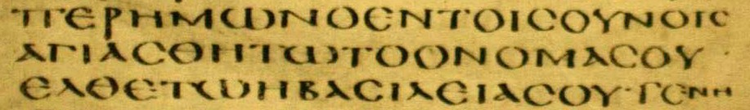
Codex Alexandrinus (Symbol: A)*
*Codex Alexandrinus (A) is a 5th century uncial manuscript of the Greek Bible

Slide 103


A Comparison of Two Greek Manuscripts of Luke 11:2b
Codex Sinaiticus (א):
Codex Alexandrinus (A):

Slide 104
A Comparison of Two Greek Manuscripts of Luke 11:2b
Codex Sinaiticus (א):
Codex Alexandrinus (A):
PATER = Father

Slide 105
A Comparison of Two Greek Manuscripts of Luke 11:2b
Codex Sinaiticus (א):
Codex Alexandrinus (A):
(H)AGIASTHETO = Let it be set apart as holy

Slide 106
A Comparison of Two Greek Manuscripts of Luke 11:2b
Codex Sinaiticus (א):
Codex Alexandrinus (A):
TO ONOMA SOU = the name of you (your name)

Slide 107
A Comparison of Two Greek Manuscripts of Luke 11:2b
Codex Sinaiticus (א):
?
Codex Alexandrinus (A):
(H)EMON (H)O EN TOIS OURANOIS
= [Father] of us, the one in the heavens

Slide 108
NIV Study Bible – Luke 11:2
Main Text:
Footnote:

Slide 109
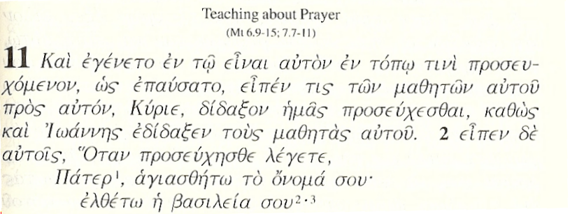
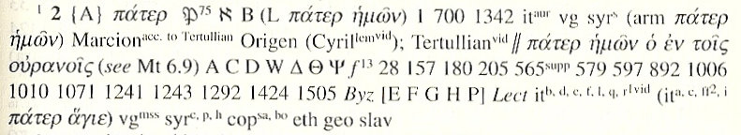
Greek NT (UBS4) – Luke 11:1-2
Main Text:
Footnote:

Slide 110
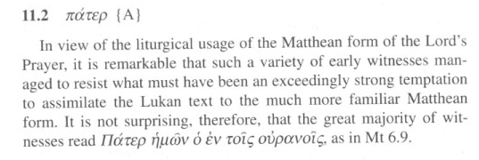
A Textual Commentary on the Greek New Testament by Bruce Metzger

