Slide 1




God
How God Provides Us With His Word
Revelation
Prophet
or Apostle
Illumination
Application
Inspiration
Christians
Today
Observation
and
Interpretation
Original
Manuscript
Manuscript
Copies
Preservation
Translation

Slide 2
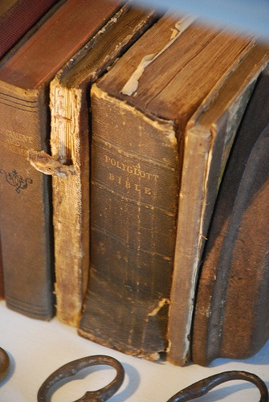
Bible Translations

Slide 3
Bible Translations
The Old Testament was originally written in (mostly) Hebrew (and some Aramaic). The New Testament was originally written in Greek.
As the Bible has gone out to various nations at various times, it has been necessary to translate the Bible into other languages.
We have already seen an example of this in the case of the Septuagint translation of the Hebrew Old Testament into Greek.

Slide 4
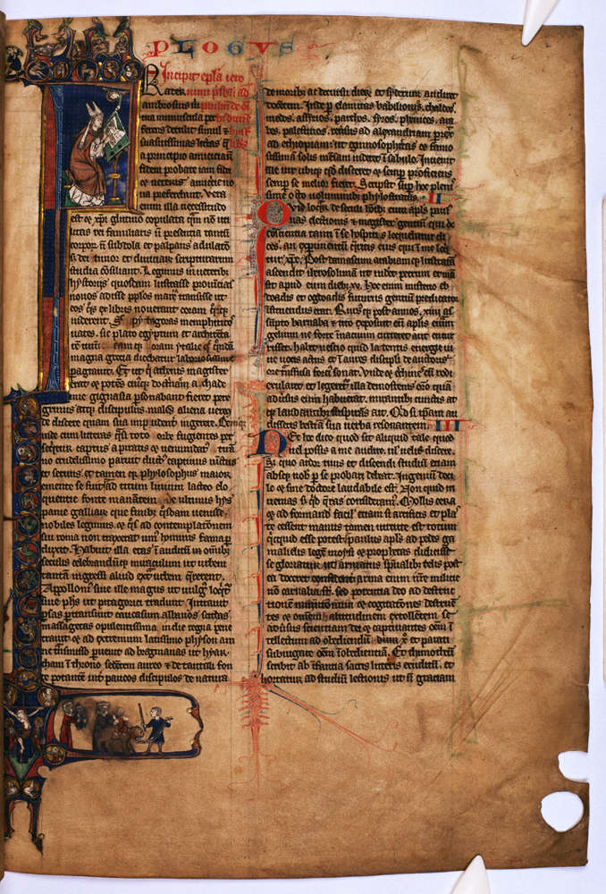
The Latin Vulgate

Slide 5
The Latin Vulgate
By the middle of the fourth century, there were a number of Latin translations of the Bible, most of inferior quality.
Most of these Latin translations translated the Old Testament from the Septuagint , because:
  Very few Christians at that time could read Hebrew
  And by this time many had come to believe that the Septuagint was an “inspired” translation!
In the beginning of the fifth century, a scholar named Jerome produced a fresh Latin translation of the Old Testament .
What was unique about Jerome’s translation is that he translated it from the original Hebrew, rather than the Septuagint.
James White, King James Only Controversy, p. 10-11

Slide 6
The Latin Vulgate
At first there was much resistance to Jerome’s translation because it differed from the Septuagint and many of the previous Latin translations.
Augustine (bishop of Hippo) wrote in a letter to Jerome:
  My only reason for objecting to the public reading of your translation from the Hebrew was, lest, bringing forward anything which was, as it were, new and opposed to the authority of the Septuagint version, we should trouble by serious cause of offense the flocks of Christ, whose ears and hearts have become accustomed to listen to that version to which the seal of approbation was given by the apostles themselves (Augustine - Letter LXXXII in The Nicene and Post-Nicene Fathers, Eerdmans: 1983, Series I, I:361)
James White, King James Only Controversy, p. 11-12

Slide 7
The Latin Vulgate
Over 1,100 years after Jerome published his Latin translation of the Bible, which came to be called the Vulgate, it had become the most popular translation in Europe.
In 1516, a scholar by the name of Erasmus updated Jerome’s Vulgate by publishing his own Latin translation alongside the first published Greek New Testament.
Erasmus considered his translation to be more readable in his day than the Vulgate declaring that “It is only fair that Paul should address the Romans in somewhat better Latin.” (Wikipedia, Desiderius Erasmus)
But Erasmus was criticized by many in his day for “altering the Word of God” (so they claimed).
James White, King James Only Controversy, p. 13-17

Slide 8

The Textus Receptus
Erasmus’ Greek text went through several revisions over the next 20 years before his death (1516, 1519, 1522, 1527, and 1535).
This Greek text was the forerunner of what would later become known as the Textus Receptus (which means, “received text”) – the Greek text upon which the King James Version of the Bible would later be based.
Erasmus’ Greek text was remarkably accurate considering the fact that he based it on a relatively small number of late manuscripts compared to what we have available to us today.
James White, King James Only Controversy, p. 54-55

Slide 9
Review Questions

Slide 10
Review Questions
So far in this study we have examined two historic Bible translations:
  Greek Septuagint
  Latin Vulgate
Explain why each of these translations was produced.
  Greek Septuagint – produced because Jews living outside of Palestine had come to speak Greek rather than Hebrew and therefore needed a translation of the Old Testament in their common language.
  Latin Vulgate – produced by Jerome from the original Hebrew in the beginning of the 5th century because most other Latin Old Testaments in his day had been translated from a translation of the Old Testament (the Septuagint) rather than the original Hebrew.

Slide 11
Review Questions
At first, Jerome’s Latin Vulgate was not well received.
What was the primary objection to Jerome’s Latin Vulgate translation at the time it was produced?
  It was unfamiliar to the Latin speaking Romans who were used to hearing the less accurate Latin translations that were based on the Septuagint – therefore many of them found Jerome’s translation to be offensive.

Slide 12
Review Questions
But over time the Vulgate ended up becoming the standard translation that everyone used.
So much so, that in 1516, when a scholar by the name of Erasmus updated Jerome’s Vulgate by publishing his own Latin translation, which he considered to be more readable – he encountered much resistance.
What was the primary objection to Erasmus’ updated Latin translation?
  It differed from the Vulgate translation which everyone had come to accept as authoritative, therefore Erasmus was accused of “changing the Word of God”.

Slide 13
Review Questions
What other scholarly work, having to do with the Greek New Testament, is Erasmus known for?
  Erasmus produced (and over time revised) the first published critical Greek text. This text, though based on a relatively small number of Greek manuscripts, was remarkably accurate and was the forerunner of what later became known as the Textus Receptus (meaning “received text” – a text that had come to be favorably received by most people). This was the Greek text upon which the King James NT was later based.

Slide 14

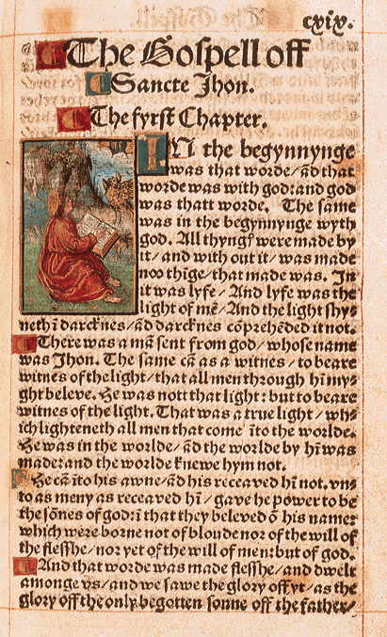
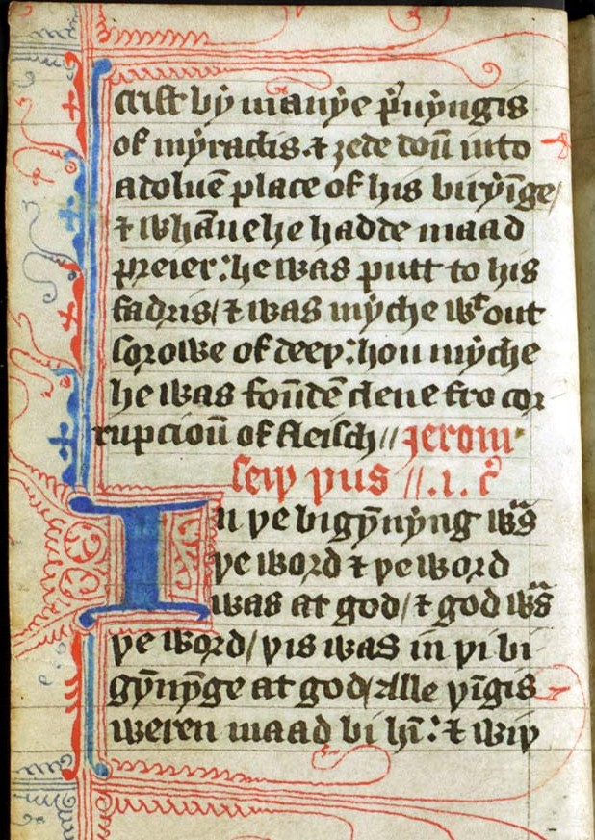
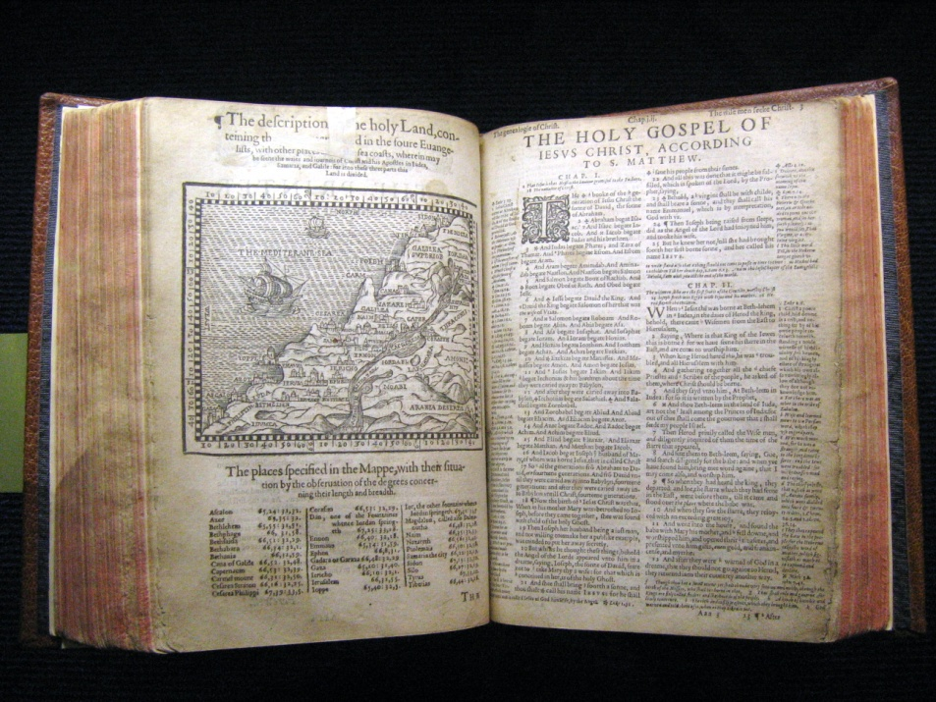
The History of Early English Bibles

Slide 15
The History of Early English Bibles
There have been numerous English translations of the Bible. The earliest translations were portions of the Bible that were translated into Anglo-Saxon and Middle English.
The first full translation of the Bible into English was the Wycliffe translation which was done in about 1380 AD.
The following chart shows some of the more popular early English Bible translations along with some of the relevant history that led up to the most popular English translation of all times – the King James translation of 1611.

Slide 16
The History of Early English Bibles
Matthew’s
Bible
Geneva
Bible
Douay-Rheims
Tyndale
1525
1537
1560
1609
Wycliffe
Translation of the Bible into English Forbidden
1408
Great
Bible
Bishops'
Bible
King
James
Coverdale
1380
1535
1539
1568
1611
1400
1500
1600
First Bible Printed in Latin by Gutenberg
1450
Church of England Severs Ties with Rome
1532
Protestant Reformation Begins to Take Root in the Church of England
1547

Slide 17
The History of Early English Bibles
As we look briefly at the history of English translations we will see:
  Even though the best translations make use of the original languages, all translations tend to make use of translations that have gone before.
  While we tend to think of the King James Version as the earliest English translation, there were many translations the preceded it.
  Though we take our current English translations for granted, many early English translations came at great cost to those who made them – some even lost their lives as a result of their translation efforts.

Slide 18
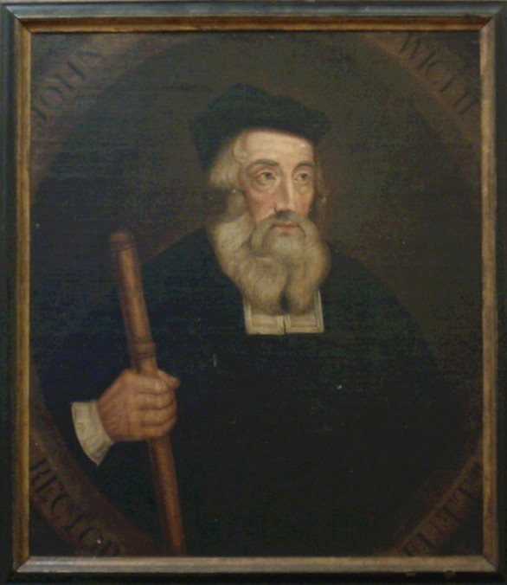
The Wycliffe Bible

Slide 19
The Wycliffe Bible
Was translated by John Wycliffe in 1380
This was the first full translation of the Bible into English.
It was translated from the Latin Vulgate and was very literal even to the point of following the Latin word order.

Slide 20
The Wycliffe Bible
John Wycliffe was born in Yorkshire, England and studied at Oxford where he received a doctorate in theology in 1372.
He has been called the “Morning Star of the Reformation” because of his belief that the Bible was the only authoritative guide for faith.
He denied transubstantiation, attacked the institution of the papacy, and repudiated indulgences.
He died of a stroke in 1384 and was buried in a church graveyard.
In 1428, the Roman Catholics dug up his body, tried him for heresy, found him guilty and had his body burned and thrown into the Swift River!
Dictionary of the Christian Church, J. D. Douglas General Editor, Zondervan Publishing, 1978, Wycliffe, John, p.1064

Slide 21
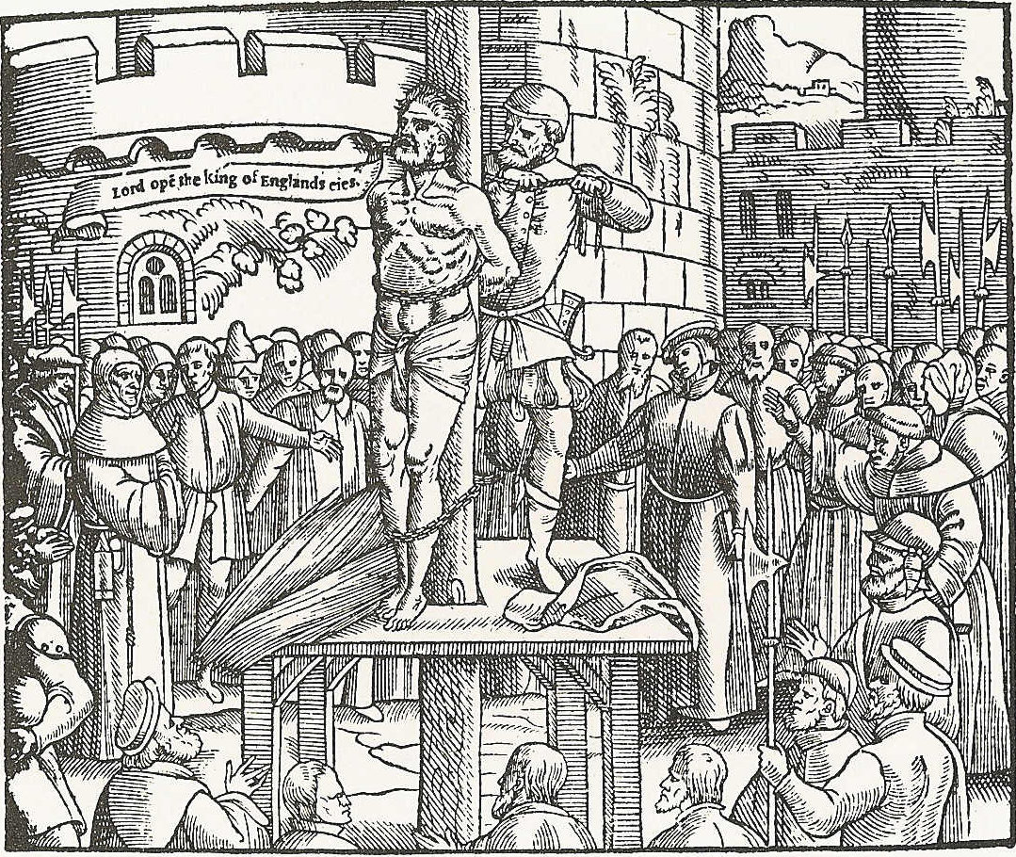
Translation of the Bible into English Forbidden
In 1408 the English Catholic Church made the translation of the Bible into English illegal except by specific permission from the Church.
Christian History Magazine, Volume IV, No. 4, Issue 16, pp. 4, 17

Slide 22
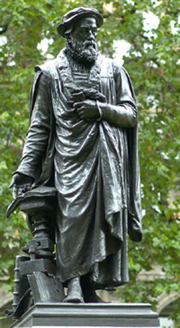
Tyndale Translation

Slide 23
Tyndale Translation
William Tyndale was born in England educated at Oxford and afterward at Cambridge.
Frustrated with church’s hypocrisy and denied special permission to translate the Bible onto English, he left England never to return.
He worked on his translation from outside the country beginning in 1525.
In spite of being continuously pursued by those who opposed his work, and enduring various other hardships he continued the work of translation.
Christian History Magazine, Volume IV, No. 4, Issue 16, p. 4

Slide 24
Tyndale Translation
Tyndale did his own translation from the original languages.
Tyndale produced a quality translation that was lucid, clear and concise.
Tyndale’s translation work was so good that 90 percent of his wordings appeared in the King James Version published 100 years later.
Numerous copies of this translation were printed using the printing press.
Tyndale was strangled and burned for his translations in 1536.
Christian History Magazine, Volume IV, No. 4, Issue 16, p. 4

Slide 25
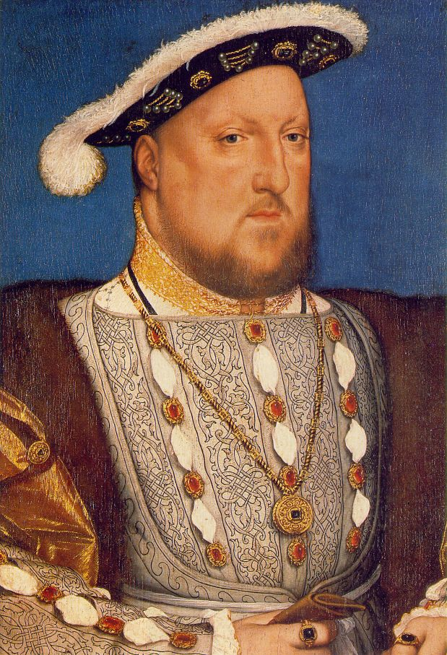
Church of England Severs Ties with Rome
Henry VIII (King of England and Ireland 1491 – 1547) used his divorce from Catherine of Aragon as grounds for detaching England from the authority of the Roman Catholic Church.
The English parliament appointed Henry VIII head of the Church of England in 1532.

Slide 26
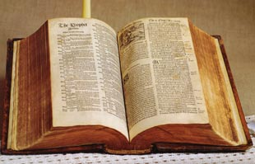
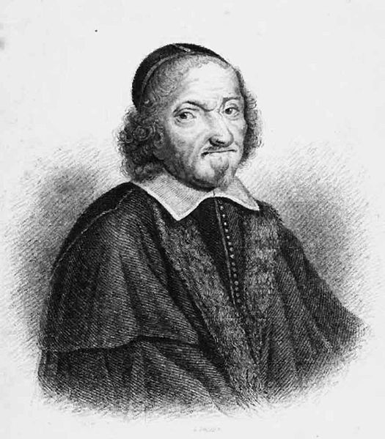
Coverdale Translation

Slide 27
Coverdale Translation
Produced in 1535 by Miles Coverdale, a younger contemporary of Tyndale.
Like Tyndale, Coverdale was forced to flee England and spent many years in hiding for fear of his life.
Coverdale took Tyndale's New Testament and the published portions of his Old Testament, and translated the remainder of the Old Testament himself from Latin and German versions. (Wikipedia – Coverdale’s Bible)
He successfully studied the use of musical effects in his sentences and many of the finest phrases in the King James Version are directly traced to Coverdale.
His version of the Psalms is still in daily use in the ritual of the Church of England
ISBE, CD version (1901), English Versions of the Scriptures

Slide 28
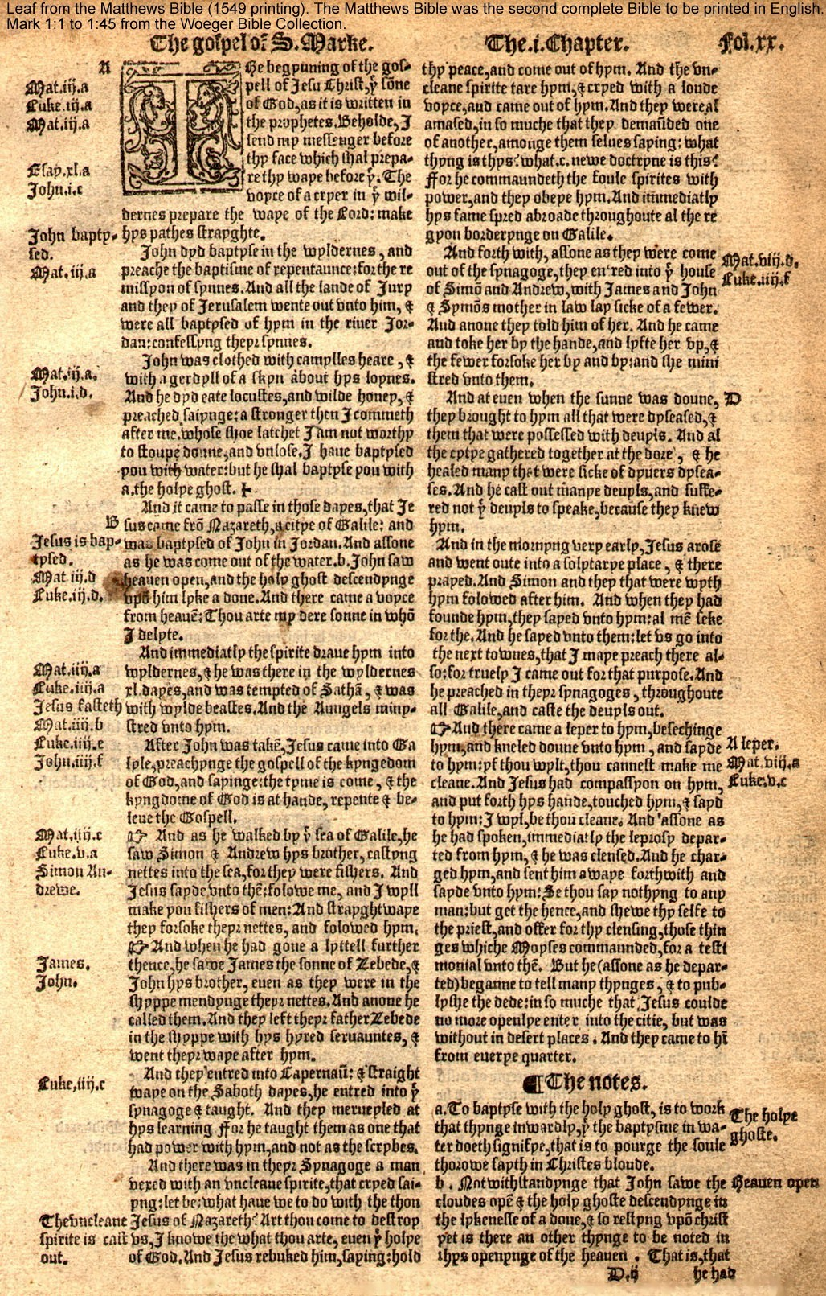
Matthew’s Bible
Matthew's Bible was produced by John Rogers, working under the pseudonym "Thomas Matthew" for safety, in 1537.
It was based on Tyndale's previously published editions with the addition of his unpublished Old Testament material.
The remainder used Coverdale's translation.
It received the approval of Henry VIII.
Wikipedia – Early Modern English Bible translations

Slide 29
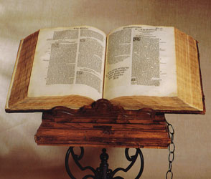
The Great Bible
Was compiled by Myles Coverdale in 1539. The version gets its name from the size of the volume (15” by 9”).
The Great Bible was issued to meet a decree that each church should make available in some convenient place the largest possible copy of the whole Bible, where all the parishioners could have access to it.
That decree dates 1538 – twelve years after Tyndale's books were burned, two years after he was burned.
The installation of these great books caused tremendous excitement as crowds gathered everywhere to see it.
The Great Bible remained the authorized version of the Church of England for thirty years.
Wikipedia - Early Modern English Bible translations

Slide 30
The History of Early English Bibles
Matthew’s
Bible
Geneva
Bible
Douay-Rheims
Tyndale
1525
1537
1560
1609
Wycliffe
Translation of the Bible into English Forbidden
1408
Great
Bible
Bishops'
Bible
King
James
Coverdale
1380
1535
1539
1568
1611
1400
1500
1600
First Bible Printed in Latin by Gutenberg
1450
Church of England Severs Ties with Rome
1532
Protestant Reformation Begins to Take Root in the Church of England
1547

Slide 31
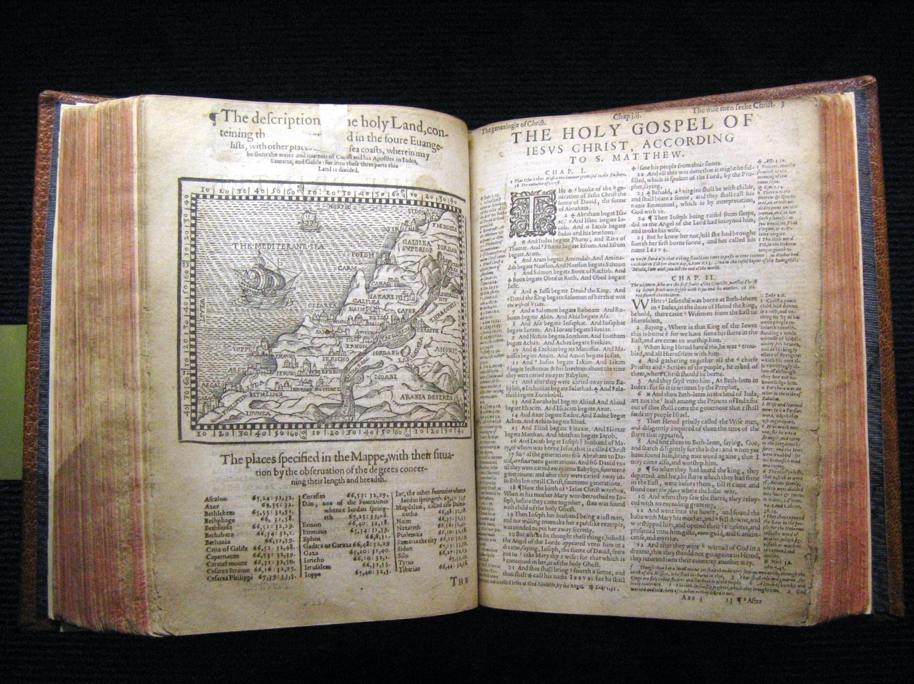
The Geneva Bible
Wikipedia – Early Modern English Bible translations

Slide 32
The Geneva Bible
The Geneva Bible was published in Geneva in 1560, by William Whittingham, brother-in-law to John Calvin.
It was translated from the original languages and was often more direct and modern in style than the King James Version printed 51 years later.
It was the primary Bible of the 16th Century Protestant movement and was the Bible used by William Shakespeare, John Knox, and John Bunyan, author of Pilgrim's Progress.
It was also popular with the Puritans and was one of the Bibles taken to America on the Mayflower.
Wikipedia – Early Modern English Bible translations

Slide 33
The Geneva Bible
The Geneva Bible was the first printed, mass – produced Bible made available directly to the general public which came with cross-references, introductions to each book of the Bible, maps, tables, indexes, etc.— making the Geneva Bible the first English study bible.
It was the first English Bible to include verse numbers (which were introduced by Robert Stephanus in his 1551 revision of Erausmus’ Greek text)
It had full "notes on hard passages", some of which eventually proved controversial to King James and prompting him to call for the production of the King James version.
Wikipedia – Early Modern English Bible translations

Slide 34
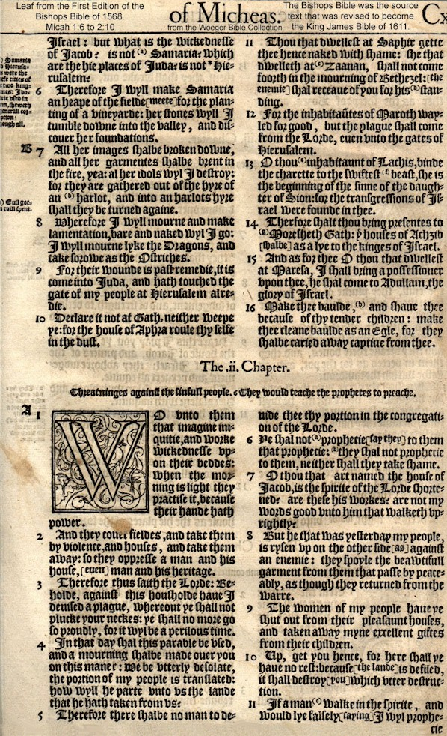
The Bishops' Bible
The Bishop’s Bible was produced in 1568 by Archbishop Parker and eight bishops--from whom the version received its name.
This became the next officially sanctioned Bible (by the Church of England under Elizabeth) replacing the previously authorized “Great Bible”.
It was hoped that the Bishop’s Bible would effectively compete with the unsanctioned Geneva Bible which had no hope of receiving official approval from the Queen or the Church of England.
Wikipedia – Early Modern English Bible translations

Slide 35


The Douay-Rheims Version
The Douai (or Douay) version was the work of English Roman Catholic scholars connected with the University of Douai in France.
It was completed at Rheims, France in in 1609, just before the King James version.
It is made, not from the Hebrew and the Greek, but from the Latin Vulgate.
Its notes were strongly anti-Protestant, and in its preface it explains its existence by saying that Protestants have been guilty of “casting the holy to dogs and pearls to hogs.”
Wikipedia – Early Modern English Bible translations

Slide 36
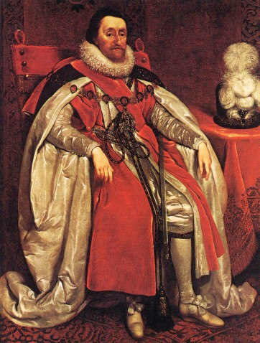
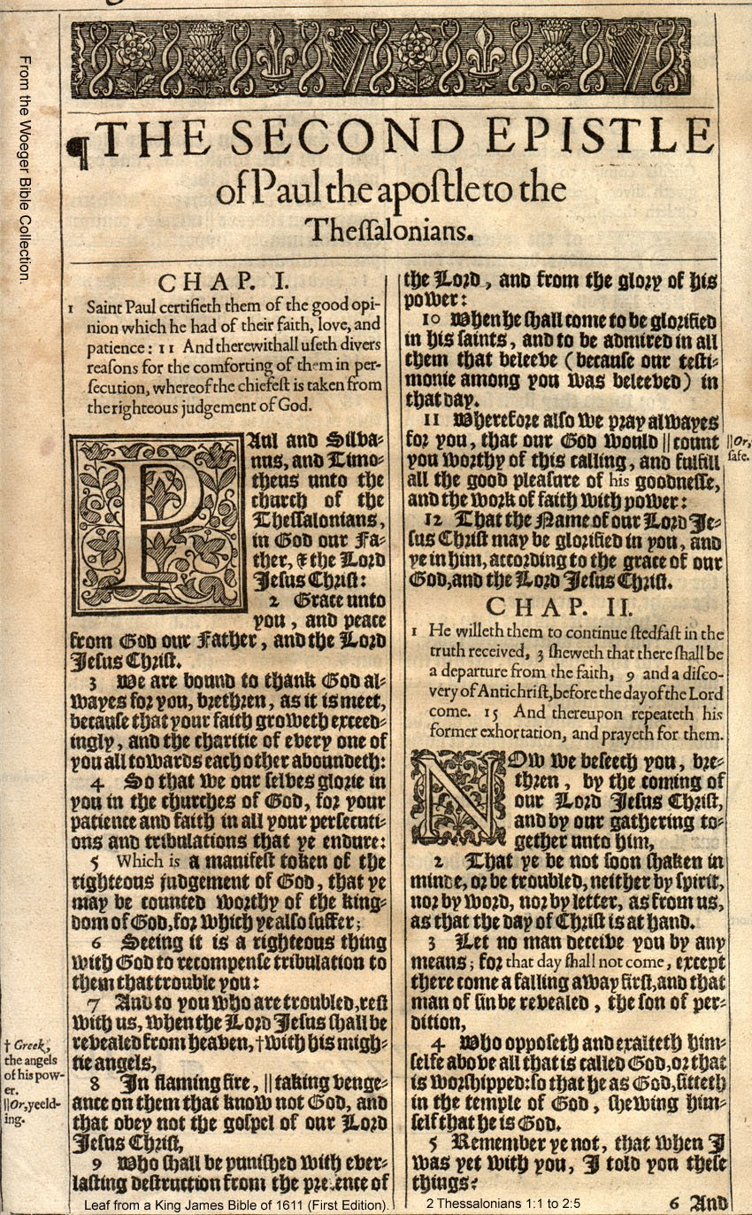
King James Bible
The King James Version (KJV), or Authorized Version was commissioned for the benefit of the Church of England by James I of England in 1611.
Translated by the largest group of translators up to that time, (around 50) and using the widest range of source texts, it became the most widely used of the early modern English Bible translations and its use has continued in some traditions up to the present.
Wikipedia – Early Modern English Bible translations

Slide 37

The King James Only Debate

Slide 38
The King James Only Debate
Like other popular translations of the past (e.g. the Greek Septuagint and the Latin Vulgate), the King James translation has become, for some, the only acceptable translation.

Slide 39
The King James Only Debate
Categories of King James Only Advocates*:
  Prefers the way the KJV Reads – This group is not a big problem.
  Insists on Greek and Hebrew “Majority Text”– the text upon which the KJV is based does tend to line up with the majority of Greek and Hebrew manuscripts
  Insists we use the “Textus Receptus” – the actual text used by the KJV translators between 1604 and 1611
  Believes the KJV is an inspired English translation –
    The King James Bible Alone = the Word of God Alone
    Any translation that differs from the KJV is “corrupt” and those who use differing translations are “changing the Word of God”!
*Adapted from James White’s, The King James Only Controversy, pp. 1-4

Slide 40
An Irony of the “King James Only” View*
The KJV New Testament was translated from a Greek text originally compiled by Erasmus which later came to be known as the “Textus Receptus”
Yet many of the arguments that the King James Only Advocates use against other English translations are the same arguments that people used against Erasmus’ Greek text (and the updated Latin translation that he produced from that text)!
*Adapted from James White’s, The King James Only Controversy, p. 55

Slide 41
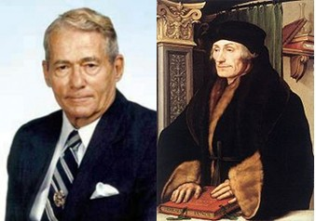
An Irony of the “King James Only” View*
KJV Advocates often object to using other English translations because you would have to know Greek and Hebrew to decide which is right and they would rather just go with the KJV.
Erasmus often had to argue against those who complained that going back to the original Greek and Hebrew was unnecessary –they thought it was good enough just to go with the Latin Vulgate.
*Adapted from James White’s, The King James Only Controversy, pp. 55-56

Slide 42
An Irony of the “King James Only” View*
We are often told that God has blessed the KJV more than any other translation of the Bible, and that the fact that it was the “only” Bible for hundreds of years should be grounds enough for us today to hold to it as the standard.
Erasmus was told: “It is not reasonable that the whole church, which has always used [the Latin Vulgate] and still both approves and uses it, should for all these centuries have been wrong.”
*Adapted from James White’s, The King James Only Controversy, p. 56

Slide 43
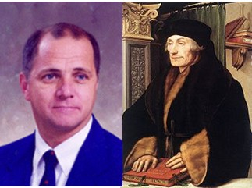
An Irony of the “King James Only” View*
KJV Advocate Dr. Samuel Gipp was asked, “What should I do where my [KJV] and my Greek Lexicon contradict?
Gipp’s Answer: “Throw out the Lexicon”
One of Erasmus’ detractors went so far as to say, “If … a sentence as rendered by the Latin translator varies in a point of truth from the Greek manuscript, at that point I bid the Greeks goodbye and cleave to the Latins.”
*Adapted from James White’s, The King James Only Controversy, pp. 56-7

Slide 44
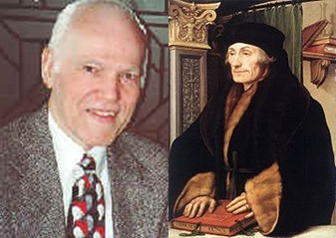
An Irony of the “King James Only” View*
KJV Advocate D.A. Waite writes, “The diabolical nature of the New King James Version shows itself in their printing all the various readings of the Greek text in the footnotes… By doing so they confuse the readers.”
Someone once complained in a letter to Erasmus that because he noted textual variants in his Greek text, “A great many people will discuss the integrity of the Scriptures and have doubts about it.”
*Adapted from James White’s, The King James Only Controversy, p. 57

Slide 45
An Irony of the “King James Only” View*
Erasmus argued against his critics using many of the arguments and facts used by modern textual scholars:
  “Granted that Greek books are just as corrupt as the Latin ones, yet by collating manuscripts that are equally corrupt one can often discover the true reading, for it frequently happens that what has been corrupted by chance in one is found intact in another.”
*Adapted from James White’s, The King James Only Controversy, p. 57

Slide 46
Interesting Quotations from the KJV Translators*
Without a translation into the vulgar [i.e. common] tongue, the unlearned are like children at Jacob’s well …without a bucket or something to draw with… Now what can be more available thereto, than to deliver God’s book unto God’s people in a tongue which they understand?
*Adapted from James White’s, The King James Only Controversy, pp. 72-76

Slide 47
Interesting Quotations from the KJV Translators*
Many men’s mouths have been open a good while (and yet are not stopped) with speeches about the Translation so long in hand… Hath the Church been deceived, say they, all this while?
*Adapted from James White’s, The King James Only Controversy, pp. 72-76

Slide 48

The Revisions of the KJV*
The KJV that is carried by the KJV Only advocate today looks very different from the edition that came off the press of Robert Barker (the royal printer) in 1611.
Numerous editions of the KJV were printed over the years, making numerous changes and corrections – although most of these changes are rather minor, it raises serious questions for the radical KJV Only proponent. Which revision is the correct one?
*Adapted from James White’s, The King James Only Controversy, pp. 78-82

Slide 49
Some Amusing Errors Found in Early Versions of the KJV*
In 1611 some KJV Bibles had Matthew 26:36 as “Then cometh Judas,” when it should read “Then cometh Jesus.”
One printing of the KJV omitted the word “not” from the Seventh Commandment (Thou shalt not commit adultery) earning it the title “The Wicked Bible”)
*Adapted from James White’s, The King James Only Controversy, p. 78

Slide 50
Some Amusing Errors Found in Early Versions of the KJV*
The unrighteous inheriting the kingdom at 1Corinthians 6:9
“Printers have persecuted” rather than “princes have persecuted” at Psalm 119:161
The use of “sin on more” rather than “sin no more” at John 5:14
The “parable of the Vinegar” rather than “Vineyard” at Luke 20.
*Adapted from James White’s, The King James Only Controversy, p. 78

Slide 51
The Revisions of the KJV*
It may surprise some readers to discover that there are differences between various printed additions of the KJV even today in our age of computer-typesetting and proofing.
The American Bible Society examined six editions of the KJV in the nineteenth century and discovered 24,000 variant in the text and punctuation as a result of this survey
Even today differences remain, sometimes in editions printed by the very same publisher.
*Adapted from James White’s, The King James Only Controversy, pp. 78-82

Slide 52
Conclusion
The King James Version is a monument to those who labored to bring it into existence. Of this there can be no question. But as we have seen, it was a human process, and as in all of human life and endeavor, it did not partake of infallibility. (James White, The King James Only Controversy, p. 82)

Slide 53
After the Kings James Version*
The early users of the KJV did not regard it as the final word in the way that King James Only advocates do today.
For a time after the King James was published:
  Some continued to buy previous versions (like the Geneva Bible)
  Others worked steadily at improving the KJV itself (over 300 corrections were made in the 1613 edition)
  Others attempted new translations because:
    Better manuscripts were becoming available
    Changes in vocabulary and style demanded more up to date renderings
*Adapted from ISBE, English Versions, p. 92

Slide 54
18th and 19th Century English Translations
Young's
Literal
Translation
Darby Bible
1862
1890
Quaker
Bible
Webster’s
Revision
Revised Version
1764
1833
1885
1700
1800
1900
http://en.wikipedia.org/wiki/Modern_English_Bible_translations

Slide 55
Quaker Bible (1764)
Translated into English by Anthony Purver (1702–1777), a Quaker, over a period of thirty years.
Purver was never able to interest anyone in publishing his translation.
Charles Haddon Spurgeon, who was acquainted with Purver’s version remarks "A Quaker Translation. Often ungrammatical and unintelligible. Not without its good points, but much more curious than useful."
http://en.wikipedia.org/wiki/Quaker_Bible

Slide 56
Webster’s Revision (1833)
A limited revision of the King James Bible focused mainly on replacing archaic words and making simple grammatical changes. Some examples:
  "why" instead of "wherefore“
  "its" instead of "his" when referring to nonliving things
  "male child" instead of "manchild“
Overall, very few changes were made, and the result is a book which is almost indistinguishable from the King James Bible.
http://en.wikipedia.org/wiki/Webster%27s_Revision

Slide 57
Young's Literal Translation (1862)
The translation was made by Robert Young, compiler of Young's Analytical Concordance to the Bible
The Literal Translation is unusual in that, as the name implies, it is a strictly literal translation of the original Hebrew and Greek texts.
Young believed that to translate the original Greek or Hebrew into a different tense in English was to tamper with the original. And so he was careful to preserve the original verb tenses, even if it made for very rough reading in English. For example in Genesis 1:3:
  YLT: … and God saith, 'Let light be;' and light is.
  NIV: And God said, "Let there be light," and there was light.
http://en.wikipedia.org/wiki/Young%27s_Literal_Translation

Slide 58
Darby Bible (1890)
Translated from Hebrew and Greek by John Nelson Darby – cofounder of the Plymouth Brethren and regarded by many as the father of premillennial Dispensationalism.
J N Darby’s purpose was, as he states in the preface to his English NT, to make a modern translation for the unlearned who have neither access to manuscript texts or training and knowledge of ancient languages of the Scriptures.
Darby’s translation work was not intended to be read aloud. His work was for study and private use. In his own oral ministry he generally used the English KJV.
http://en.wikipedia.org/wiki/Darby_Bible

Slide 59
Revised Version (1885)
A late 19th-century British revision of the King James Version, translated by a committee scholars including Westcott and Hort
The stated aim of the RV's translators was "to adapt King James' version to the present state of the English language without changing the idiom and vocabulary," and "to adapt it to the present standard of Biblical scholarship.“
The RV is regarded as the forerunner of the entire modern translation tradition.
http://en.wikipedia.org/wiki/Revised_Version

Slide 60

Modern Translation Issues

Slide 61
Modern Translation Issues
Archaic Versus Modern Language
Translation Done by Individual Versus Committee
Translation Sources:
  Original Languages Versus Other Translation(s)
  Which Manuscripts Used:
    Late Manuscripts (Majority Text)
    Early Manuscripts
Literal Versus Free
Gender Neutral

Slide 62
Literal Versus Free Translation
Many people today think that a faithful translation of the Bible means a “word-for-word” translation:
  If the original has a noun, they expect a noun in the translation.
  If the original has sixteen words, they don’t want to see seventeen in the translation.
  This type of translation is sometimes called “formal equivalence” or what I will refer to as a more literal translation.
  The KJV, NASB, and ESV come the closest to this ideal.
http://www.biblestudymagazine.com/preview/choosetranslationWeb.pdf

Slide 63
Literal Versus Free Translation
Towards the other end of the spectrum are what I will refer to as “freer” translations:
  On the far extreme is a paraphrase of the Bible
  And somewhere between a literal translation and a paraphrase are the “phrase-for-phrase” translations, also known as a “dynamic equivalence” translations.
A freer translation is not as concerned with the grammatical form of the original language, as it is with the meaning of the original.
  It does more interpreting for the reader and is therefore easier to understand.
  The NIV and the NEB follow the “dynamic equivalence” philosophy.
  The NLT and The Living Bible would be considered paraphrases.
http://www.biblestudymagazine.com/preview/choosetranslationWeb.pdf

Slide 64
Literal Versus Free Translation
More Literal
More Free
Tries to translate word for word
Tries to stay close to the original word order and form.
Tends to sacrifice readability in English in order to follow the above guidelines
Not as much word for word translation
Will often vary from original word order and form if it makes for better reading in English
Tries to convey the thoughts expressed in the original

Slide 65
Literal Versus Free Translation
More Literal
More Free
Formal Equivalence or “word for word”, literal translation (KJV, NASB, ESV)
Dynamic Equivalence or “thought for thought” translation (NIV, NEB)
Paraphrase or “free” translation (The Living Translation, NLT)

Slide 66
Literal Versus Free Translation
Anyone who has learned a second language knows that a word-for-word translation is impossible much or most of the time: Idioms and colloquialisms in a language need to be paraphrased to make sense in another language.
Even the KJV translators realized this:
  In a couple of places in the Old Testament, the Hebrew text literally reads, “God’s nostrils enlarged.” But, the KJV translates this as, “God became angry”—which is what the expression means.
  In Matthew 1:18 the KJV says that Mary was found to be with child. But the Greek is quite different and quite graphic: “Mary was having it in the belly!”
http://www.biblestudymagazine.com/preview/choosetranslationWeb.pdf

Slide 67
Literal Versus Free Translation
There are problems with each of the translation philosophies:
  The KJV, with its attempted fidelity to form, does not make sense in some passages. (In 1611, these instances did not make sense either). Likewise, The NASB often contains wooden, stilted English.
  On the other hand, freer translations sometimes go too far in their interpretation of a particular phrase.
http://www.biblestudymagazine.com/preview/choosetranslationWeb.pdf

Slide 68
Literal Versus Free Translation
A formal equivalence translation lets the reader interpret for himself.
However, the reader often does not have the background information or the tools to interpret accurately.
The net result is that the reader runs the risk of misunderstanding the text, simply because their translation was not clear enough.
http://www.biblestudymagazine.com/preview/choosetranslationWeb.pdf

Slide 69
Literal Versus Free Translation
On the other hand, a freer translation is usually clear and quite understandable.
But if the translators missed the point of the original (either intentionally or unintentionally) they may communicate an idea that is not found in the biblical text.
http://www.biblestudymagazine.com/preview/choosetranslationWeb.pdf

Slide 70
Literal Versus Free Translation
More Literal
More Free
A more literal translation lets the reader interpret for himself:
A freer translation does more interpreting for the reader, which sometimes obscures other possible interpretations
Brothers, if anyone is caught in any transgression, you who are spiritual should restore him… (Gal 6:1a ESV)
Brothers, if someone is caught in a sin, you who are spiritual should restore him… (Gal 6:1a NIV)
Dear brothers and sisters, if another believer is overcome by some sin, you who are godly should … help that person… (Gal 6:1a NLT)
Brothers and sisters, if a person is discovered in some sin, you who are spiritual restore such a person… (Gal 6:1a NET)

Slide 71
Literal Versus Free Translation
Some versions don’t interpret — they distort:
  Some are notorious for omitting references to God’s sovereignty in salvation, or for attempting to deny the deity of Christ.
  In these instances, the translators are neither faithful to the form or the meaning. They have perverted the Word of God.
http://www.biblestudymagazine.com/preview/choosetranslationWeb.pdf

Slide 72
Literal Versus Free Translation
More Literal
More Free
John 2:4b
YLT: What -- to me and to thee, woman?
NASB: Woman, what does that have to do with us?
NIV: Dear woman, why do you involve me?
TEV: You must not tell me what to do

Slide 73
Literal Versus Free Translation
More Literal
More Free
John 17:6a
NASB: I have manifested Your name to the men whom You gave Me out of the world.
ESV: I have manifested your name to the people whom you gave me out of the world.
NIV: I have revealed you to those whom you gave me out of the world.
CEV: You have given me some followers from this world, and I have shown them what you are like.

Slide 74
Review Questions on
Literal Versus Free Translations

Slide 75
Review Questions
Name the three categories of translations that I described last time and explain the differences between these categories – name one or two translations that fit in each category:
  Literal or “word for word” translations – try as much as possible to follow the structure and wording of the original Greek or Hebrew (KJV, NASB, NKJV, ESV)
  “Dynamic equivalent” translations – try to express the ideas found in the original without as much concern for the original structure or wording. (NIV, NEB)
  Paraphrases – seek to communicate the general meaning of the original with little or no regard for the structure or wording of the original. (NLT, The Living Bible)

Slide 76
Review Questions
Is there such thing as a strictly literal, “word for word” translation out there?
  No, even the most literal translations have to paraphrase idioms and colloquialisms in the original Greek or Hebrew in order to make sense in English
  In a couple of places in the Old Testament, the Hebrew text literally reads, “God’s nostrils enlarged.” But, the KJV translates this as, “God became angry”—which is what the expression means.
  In Matthew 1:18 the KJV says that Mary was found to be with child. But the Greek is quite different and quite graphic: “Mary was having it in the belly!

Slide 77
Review Questions
A freer translation tends to be easier to read and understand than a literal or “word for word” translation. What is the disadvantage of a freer translation (versus a more literal translation)?
  A freer translation does more interpreting for the reader, and may misinterpret or at least obscure other possible interpretations.
  Brothers, if anyone is caught in any transgression, you who are spiritual should restore him… (Gal 6:1a ESV)
  Dear brothers and sisters, if another believer is overcome by some sin, you who are godly should … help that person… (Gal 6:1a NLT)
  Brothers and sisters, if a person is discovered in some sin, you who are spiritual restore such a person… (Gal 6:1a NET)

Slide 78
Choosing a Bible Translation
I suggest that every Christian who is serious about studying the Bible own at least:
  One literal, “word for word” translation.
  Two good dynamic equivalent translations:
    If the translator’s interpretation is correct, it can only clarify the meaning of the text
    If the translator’s interpretation is incorrect, then a comparison with the other translation will make this evident!
And then, make sure that you read the book!
Dan Wallace, “Choosing a Bible Translation”
http://www.biblestudymagazine.com/preview/choosetranslationWeb.pdf

Slide 79
Modern Bible Translations
18th – 21st Centuries

Slide 80
20th and 21st Century English Translations
Amplified Bible
New American Standard
New King James
New English Translation
1965
1971
1982
2005
American Standard Version
Revised Standard Version
New English Bible
New International Version
English Standard Version
1901
1952
1970
1978
2001
1900
1950
2000
http://en.wikipedia.org/wiki/Modern_English_Bible_translations

Slide 81
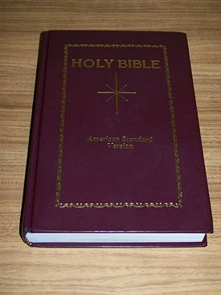
American Standard Version (1901)
The American Standard Version is rooted in the work that was done with the Revised Version (RV).
Because the language of the ASV was limited to Elizabethan English, as well as because of what some perceived to be its excessive literalism, it never achieved wide popularity, and the King James Version would remain the primary translation for most American Protestant Christians until the publication of the Revised Standard Version in 1952.
http://en.wikipedia.org/wiki/American_Standard_Version

Slide 82
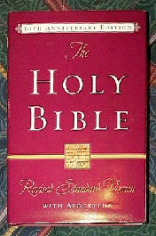
Revised Standard Version (1952)
The RSV posed the first serious challenge to the popularity of the KJV, aiming to be a readable and literally accurate modern English translation of the Bible.
The RSV New Testament was well received, but reactions to the Old Testament were varied and not without controversy.
The focus of the controversy was the translation of the Hebrew word ALMAH in Isaiah 7:14 as "young woman" rather than the traditional Christian translation of "virgin", agreeing with the Greek word found in the Septuagint's translation of this passage as well as the New Testament at Matthew 1:23.
Fundamentalists and evangelicals, in particular, accused the translators of deliberately tampering with the Scriptures to deny the doctrine of the Virgin Birth of Jesus.
http://en.wikipedia.org/wiki/Revised_Standard_Version

Slide 83

Amplified Bible (1965)
The Amplified Bible (AMP) is an English translation of the Bible produced jointly by The Zondervan Corporation and The Lockman Foundation.
It is largely a revision of the American Standard Version of 1901
It is designed to "amplify" the text by using a system of punctuation and other typographical features to bring out all shades of meaning present in the original texts:
  THE LORD is my Shepherd [to feed, guide, and shield me], I shall not lack. He makes me lie down in [fresh, tender] green pastures; He leads me beside the still and restful waters. He refreshes and restores my life (my self); He leads me in the paths of righteousness [uprightness and right standing with Him--not for my earning it, but] for His name's sake.
http://en.wikipedia.org/wiki/Amplified_Bible

Slide 84
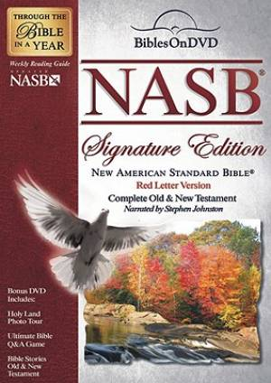
New American Standard Bible (1971, 1995)
Was first published in 1971 by the Lockman Foundation. It was then updated in 1995.
The revised NASB (1995) involved over 20 translators from a variety of denominational backgrounds who are conservative Bible scholars with doctorates in biblical languages, theology, or other advanced degrees.
As its name implies, the NASB is a revision of the American Standard Version of 1901.
This translation was begun as an alternative to the Revised Standard Version, itself a revision of the ASV, but considered by many to be theologically liberal.
The NASB is very accurate and very literal in its translation making it a good study Bible but makes for somewhat stiff reading.
http://en.wikipedia.org/wiki/New_American_Standard_Bible

Slide 85
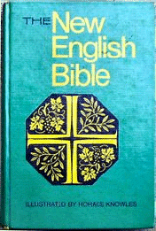
The New English Bible (1970)
The New English Bible (NEB) was a fresh translation of the Bible into modern English directly from the original Greek, Hebrew, and Aramaic texts.
Three committees of translators and one committee of literary advisers were enlisted and charged with the task of producing the New English Bible.
The translators of the New English Bible used a principle of translation called dynamic equivalence (also referred to as thought-for-thought translation).
C. H. Dodd, Vice-Chairman and Director of the Joint Committee, commented that the translators "...conceived our task to be that of understanding the original as precisely as we could... and then saying again in our own native idiom what we believed the author to be saying in his."
http://en.wikipedia.org/wiki/New_English_Bible

Slide 86
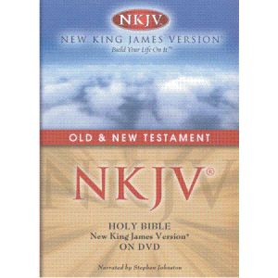
New King James (1982)
The translators sought to update the vocabulary and grammar of the King James Version, “while preserving the classic style and beauty of the 1611 version”.
The New King James Version also uses the Textus Receptus ("Received Text") for the New Testament, just as the King James Version had used.
In spite of the efforts made to stay true to the KJV, many proponents of the King-James-Only Movement see the New King James Version as something less than a true successor to the KJV.
http://en.wikipedia.org/wiki/New_King_James_Version

Slide 87
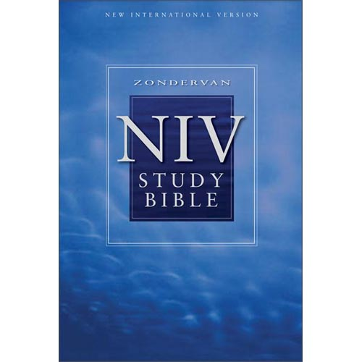
New International Version (1978)
Published by Zondervan, the NIV became one of the most popular modern translations made in the twentieth century.
The core translation group consisted of fifteen Biblical scholars. The translation took ten years and involved a team of up to 100 people from the USA, Canada, the United Kingdom, Australia, New Zealand, and South Africa.
The range of those participating included over twenty different denominations such as Baptists, Evangelicals, Methodists, Lutherans, Anglicans, and more.
The translators tried to produce an accurate and readable translation that would fall between a literal word-for-word translation and a paraphrase.
http://en.wikipedia.org/wiki/New_International_Version

Slide 88
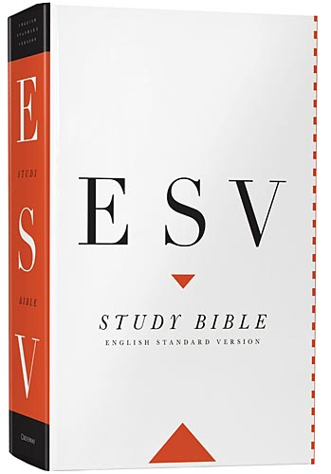
English Standard Version (2001)
A revision of the 1971 edition of the Revised Standard Version.
Like the NASB and others before that, it follows a somewhat literal style of translation.
The ESV also tried to avoid the degree of “gender-neutral” style of translation used by later revisions of the NIV (such as the TNIV).
The ESV Study Bible was released by Crossway Bibles in October 2008. The general editor is Wayne Grudem, and features ESV editor J.I. Packer as theological editor
http://en.wikipedia.org/wiki/English_Standard_Version

Slide 89
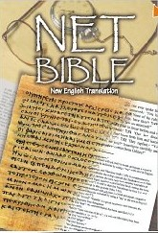
New English Translation (2005)
A completely new translation of the Bible, not an update or revision of an older one .
The translation and extensive notes were undertaken by more than twenty biblical scholars who worked directly from the best currently available Hebrew, Aramaic, and Greek texts.
The translation is most notable for:
  An immense number of lengthy footnotes (which often explain its textual translation decision)
  Its open translation process
  Its availability on the Internet
  Its open copyright permitting free downloads.
http://en.wikipedia.org/wiki/English_Standard_Version

Slide 90

What’s Wrong with Gender-Neutral Bible Translations?

Slide 91
What’s Wrong with Gender-Neutral Bible Translations?
At first the idea of a gender neutral (or what some would call “gender-inclusive”) translation of the Bible can sound like a good idea:
At last, we are told, misleading, masculine-oriented language has been removed from the Bible. For example, in Romans 3:28:
  NIV - Paul no longer says, “we maintain that a man is justified by faith apart from observing the law ”
  NRSV - But instead, “For we hold that a person is justified by faith apart from works prescribed by the law”
http://www.cbmw.org/Resources/Articles/What-s-Wrong-with-Gender-Neutral-Bible-Translations

Slide 92
What’s Wrong with Gender-Neutral Bible Translations?
The NRSV in 1989 was one of the first major "gender neutral" translations, but many of its patterns have been followed by:
  Contemporary English Version (CEV) - 1995
  New Living Translation (NLT) - 1996
  New International Version-Inclusive Language Edition (NIVI ) - 1997 (In England only)
  Today's New International Version (TNIV) – 2002
“In 1952, one woman was at the center of the storm of Bible translations; beginning in 1989, all women were the focus. And, once again, it was the (N)RSV that was the instigator.” (Dan Wallace)
http://www.cbmw.org/Resources/Articles/What-s-Wrong-with-Gender-Neutral-Bible-Translations (by Wayne Grudem)

Slide 93
What’s Wrong with Gender-Neutral Bible Translations?
To their credit, the NRSV has not gone as far as some people wanted, because it still calls:
  God "Father" (not "Parent")
  Jesus the "Son of God" (not "Child of God")—
This was probably in large measure due to the conservative influence of the chairman of the NRSV translation committee: Bruce Metzger.
But there are many other changes that should cause evangelicals concern.
http://www.cbmw.org/Resources/Articles/What-s-Wrong-with-Gender-Neutral-Bible-Translations (by Wayne Grudem)

Slide 94
What’s Wrong with Gender-Neutral Bible Translations?
The biggest concern comes as we see that modern society is becoming increasingly opposed to the Biblical distinctions that the Bible makes between men and women. For example:
  Modern feminists reject many of the role distinctions that God has established for men and women
  There is a strong movement underway in many parts of our country today to do away with all gender distinctions!
So when we see translators attempting to remove gender distinctions that exist in the Bible, we are rightly concerned that they may be twisting what the Bible says in an effort to make it conform to modern worldly thinking.

Slide 95

The Gender-Neutral Controversy Erupts
http://www.salemthesoldier.us/TNIV_concordia_debate.html
http://www.cbmw.org/Resources/Articles/What-s-Wrong-with-Gender-Neutral-Bible-Translations

Slide 96
Gender-Neutral Controversy Erupts
In 1997, the translators of the NIV Bible (IBS), produced the NIVI – a new gender-neutral translation of the Bible which was published in England.
They intended to go on and produce an American gender-neutral translation as well, but when word got out, there was a strong public outcry among conservative evangelicals.
In May, 1997, Dr. James Dobson convened a meeting in Colorado Springs with a number of well known conservative evangelical leaders to try to address the issue.
  Attendees included: Wayne Grudem, John Piper, Ken Barker, R.C. Sproul, Joel Belz, and others

Slide 97
Gender-Neutral Controversy Erupts
In this meeting they produced a list of guidelines that they believed should be followed when translating gender in an English translation of the Bible.
Later these guidelines were endorsed by an even wider range of evangelical leaders including J. I. Packer, Al Mohler, Bill Bright, Stu Weber, Gleason Archer, Robert Lewis, etc.
In response to public outcry and the concerns expressed by these evangelical leaders, IBS promised to “abandon all plans for gender-related changes in future editions of the NIV”.
But in 2002, IBS secretly worked to produce a gender neutral translation known as the TNIV and, after it was published, notified Wayne Grudem and others that they were “withdrawing” from their agreement not to produce a gender neutral translation!

Slide 98
Examples of
Gender-Neutral Translation Problems
http://www.cbmw.org/Resources/Articles/What-s-Wrong-with-Gender-Neutral-Bible-Translations (by Wayne Grudem)

Slide 99
Gender-Neutral Translation Problems
Psalm 34:20:
RSV: “He keeps all his bones; not one of them is broken.”
  John's gospel refers to this (and probably Exod. 12:46) with respect to Jesus' death: "For these things took place that the scripture might be fulfilled, 'Not a bone of him shall be broken'" (19:36, RSV).
NRSV: "He keeps all their bones; not one of them will be broken.”
  The individuality of the Messianic prediction, so wonderfully fulfilled in Jesus' death, is lost to readers of the NRSV.
  And the NCV, NLT, and TNIV all have "their bones" as well, even though the statement is singular ("his bones") in Hebrew.
http://www.cbmw.org/Resources/Articles/What-s-Wrong-with-Gender-Neutral-Bible-Translations (by Wayne Grudem)

Slide 100
Gender-Neutral Translation Problems
Psalm 19:9-12
NRSV: "The ordinances of the Lord are true....More to be desired are they than gold....in keeping them there is great reward. But who can detect their errors?"
RSV: the ordinances of the LORD are true…. More to be desired are they than gold …. in keeping them there is great reward. But who can discern his errors?
http://www.cbmw.org/Resources/Articles/What-s-Wrong-with-Gender-Neutral-Bible-Translations (by Wayne Grudem)

Slide 101
Gender-Neutral Translation Problems
Proverbs 16:9
RSV: A man's mind plans his way, but the Lord directs his steps. (The NIV, NASB, KJV, and nKJV all have the literal translation "his" as well).
NCV: People may make plans in their minds, but the Lord decides what they will do.
NIVI: In your heart you may plan your course, but the Lord determines your steps.
NLT: We can make our plans, but the Lord determines our steps. (CEV is similar.)
NRSV: The human mind plans the way, but the Lord directs the steps.
http://www.cbmw.org/Resources/Articles/What-s-Wrong-with-Gender-Neutral-Bible-Translations (by Wayne Grudem)

Slide 102
Gender-Neutral Translation Problems
How often are singulars changed to plurals? The words "they, them, their, those" occur 1,732 more times in the NRSV than in the RSV. In many other places, “he” has been changed to “you” or “we.”
Why? There have been no new archaeological discoveries, no changes in our knowledge of Greek and Hebrew, no ancient texts discovered that make us put plural pronouns instead of singular in these places, or first or second person in place of third person.
The changes have been made because the NRSV translators were required by a division of the National Council of Churches to remove “masculine oriented language” from the Bible.
http://www.cbmw.org/Resources/Articles/What-s-Wrong-with-Gender-Neutral-Bible-Translations (by Wayne Grudem)

Slide 103
Gender-Neutral Translation Problems
Genesis 5:2
RSV: “Male and female he created them, and he blessed them and named them Man (Hebrew: adam) when they were created”
NRSV: "Male and female he created them, and he...named them 'Humankind' when they were created"
  Here God gives the Hebrew name adam to the male and female together they constitute the human race.
  The Hebrew word adam is also used to refer to Adam in particular, and it is sometimes used to refer to man in distinction from woman – see Gen 2:25, “the man (adam) and his wife were both naked, and were not ashamed”.
  The English word “man” most accurately translates adam because it is the only word we have that has those same two meanings (the human race, or a male human being).
http://www.cbmw.org/Resources/Articles/What-s-Wrong-with-Gender-Neutral-Bible-Translations (by Wayne Grudem)

Slide 104
Gender-Neutral Translation Problems
Matthew 18.15
RSV: “If your brother sins against you, go and tell him his fault, between you and him alone. If he listens to you, you have gained your brother.”
NRSV: “If another member of the church sins against you, go and point out the fault when the two of you are alone. If the member listens to you, you have regained that one.”
  In Matt 18.15, the NRSV is an ugly translation. This is due to an overriding principle of making the translation gender inclusive, even if the English ends up being terrible. Who speaks like this: “If the member listens to you, you have regained that one”? In this respect, the NRSV has gone retro, mimicking the homeliness of the old RV, but without its accuracy. (Dan Wallace)
http://www.reclaimingthemind.org/blog/2011/07/a-review-of-the-niv-2011-part-1-of-4/ (by Dan Wallace)

Slide 105
Gender-Neutral Translation Problems
Titus 1:5-6
RSV: ….appoint elders in every town as I directed you….the husband (Greek: aner) of one wife…
NRSV: ….appoint elders in every town, as I directed you…. married only once…
http://www.cbmw.org/Resources/Articles/What-s-Wrong-with-Gender-Neutral-Bible-Translations (by Wayne Grudem)

Slide 106
Gender-Neutral Translation Problems
Numbers 31:28
RSV - “the men of war who went out to battle”
NRSV – “the warriors who went out to battle”
http://www.cbmw.org/Resources/Articles/What-s-Wrong-with-Gender-Neutral-Bible-Translations (by Wayne Grudem)

Slide 107
Gender-Neutral Translation Problems
Daniel 7:13
RSV - “I saw in the night visions, and behold, with the clouds of heaven there came one like a son of man…
NRSV – “As I watched in the night visions, I saw one like a human being coming with the clouds of heaven…
Compare with Matthew 26:64
RSV: Jesus said to him, “…hereafter you will see the Son of man seated at the right hand of Power, and coming on the clouds of heaven.”
NRSV: Jesus said to him, “…From now on you will see the Son of Man seated at the right hand of Power and coming on the clouds of heaven.”
http://www.cbmw.org/Resources/Articles/What-s-Wrong-with-Gender-Neutral-Bible-Translations (by Wayne Grudem)

Slide 108
Literal Versus Free Translation
More Literal
More Free
Formal Equivalence or “word for word” translation
Dynamic Equivalence or “thought for thought” translation
Paraphrase or “free” translation

Slide 109
20th and 21st Century English Paraphrases
J.B. Phillips NT
Good News Bible
New Living Translation
1958
1976
1996
The Living Bible
Contemporary English Version
The Message
1971
1995
2002
1900
1950
2000
http://en.wikipedia.org/wiki/Modern_English_Bible_translations

Slide 110
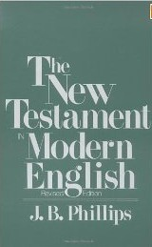
J.B. Phillip’s New Testament (1958)
A paraphrase of the New Testament by Anglican clergyman J. B. Phillips.
While the translation is not well known it has many ardent fans:
  Os Guinness
  Chuck Swindoll
  The late Ray Stedman
  Corrie ten Boom considered it her favorite in English.
  The songwriter Michael Card often used Phillips' wording.
Phillips began by rewording the New Testament epistles for his church's youth group as they met during World War II in bomb shelters. He published in 1947 under the title Letters to Young Churches.
Phillips worked entirely from the Greek Testament
The most famous passage from this translation is a portion of Romans 12:2, “Don't let the world around you squeeze you into its own mould.”
http://en.wikipedia.org/wiki/Phillips_New_Testament_in_Modern_English

Slide 111

The Living Bible (1971)
English version of the Bible is a paraphrase created by Kenneth N. Taylor using the American Standard Version of 1901 as his base text.
This particular paraphrase is notorious for being inaccurate in a number of places. For example in Acts 13:48 :
  ESV: And when the Gentiles heard this, they began rejoicing and glorifying the word of the Lord, and as many as were appointed to eternal life believed.
  TLB: When the Gentiles heard this, they were very glad and rejoiced in Paul’s message, and as many as wanted eternal life, believed.
http://en.wikipedia.org/wiki/The_Living_Bible

Slide 112
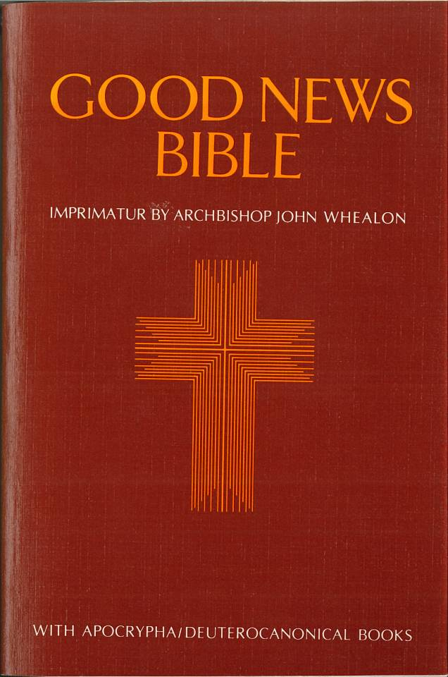
Good News Bible (1976)
An English language translation of the Bible by the American Bible Society, also known as Today's English Version (TEV), was first published as the New Testament under the name Good News for Modern Man in 1966.
The beginnings of the Good News Bible can be traced to requests made by people in Africa and the Far East for a version of the Bible that was friendly to non-native English speakers.
http://en.wikipedia.org/wiki/Good_News_Bible

Slide 113

Contemporary English Version (1995)
A new translation of the Bible published by the American Bible Society.
The CEV project began as a result of studies conducted by Barclay Newman in 1985 into speech patterns used in books, magazines, newspapers, and television. These studies focused on how English was read and heard.
These studies eventually led to the publication of the Contemporary English Version.
http://en.wikipedia.org/wiki/Contemporary_English_Version

Slide 114

New Living Translation (1996)
Originally starting out as an effort to revise The Living Bible, but ended up evolving into the production of an entirely new English translation with ninety translators working from the original Greek and Hebrew.
The translators have sought to create a translation that bridges the gap between the ancient world and modern readers of English.
Ancient systems of measure (weights, measures, money, dates, etc.) are converted to modern equivalents, often with footnotes.
http://en.wikipedia.org/wiki/New_Living_Translation

Slide 115

The Message (2002)
A paraphrase created by Eugene H. Peterson.
In the introduction to this paraphrase they claim its “contemporary idiom keeps the language of the Message (Bible) current and fresh and understandable” – but like any paraphrase, it does sometimes take liberties that go beyond the original, e.g. 1Cor 6:9-10:
  ESV: Or do you not know that the unrighteous will not inherit the kingdom of God? Do not be deceived: neither the sexually immoral, nor idolaters, nor adulterers, nor men who practice homosexuality, nor thieves, nor the greedy, nor drunkards, nor revilers, nor swindlers will inherit the kingdom of God.
  The Message: Don't you realize that this is not the way to live? Unjust people who don't care about God will not be joining in his kingdom. Those who use and abuse each other, use and abuse sex, use and abuse the earth and everything in it, don't qualify as citizens in God's kingdom.
http://en.wikipedia.org/wiki/The_Message_(Bible)

Slide 116
Ranking of Translations From Literal to Paraphrase
Translation | Ranking
King James Version | 1
New American Standard Bible | 1
English Standard Version | 1
New King James Version | 2
New International Version | 5
New English Translation | 5
New Living Translation | 7
The Message | 9
Contemporary English Version | 9
Today’s English Version (Good News Bible) | 9
http://www.participatorystudyseries.com/versioncomp.php

Slide 117
Which English Translation?
An Area of Wisdom and Liberty
Not a Test of Orthodoxy!
In studying, it is a good idea to use a number of good translations so as to get more of the possible flavors of what a text might mean.
Generally translations that are the most helpful will be those that:
  Are translated by a team of good scholars
  Use the best (and usually oldest) manuscripts available
  Stick as close to the original as possible (not a paraphrase)
  Use good readable modern English (but avoid gender-neutral language where it is not appropriate)
Although paraphrases have their place, use them carefully recognizing that ideas can be introduced that are not in the original

Slide 118
Elegance, Accuracy, Readability in Major English Bibles*
(scale of 1-10, with 10 being the best score)
 | Elegance | Accuracy | Readability
KJV | 9 | 5 | 3
RV | 1 | 9 | 2
ASV | 4 | 9 | 5
RSV | 7 | 8 | 8
NASB | 4 | 8 | 4
NRSV | 6 | 8 | 6
ESV | 8 | 8 | 8
NIV (whole tradition) | 4 | 8 | 10
NET | 7 | 10 | 6
*Given in a recent blog by Dan Wallace:
http://www.reclaimingthemind.org/blog/2011/07/a-review-of-the-niv-2011-part-3-of-4/

