Slide 1


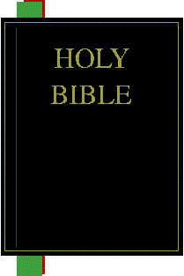

God
How God Provides Us With His Word
Revelation
Prophet
or Apostle
Illumination
Application
Inspiration
Christians
Today
Observation
and
Interpretation
Original
Manuscript
Manuscript
Copies
Preservation
Translation

Slide 2
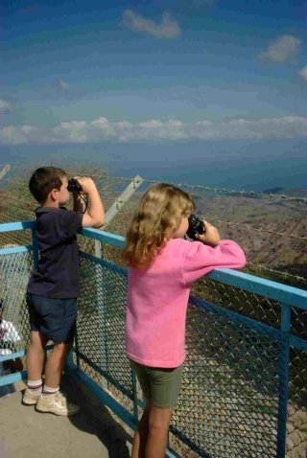
Observation

Slide 3
How Our Bible is Divided
Old Testament |  | 39 Books
Pentateuch | Genesis – Deuteronomy | 5 Books
Historical Books | Joshua - Esther | 12 Books
Poetry and Wisdom Books | Job – Song of Solomon | 5 Books
Major Prophets | Isaiah – Daniel | 5 Books
Minor Prophets | Hosea – Malachi | 12 Books
New Testament |  | 27 Books
Historical Narrative | Gospels – Acts | 5 Books
Paul’s Letters | Romans – Philemon | 13 Books
General Letters | Hebrews – Jude | 8 Books
Revelation |  | 1 Book

Slide 4
Jewish Division of the Bible = TaNaKh
Torah = “Teaching” | Nevi'im = “Prophets” |  |  | Ketuvim = “Writings
1. Genesis | 6. Joshua |  |  | 14. Psalms
2. Exodus | 7. Judges |  |  | 15. Proverbs
3. Leviticus | 8. Samuel (I & II) |  |  | 16. Job
4. Numbers | 9. Kings (I & II) |  |  | 17. Song of Songs
5. Deuteronomy | 10. Isaiah |  |  | 18. Ruth
 | 11. Jeremiah |  |  | 19. Lamentations
 | 12. Ezekiel |  |  | 20. Ecclesiastes
 | 13. The Twelve Prophets: |  |  | 21. Esther
 | Hosea | Jonah | Zephaniah
 | Joel | Micah | Haggai
 | Amos | Nahum | Zechariah
 | Obadiah | Habakkuk | Malachi
 |  |  |  | 22. Daniel
 |  |  |  | 23. Ezra-Nehemiah
 |  |  |  | 24. Chronicles (I & II)
http://en.wikipedia.org/wiki/Tanakh

Slide 5
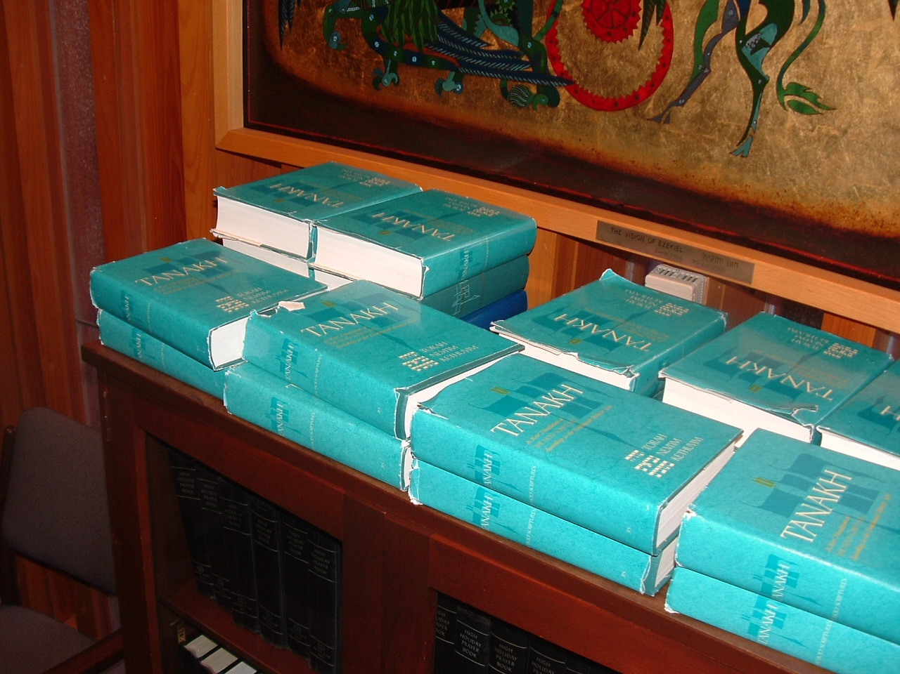
TANAKHs in a Jewish Synagogue
(Air Force Academy Chapel)

Slide 6
Six Types of Biblical Literature
Type | Description | Explanation | Examples
The Law | Regulations to order one’s life by | Rules and regulations for every aspect of life | Leviticus, Numbers
Narrative | Historical Account | Written in a straightforward literal fashion. The easiest form of literature to understand – but sometimes it is hard to tell if what someone is doing is right or wrong since the narrative often doesn’t say. | Genesis, Ruth, Judges, Acts
Poetic | Feelings put into words | Feelings pointed in the right direction | Job, Psalms
Proverbial | Wise sayings | Gives us general principles of wisdom usually short pithy sayings | Proverbs
Didactic | Teaching | Gives us principles to live by. The challenge comes in knowing how to apply these principles in varying times and circumstances. | Ex 20:8 cf. Col 2:16; Prov 23:9 cf. 26:5; Mat 19:24 cf. 1Tim 6:17
Prophetic | Predictions – often given in symbolic language | Reveals God’s predetermined plans. Because they are often given in veiled and symbolic language, the exact meaning of prophesies are sometimes difficult to discern until after their fulfillment (1Pet 1:10-12) | Isaiah 53; Rev 12:1ff

Slide 7
God
How God Provides Us With His Word
Revelation
Prophet
or Apostle
Illumination
Application
Inspiration
Christians
Today
Observation
and
Interpretation
Original
Manuscript
Manuscript
Copies
Preservation
Translation

Slide 8

Before You Begin to Study the Text . . .
Pray –
  All good things come from God (Jas. 1:17) – even the ability to notice important things in the text itself.
  We are commanded to ask for wisdom (Jas. 1:5) and we should acknowledge our dependency on God any time we study by asking Him to open our mind and heart to know Him more as we study.

Slide 9
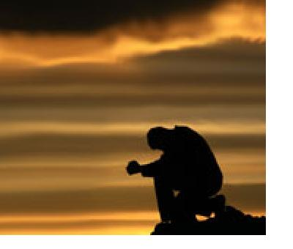
Before You Begin to Study the Text . . .
Approach the text with humility –
  Recognize that in spite of your best intentions you will:
    Miss some things,
    Misread some things,
    Never fully understand all that God is communicating in the text.
  Nevertheless, trust that God will not send you away from His word empty handed. Be thankful for everything He gives you!

Slide 10
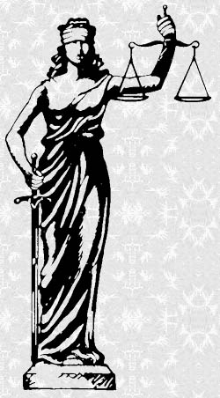
Before You Begin to Study the Text . . .
Approach the text with objectivity –
  Always strive to be fair with the text.
  Be careful not to read your preconceived ideas into the text:
    What someone told you it says
    What you always thought it was saying
    What fits with your preconceived theological ideas
  Though these things will be in your mind as you study the text – always try to differentiate between what is actually in the text and what you would tend to bring to the text because of your presuppositions.

Slide 11

Examining the Context
Before you even begin making observations about a passage in the Bible, it is often very helpful to study the context in which the passage is found.
Understanding the context of a passage and how it fits into that context is foundational to understanding that passage.
Start with the larger context and work your way to the more immediate context.

Slide 12
Examining the Context
What Testament is it in?
  The Old Testament is primarily addressed to the nation of Israel and looks forward to Christ’s coming.
  The New Testament is addressed to spiritual Israel - Christians from every nation tongue and tribe. It explains the coming of Christ and looks forward to His Second Coming.

Slide 13
Examining the Context
What is the context of the book in which it occurs?
  In many cases, the context of a Biblical book can be found by looking in other books of the Bible. For example, the context of many of the New Testament letters is given in the Book of Acts.
  We can also look at extra-Biblical historical information for help in understanding the context.

Slide 14
Examining the Context
Ask the Who – When – Where – To Whom – What Questions about the book where the passage is found:
  Who wrote the book? Identify the author (if possible). It is also helpful to go on and familiarize yourself with the author – his life, his personality, and where the writing of this book fits into his life.
  When was it written? Identify the year in which the book was written. It is also helpful to identify major events that occurred around that time.
  Where was it written? It is helpful to identify on a map the location where the letter was written. What country, province, city? What was it like there? What were the circumstances under which the author was writing?

Slide 15
Examining the Context
Ask the Who – When – Where – To Whom – What Questions about the book where the passage is found:
  To Whom was it written? Was it written to a person or group of people? Find out what you can about the recipient(s) of this book. What were they like? How would they have viewed this book?
  What was the occasion of the writing of this book? What circumstances lead up to the writing of this book? Identify (if possible) the circumstances surrounding the delivery of this book to its recipients.
  What is the overall purpose of the book? What purpose does the human author seem to have had at the time he wrote the book? What is the theme of the book? What issue(s) was the book addressing?

Slide 16
Examining the Context
How does the passage that you are studying fit into the overall context of the book?
  Given the books overall purpose what part does this passage play in that purpose?
  The best way to do this is to make an outline of the book and identify where this passage fits in the outline.

Slide 17
Observation – What Does It Say?
Read the text – There is no substitute for just reading the text. Much of what scripture says can be understood by just reading it. Of course you will make some important discoveries as you study the text more carefully – but learn what you can by just reading it first.
Identify the type of literature – Identifying the type of literature will give you some preliminary clues as to how to approach the text. For example:
  If you are dealing with poetry, then you will be looking for symbols, figures of speech, etc.
  If you are reading narrative, the text will tend to read in a straightforward manner – but you will need to be careful about trying to build doctrine on a narrative example.

Slide 18
Observation – What Does It Say?
Reread the text a number of times– Each time you read the text there is a chance that you will notice something that you hadn’t noticed before.

Slide 19
Observation – What Does It Say?
Read the text in several translations
  It is generally best to use a somewhat literal contemporary translation done by a team of reputable scholars (I recommend the NIV, ESV, or the NASB) as your base translation from which you will do your main work.
  But after having read the text in this translation, try reading it in other translations. Sometimes the best commentary on a passage is another translation.
  Try reading different types of translations. Differences in good translations sometimes show that from a linguistic standpoint a passage can be translated more than one way.
    Paraphrased translations, if done well, can give fuller sense to a text.
    Amplified translations often bring out other possible word meanings, etc.

Slide 20
Observation – What Does It Say?
Some possible things to look for:
  Key words – Look for key words that “jump out at you”. Repeated words, words (or phrases) which the author seems to give special emphasis, or words which if removed would leave the text devoid of meaning.
  Names of people and places – If a text mentions individuals or places then you will need to identify these for future reference.
  Contrasts – Many times a contrast is noted by the words such as “but”, “however”, “nevertheless” etc. Sometimes a contrast can between contrasting words such as “day” and “night”, “light” and “darkness”, etc.

Slide 21
Observation – What Does It Say?
Some possible things to look for:
  Comparisons – Usually comparisons can be identified by words such as “like” or “as”.
  Expressions of Time – Some common “time” words are “then”, “after this”, “until”, “when”, etc.
  Conclusions, Summaries, or Results – Identified by such words as “therefore”, “for”, “so that”, “for this reason”, etc.
  Citations of Scripture – Sometimes a text will cite another scripture. Try to identify the citation(s) given and study them in their original context.

Slide 22
Observation – What Does It Say?
Ask the Who, What, When, Where, Why, and How Questions about the passage itself – These questions will get you started making foundational observations
Identify words whose meaning you are uncertain of – These words should be identified for future research as you get further in your study of the text.
Identify major doctrines or topics addressed in this text – These topics will lead you to compare scripture with scripture as you dig further into the interpretation of this text.

Slide 23
Observation – What Does It Say?
List questions that the text raises in your mind or, if you are teaching, look for questions that others might ask – List as many questions as you can, the more questions you raise (and eventually answer) the more you will understand about the text. For example, ask yourself:
  What each word means in this context.
  What it is the writer is really saying (can you put it in other words?).
  What limits there might be to what the writer is saying?
  Are there seeming conflicts with other things you believe to be true from the Bible or otherwise – how do you reconcile those ideas?
Develop an outline of the text – An outline breaks down and organizes the logical thought expressed in the passage and helps set the context.

Slide 24

John 10:31-42

Slide 25
John 10:31-33 (ESV) NLT AMP
³¹ The Jews picked up stones again to stone him.
³² Jesus answered them, “I have shown you many good works from the Father; for which of them are you going to stone me?”
³³ The Jews answered him, “It is not for a good work that we are going to stone you but for blasphemy, because you, being a man, make yourself God.”

Slide 26
John 10:31-33 (NLT) ESV
³¹ Once again the people picked up stones to kill him. ³² Jesus said, "At my Father's direction I have done many good works. For which one are you going to stone me?" ³³ They replied, "We're stoning you not for any good work, but for blasphemy! You, a mere man, claim to be God.”

Slide 27
John 10:31-33 (AMP) ESV
³¹ Again the Jews brought up stones to stone Him. ³² Jesus said to them, My Father has enabled Me to do many good deeds. [I have shown many acts of mercy in your presence.] For which of these do you mean to stone Me? ³³ The Jews replied, We are not going to stone You for a good act, but for blasphemy, because You, a mere Man, make Yourself [out to be] God.

Slide 28
John 10:34-38 (ESV) NLT AMP
³⁴ Jesus answered them, “Is it not written in your Law, ‘I said, you are gods’?* ³⁵ If he called them gods to whom the word of God came--and Scripture cannot be broken-- ³⁶ do you say of him whom the Father consecrated and sent into the world, ‘You are blaspheming,’ because I said, ‘I am the Son of God’? ³⁷ If I am not doing the works of my Father, then do not believe me; ³⁸ but if I do them, even though you do not believe me, believe the works, that you may know and understand that the Father is in me and I am in the Father.”

Slide 29
John 10:34-38 (NLT) ESV
³⁴ Jesus replied, “It is written in your own Scriptures that God said to certain leaders of the people, ‘I say, you are gods!’ ³⁵ And you know that the Scriptures cannot be altered. So if those people who received God's message were called ‘gods,’ ³⁶ why do you call it blasphemy when I say, ‘I am the Son of God’? After all, the Father set me apart and sent me into the world. ³⁷ Don't believe me unless I carry out my Father's work. ³⁸ But if I do his work, believe in the evidence of the miraculous works I have done, even if you don't believe me. Then you will know and understand that the Father is in me, and I am in the Father.”

Slide 30
John 10:34-38 (AMP) ESV
³¹ Jesus answered, Is it not written in your Law, I said, You are gods? ³⁵ So men are called gods [by the Law], men to whom God’s message came—and the Scripture cannot be set aside or cancelled or broken or annulled— ³⁶ [If that is true] do you say of the One Whom the Father consecrated and dedicated and set apart for Himself and sent into the world, You are blaspheming, because I said, I am the Son of God? ³⁷ If I am not doing the works [performing the deeds] of My Father, then do not believe Me [do not adhere to Me and trust Me and rely on Me]. ³⁸ But if I do them, even though you do not believe Me or have faith in Me, [at least] believe the works and have faith in what I do, in order that you may know and understand [clearly] that the Father is in Me, and I am in the Father [One with Him].

Slide 31
Psalm 82:1-7 (ESV) John 10
³¹ God has taken his place in the divine council; in the midst of the gods he holds judgment: ² “How long will you judge unjustly and show partiality to the wicked? Selah ³ Give justice to the weak and the fatherless; maintain the right of the afflicted and the destitute. ⁴ Rescue the weak and the needy; deliver them from the hand of the wicked.” ⁵ They have neither knowledge nor understanding, they walk about in darkness; all the foundations of the earth are shaken. 6 I said, “You are gods, sons of the Most High, all of you; ⁷ nevertheless, like men you shall die, and fall like any prince.”

Slide 32
John 10:39-42 (ESV) NLT AMP
³⁹ Again they sought to arrest him, but he escaped from their hands. ⁴⁰ He went away again across the Jordan to the place where John had been baptizing at first, and there he remained. ⁴¹ And many came to him. And they said, "John did no sign, but everything that John said about this man was true." ⁴² And many believed in him there.

Slide 33
John 10:39-42 (NLT) ESV
³⁹ Once again they tried to arrest him, but he got away and left them. ⁴⁰ He went beyond the Jordan River near the place where John was first baptizing and stayed there awhile. ⁴¹ And many followed him. “John didn't perform miraculous signs,” they remarked to one another, “but everything he said about this man has come true.” ⁴² And many who were there believed in Jesus.

Slide 34
John 10:39-42 (AMP) ESV
³⁹ They sought again to arrest Him, but He escaped from their hands. ⁴⁰ He went back again across the Jordan to the locality where John was when he first baptized, and there He remained. ⁴¹ And many came to Him, and they kept saying, John did not perform a [single] sign or miracle, but everything John said about this Man was true. ⁴² And many [people] there became believers in Him. [They adhered to and trusted in and relied on Him.]

Slide 35
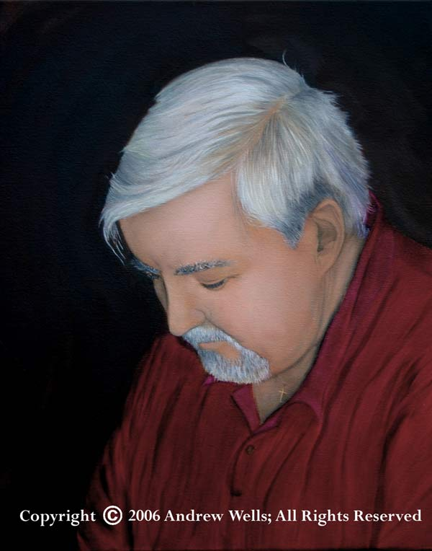
Interpreting the Word of God

Slide 36
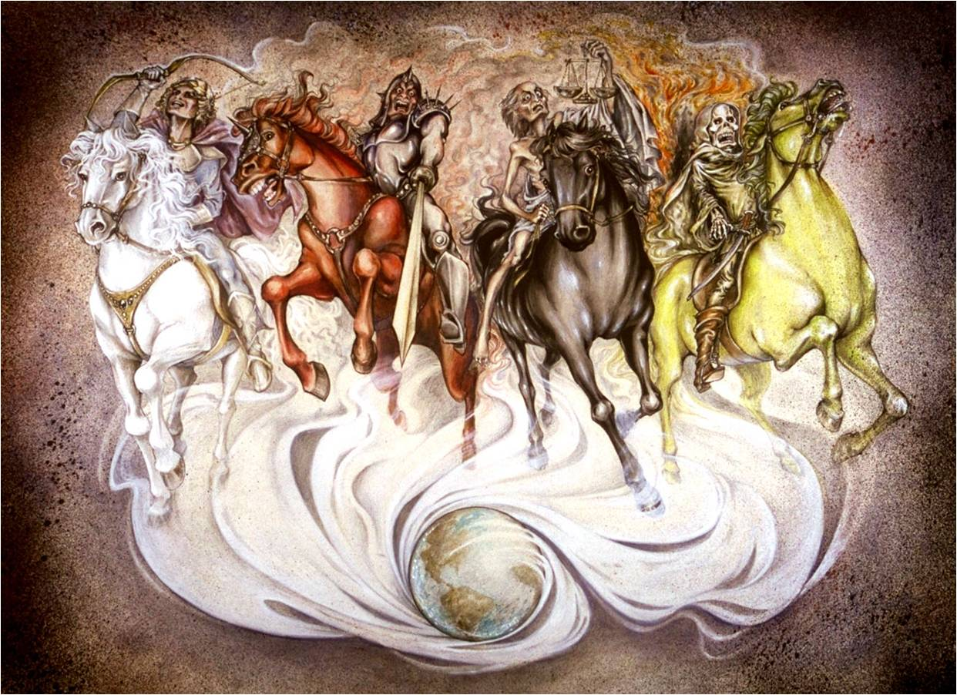
Literal Versus Figurative

Slide 37
Literal Versus Figurative
A question that often arises in Bible interpretation is whether, in a particular passage, the Bible should be interpreted literally or figuratively.
We must keep in mind that the Bible is not a mystical or spooky book that requires special rules of interpretation.
The Bible was written in the common language of the people to whom it was written and it was written in forms of literature that were common outside the Bible.
Therefore we should approach Bible interpretation in the same way that we would approach the interpretation of other similar kinds of literature.

Slide 38
Literal Versus Figurative
When determining whether a particular statement in the Bible is to be taken literally or figuratively, we should take into account:
  Type of literature – Narrative passages should be taken literally unless common sense or something in the context alerts us to the fact that particular part of it should be taken figuratively. On the other hand, we should not try to force crass literalism on a passage of poetry or on a section of apocalyptic literature.
  Context – Usually the context will contain clues that will tell you whether something was intended literally or not.

Slide 39
Literal Versus Figurative
When determining whether a particular statement in the Bible is to be taken literally or figuratively, we should take into account:
  Comparing Scripture with Scripture – Often times, comparing a passage in question with other clear passages on the same subject will help us determine whether to take a passage literally or figuratively.
  Common Sense – Giving consideration to the points above and using the same common sense that you use in everyday communication - most of the time it’s pretty obvious whether a passage should be interpreted literally or figuratively.

Slide 40
Literal Versus Figurative
If, after going through the above process, you are still uncertain, then you will have to remain open on how to interpret the passage until God gives you greater understanding.

Slide 41
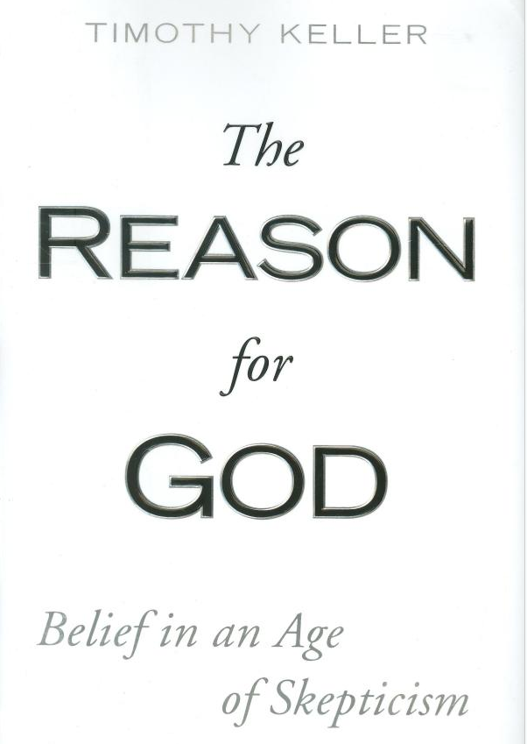
An Example of the Abuse of Figurative Language:
Calling Something Figurative When It’s Not

Slide 42
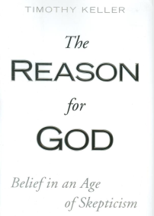
Calling Something Figurative When It’s Not
Tim Keller in his book The Reason for God says:
  “Genesis 1 is a passage whose interpretation is up for debate among Christians … I personally take the view that Genesis 1 and 2 relate to each other the way Judges 4 and 5 and Exodus 14 and 15 do. In each couplet one chapter describes a historical event and the other is a song or poem about the theological meaning of the event. When reading Judges 4 it is obvious that it is a sober recounting of what happened in the battle, but when we read Judges 5, Deborah’s Song about the battle, the language is poetic and metaphorical.”
Tim Keller – The Reason for God, pp. 93-94

Slide 43
Narrative Account
  Judges 4:4,6-7
  ⁴ Now Deborah, a prophetess, the wife of Lappidoth, was judging Israel at that time… ⁶ She sent and summoned Barak the son of Abinoam from Kedesh-naphtali and said to him, “Has not the LORD, the God of Israel, commanded you, ‘Go, gather your men at Mount Tabor, taking 10,000 from the people of Naphtali and the people of Zebulun. ⁷ And I will draw out Sisera, the general of Jabin's army, to meet you by the river Kishon with his chariots and his troops, and I will give him into your hand’?” … ¹⁰ And Barak called out Zebulun and Naphtali to Kedesh. And 10,000 men went up at his heels, and Deborah went up with him…

Slide 44
Narrative Account (continued)
  Judges 4:12-16
  ¹² When Sisera was told that Barak the son of Abinoam had gone up to Mount Tabor, ¹³ Sisera called out all his chariots, 900 chariots of iron, and all the men who were with him, from Harosheth-hagoyim to the river Kishon. ¹⁴ And Deborah said to Barak, “Up! For this is the day in which the LORD has given Sisera into your hand. Does not the LORD go out before you?” So Barak went down from Mount Tabor with 10,000 men following him. ¹⁵ And the LORD routed Sisera and all his chariots and all his army before Barak by the edge of the sword. And Sisera got down from his chariot and fled away on foot. ¹⁶ And Barak pursued the chariots and the army to Harosheth-hagoyim, and all the army of Sisera fell by the edge of the sword; not a man was left.

Slide 45
A Song Celebrating the Event
  Judges 5:1-3; 12-13; 20-21
  ¹ Then sang Deborah and Barak the son of Abinoam on that day: ² “That the leaders took the lead in Israel, that the people offered themselves willingly, bless the LORD! ³ Hear, O kings; give ear, O princes; to the LORD I will sing; I will make melody to the LORD, the God of Israel”…
  ¹² “Awake, awake, Deborah! Awake, awake, break out in a song! Arise, Barak, lead away your captives, O son of Abinoam. ¹³ Then down marched the remnant of the noble; the people of the LORD marched down for me against the mighty…¹⁹ The kings came, they fought; then fought the kings of Canaan, at Taanach, by the waters of Megiddo; they got no spoils of silver. ²⁰ From heaven the stars fought, from their courses they fought against Sisera. ²¹ The torrent Kishon swept them away, the ancient torrent, the torrent Kishon. March on, my soul, with might!”

Slide 46
Calling Something Figurative When It’s Not
Tim Keller continues:
  “When Deborah sings that the stars in the heavens came down to fight for the Israelites, we understand that she means that metaphorically. I think Genesis 1 has the earmarks of poetry and is therefore a ‘song’ about the wonder and meaning of God’s creation. Genesis 2 is an account of how it happened. There will always be debates about how to interpret some passages – including Genesis 1. But it is false logic to argue that if one part of scripture can’t be taken literally then none of it can be.”
Tim Keller – The Reason for God, pp. 93-94

Slide 47
Where Are the “Earmarks” of Poetry?
  Genesis 1:1-8
  ¹ In the beginning, God created the heavens and the earth. ² The earth was without form and void, and darkness was over the face of the deep. And the Spirit of God was hovering over the face of the waters. ³ And God said, "Let there be light," and there was light. ⁴ And God saw that the light was good. And God separated the light from the darkness. ⁵ God called the light Day, and the darkness he called Night. And there was evening and there was morning, the first day. ⁶ And God said, "Let there be an expanse in the midst of the waters, and let it separate the waters from the waters." ⁷ And God made the expanse and separated the waters that were under the expanse from the waters that were above the expanse. And it was so. ⁸ And God called the expanse Heaven. And there was evening and there was morning, the second day.

Slide 48
Where Are the “Earmarks” of Poetry?
  Genesis 1:9-13
  ⁹ And God said, "Let the waters under the heavens be gathered together into one place, and let the dry land appear." And it was so. ¹⁰ God called the dry land Earth, and the waters that were gathered together he called Seas. And God saw that it was good. ¹¹ And God said, "Let the earth sprout vegetation, plants yielding seed, and fruit trees bearing fruit in which is their seed, each according to its kind, on the earth." And it was so. ¹² The earth brought forth vegetation, plants yielding seed according to their own kinds, and trees bearing fruit in which is their seed, each according to its kind. And God saw that it was good. ¹³ And there was evening and there was morning, the third day.

Slide 49
Calling Something Figurative When It’s Not
What reasons do you think Keller might have for wanting to classify Genesis 1 as “poetry” when, in fact, it is a straightforward narrative text that never says anything about being a song or a poem?
Tim Keller – The Reason for God, pp. 93-94

Slide 50
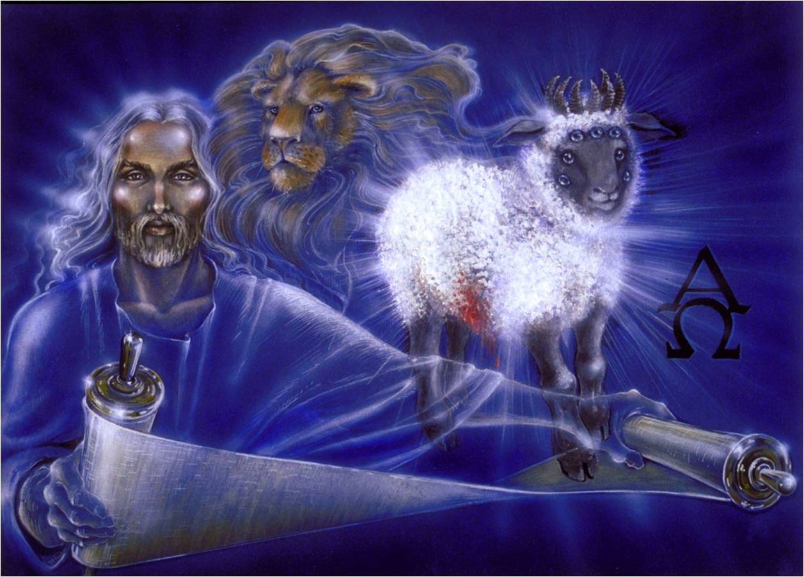
Types of Figurative Language Used in the Bible

Slide 51
Types of Figurative Language Used in the Bible
Simile – a comparison of two different things or ideas that uses the connecting words like, as, such as, or the word pair as . . . so.
  Revelation 1:14 - The hairs of his head were white, like white wool, like snow. His eyes were like a flame of fire
  Psalm 42:1 - As a deer pants for flowing streams, so pants my soul for you, O God.

Slide 52
Types of Figurative Language Used in the Bible
Metaphor – an implied comparison between two different things or ideas.
  John 15:5 - I am the vine; you are the branches. Whoever abides in me and I in him, he it is that bears much fruit, for apart from me you can do nothing.
  John 1:29 - The next day he saw Jesus coming toward him, and said, “Behold, the Lamb of God, who takes away the sin of the world!”
  Matthew 26:26 - Now as they were eating, Jesus took bread, and after blessing it broke it and gave it to the disciples, and said, “Take, eat; this is my body.”

Slide 53
Types of Figurative Language Used in the Bible
Exaggeration or Hyperbole – a deliberate overstatement for effect or emphasis.
  Genesis 22:17 - I will surely bless you, and I will surely multiply your offspring as the stars of heaven and as the sand that is on the seashore. And your offspring shall possess the gate of his enemies
  John 12:19 - So the Pharisees said to one another, “You see that you are gaining nothing. Look, the world has gone after him.”
  Colossians 1:23b - …the gospel that you heard, which has been proclaimed in all creation under heaven, and of which I, Paul, became a minister.

Slide 54
Review of Figures of Speech in the Bible
Last week we have looked at three types of figurative language used in the Bible:
  Simile
  Metaphor
  Exaggeration or Hyperbole
What is the difference between a simile and a metaphor? Can you give an example?
  A simile uses the words “like” or “as” when comparing
  A metaphor – just makes an implied comparison
What does Paul mean when he says in Col 1:23 that the gospel has been “proclaimed in all creation under heaven”? Is this a figure of speech? If so, what type?
  A hyperbole to get across the idea that the gospel had been preached throughout the known world.

Slide 55
Types of Figurative Language Used in the Bible
Metonymy – a figure of association, when the name of one object or concept is used for that of another to which it is related.
  Genesis 42:38 – But [Jacob] said, “My son [Benjamin] shall not go down with you, for his brother [Joseph] is dead, and he is the only one left. If harm should happen to him on the journey that you are to make, you would bring down my gray hairs with sorrow to Sheol.”
  Ezekiel 14:17 - Or if I [God] bring a sword against that country and say, ‘Let the sword pass throughout the land,’ and I kill its men and their animals (NIV) …

Slide 56
Types of Figurative Language Used in the Bible
Synecdoche – a figure of association where the whole can refer to the part or the part to the whole.
  Luke 2:1 - In those days a decree went out from Caesar Augustus that all the world should be registered.
  Genesis 22:17 - I [God] will surely bless you [Abraham], and … your offspring shall possess the gate of his enemies.
  Romans 3:15 - Their feet are swift to shed blood

Slide 57
Types of Figurative Language Used in the Bible
Personification – an object is given characteristics or attributes that belong to people
  Psalm 19:1 - The heavens declare the glory of God, and the sky above proclaims his handiwork.
  Psalm 148:3 - Praise him, sun and moon, praise him, all you shining stars!
  Isaiah 55:12 - For you shall go out in joy and be led forth in peace; the mountains and the hills before you shall break forth into singing, and all the trees of the field shall clap their hands.
  Romans 8:22 - For we know that the whole creation has been groaning together in the pains of childbirth until now.

Slide 58
Types of Figurative Language Used in the Bible
Anthropomorphism - ascribing a human characteristic to God in order to illustrate an aspect of His nature
  2 Chronicles 16:9a - For the eyes of the LORD run to and fro throughout the whole earth, to give strong support to those whose heart is blameless toward him.
  Exodus 9:3 - Behold, the hand of the LORD will fall with a very severe plague upon your livestock that are in the field, the horses, the donkeys, the camels, the herds, and the flocks.
  Genesis 18:20-21 - Then the LORD said, “Because the outcry against Sodom and Gomorrah is great and their sin is very grave, I will go down to see whether they have done altogether according to the outcry that has come to me. And if not, I will know.”
  Jeremiah 18:8 - …and if that nation, concerning which I have spoken, turns from its evil, I will relent of the disaster that I intended to do to it

Slide 59
Types of Figurative Language Used in the Bible
Irony or Sarcasm – a statement that says the opposite of what is meant. Irony is used for emphasis of effect.
  1 Kings 18:27 - And at noon Elijah mocked them, saying, “Cry aloud, for he is a god. Either he is musing, or he is relieving himself, or he is on a journey, or perhaps he is asleep and must be awakened.”
  Job 12:2 - [Job speaking to his “friends”:] No doubt you are the people, and wisdom will die with you.
  1 Corinthians 4:8 - Already you have all you want! Already you have become rich! Without us you have become kings! And would that you did reign, so that we might share the rule with you!

Slide 60
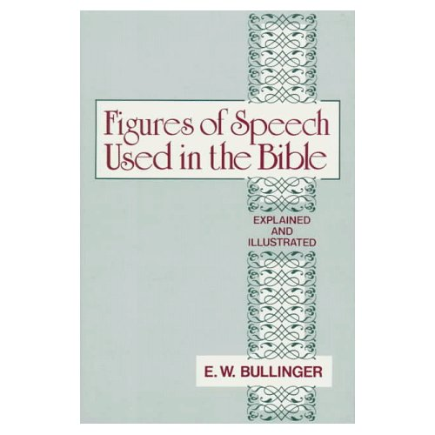
The Ultimate Book on Figures of Speech Used in the Bible
1,104 pages
$48.99 on Amazon.com

Slide 61
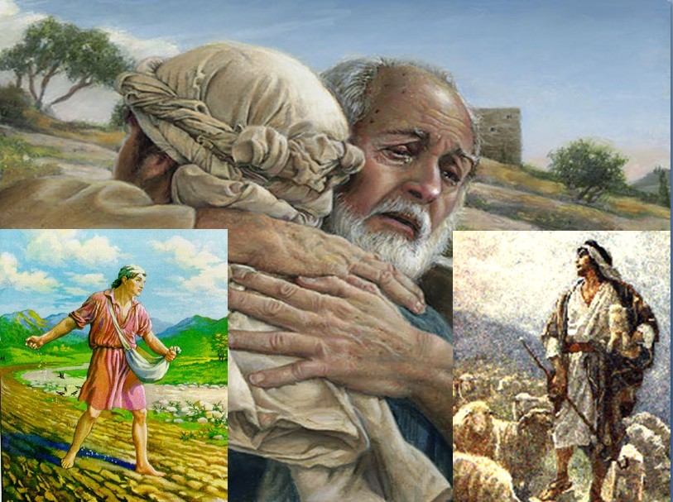
Interpreting Parables

Slide 62
Interpreting Parables
A parable is a story that teaches a moral lesson or spiritual truth.
A parable is an extended simile – an illustration in which one set of circumstances is likened to another.
Although a parable is not usually factual, a parable is a story that is true to life.
A parable is usually designed to make one central point and the details of the parable will enforce that central point.
Do not assume that there is a specific spiritual meaning for every detail of parable. Some things are given in the parable simply to complete the picture painted by the parable.

Slide 63
Interpreting Parables
When interpreting a parable, first look for an explanation of the parable given in the context.
If such an explanation is given, do not try to find meanings beyond that.

Slide 64
A Parable Where the Interpretation is Given
Matthew 13:3-9 - And [Jesus] told them many things in parables, saying: “A sower went out to sow. ⁴ And as he sowed, some seeds fell along the path, and the birds came and devoured them. ⁵ Other seeds fell on rocky ground, where they did not have much soil, and immediately they sprang up, since they had no depth of soil, ⁶ but when the sun rose they were scorched. And since they had no root, they withered away. ⁷ Other seeds fell among thorns, and the thorns grew up and choked them. ⁸ Other seeds fell on good soil and produced grain, some a hundredfold, some sixty, some thirty. ⁹ He who has ears, let him hear.”

Slide 65
A Parable Where the Interpretation is Given
Matthew 13:18-23 - “Hear then the parable of the sower: ¹⁹ When anyone hears the word of the kingdom and does not understand it, the evil one comes and snatches away what has been sown in his heart. This is what was sown along the path. ²⁰ As for what was sown on rocky ground, this is the one who hears the word and immediately receives it with joy, ²¹ yet he has no root in himself, but endures for a while, and when tribulation or persecution arises on account of the word, immediately he falls away. ²² As for what was sown among thorns, this is the one who hears the word, but the cares of the world and the deceitfulness of riches choke the word, and it proves unfruitful. ²³ As for what was sown on good soil, this is the one who hears the word and understands it. He indeed bears fruit and yields, in one case a hundredfold, in another sixty, and in another thirty.”

Slide 66
Interpreting Parables
If an explanation of a parable is not given then you will have to look at the context of the parable to understand its intended meaning:
  Why was the parable told? What prompted it?
  Are there other parables in the immediate context that address a similar idea to the parable in question?

Slide 67
Using the Context to Interpret a Parable
When interpreting the parable of the “prodigal son” (Luke 15:11-32), for example, you should begin by looking at the preceding context (15:1-10).
The parable of the prodigal son is sometimes cited as a text that was given to teach us how a parents should respond to wayward children.
Was that Jesus’ point in giving the parable? Let’s take a look at the context!

Slide 68
The Preceding Context to the “Prodigal Son”
Luke 15:1-7 - Now the tax collectors and sinners were all drawing near to hear [Jesus]. ² And the Pharisees and the scribes grumbled, saying, "This man receives sinners and eats with them." ³ So he told them this parable: ⁴ "What man of you, having a hundred sheep, if he has lost one of them, does not leave the ninety-nine in the open country, and go after the one that is lost, until he finds it? ⁵ And when he has found it, he lays it on his shoulders, rejoicing. ⁶ And when he comes home, he calls together his friends and his neighbors, saying to them, 'Rejoice with me, for I have found my sheep that was lost.' ⁷ Just so, I tell you, there will be more joy in heaven over one sinner who repents than over ninety-nine righteous persons who need no repentance.

Slide 69
The Preceding Context to the “Prodigal Son”
Luke 15:8-10 – “Or what woman, having ten silver coins, if she loses one coin, does not light a lamp and sweep the house and seek diligently until she finds it? ⁹ And when she has found it, she calls together her friends and neighbors, saying, 'Rejoice with me, for I have found the coin that I had lost.' ¹⁰ Just so, I tell you, there is joy before the angels of God over one sinner who repents.”

Slide 70
The Prodigal Son Parable
Luke 15:11-19 - And [Jesus] said, “There was a man who had two sons. ¹² And the younger of them said to his father, 'Father, give me the share of property that is coming to me.' And he divided his property between them. ¹³ Not many days later, the younger son gathered all he had and took a journey into a far country, and there he squandered his property in reckless living. ¹⁴ And when he had spent everything, a severe famine arose in that country, and he began to be in need. ¹⁵ So he went and hired himself out to one of the citizens of that country, who sent him into his fields to feed pigs. ¹⁶ And he was longing to be fed with the pods that the pigs ate, and no one gave him anything. ¹⁷ But when he came to himself, he said, ‘How many of my father's hired servants have more than enough bread, but I perish here with hunger! ¹⁸ I will arise and go to my father, and I will say to him, "Father, I have sinned against heaven and before you. ¹⁹ I am no longer worthy to be called your son. Treat me as one of your hired servants.”’

Slide 71
The Prodigal Son Parable
Luke 15:20-24 - And he arose and came to his father. But while he was still a long way off, his father saw him and felt compassion, and ran and embraced him and kissed him. ²¹ And the son said to him, ‘Father, I have sinned against heaven and before you. I am no longer worthy to be called your son.’ ²² But the father said to his servants, ‘Bring quickly the best robe, and put it on him, and put a ring on his hand, and shoes on his feet. ²³ And bring the fattened calf and kill it, and let us eat and celebrate. ²⁴ For this my son was dead, and is alive again; he was lost, and is found.’ And they began to celebrate.

Slide 72
The Prodigal Son Parable
Luke 15:25-32 - “Now his older son was in the field, and as he came and drew near to the house, he heard music and dancing. ²⁶ And he called one of the servants and asked what these things meant. ²⁷ And he said to him, ‘Your brother has come, and your father has killed the fattened calf, because he has received him back safe and sound.’ ²⁸ But he was angry and refused to go in. His father came out and entreated him, ²⁹ but he answered his father, 'Look, these many years I have served you, and I never disobeyed your command, yet you never gave me a young goat, that I might celebrate with my friends. ³⁰ But when this son of yours came, who has devoured your property with prostitutes, you killed the fattened calf for him!' ³¹ And he said to him, 'Son, you are always with me, and all that is mine is yours. ³² It was fitting to celebrate and be glad, for this your brother was dead, and is alive; he was lost, and is found.’”

Slide 73
Using the Context to Interpret a Parable
Summarizing, we have:
  A preceding incident: the Pharisees’ were grumbling about Jesus spending time with sinners
  Two preceding parables given by Jesus in response to the Pharisee’s grumbling:
    The parable of the lost sheep – where someone with 100 sheep loses one and leaves the other 99 sheep (at risk) to go look for it and rejoices when he finds it. A point is made that there is more joy in heaven over one sinner who repents, than 99 righteous ones who feel no need to repent.
    The parable of the lost coin – where a woman loses a coin, looks hard for it and rejoices when she finds it
  The parable of the prodigal son itself – where a son comes and asks for his father’s inheritance and leaves. Then after squandering it returns and the father rejoices to see him, but his older brother grumbles about it.
Based on the preceding context, what would you say is the point of the parable of the prodigal son?

Slide 74
Avoid Reading Too Much Into a Parable
Tim Keller in his book Prodigal God makes the following assertions about the parable of the prodigal son:
  It may be that the elder brother, to bolster his image of himself needed a chronically wayward sibling to criticize, and the smug older brother only made it harder for the younger brother to admit his problems and change his life. (p.56)
  When we see the attitude of the older brother in the story we begin to realize one of the reasons the younger brother wanted to leave in the first place. (p.66)
  [The elder brother] says, “I’ve never disobeyed you,” and the father doesn’t contradict him, which is Jesus’ way of showing us he is virtually faultless regarding the moral rules. (p.76)

Slide 75
Interpreting Parables
Do not assume that the characters in a parable are being held up as examples of good behavior.
  For an example when Jesus compares His Second Coming to a thief breaking into a house (Matthew 24:42-44), He is not condoning theft!
  For another example, Matthew 22:1-14 (the Parable of the Wedding Banquet) cannot be used to condone tying someone up and throwing them out because they came to a wedding without wedding clothes!

Slide 76
Interpreting Parables
We should be cautious about establishing a doctrine based on parables alone –
  Most people mistakenly believe that parables were intended to make things clear and plain.
  Consequently they turn to the parables as though they were easy to understand.
  Jesus tells us that he spoke in parables so that the truth might be hidden from those who "Though seeing, they do not see; though hearing, they do not hear or understand.” (Matthew 13:13)
  Therefore the parables are actually among the most difficult portions of God’s Word to interpret!

Slide 77
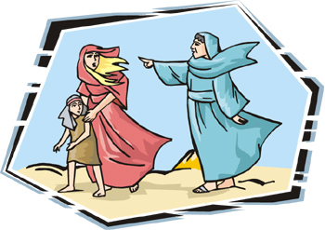
Allegory

Slide 78
Allegory - Definition
A story, whether historical or fictional, that figuratively illustrates another idea or set of events.
While a parable is an extended simile, an allegory is an extended metaphor.
An example of a well-known allegory outside of the Bible would be Pilgrim's Progress by John Bunyan.
There are a number of allegories in the Bible.

Slide 79
Examples of Biblical Allegory
2 Samuel 12:1-7 – Nathan used an allegory to show David the hideous nature of his sin with Bathsheba: And the LORD sent Nathan to David. He came to him and said to him, "There were two men in a certain city, the one rich and the other poor. ² The rich man had very many flocks and herds, ³ but the poor man had nothing but one little ewe lamb, which he had bought. And he brought it up, and it grew up with him and with his children. It used to eat of his morsel and drink from his cup and lie in his arms, and it was like a daughter to him. ⁴ Now there came a traveler to the rich man, and he was unwilling to take one of his own flock or herd to prepare for the guest who had come to him, but he took the poor man's lamb and prepared it for the man who had come to him." ⁵ Then David's anger was greatly kindled against the man, and he said to Nathan, “As the LORD lives, the man who has done this deserves to die, ⁶ and he shall restore the lamb fourfold, because he did this thing, and because he had no pity.” ⁷ Nathan said to David, “You are the man!”

Slide 80
Examples of Biblical Allegory
Psalm 80:8-19 - the Psalmist, in an appeal to God to deliver Israel from its plight, gives an allegorical description of Israel as a vine that God planted but is now being destroyed: You brought a vine out of Egypt; you drove out the nations and planted it. ⁹ You cleared the ground for it; it took deep root and filled the land. ¹⁰ The mountains were covered with its shade, the mighty cedars with its branches. ¹¹ It sent out its branches to the sea and its shoots to the River. ¹² Why then have you broken down its walls, so that all who pass along the way pluck its fruit? ¹³ The boar from the forest ravages it, and all that move in the field feed on it. ¹⁴ Turn again, O God of hosts! Look down from heaven, and see; have regard for this vine, ¹⁵ the stock that your right hand planted …¹⁶ They have burned it with fire; they have cut it down; may they perish at the rebuke of your face! ... ¹⁹ Restore us, O LORD God of hosts! Let your face shine, that we may be saved!

Slide 81
Examples of Biblical Allegory
John 10:11-16 – Jesus uses an allegory to describe his relationship with his people: ¹¹ I am the good shepherd. The good shepherd lays down his life for the sheep. ¹² He who is a hired hand and not a shepherd, who does not own the sheep, sees the wolf coming and leaves the sheep and flees, and the wolf snatches them and scatters them. ¹³ He flees because he is a hired hand and cares nothing for the sheep. ¹⁴ I am the good shepherd. I know my own and my own know me, ¹⁵ just as the Father knows me and I know the Father; and I lay down my life for the sheep. ¹⁶ And I have other sheep that are not of this fold. I must bring them also, and they will listen to my voice. So there will be one flock, one shepherd.

Slide 82
Allegorical Interpretation
A distinction must be made between:
  Allegory as a medium of revelation (like the examples we have just seen)
  Allegory as a method of interpretation where someone treats a historical account given in the Bible as though it were an allegory written to express some deeper spiritual truth.
The allegorical method of interpretation was used early on by Philo of Alexandria (20 BC – AD 50), a Jewish philosopher, who used this method of interpretation to “harmonize” the Old Testament with Greek philosophy.*
* ISBE, Eerdmans Publishing Co., 1982, History of Interpretation, p. 865

Slide 83
Allegorical Interpretation
The allegorical method of interpretation later became very popular among many of the early church fathers - beginning with Origen¹ and later Clement of Rome, Irenaeus, Tertullian, Jerome, Hilary , Ambrose , and even Augustine.²
It was common during this era to claim that God intended for every narrative passage in the Bible to be interpreted in four ways³:
  Literally – which shows what actually happened
  Allegorically – which shows what you are to believe
  Morally – which shows what you are to do
  Anagogically – which shows what you are to hope
¹ISBE, Eerdmans Publishing Co., 1982, History of Interpretation, p. 865
²Dictionary of the Christian Church, Zondervan, 1978, Allegory, p.28
³ISBE, Allegory, p. 27

Slide 84
An Example of Allegorical Interpretation
Origen (AD 185-254) preaching on the battle of Jericho (Joshua 6) taught that:
  “Joshua stands for Jesus, and Jericho for this world. The seven priests carrying trumpets represent Matthew, Mark, Luke, John, James, Jude and Peter. The prostitute Rehab stands for the Church, which consists of sinners; and the scarlet cord which she displayed to save herself and her household from the massacre stands for the redemptive blood of Christ”*
*Sidney Greidanus, Preaching Christ from the Old Testament: a Contemporary Hermeneutical Method, (Grand Rapids: Eerdmans Publishing, 1999) p. 87

Slide 85
Allegorical Interpretation
The Roman Catholic Church, to this day, still uses the allegorical method of interpretation so as to more easily “harmonize” the Bible with Roman Catholic teachings.
The reformers, beginning with Luther, rightly rejected the allegorical method of interpretation.
Luther once remarked: “When I was a monk, I was an expert at allegorizing scripture, but now my best skill is to give the literal, simple sense of Scripture, from which comes power, life, comfort, and instruction.”
ISBE, Eerdmans Publishing Co.,1982, History of Interpretation, p. 865

Slide 86
The Problem With Allegorical Interpretation
The problem with the allegorical method of interpretation is that it allows you to make the scriptures seem to teach almost anything that you would like them to teach – which is why, historically, this method has been so popular with those who are prone to twist the scriptures.
Therefore, as you study and try to understand the Bible, you should avoid allegorizing the historical narratives in the Bible.

Slide 87
A Case for Allegorical Interpretation?
The Apostle Paul did, on one occasion (Galatians 4:22-31), allegorize the story of Sarah and Hagar and their sons (Genesis 16:1-16; 21:9-12 ) to illustrate the difference between the Old and the New Covenants:
For it is written that Abraham had two sons, one by a slave woman and one by a free woman. ²³ But the son of the slave was born according to the flesh, while the son of the free woman was born through promise. ²⁴ Now this may be interpreted allegorically: these women are two covenants. One is from Mount Sinai, bearing children for slavery; she is Hagar. ²⁵ Now Hagar is Mount Sinai in Arabia; she corresponds to the present Jerusalem, for she is in slavery with her children. ²⁶ But the Jerusalem above is free, and she is our mother.

Slide 88
A Case for Allegorical Interpretation?
But the Apostle Paul was writing under the inspiration of the Holy Spirit, and therefore we can be assured that the point he made in allegorizing this passage accurately reflects the God’s thinking on the matter!
If you feel you must allegorize a passage of scripture (in your preaching, for example), at least be certain that the teaching that you derive from your allegory can be clearly supported by other clear (non-allegorized) texts of scripture.

Slide 89

Types

Slide 90
Types
The Greek word for type (tupos) means an impression or mark left by a blow.
When we use the word “type” theologically, we are referring to someone or something (usually in the Old Testament) that God has designed to prefigure a later person or event (usually in the New Testament) which we call the “antitype”.
While the antitype resembles the type at one or more points, the antitype exceeds and goes beyond what the type prefigured.
The New Testament sometimes uses other words to designate a type, such as the word “shadow”. (Heb 10:1, Col 2:17)

Slide 91
Examples of Types
Romans 5:14 tells us that Adam was a “type” (Greek work, tupos) of the “one to come” (Christ):
  Through Adam’s disobedience, those in him (the human race) were made sinners (Rom 5:19a)
  Through Jesus’ obedience, those in him (Christians) will be made righteous (Rom 5:19b)

Slide 92
Examples of Types
Heb 10:1 tells us that the law (of Moses) with its sacrificial offerings “has but a shadow [a type] of the good things to come”
  The Jewish sacrifices were “repeated endlessly year after year” (Heb 10:1b) for the sins of the people.
  But now “we have been made holy through the sacrifice of the body of Jesus Christ once for all.” (Hebrews 10:10)

Slide 93
Examples of Types
Col 2:16-17 tell us that we should not let anyone judge (i.e. condemn) us for not keeping the requirements of the Law of Moses such as the various food laws or Sabbath days, because these things were a “shadow [a type] of the things that were to come; the reality [the antitype] , however, is found in Christ”.

Slide 94
A Caution Concerning Types
Before we can safely identify something as a type, we should look for evidence in the text that God considers something to be a type. Otherwise we are simply observing a similarity between two things.

Slide 95
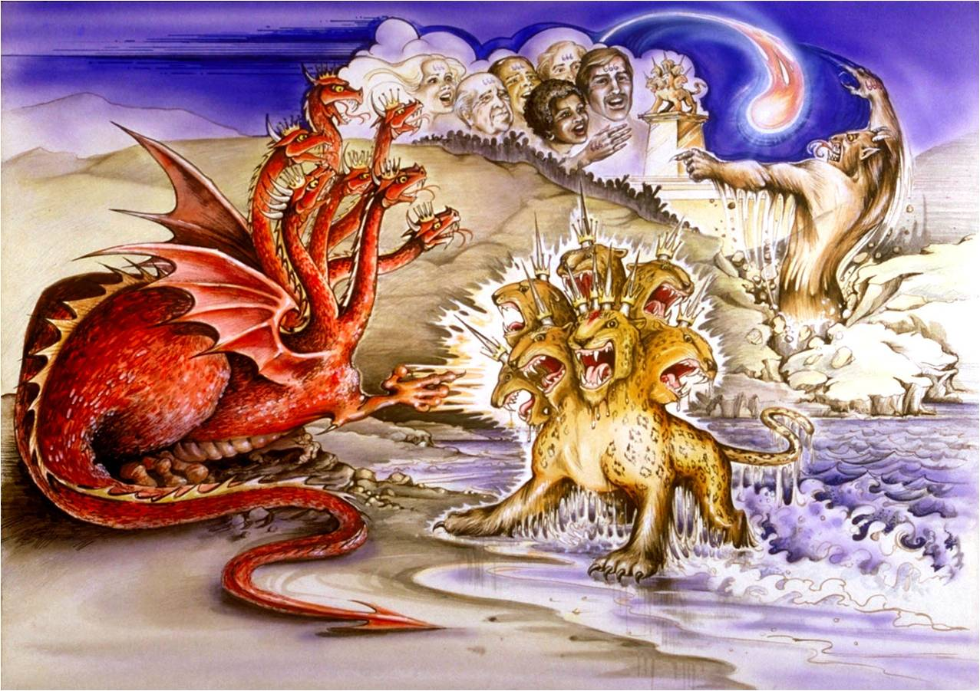
Symbols

Slide 96
Symbols
Definition: A symbol is a picture or an object that stands for or represents another thing or idea.
Generally a symbol is chosen because it has some characteristic(s) or quality(s) that it shares with the thing it represents.
The Bible is rich with symbols throughout the Old and New Testament.

Slide 97
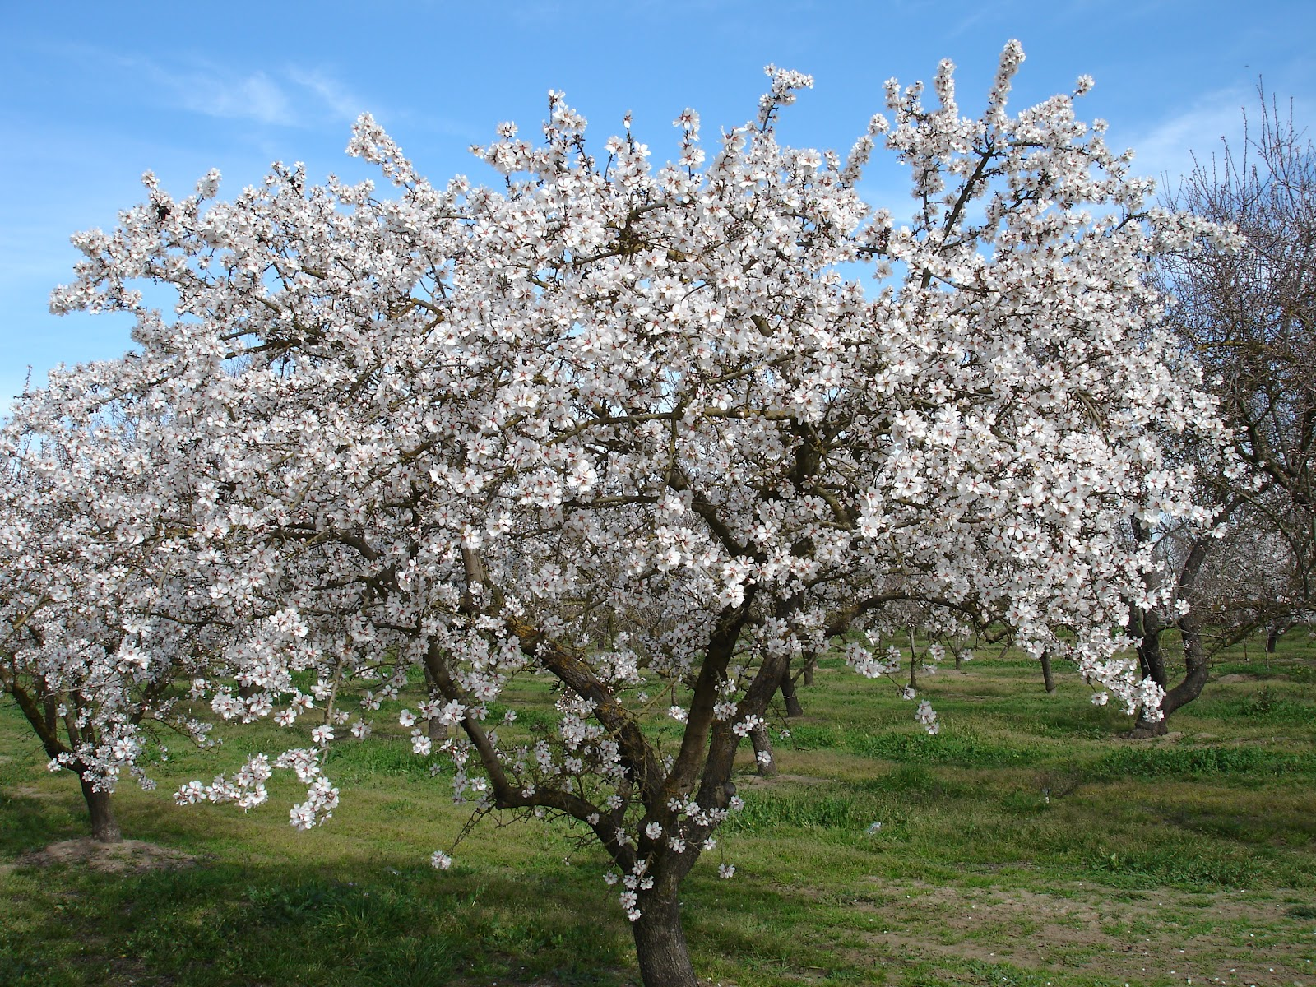
Symbols in the Old Testament

Slide 98
Symbols in the Old Testament
Remember also your Creator in the days of your youth, before the evil days come and the years draw near of which you will say, "I have no pleasure in them"; ² before the sun and the light and the moon and the stars are darkened and the clouds return after the rain, ³ in the day when the keepers of the house tremble, and the strong men are bent, and the grinders cease because they are few, and those who look through the windows are dimmed, ⁴ and the doors on the street are shut--when the sound of the grinding is low, and one rises up at the sound of a bird, and all the daughters of song are brought low-- ⁵ they are afraid also of what is high, and terrors are in the way; the almond tree blossoms, the grasshopper drags itself along, and desire fails, because man is going to his eternal home, and the mourners go about the streets-- ⁶ before the silver cord is snapped, or the golden bowl is broken, or the pitcher is shattered at the fountain, or the wheel broken at the cistern, ⁷ and the dust returns to the earth as it was, and the spirit returns to God who gave it. (Ecclesiastes 12:1-7 ESV)

Slide 99
Symbols in the Old Testament
Don't let the excitement of youth cause you to forget your Creator. Honor him in your youth before you grow old and say, "Life is not pleasant anymore." ² Remember him before the light of the sun, moon, and stars is dim to your old eyes, and rain clouds continually darken your sky. ³ Remember him before your legs-- the guards of your house-- start to tremble; and before your shoulders-- the strong men-- stoop. Remember him before your teeth-- your few remaining servants-- stop grinding; and before your eyes-- the women looking through the windows-- see dimly. ⁴ Remember him before the door to life's opportunities is closed and the sound of work fades. Now you rise at the first chirping of the birds, but then all their sounds will grow faint. ⁵ Remember him before you become fearful of falling and worry about danger in the streets; before your hair turns white like an almond tree in bloom, and you drag along without energy like a dying grasshopper, and the caperberry no longer inspires sexual desire. Remember him before you near the grave, your everlasting home, when the mourners will weep at your funeral. ⁶ Yes, remember your Creator now while you are young, before the silver cord of life snaps and the golden bowl is broken. Don't wait until the water jar is smashed at the spring and the pulley is broken at the well. ⁷ For then the dust will return to the earth, and the spirit will return to God who gave it. (Ecclesiastes 12:1-7 NLT)

Slide 100
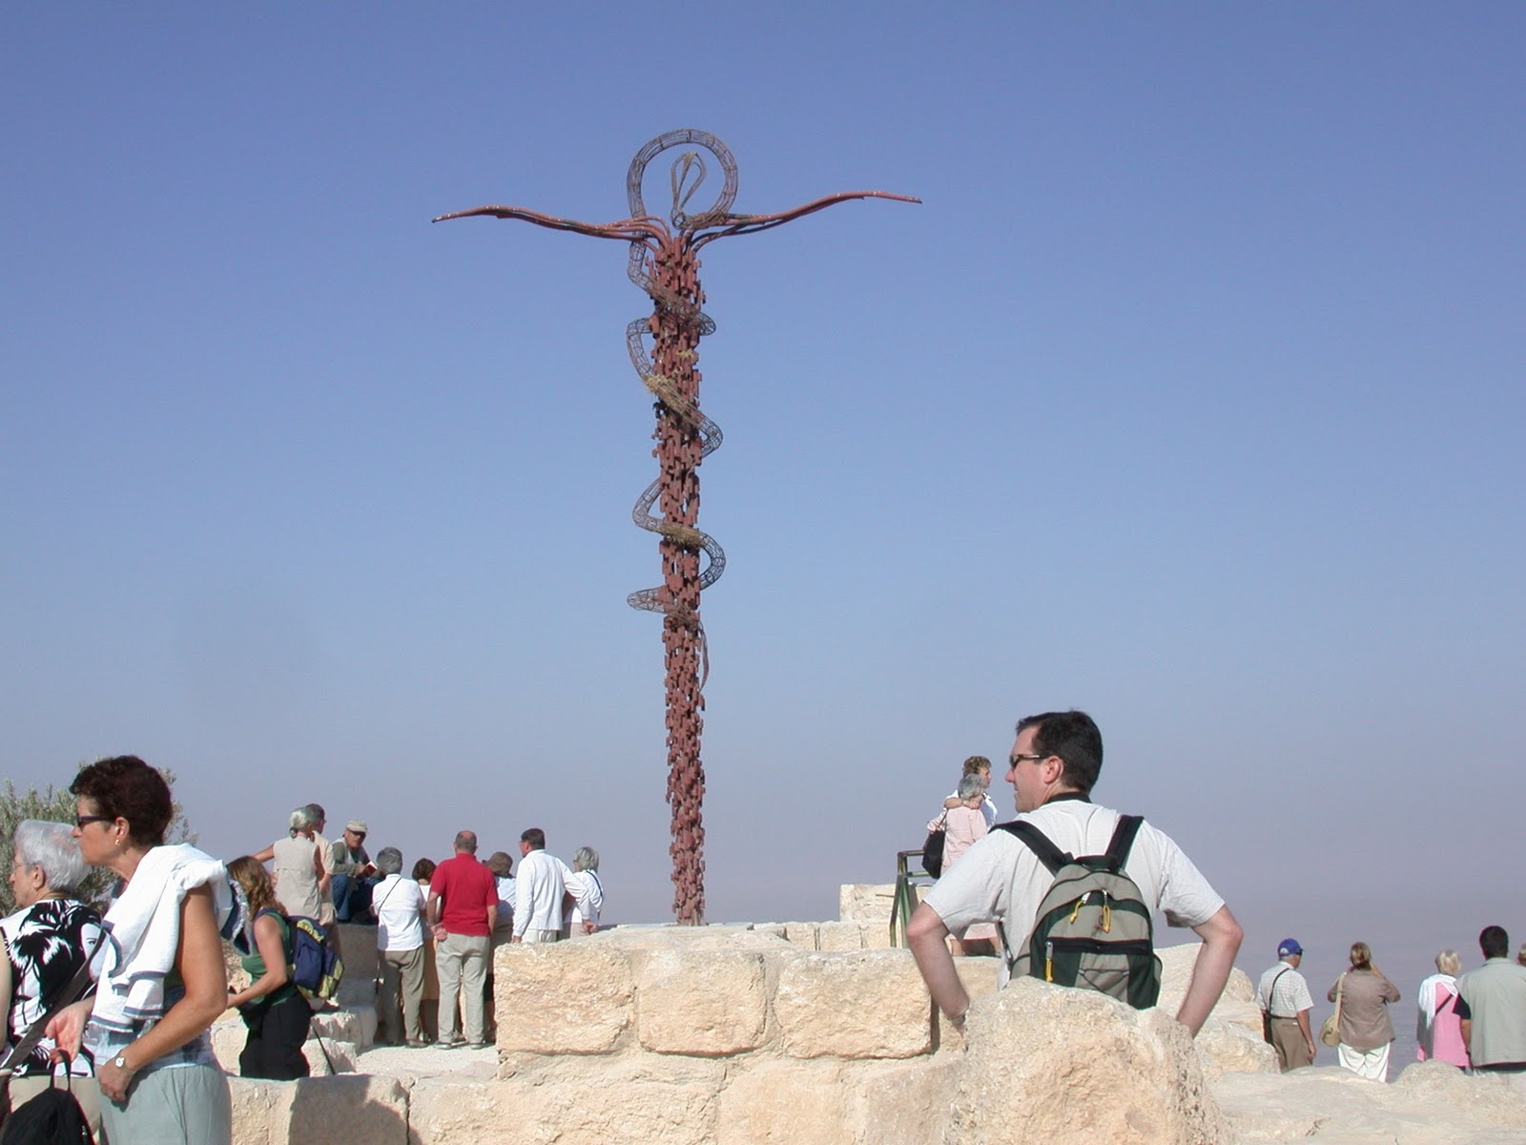
Symbols in the Old Testament
Many of the symbols in the Old Testament are only identifiable once their meaning is revealed in the New Testament:
  And as Moses lifted up the serpent in the wilderness, so must the Son of Man be lifted up, ¹⁵ that whoever believes in him may have eternal life. (John 3:14-15) – a reference to the time when the Israelites grumbled against Moses and God sent snakes among them causing many of them to die. Later the people were delivered from death when they looked on a serpent that God instructed Moses to hold up on a pole. (Numbers 21:4-9)
  [John the Baptist] saw Jesus coming toward him, and said, "Behold, the Lamb of God, who takes away the sin of the world! (John 1:29) – a reference to a lamb offered in the Old Testament as a sacrifice for the people of God (cf. Ex 12-13; Num 28:4; Isaiah 53:6-10)

Slide 101
Symbols in the New Testament
There are a number of symbols used in the two ordinances given to the New Testament church. :
The Lord’s Supper involves two symbols:
  ¹⁹ [Jesus] took bread, and when he had given thanks, he broke it and gave it to them, saying, “This is my body, which is given for you. Do this in remembrance of me.”
  ²⁰ And likewise the cup after they had eaten, saying, “This cup that is poured out for you is the new covenant in my blood.” (Luke 22:19-20)
There are at least two ideas symbolized by baptism –
  Rise and be baptized and wash away your sins, calling on his name (Act 22:16b cf. 1 Peter 3:21)
  Having been buried with him in baptism, in which you were also raised with him through faith in the powerful working of God, who raised him from the dead. (Colossians 2:12 cf. Romans 6:3-4)

Slide 102
Symbols in the New Testament
Without a doubt, the greatest abundance of symbols in the New Testament can be found within the book of Revelation.
Frequently the book of Revelation will give us the meaning of its symbols, but in spite of this help, we are sometimes still left with questions that are difficult to answer!
  And I saw a beast rising out of the sea, with ten horns and seven heads... (Rev 13:1)
  This calls for a mind with wisdom: the seven heads are seven mountains on which the woman is seated; ¹⁰ they are also seven kings, five of whom have fallen, one is, the other has not yet come, and when he does come he must remain only a little while. ¹¹ As for the beast that was and is not, it is an eighth but it belongs to the seven, and it goes to destruction. ¹² And the ten horns that you saw are ten kings who have not yet received royal power, but they are to receive authority as kings for one hour, together with the beast. (Rev 17:9-12)

Slide 103
Things to Remember About Symbols
Be aware that a particular symbol can symbolize different things in different passages. For example:
  Water – In Ephesians 5:25-26, symbolizes the word of the gospel which cleanses us from sin; in John 7:38-39, we’re told that water symbolizes the Holy Spirit!
  Lion – is used as a symbol for Satan in 1 Peter 5:8, in Revelation 5:5 is used as a symbol for Christ!
  Serpent – in John 3:14 is a symbol for Christ, in Revelation 12:14-15 a symbol for Satan.
  Leaven – is normally a symbol for sin and corruption (Mat 6:16; 1 Cor 5:6ff), but in Mat 13:3 it is used as a symbol of the rapid growth of God’s kingdom.
Therefore it is important to allow the context to determine the meaning of a symbol in a particular passage.

Slide 104
Things to Remember About Symbols
Before trying to assign a meaning to a symbol, look to see if the scriptures themselves give the meaning of the symbol (perhaps within the passage itself or perhaps later in the book)
  ¹² Then I turned to see the voice that was speaking to me, and on turning I saw seven golden lampstands, ¹³ and in the midst of the lampstands one like a son of man … ¹⁶ In his right hand he held seven stars, from his mouth came a sharp two-edged sword, and his face was like the sun shining in full strength. ¹⁷ When I saw him, I fell at his feet as though dead. But he laid his right hand on me, saying, “Fear not, I am the first and the last … ²⁰ As for the mystery of the seven stars that you saw in my right hand, and the seven golden lampstands, the seven stars are the angels of the seven churches, and the seven lampstands are the seven churches.” (Rev 1:12-20 ESV)

Slide 105
Things to Remember About Symbols
If the scriptures do not define a symbol for us, then look to see if the meaning is evident in the immediate context.
If a symbol is not defined for us and its meaning is not readily apparent in the immediate context then:
  We can look at how that symbol is used in other passages of scripture – especially passages where there are similar symbols being used and similar ideas being discussed.
  In such a case as this, our level of certainty about what the symbol means should be tempered with good dose humility!

Slide 106
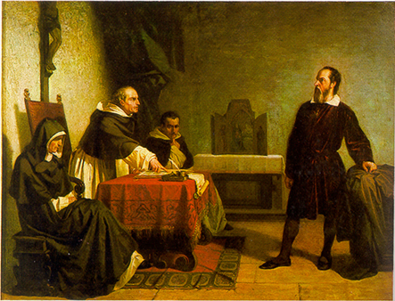
Frame of Reference in the Bible

Slide 107
Frame of Reference in the Bible
In the 17th century, Galileo (1564-1642) proposed that it made more sense to describe the motion of the planets in our solar system from a frame of reference which viewed the sun as being stationary and the earth (and the other planets) as orbiting around the sun rather than from the traditional frame of reference which viewed the earth as being stationary.
The Roman Catholic Church hierarchy at that time argued that Biblical passages that talk about the sun “rising” (Ecclesiastes 1:5) and rain “falling” and passages like Psalm 93:1; 96:10; and 104:5 which say that the that earth “cannot be moved” require us (as biblical dogma) to always view the earth as stationary and to view the sun and planets as orbiting around the earth.

Slide 108
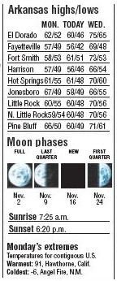
Frame of Reference in the Bible
The Biblical writers, like all writers, view the physical world from a particular frame of reference. When the Bible will speaks of the sun “rising” (Ecclesiastes 1:5) it is using the same frame of reference that modern newspapers do!
From the frame of reference of anyone standing on the earth’s surface (which, of course, was true of all the biblical writers!) the sun does indeed “rise” in the sky every morning.
This statement in the Bible, however, must not be pressed to say that we cannot (under other circumstances) view the earth as moving or rotating with respect to the sun when we study astronomy.
Arkansas Democrat Gazette; October 27, 2009; p. 6D

Slide 109

Frame of Reference in the Bible
Similarly the Bible speaks of rain “falling” (Psalm 72:6).
From another frame of reference (out in space), rain on some parts of the earth could actually be viewed as rising!
Therefore, when we interpret such statements, we must keep in mind the frame of reference implied by the writer.

Slide 110
Frame of Reference in the Bible
Psalm 93:1 and 96:10, when examined in context, are not talking about interplanetary movement at all but about God’s sovereign control over the earth:
  Psalm 93:1-2 – The LORD reigns; he is robed in majesty; the LORD is robed; he has put on strength as his belt. Yes, the world is established; it shall never be moved [i.e. from under God’s sovereign control]. ² Your throne is established from of old; you are from everlasting.
  Psalm 96:9-10 – Worship the LORD in the splendor of holiness; tremble before him, all the earth! ¹⁰ Say among the nations, "The LORD reigns! Yes, the world is established; it shall never be moved [i.e. from under God’s sovereign control]; He will judge the peoples with equity.”

Slide 111
Frame of Reference
The term “earth” as used in Psalm 104:5, does not refer to the planet, but to the land as distinct from the seas. The Hebrew word for “earth” (erets) can have either meaning, depending on the context.
Psalm 104:5-9 – ⁵ He set the earth [i.e. the land] on its foundations, so that it should never be moved. ⁶ You covered it with the deep as with a garment; the waters stood above the mountains. ⁷ At your rebuke they fled; at the sound of your thunder they took to flight. ⁸ The mountains rose, the valleys sank down to the place that you appointed for them. ⁹ You set a boundary that they may not pass, so that they might not again cover the earth.

Slide 112
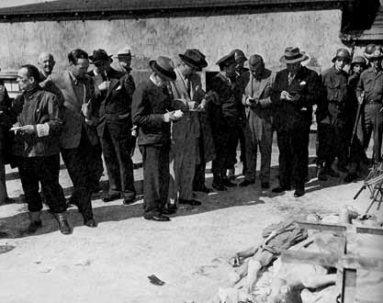
Quotations in the Bible

Slide 113
Quotations in the Bible
In contemporary American culture, we are used to quoting a person’s exact words, and placing them in quotation marks. We call this a direct quote. But when we give an indirect quote (with no quotation marks) we only expect an accurate report of the substance of the statement.
For example, if we say: “Elliot said that he would return home for supper right away.”
When Elliot actually said: “I will come to the house to eat in two minutes.”
Our statement does not quote Elliot directly, but it is an acceptable and truthful report of Elliot’s actual statement even though our indirect quotation included none of Elliot’s original words!

Slide 114
Quotations in the Bible
In biblical times, written Hebrew and Greek had no quotation marks or equivalent kinds of punctuation, nor were they particularly bound by our Western ideas about the importance of giving direct, word-for-word quotations.
In biblical times, a citation of what another person said, needed only to accurately represent the content of what a person said (like our indirect quotes).
Therefore we need to recognize that when a biblical writer “quotes” or cites something that was written or spoken in their day, they are not necessarily giving us a word for word quotation, but rather an accurate representation of what was originally written or spoken.

Slide 115
Quotations in the Bible
So for example, the Bible tells us that when Jesus was crucified “Pilate also wrote an inscription and put it on the cross.” (John 19:19). Each of the four Gospels quote the notice in a slightly different way:
  This is Jesus, the King of the Jews (Matthew 27:37)
  The King of the Jews (Mark 15:26)
  This is the King of the Jews (Luke 23:38)
  Jesus of Nazareth, the King of the Jews (John 19:19)
William Hendriksen in his commentary on John suggests that the full title must have been: “This is Jesus of Nazareth the King of the Jews” – and each writer gives the gist as he sees it.*
*William Hendriksen, NTC on the Gospel of John, p. 427

Slide 116
Quotations in the Bible
Likewise, we should not assume when speeches or long discourses are recorded in the Bible (for example, Jesus’ “Sermon on the Mount” or Paul’s “Mars Hill” speech at Athens) that we have been given a word for word transcript of what was said.
Most likely, we have been given a summary of the main ideas that were expressed by the speaker on those occasions.

Slide 117
Quoting the Old Testament in the New
When New Testament writers quote the Old Testament they will sometimes cite the author of their source:
  Romans 10:16 – For Isaiah says, "Lord, who has believed what he has heard from us?”
  Acts 2:25 – For David says concerning him, "'I saw the Lord always before me, for he is at my right hand that I may not be shaken”
Note: The New Testament writers could not give us the chapter and verse of their citation, because the chapter and verse divisions found in our modern Bibles did not exist at time the New Testament was being written!

Slide 118
Quoting the Old Testament in the New
Most of the time when New Testament writers quote the Old Testament they will simply use a phrase that indicates to their reader that they are quoting scripture, without giving the specific source:
  Rom 9:17a – For the Scripture says to Pharaoh, “For this very purpose I have raised you up”
  Hebrews 3:7 – Therefore as the Holy Spirit says, “Today, if you hear his voice…”
  Matthew 4:4b – It is written, “Man shall not live by bread alone…”
  Hebrews 2:6a – It has been testified somewhere, "What is man, that you are mindful of him…”

Slide 119
Quoting the Old Testament in the New
Sometimes New Testament writers will string together several Old Testament texts without differentiating the different sources:
Romans 3:10-18 – As it is written: “None is righteous, no, not one; no one understands; no one seeks for God. All have turned aside; together they have become worthless; no one does good, not even one.” (Psalm 14:1-3; 53:1-3) “Their throat is an open grave; they use their tongues to deceive.” (Psalm 5:9) “The venom of asps is under their lips.” (Psalm 140:3) “Their mouth is full of curses and bitterness.” (Psalm 10:7) “Their feet are swift to shed blood; in their paths are ruin and misery, and the way of peace they have not known.” (Isaiah 59:7,8) “There is no fear of God before their eyes.” (Psalm 36:1)

Slide 120
Quoting the Old Testament in the New
Sometimes the New Testament writers will intermingle and paraphrase multiple Old Testament texts:
  Romans 9:33 - As it is written: “See, I lay in Zion a stone that causes men to stumble and a rock that makes them fall, and the one who trusts in him will never be put to shame.”(NIV)
  Isaiah 8:14 - he will be a stone that causes men to stumble and a rock that makes them fall. (NIV)
  Isaiah 28:16 - See, I lay a stone in Zion, a tested stone, a precious cornerstone for a sure foundation; the one who trusts will never be dismayed. (NIV)

Slide 121
Quoting the Septuagint in the New Testament
When New Testament writers quote the Old Testament:
  Sometimes they translate (or paraphrase) from the original Hebrew (the Masoretic Text)
  Sometimes they quote from the Septuagint – a Greek translation of the Old Testament produced beginning in the third century before Christ
Because it is a translation and is not inspired, the Septuagint can vary from or contain nuances not found in the original Hebrew text that it translated.
Nevertheless, when the New Testament writers quote the Septuagint, the portion they quote becomes part of the inspired New Testament text!

Slide 122
Quoting the Septuagint in the New Testament
For example:
  Isaiah 7:14 - Therefore the Lord himself will give you a sign. Behold, the virgin [RSV: “young woman”] shall conceive and bear a son, and shall call his name Immanuel.
  Matthew 1:22-23 - All this took place to fulfill what the Lord had spoken by the prophet: “Behold, the virgin shall conceive and bear a son, and they shall call his name Immanuel” (which means, God with us).
The Hebrew word (almah) (translated “virgin” in Isaiah 7:14) means “young woman” and can refer to either:
  A virgin of marriageable age
  A newly married woman.
In his gospel, Matthew chose to use the Greek word (parthenos) that is used in the Septuagint which can only mean “virgin”.

Slide 123
Quoting the Septuagint in the New Testament
Another example:
  Psalm 40:6-8 In sacrifice and offering you have not delighted, but you have given me an open ear… Behold, I have come… I desire to do your will, O my God…
  Hebrews 10:5,7 Sacrifices and offerings you have not desired, but a body have you prepared for me… Behold, I have come to do your will, O God.
Here the writer of Hebrews quotes the Septuagint which in one phrase differs significantly (see bold text above) from the Hebrew text.
It appears that the Septuagint translator decided to replace a Hebrew idiom with one that has the same meaning but makes more sense to a Greek audience.
In the providence of God, this upgraded idiom applied in an even more fitting way to Christ whom this Psalm ultimately describes.

Slide 124
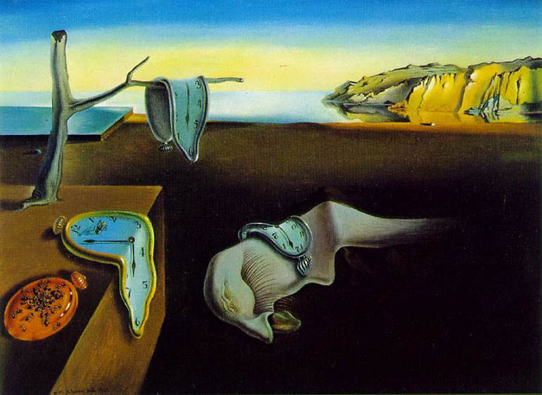
Counts and Measurements in the Bible

Slide 125
Counts and Measurements in the Bible
Today when a reporter says that 50,000 troops were deployed to Iraq, we recognize that he is probably giving us a round number and that in fact the exact number might have been something like 49,823 troops or 51,127 troops.
Likewise, the Bible often gives us counts using rounded numbers. For example:
  1 Chronicles 12:23-26 – These are the numbers of the divisions of the armed troops who came to David in Hebron to turn the kingdom of Saul over to him, according to the word of the LORD. ²⁴ The men of Judah bearing shield and spear were 6,800 armed troops. ²⁵ Of the Simeonites, mighty men of valor for war, 7,100. ²⁶ Of the Levites 4,600 … etc.
Therefore as we interpret these counts we should recognize that these counts probably represent a round figure rather than a precise count.

Slide 126
Counts and Measurements in the Bible
In the same way, measurements can only be given to a certain degree of accuracy.
For example, I might say, “I live a mile from where I work”. In actuality I might live 1.237 miles or .983 miles from my work. In interpreting my statement, everyone recognizes that I am implying that the distance between my house and work is one mile when rounded off to the nearest mile.
Likewise measurements in the Bible should be understood to represent measurement rounded to a reasonable level of precision.

Slide 127
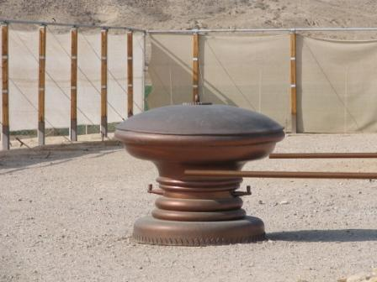
Counts and Measurements in the Bible
Bible skeptics have claimed that 1 Kings 7:23 gives an inaccurate value for Pi (π):
  1 Kings 7:23 - Then he made the sea of cast metal. It was round, ten cubits from brim to brim, and five cubits high, and a line of thirty cubits measured its circumference.
A circular object that is 10 cubits in diameter would have a circumference of 31.4159265 cubits (10 times Pi) rather than 30 cubits.
The measurements, however, are accurate if they were rounded to the nearest 10 cubits.

Slide 128
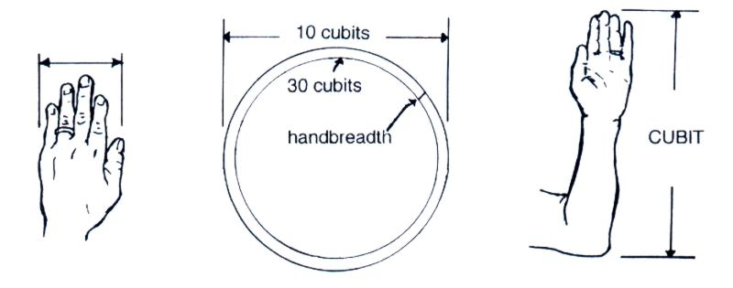
Counts and Measurements in the Bible
There is one other interesting observation we could make in this text – a few verses later it tells us the thickness of the water reservoir:
  1 Kings 7:26 - Its thickness was a handbreadth, and its brim was made like the brim of a cup, like the flower of a lily. It held two thousand baths.

Slide 129
Counts and Measurements in the Bible
If we take into account the extra thickness added by the wall of the reservoir, depending on the exact value of a cubit and a handbreadth at the time, it may well be that the inside diameter of the basin being described was exactly 30 cubits!

Slide 130
When Counts Don’t Match
Sometimes when counts don’t match in two different Bible passages, it is not because of a lack of precision or accuracy, but it is due instead to the fact that two different events are being described – even though on the surface they sound like the same event.
Following is a an example where, on the surface, it could appear that there is a discrepancy in the counts given.

Slide 131
When Counts Don’t Match
Mark 6:39-42 – Then [Jesus] commanded them all to sit down in groups on the green grass. ⁴⁰ So they sat down in groups, by hundreds and by fifties. ⁴¹ And taking the five loaves and the two fish he looked up to heaven and said a blessing and broke the loaves and gave them to the disciples to set before the people. And he divided the two fish among them all. ⁴² And they all ate and were satisfied. ⁴³ And they took up twelve baskets full of broken pieces and of the fish. ⁴⁴ And those who ate the loaves were five thousand men.
Matthew 15:35-38 – And directing the crowd to sit down on the ground, ³⁶ he took the seven loaves and the fish, and having given thanks he broke them and gave them to the disciples, and the disciples gave them to the crowds. ³⁷ And they all ate and were satisfied. And they took up seven baskets full of the broken pieces left over. ³⁸ Those who ate were four thousand men, besides women and children.

Slide 132
When Counts Don’t Match
This particular discrepancy is easy to resolve, because Mark records Jesus making a reference to both events:
  Mark 8:18b-20 – [Jesus speaking to the disciples:] “And do you not remember? ¹⁹ When I broke the five loaves for the five thousand, how many baskets full of broken pieces did you take up?” They said to him, “Twelve.” ²⁰ “And the seven for the four thousand, how many baskets full of broken pieces did you take up?” And they said to him, “Seven.”

Slide 133
When Counts Don’t Match
Here is one that is a little tougher to deal with:
  1 Corinthians 10:8 – We must not indulge in sexual immorality as some of them did, and twenty-three thousand fell in a single day.
But in the Old Testament we read:
  Numbers 25:1-3,9 – While Israel lived in Shittim, the people began to whore with the daughters of Moab. ² These invited the people to the sacrifices of their gods, and the people ate and bowed down to their gods. ³ So Israel yoked himself to Baal of Peor. And the anger of the LORD was kindled against Israel… those who died by the plague were twenty-four thousand.
Some commentaries that deal with these texts point out that there were probably somewhere close to 23,500 who died that day and each writer is simply reporting in round numbers: one rounded up and the other rounded down.

Slide 134
When Counts Don’t Match
Gleason Archer* points out that in the context where this count is given, Paul is quoting from Exodus not Numbers:
  1 Corinthians 10:7 – Do not be idolaters as some of them were; as it is written, “The people sat down to eat and drink and rose up to play.”
  Exodus 32:6b – And the people sat down to eat and drink and rose up to play.
*Gleason L. Archer, Encyclopedia of Bible Difficulties, p. 401

Slide 135
When Counts Don’t Match
On the occasion that Paul cites in Exodus (the golden calf incident) we read a few verses later:
  Exodus 32:27-28 – And [Moses] said to them, "Thus says the LORD God of Israel, 'Put your sword on your side each of you, and go to and fro from gate to gate throughout the camp, and each of you kill his brother and his companion and his neighbor.'" ²⁸ And the sons of Levi did according to the word of Moses. And that day about three thousand men of the people fell.
And then right after that we read:
  Exodus 32:35 – Then the LORD sent a plague on the people, because they made the calf, the one that Aaron made.
We’re not told how many died in the plague that day.
Archer points out that since Paul (in 1 Corinthians 10:8) tells us that 23,000 died that day, we can deduce that 20,000 additional people (besides the 3,000 killed by the Levites) must have died that day from the plague that God sent.

Slide 136
When Counts Don’t Match - Review
We have been looking at how to go about interpreting the Bible in a case when a count or measurement is given in a passage that:
  Doesn’t seem to match what we know to be true (e.g. the value of pi)
  Seems to not match a count or measurement given for that same event in another passage
We have seen that in such cases further study is needed because we know that the Bible is consistent with reality and with itself.
  As for God, his way is perfect; the word of the LORD is flawless. (Psalm 18:30a – NIV)
  Let God be true though every one were a liar (Romans 3:4b)

Slide 137
When Counts Don’t Match - Review
In the examples that we have looked at so far, we have seen that apparent discrepancies in scripture can be the result of:
  Failing to allow for the reasonable rounding of numbers
  Thinking that two passages describe the same event, when in fact they are describing different events.
  A failure to fully or properly understand what the passage is actually teaching.

Slide 138
When Counts Don’t Match
Another kind of apparent discrepancy that we encounter, especially in the Gospels, is that different writers, because they are writing with a different purpose will sometimes choose to report (or not report) different things:
  And as [Jesus and His disciples] went out of Jericho, a great crowd followed him. And behold, there were two blind men sitting by the roadside, and when they heard that Jesus was passing by, they cried out, “Lord, have mercy on us, Son of David!” (Matthew 20:29-30)
  And as [Jesus] was leaving Jericho with his disciples and a great crowd, Bartimaeus, a blind beggar, the son of Timaeus, was sitting by the roadside. And when he heard that it was Jesus of Nazareth, he began to cry out and say, “Jesus, Son of David, have mercy on me!” (Mark 10:46b-47)
There were apparently two men calling out to Jesus. It served Mark’s purpose to mention only one of them (perhaps the more vocal of the two). He also gives us the man’s name, which Matthew does not. This is not a contradiction or discrepancy, but two men choosing to report different aspects of the same event.

Slide 139
When Counts Don’t Match
One more example – this time the apparent discrepancy involves a period of time:
  Acts 19:10 states that Paul’s teaching at the school of Tyrannus (in Ephesus) “continued for two years, so that all the residents of Asia heard the word of the Lord, both Jews and Greeks.”
  But in his charge to the Ephesian elders, as recorded in Acts 20:31, Paul says, “Therefore be alert, remembering that for three years I did not cease night or day to admonish everyone with tears.”
  Which was it then, two years or three?

Slide 140
When Counts Don’t Match
When we examine the whole account of Paul’s mission to Ephesus in Acts, we find that he was there for more than two years – which was merely the length of time he spent teaching at the school of Tyrannus:
  Acts 18:19-21 – Paul spent some time (we’re not told how long) in Ephesus reasoning with the Jews in the synagogue. He left promising to return.
  Acts 19:1-6 – Paul then returned to Ephesus where he encountered a group of 12 men who had received “John’s baptism” but had not heard of the Holy Spirit. We’re not told how long he spent ministering to these men.
  Acts 19:8-9 – After this Paul returned to the synagogue in Ephesus and “spoke boldly there for three months”
  After all this, we are told that Paul was “reasoning daily in the hall of Tyrannus” for two years. (Acts 19:9-10)

Slide 141
General Principals For Dealing With Bible Difficulties*
Be fully persuaded in your own mind that an adequate explanation exists, even though you have not yet found it.
When we are unable to understand how God’s Word fits together we must bow before Him in humility and patiently wait for Him to clear up the difficulty.
Carefully study the passage in question, looking at context, grammar, word meanings, etc.
In the case of parallel passages, all the testimonies of the various witnesses are to be taken as trustworthy reports of what was said or done, even though the events may be viewed from a different perspective.
Consult the best commentaries available, especially those written by Evangelical scholars who believe in the integrity of scripture.
*Condensed from: Gleason L. Archer, Encyclopedia of Bible Difficulties, p. 15-16

Slide 142

An Amazing Example of a Resolved Biblical Discrepancy
The video you are about to see was taken from the last 15 minutes of the 4th lesson of a 12 part series put out by Focus on the Family

Slide 143
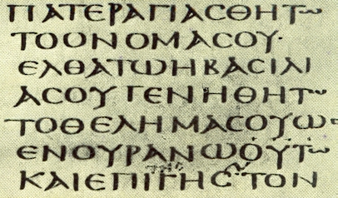
Finding the Meaning of Words in the Bible

Slide 144
Finding the Meaning of Words
Humpty Dumpty said … “There's glory for you!”
“I don't know what you mean by ‘glory’,” Alice said.
Humpty Dumpty smiled contemptuously. “Of course you don't — till I tell you. I meant ‘there's a nice knock-down argument for you!’”
“But ‘glory’ doesn't mean ‘a nice knock-down argument’,” Alice objected.
“When I use a word,” Humpty Dumpty said, in rather a scornful tone, “it means just what I choose it to mean — neither more nor less.”
(Louis Carroll, Through the Looking Glass)

Slide 145
Finding the Meaning of Words
When a French semanticist asked a child whether the moon could have been called “the sun” and the sun “moon,” the child said, “No, because the sun makes it warm and the moon gives light.”
Another little boy once asked his mother: “Mother, when I was born, how did you know I was really Charlie, and not some other little boy?”
(Lionel Ruby, The Art of Making Sense)

Slide 146
Finding the Meaning of Words
Because words are the basic building blocks for conveying meaning, in order to properly understand a passage in the Bible, you must first understand the meaning intended by the author of each of the words used in that passage.
The English word chosen by the translator of your English bible will be your first clue as to the meaning of a particular word in the passage you are studying.
But in order to understand the meaning of a word as precisely as possible, you will need to find the meaning of the original Greek or Hebrew word (using a Greek or Hebrew lexicon).

Slide 147
Some Things to Keep in Mind About Words
A written word is simply a set of symbols which, through conventional usage within a particular society, culture, or group of people is used to convey a particular idea or meaning.
Therefore the meaning of a word is determined entirely by usage – how a particular group of people used the word at a particular time.
The meaning of words can change over time (consider, for example, the English word “gay”).
When determining the meaning of a word in the Bible, a good lexicon (and sometimes a good commentary) will help you to understand what a particular word meant at the time the passage was written.

Slide 148
Some Things to Keep in Mind About Words
You must also keep in mind a word can have a range of meanings (or usages). The range of meanings for a particular word is known as the semantic range for that word.
For example, if we look up the word kephale (usually translated “head”) in a Greek Lexicon* we find the following definitions:
  literally: of a human or animal head (Mat.6:17);
  figuratively:
    of Christ as the head of which the church is the body (Ephesians 1:22);
    of persons, designating first or superior rank
* Timothy Friberg, Analytical Lexicon of the Greek New Testament

Slide 149
Some Things to Keep in Mind About Words
So, when we see the word kephale (“head”) in 1 Corinthians 11:3-4, we must use the context to determine which of the possible meanings was intended in each case where the word is used:
  But I want you to understand that the head of every man is Christ, the head of a wife is her husband, and the head of Christ is God. ⁴ Every man who prays or prophesies with his head covered dishonors his head

Slide 150
Some Things to Keep in Mind About Words
Unless the writer of the text is using a deliberate play on words, a word will usually only have one meaning/usage in a particular passage of scripture.
Your objective, once you have determined the possible meanings for a word (using a lexicon), will be to determine which meaning the author intended when he used that word in the specific passage that you are studying.

Slide 151
Suggested Steps in Determining the Meaning of Word*
Analyze the immediate context carefully to determine which of the range of meanings is the most likely in the passage you are exegeting.
  Are there clues in the context that help to narrow the choices?
  For example does the author use the word in conjunction with, or in contrast to, other words – perhaps in a way similar to other contexts?
  Does the argument itself seem to demand one usage over against others?
*Gordon Fee, New Testament Exegesis, p. 85

Slide 152
Suggested Steps in Determining the Meaning of Word
Going outside the immediate context – If there is not enough in the immediate context to settle the question of how a word is being used then look to see:
  The meaning of this word as it is used in this particular book of the Bible.
  The meaning of this word as it is used by this same author in other places.
  Look to see if there are parallel passages or passages that address the same issue being discussed in this verse that will help to determine which meaning is intended here.

Slide 153
Some Pitfalls to Avoid in Determining Word Meanings*
The root fallacy – Do not assume that because a word comes from another word (or words) that it has the same meaning as that word (or those words). Two examples in English:
  The English word “nice” comes from the Latin word nescius, which means “ignorant”. But when we say someone is “nice”, we are not saying that they are ignorant!
  Even though the word “pineapple” is composed of the words “pine” and “apple”, this does not mean that a pineapple is a special kind of apple that grows on pines!
*D.A. Carson, Exegetical Fallacies, pp.26-34

Slide 154
Some Pitfalls to Avoid in Determining Word Meanings*
Semantic anachronism – Do not read a later use of a word back into earlier literature. For example:
  We should not read the meaning assigned by the church fathers (in the second and third centuries) to the word episkopos (bishop) back into the New Testament writer’s usage of that word.
  It is a mistake to assume that the Greek word dunamis (power) means “dynamite” because our English word “dynamite” comes from the Greek word dunamis!
*D.A. Carson, Exegetical Fallacies, pp.26-34

Slide 155
Some Pitfalls to Avoid in Determining Word Meanings*
Do not make the mistake of assuming that a word always the same meaning every place that it appears.
For example, the word “sanctification” (or “sanctify”) often refers to the progressive purification of the believer in his daily walk after the initial justification that comes at the point of salvation.
  But now that you have been set free from sin and have become slaves of God, the fruit you get leads to sanctification and its end, eternal life. (Romans 6:22)
But the word sanctification sometimes refers to the setting aside of an individual for God at his conversion:
  To the church of God that is in Corinth, to those sanctified in Christ Jesus, called to be saints together with all those who in every place call upon the name of our Lord Jesus Christ (1 Corinthians 1:2)
*D.A. Carson, Exegetical Fallacies, pp.26-34

Slide 156
Some Examples
Let’s start with an easy example: consider the how the word “seed” is used in the following passage:
  The promises were spoken to Abraham and to his seed. The Scripture does not say "and to seeds," meaning many people, but "and to your seed," meaning one person, who is Christ. (Galatians 3:16 - NIV)
The Greek word for “seed” in this passage is sperma.

Slide 157
Some Examples
If we look up the word sperma in a Greek Lexicon* we find the following definitions:
  (a) seed (from which a plant germinates)
  (b) descendants
  (c) an imparted nature
Looking at the immediate context, which meaning is most likely to be the one that Paul intends and why?
  The promises were spoken to Abraham and to his seed. The Scripture does not say "and to seeds," meaning many people, but "and to your seed," meaning one person, who is Christ. (Galatians 3:16 - NIV)
* Johannes P. Louw and Eugene A. Nida (eds.): Greek-English Lexicon of the New Testament Based on Semantic Domains. New York: United Bible Societies, 1988. 2 vols.

Slide 158
Some Examples
Let’s look at another example: consider the how the word “called” is used in the following passage:
  And those whom he predestined he also called, and those whom he called he also justified, and those whom he justified he also glorified. (Romans 8:30)
The Greek word for “called” this passage is kaleo.

Slide 159
Some Examples
If we look up the word kaleo in a Greek Lexicon* we find the following definitions:
  call, name, address
  invite
  call together
  summon
  God or Christ call to eternal salvation, repentance, etc.
Looking at the immediate context, which meaning is most likely to be the one that Paul intends and why?
And those whom he predestined he also called, and those whom he called he also justified, and those whom he justified he also glorified. (Romans 8:30)
* Shorter Lexicon of the Greek New Testament by F. Wilbur Gingrich and Frederick William Danker (Nov 15, 1983)

Slide 160
Some Examples
Let’s look at a little tougher example: consider the how the word “believe” or “faithful” is used in Titus 1:6:
  An elder must be blameless, the husband of one wife, with faithful children who cannot be charged with dissipation or rebellion. (NET)
  An elder must be blameless, the husband of but one wife, a man whose children believe [or ESV – “his children are believers”] and are not open to the charge of being wild and disobedient. (NIV)
The Greek word for “believe” or “faithful” in this passage is pistos.

Slide 161
Some Examples
If we look up the word pistos in a Greek Lexicon* we find the following definitions:
  faithful, trustworthy, reliable;
  believing (believer, Christian)
Looking at the immediate context, which meaning is most likely to be the one that Paul intends and why?
  An elder must be … a man…
    with faithful children (NET)
    whose children believe (NIV)
* UBS Greek/English Dictionary of the New Testament by Barclay M. Newman

Slide 162
Some Observations* on Titus 1:6
The contrast made is not between believing and unbelieving children but between obedient respectful children and lawless uncontrolled children.
The strong terms “wild and disobedient” stress the children’s behavior not their eternal state.
The parallel passage in 1 Tim 3:4 states that the prospective elder “must manage his own family well and see that his children obey him with proper respect”. Since 1 Tim 3:4 is the clearer passage, it should be allowed to interpret the ambiguity of Titus 1:6.
Salvation is a supernatural act of God. God, not good parents (although they are certainly used of God), ultimately bring salvation (Jn 1:12-13)
* Alexander Strauch, Biblical Eldership: An Urgent Call to Restore Biblical Church Leadership, p.229

Slide 163
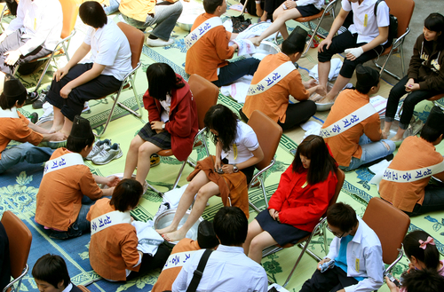
Considering Cultural Differences

Slide 164
Considering Cultural Differences
Perhaps one of the most controversial areas of biblical interpretation and application is the issue of culture differences.
There are a few places where the Bible advocates or commands a cultural practice that is foreign to our present culture. For example:
  Paul commanded Christians to “Greet one another with a holy kiss” (Rom 16:16, 1 Cor 16:20, 2 Cor 13:12, 1 Thes 5:26; also compare 1 Pet 5:14).
  Kissing was a common way for men to greet one another in the culture to whom Paul wrote – and it still is in the Middle East today.
  But because such a practice is foreign to American culture, American men will substitute a “holy handshake” in carrying out the apostles’ command.

Slide 165
Considering Cultural Differences
So when is it okay to make such a substitution and when is such a substitution a compromise?
  First of all, keep in mind that the vast majority of scriptural commands do not involve a foreign cultural practice and therefore should be obeyed as written!
  Before you decide that a specific practice commanded in the Bible requires a cultural substitution, look at the context to make sure that what is commanded is not a timeless biblical obligation.
  If you determine that a specific biblical command involves a cultural practice that is not a timeless biblical obligation and requires a cultural substitution, look for the underlying timeless principle behind the original cultural practice and think about how that principle can be lived out in our present culture.

Slide 166
Look for the Underlying Principle
For example, in the case of the “holy kiss”, the purpose of such a practice was for fellow believers to demonstrate acceptance and a godly affection for one another.
  In modern American culture, if a man were to greet another man with a kiss it would cause great embarrassment and would actually violate the very idea the apostle had in mind!
  Therefore we keep this command by substituting a modern cultural practice (such as a “holy” handshake) that communicates the kind of acceptance and godly affection that the apostle had in mind.

Slide 167
Look for the Underlying Principle
Let’s look at another example: In John 13:14-15, Jesus washed his disciple’s feet and then told them that they should follow his example and wash one another’s feet.
Because they wore sandals and their feet were exposed to sand and dust, it was a common cultural practice in that day for a host to serve his guests by providing for the washing of their feet (cf. Gen 18:4; 1 Sam 25:41; Luke 7:44). Thus Jesus was commanding his disciples to serve one another in humility.
If you were to try to take off the shoes of a guest that visited your home and wash their feet, how do you think that would that be viewed in most cases?
What are some other ways that the underlying principle of serving one another in humility might be expressed in our culture?

Slide 168
Look for the Underlying Principle
One more example: In 1 Corinthians 11, Paul tells the women of that church that they dishonor themselves and/or their husbands if they pray or prophesy without a head covering or a veil. (1 Cor 11:5-6, 10, 13):
1 Corinthians 11:2-16 ² Now I commend you because you remember me in everything and maintain the traditions even as I delivered them to you. ³ But I want you to understand that the head of every man is Christ, the head of a wife is her husband, and the head of Christ is God. ⁴ Every man who prays or prophesies with his head covered dishonors his head, ⁵ but every wife who prays or prophesies with her head uncovered dishonors her head, since it is the same as if her head were shaven. ⁶ For if a wife will not cover her head, then she should cut her hair short. But since it is disgraceful for a wife to cut off her hair or shave her head, let her cover her head.

Slide 169
Look for the Underlying Principle
1 Corinthians 11:2-16 (continued). ⁷ For a man ought not to cover his head, since he is the image and glory of God, but woman is the glory of man. ⁸ For man was not made from woman, but woman from man. ⁹ Neither was man created for woman, but woman for man. ¹⁰ That is why a wife ought to have a symbol of authority on her head, because of the angels. ¹¹ Nevertheless, in the Lord woman is not independent of man nor man of woman; ¹² for as woman was made from man, so man is now born of woman. And all things are from God. ¹³ Judge for yourselves: is it proper for a wife to pray to God with her head uncovered? ¹⁴ Does not nature itself teach you that if a man wears long hair it is a disgrace for him, ¹⁵ but if a woman has long hair, it is her glory? For her hair is given to her for a covering. ¹⁶ If anyone is inclined to be contentious, we have no such practice, nor do the churches of God.

Slide 170
Look for the Underlying Principle
In Corinth at that time, like in many places in the Middle East today, it was considered shameful for a woman to appear in public without a head covering or veil. To do so in that culture would suggest that she was throwing off her husband’s authority and perhaps was a woman with low moral standards.
Apparently there were women in the Corinthian church who were wanting to join the “feminists” of their day and publically dress in a way that communicated to that society that they were throwing off their husbands authority.
And to make matters worse, they were evidently engaging in “spiritual” activities (praying and prophesying – 1 Cor. 11:5,13) while appearing in public without a veil.

Slide 171
Look for the Underlying Principle
One of the arguments Paul makes in this passage is that just as Christ is under God the Father’s authority, and the man is under Christ’s authority, so the woman is under the husbands authority (1 Cor 11:2).
Therefore, Paul argues, the women in Corinth ought to wear the veil as a “symbol of authority” (verse 10) on her head since it was a cultural symbol that communicated that they viewed themselves as being under their husband’s authority.
So the underlying principle for the cultural expression of wearing a veil in Corinth, was the principle that women are to be in submission to their husbands.
In our culture, the veil no longer conveys the idea of a Christian woman who recognizes her husband’s authority. People who see a woman wearing a veil in our society will probably think she is a Muslim!

Slide 172
Look for the Underlying Principle
Are there any cultural practices in our society that communicate the same idea that a woman wearing a veil did in the Corinthian society?
One of the arguments that Paul makes in 1 Corinthians 11 for a woman wearing a head covering may provide us with a way to carry out this command in our culture:
  Paul points that women normally have longer hair than men and their long hair serves as a natural head covering. And he argues that just as it would be shameful for a woman to shave her head (which the prostitutes did in that day) so it would be shameful for a woman in that day to not wear a head covering. (1 Cor. 11:5-6)
  Paul likewise argues in this passage that men show they are under God’s authority by having short hair and praying with their head uncovered. Paul then goes on to appeal to his readers’ native sense of propriety that “if a man has long hair, it is a disgrace to him” (1 Cor. 11:14)

Slide 173
Temporal Cultural Practices Versus Timeless Biblical Obligations
While it is sometimes appropriate to substitute a modern cultural practice for an ancient one in order to preserve the underlying principle, we need to make sure that we are not using “culture” as an excuse to ignore biblical commands simply because they are unpopular in our culture!

Slide 174
Temporal Cultural Practices Versus Timeless Biblical Obligations
For example, in many (perhaps most) places in the world, it is goes against the culture to proclaim the gospel!
But because our responsibility to proclaim the gospel is a timeless biblical obligation, we must do as the apostles did when they chose to “obey God rather than men” (Acts 5:29) and be willing to preach the gospel in spite of cultural opposition.

Slide 175
Temporal Cultural Practices Versus Timeless Biblical Obligations
Another timeless biblical obligation that goes contrary to modern culture: Not divorcing your spouse – except for marital unfaithfulness (Mat 19:9) or abandonment (1 Cor. 7:15)
Jesus taught that the permanence of marriage goes back to what God put in place when he instituted the first marriage in Genesis:
  Matthew 19:4-6 [Jesus speaking]: Have you not read that he who created them from the beginning made them male and female, ⁵ and said, 'Therefore a man shall leave his father and his mother and hold fast to his wife, and the two shall become one flesh'? ⁶ So they are no longer two but one flesh. What therefore God has joined together, let not man separate.

Slide 176
Temporal Cultural Practices Versus Timeless Biblical Obligations
Another timeless biblical obligation that goes contrary to modern culture: women submitting to their husbands.
Even some so-called “conservative” Christians will try to claim that when the Biblical writers told women to obey their husbands, they were just trying to accommodate the oppressive culture of their day.
But Paul teaches that the woman is under a man’s authority not because of culture but because of creation :
  For man was not made from woman, but woman from man. Neither was man created for woman, but woman for man. (1 Corinthians 11:8-9 )

Slide 177
Temporal Cultural Practices Versus Timeless Biblical Obligations
Similarly, some so-called “conservative” Christians will try to claim that when Paul prohibited women from teaching or having authority over men in the church he was just following an outdated chauvinistic cultural practice.
But again, we can see that Paul grounds this command not in culture but in creation :
  I do not permit a woman to teach or to have authority over a man; she must be silent. For Adam was formed first, then Eve. And Adam was not the one deceived; it was the woman who was deceived and became a sinner. (1 Timothy 2:12-14)

Slide 178
In Summary
The vast majority of scriptural commands do not involve a foreign cultural practice and therefore should be obeyed as written!
Before you decide that a specific practice commanded in the Bible requires a cultural substitution, look at the context to make sure that what is commanded is not a timeless biblical obligation.
If you determine that a specific biblical command involves a cultural practice that is not a timeless biblical obligation and requires a cultural substitution, look for the underlying timeless principle behind the original cultural practice and think about how that principle can be lived out in our present culture.

Slide 179

Resources for Studying the Bible

Slide 180
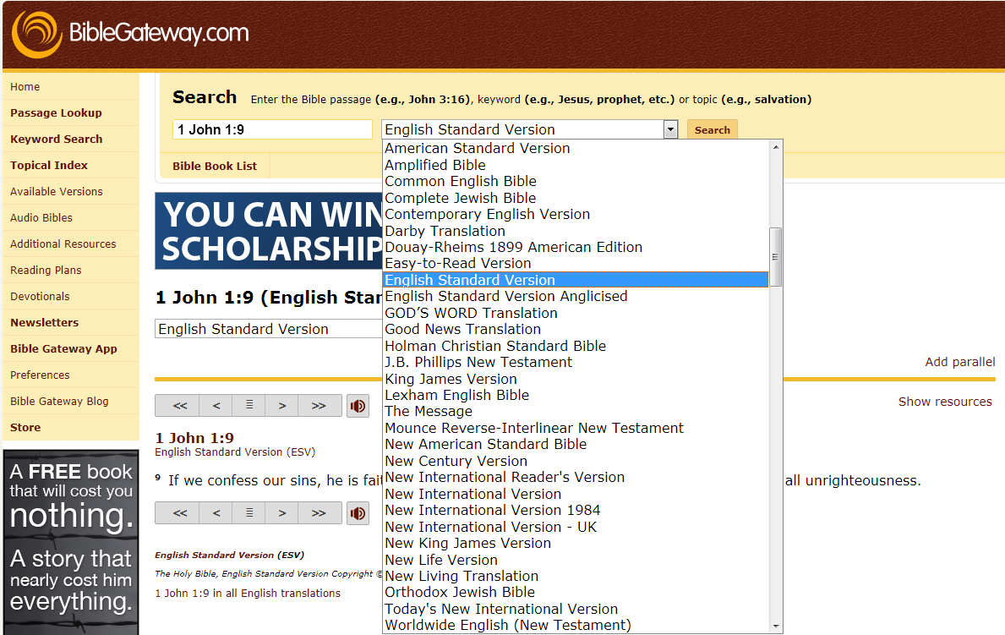
Free Online Resources
BibleGateway.com

Slide 181

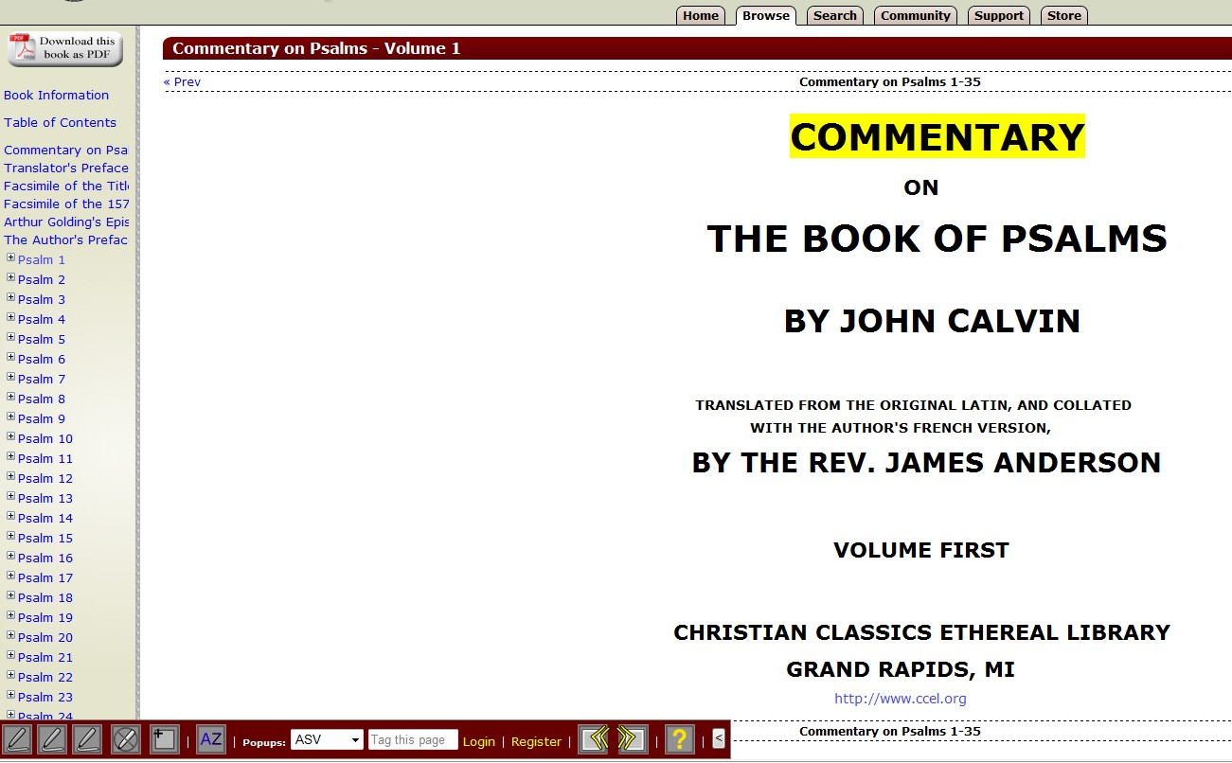
Free Online Resources
Commentaries Online
http://www.ccel.org

Slide 182

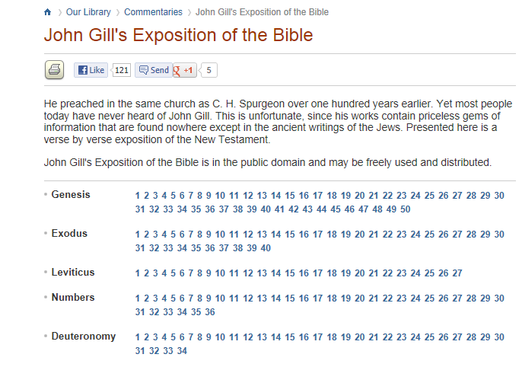
Free Online Resources
Commentaries Online
http://www.biblestudytools.com

Slide 183
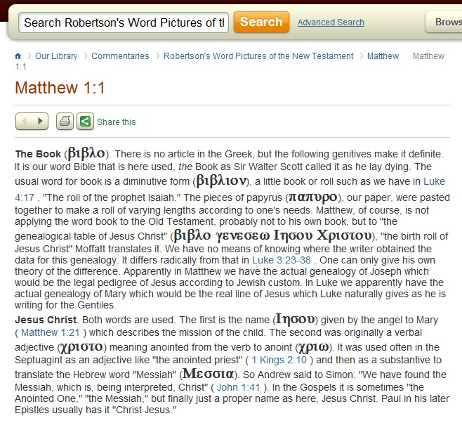
Free Online Resources
Commentaries Online
http://www.biblestudytools.com

Slide 184
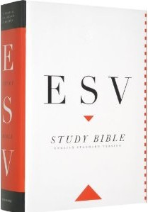
Books
Single Best Book for Bible Study
Current Price (on Amazon): $31.15 (hardcover)

Slide 185

Books
The Other Single Best Book for Bible Study
Current Price (on Amazon): $31.49 (hardcover)

Slide 186
Books for the More Serious Student
Commentaries
Bible Dictionaries and Encyclopedias
Concordances
Lexicons and Other Language Helps

Slide 187
Commentaries
Is it a good idea to use Commentaries?
There are some good sets of commentaries (that cover the entire Old and/or New Testament) that you can buy, but in my opinion it is best to buy commentaries individually for each book of the Bible as you study it.
Things to Beware of in a Commentary:
  Bad Theology
    Liberals
    Be aware if a commentator has areas of bad theology
  Too shallow
  Too wordy
  Too technical (for you)

Slide 188


Commentaries
http://www.christianbook.com

Slide 189
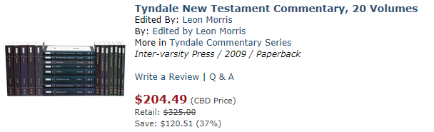
Commentaries
http://www.christianbook.com

Slide 190
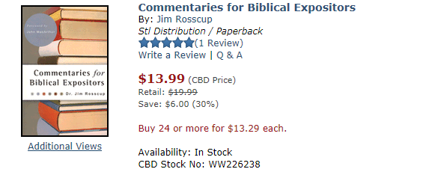
Commentaries
http://www.christianbook.com

Slide 191
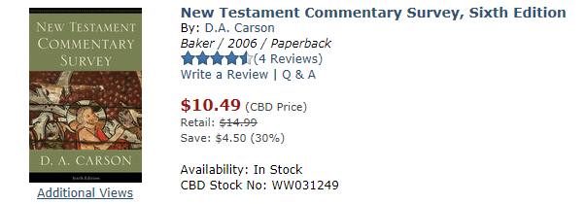
Commentaries
http://www.christianbook.com

Slide 192
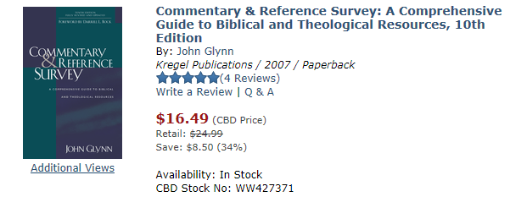
Commentaries
http://www.christianbook.com

Slide 193
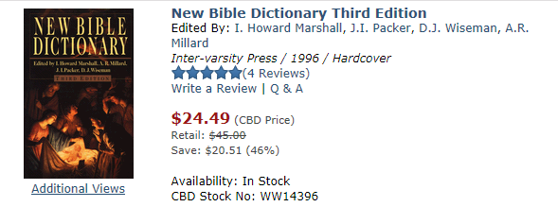
Bible Dictionaries and Encyclopedias
http://www.christianbook.com

Slide 194
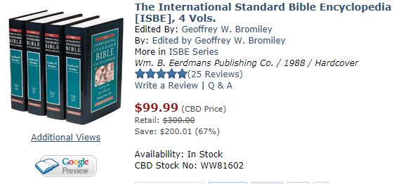
Bible Dictionaries and Encyclopedias
http://www.christianbook.com

Slide 195
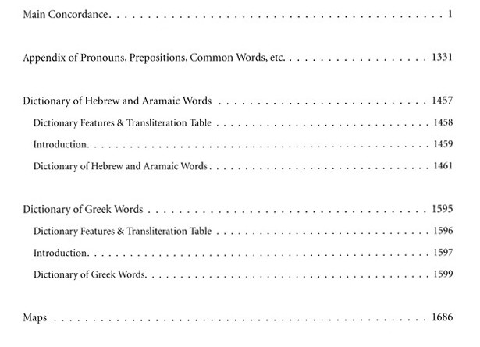
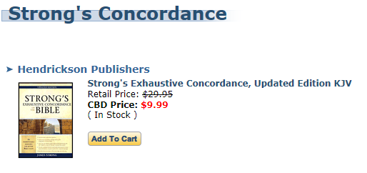
Concordances
http://www.christianbook.com

Slide 196
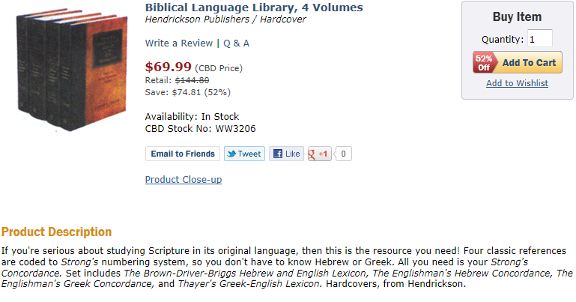
Lexicons and Other Language Helps
http://www.christianbook.com

Slide 197
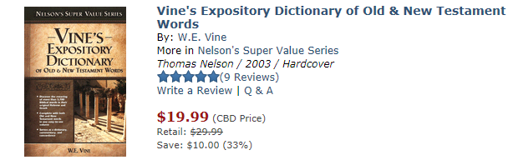
Lexicons and Other Language Helps
http://www.christianbook.com

