Slide 1
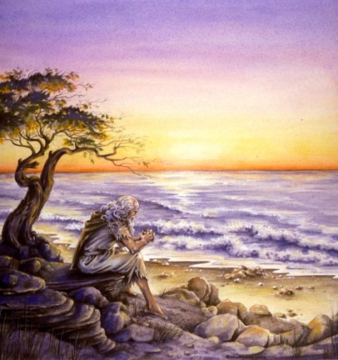
The Book of 1 John
https://revelationillustrated.com/

Slide 2
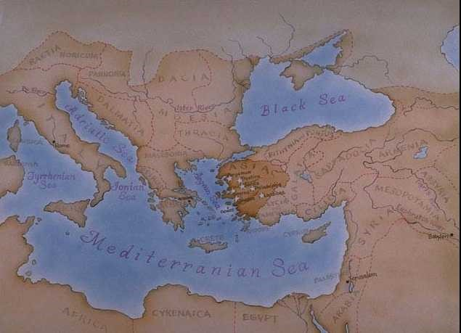
Background of 1 John

Slide 3
Background of 1 John
1 John was written by the Apostle John (who also wrote the Fourth Gospel, 2 and 3 John, and Revelation).
Many scholars believe that 1 John was written near the close of the first century (around 85-95 AD).
1 John 2:12-14, 19; 3:1; 5:13 make it clear this letter was written to Christians, but the letter does not indicate who they were or where they lived.
Evidence from early Christian writers give us reason to believe that John was in Ephesus when he wrote this letter and that it was sent to one or more churches in Asia Minor (modern day Turkey) where he ministered in his later years.
NIV Study Bible, Introduction to 1 John

Slide 4
How Do We Know Who Wrote 1 John?
Unlike most New Testament Letters, 1 John does not tell us who its author is. In fact:
  1 John does not contain a single proper name (except our Lord's) ¹
  Nor a single definite allusion - personal, geographical, or historical ¹
The earliest identification of the Apostle John as the author of 1 John comes from the early church fathers: ²
  Irenaeus (c. A.D. 140-203)
  Tertullian (c. A.D. 150-222)
  Clement of Alexandria (c. A.D. 155-215)
  Origen (c. A.D. 185-253)
As far as we know, no other author was suggested by the early church. ²
This traditional identification is confirmed by evidence in the letter itself. ²
¹ Robert Law, The Tests of Life, Third Edition, 1914, p.39
² NIV Study Bible, Introduction to 1 John

Slide 5
Internal Evidence That John Wrote 1 John
The mention of eyewitness testimony – what we have heard, what we have seen with our eyes, what we have looked at and our hands have touched (1:1 NET) – harmonizes with the fact that John was a follower of Christ from the earliest days of His ministry.
The authoritative manner that pervades the letter is what would be expected from an apostle:
  Commands (2:15,24,28; 4:1; 5:21)
  Firm Assertions (2:6; 3:14; 4:12)
  Pointed Identification of Error (1:6,8; 2:4,22)
The style of this letter is markedly similar to the Gospel of John.
NIV Study Bible, Introduction to 1 John

Slide 6
Similarities Between
1 John and the Gospel of John
Both use a limited range of vocabulary
Both are written using very simple syntax
Both describe almost every subject in very black and white terms – with no shades in between:
  Light and Darkness
  Life and Death
  Love and Hate
  Truth and Falsehood
Both frequently repeat key words and phrases like:
  “Begotten of God"
  “Abiding"
  “Keeping His commandments”
Robert Law, The Tests of Life, Third Edition, 1914, p.340

Slide 7
Similar Phrases and Expressions Found in Both 1 John and the Gospel of John
1 John
John
1 John 1:1-2 - That which was from the beginning . . . the Word of life . . . which was with the Father and has appeared to us.
John 1:1,14 - In the beginning was the Word, and the Word was with God, and the Word was God . . . The Word became flesh and made his dwelling among us.
1 John 1:4 - We write this to make our joy complete.
John 16:24 - . . . and your joy will be complete.
1 John 1:6-7 - If we claim to have fellowship with him yet walk in the darkness, we lie and do not live by the truth. ⁷ But if we walk in the light, as he is in the light, we have fellowship with one another, and the blood of Jesus, his Son, purifies us from all sin.
John 3:19-21 - This is the verdict: Light has come into the world, but men loved darkness instead of light because their deeds were evil. ²⁰ Everyone who does evil hates the light, and will not come into the light for fear that his deeds will be exposed. ²¹ But whoever lives by the truth comes into the light, so that it may be seen plainly that what he has done has been done through God."

Slide 8
Similar Phrases and Expressions Found in Both 1 John and the Gospel of John
1 John
John
1 John 2:7 - Dear friends, I am not writing you a new command but an old one, which you have had since the beginning.
John 13:34 - "A new command I give you: Love one another. As I have loved you, so you must love one another.
1 John 3:8 - He who does what is sinful is of the devil, because the devil has been sinning from the beginning.
John 8:44 - You belong to your father, the devil, and you want to carry out your father's desire. He was a murderer from the beginning.
1 John 3:14 - We know that we have passed from death to life, because we love our brothers. Anyone who does not love remains in death.
John 5:24 - "I tell you the truth, whoever hears my word and believes him who sent me has eternal life and will not be condemned; he has crossed over from death to life.
1 John 4:6 - We are from God, and whoever knows God listens to us; but whoever is not from God does not listen to us. This is how we recognize the Spirit of truth and the spirit of falsehood.
John 8:47 - He who belongs to God hears what God says. The reason you do not hear is that you do not belong to God."

Slide 9
Similar Phrases and Expressions Found in Both 1 John and the Gospel of John
1 John
John
1 John 4:9 - This is how God showed his love among us: He sent his one and only Son into the world that we might live through him.
John 3:16 - For God so loved the world that he gave his one and only Son, that whoever believes in him shall not perish but have eternal life.
1 John 5:9 - We accept man's testimony, but God's testimony is greater because it is the testimony of God, which he has given about his Son.
John 5:32 - There is another who testifies in my favor, and I know that his testimony about me is valid.
1 John 5:12 - He who has the Son has life; he who does not have the Son of God does not have life.
John 3:36 - Whoever believes in the Son has eternal life, but whoever rejects the Son will not see life, for God's wrath remains on him."
Above examples were given in the NIV Study Bible, Introduction to 1 John

Slide 10
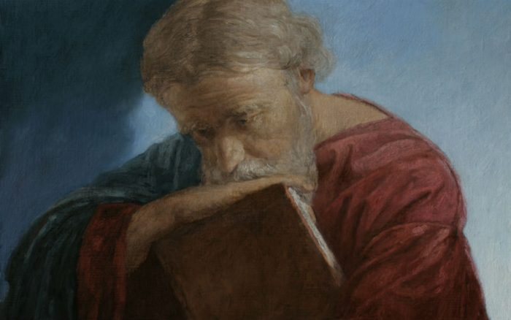
A Brief Biographical Sketch of the Apostle John

Slide 11
Biographical Sketch of the Apostle John
John was the son of Zebedee, a fisherman. He is probably the younger son since he is usually mentioned after his brother James (see Matthew 4:21, Mark 1:19)
His mother was probably Salome (suggested by inference – Mark 15:40 cf. Matthew 27:55-56)
John was probably Jesus’ first cousin on his mother’s side (suggested by inference – John 19:25 cf. Mark 15:40 and Matthew 27:55-56)
John and his brother James were nicknamed by Jesus as “Sons of Thunder” (Mark 3:17)
New Bible Dictionary, Tyndale, Second Edition, 1982, “John, The Apostle”, pp. 601-602

Slide 12
Biographical Sketch of the Apostle John
John was one of the “inner circle” of Jesus’ disciples along with Peter and his brother James
  At the raising of Jairus’ daughter (Mark 5:37)
  At the Transfiguration (Mark 9:2)
  In the Garden of Gethsemane (Mark 14:33)
John is not mentioned by name in the Gospel of John, but he consistently refers to himself throughout that Gospel as “the disciple whom Jesus loved” who lay close to the breast of Jesus at the Last Supper (John 13:23)
John was charged with the care of Jesus’ mother by Jesus as He hung on the cross (John 19:26-27)
New Bible Dictionary, Tyndale, Second Edition, 1982, “John, The Apostle”, pp. 601-602

Slide 13
Biographical Sketch of the Apostle John
John along with Peter bore the main brunt of Jewish hostility to the early Christian church (Acts 4:13; 5:33, 40)
Both John and Peter showed a boldness of speech and action that astounded the Jewish authorities, who regarded them as “unschooled, ordinary men” (Acts 4:13)
John’s brother James was martyred by Herod (Acts 12:2)
John was reputed to be a “pillar” in the Jerusalem church at the time when Paul visited the city 14 years after his conversion in around A.D. 46 (Galatians 2:9)
We do not know (from scripture) when John left Jerusalem nor where he went after his departure.
He was presumably at Ephesus when he was banished to the “island of Patmos because of the word of God and the testimony of Jesus” (Revelation 1:9) where wrote the book of Revelation
New Bible Dictionary, Tyndale, Second Edition, 1982, “John, The Apostle”, pp. 601-602

Slide 14
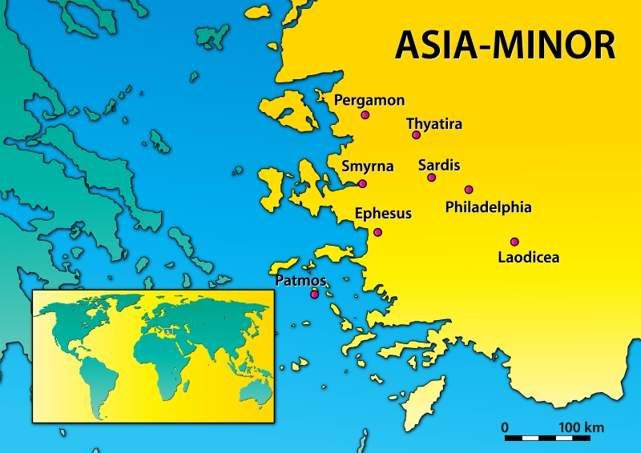
Asia Minor in John’s Day
https://lavistachurchofchrist.org/LVstudies/Revelation/03DeityOfJesus.html

Slide 15
Biographical Sketch of the Apostle John
The Early Church Fathers on the Apostle John:
  Polycrates, Bishop of Ephesus (A.D. 130-196) tells us that John “who reclined on the Lord’s breast”, after being “a witness and a teacher fell asleep at Ephesus”.
  According to Irenaeus (A.D. 130-202), it was at Ephesus that John “gave out” the Gospel, and confuted the heretics, refusing to remain under the same roof as Cerinthus [an early Gnostic teacher], “the enemy of truth”; at Ephesus he lingered on “till the days of Trajan”, who reigned A.D. 98-117.
  Jerome (A.D. 342-420) also repeats the tradition that John tarried at Ephesus to extreme old age, and records that, when John had to be carried to the Christian meetings, he used to repeat again and again “Little children, love one another”.
New Bible Dictionary, Tyndale, Second Edition, 1982, “John, The Apostle”, pp. 601-602

Slide 16

The Purpose of 1 John

Slide 17
The Two-Fold Purpose of 1 John
1 John was written to give assurance of salvation to true Christians.
  1 John 5:13 - I write these things to you who believe in the name of the Son of God so that you may know that you have eternal life.
1 John also appears to have been written to combat an early form of counterfeit Christianity known as Gnosticism.

Slide 18
1 John Was Written to Give Assurance of Salvation to True Christians.
John sets forth and discusses three tests by which professing Christians can determine whether or not they have been born of God.
Everyone who passes these three tests can know that he is a child of God and has eternal life.
Everyone who claims to be a Christian but fails to pass these three tests is lost-- he is a child of the devil and is walking in darkness.
This letter gives the marks or characteristics of those who have fellowship with God.

Slide 19
Three Marks of the True Christian
(as Given in 1 John)
Righteousness (obedience to God's commands).
Love (for Christians and for God).
Orthodox Belief (that Jesus is the Christ, come in the flesh, sent by the Father to die for sinners so that they can be saved through faith in Him).

Slide 20
1 John Was Written to Combat an Early Form of Counterfeit Christianity Known as Gnosticism.
The name "Gnosticism" is derived from the Greek word gnosis which means "knowledge".
This system of belief was drawn from oriental mysticism and Greek philosophy.
Scholars are uncertain as to exactly what the Gnostics of the first century believed, but the following false concepts seem to have made up the underlying elements of their doctrine:
  The Gnostics held to a spirit-matter dualism.
  The Gnostics held that knowledge was the highest virtue and the sole means by which one obtained salvation.

Slide 21
The Gnostics Held to a
Spirit-Matter Dualism
They believed that all "matter" (everything physical) is evil - Only that which is "spirit" is good.
Some held that matter is eternal, because God (who is spirit) could not have created matter (which is evil).
This unbiblical view of matter (viewing it as intrinsically evil) led the Gnostics into two fatal errors:
  The Gnostic belief in the inherent evil of matter caused them to reject outright the incarnation of God's Son.
  The Gnostic belief in the inherent evil of matter caused them to adopt a totally wrong view of Christian duty.

Slide 22
The Gnostics Rejected the
Incarnation of God's Son.
They claimed that the man Jesus (born of Mary) was a separate being from the Christ (sent from God).
Since Jesus had a physical body, He had to be sinful, like any other man.
When Jesus was baptized, the Christ (which was spirit) came upon Him. (It was the Christ which enabled Jesus to perform miracles, etc.)
Before Jesus died the Christ left Him.
The Christ had not been born of the virgin Mary, nor did the Christ die for men's sins on the cross.
Hence, faith in the shed blood of Jesus has nothing to do with being saved.

Slide 23
The Gnostics had a Wrong View of Christian Duty
The belief that matter was evil led some Gnostics into asceticism (the practice of strict self-denial by avoiding pleasure derived from physical things; e.g., eating, drinking, marriage, etc.) Paul combats this form of Gnosticism in Col. 2:6-23.
Other Gnostics went to the opposite extreme of antinomianism (the belief that the Christian is under no obligation to keep God's law). They would reason like this:
  The body is evil and therefore is doomed to sin, so don't worry about it.
  Why? Because the sins of the flesh do not defile man's spirit (which cannot sin).
  It is this form of Gnosticism (namely, antinomianism) which is combated in 1 John.

Slide 24
The Gnostics Held That Knowledge Was The Highest Virtue
Gnosticism made knowledge [Greek, gnosis], not faith, the one condition of salvation and the only test of fellowship with God.
This knowledge, however was not available to common people. Only the intellectuals which were initiated into the mysteries of their system could “know” God.
This distorted view of knowledge led to arrogance, lovelessness, and exclusion.
Note: the word “know” is used approximately 25 times in 1 John.

Slide 25

The Structure of 1 John

Slide 26

The Structure of 1 John
“[1John] is like a winding staircase always revolving around the same center, always recurring to the same topics, but at a higher level.” (Robert Law)

Slide 27
The Structure of 1 John
“The Epistle works with a comparatively small number of themes, which are introduced many times, and are brought into every possible relation to one another. As some master-builder of music takes two or three melodious phrases and, introducing them in due order, repeating them, inverting them, skillfully interlacing them in diverse modes and keys, rears up from them an edifice of stately harmonies; so the Apostle weaves together a few leading ideas into a majestic fugue in which unity of material and variety of tone and effect are wonderfully blended.”
Robert Law, The Tests of Life, Third Edition, 1914, p.5

Slide 28
Outline of 1 John
1:1-4 - Prologue: John Introduces the Major Theme of the Letter - FELLOWSHIP WITH GOD
1:5-2:28 - The First Presentation of the Three Themes of RIGHTEOUSNESS, LOVE and BELIEF in Jesus
2:29-4:6 -The Second Presentation of the Three Themes of RIGHTEOUSNESS, LOVE and BELIEF in Jesus
4:7-5:21 - The Third Presentation of the Three Themes of RIGHTEOUSNESS, LOVE and BELIEF in Jesus
Robert Law, The Tests of Life, Third Edition, 1914, p.21-24

Slide 29
1:5-2:28
The First Presentation of the Three Themes of RIGHTEOUSNESS, LOVE and BELIEF in Jesus
1:5-7 - John states that:
  “God is light" (i.e. God is truth and the revealer of truth)
  A person's claim to have FELLOWSHIP with God is verified only if he "walks in the light" (i.e. lives according to God's truth).
1:8-2:6 - "Walking in the Light" Tested by RIGHTEOUSNESS
  First - in confession of sin (1:8-2:2)
  Secondly - in actual obedience (2:3-6)
2:7-17 - "Walking in the Light" Tested by LOVE
  Positively - By love of one's brother (2:7-11)
  [Parenthetical Passage in (2:12-14)]
  Negatively - By not loving the World (2:15-17)
2:18-28 - "Walking in the Light" Tested by BELIEF in Jesus the Son of God.
  Contrast Between False Teachers and True Believers (2:18-21)
  Christological Test (2:22-23)
  Exhortation to Continue in the Truth (2:24-28)

Slide 30
2:29-4:6
The Second Presentation of the Themes of RIGHTEOUSNESS, LOVE and BELIEF in Jesus
2:29-3:10a - Divine Sonship tested by RIGHTEOUSNESS
  God is righteous therefore everyone who “does what is right” is “born of Him” (2:29)
  The present status and future hope of the “children of God” (3:1-3)
  Divine Sonship is utterly contrary to all sin (3:4-10a)
3:10b-24a - Divine Sonship tested by LOVE
  Anyone who does not obey the command to “love one another” is not a child of God (3:10b-11)
  Cain as the model of murder and hate - whose example is followed by the world (3:12-15)
  Christ as the model of love – whose example we must follow in order to have confidence in our relationship with God (3:16-24a)
3:24b-4:6 - Divine Sonship tested by BELIEF in the Spirit’s Message

Slide 31
4:7-5:21
The Third Presentation of the Three Themes of RIGHTEOUSNESS, LOVE and BELIEF in Jesus
4:7-5:3a – Christian LOVE
  4:7-12 – The Source of LOVE
  4:13-16 – The Synthesis of LOVE and BELIEF– true belief is the vital ground of Christian love
  4:17-5:1 – The Effect and Motives of LOVE
  5:2-3a – The Synthesis of LOVE and RIGHTEOUSNESS – we love God by keeping His commandments
5:3b-21 – Christian BELIEF
  5:3b-4 – The Synthesis of BELIEF and RIGHTEOUSNESS – in belief lies the power of obedience
  5:5-12 – The Contents, Basis, and Issue of Christian BELIEF
  5:13-21 – The Certainties of Christian BELIEF

Slide 32

1 John 1:1-4
John's Introduction To The Letter
http://ullesthorpe.org/bible-owner/

Slide 33

Class Discussion Time
https://www.weareteachers.com/moving-beyond-classroom-discussions/

Slide 34
*Class Discussion Time
What are you most looking forward to hearing about as we embark on this study of 1 John?
The fact that John needs to give Christians a means of assurance that they are truly saved may seem like a strange idea in our day, when most people just assume that anyone who claims to be a Christian is saved. Do you believe it’s possible for someone to think they are saved, when in fact they’re really not? As you think about that, consider the verse, where Jesus says: “Not everyone who says to me, 'Lord, Lord,' will enter the kingdom of heaven, but the one who does the will of my Father who is in heaven. On that day many will say to me, ‘Lord, Lord, did we not prophesy in your name, and cast out demons in your name, and do many mighty works in your name?’ And then will I declare to them, ‘I never knew you; depart from me, you workers of lawlessness.’” (Mat. 7:21-23 )
Do you struggle with the idea that your Christian faith may not prove genuine in the end? Why or why not?
Should a Christian concern themselves with whether their faith is genuine? Is it possible for a Christian to get overly focused on this idea to a point where it’s unhelpful? Is there a balance to be had?

Slide 35
The Book of 1 John
https://revelationillustrated.com/

