Slide 1
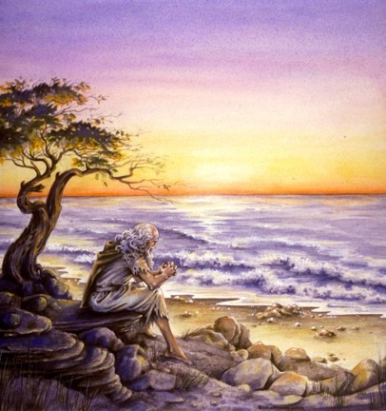
The Book of 1 John
To Download this lesson go to:
http://www.purifiedbyfaith.com/1John/1John.htm
https://revelationillustrated.com/

Slide 2
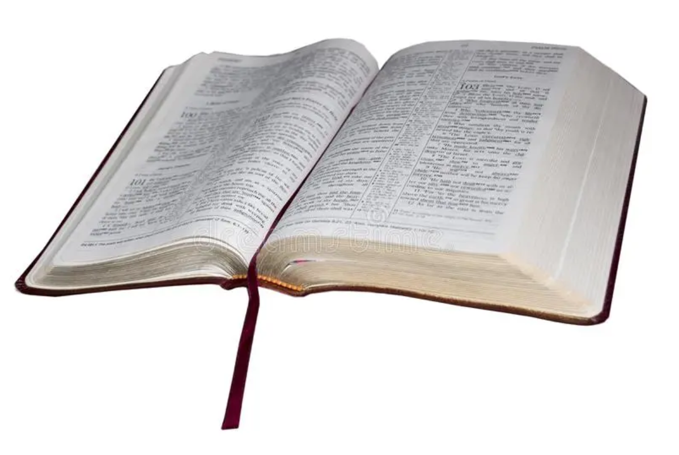
1 John 1:1-4
John's Introduction To His Letter
http://ullesthorpe.org/bible-owner/

Slide 3
1 John 1:1-4 John's Introduction To His Letter
¹ That which was from the beginning, which we have heard, which we have seen with our eyes, which we looked upon and have touched with our hands, concerning the word of life-- ² the life was made manifest, and we have seen it, and testify to it and proclaim to you the eternal life, which was with the Father and was made manifest to us-- ³ that which we have seen and heard we proclaim also to you, so that you too may have fellowship with us; and indeed our fellowship is with the Father and with his Son Jesus Christ. ⁴ And we are writing these things so that our joy may be complete.

Slide 4
Some Initial Observations
Some passages in the Bible are more difficult to interpret than others:
2 Peter 3:16 - [The Apostle Paul’s] letters contain some things that are hard to understand, which ignorant and unstable people distort, as they do the other Scriptures, to their own destruction.

Slide 5
Some Initial Observations
In the opinion of some scholars, 1 John 1:1-4 is a difficult passage to interpret:
“[1 John 1:1ff] is unusually complicated for the Johannine writings”
(F.F. Bruce, The Epistles of John, 1970, p.34)
“All commentators have found this first paragraph involved in syntax and abstruse in meaning. It is, in fact, a grammatical tangle”
(John R. W. Stott, The Epistles of John – An Introduction and Commentary, Eerdmans, 1979, p.57)
Therefore we will need to apply extra diligence in interpreting this passage!
One advantage we have in interpreting 1 John 1:1-4, is that we have a parallel passage written by the same author in the Gospel of John (1:1-17) to compare with this text.

Slide 6
A Parallel Passage: John 1:1-17
¹ In the beginning was the Word, and the Word was with God, and the Word was God. ² He was in the beginning with God. ³ All things were made through him, and without him was not any thing made that was made. ⁴ In him was life, and the life was the light of men. ⁵ The light shines in the darkness, and the darkness has not overcome it. ⁶ There was a man sent from God, whose name was John. ⁷ He came as a witness, to bear witness about the light, that all might believe through him. ⁸ He was not the light, but came to bear witness about the light. ⁹ The true light, which enlightens everyone, was coming into the world. ¹⁰ He was in the world, and the world was made through him, yet the world did not know him. ¹¹ He came to his own, and his own people did not receive him. ¹² But to all who did receive him, who believed in his name, he gave the right to become children of God, ¹³ who were born, not of blood nor of the will of the flesh nor of the will of man, but of God. ¹⁴ And the Word became flesh and dwelt among us, and we have seen his glory, glory as of the only Son from the Father, full of grace and truth. ¹⁵ (John bore witness about him, and cried out, “This was he of whom I said, ‘He who comes after me ranks before me, because he was before me.’”) ¹⁶ And from his fullness we have all received, grace upon grace. ¹⁷ For the law was given through Moses; grace and truth came through Jesus Christ.

Slide 7
What are the Parallels Between 1 John 1:1-3 and John 1:1-17?
Both passages open with a reference to “the beginning”
1 John 1:1 - That which was from the beginning
John 1:1-2 - In the beginning was the Word . . . He was in the beginning with God.
Both speak of the Word in connection with the Father and with life
1 John 1:1b-2 - concerning the word of life . . . proclaim to you the eternal life, which was with the Father
John 1:1,4 - In the beginning was the Word, and the Word was with God. . . . In him was life
Both talk about the eternal God entering human history
1 John 1:2b – we… proclaim to you the eternal life, which was with the Father and was made manifest to us.
John 1:10 - He was in the world, and the world was made through him, yet the world did not know him.
Both say that the divine manifestation was seen by men
1 John 1:2b-3a - the eternal life, which was with the Father and was made manifest to us
John 1:14b - we have seen his glory, glory as of the only Son from the Father
John R. W. Stott, The Epistles of John – An Introduction and Commentary, Eerdmans, 1979, p.66-67

Slide 8
What are the Parallels Between 1 John 1:1-3 and John 1:1-17?
Both passages mention testifying or bearing witness to what was seen.
1 John 1:2a - the life was made manifest, and we have seen it, and testify to it
John 1:7a – [John the Baptist] came as a witness, to bear witness about the light, that all might believe through him.
Both describe a new relationship with God that is the result of responding to Christ.
1 John 1:3 - that which we have seen and heard we proclaim also to you, so that you too may have fellowship with us; and indeed our fellowship is with the Father and with his Son Jesus Christ.
John 1:12 – But to all who did receive him, who believed in his name, he gave the right to become children of God
John R. W. Stott, The Epistles of John – An Introduction and Commentary, Eerdmans, 1979, p.66-67

Slide 9
1 John 1:1-4 begins with the English words, “That which” – taken from the Greek word (ho), which is the nominative neuter singular of the relative pronoun (hos).
¹ That which was from the beginning, which we have heard, which we have seen with our eyes, which we looked upon and have touched with our hands, concerning the word of life-- ² the life was made manifest, and we have seen it, and testify to it and proclaim to you the eternal life, which was with the Father and was made manifest to us-- ³ that which we have seen and heard we proclaim also to you, so that you too may have fellowship with us; and indeed our fellowship is with the Father and with his Son Jesus Christ. ⁴ And we are writing these things so that our joy may be complete. (1 John 1:1-4 )

Slide 10
The Greek pronoun (ho), appears 5 times in this passage. From the way the passage is structured we can tell that it refers to the same thing in every case.
¹ That which was from the beginning, which we have heard, which we have seen with our eyes, which we looked upon and have touched with our hands, concerning the word of life-- ² the life was made manifest, and we have seen it, and testify to it and proclaim to you the eternal life, which was with the Father and was made manifest to us-- ³ that which we have seen and heard we proclaim also to you, so that you too may have fellowship with us; and indeed our fellowship is with the Father and with his Son Jesus Christ. ⁴ And we are writing these things so that our joy may be complete. (1 John 1:1-4 )

Slide 11
What (or who) does ho (That which . . .which . . .which . . . which . . . what) refer to in this passage?
What (or who) is it that:
Was from the beginning
John and others had:
Heard
Seen with their eyes
Looked at
Touched with their hands
Proclaimed to his readers so that they also might have fellowship those who had seen and heard
John R. W. Stott, The Epistles of John – An Introduction and Commentary, Eerdmans, 1979, p.66-67

Slide 12
John tells us at the end of verse 1 that what he proclaimed concerned the Word of life.
¹ That which was from the beginning, which we have heard, which we have seen with our eyes, which we looked upon and have touched with our hands, concerning the word of life-- ² the life was made manifest, and we have seen it, and testify to it and proclaim to you the eternal life, which was with the Father and was made manifest to us-- ³ that which we have seen and heard we proclaim also to you, so that you too may have fellowship with us; and indeed our fellowship is with the Father and with his Son Jesus Christ. ⁴ And we are writing these things so that our joy may be complete. (1 John 1:1-4 )

Slide 13
Verse 2, then, is a parenthetical statement where John elaborates on the Word of life that he introduced at the end of verse 1.
¹ That which was from the beginning, which we have heard, which we have seen with our eyes, which we looked upon and have touched with our hands, concerning the word of life-- ² (the life was made manifest, and we have seen it, and testify to it and proclaim to you the eternal life, which was with the Father and was made manifest to us)-- ³ that which we have seen and heard we proclaim also to you, so that you too may have fellowship with us; and indeed our fellowship is with the Father and with his Son Jesus Christ. ⁴ And we are writing these things so that our joy may be complete. (1 John 1:1-4 )

Slide 14
Some Observations on 1 John 1:2
The life was made manifest, and we have seen it, and testify to it and proclaim to you the eternal life, which was with the Father and was made manifest to us.
In this verse, John elaborates on the expression that he introduced at the end of verse 1: the word of life (or, as it’s called here: the life)
John begins by telling us that “the life” was made manifest, that is to say that he and others:
Have seen it
Testify to it
Proclaim it to his readers
John then refers to “the life” as “the eternal life” and tells us that this eternal life:
Was with the Father
Has (subsequently) been made manifest to John and others

Slide 15
So what (or who) is it that John is describing in this passage?
Let’s summarize what John has told us about his subject:
Was from the beginning
Was with the Father
Is eternal
Embodies life in such a way as to be called “the life”
Was made manifest
Was seen, heard, and touched by John (and others)
Is now proclaimed and testified to by John to his readers so that they also might have fellowship with John (and others) who had seen and heard
While John never explicitly identifies his subject by name, it is patently obvious when we look at what he says about his subject that he is talking about the person of Jesus Christ!

Slide 16
Our identification of Jesus Christ as John’s subject in 1 John 1:1-4 is reinforced when we compare it with what John wrote in the parallel passage in the Gospel of John 1:1-17:
In the Gospel, John starts out talking about “the Word” without immediately identifying for us who “the Word” is. (1 John refers to Jesus as “the word of life”)
John then begins telling us about “the Word”:
He was in the beginning (1 John tells us the same thing about Jesus)
He was with God (1 John tells us Jesus was with the Father)
He was God (1 John does not explicitly tell us that Jesus is God in the first 4 verses, but John does explicitly identify Jesus as God later on in the letter – see 1 John 5:20)
He made all things (1 John does not explicitly speak of this)
In him was life (1 John refers to Jesus as “the life”)
He became flesh and dwelt among us (1 John tells us that Jesus appeared and was seen by men)

Slide 17
So, if John is talking about a person (Jesus) rather than a thing, then why are the pronouns that he uses to refer to Jesus in the neuter (“which”), rather than the masculine (“who”)?
In the NT as also classical Greek, and especially in John’s writings, the neuter is frequently used of a person when he is being thought of in an abstract way. This happens at least 6 times in which a neuter relative is used to refer to an antecedent who is obviously a person. An example is found in John 17:24: “Father, I desire that they also whom [the neuter, ὅ] Thou has given Me be with Me where I am.” The antecedent is obviously not impersonal. This abstract neuter is used elsewhere of God (John 4:22) and of men (John 6:37, 39; 17:2 ; 1 John 5:4).
James L. Boyer, “Relative Clauses in the Greek New Testament: A Statistical Study,” Grace Theological Journal 9 (Fall 1988): p.247

Slide 18
Now that we’ve figured out who John is talking about, let’s take a closer look at what John tells us about the person of Jesus Christ. The first thing John tells us is that Jesus was from the beginning:
¹ That which was from the beginning, which we have heard, which we have seen with our eyes, which we looked upon and have touched with our hands, concerning the word of life-- ² the life was made manifest, and we have seen it, and testify to it and proclaim to you the eternal life, which was with the Father and was made manifest to us-- ³ that which we have seen and heard we proclaim also to you, so that you too may have fellowship with us; and indeed our fellowship is with the Father and with his Son Jesus Christ. ⁴ And we are writing these things so that our joy may be complete. (1 John 1:1-4 )

Slide 19
From the Beginning
The Bible speaks of many “beginnings”. For example:
The beginning of eternity when Jesus coexisted with the Father before anything was created:
John 1:1,3 - In the beginning was the Word, and the Word was with God, and … All things were made through him, and without him was not any thing made that was made.
The beginning of the world or creation:
Matthew 24:21 - For then there will be great tribulation, such as has not been from the beginning of the world until now, no, and never will be.
Matthew 19:4 - He answered, "Have you not read that he who created them from the beginning made them male and female”
The beginning of Jesus’ ministry:
John 15:27 - And you also will bear witness, because you have been with me from the beginning.
The beginning of one’s Christian experience when they first heard and believed the Gospel:
1 John 3:11 - For this is the message that you have heard from the beginning, that we should love one another.

Slide 20
From the Beginning
When a Biblical writer (such as John) talks about something being “from the beginning”, we must examine the context to determine which “beginning” the writer is talking about.
It is not always possible to determine with certainty which “beginning” is being referenced. For example:
John 6:64b - Jesus knew from the beginning who those were who did not believe, and who it was who would betray him.
Does this refer to the beginning of Jesus’ ministry when he chose His disciples?
Or does this refer to eternity past when Jesus as God knew which of His disciples would betray Him?
1 John 3:8b - the devil has been sinning from the beginning.
Does this refer to the beginning of the devil’s rebellion?
Does this refer to the beginning of sin?
Does this refer to (near) the beginning of mankind?
Does this refer to some other beginning?

Slide 21
From the Beginning
So, what beginning does John have in mind in 1 John 1:1?
The beginning of Jesus’ incarnation?
The beginning of Jesus’ ministry?
The beginning of eternity when Jesus was present with the Father?

Slide 22
From the Beginning
I believe it makes the most sense to understand “beginning” in 1 John 1:1 as referring to eternity past for the following reasons:
The references to Jesus in this passage are to the person of Jesus Christ as a whole – not some aspect of Jesus (such as His incarnation or his ministry)
The person of Christ has no beginning. Therefore when we speak of His being in the beginning it only makes sense that John would be speaking of eternity past.
It is for this reason that most commentators take the only other reference in this letter to Christ’s or the Father’s being “in the beginning” (in 1 John 2:13-14) as a reference to eternity past.
The whole point of 1 John 1:1ff seems to be to show that Jesus, who has existed eternally with the Father has now been manifested in human history to be seen by men.
Taking this beginning as eternity past therefore supports this message and reinforces what John says in verse 2 that the eternal life who was with the Father has appeared to men.
The parallel passage (John 1:1) talks about Jesus being “in the beginning” and clearly has reference to eternity past.

Slide 23
Jesus, who existed eternally with the Father, made God known in a very tangible way by appearing in human flesh. Nine times in verses 1-3 John uses words that speak of Jesus’ tangible, observable reality as a man.
¹ That which was from the beginning, which we have heard, which we have seen with our eyes, which we looked upon and have touched with our hands, concerning the word of life-- ² the life was made manifest, and we have seen it, and testify to it and proclaim to you the eternal life, which was with the Father and was made manifest to us-- ³ that which we have seen and heard we proclaim also to you, so that you too may have fellowship with us; and indeed our fellowship is with the Father and with his Son Jesus Christ. ⁴ And we are writing these things so that our joy may be complete. (1 John 1:1-4 )

Slide 24
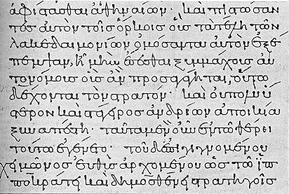
Let’s take a quick look at the words used in 1 John 1:1-3 to portray the tangible reality of Jesus appearance as a man:
We are told that Jesus:
Was heard (akouo, hence acoustic – heard talking, praying, questioning, preaching, denouncing, crying out);
Was seen with our eyes (ophthalmos, hence ophthalmologist -- seen walking, smiling, angry, weary, sweating, bleeding);
Was looked upon (theaomai, hence theater -- viewed, contemplated);
Was touched (pselaphao, to handle -- compare Luke 5:13; Matthew 14:31; John 13:25; Luke 24:39; John 20:27);
Was made manifest (phaneroo, become known, be shown, be in true character (2Cor. 5:11); appear, become visible, be revealed (Jn. 21:14; 1Tim. 3:16)
https://www.wikiwand.com/en/Greek_minuscule

Slide 25
As we observed earlier, Jesus is referred to by John as the word of life, the life, and the eternal life. What is the significance of these titles as the relate to Jesus?
¹ That which was from the beginning, which we have heard, which we have seen with our eyes, which we looked upon and have touched with our hands, concerning the word of life-- ² the life was made manifest, and we have seen it, and testify to it and proclaim to you the eternal life, which was with the Father and was made manifest to us-- ³ that which we have seen and heard we proclaim also to you, so that you too may have fellowship with us; and indeed our fellowship is with the Father and with his Son Jesus Christ. ⁴ And we are writing these things so that our joy may be complete. (1 John 1:1-4 )

Slide 26
A Short Explanation of Some of the Titles Used by John Concerning Jesus
The word (of life) (logos)– Essentially a word is an expression of revelation and/or communication. The spoken or written word reveals and communicates what is in the mind of the speaker. In the incarnation, the Word (i.e. Jesus), who is in essence Deity, took on human flesh. Prior to that event no one had ever seen God, but in the incarnation the Word revealed God to men. (cf. John 1:1)
The life (zoe) – Jesus is not only the source of life but life itself. (cf. John 1:4)
The eternal (life) (aionios) – In the New Testament this word always refers to that which, like God, is eternal. It is both quantitative and qualitative, referring to length of life as well as kind of life. It is unending life, but it is a life characterized by such qualities as spirituality, glory, abundance, holiness and love. In Christ this life is personified. He is eternal life.
Donald W. Burdick, The Epistles of John, Moody Press, 1970, p.19-20

Slide 27
When John speaks of his observation and eyewitness proclamation of Jesus Christ, he speaks in the first person plural (“we”, “our”, “us”)
¹ That which was from the beginning, which we have heard, which we have seen with our eyes, which we looked upon and have touched with our hands, concerning the word of life-- ² the life was made manifest, and we have seen it, and testify to it and proclaim to you the eternal life, which was with the Father and was made manifest to us-- ³ that which we have seen and heard we proclaim also to you, so that you too may have fellowship with us; and indeed our fellowship is with the Father and with his Son Jesus Christ. ⁴ And we are writing these things so that our joy may be complete. (1 John 1:1-4 )

Slide 28
The “we” who saw Jesus and proclaimed Him based on eyewitness observation does not include John’s readers whom he addresses as “you” (second person plural).
¹ That which was from the beginning, which we have heard, which we have seen with our eyes, which we looked upon and have touched with our hands, concerning the word of life-- ² the life was made manifest, and we have seen it, and testify to it and proclaim to you the eternal life, which was with the Father and was made manifest to us-- ³ that which we have seen and heard we proclaim also to you, so that you too may have fellowship with us; and indeed our fellowship is with the Father and with his Son Jesus Christ. ⁴ And we are writing these things so that our joy may be complete. (1 John 1:1-4 )

Slide 29
So who, besides John, is included in the “we” who saw Jesus and then proclaimed him to others?
Answer: The disciples who were with Jesus and saw Him after His resurrection were commissioned by Jesus to testify on His behalf since they had been with Him and had seen Him:
John 15:26b-27 – The Spirit of truth who goes out from the Father, he will testify about me [Jesus]. And you [disciples] also must testify, for you have been with me from the beginning.
Luke 24:46-48 – Thus it is written, that the Christ should suffer and on the third day rise from the dead, and that repentance and forgiveness of sins should be proclaimed in his name to all nations, beginning from Jerusalem. You are witnesses of these things.
Acts 10:41 – And we [Peter and his fellow apostles] are witnesses of all that [Jesus] did… They put him to death by hanging him on a tree, but God raised him on the third day and made him to appear, not to all the people but to us who had been chosen by God as witnesses, who ate and drank with him after he rose from the dead.

Slide 30
So who, besides John, is included in the “we” who saw Jesus and then proclaimed him to others?
Therefore when John speaks of “we” who have seen Christ and proclaim Him – he is referring to himself and the other disciples who had been commissioned by God as apostles.
1 John 1:2 - the life was made manifest, and we have seen it, and testify to it and proclaim to you the eternal life, which was with the Father and was made manifest to us--
The historical manifestation of the Eternal life was then proclaimed by the apostles to mankind at large--the revelation was given to the few ("to us") for the many ("to you").
John wants his readers to enjoy the same blessing which he himself and his fellow apostles enjoyed; namely, to know God through knowing Jesus Christ and thereby to possess eternal life through Him.

Slide 31
The purpose of the apostle's proclamation was that others might have fellowship with them (in the Christian Faith) which would bring them into fellowship with the Father and with his Son, Jesus Christ.
¹ That which was from the beginning, which we have heard, which we have seen with our eyes, which we looked upon and have touched with our hands, concerning the word of life-- ² the life was made manifest, and we have seen it, and testify to it and proclaim to you the eternal life, which was with the Father and was made manifest to us-- ³ that which we have seen and heard we proclaim also to you, so that you too may have fellowship with us; and indeed our fellowship is with the Father and with his Son Jesus Christ. ⁴ And we are writing these things so that our joy may be complete. (1 John 1:1-4 )

Slide 32
Fellowship (koinonia)
Louw-Nida Lexicon – an association involving close mutual relations and involvement
Liddel-Scott Lexicon – communion, associate, partnership, fellowship
Friberg Lexicon – a relationship characterized by sharing in common, fellowship, participation

Slide 33
John states his purpose for writing these things: to make our joy complete.
¹ That which was from the beginning, which we have heard, which we have seen with our eyes, which we looked upon and have touched with our hands, concerning the word of life-- ² the life was made manifest, and we have seen it, and testify to it and proclaim to you the eternal life, which was with the Father and was made manifest to us-- ³ that which we have seen and heard we proclaim also to you, so that you too may have fellowship with us; and indeed our fellowship is with the Father and with his Son Jesus Christ. ⁴ And we are writing these things so that our joy may be complete. (1 John 1:1-4 )

Slide 34
And we are writing these things so that our joy may be complete. (1 John 1:4)
There is a textual variant behind the word translated “our”. A number of manuscripts support a translation of “your” rather than “our”.
“It is difficult to decide whether ‘your’ (humon) or ‘our’ (hemon) joy is the correct reading. Indeed both are well supported, Wescott declares that ‘a positive decision on the reading here is impossible’.”
A number of modern translations (ESV, RSV, NIV, NASB) go with “our”.
But even if “our” is the correct rendering, Stott notes: “This need not be understood as referring exclusively to the author [John] and those associated with him, but may well include the readers, 'you...with us' as in vs. 3”
John R. W. Stott, The Epistles of John – An Introduction and Commentary, Eerdmans, 1979, p.65

Slide 35
Joy - (chara)
Friberg Lexicon –
Joy as a feeling of inner happiness, gladness, delight
Matthew 2:10 - When they saw the star, they rejoiced exceedingly with great joy.
A state or condition of happiness or blessedness
Matthew 25:21 - His master said to him, “Well done, good and faithful servant. You have been faithful over a little; I will set you over much. Enter into the joy of your master.”
Hebrews 12:2 - Looking to Jesus, the founder and perfecter of our faith, who for the joy that was set before him endured the cross, despising the shame, and is seated at the right hand of the throne of God.

Slide 36

1:1-4 - John's Introduction To The Letter
1:1-2 - John opens the letter by explaining that the message which he (along with the other apostles) was proclaiming concerns "the Word of Life" (namely, the eternal Son of God who had taken upon Himself human nature and became the man, Jesus).
In his opening statement, John tells his readers of the ETERNAL PRE-EXISTENCE of "the Word of life". (1:1a)
John declares that "the Word of life" (God's eternal Son) appeared in history as a MAN who was heard, seen, and touched by the apostles. (1:1b)
The historical manifestation of the Eternal life was proclaimed by the apostles to mankind at large--the revelation was given to the few ("to us") for the many ("to you"). (1:2)
1:3 - The purpose of the apostle's proclamation was that others might have FELLOWSHIP with them (in the Christian Faith) which would bring them into FELLOWSHIP with the FATHER and with his SON, JESUS CHRIST.
1:4 - John states his purpose for writing these things: to make (your or our) joy complete

Slide 37
1 John 1:5 – 2:28
The First Presentation of the Three Themes of RIGHTEOUSNESS, LOVE and BELIEF in Jesus
http://ullesthorpe.org/bible-owner/

Slide 38

Class Discussion Time
https://www.weareteachers.com/moving-beyond-classroom-discussions/

Slide 39
*Class Discussion Time
We cited some scholars who find this to be a difficult passage to interpret. Does the passage strike you as difficult to understand?
What do you think about my identification of the antecedent of the neuter pronouns (“that which”) as being the person of Jesus Christ?
Do you see how John’s argument that revelation concerning the person of Christ was intended by God to be given through the eye witness testimony of the apostles (which we now have in scripture) might serve as a caution against those who want to claim ongoing direct revelation from God?
In our study today, we have not really covered any “what to do on Thursday” kinds of applications that could be made of this passage. Do you see any applications that we could make of this passage?

