Slide 1
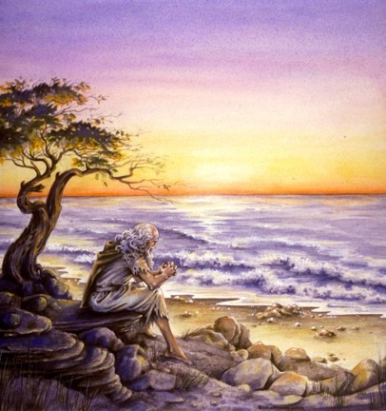
The Book of 1 John
To Download this lesson go to:
http://www.purifiedbyfaith.com/1John/1John.htm
https://revelationillustrated.com/

Slide 2

Outline of 1 John
1:1-4 - Prologue: John Introduces the Major Theme of the Letter - FELLOWSHIP WITH GOD
1:5-2:28 - The First Presentation of the Three Themes of RIGHTEOUSNESS, LOVE and BELIEF in Jesus
2:29-4:6 -The Second Presentation of the Three Themes of RIGHTEOUSNESS, LOVE and BELIEF in Jesus
4:7-5:21 - The Third Presentation of the Three Themes of RIGHTEOUSNESS, LOVE and BELIEF in Jesus
Robert Law, The Tests of Life, Third Edition, 1914, p.21-24

Slide 3
1:5-2:28 The First Presentation of the Three Themes of RIGHTEOUSNESS, LOVE and BELIEF in Jesus
1:5-7 - John states that:
“God is light" (i.e. God is truth and the revealer of truth)
A person's claim to have FELLOWSHIP with God is verified only if he "walks in the light" (i.e. lives according to God's truth).
1:8-2:6 - "Walking in the Light" Tested by RIGHTEOUSNESS
First - in confession of sin (1:8-2:2)
Secondly - in actual obedience (2:3-6)
2:7-17 - "Walking in the Light" Tested by LOVE
Positively - By love of one's brother (2:7-11)
[Parenthetical Passage in (2:12-14)]
Negatively - By not loving the World (2:15-17)
2:18-28 - "Walking in the Light" Tested by BELIEF in Jesus the Son of God.
Contrast Between False Teachers and True Believers (2:18-21)
Christological Test (2:22-23)
Exhortation to Continue in the Truth (2:24-28)

Slide 4
1:5-2:28 The First Presentation of the Three Themes of RIGHTEOUSNESS, LOVE and BELIEF in Jesus
1:5-7 - John states that:
“God is light" (i.e. God is truth and the revealer of truth)
A person's claim to have FELLOWSHIP with God is verified only if he "walks in the light" (i.e. lives according to God's truth).
1:8-2:6 - "Walking in the Light" Tested by RIGHTEOUSNESS
First - in confession of sin (1:8-2:2)
Secondly - in actual obedience (2:3-6)
2:7-17 - "Walking in the Light" Tested by LOVE
Positively - By love of one's brother (2:7-11)
[Parenthetical Passage in (2:12-14)]
Negatively - By not loving the World (2:15-17)
2:18-28 - "Walking in the Light" Tested by BELIEF in Jesus the Son of God.
Contrast Between False Teachers and True Believers (2:18-21)
Christological Test (2:22-23)
Exhortation to Continue in the Truth (2:24-28)

Slide 5
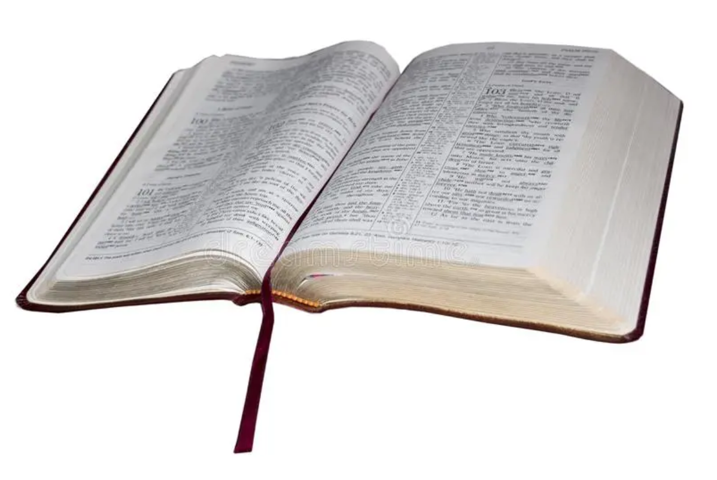
1 John 2:3-6 Walking in the Light Tested by Righteousness Secondly in Actual Obedience
³ And by this we know that we have come to know him, if we keep his commandments. ⁴ Whoever says “I know him” but does not keep his commandments is a liar, and the truth is not in him, ⁵ but whoever keeps his word, in him truly the love of God is perfected. By this we may know that we are in him: ⁶ whoever says he abides in him ought to walk in the same way in which he walked.

Slide 6
John begins by giving a general statement of the test of obedience:
³ And by this we know that we have come to know him, if we keep his commandments. ⁴ Whoever says “I know him” but does not keep his commandments is a liar, and the truth is not in him, ⁵ but whoever keeps his word, in him truly the love of God is perfected. By this we may know that we are in him: ⁶ whoever says he abides in him ought to walk in the same way in which he walked.
(1 John 2:3-6)

Slide 7
John then gives two possible outcomes to the obedience test. First he gives an example of someone who fails the test:
³ And by this we know that we have come to know him, if we keep his commandments. ⁴ Whoever says “I know him” but does not keep his commandments is a liar, and the truth is not in him, ⁵ but whoever keeps his word, in him truly the love of God is perfected. By this we may know that we are in him: ⁶ whoever says he abides in him ought to walk in the same way in which he walked.
(1 John 2:3-6)

Slide 8
Then John gives an example of someone who passes the test:
³ And by this we know that we have come to know him, if we keep his commandments. ⁴ Whoever says “I know him” but does not keep his commandments is a liar, and the truth is not in him, ⁵ but whoever keeps his word, in him truly the love of God is perfected. By this we may know that we are in him: ⁶ whoever says he abides in him ought to walk in the same way in which he walked.
(1 John 2:3-6)

Slide 9
Finally, John concludes with a summary statement that essentially restates the test of obedience using different words:
³ And by this we know that we have come to know him, if we keep his commandments. ⁴ Whoever says “I know him” but does not keep his commandments is a liar, and the truth is not in him, ⁵ but whoever keeps his word, in him truly the love of God is perfected. By this we may know that we are in him: ⁶ whoever says he abides in him ought to walk in the same way in which he walked.
(1 John 2:3-6)

Slide 10
John begins this section with the phrase, “we know” – the first occurrence of a phrase that appears seven times in the book of 1 John:
³ And by this we know that we have come to know him, if we keep his commandments. ⁴ Whoever says “I know him” but does not keep his commandments is a liar, and the truth is not in him, ⁵ but whoever keeps his word, in him truly the love of God is perfected. By this we may know that we are in him: ⁶ whoever says he abides in him ought to walk in the same way in which he walked.
(1 John 2:3-6)

Slide 11
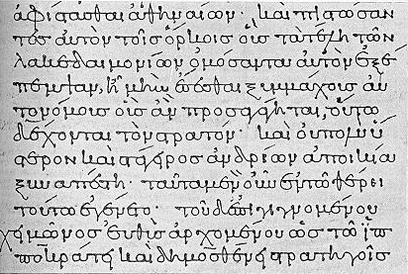
“know” - ginw,skw ginosko
Friberg -
Come to understand, ascertain (a fact)
Know or be acquainted with (a person)
Learn of, become aware of, find out, perceive
Euphemism for intimate relations between a man and a woman (cf. Matthew 1:25)
Acknowledge, recognize
Come to know or be sure of a thing or a person

Slide 12
One of the distinctive features of John’s writings is how often he uses the word “know” (ginosko). The word appears 21 times in this short letter! And, as you can see, it appears 4 times in just these 4 verses alone:
³ And by this we know that we have come to know him, if we keep his commandments. ⁴ Whoever says “I know him” but does not keep his commandments is a liar, and the truth is not in him, ⁵ but whoever keeps his word, in him truly the love of God is perfected. By this we may know that we are in him: ⁶ whoever says he abides in him ought to walk in the same way in which he walked.
(1 John 2:3-6)

Slide 13
Why does John refer to “knowledge” so frequently in this letter?
I would suggest two reasons:
John wants those of us who truly know God to have assurance that our faith in Him is genuine.
At the same time, John wants to expose the false claims of the Gnostics (with their so-called “knowledge”) and those like them who think they know God, but really don’t.

Slide 14
In the opening of lines of this letter John describes a genuine relationship with God as having “fellowship” with Him (1:3,6). Notice the terminology John uses in this section to describe what a genuine relationship with God looks like:
³ And by this we know that we have come to know him, if we keep his commandments. ⁴ Whoever says “I know him” but does not keep his commandments is a liar, and the truth is not in him, ⁵ but whoever keeps his word, in him truly the love of God is perfected. By this we may know that we are in him: ⁶ whoever says he abides in him ought to walk in the same way in which he walked.
(1 John 2:3-6)

Slide 15
“abide (in Him)” me,nw meno
The word “abide” speaks of a continuing and intimate relationship rather than a temporary superficial association…This concept of abiding no doubt comes from John 15 where Jesus declares that the fruit-bearing branch is the one which stands in continuing vital relationship to the vine.
Jesus speaking to His disciples at the Last Supper: I am the vine; you are the branches. If a man remains [i.e.“abides”] in me and I in him, he will bear much fruit; apart from me you can do nothing. If anyone does not remain in me, he is like a branch that is thrown away and withers; such branches are picked up, thrown into the fire and burned… If you obey my commands, you will remain in my love, just as I have obeyed my Father's commands and remain in his love. (John 15:5-6,10 NIV)
Donald W. Burdick, The Epistles of John, Moody Press, 1970, p.31

Slide 16
Another example of where John varies his terminology is his description of righteousness. In 1:6-7 he described righteousness as “practicing the truth” and “walking in the light”. Notice the terminology used in this section:
³ And by this we know that we have come to know him, if we keep his commandments. ⁴ Whoever says “I know him” but does not keep his commandments is a liar, and the truth is not in him, ⁵ but whoever keeps his word, in him truly the love of God is perfected. By this we may know that we are in him: ⁶ whoever says he abides in him ought to walk in the same way in which he walked.
(1 John 2:3-6)

Slide 17
…whoever says he abides in him ought to walk in the same way in which he walked. (1 John 2:6)
If we’re going to claim we have a relationship with God, then we must “keep his commandments” (2:3) and we must “walk in the same way in which he [Jesus] walked”.
The term “walk” is a figure of speech depicting the conduct of one’s life.
So in other words, John is telling us that “we cannot claim to abide in him unless we behave like him.” (Stott, p. 94)
As John has already made clear (1:8), Christians will continue to sin, but unlike the Gnostics of John’s day, a true Christian:
Regularly confesses his sin (1:9)
Longs to overcome sin
Has a heart that wants to please God
Exhibits an overall pattern of obedience in his life

Slide 18
1:5-2:28 The First Presentation of the Three Themes of RIGHTEOUSNESS, LOVE and BELIEF in Jesus
1:5-7 - John states that:
“God is light" (i.e. God is truth and the revealer of truth)
A person's claim to have FELLOWSHIP with God is verified only if he "walks in the light" (i.e. lives according to God's truth).
1:8-2:6 - "Walking in the Light" Tested by RIGHTEOUSNESS
First - in confession of sin (1:8-2:2)
Secondly - in actual obedience (2:3-6)
2:7-17 - "Walking in the Light" Tested by LOVE
Positively - By love of one's brother (2:7-11)
[Parenthetical Passage in (2:12-14)]
Negatively - By not loving the World (2:15-17)
2:18-28 - "Walking in the Light" Tested by BELIEF in Jesus the Son of God.
Contrast Between False Teachers and True Believers (2:18-21)
Christological Test (2:22-23)
Exhortation to Continue in the Truth (2:24-28)

Slide 19
1:5-2:28 The First Presentation of the Three Themes of RIGHTEOUSNESS, LOVE and BELIEF in Jesus
1:5-7 - John states that:
“God is light" (i.e. God is truth and the revealer of truth)
A person's claim to have FELLOWSHIP with God is verified only if he "walks in the light" (i.e. lives according to God's truth).
1:8-2:6 - "Walking in the Light" Tested by RIGHTEOUSNESS
First - in confession of sin (1:8-2:2)
Secondly - in actual obedience (2:3-6)
2:7-17 - "Walking in the Light" Tested by LOVE
Positively - By love of one's brother (2:7-11)
[Parenthetical Passage in (2:12-14)]
Negatively - By not loving the World (2:15-17)
2:18-28 - "Walking in the Light" Tested by BELIEF in Jesus the Son of God.
Contrast Between False Teachers and True Believers (2:18-21)
Christological Test (2:22-23)
Exhortation to Continue in the Truth (2:24-28)

Slide 20
1 John 2:7-11 Walking in the Light Tested by Love Positively – By Love of One’s Brother
⁷ Beloved, I am writing you no new commandment, but an old commandment that you had from the beginning. The old commandment is the word that you have heard. ⁸ At the same time, it is a new commandment that I am writing to you, which is true in him and in you, because the darkness is passing away and the true light is already shining. ⁹ Whoever says he is in the light and hates his brother is still in darkness. ¹⁰ Whoever loves his brother abides in the light, and in him there is no cause for stumbling. ¹¹ But whoever hates his brother is in the darkness and walks in the darkness, and does not know where he is going, because the darkness has blinded his eyes.

Slide 21
John opens this section by addressing his readers as “Beloved”.
⁷ Beloved, I am writing you no new commandment, but an old commandment that you had from the beginning. The old commandment is the word that you have heard. ⁸ At the same time, it is a new commandment that I am writing to you, which is true in him and in you, because the darkness is passing away and the true light is already shining. ⁹ Whoever says he is in the light and hates his brother is still in darkness. ¹⁰ Whoever loves his brother abides in the light, and in him there is no cause for stumbling. ¹¹ But whoever hates his brother is in the darkness and walks in the darkness, and does not know where he is going, because the darkness has blinded his eyes. (1 John 2:7-11)

Slide 22
“Beloved” - avgaphto,j agapetos
Friberg Lexicon –
Those who are very much loved
John addresses his readers using this word five other times in this letter (3:2, 3:21, 4:1, 4:7, 4:11)
I think it’s probably significant that the initial occurrence of “Beloved” is used here where the theme of love is first introduced.
Part of the reason we are expected to love our fellow believers is because Christ, who loves us, also loves them!

Slide 23
John then begins this section by focusing on a command which is old and yet new -- the command is that Christians must love one another (see verse 10).
⁷ Beloved, I am writing you no new commandment, but an old commandment that you had from the beginning. The old commandment is the word that you have heard. ⁸ At the same time, it is a new commandment that I am writing to you, which is true in him and in you, because the darkness is passing away and the true light is already shining. ⁹ Whoever says he is in the light and hates his brother is still in darkness. ¹⁰ Whoever loves his brother abides in the light, and in him there is no cause for stumbling. ¹¹ But whoever hates his brother is in the darkness and walks in the darkness, and does not know where he is going, because the darkness has blinded his eyes. (1 John 2:7-11)

Slide 24
An Old / New Command
This command to love one another, which is both “old” (given by Jesus some 60 years earlier) yet “new” is clearly identified in John’s other writings:
John 13:34-35 - A new commandment I give to you, that you love one another: just as I have loved you, you also are to love one another. By this all people will know that you are my disciples, if you have love for one another.
John 15:12, 17 - This is my commandment, that you love one another as I have loved you… These things I command you, so that you will love one another.
2 John 1:5-6 - And now I ask you, dear lady--not as though I were writing you a new commandment, but the one we have had from the beginning--that we love one another… this is the commandment, just as you have heard from the beginning, so that you should walk in it.

Slide 25
In What Sense Was the Love-Command Old?
It was "old" in that John's readers have had it “from the beginning” (2:7).
For John’s older readers this might date back to the time when Christ lived on earth and gave the command.
For John’s younger readers, the "beginning" may refer to the beginning of their walk as Christians, when they were first taught, the Gospel.
John may be making the point that Christ's love-command was much older than the newer teaching of the Gnostics – which denied the necessity of brotherly love.

Slide 26
In What Sense Was the Love-Command New?
The law of love became the basic law of the new age, which Jesus inaugurated when He established the New Covenant.
Part of what made the love command as given by Jesus new, was that Jesus made His own love for the disciples the standard by which they were to love one another:
John 13:34b – A new commandment I give to you, that you love one another: just as I [Jesus] have loved you, you also are to love one another.
Compare this with the Old Covenant command where the standard was to love your neighbor as yourself:
Leviticus 19:18 - You shall not take vengeance or bear a grudge against the sons of your own people, but you shall love your neighbor as yourself: I am the LORD.

Slide 27
John tells us that the “old” command to love the brothers is “new” because it belongs to the new age which has been ushered in by the shining of Jesus as the true light.
⁷ Beloved, I am writing you no new commandment, but an old commandment that you had from the beginning. The old commandment is the word that you have heard. ⁸ At the same time, it is a new commandment that I am writing to you, which is true in him and in you, because the darkness is passing away and the true light is already shining. ⁹ Whoever says he is in the light and hates his brother is still in darkness. ¹⁰ Whoever loves his brother abides in the light, and in him there is no cause for stumbling. ¹¹ But whoever hates his brother is in the darkness and walks in the darkness, and does not know where he is going, because the darkness has blinded his eyes. (1 John 2:7-11)

Slide 28
…because the darkness is passing away and the true light is already shining (1 John 2:8b)
The “darkness” is the present age or the “world” which in 2:17 is also said to be passing away. (Stott, p.93-94)
The “true light” here is best understood to refer to Jesus Christ himself. In the Fourth Gospel, Jesus Christ is the true light coming into the world which the darkness cannot overcome. (Kruse, p.84):
John 1:4-5, 9 - In [Jesus] was life, and the life was the light of men. ⁵ The light shines in the darkness, and the darkness has not overcome it… ⁹ The true light, which enlightens everyone, was coming into the world.
John 12:46 - I [Jesus] have come into the world as light, so that whoever believes in me may not remain in darkness.
So the commandment remains new because it belongs to the new age which has been ushered in by the shining of the new light. (Stott, p. 94)

Slide 29
Next John shows how the love command is a test for whether a person is truly walking in the light. He begins by describing a person who fails the love test:
⁷ Beloved, I am writing you no new commandment, but an old commandment that you had from the beginning. The old commandment is the word that you have heard. ⁸ At the same time, it is a new commandment that I am writing to you, which is true in him and in you, because the darkness is passing away and the true light is already shining. ⁹ Whoever says he is in the light and hates his brother is still in darkness. ¹⁰ Whoever loves his brother abides in the light, and in him there is no cause for stumbling. ¹¹ But whoever hates his brother is in the darkness and walks in the darkness, and does not know where he is going, because the darkness has blinded his eyes. (1 John 2:7-11)

Slide 30
Whoever says he is in the light and hates his brother… (1 John 2:9)
F. F. Bruce points out:
John characteristically sees life in terms of black and white; intermediate grays have no existence for him.
So there is no middle course between love and hatred.
And by hatred John does not necessarily mean positive animosity but mere lack of love.
Notice that John employs the test of love, not for the world at large, but for one’s brother in Christ. Compare this with Paul’s statement:
Galatians 6:10 – So then, as we have opportunity, let us do good to everyone, and especially to those who are of the household of faith.

Slide 31
Next John describes a person who passes the love test:
⁷ Beloved, I am writing you no new commandment, but an old commandment that you had from the beginning. The old commandment is the word that you have heard. ⁸ At the same time, it is a new commandment that I am writing to you, which is true in him and in you, because the darkness is passing away and the true light is already shining. ⁹ Whoever says he is in the light and hates his brother is still in darkness. ¹⁰ Whoever loves his brother abides in the light, and in him there is no cause for stumbling. ¹¹ But whoever hates his brother is in the darkness and walks in the darkness, and does not know where he is going, because the darkness has blinded his eyes. (1 John 2:7-11)

Slide 32
love - avgapa,w agapao
W.E. Vine (An Expository Dictionary of Biblical Words, Nelson, 1985, p.382):
Christian love, whether exercised toward the brethren, or toward men generally:
Is not an impulse from feelings
Does not always run with the natural inclinations, nor does it spend itself only upon those whom affinity is discovered.
Love seeks the welfare of all (Rom. 15:2) and works no ill to any (Rom. 13:8-10);
Love seeks opportunity to do good to ‘all men and especially toward them that are of the household of faith’ (Gal. 6:10)

Slide 33
love - avgapa,w agapao
Some Scriptures on Love:
1 Corinthians 13:4-5 – Love is patient and kind; love does not envy or boast; it is not arrogant or rude. It does not insist on its own way; it is not irritable or resentful…
Matthew 5:46 - For if you love those who love you, what reward do you have? Do not even the tax collectors do the same?
John 15:13 - Greater love has no one than this, that someone lay down his life for his friends.

Slide 34
John tells us that whoever loves his brother: 1. Abides in the light 2. There is no cause in him for stumbling
⁷ Beloved, I am writing you no new commandment, but an old commandment that you had from the beginning. The old commandment is the word that you have heard. ⁸ At the same time, it is a new commandment that I am writing to you, which is true in him and in you, because the darkness is passing away and the true light is already shining. ⁹ Whoever says he is in the light and hates his brother is still in darkness. ¹⁰ Whoever loves his brother abides in the light, and in him there is no cause for stumbling. ¹¹ But whoever hates his brother is in the darkness and walks in the darkness, and does not know where he is going, because the darkness has blinded his eyes. (1 John 2:7-11)

Slide 35
Whoever loves his brother abides in the light, and in him there is no cause for stumbling. (1 John 2:10)
As in broad daylight obstructions over which one might trip and fall are seen and avoided, so, if we live in the habitual disposition of love, we are not liable to be taken unawares by any temptation to sin against our brother.
Robert Law, The Tests of Life, Third Edition, 1914, p.236

Slide 36
In closing this section, John again describes a person who fails the love test (as he does in 2:9). Here the apostle adds force to his declaration by piling up the negative effects that befall that person: he “walks in the darkness”, “and does not know where he is going”, and “the darkness has blinded his eyes”
⁷ Beloved, I am writing you no new commandment, but an old commandment that you had from the beginning. The old commandment is the word that you have heard. ⁸ At the same time, it is a new commandment that I am writing to you, which is true in him and in you, because the darkness is passing away and the true light is already shining. ⁹ Whoever says he is in the light and hates his brother is still in darkness. ¹⁰ Whoever loves his brother abides in the light, and in him there is no cause for stumbling. ¹¹ But whoever hates his brother is in the darkness and walks in the darkness, and does not know where he is going, because the darkness has blinded his eyes. (1 John 2:7-11)

Slide 37
1:5-2:28 The First Presentation of the Three Themes of RIGHTEOUSNESS, LOVE and BELIEF in Jesus
1:5-7 - John states that:
“God is light" (i.e. God is truth and the revealer of truth)
A person's claim to have FELLOWSHIP with God is verified only if he "walks in the light" (i.e. lives according to God's truth).
1:8-2:6 - "Walking in the Light" Tested by RIGHTEOUSNESS
First - in confession of sin (1:8-2:2)
Secondly - in actual obedience (2:3-6)
2:7-17 - "Walking in the Light" Tested by LOVE
Positively - By love of one's brother (2:7-11)
[Parenthetical Passage in (2:12-14)]
Negatively - By not loving the World (2:15-17)
2:18-28 - "Walking in the Light" Tested by BELIEF in Jesus the Son of God.
Contrast Between False Teachers and True Believers (2:18-21)
Christological Test (2:22-23)
Exhortation to Continue in the Truth (2:24-28)

Slide 38

Class Discussion Time
https://www.weareteachers.com/moving-beyond-classroom-discussions/

Slide 39
*Class Discussion Time
Which do you personally struggle with more: feelings of despair over concern that you may not really be the Christian that you claim to others that you are, or being overconfident and not taking seriously the admonition of scripture to examine yourselves:
Examine yourselves, to see whether you are in the faith. Test yourselves. Or do you not realize this about yourselves, that Jesus Christ is in you?--unless indeed you fail to meet the test! (2 Corinthians 13:5)
What do you find to be the biggest challenge in loving fellow believers?

