Slide 1
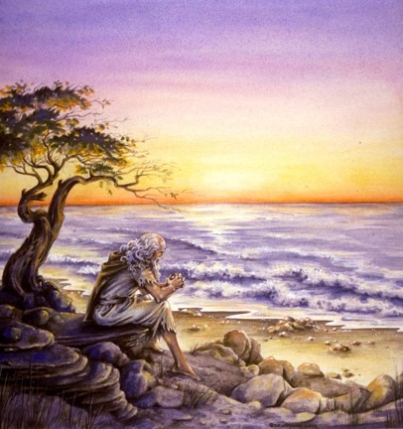
The Book of 1 John
To Download this lesson go to:
http://www.purifiedbyfaith.com/1John/1John.htm
https://revelationillustrated.com/

Slide 2

Outline of 1 John
1:1-4 - Prologue: John Introduces the Major Theme of the Letter - FELLOWSHIP WITH GOD
1:5-2:28 - The First Presentation of the Three Tests of FELLOWSHIP WITH GOD: RIGHTEOUSNESS, LOVE and BELIEF in Jesus
2:29-4:6 -The Second Presentation of the Three Tests of FELLOWSHIP WITH GOD: RIGHTEOUSNESS, LOVE and BELIEF in Jesus
4:7-5:21 - The Third Presentation of the Three Tests of FELLOWSHIP WITH GOD: RIGHTEOUSNESS, LOVE and BELIEF in Jesus
Robert Law, The Tests of Life, Third Edition, 1914, p.21-24

Slide 3
1:5-2:28
The First Presentation of the Three Tests of FELLOWSHIP WITH GOD: RIGHTEOUSNESS, LOVE and BELIEF in Jesus
1:5-7 - John states that:
  “God is light" (i.e. God is truth and the revealer of truth)
  A person's claim to have FELLOWSHIP with God is verified only if he "walks in the light" (i.e. lives according to God's truth).
1:8-2:6 - "Walking in the Light" Tested by RIGHTEOUSNESS
  First - in confession of sin (1:8-2:2)
  Secondly - in actual obedience (2:3-6)
2:7-17 - "Walking in the Light" Tested by LOVE
  Positively - By love of one's brother (2:7-11)
  [Parenthetical Passage in (2:12-14)]
  Negatively - By not loving the World (2:15-17)
2:18-28 - "Walking in the Light" Tested by BELIEF in Jesus the Son of God.
  Contrast Between False Teachers and True Believers (2:18-21)
  Christological Test (2:22-23)
  Exhortation to Continue in the Truth (2:24-28)

Slide 4
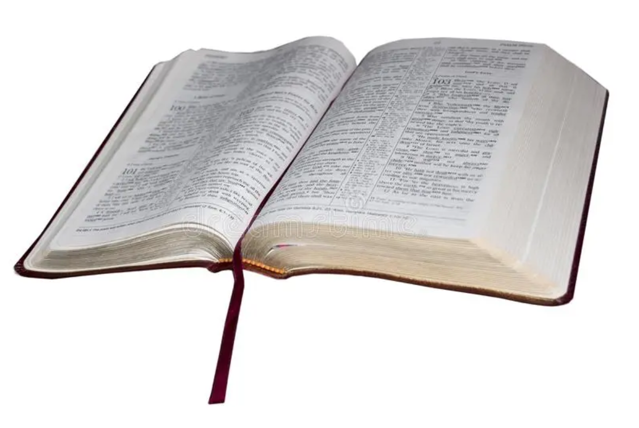
1 John 2:18-21
Contrast Between
False Teachers and True Believers
¹⁸ Children, it is the last hour, and as you have heard that antichrist is coming, so now many antichrists have come. Therefore we know that it is the last hour. ¹⁹ They went out from us, but they were not of us; for if they had been of us, they would have continued with us. But they went out, that it might become plain that they all are not of us. ²⁰ But you have been anointed by the Holy One, and you all have knowledge. ²¹ I write to you, not because you do not know the truth, but because you know it, and because no lie is of the truth.

Slide 5

1 John 2:18-21
Contrast Between
False Teachers and
True Believers
^{High Level Overview}
https://imgur.com/gallery/kOGmSB0

Slide 6
Concerning the false teachers, John shows that:
- Their presence is an eschatological sign
¹⁸ Children, it is the last hour, and as you have heard that antichrist is coming, so now many antichrists have come. Therefore we know that it is the last hour. ¹⁹ They went out from us, but they were not of us; for if they had been of us, they would have continued with us. But they went out, that it might become plain that they all are not of us. ²⁰ But you have been anointed by the Holy One, and you all have knowledge. ²¹ I write to you, not because you do not know the truth, but because you know it, and because no lie is of the truth.
(1 John 2:18-21)

Slide 7
Concerning the false teachers, John shows that:
- Their presence is an eschatological sign
- Their departure from the fellowship of John and his readers is proof of their true nature
¹⁸ Children, it is the last hour, and as you have heard that antichrist is coming, so now many antichrists have come. Therefore we know that it is the last hour. ¹⁹ They went out from us, but they were not of us; for if they had been of us, they would have continued with us. But they went out, that it might become plain that they all are not of us. ²⁰ But you have been anointed by the Holy One, and you all have knowledge. ²¹ I write to you, not because you do not know the truth, but because you know it, and because no lie is of the truth.
(1 John 2:18-21)

Slide 8
Concerning the true believers (John’s readers) , John shows that:
- God has “anointed” his readers
¹⁸ Children, it is the last hour, and as you have heard that antichrist is coming, so now many antichrists have come. Therefore we know that it is the last hour. ¹⁹ They went out from us, but they were not of us; for if they had been of us, they would have continued with us. But they went out, that it might become plain that they all are not of us. ²⁰ But you have been anointed by the Holy One, and you all have knowledge. ²¹ I write to you, not because you do not know the truth, but because you know it, and because no lie is of the truth.
(1 John 2:18-21)

Slide 9
Concerning the true believers (John’s readers) , John shows that:
- God has “anointed” his readers
- John’s readers possess genuine spiritual knowledge
¹⁸ Children, it is the last hour, and as you have heard that antichrist is coming, so now many antichrists have come. Therefore we know that it is the last hour. ¹⁹ They went out from us, but they were not of us; for if they had been of us, they would have continued with us. But they went out, that it might become plain that they all are not of us. ²⁰ But you have been anointed by the Holy One, and you all have knowledge. ²¹ I write to you, not because you do not know the truth, but because you know it, and because no lie is of the truth.
(1 John 2:18-21)

Slide 10
John addresses his readers as “children” reflecting both his:
- Affectionate relationship to them
- Position as one more mature in the faith
¹⁸ Children, it is the last hour, and as you have heard that antichrist is coming, so now many antichrists have come. Therefore we know that it is the last hour. ¹⁹ They went out from us, but they were not of us; for if they had been of us, they would have continued with us. But they went out, that it might become plain that they all are not of us. ²⁰ But you have been anointed by the Holy One, and you all have knowledge. ²¹ I write to you, not because you do not know the truth, but because you know it, and because no lie is of the truth.
(1 John 2:18-21)

Slide 11
John then tells his readers that this is the “last hour”.
¹⁸ Children, it is the last hour, and as you have heard that antichrist is coming, so now many antichrists have come. Therefore we know that it is the last hour. ¹⁹ They went out from us, but they were not of us; for if they had been of us, they would have continued with us. But they went out, that it might become plain that they all are not of us. ²⁰ But you have been anointed by the Holy One, and you all have knowledge. ²¹ I write to you, not because you do not know the truth, but because you know it, and because no lie is of the truth.
(1 John 2:18-21)

Slide 12
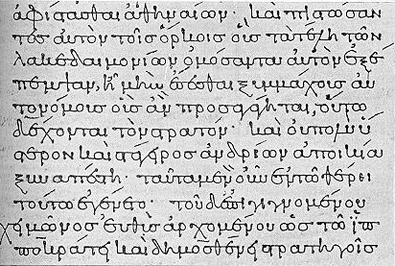
The last hour evsca,th w[ra eschate hora
Kruse – An expression which is found only here in the NT.
However in several places in the NT there are similar expressions such as:
  Last Days:
    Acts 2:17a - And in the last days it shall be, God declares, that I will pour out my Spirit on all flesh…
    2 Timothy 3:1 - But understand this, that in the last days there will come times of difficulty.
    Hebrews 1:1-2a - Long ago, at many times and in many ways, God spoke to our fathers by the prophets, but in these last days he has spoken to us by his Son…
    2 Peter 3:3 - knowing this first of all, that scoffers will come in the last days with scoffing, following their own sinful desires.
  Last Time(s):
    1 Peter 1:20 - He was foreknown before the foundation of the world but was made manifest in the last times for the sake of you
    Jude 1:17-18 - In the last time there will be scoffers, following their own ungodly passions.
Colin G. Kruse, The Letters of John, The New Pillar Commentary, 2000, p.98

Slide 13
What do John and other New Testament writers mean when they refer to “the last hour/days/times”?
Christ and the apostles followed the Jewish custom of dividing time into two ages:
  The Present Age – characterized by evil
  The Coming Age – to be marked by righteousness
The event that was expected to bring down the curtain on the old age and to usher in the new was the coming of Messiah.
The present age had begun with the fall of Adam and was still continuing in the time of John
However, recently – within John’s lifetime – a significant event had taken place: The Messiah had come in lowly fashion and had died on a Roman cross after promising to return again.
The present evil age was still a current reality, but a change had occurred: Christians now found themselves between the two advents of the Messiah:
  The time from Adam to Christ had been a preparatory period when God was making ready for the Savior to come
  The time between the two advents was looked upon as . . . The last hour/days/times.
Donald W. Burdick, The Letters of John, Moody Press, 1985, p.212

Slide 14
Eschatology of 1 John
Jesus Christ
(1 John 1:1)
The First Advent
(1John 1:2)
Resurrection and Ascension
The Second Advent
(1 John 2:28)
The
Fall
(Adam)
Old Testament Written
New Testament Written

The
antichrist
4000
1400
400
5BC
AD 33
95
2021
The Coming Age
?
The Present Evil Age
The Last Hour
1Jn 2:18
The darkness is passing and the true light is shining (1Jn.2:8)
Many antichrists have come (1Jn.2:18b)

Slide 15
The Last Hour/Days/Times
A Time of Trouble, Deception, and Intensified Wickedness
2 Timothy 3:1-5
¹ But understand this, that in the last days there will come times of difficulty.
People are Lovers of Self and Money, Proud, Abusive, etc. – ²For people will be lovers of self, lovers of money, proud, arrogant, abusive, disobedient to their parents, ungrateful, unholy, ³ heartless, unappeasable, slanderous, without self-control, brutal, not loving good, ⁴ treacherous, reckless, swollen with conceit, lovers of pleasure rather than lovers of God,
Paul warns Timothy to stay away from these people, which would seem to indicate that those “last day” things were going on at the time Paul was writing! – ⁵ having the appearance of godliness, but denying its power. Avoid such people.

Slide 16
The Last Hour/Days/Times
A Time of Trouble, Deception, and Intensified Wickedness
Matthew 24:3-12
³ The disciples came to [Jesus] privately, saying, "Tell us, when will these things [the destruction of the temple] be, and what will be the sign of your coming and of the close of the age?" ⁴ And Jesus answered them, "See that no one leads you astray.”
False Christs – cf. 1 John 2:18 (“many antichrists”) – ⁵ For many will come in my name, saying, 'I am the Christ,' and they will lead many astray.
Wars, famines, earthquakes – ⁶ And you will hear of wars and rumors of wars. See that you are not alarmed, for this must take place, but the end is not yet. ⁷ For nation will rise against nation, and kingdom against kingdom, and there will be famines and earthquakes in various places.
Persecution – ⁹ “Then they will deliver you up to tribulation and put you to death, and you will be hated by all nations for my name's sake. ¹⁰ And then many will fall away and betray one another and hate one another.
False Prophets – cf. 1 John 4:1 – ¹¹ And many false prophets will arise and lead many astray.
Abounding Lawlessness and Spiritual Decline – ¹² And because lawlessness will be increased, the love of many will grow cold.”

Slide 17
Was John Mistaken In Thinking That the Second Coming of Christ Was Imminent?
John uses the term “last hour” in much the same way that the other New Testament writers use similar terms such as “last times” or “last days” – John is telling his readers that Christ’s return is imminent.
Because of this, a few commentaries (Dodd and Barclay, for example) claim that John was mistaken when he wrote that he and his readers were living in the last hour! After all, nearly 2000 years have passed and Christ has not yet returned!
Indeed all the apostles considered it possible (perhaps even likely) that Christ would return during their lifetime. For example, Paul writes:
  1 Thessalonians 4:15 - we who are alive, who are left until the coming of the Lord...

Slide 18
Was John Mistaken In Thinking That the Second Coming of Christ Was Imminent?
But notice John does not say exactly how imminent Christ’s return was to be!
John was present (cf. Mark 13:3) when Christ taught that no one knows the “day or hour” when Christ will return – not even the angels or Christ Himself (in his humanity)! (Mark 13:32).
Therefore it is not reasonable to think that John would presume to know the “hour” or “day” when Jesus would return.
Indeed, it seems that at least part of the design in not revealing the day or hour when Christ will return, is to give us incentive to remain alert at all times:
  Matthew 25:13 - Watch therefore, for you know neither the day nor the hour.

Slide 19
Was John Mistaken In Thinking That the Second Coming of Christ Was Imminent?
The apostles were not mistaken when they stated that Christ’s return was imminent nearly 2000 years ago, because from God’s perspective 2000 years is not a long time. Peter warned his readers about this very thing:
  2 Peter 3:8-10 - But do not overlook this one fact, beloved, that with the Lord one day is as a thousand years, and a thousand years as one day. ⁹ The Lord is not slow to fulfill his promise as some count slowness, but is patient toward you, not wishing that any should perish, but that all should reach repentance. ¹⁰ But the day of the Lord will come like a thief, and then the heavens will pass away with a roar, and the heavenly bodies will be burned up and dissolved, and the earth and the works that are done on it will be exposed
From our perspective, ever since the first advent, Christ’s return has been imminent because He could return at any time – therefore we are to remain vigilant in serving Him. These are the last days!

Slide 20
Was John Mistaken In Thinking That the Second Coming of Christ Was Imminent?
But in what sense was it the last hour? John may have thought that in fact the last decade of the first century was five minutes to midnight on the clock of destiny: that he and his fellow-Christians were witnessing the onset of the great revolt which would immediately precede the [Second Coming]. Nothing that he knew precluded such an expectation; much that he knew encouraged it. . . In the Christian era it is always five minutes to midnight. But as the course of things runs along the edge of the final consummation, that edge at times becomes a knife-edge, and at such times the sense of its being the last hour is especially acute.
F.F. Bruce, The Epistles of John, Kingsley Books, 2018, p.65

Slide 21
John reminds his readers of what they had previously been taught (“you have heard”) in relation to the last hour: “that antichrist is coming” (yet future).
¹⁸ Children, it is the last hour, and as you have heard that antichrist is coming, so now many antichrists have come. Therefore we know that it is the last hour. ¹⁹ They went out from us, but they were not of us; for if they had been of us, they would have continued with us. But they went out, that it might become plain that they all are not of us. ²⁰ But you have been anointed by the Holy One, and you all have knowledge. ²¹ I write to you, not because you do not know the truth, but because you know it, and because no lie is of the truth.
(1 John 2:18-21)

Slide 22
The antichrist is yet future. But John tells his readers that the false teachers who are troubling them are “antichrists” or forerunners to the antichrist. Because of this, John and his readers “know” they are living in the “last hour”.
¹⁸ Children, it is the last hour, and as you have heard that antichrist is coming, so now many antichrists have come. Therefore we know that it is the last hour. ¹⁹ They went out from us, but they were not of us; for if they had been of us, they would have continued with us. But they went out, that it might become plain that they all are not of us. ²⁰ But you have been anointed by the Holy One, and you all have knowledge. ²¹ I write to you, not because you do not know the truth, but because you know it, and because no lie is of the truth.
(1 John 2:18-21)

Slide 23
The antichrist avnti,cristoj (antichristos)
Burdick - The only occurrences of the term antichrist in Scripture are found in the Johannine epistles (1 John 2:18, 22; 4:3; 2 John 7).
These are apparently the first uses of the word in literature.
The preposition [anti] may mean “against” or “instead of”. . . A substitute Christ is, in the very nature of the case, an opposition Christ.
Although the only biblical writer who uses the term “antichrist” is the apostle John, the concept is set forth by other inspired authors as well.
Donald W. Burdick, The Letters of John, Moody Press, 1985, p.194, 213

Slide 24
The antichrist avnti,cristoj (antichristos)
Dan 7:24b-27 – … Another shall arise ... ²⁵ He shall speak words against the Most High, and shall wear out the saints of the Most High, and shall think to change the times and the law; and they shall be given into his hand for a time, times, and half a time. ²⁶ But … his dominion shall be taken away, to be consumed and destroyed to the end. ²⁷ And the kingdom and the dominion and the greatness of the kingdoms under the whole heaven shall be given to the people of the saints of the Most High; their kingdom shall be an everlasting kingdom, and all dominions shall serve and obey them.

Slide 25
The antichrist avnti,cristoj (antichristos)
2 Thessalonians 2:3-10 – Let no one deceive you in any way. For that day will not come, unless the rebellion comes first, and the man of lawlessness is revealed, the son of destruction, ⁴ who opposes and exalts himself against every so-called god or object of worship, so that he takes his seat in the temple of God, proclaiming himself to be God. ⁵ Do you not remember that when I was still with you I told you these things? ⁶ And you know what is restraining him now so that he may be revealed in his time. ⁷ For the mystery of lawlessness is already at work. Only he who now restrains it will do so until he is out of the way. ⁸ And then the lawless one will be revealed, whom the Lord Jesus will kill with the breath of his mouth and bring to nothing by the appearance of his coming. ⁹ The coming of the lawless one is by the activity of Satan with all power and false signs and wonders, ¹⁰ and with all wicked deception for those who are perishing, because they refused to love the truth and so be saved.

Slide 26
The antichrist avnti,cristoj (antichristos)
Matthew 24 | 2 Thessalonians 2 | 1 John
False Christs/ prophets shall come (24:4-5, 11, 24) | Man of lawlessness is coming (2:3) | Antichrist is coming (2:18)
I have told you beforehand (24:25) | When I was with you I told you about this (2:5) | As you have heard, antichrist is coming (2:18)
 | Mystery of lawlessness already at work (2:7) | Now there are already many antichrists (2:18)
False Christs/ prophets will show great signs and wonders (24:24) | Coming of lawless one with great signs and wonders (2:9)
They lead many astray – even the elect - if that were possible (24:4, 11, 24) | To deceive those who perish (2:10) | I write about those who would deceive you (2:26)
Information on the above chart was selected from a similar chart by Kruse, p.99-100

Slide 27
In Summary
Both the Old and New Testament speak of the future glorious return of Christ which brings about:
  The End of this Present Evil Age
  The Last Judgment
  The Final Eternal State
Both Old and New Testament writers predict that just prior to Christ’s return there will be a final period of intense wickedness, deception, and rebellion ultimately lead by the final Satanic figure who:
  Has Great Miraculous Powers
  Demands Worship
  Deceives the World
  Leads an Attack Against God
  Is Destroyed by the Returning Christ

Slide 28
In Summary
The New Testament writers view the time since Christ’s first coming as the beginning of the end. These last days (which continue to the present time) are characterized by ever-increasing:
  Trouble
  Deception
  Wickedness
John points to the Gnostic false teachers who have been troubling his readers as examples of those who exhibit the evil behaviors so prominent in the last days, thus giving evidence that we (from John’s day to the present) are indeed in the last days.

Slide 29
John reminds his readers that these “antichrists” (false teachers) were once members of their local church who had since left the church – no doubt, because of serious doctrinal disagreements.
¹⁸ Children, it is the last hour, and as you have heard that antichrist is coming, so now many antichrists have come. Therefore we know that it is the last hour. ¹⁹ They went out from us, but they were not of us; for if they had been of us, they would have continued with us. But they went out, that it might become plain that they all are not of us. ²⁰ But you have been anointed by the Holy One, and you all have knowledge. ²¹ I write to you, not because you do not know the truth, but because you know it, and because no lie is of the truth.
(1 John 2:18-21)

Slide 30
Their leaving (over essential doctrinal truths), John says, demonstrates that these false teachers “were not of us” – i.e., they were not genuine Christians.
¹⁸ Children, it is the last hour, and as you have heard that antichrist is coming, so now many antichrists have come. Therefore we know that it is the last hour. ¹⁹ They went out from us, but they were not of us; for if they had been of us, they would have continued with us. But they went out, that it might become plain that they all are not of us. ²⁰ But you have been anointed by the Holy One, and you all have knowledge. ²¹ I write to you, not because you do not know the truth, but because you know it, and because no lie is of the truth.
(1 John 2:18-21)

Slide 31
For if they had been of us, they would have continued with us. (1 John 2:19b)
As the parable of the sower teaches, to make a spectacular beginning is not the important thing; it is those who “hear the word and accept it and bear fruit” (Mark 4:20), not those who merely “endure for a while” (Mark 4:17) who show the genuineness of their profession. (Bruce, p. 69)
Genuine believers persevere in the faith and in their association with other believers. Thus John establishes another test of spiritual genuineness. (Burdick, p.195)

Slide 32
But they went out, that it might become plain that they all are not of us. (1 John 2:19c)
The last clause in the sentence is actually a subordinate purpose clause... Translated literally, it would read: “but [their going was] in order that they be revealed that they are not of us”. (Kruse, p.102)
Thus John says that it was the divine intent that the heretics by their departure might make it clear that “none of them belonged to us” (Burdick, p.196)

Slide 33
But they went out, that it might become plain that they all are not of us. (1 John 2:19c)
John’s words are not applicable (although they have sometimes been misapplied) to people who leave one Christian company for another; they are applicable only to people who deliberately abandon the ground of Christianity rightly so called – and one should be quite certain that this is what they have done before speaking or thinking in these terms. (Bruce, p. 69)

Slide 34
In contrast to the “antichrists” (false teachers) who have demonstrated that their faith is not genuine (by forsaking the gospel message and leaving the fellowship of genuine believers) – John’s readers have an “anointing from the Holy One”.
¹⁸ Children, it is the last hour, and as you have heard that antichrist is coming, so now many antichrists have come. Therefore we know that it is the last hour. ¹⁹ They went out from us, but they were not of us; for if they had been of us, they would have continued with us. But they went out, that it might become plain that they all are not of us. ²⁰ But you have been anointed by the Holy One, and you all have knowledge. ²¹ I write to you, not because you do not know the truth, but because you know it, and because no lie is of the truth.
(1 John 2:18-21)

Slide 35
anointing cri/sma (chrisma)
Friberg – What has been spread on, ointment, unguent, anointing, used in the OT to symbolize appointment to and empowerment for a task; fig. in the NT, as the gift and empowering of the Holy Spirit for a task anointing, endowment, appointment
Burdick (The Letters of John, p. 196-197) – The author no doubt used the word chrisma, “anointing” in contrast to the usage of antichristoi, “antichrists”. The basic word is chrio, “I anoint”. It is from this term that Christos, “Christ”, the anointed one, comes. There is a sense in which believers are christs (anointed ones)

Slide 36
anointing cri/sma (chrisma)
The word “anointing” is found only here and in 2:27 (2x) in the NT. The cognate verb ‘’to anoint’ (chiro) is found in several other places.
Apart from one metaphorical use of the verb “to anoint” in Heb 1:9, its consistent use in the NT is in relation to an anointing where the agent is God and the element is the Holy Spirit:
  Luke 4:18 - The Spirit of the Lord is upon me, because he has anointed me to proclaim good news to the poor. He has sent me to proclaim liberty to the captives and recovering of sight to the blind, to set at liberty those who are oppressed…
  Acts 10:38 - God anointed Jesus of Nazareth with the Holy Spirit and with power. He went about doing good and healing all who were oppressed by the devil, for God was with him.
  2 Corinthians 1:21-22 – And it is God who establishes us with you in Christ, and has anointed us, ²² and who has also put his seal on us and given us his Spirit in our hearts as a guarantee.
Colin G. Kruse, The Letters of John, The New Pillar Commentary, 2000, pp.102-103

Slide 37
anointing cri/sma (chrisma)
In light of this, the . . . anointing . . . is best interpreted as a reference to the Holy Spirit, with whom they had been endowed by God (when they first believed), and who confirms to them the truth of the message that they heard at that time.
Colin G. Kruse, The Letters of John, The New Pillar Commentary, 2000, pp.102-103

Slide 38
Here John expresses confidence in his readers: they not only have the indwelling Holy Spirit, but all of them “have knowledge”.
¹⁸ Children, it is the last hour, and as you have heard that antichrist is coming, so now many antichrists have come. Therefore we know that it is the last hour. ¹⁹ They went out from us, but they were not of us; for if they had been of us, they would have continued with us. But they went out, that it might become plain that they all are not of us. ²⁰ But you have been anointed by the Holy One, and you all have knowledge. ²¹ I write to you, not because you do not know the truth, but because you know it, and because no lie is of the truth.
(1 John 2:18-21)

Slide 39
John does not write to impart new truth, but to alert them to the danger and urge them to apply the truth they already possess. (Burdick, p.198)
¹⁸ Children, it is the last hour, and as you have heard that antichrist is coming, so now many antichrists have come. Therefore we know that it is the last hour. ¹⁹ They went out from us, but they were not of us; for if they had been of us, they would have continued with us. But they went out, that it might become plain that they all are not of us. ²⁰ But you have been anointed by the Holy One, and you all have knowledge. ²¹ I write to you, not because you do not know the truth, but because you know it, and because no lie is of the truth.
(1 John 2:18-21)

Slide 40
1:5-2:28
The First Presentation of the Three Tests of FELLOWSHIP WITH GOD: RIGHTEOUSNESS, LOVE and BELIEF in Jesus
1:5-7 - John states that:
  “God is light" (i.e. God is truth and the revealer of truth)
  A person's claim to have FELLOWSHIP with God is verified only if he "walks in the light" (i.e. lives according to God's truth).
1:8-2:6 - "Walking in the Light" Tested by RIGHTEOUSNESS
  First - in confession of sin (1:8-2:2)
  Secondly - in actual obedience (2:3-6)
2:7-17 - "Walking in the Light" Tested by LOVE
  Positively - By love of one's brother (2:7-11)
  [Parenthetical Passage in (2:12-14)]
  Negatively - By not loving the World (2:15-17)
2:18-28 - "Walking in the Light" Tested by BELIEF in Jesus the Son of God.
  Contrast Between False Teachers and True Believers (2:18-21)
  Christological Test (2:22-23)
  Exhortation to Continue in the Truth (2:24-28)

Slide 41

Class Discussion Time
https://www.weareteachers.com/moving-beyond-classroom-discussions/

Slide 42
*Class Discussion Time
Were you surprised to find out that the apostles considered themselves to be living in the “last days” and believed that Christ could very likely have returned in their lifetime?
Those who hold to some of the more elaborate “Dispensational” eschatological views, will paint a much more elaborate view of the end times than what I presented today. Have you been exposed to “Dispensational” eschatology, and if so, what do you think of it?
Have you ever been tempted to label those who left your local church as those who are “not of Christ”, when they may have been leaving for other reasons?
Are there legitimate reasons for leaving a particular local church? If so, what are they?
In the case of the false teachers John is writing about, they left for wrong reasons – they were abandoning the true Christian faith. What are some other wrong reasons for leaving a local church?

