Slide 1

The Book of 1 John
To Download this lesson go to:
http://www.purifiedbyfaith.com/1John/1John.htm
https://revelationillustrated.com/

Slide 2

Outline of 1 John
1:1-4 - Prologue: John Introduces the Major Theme of the Letter - FELLOWSHIP WITH GOD
1:5-2:28 - The First Presentation of the Three Tests of FELLOWSHIP WITH GOD: RIGHTEOUSNESS, LOVE and BELIEF in Jesus
2:29-4:6 -The Second Presentation of the Three Tests of FELLOWSHIP WITH GOD: RIGHTEOUSNESS, LOVE and BELIEF in Jesus
4:7-5:21 - The Third Presentation of the Three Tests of FELLOWSHIP WITH GOD: RIGHTEOUSNESS, LOVE and BELIEF in Jesus
Robert Law, The Tests of Life, Third Edition, 1914, p.21-24

Slide 3
1:5-2:28 The First Presentation of the Three Tests of FELLOWSHIP WITH GOD: RIGHTEOUSNESS, LOVE and BELIEF in Jesus
1:5-7 - John states that:
“God is light" (i.e. God is truth and the revealer of truth)
A person's claim to have FELLOWSHIP with God is verified only if he "walks in the light" (i.e. lives according to God's truth).
1:8-2:6 - "Walking in the Light" Tested by RIGHTEOUSNESS
First - in confession of sin (1:8-2:2)
Secondly - in actual obedience (2:3-6)
2:7-17 - "Walking in the Light" Tested by LOVE
Positively - By love of one's brother (2:7-11)
[Parenthetical Passage in (2:12-14)]
Negatively - By not loving the World (2:15-17)
2:18-28 - "Walking in the Light" Tested by BELIEF in Jesus the Son of God.
Contrast Between False Teachers and True Believers (2:18-21)
Christological Test (2:22-23)
Exhortation to Continue in the Truth (2:24-28)

Slide 4
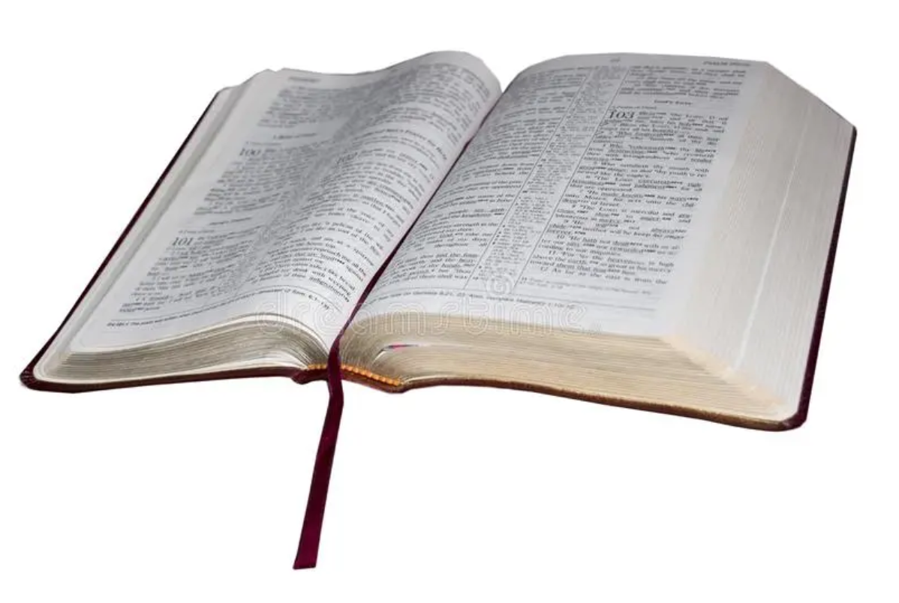
1 John 2:22-23 Christological Test
²² Who is the liar but he who denies that Jesus is the Christ? This is the antichrist, he who denies the Father and the Son. ²³ No one who denies the Son has the Father. Whoever confesses the Son has the Father also.

Slide 5

1 John 2:22-23 Christological Test
^{High Level Overview}
https://imgur.com/gallery/kOGmSB0

Slide 6
John begins by giving a negative statement of the Christological test. The one who denies that Jesus is the Christ is:
The liar
²² Who is the liar but he who denies that Jesus is the Christ? This is the antichrist, he who denies the Father and the Son. ²³ No one who denies the Son has the Father. Whoever confesses the Son has the Father also.
(1 John 2:22-23)

Slide 7
John begins by giving a negative statement of the Christological test. The one who denies that Jesus is the Christ is:
The liar
[Embodies the spirit of ] the antichrist
²² Who is the liar but he who denies that Jesus is the Christ? This is the antichrist, he who denies the Father and the Son. ²³ No one who denies the Son has the Father. Whoever confesses the Son has the Father also.
(1 John 2:22-23)

Slide 8
John begins by giving a negative statement of the Christological test. The one who denies that Jesus is the Christ is:
The liar
[Embodies the spirit of ] the antichrist
Does not have [fellowship with] the Father
²² Who is the liar but he who denies that Jesus is the Christ? This is the antichrist, he who denies the Father and the Son. ²³ No one who denies the Son has the Father. Whoever confesses the Son has the Father also.
(1 John 2:22-23)

Slide 9
John concludes by giving a positive statement of the Christological test: The one who confesses Jesus [as the Christ] has [fellowship with] the Father
²² Who is the liar but he who denies that Jesus is the Christ? This is the antichrist, he who denies the Father and the Son. ²³ No one who denies the Son has the Father. Whoever confesses the Son has the Father also.
(1 John 2:22-23)

Slide 10
1 John 1:6 - If we claim to enjoy fellowship with God while we walk in darkness “we lie”
1 John 2:4 - He who says he knows God but disobeys His commandments “is a liar”.
1 John 2:22 - But he that denies that Jesus is the Christ is “the liar” - i.e., “the liar par excellence” (Stott, p.111).
²² Who is the liar but he who denies that Jesus is the Christ? This is the antichrist, he who denies the Father and the Son. ²³ No one who denies the Son has the Father. Whoever confesses the Son has the Father also.
(1 John 2:22-23)

Slide 11
Indeed you can tell that this is the arch-lie, because he who perpetuates it is none other than the antichrist, not the personal antichrist who is to come (see 2:18), but a living embodiment of the spirit of antichrist. The heretic’s theology is not just defective, it is diabolical. The fundamental doctrinal test of the professing Christian concerns his view of the Person of Jesus. (Stott, p. 111)
²² Who is the liar but he who denies that Jesus is the Christ? This is the antichrist, he who denies the Father and the Son. ²³ No one who denies the Son has the Father. Whoever confesses the Son has the Father also.
(1 John 2:22-23)

Slide 12
What does it mean to deny “that Jesus is the Christ”?
In 1 John 2:22-23, John gives what appears to be the most crucial of the three tests of genuine Christian faith given in this letter: a right belief about Jesus Christ.
The importance of this test can be seen by the language that John uses to describe the one who fails it:
He is the liar (par excellence) (2:22a)
He embodies the spirit of the antichrist, and is therefore an antichrist himself (2:22b cf. 2:18)
Does not have fellowship with the Father (2:23a cf. 1:3)
Therefore, it is important for us to understand exactly what John means by this and other similar statements so that we can rightly apply this test to ourselves and others!

Slide 13
What does it mean to deny “that Jesus is the Christ”?
Let’s begin by examining the ways in which John describes this test in our present text:
1 John 2:22-23 - ²² Who is the liar but he who denies that Jesus is the Christ? This is the antichrist, he who denies the Father and the Son. ²³ No one who denies the Son has the Father. Whoever confesses the Son has the Father also.
In summary, the test (expressed negatively) is:
1John 2:22b – He denies that Jesus is the Christ.
1John 2:22c, 23a - He denies the Son (and therefore by implication denies the Father also)
1John 2:23b – He does not confess the Son

Slide 14
What does it mean to deny “that Jesus is the Christ”?
Next let’s see how John describes this same test in other passages:
1 John 4:2-3 - By this you know the Spirit of God: every spirit that confesses that Jesus Christ has come in the flesh is from God, and every spirit that does not confess Jesus is not from God. This is the spirit of the antichrist, which you heard was coming and now is in the world already.
1 John 4:15 - Whoever confesses that Jesus is the Son of God, God abides in him, and he in God.
1 John 5:1a - Everyone who believes that Jesus is the Christ has been born of God
2 John 1:7 - For many deceivers have gone out into the world, those who do not confess the coming of Jesus Christ in the flesh. Such a one is the deceiver and the antichrist.

Slide 15
What does it mean to deny “that Jesus is the Christ”?
In summary, the test (expressed negatively) is:
1 John 4:2-3 and 2 John 1:7 – He does not confess that Jesus Christ has come in the flesh
1 John 4:15 – He does not confess that Jesus is the Son of God
1 John 5:1 – He does not believe that Jesus is the Christ

Slide 16
What does it mean to deny “that Jesus is the Christ”?
Pulling the teachings of these texts together, we can see that to fail this test, one must deny (or fail to believe and confess) that:
Jesus is the Christ
Jesus is the Son of God
Jesus Christ has come in the flesh

Slide 17
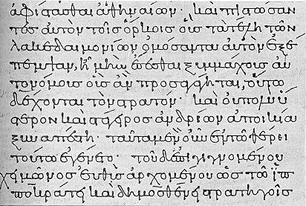
The Christ Cristo,j (christos)
UBS Greek Dictionary: the Anointed One, equivalent to the Hebrew, “Messiah”
The actual Hebrew word only appears twice in the Old Testament in reference to the coming Messiah (Daniel 9:25-26):
Know therefore and understand that from the going out of the word to restore and build Jerusalem to the coming of an anointed one, a prince, there shall be seven weeks. Then for sixty-two weeks it shall be built again with squares and moat, but in a troubled time. ²⁶ And after the sixty-two weeks, an anointed one shall be cut off and shall have nothing. And the people of the prince who is to come shall destroy the city and the sanctuary. Its end shall come with a flood, and to the end there shall be war. Desolations are decreed.

Slide 18
The Christ Cristo,j (christos)
But there were numerous other Old Testament prophecies concerning the coming Messiah (or Christ). He was prophesied to be:
Born in Bethlehem, a ruler who would be the shepherd of God’s people (Matthew 2:4-6 cf. Micah 5:2ff)
King of Israel (Mark 15:32; Luke 23:2 – cf. Psalm 2:6)
The Son of God or “the Son of the Blessed One” (Matthew 26:63, Mark 14:61, Luke 4:41, John 11:27 – cf. Psalm 2:7-12)
David son, yet David’s Lord! (Mark 12:35-37; Luke 20:41-44 – Psalm 110:1ff)
One who would suffer and rise from the dead on the third day, and repentance and forgiveness of sins would be preached in his name to all nations, beginning at Jerusalem. (Luke 24:46-47 – cf. Psalm 16:9-11; 22:1ff; 31:5; 118:22; Isaiah 53)
One who would remain forever (John 12:34 cf. Psalm 89:36; Isaiah 9:7; Daniel 7:14)
Thus, to acknowledge that Jesus is the Christ, is, among other things, to acknowledge Jesus’ Deity.

Slide 19
The Son of God ui`o.j tou/ qeou/ (huios tou theou)
Jesus, as the Son of God, enjoys a unique intimate relationship with God the Father:
Matthew 11:27 - All things have been handed over to me by my Father, and no one knows the Son except the Father, and no one knows the Father except the Son and anyone to whom the Son chooses to reveal him.
John 5:19-27 - So Jesus said to them, "Truly, truly, I say to you, the Son can do nothing of his own accord, but only what he sees the Father doing. For whatever the Father does, that the Son does likewise. ²⁰ For the Father loves the Son and shows him all that he himself is doing. And greater works than these will he show him, so that you may marvel. ²¹ For as the Father raises the dead and gives them life, so also the Son gives life to whom he will. ²² The Father judges no one, but has given all judgment to the Son, ²³ that all may honor the Son, just as they honor the Father. Whoever does not honor the Son does not honor the Father who sent him. ²⁴ Truly, truly, I say to you, whoever hears my word and believes him who sent me has eternal life. He does not come into judgment, but has passed from death to life. ²⁵ "Truly, truly, I say to you, an hour is coming, and is now here, when the dead will hear the voice of the Son of God, and those who hear will live. ²⁶ For as the Father has life in himself, so he has granted the Son also to have life in himself. ²⁷ And he has given him authority to execute judgment, because he is the Son of Man.

Slide 20
The Son of God ui`o.j tou/ qeou/ (huios tou theou)
In calling Himself the Son of God, the Jews rightly understood that Jesus was, in essence claiming equality with God:
John 5:18b – [Jesus] he was even calling God his own Father, making himself equal with God.
In other words, to acknowledge that Jesus is the Son of God is to acknowledge Jesus’ deity.

Slide 21
What does it mean to deny “that Jesus is the Christ”?
Because John interchanges the terms “the Christ” and “the Son of God” in the Christological test, it would seem that what John has in mind in using these terms is an acknowledgement of Christ’s Deity:
The Apostle also uses the name “Christ” as equivalent to the “Word” or the “Son of God”, to signify the Divine pre-existent factor in the personality of Jesus (Law, p.93)
John does not simply mean a denial that Jesus was the Messiah of Old Testament expectation. In the second part of this verse and in verse 23 he refers to Jesus as the Son . . . Thus they denied that Jesus was or is the Christ or the Son . . . they denied that the man Jesus and the Eternal Son were the same person, possessing two perfect natures, human and divine. In a word they denied the incarnation. (Stott, p.111)

Slide 22
What does it mean to deny “that Jesus is the Christ”?
When John refers to the one who “denies that Jesus is the Christ” in 1 John 2:22, he is referring to the false teaching about Jesus Christ espoused by the “antichrists”.
If we pull together all the passages that we have looked at thus far, we see that this false teaching about Jesus Christ can be summarized as a denial (or failure to believe and confess) that: Jesus Christ is fully God and fully man:
1 John 1:1-2 - That which was from the beginning, which we have heard, which we have seen with our eyes, which we looked upon and have touched with our hands, concerning the word of life-- ² the life was made manifest, and we have seen it, and testify to it and proclaim to you the eternal life, which was with the Father and was made manifest to us–
John 1:14 - And the Word [who was God, cf. verse 1] became flesh and dwelt among us…

Slide 23
What does it mean to deny “that Jesus is the Christ”?
There is one additional passage where John addresses this issue, but because of the difficulties involved in interpreting this passage, I will now deal with it separately:
1 John 5:6 - This is the one who came by water and blood-- Jesus Christ. He did not come by water only, but by water and blood.
Regarding this passage, Law notes:
The obscurity of the whole passage is due, doubtless, to the fact that the first readers of the Epistle for whom it was written, were already familiar with the author’s handling of the topics that are here merely indicated. Such expressions as “the water” and “the blood” are a kind of verbal shorthand, intended merely to recall to his readers the exposition of those themes which they had heard from his lips. (Law, p.95)
Having acknowledged the difficulties in understanding this text, Law suggests the following interpretation:
The “water” here denotes our Lord’s Baptism, the “blood,” His death on Calvary. The Cerinthian [Gnostic] heresy taught that Christ came by “water,” but denied He came by “Blood” also. Hence St. John’s repeated and emphatic assertion that He came “not by the water only, but by the water and the blood.” (Law, p. 96)

Slide 24
What does it mean to deny “that Jesus is the Christ”?
1 John 5:6 - This is the one who came by water and blood-- Jesus Christ. He did not come by water only, but by water and blood.
This passage introduces a final element of the false teaching concerning Christ that John rebuts in this letter: a denial that Jesus Christ died a sacrificial death on our behalf.
1 John 1:7b - the blood of Jesus his Son cleanses us from all sin.
1 John 3:16b – [Jesus Christ] laid down his life for us…
Thus the Christological test given in 1 John can be fully stated as follows:
Jesus Christ
Is fully God
Is fully man
Died a sacrificial death on our behalf
Anyone who denies this is the liar who comes in the spirit of the antichrist!

Slide 25
Cerinthian Gnosticism
There is a body of historical data available, which gives us a keener insight into the nature of the false teaching which John is addressing in 1 John 2:22-23.
It appears that one of John’s purposes in writing 1 John was to combat a form of false teaching known as Gnosticism.
Most of the historical information we have concerning Gnosticism:
Comes to us from the writings of the church fathers
Relates to Gnosticism as it existed in the second and third centuries (at least several years after John wrote 1 John)
While it is not directly relevant to what John wrote, it does not take much imagination to see how the heresy that John addresses in his letter could have grown into the Gnosticism of the second and third centuries.

Slide 26
Cerinthian Gnosticism
The earliest Gnostic known by name is Cerinthus” [who was] an antagonist of the Apostle John.
On the authority of Irenaeus [A.D.115-142?], who quoted Polycarp [A.D. 69?-156?] the disciple of John, there is little doubt that the two met in Ephesus:
John, the disciple of the Lord, going to bathe at Ephesus, and perceiving Cerinthus within, rushed out of the bath-house without bathing, exclaiming, “Let us fly, lest even the bath-house fall down, because Cerinthus, the enemy of the truth, is within”. (Burdick, p.59 quoting Irenaeus Against Heresies 3.3.4)
International Standard Bible Encyclopedia, 1979, Volume 2, p.489

Slide 27
Cerinthian Gnosticism
From the accounts that have been preserved of Cerinthus and his teaching we know he taught that:
The world was not the creation of the Supreme God, but that of an inferior angel who held the world in bondage.
Jesus was a normal man, son of Joseph and Mary, who differed from ordinary men only in greater wisdom and righteousness.
Jesus was chosen by the Supreme God to proclaim Him and release the world from its bondage.
For this task, the Christ descended upon Jesus at his baptism in the form of a dove sent from the Father.
This Christ then departed from Jesus before his crucifixion.
Therefore it was only the man Jesus who suffered and rose again.
The New International Dictionary of the Christian Church, Zondervan, 1978, Cerinthus, p.207)

Slide 28
Cerinthian Gnosticism
Most scholars believe that 1 John, especially the Christological passages, were written with early Gnostics like Cerinthus in mind because:
We have strong historical evidence that John knew and opposed Cerinthus in Ephesus (where many scholars believe the that the readers of 1John lived)
The false teachings that John addresses in his first letter match very closely with what we know of the teachings of Cerinthus
One statement of the Christological test is given in 2:22. . . This test seems aimed specifically at Cerinthus, who made a distinction between the human Jesus and the divine Christ. John’s statement rests on the premise that they comprise one person, Jesus Christ the God-man. (Burdick, p.216)

Slide 29
Cerinthian Gnosticism
That we must recognize in these “antichrists” one or more of the many ramifications of Gnosticism, is beyond question. Though our knowledge of Gnosticism in the Johannine age is but dim and fragmentary, still, what we do gather from the scanty records of the Apostolic Fathers fits into the Christological passages of the Epistle so accurately that it renders their interpretation certain where otherwise it would only be conjectural. . . (p.94) Evidently, then, it is the Cerinthian heresy that is here repudiated. . . The essential significance of the [Cerinthian heresy] . . . was that Jesus was not the Christ. (Law, p.91-92, 94)
The antichrists probably taught (as some later Gnostics certainly taught) that Jesus was born and died a man and that ‘the Christ’, by which they meant a divine emanation, was within Him only during His public ministry, descending on Him at His baptism and leaving Him before the cross. . . In a word they denied the incarnation. (Stott p.111)

Slide 30
1:5-2:28 The First Presentation of the Three Tests of FELLOWSHIP WITH GOD: RIGHTEOUSNESS, LOVE and BELIEF in Jesus
1:5-7 - John states that:
“God is light" (i.e. God is truth and the revealer of truth)
A person's claim to have FELLOWSHIP with God is verified only if he "walks in the light" (i.e. lives according to God's truth).
1:8-2:6 - "Walking in the Light" Tested by RIGHTEOUSNESS
First - in confession of sin (1:8-2:2)
Secondly - in actual obedience (2:3-6)
2:7-17 - "Walking in the Light" Tested by LOVE
Positively - By love of one's brother (2:7-11)
[Parenthetical Passage in (2:12-14)]
Negatively - By not loving the World (2:15-17)
2:18-28 - "Walking in the Light" Tested by BELIEF in Jesus the Son of God.
Contrast Between False Teachers and True Believers (2:18-21)
Christological Test (2:22-23)
Exhortation to Continue in the Truth (2:24-28)

Slide 31

Class Discussion Time
https://www.weareteachers.com/moving-beyond-classroom-discussions/

Slide 32
*Class Discussion Time
In an earlier lesson, during the discussion time, I stated that while I believe it is important to try and determine from scripture what will happen in the “end times”, I have no problem extending the “right hand of fellowship” (so to speak) to those who hold a different view of the end times than I do.
In light of the strong statements that John makes concerning a right view of the person of Jesus Christ, do you think we can be as tolerant of those who deny critical teachings about Christ and His essential nature (for example, his deity)?
Have you ever met someone who claimed to be a Christian but denied an essential aspect of the person of Christ? What religious group were they a part of and what essential idea did they deny concerning Christ?

